Slide 1
Webinar for Students:
How Kids Learn Around the World with Jaime Joyce
Welcome! Please share your name and where you are based in the chat box!
Notes:
Welcome and introduce the three presenters

Slide 2
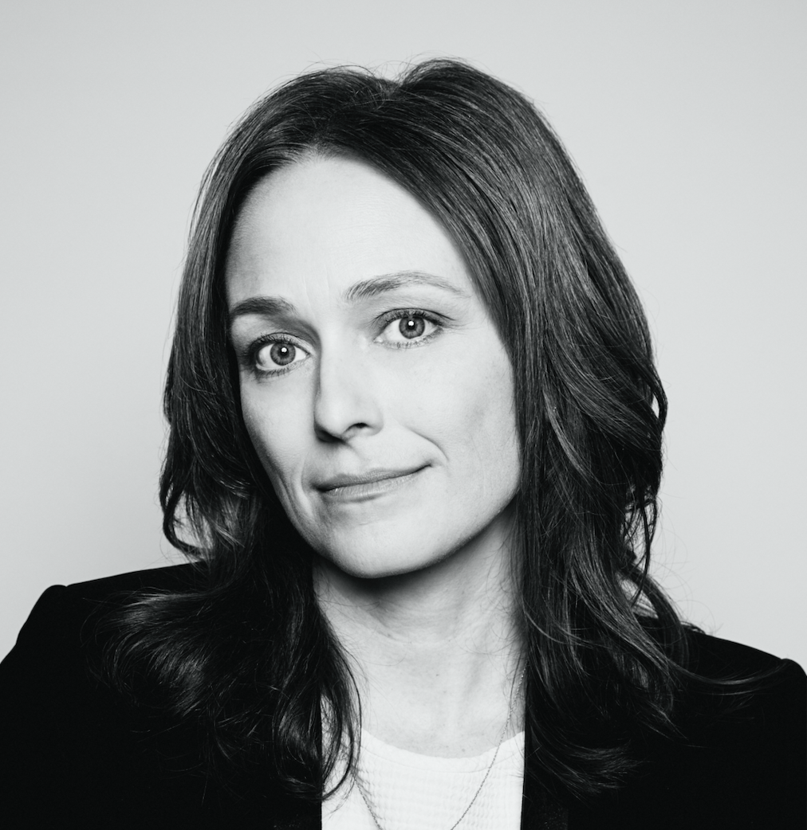
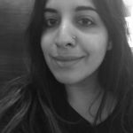
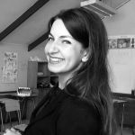
Today’s Agenda
5 minutes | Introduction: Zoom, Webinar Norms, and What is Pulitzer Center?
40 minutes | Presentation by Jaime Joyce
10 minutes | Q&A with Jaime Joyce
5 minutes | Closing and survey
Jaime Joyce, Executive Editor, TIME for Kids
Jaya Mukherjee, Education Coordinator, Pulitzer Center
Hannah Berk, Education Manager, Pulitzer Center

Slide 3
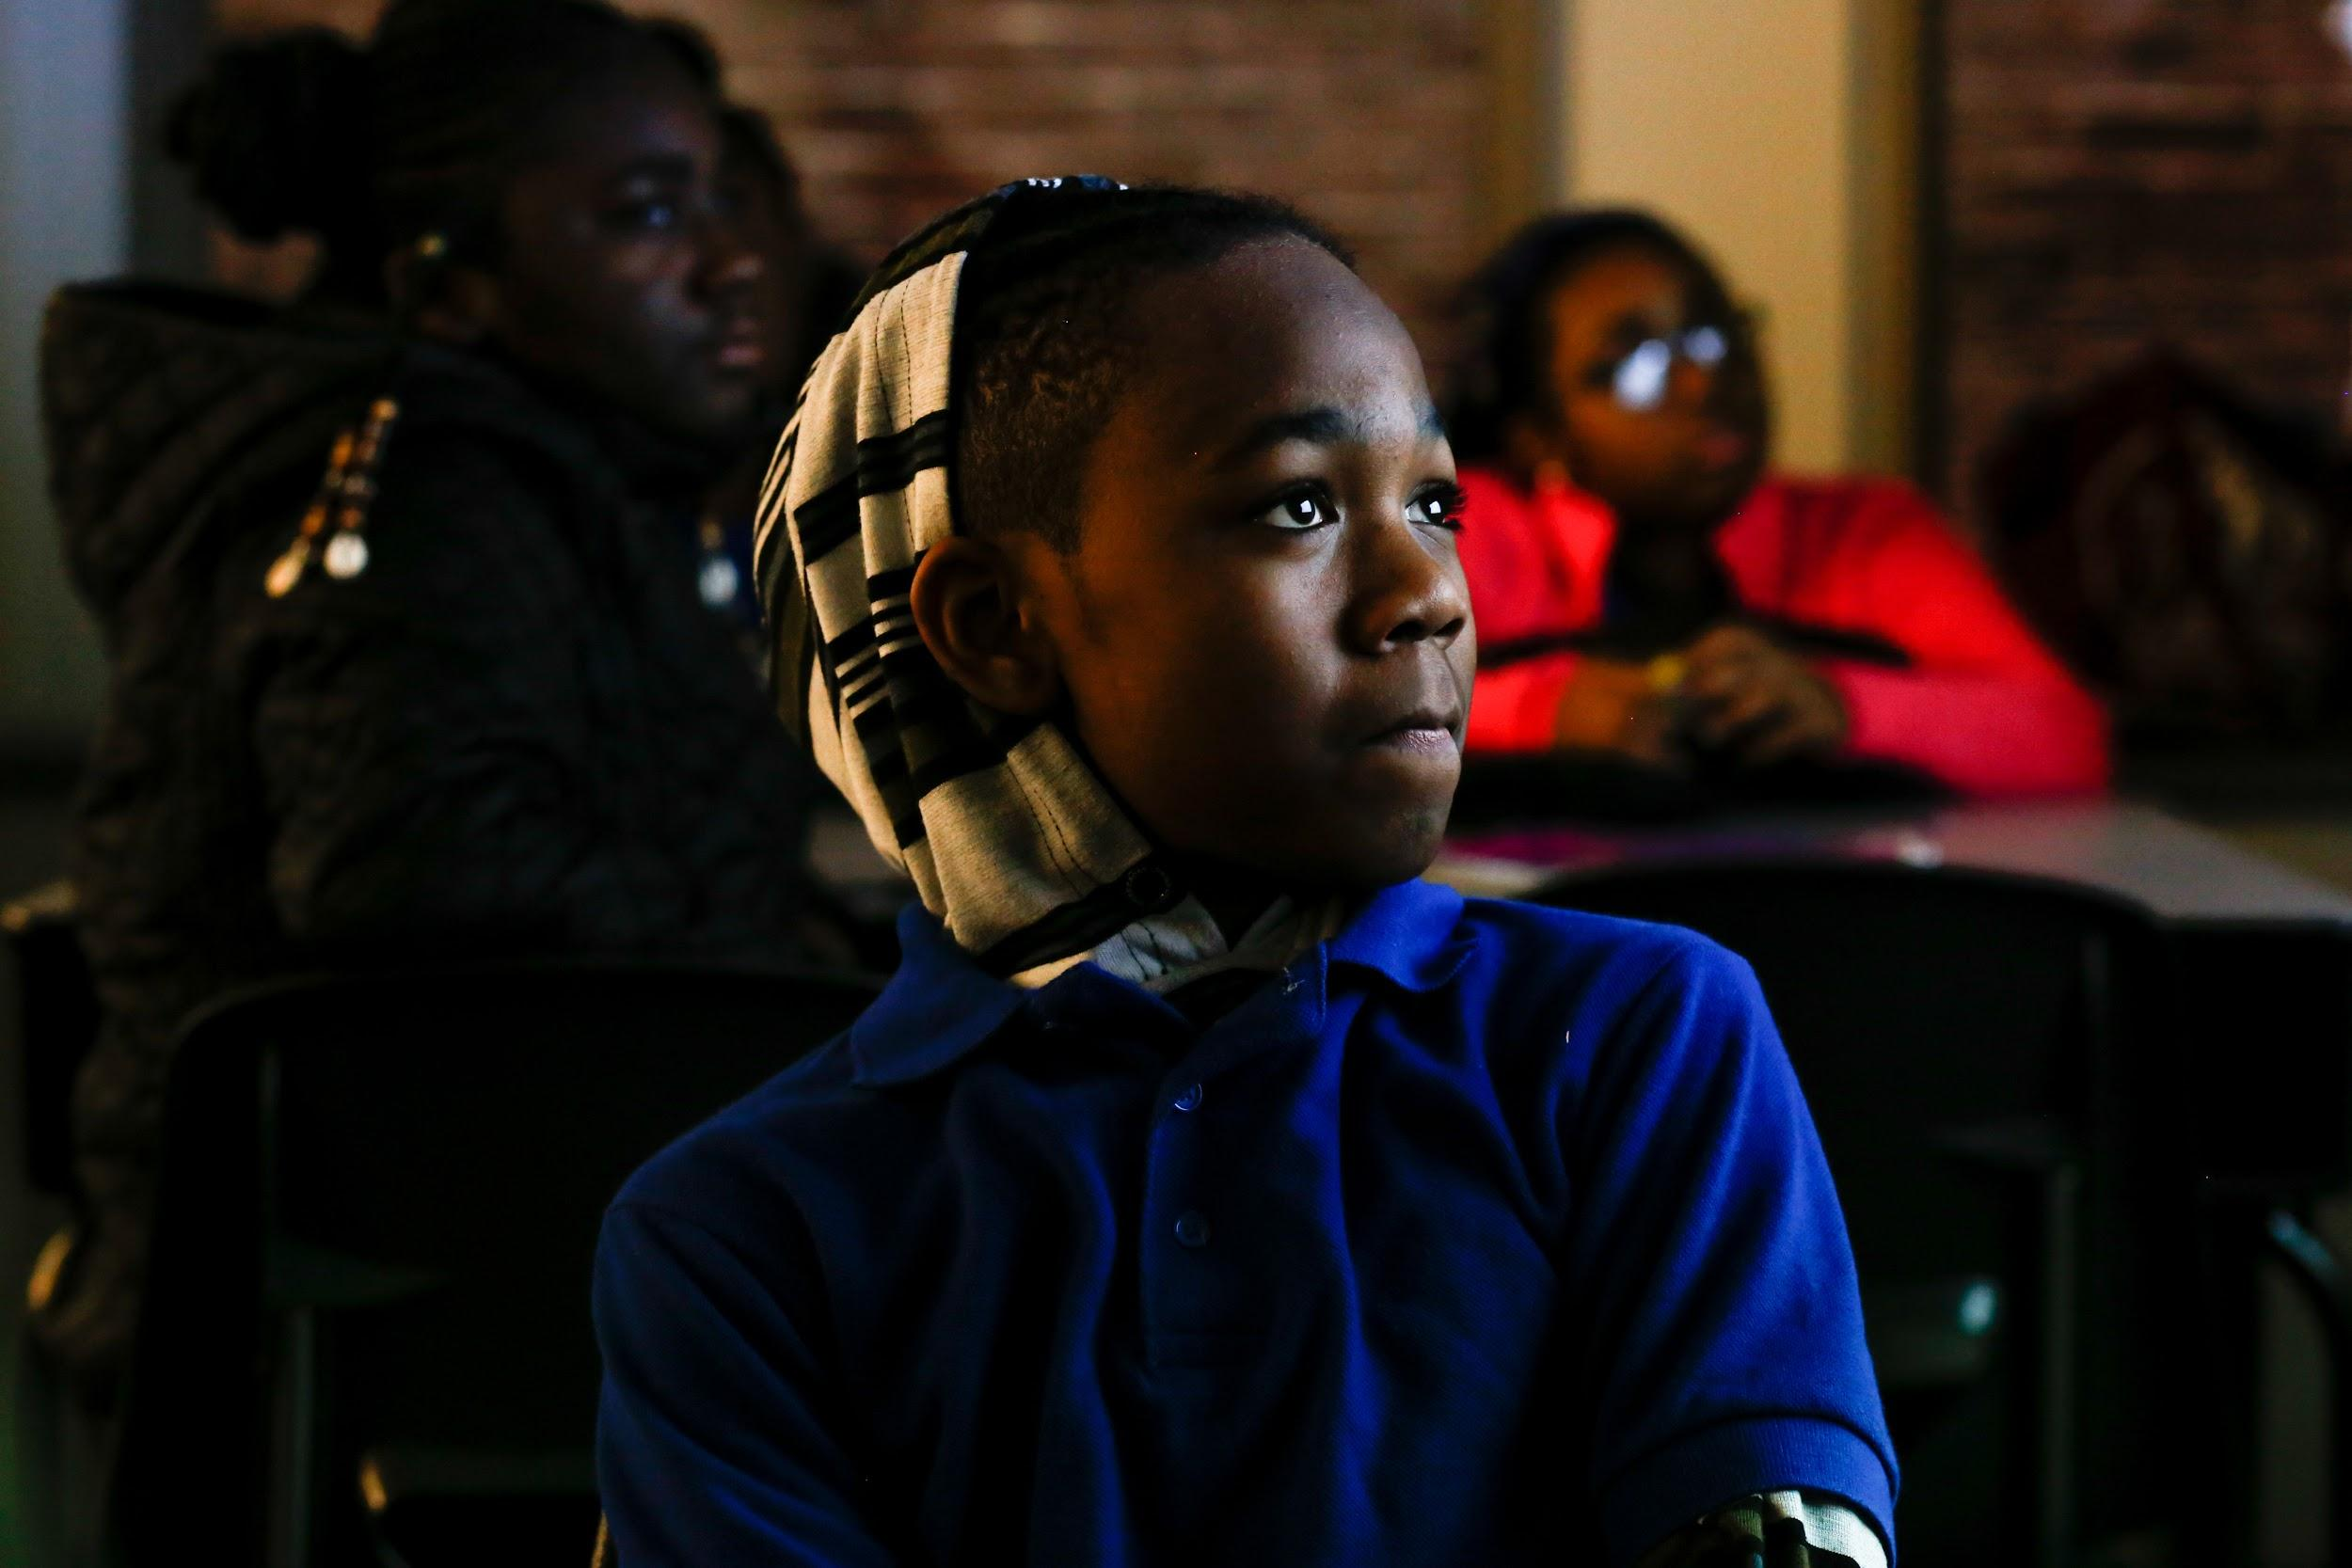
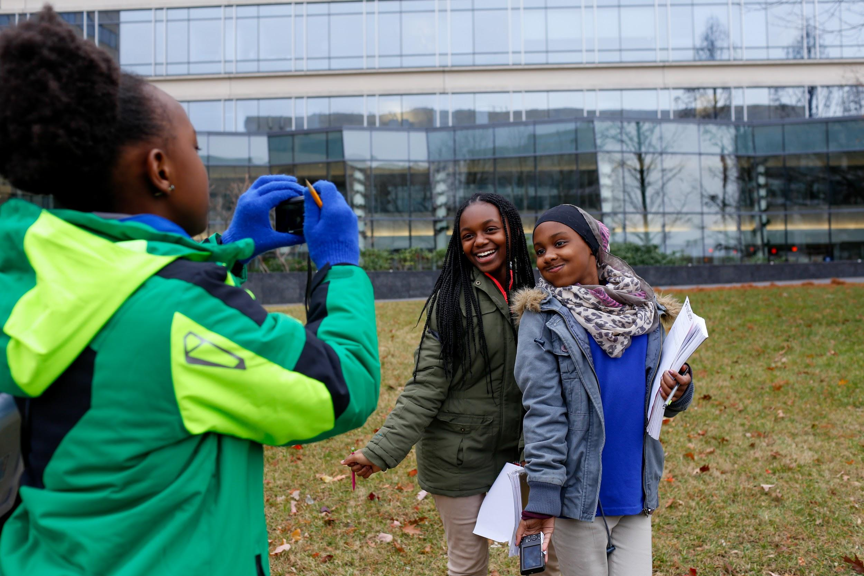
Zoom Classroom Norms
Take care of ourselves and each other!
This is a classroom space
Participate! We want to hear from you!
Image by Eslah Attar. United States, 2018.
Image by Eslah Attar. United States, 2018.

Slide 4
Using Zoom Webinar
Your video is already off, your microphone is muted
Use the Q&A any time you have a question you want to ask Jaime Joyce during the presentation
Use the chat box any time you want to share responses or reflections with everyone (Set to “All panelists and attendees”)
Notes:
Review goals for the session

Slide 5
Poll #1!
What kinds of news stories do you look at most often?
Local news about my community
National news
International news
Notes:
Read out every option as well

Slide 6
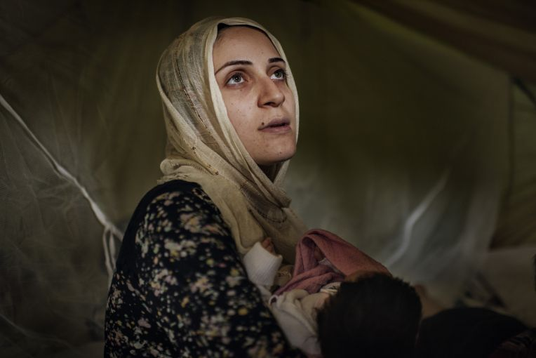
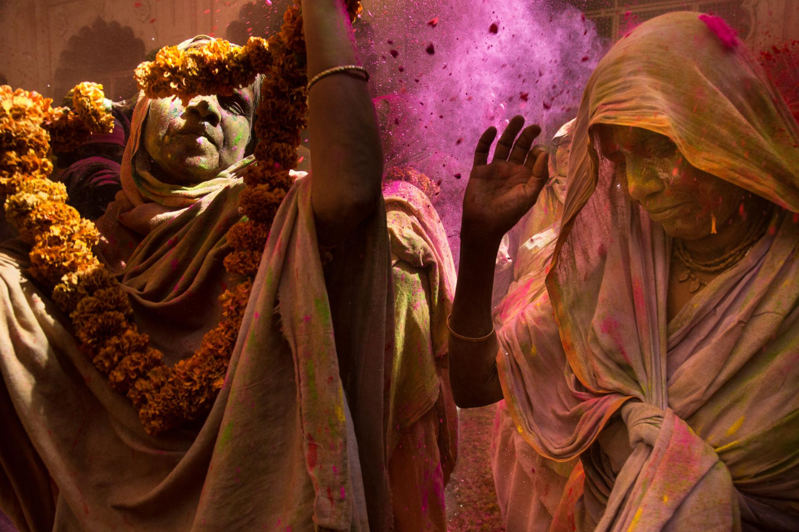
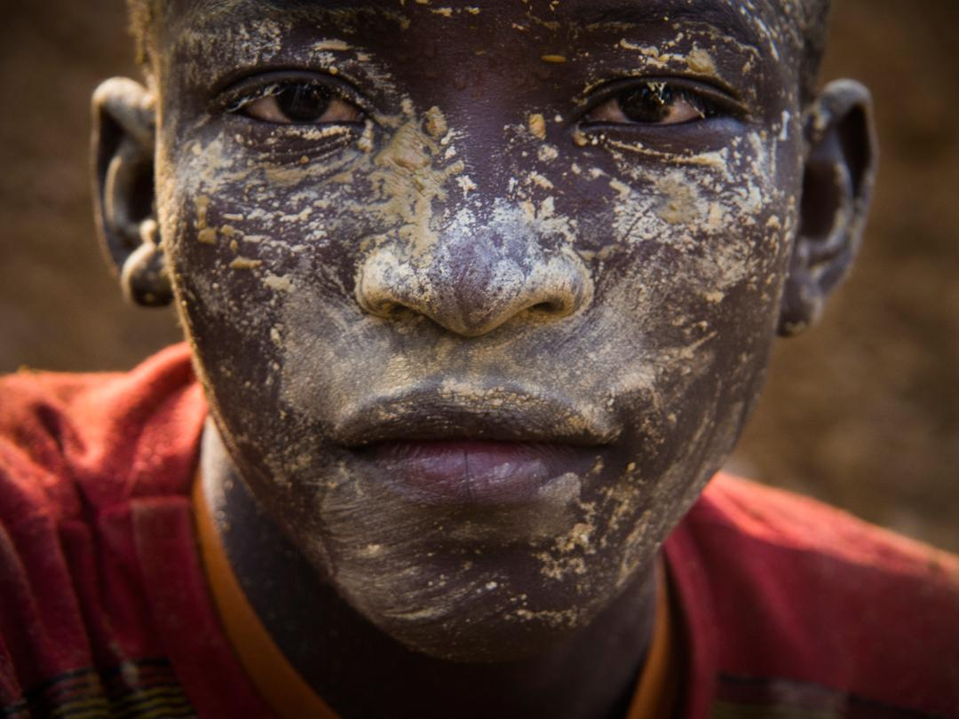
Image by Lynsey Addario. Greece, 2016.
Image by Amy Toensing. India, 2016.
Image by Larry C. Price. Burkina Faso, 2013.
@pulitzercenter
education@pulitzercenter.org

Slide 7
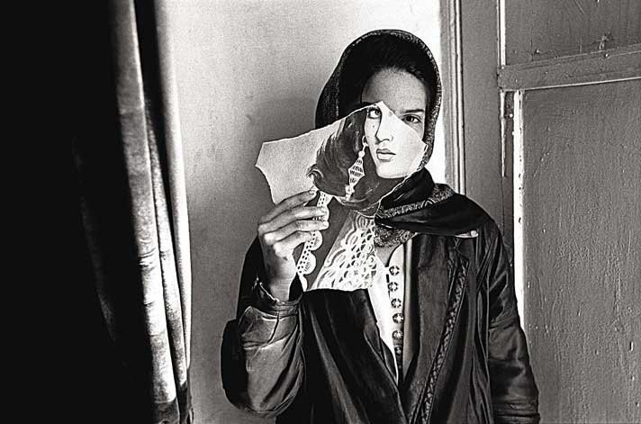
Key Terms_
Journalist
Breaking news
Under-reported story
Image by Seamus Murphy. Afghanistan, 2005.
Notes:
We focus on under-reported stories. Why might a story go under-reported?
Today, we are going to look at how we can use different forms of writing (journalism, poetry) to make our own stories and the under-reported stories of other people heard.

Slide 8
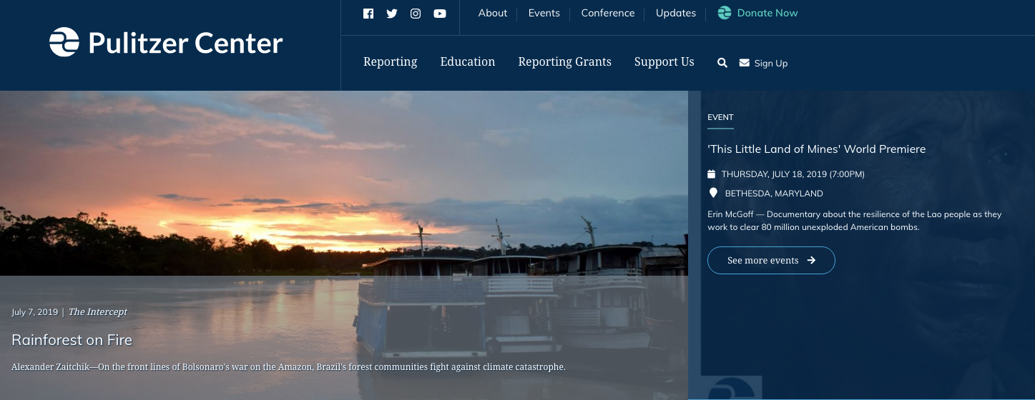
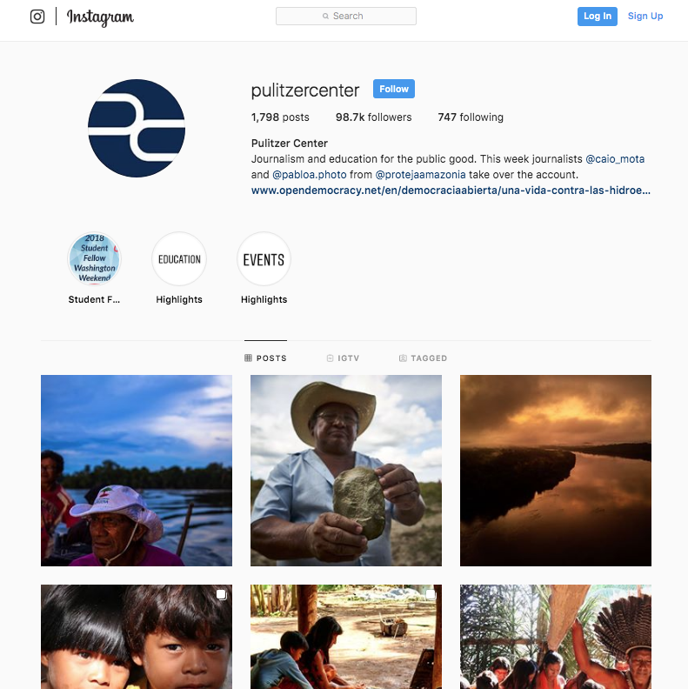
Journalism and education for the public good
• We provide grant funding ($$) to support 150 reporting projects each year:
These are under-reported stories on issues ranging from migration and human rights to climate change and global health.
• We lead more than 500 events each year for K-12 schools to connect these stories with students.
Notes:
Journalism grants. Education outreach.

Slide 9
These are some of the places that stories have been published.

Slide 10
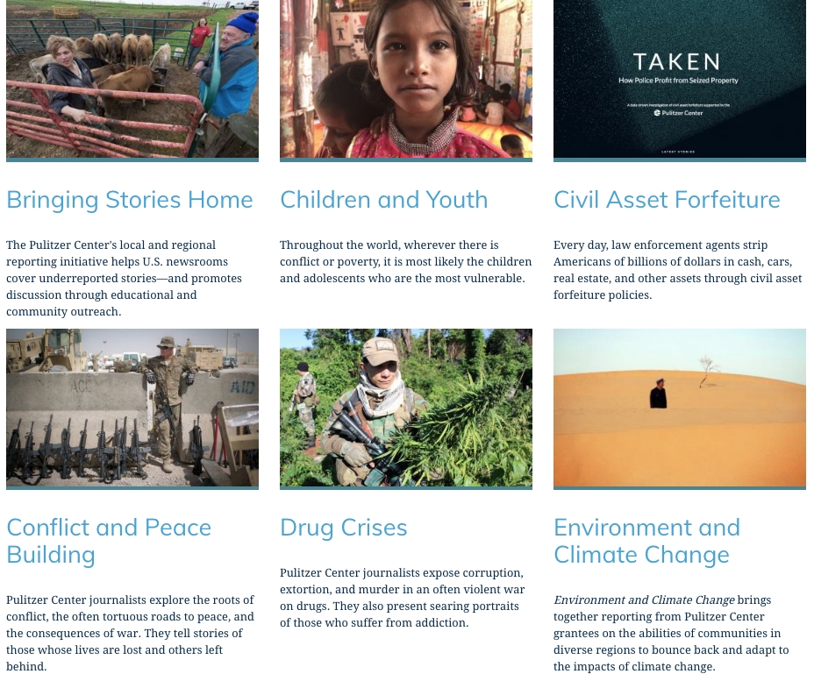
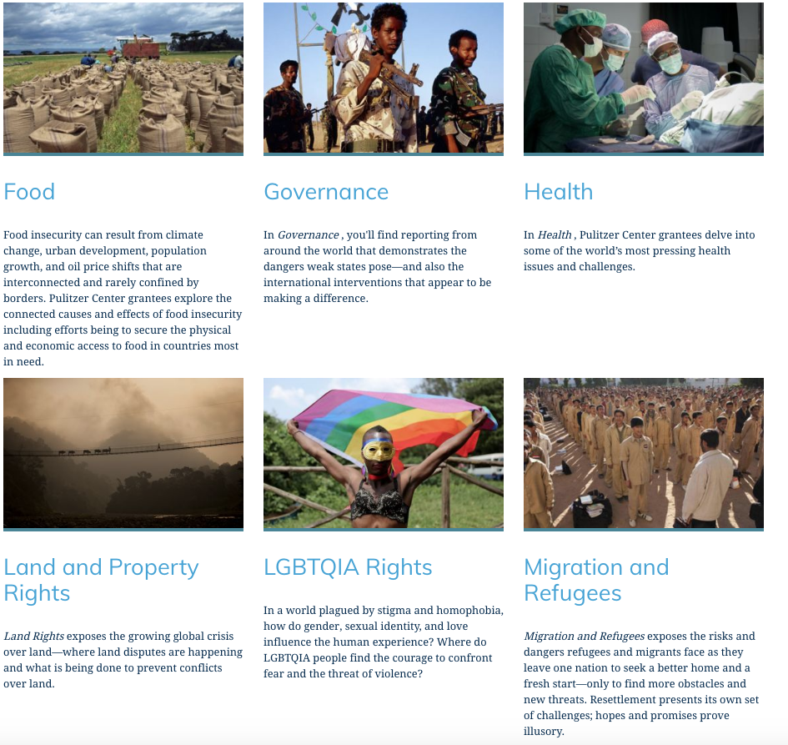
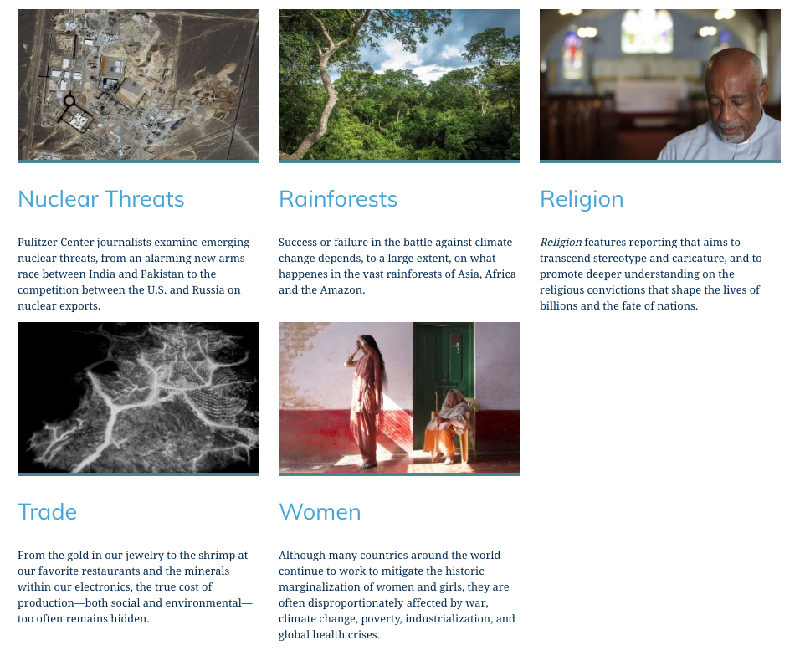
Here are some of the topics journalists
investigate with Pulitzer Center grants
Notes:
Range of topics, many telling stories with images

Slide 11
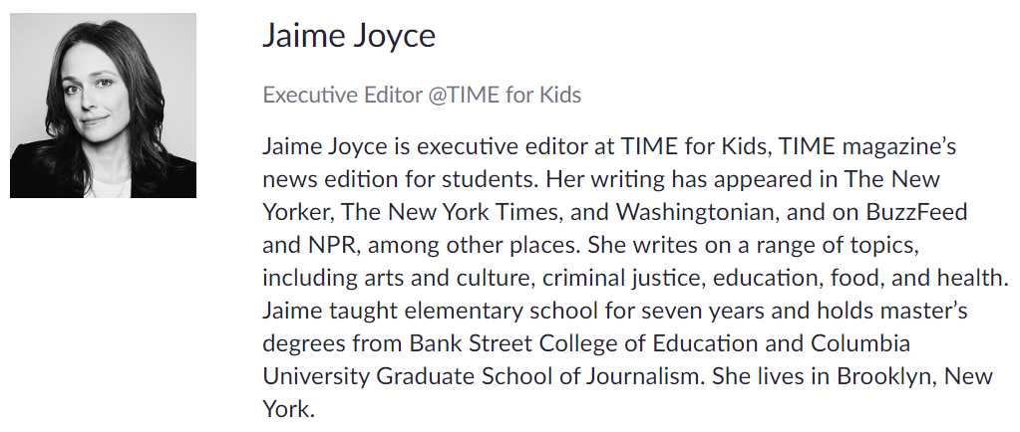
Please submit your questions throughout the presentation!
Notes:
Upcoming student opportunities

Slide 12
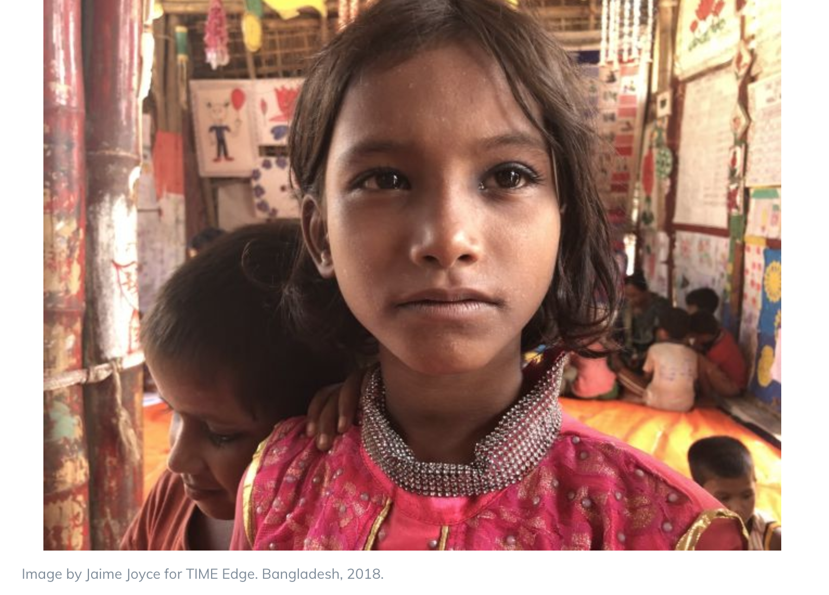
What does it mean to be a refugee?
Notes:
The Pulitzer Center webinar “How Kids Learn Around the World with Jaime Joyce” aired live on May 6, 2020.

Slide 13
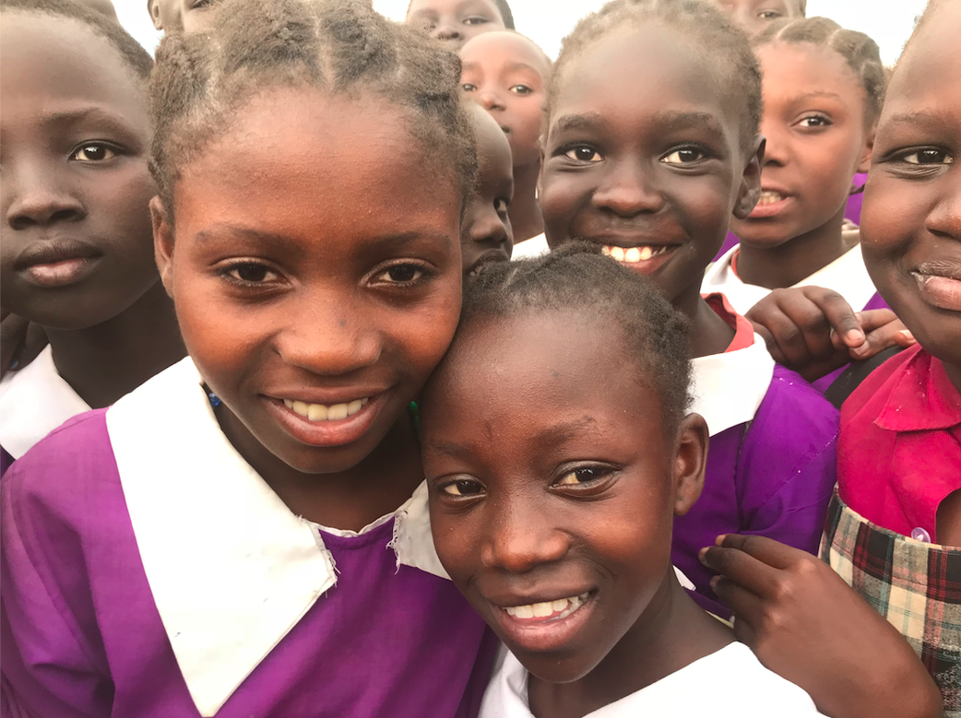
Resilience
Notes:
What does it mean to be resilient? As we go through the presentation, think about what resilience means to you and how the children we meet show us what resilience looks like. Feel free to discuss this throughout the presentation in the chat box.
** All photos and video by Jaime Joyce unless otherwise noted.

Slide 14
What does it mean to be a refugee?
Notes:
What does it mean to be a refugee?

Slide 15
“A refugee is a person who has fled his or her country due to war or fear of persecution because of race, religion, or nationality. Political opinion or membership in certain social groups can also play a role. A United Nations agreement called the 1951 Refugee Convention formally defines the term refugee. It also lays out refugees’ rights. These include the right to food, shelter, and, for children, education.”
From “Kids of Kakuma,” TIME for Kids, April 20, 2018
Notes:
From “Kids of Kakuma,” TIME for Kids, April 20, 2018

Slide 16
25.9 million
Notes:
Poll question: Of the world’s 25.9 million refugees, how many are under the age of 18?
Source: UNHCR Global Trends, 2018

Slide 17
about
½
are children
Notes:
Answer: About half of the world’s 25.9 million refugee are under 18. This means about 13 million refugees are kids. About 7 million refugee children are of school age.
Source: UNHCR Global Trends, 2018

Slide 18
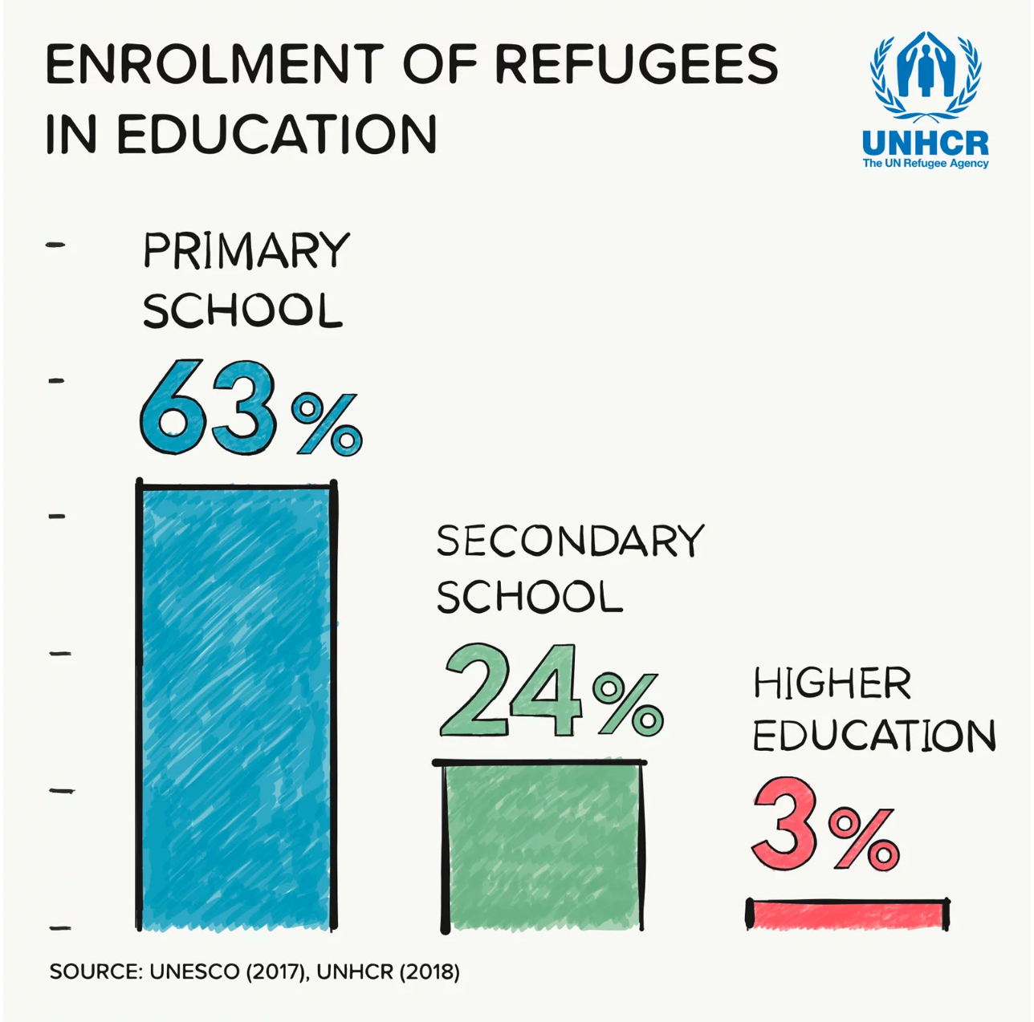
Notes:
About 91% of kids around the world are enrolled in primary school. But when it comes to refugee kids, only 63% are in primary school.
Source: UNHCR, “Stepping Up: Refugee Education in Crisis.”

Slide 19
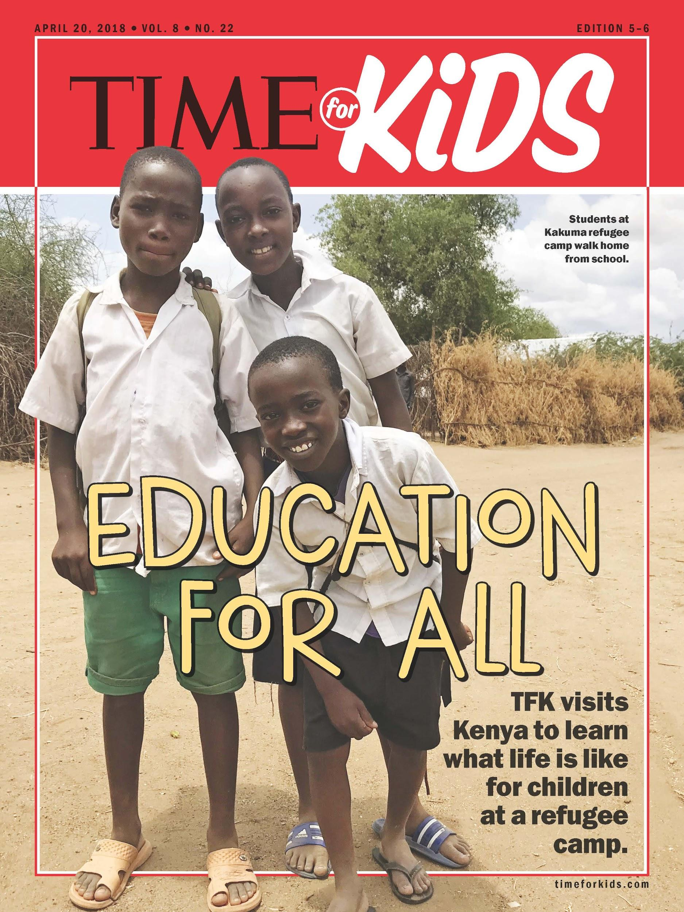
Notes:
TIME for Kids reporting on what life is like for children in a refugee camp; April 20, 2018

Slide 20
Notes:
I traveled from New York to Nairobi, Kenya, then Kakuma, to do my TIME for Kids reporting in March 2018.
20

Slide 21
What does a refugee camp look like?
Notes:
What do you think you might see? Type responses in the chat box.

Slide 22
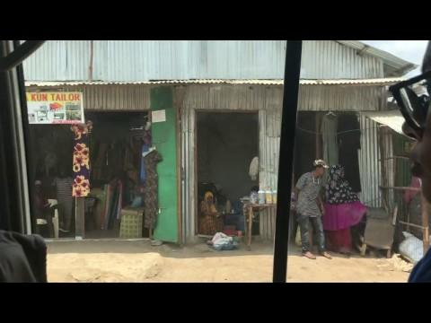
Notes:
Driving into Kakuma refugee camp, Kenya

Slide 23
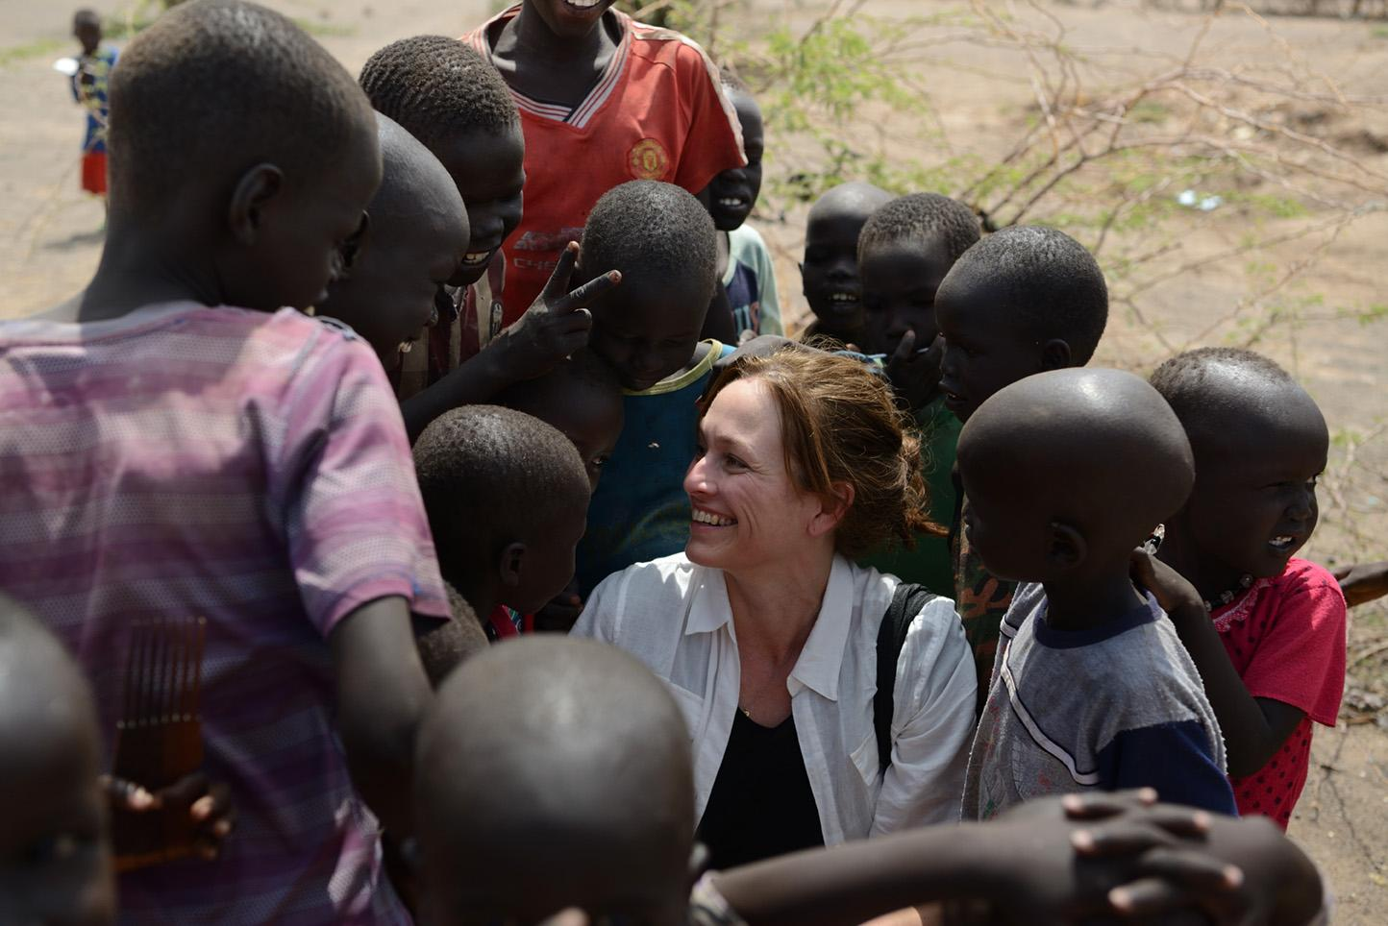
Notes:
Arriving at Kakuma refugee camp, March 2018
Credit: Rodger Bosch for UNICEF USA

Slide 24
Notes:
Rose Peter (right), 18, is a refugee from South Sudan. She came to Kenya in 2014 with 19 other children, walking in daylight and sleeping in the bush at night, where wild animals roamed. The trip took one week. “I am hoping that after I finish school my life will be changed completely.”
24

Slide 25
Notes:
Hulima, 10, is an unaccompanied minor living at the camp with a group of other boys.
25

Slide 26
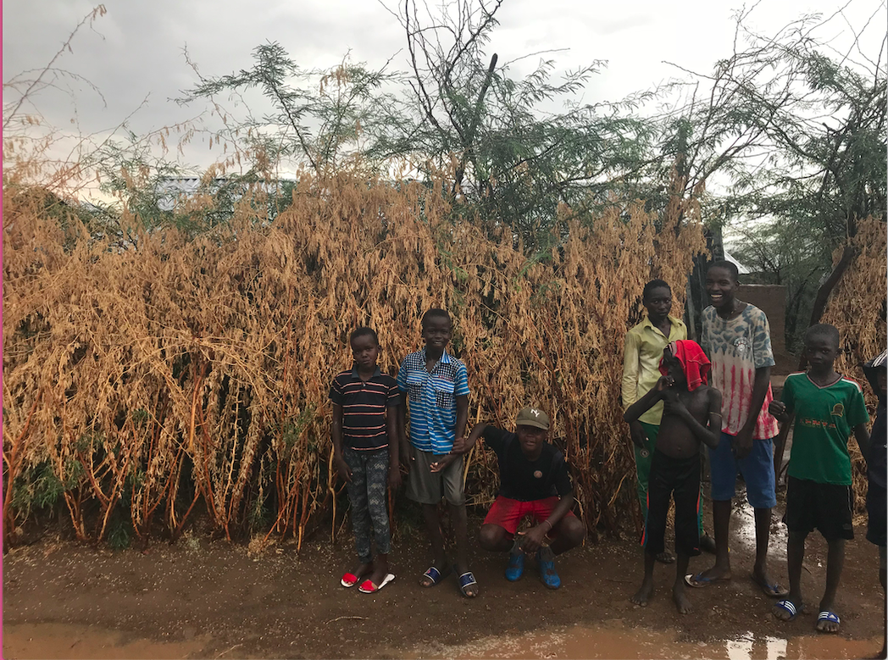
Notes:
Hulima, left, and the boys he lives with at Kakuma.

Slide 27
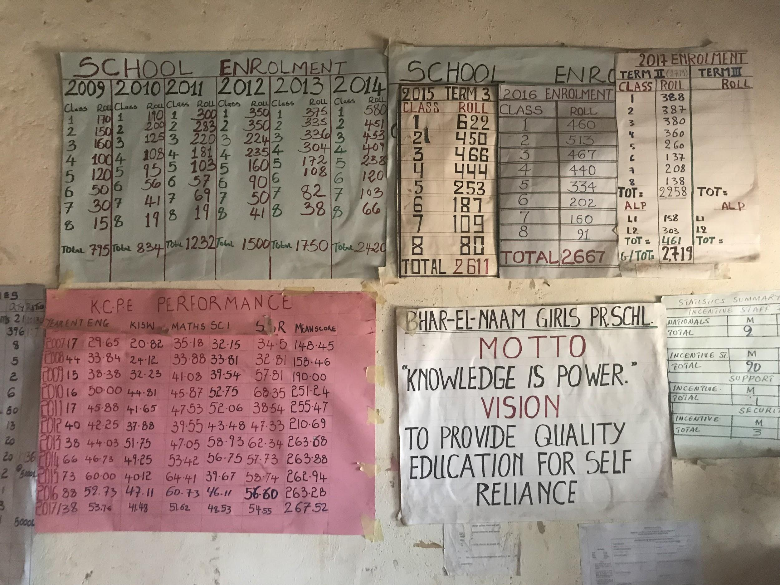
Notes:
School office, Bhar El-Naam school, Kakuma refugee camp

Slide 28
Notes:
Jessica Deng, 21, was born in Kakuma refugee camp. She is now a teacher at Bhar El-Naam school. On average, people live as refugees for more than two decades. “Nothing is simple at this camp,” she says. Especially for girls. “[Some] are told ‘Don’t go to school.’ Others are told, ‘Do this [chore] before you go to school.” And yet, “They come to school. They are so enthusiastic.”
28

Slide 29
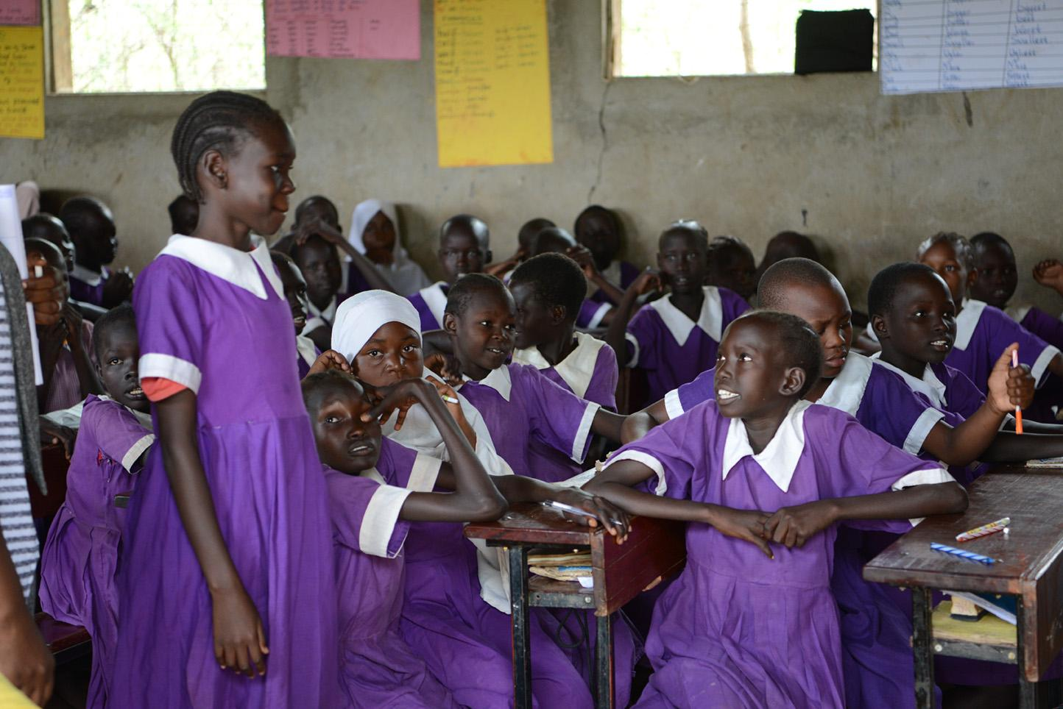
Notes:
Bhar E-Naam school is one of 21 primary schools in Kakuma; it is one of two exclusively for girls.
Photo: Rodger Bosch for UNICEF USA

Slide 30
Notes:
Mogadishu Primary School has 2,815 students and 21 teachers. That means one teacher for every 135 students. The average student-teacher ratio in Kakuma is 100 to one.
30

Slide 31
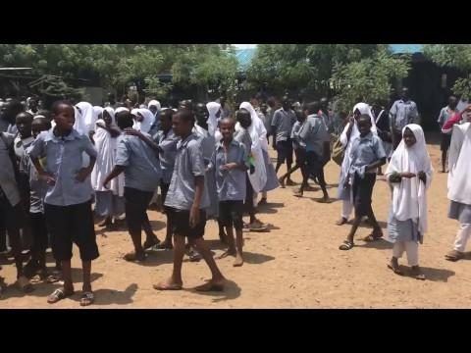
Notes:
Video: Breaktime at Mogadishu Primary. Most of the students are from Somalia, which is why the school is named after the country’s capital.
31

Slide 32
Notes:
Kalobeyei Friends School
More than 100 students in each class
32

Slide 33
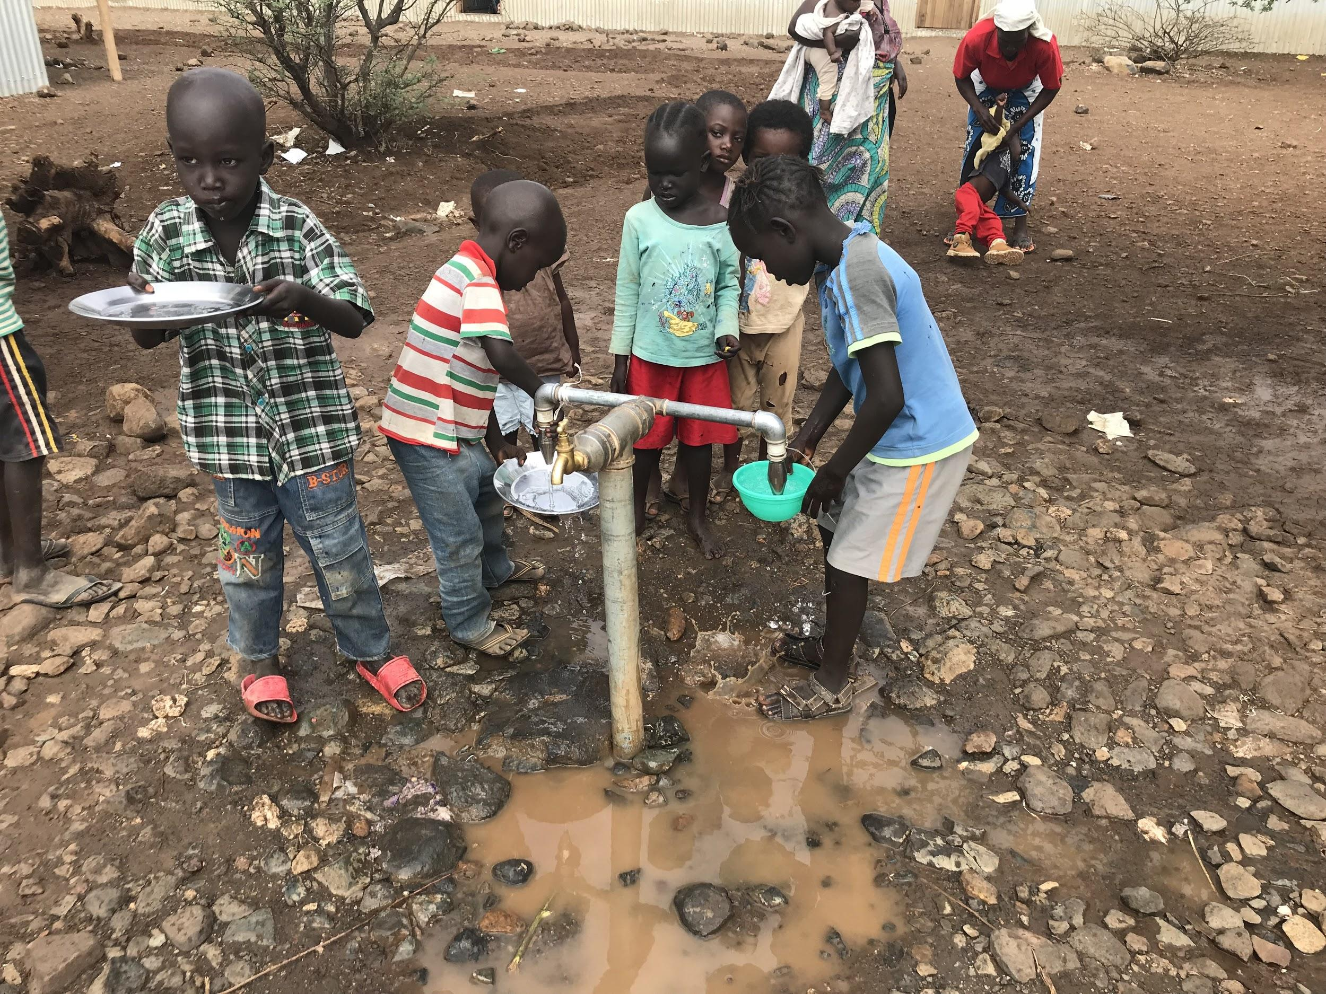
Notes:
Water fountain at Kalobeyei Friends School

Slide 34
Questions?
Notes:
What did you notice about the schools we visited in Kakuma? What questions came up for you?

Slide 35
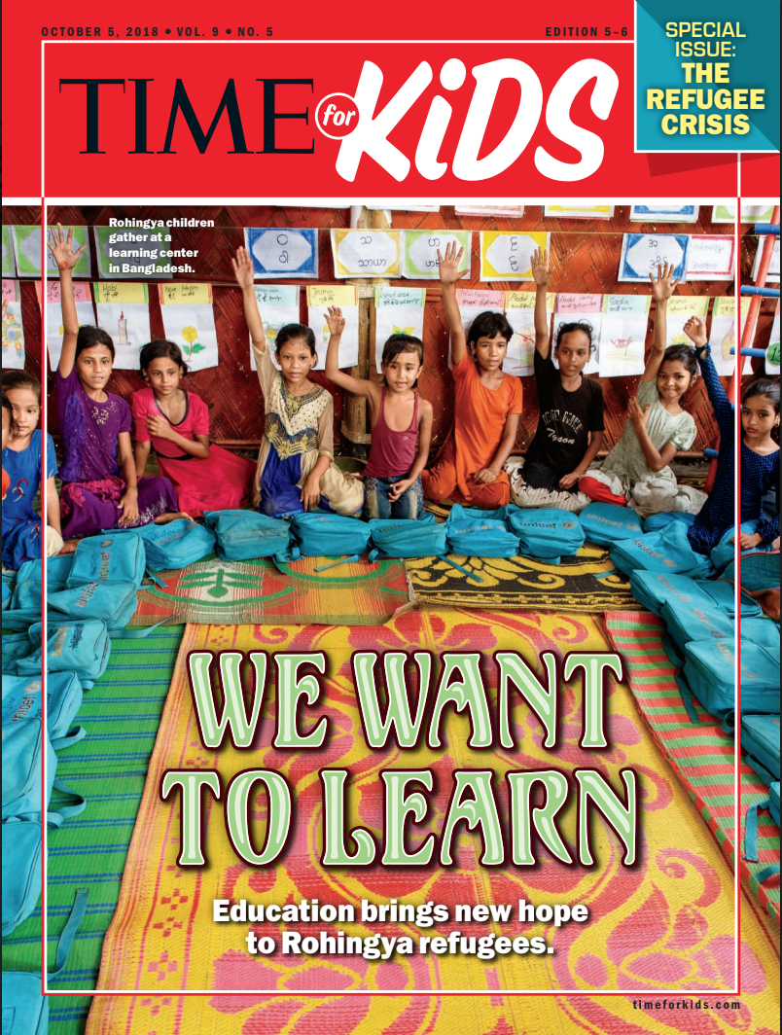
Notes:
Reporting on Rohingya refugees in Bangladesh; September 28, 2018

Slide 36
“The Rohingya are a Muslim minority in Myanmar, which is mainly Buddhist. Myanmar’s government denies them citizenship even though they have lived there for centuries. Human-rights groups say that of all the world’s peoples, none faces greater discrimination than the Rohingya.”
From “Safe in School,” TIME for Kids, September 28, 2018
Notes:
From “Safe in School,” TIME for Kids, September 28, 2018

Slide 37
Notes:
Bangladesh. On August 25, 2017, an attack on Rohingya villages by the Myanmar military forced thousands to flee. Rohingya people fled violence in Myanmar. Persecuted because they are Muslim.
37

Slide 38
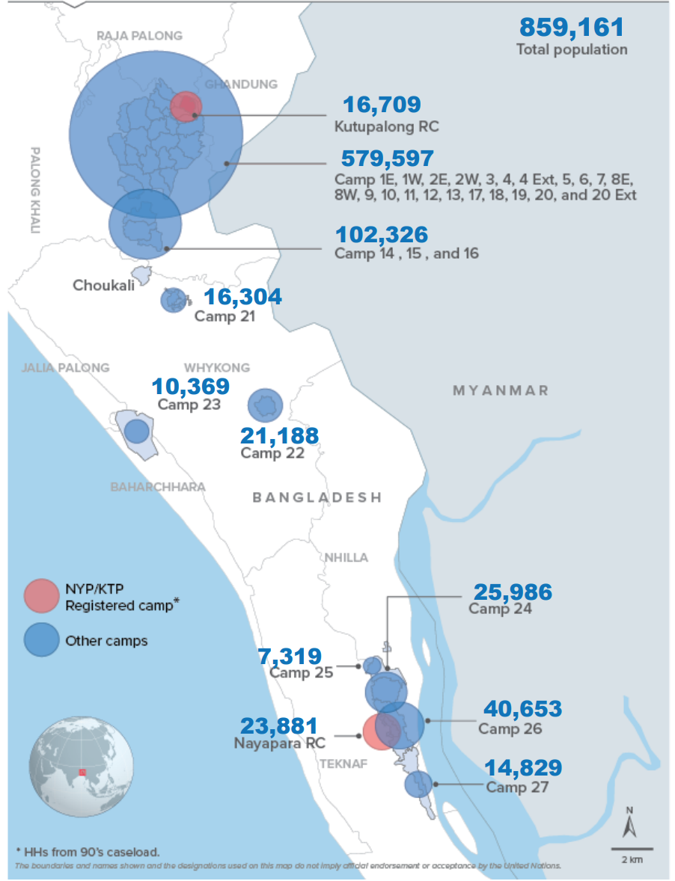
Notes:
Location of refugee camps in Cox’s Bazaar, Bangladesh (March 15, 2020)
Source: UNHCR

Slide 39
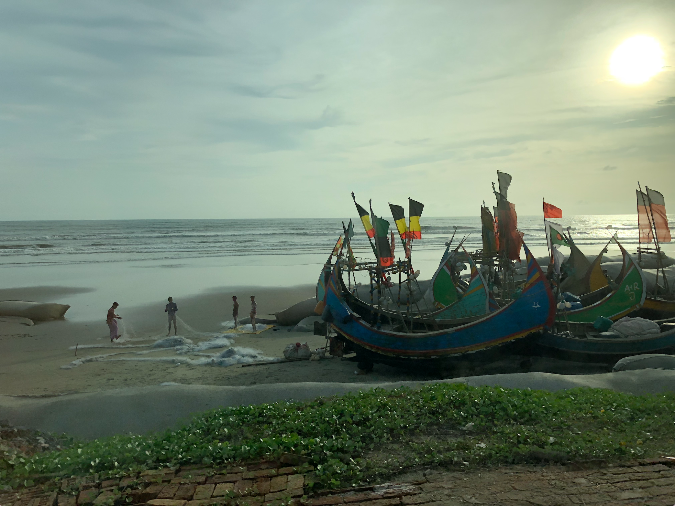
Notes:
Fishing boats on the Bay of Bengal

Slide 40
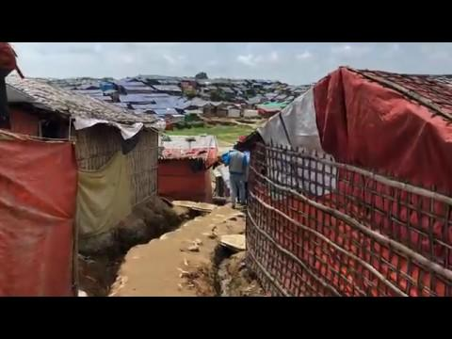
Notes:
Video: A walk though Jamtoli settlement.
40

Slide 41
Notes:
Golap Child Learning Center at Shamlapur settlement. There are around 30 children in each class
41

Slide 42
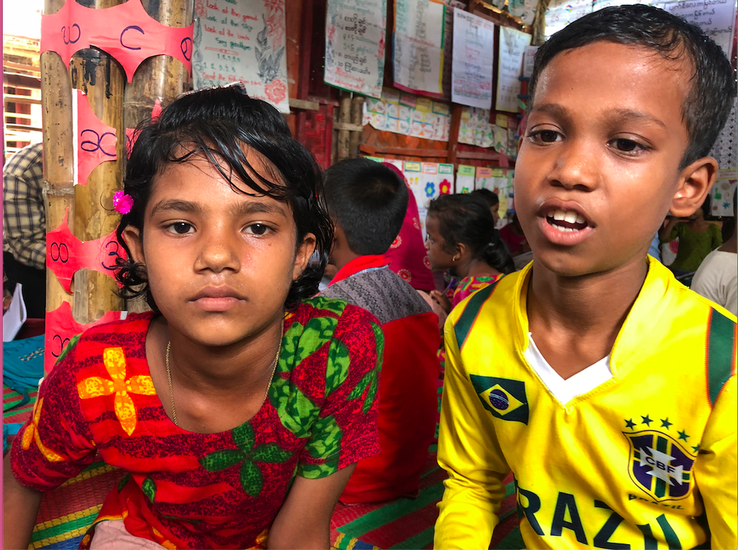
Notes:
Gulbahar is 8. She came to Bangladesh in 2017. Mohammad is 11. When we met in 2018 he told me he’d been at the camp for nine years.

Slide 43
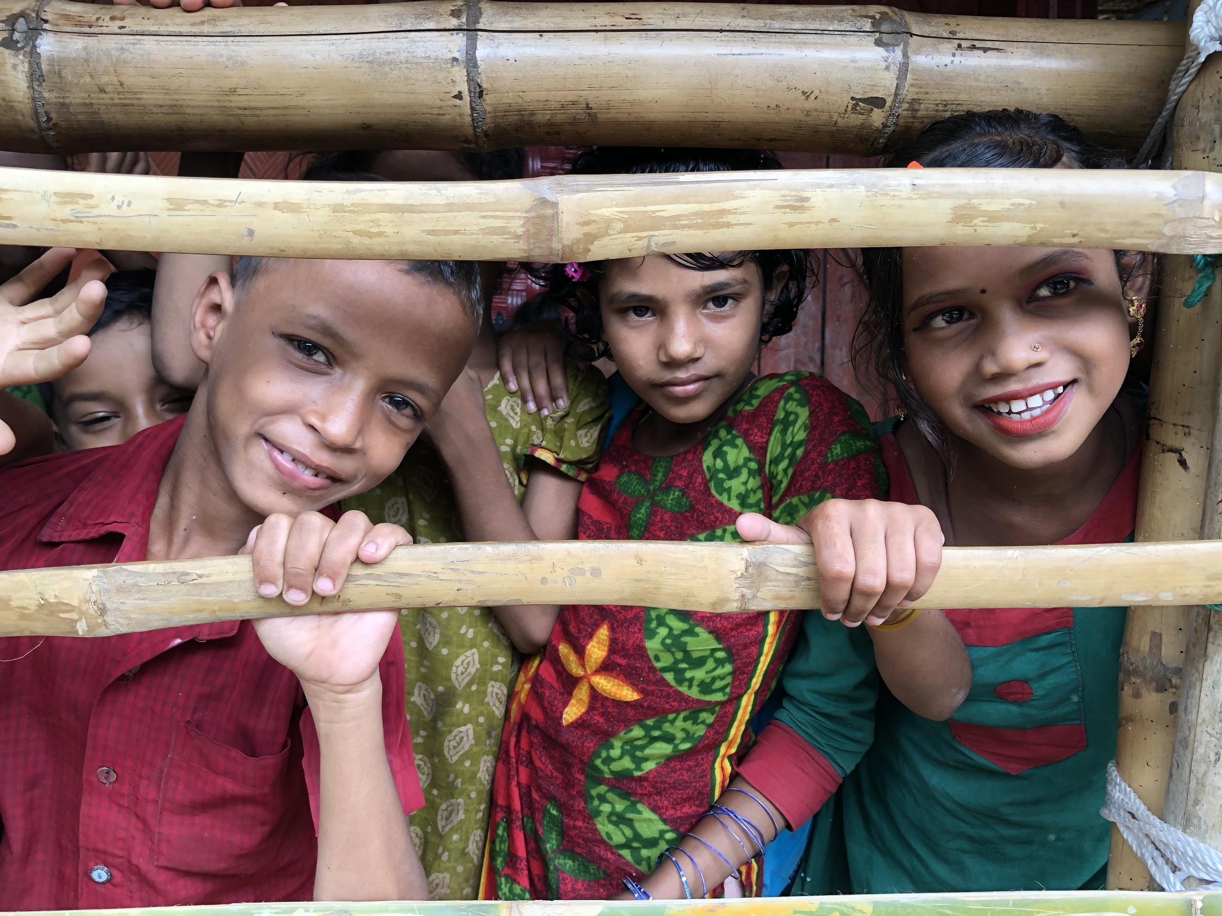
Notes:
Students waiting to enter the classroom. At the time, children attended class for two hours each day.

Slide 44
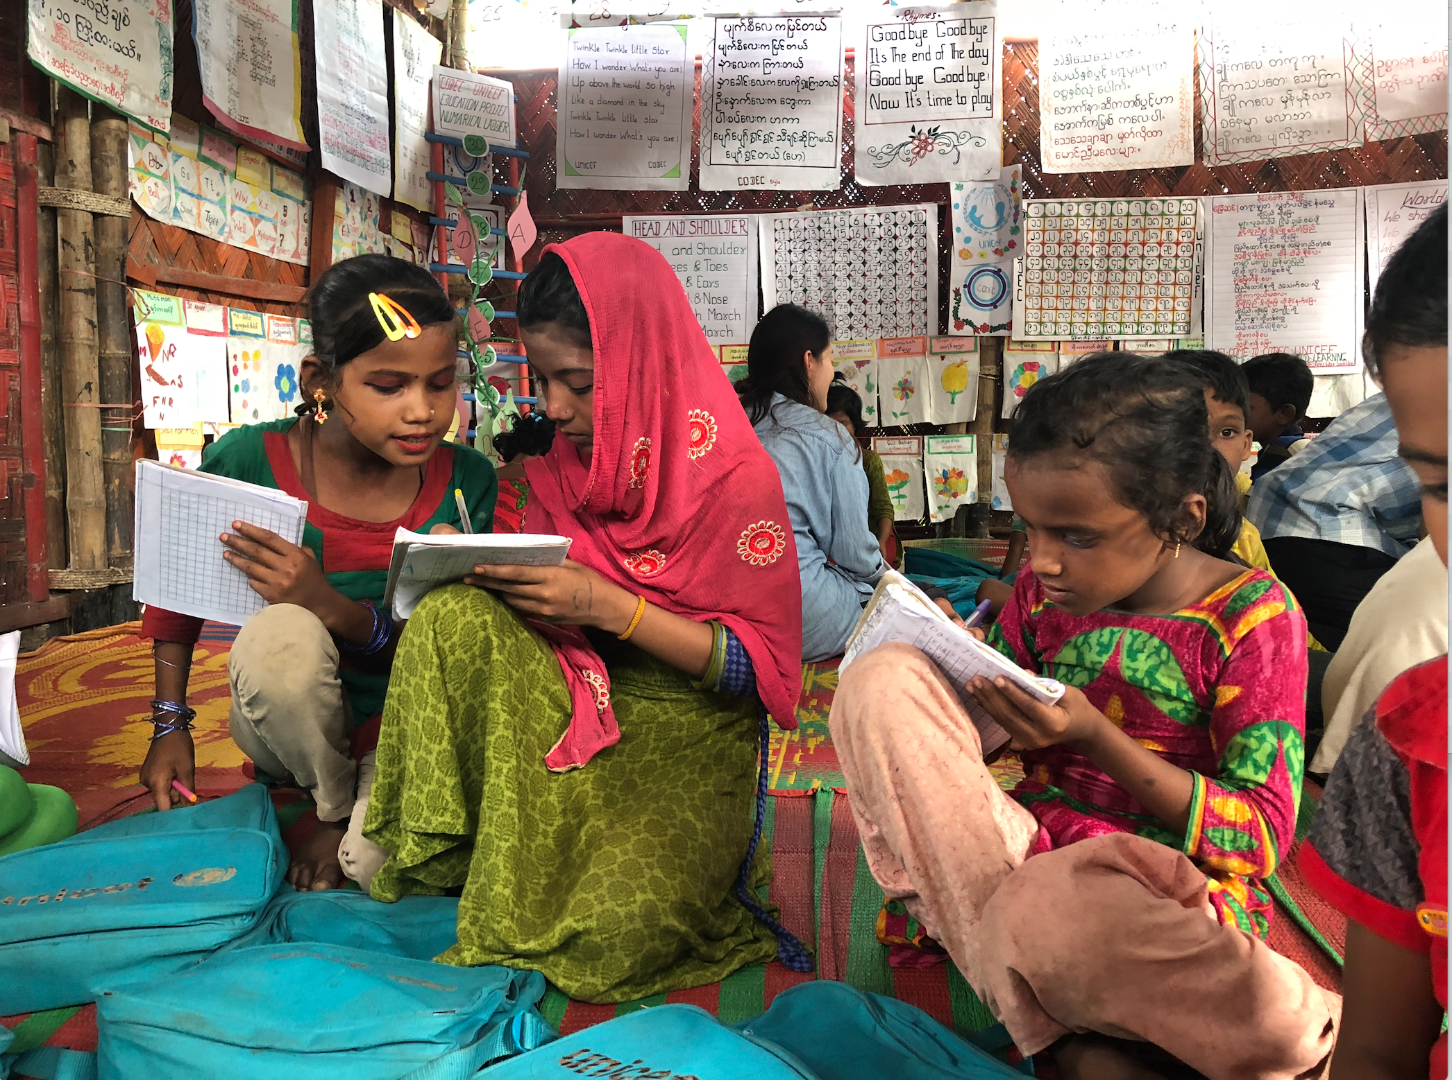
Notes:
Students work together at Golap Child Learning Center.

Slide 45
Notes:
Jaime Joyce with Rohingya teacher Muhammad Jaber Ahmed and Bangladeshi teacher Muhammad Alam Khan
45

Slide 46
Notes:
Rohingya students singing what they call “The World Song.” In the U.S., be know the song best as “We Shall Overcome,” an anthem of the civil-rights movement.

Slide 47
Questions?
Notes:
What did you notice about the schools we visited in the Rohingya camps? What questions came to mind?

Slide 48
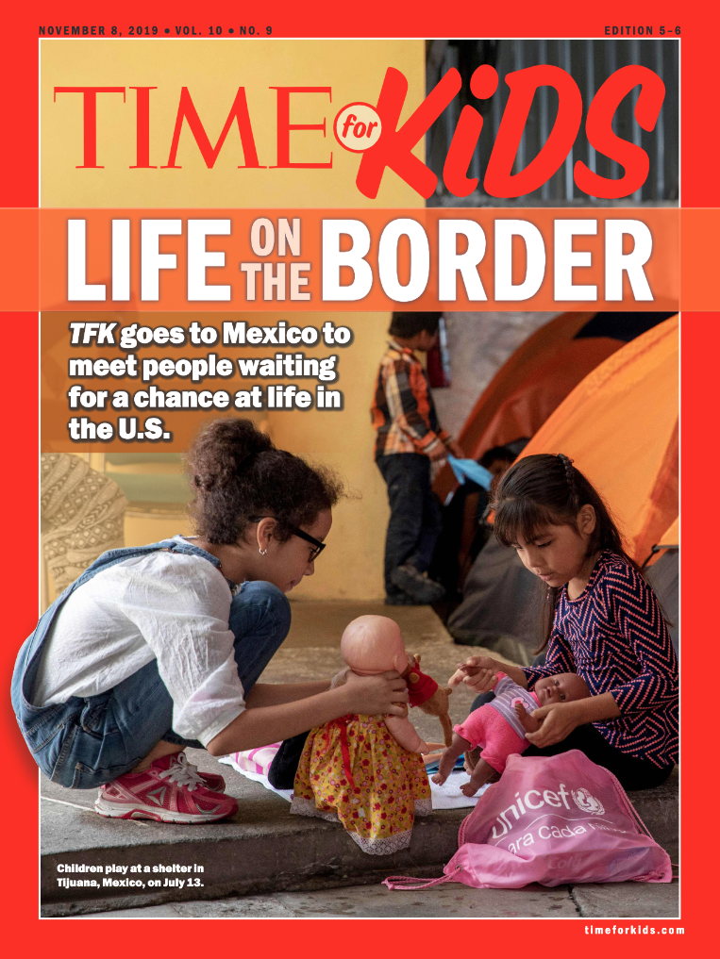
Notes:
TIME for Kids reporting from Mexico on the refugee and migrant crisis at the U.S. southern border; November 1, 2019

Slide 49
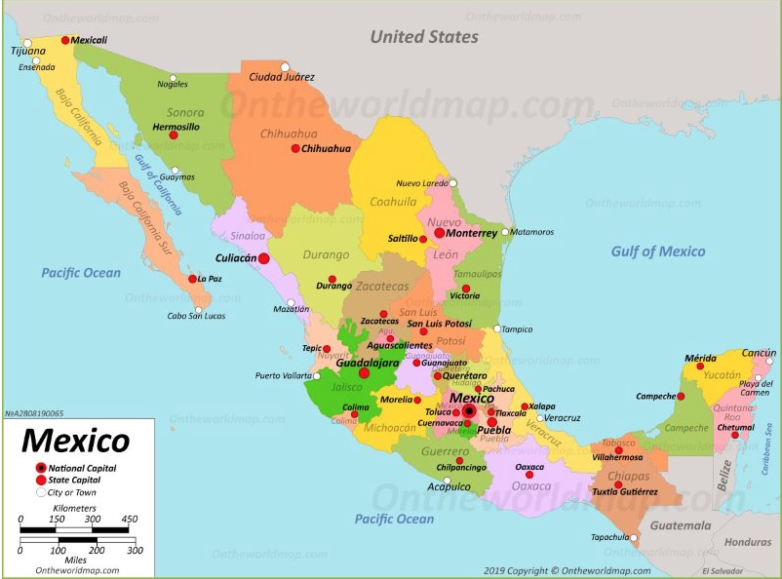
Notes:
I reported from Tijuana, Mexico, in October 2019.

Slide 50
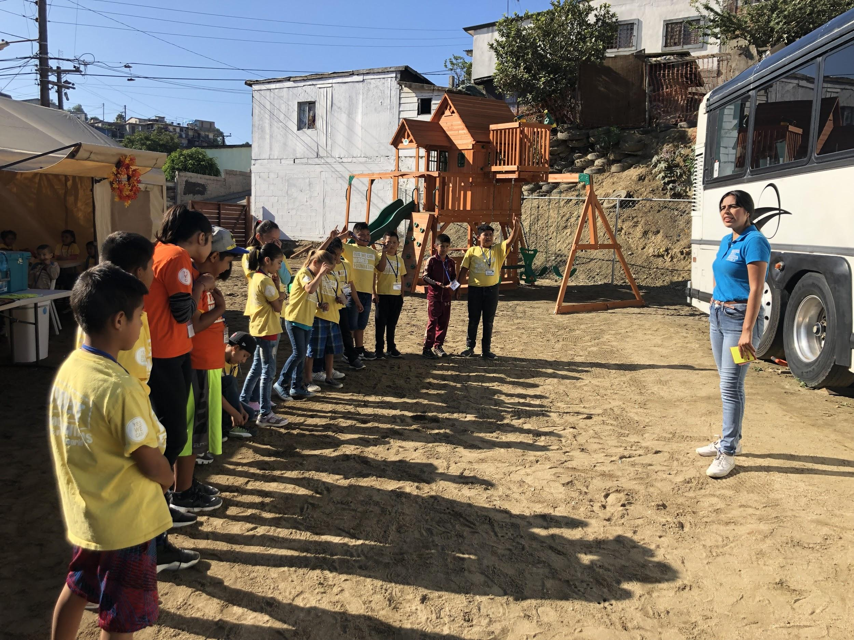
Notes:
The Yes We Can World Foundation school opened in Tijuana in July. It has 45 students. Students and their families live in the overcrowded shelter next door.
“There is no difference between our kids and kids in the U.S.,” school cofounder Estefanía Rebellón tells me. “Their whole world, their life, is moving. We’re the stable part,” she says.

Slide 51
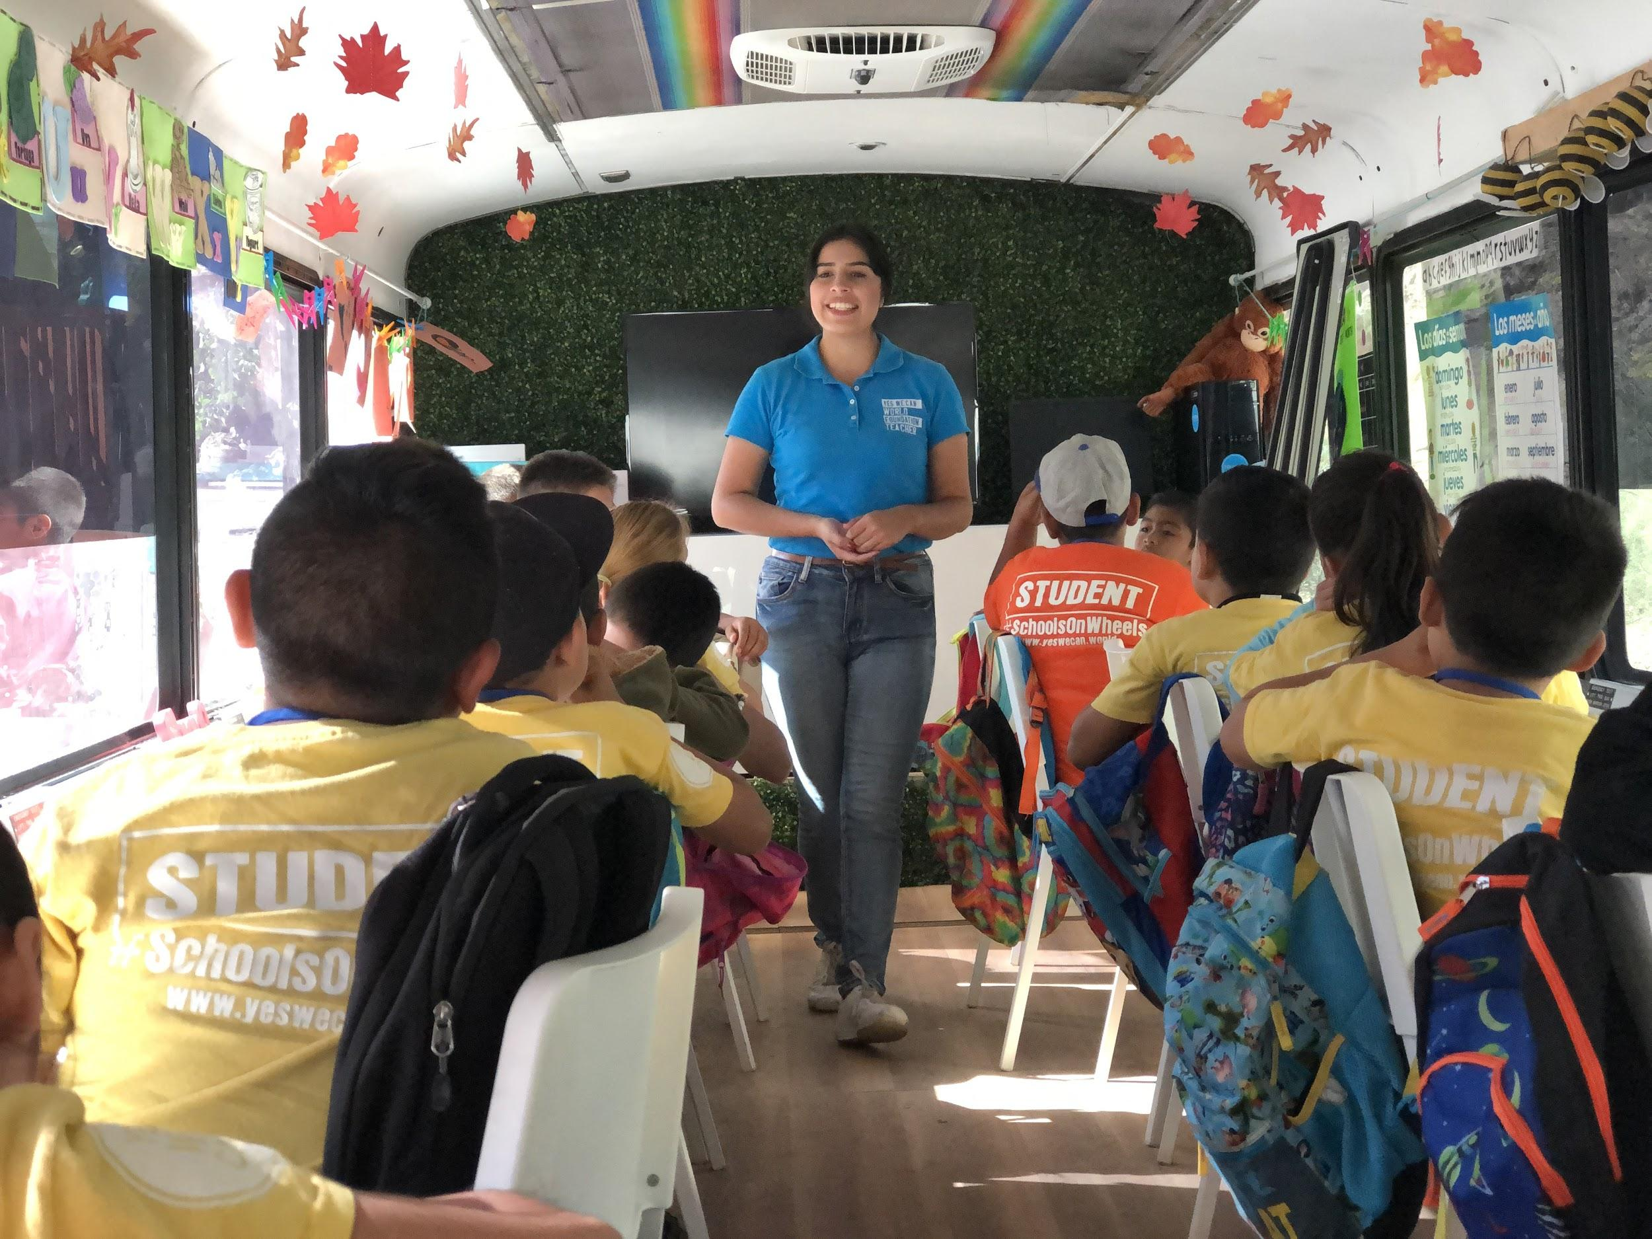
Notes:
School is bilingual; classes are held on a converted bus and in tents outside

Slide 52
“There is no difference between our kids and kids in the U.S.,” school cofounder Estefanía Rebellón tells me. “Their whole world, their life, is moving. We’re the stable part,” she says. “Even with what they’re going through, they’re so grateful.”
From “Holding On to Hope,” TIME for Kids, November 1, 2019
Notes:
From “Holding On to Hope,” TIME for Kids, November 1, 2019

Slide 53
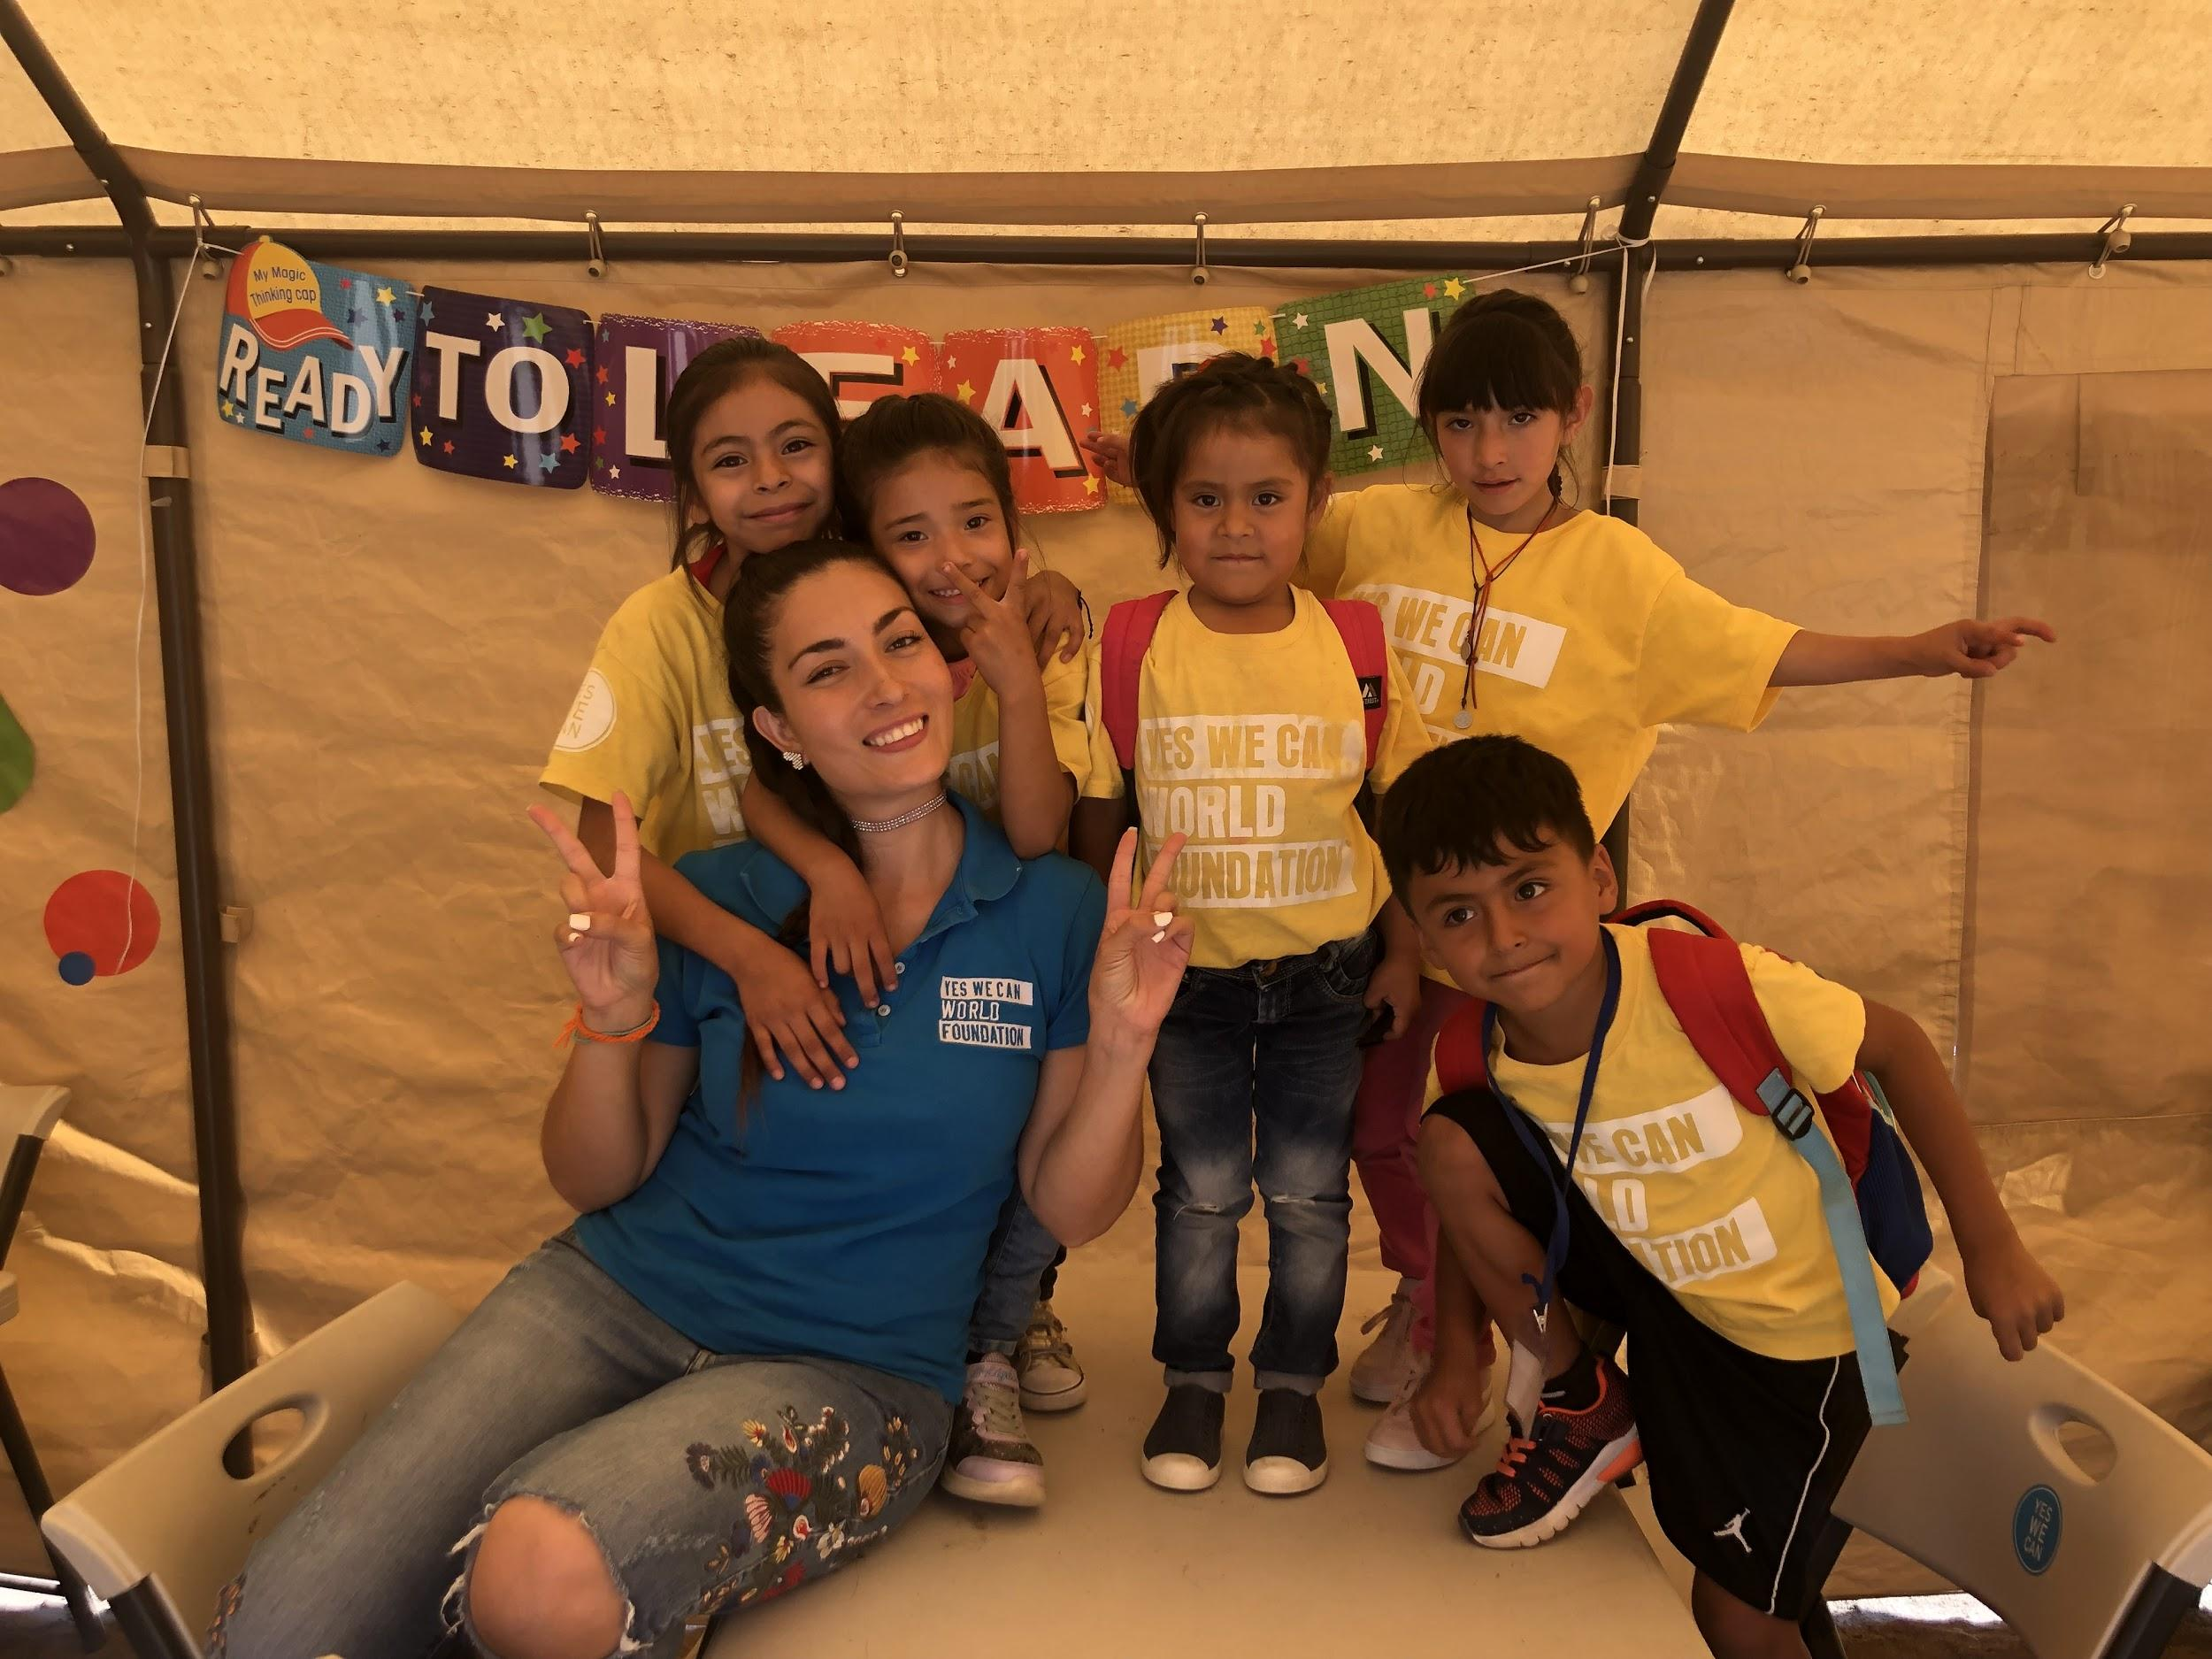
Notes:
School started by Estefania Rebellon. Her family fled violence in Colombia when she was 10 years old. They settled in Miami. “In my experience as a child coming to the U.S. from Colombia, school was the only safe space that I had. The teachers that helped me were my rock. So I decided to start the school in Tijuana because I see myself in these kids. I see what they’re going through.”

Slide 54
“In my experience as a child coming to the U.S. from Colombia, school was the only safe space that I had. The teachers that helped me were my rock. So I decided to start the school in Tijuana because I see myself in these kids. I see what they’re going through.”
— Estefanía Rebellón
From “Ready to Learn,” timeforkids.com, November 1, 2019
Notes:
Estefanía Rebellón’s family fled violence in Colombia when she was 10 years old. They settled in Miami, Florida.

Slide 55
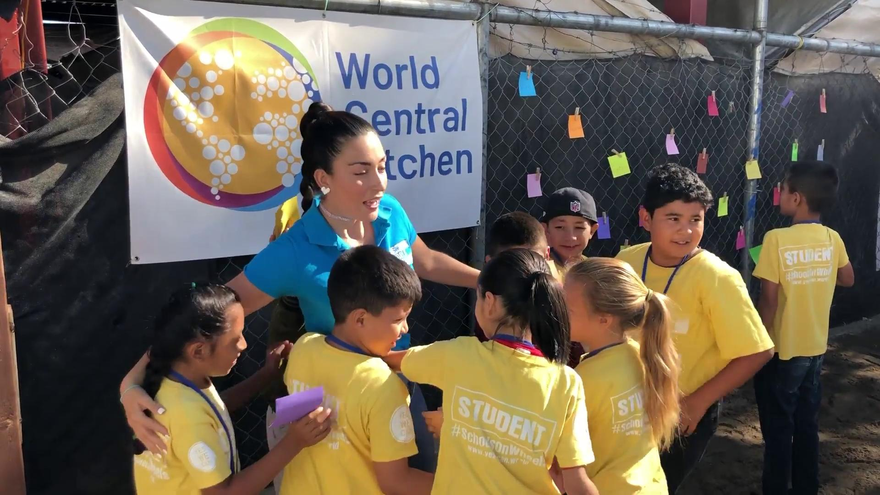
Notes:
Children greeting Rebellon when she arrives at the school on the morning I visited.

Slide 56
Questions?
Notes:
How does the learning environment at the Yes We Can school compare to those you saw in Kenya and Bangladesh?

Slide 57
What have the young people you’ve met in today’s presentation taught you about resilience?
Notes:
What have the young people you’ve met in today’s presentation taught you about resilience?

Slide 58
Get TIME for Kids!
timeforkids.com
TFK Free Digital Library
time.com/tfk-free
Notes:
Get TIME for Kids.

Slide 60
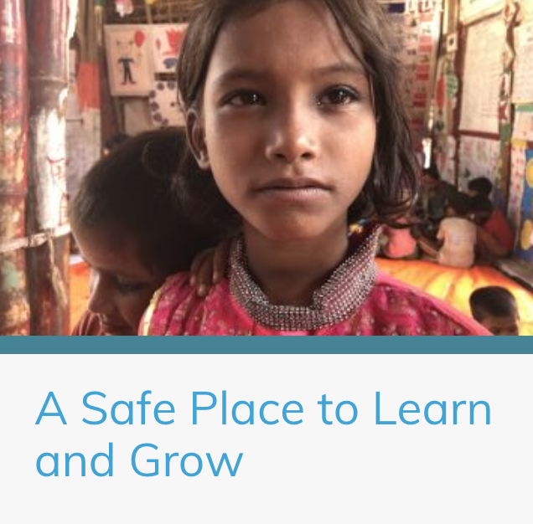
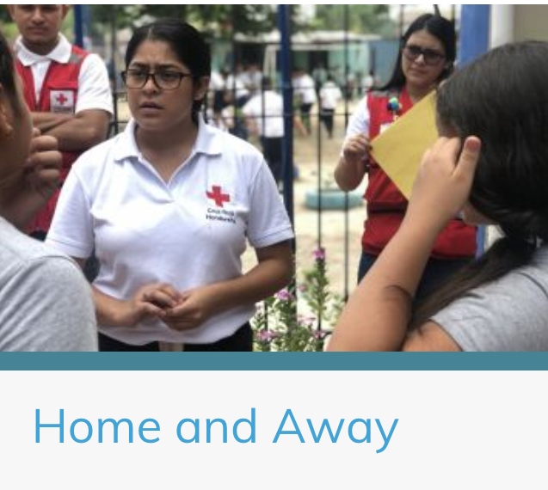
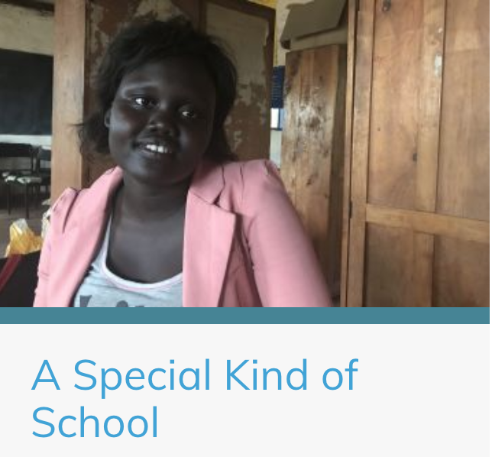
https://pulitzercenter.org/people/jaime-joyce

Slide 61
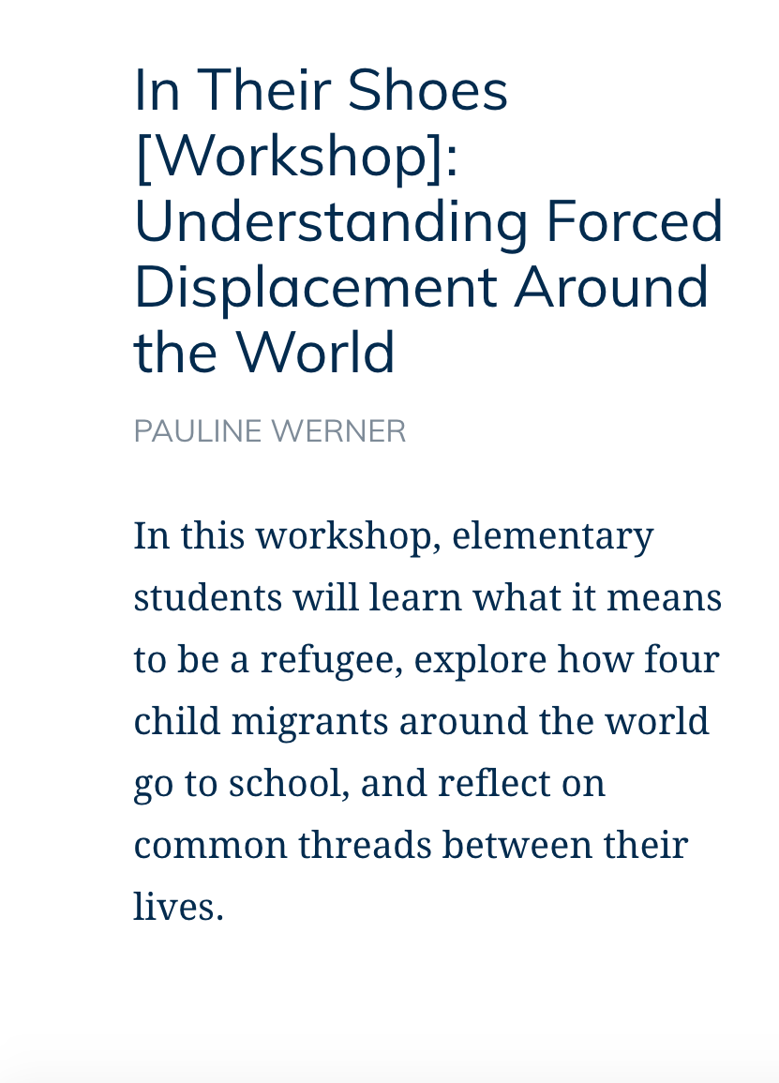
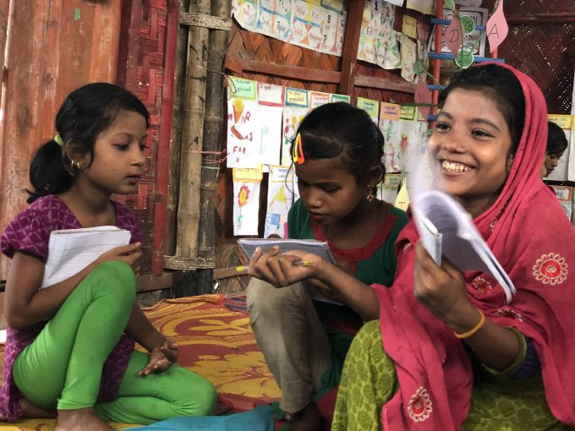
Email education@pulitzercenter.org to schedule a workshop!
Click to view workshop plan

Slide 62
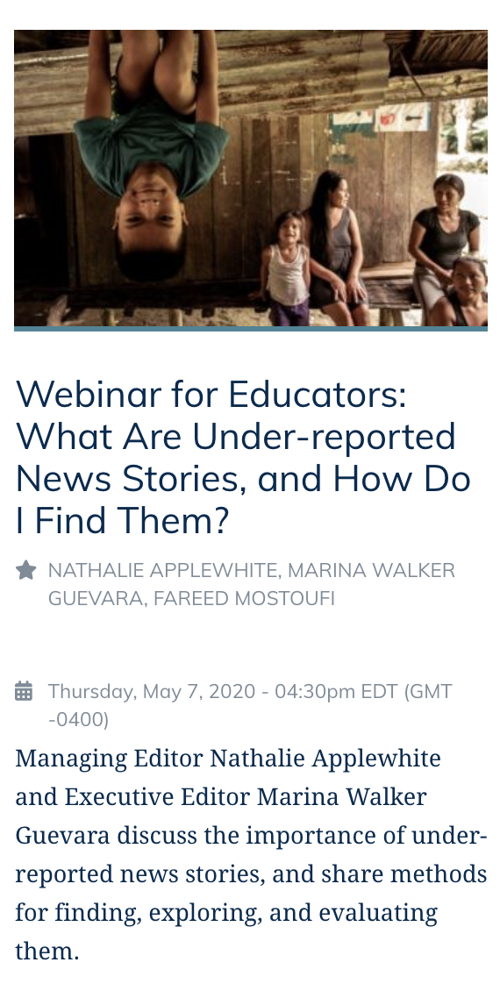
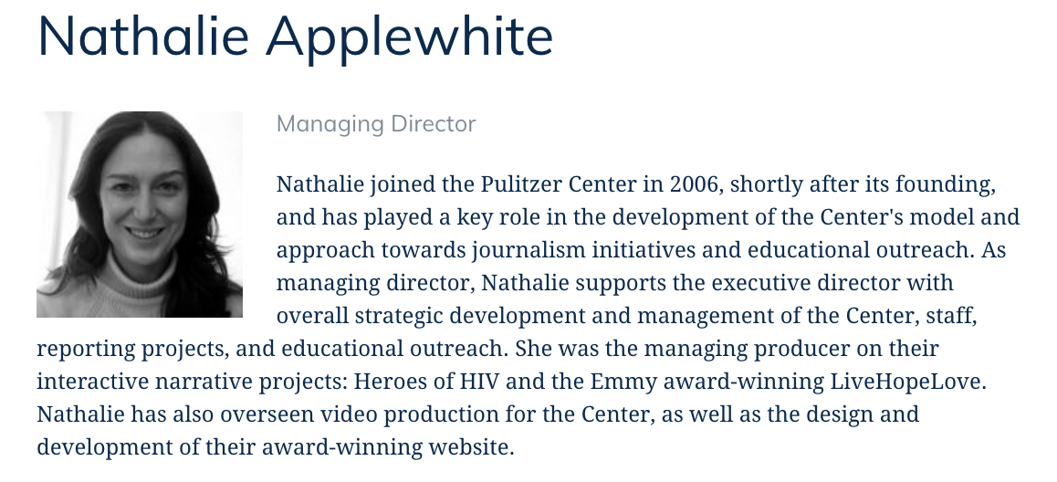
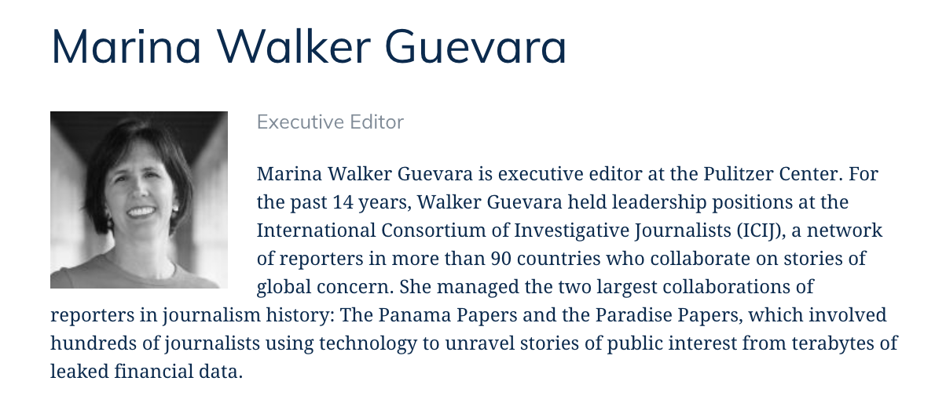
Thursday, May 7, 2020
4:30-5:30 pm
Click to register!
Notes:
Upcoming student opportunities

Slide 63
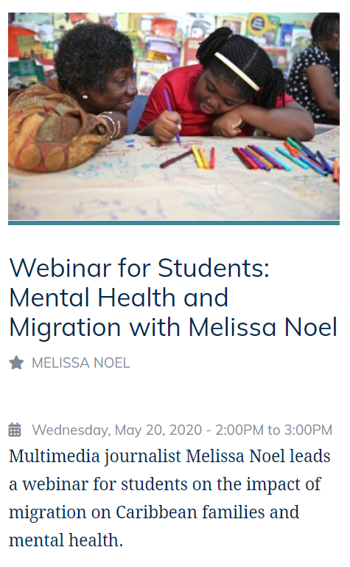
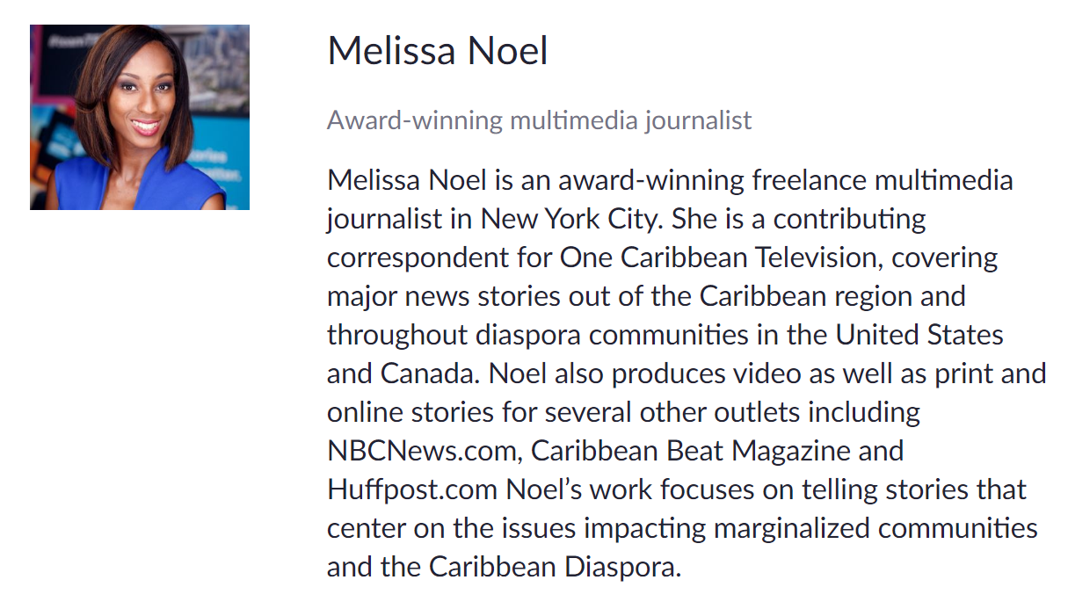
Wednesday, May 20, 2020
2:00-3:00 pm
Click to register!
Notes:
Upcoming student opportunities

Slide 64
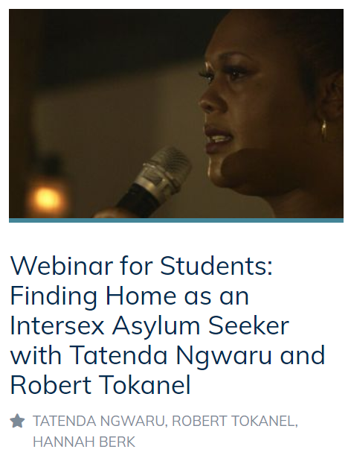
Wednesday, June 3, 2020
2:00-3:00 pm
Click to register!
Notes:
Upcoming student opportunities

Slide 65
Fighting Words Poetry Contest
Guidelines:
Include at least one line from a Pulitzer Center story
Respond to the story you cite
Prizes:
Up to $100 and publication on the Pulitzer Center website
Deadline: Friday, May 15, 2020 11:59 pm ET
Details and Google Form to submit at pulitzercenter.org/PoetryContest
Questions? Email us at hberk@pulitzercenter.org

Slide 66
Image by Lynsey Addario. Greece, 2016.
Image by Amy Toensing. India, 2016.
Image by Larry C. Price. Burkina Faso, 2013.
@pulitzercenter
education@pulitzercenter.org

