Slide 1

Migration: Push/Pull Factors
AP Human Geography

Slide 2
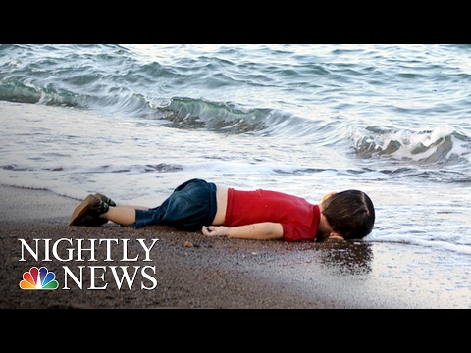
Warm Up: 9.16,19
3 CD’S: (Facts about video to summarize) AHA MOMENT: What surprised you? (Something that could have changed your mind or something new) TOUGH QUESTION: What does this make ME wonder about? WORDS OF WISDOM: What is the real lesson to learn? (Advice or insight)

Slide 3
Types of Migration
Forced Migration -refers to the coerced movement of a person or persons (refugees, asylum seekers, internally displaced persons, and slaves) away from their home or home region. Some reasons for this migration occurring is due to
environmental or natural disasters,
chemical or nuclear disasters,
famine
conflicts
slavery

Slide 4
Voluntary Migration
Voluntary Migration - comes from a person's choice to relocate to an opportunity instead of an encroaching fear for safety. Voluntary migration occurs as a result of a group of people desiring to influence their circumstances, not the other way around.
Transnational
Transhumance
Internal
Chain
Step
Guest Worker
Rural to Urban

Slide 5

Push Factor (Choral Reading)
•People want to get away from things they do not like where they live. It can be for political, economic, social, or environmental reasons.

Slide 6

Pull Factors (Choral Reading)
• People are attracted to things they do like in the city. It can be for political, economic, social, or environmental reasons.

Slide 7
Push/Pull Factor Quick Write
In you own words, define what a push and pull factor is and why people migrate from a country. Be prepared to share out.

Slide 8
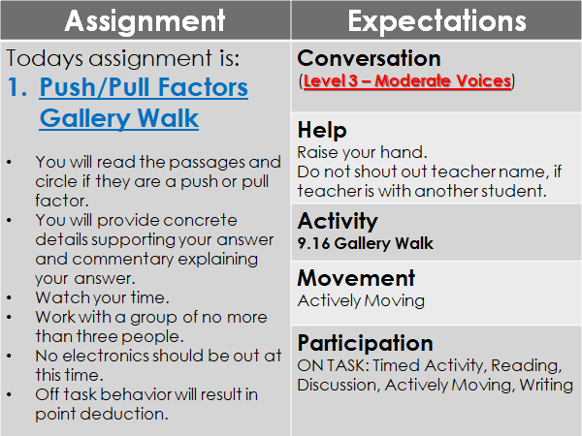

Slide 9
Closure:
Discuss in what ways the push and pull factors of your family are similar or different from those that you read about. Be sure to identify the political, economic, social, and environmental factors. Be prepared to share out.

Slide 10
Scenario #1
“My name is Mehmet Karagioules, and I am from Greece. My family may be Muslim, but we have roots in Greece going back generations. After the recent war between Greece and Turkey, the governments agreed to a population transfer: all the Greeks in Turkey would be sent to Greece and all the Turks in Greece would go to Turkey. Because we are Muslim, the government decided we were Turks. They stripped us of our Greek citizenship and planned to forcibly move us to Turkey. We decided to leave before that could happen.” (1924).

Slide 11
Scenario #2
“My name is Marcel Durand, and I am from Paris, France. I have been reading stories in the newspaper for weeks about how the Americans have found gold in the mountains of California. I am heading to California to strike it rich!” (1849)

Slide 12
Scenario #3
“My name is Muhammad, and I am from Syria. Scientists say that from 2006 through 2011, Syria suffered its worst drought and crop failure in recorded history. I am a poor farmer who as been hit hard by this terrible drought. It is no longer safe for me and my family here. ISIS is on the move, and we have nowhere left for us here that is safe. The failure of our crops have left many poor and hungry, and many have gone to join ISIS. My family and I will begin to make our way to Greece, where we hear that things are safer for people like us.”

Slide 13
Scenario #4
“My name is Arva Placencio, and I live in the Dominican Republic. I work for a political organization that President Balaguer has labeled an “enemy of the state.” I was arrested last month even though I hadn’t committed any crime. While I was in prison, some of the guards tortured me. I do not know why they released me, but I am staying in hiding until I can " flee to the United States. I hope America will be safer for me.” (1972)

Slide 14
Scenario #5
“My name is Wirat Kunchai, and I am from Thailand. I was brought to the United States as a guest worker on a Hawaiian farm. When I arrived, they took my passport and made me stay in unhealthy, overcrowded housing without enough food to eat. They said if I complained or tried to leave, I would be deported. I was never paid the money they promised me. The government found out and arrested my boss for human trafficking. I got a special visa as a victim of trafficking to stay in the U.S. permanently.” (2007)

Slide 15
Scenario #6
“My name is Rose Null, and I came to the United States after I met my husband Mark, who was a U.S. Marine passing through Sydney, Australia during the war. We fell in love and after the Americans defeated the Japanese, we got married in Sydney. A year later, I was able to join Mark in America and start raising a family. Though I miss Australia, I am excited to explore all that the United States has to offer.” (1946)

Slide 16
Scenario #7
“My name is Mattias Nilsson, and I am from Småland in Sweden. I have heard that the U.S. government is giving away rich farmland to anyone who wants it. I am sick of struggling with stony soil and poor crops. My friends who have already arrived in America say that it is easy to build a good life there. I cannot wait to join them.” (1862)

Slide 17
Scenario #8
“My name is Mona Alizadeh, and I am from Iran. I was accused of adultery by a neighbor who has never liked me. In court, my testimony was worth only half of his, because I am a woman. I could have been put to death! Luckily, my father and uncles all supported me, and I was found innocent. I am leaving for the United States, where I believe I will be free.” (2010)

Slide 18
Scenario #9
“My name is Chen Bo, and I am from China. After my sister lost her only son in the Sichuan earthquake, I started blogging about how many of the deaths were the result of corrupt officials who cared more about money than about the Chinese people. The government started monitoring everything I did online, even reading my private emails. Other internet activists were arrested and disappeared and I was afraid I would be next, so I came to the United States.” (2008)

Slide 19
Scenario #10
“My name is Heinrich Braun, and I am from Hamburg, Germany. I was thrilled when Otto von Bismarck Finally unified our country – no longer would the Germans be scattered and weak! However, shortly afterwards, Bismarck decided that Catholics were not truly German. He passed laws that discriminated against us and took over our schools. I left for the United States, where I have found a farming town full of German Catholics. Now I can raise my children in my faith.” (1871)

