Slide 1
One of Us is Lying
Author: Karen M. McManus
By: Sample Student
Period 2
Notes:
Title (italicized) and author of book (capitalized First and Last name)
Student name (capitalized First and Last name)
Class Period

Slide 2
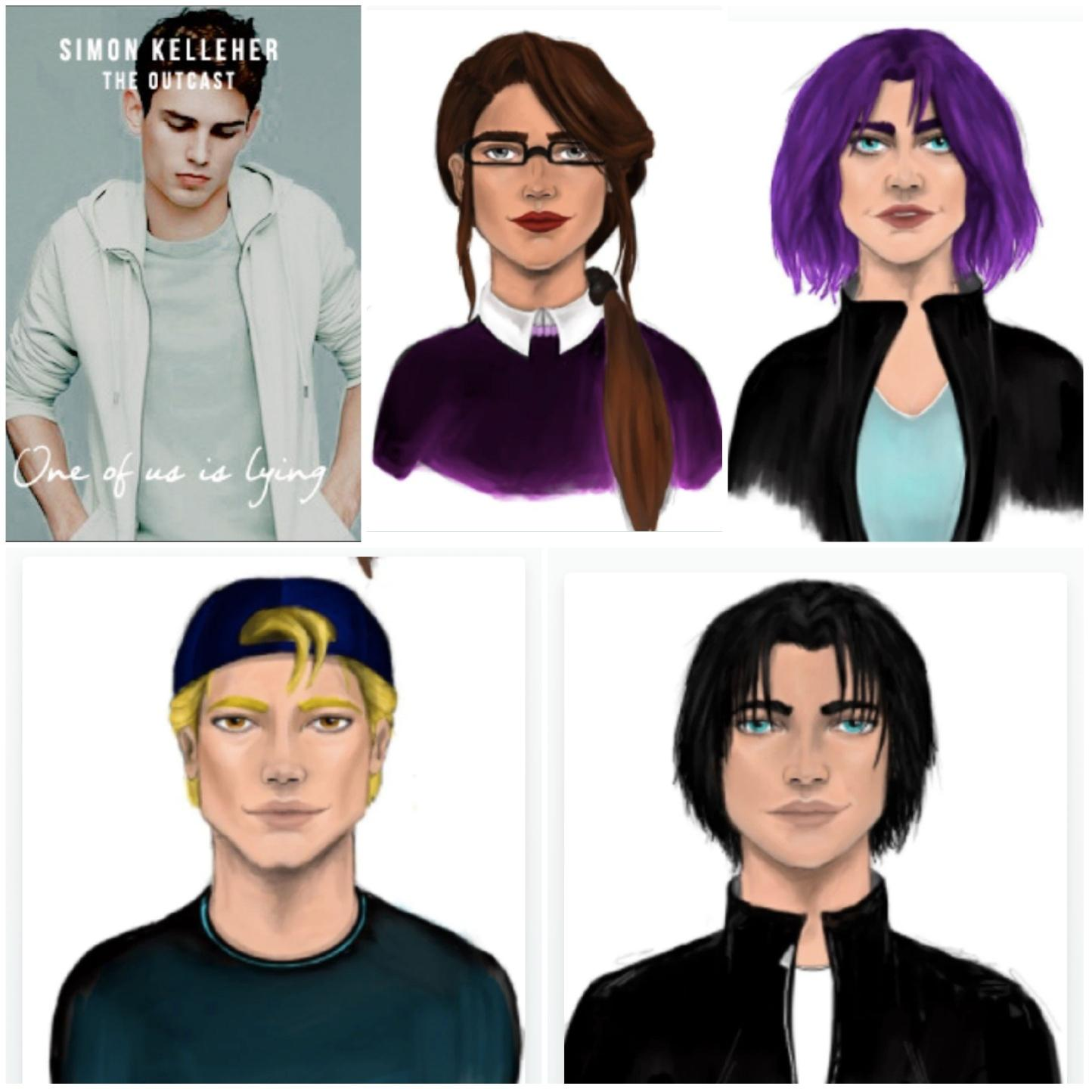
Character
Characters are used in literature to grab the interest of the reader, and move the story along. It also allows the reader to convey lessons, information, and a storyline. Good characterization allows the reader to learn about the characters’ personalities, and even relate to them.
In the book One of Us is Lying, the five main characters are:
Simon Kelleher (Top Left)
Outcast: He was infamous for his gossip app About That. “Everybody knows he has a peanut allergy.” (Pg 23)
Bronwyn Rojas (Top Middle)
Brains: She is Yale-bound and always follows the rules. “He runs his eyes over all of us and zeroes in on Bronwyn as the most responsible of the bunch” (Pg 10)
Adelaide "Addy" Prentiss (Top Right)
Beauty: She is referred to as the “picture-perfect homecoming princess.” (Cover page/Synopsis)
Cooper Clay (Bottom Left)
Athlete: He is Bayview High’s all-star baseball pitcher. “There’s not a female teacher at Bayview who can resist his all-American charm.” (Pg 17)
Nate Macauley (Bottom Right)
Criminal: At the time of Simon’s death, Nate was on probation for dealing drugs. “He’s a notorious supplier, but my knowledge is purely theoretical.” (Pg 5)
Notes:
Information about a specific literary element
Relevant evidence from the text, including page number
Pleasing and relevant visual
Images: https://one-of-us-is-lying.fandom.com/wiki/Addy_Prentiss

Slide 3
Point of View
The point of view of a book is the perspective or opinion of a story. There are three types of point of views: first, second, and third person. First person uses the words “I, me, my.” Second person uses the words “she, he, her, him.” Third person uses the words “you, your.”
The point of views of the book One of Us is Lying are from the four surviving main characters, Bronwyn, Addy, Cooper, and Nate. This book is also in the first person point of view because each section is a specific person’s opinion.
Evidence:
Bronwyn: “I can’t stop doing the math in my head. It’s eight-fifty a.m. on Tuesday, and twenty-four hours ago Simon was going to home-room for the last time.” (Pg 26)
Addy: “I shade my eyes against the sun outside the church, scanning the crowd until I spot Jake.” (Pg 78)
Cooper: “I squint at the batter.” (Pg 66)
Nate: “I hear the rumors before I see the news vans.” (Pg 162)
Notes:
Information about a specific literary element
Relevant evidence from the text, including page number
Pleasing and relevant visual

Slide 4
Conflict
Conflict is a struggle or problem that occurs in a story. It is often caused by opposing ideas, or accusations.
The conflict of the book One of Us is Lying is the murder of Simon Kelleher. He died from an allergic reaction to peanut oil that was found in his cup of water.
Evidence:
“In Monday afternoon, five students at Bayview High walk into detention...Only Simon never makes it out of that classroom. Before the end of detention, Simon’s dead. And according to investigators, his death wasn’t an accident.” (Cover Page/Synopsis)
“‘Nate, he’s gone,’ she says. ‘Simon’s dead.’” (Pg 25)
“‘The cup contained traces of peanut oil, so it seems clear Simon died from that drink. What we’re trying to figure out now is how peanut oil could have gotten into his cup.’” (Pg 35)
Notes:
Information about a specific literary element
Relevant evidence from the text, including page number
Pleasing and relevant visual

Slide 5
Genre
Genre is a category of artistic composition used to classify the different types of art, such as in music and literature by their similarities and differences in style, form, and subject.
The genres of the book One of Us is Lying is young adult fiction and mystery. Young adult fiction books are fictional stories that are focused towards ages twelve to eighteen. These books often contain mature topics, such as drugs or death. Mystery books often contain a problem and a main character who tries to solve that problem through a series of investigations.
Evidence:
Young Adult Fiction:
Death: “‘Nate, he’s gone,’ she says. ‘Simon’s dead.’” (Pg 25)
LGBTQ+: Nonny taps her cane on the floor like she wants to help me along. ‘I’m gay.’” (Pg 254)
Drugs: “They couldn’t care less that he’s a convicted drug dealer, because he’s got dreamy eyes.” (Pg 187)
Mystery:
Murder: “Before the end of detention, Simon’s dead. And according to investigators, his death wasn’t an accident.” (Cover Page/Synopsis)
Notes:
Information about a specific literary element
Relevant evidence from the text, including page number
Pleasing and relevant visual

Slide 6
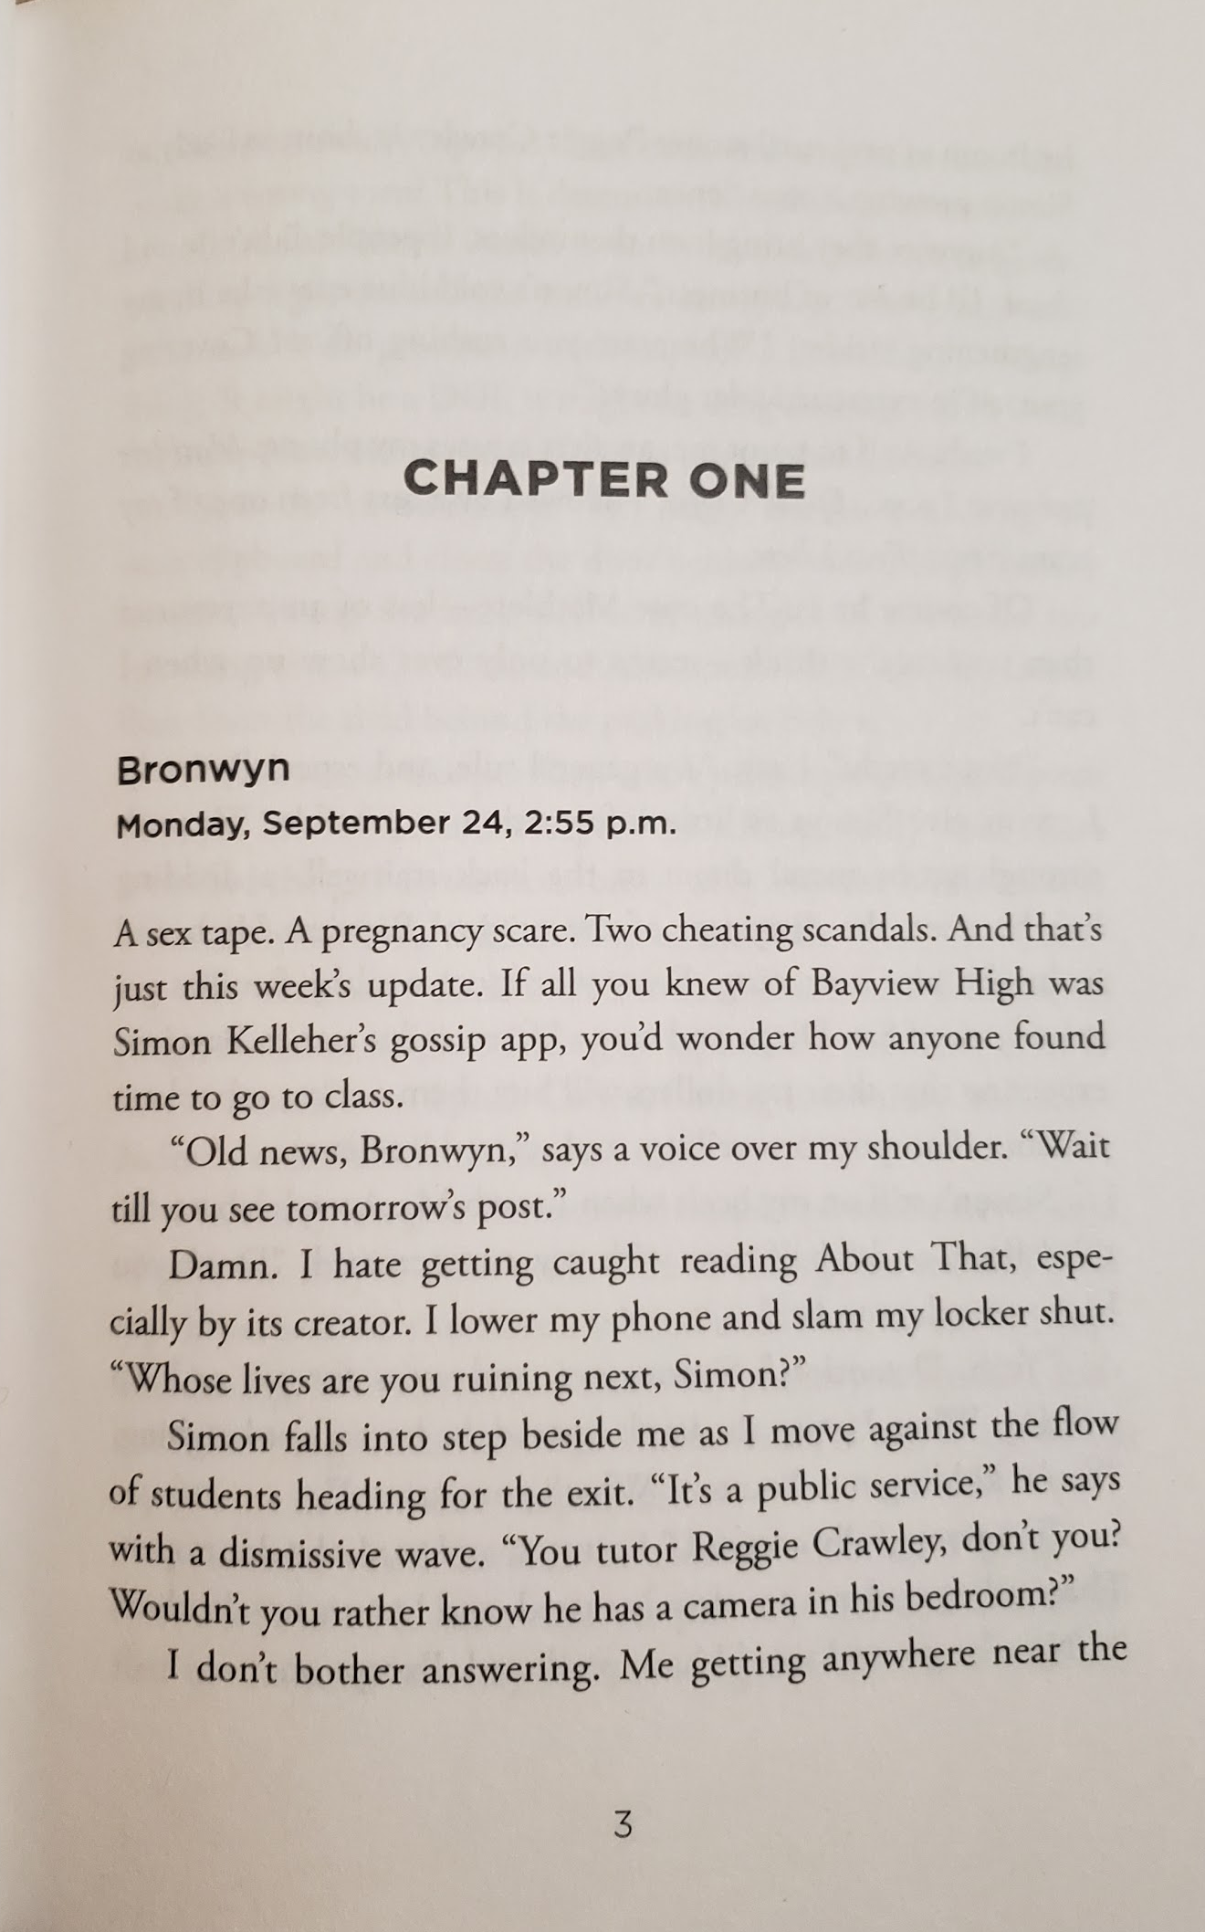
Text Organization
Text organization is the structure of text (words, sentences, paragraphs) that allows the reader to follow and understand the information in an organized manner.
The book, One of Us is Lying is organized by parts, chapters, perspective, day, and time. The three parts of the book are:
1) “Part One Simon Says” (Pg 1)
2) “Part Two Hide-And-Seek” (Pg 105)
3) “Part Three Truth Or Dare” (Pg 215)
These parts are separated by chapters 1-30, which are divided by the perspective of the four main murder suspects, the day, and the time:
“Bronwyn
Monday, September 24, 5:55 p.m.” (Pg 3)
”Addy
Saturday, October 6, 9:30 a.m. (Pg 148)
“Cooper
Monday, October 1, 11:00 a.m.” (Pg 112)
“Nate
Monday, October 15, 4:30 p.m.” (Pg 217)
Notes:
Information about a specific literary element
Relevant evidence from the text, including page number
Pleasing and relevant visual

