Slide 1
POP MUSIC

Slide 2
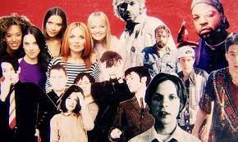
1990’s

Slide 3
1980’s

Slide 5
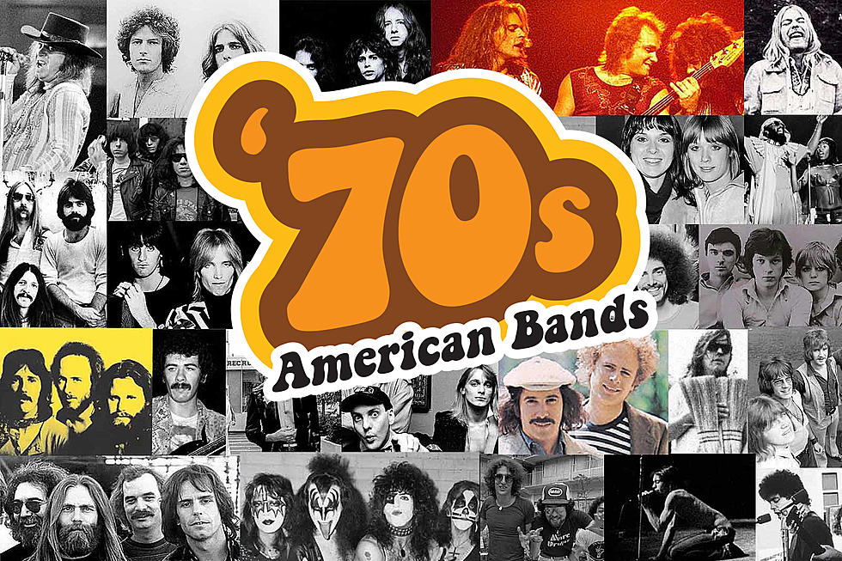

Slide 7
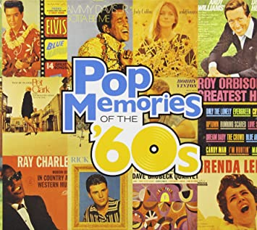

Slide 8
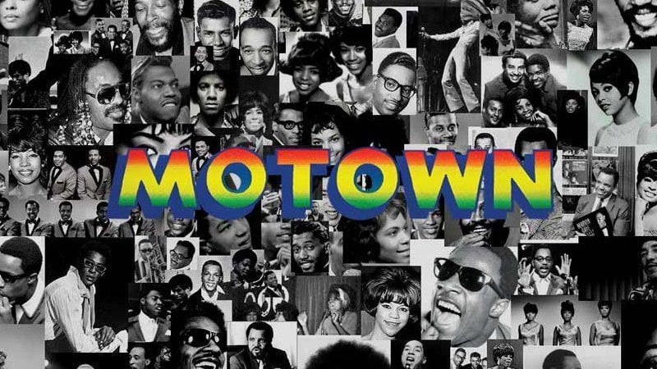

Slide 9
1950’s

Slide 10
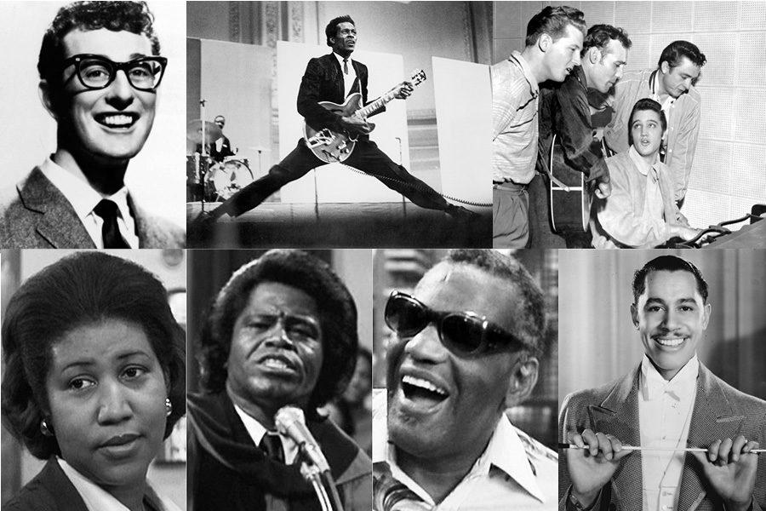
1950’s

Slide 11
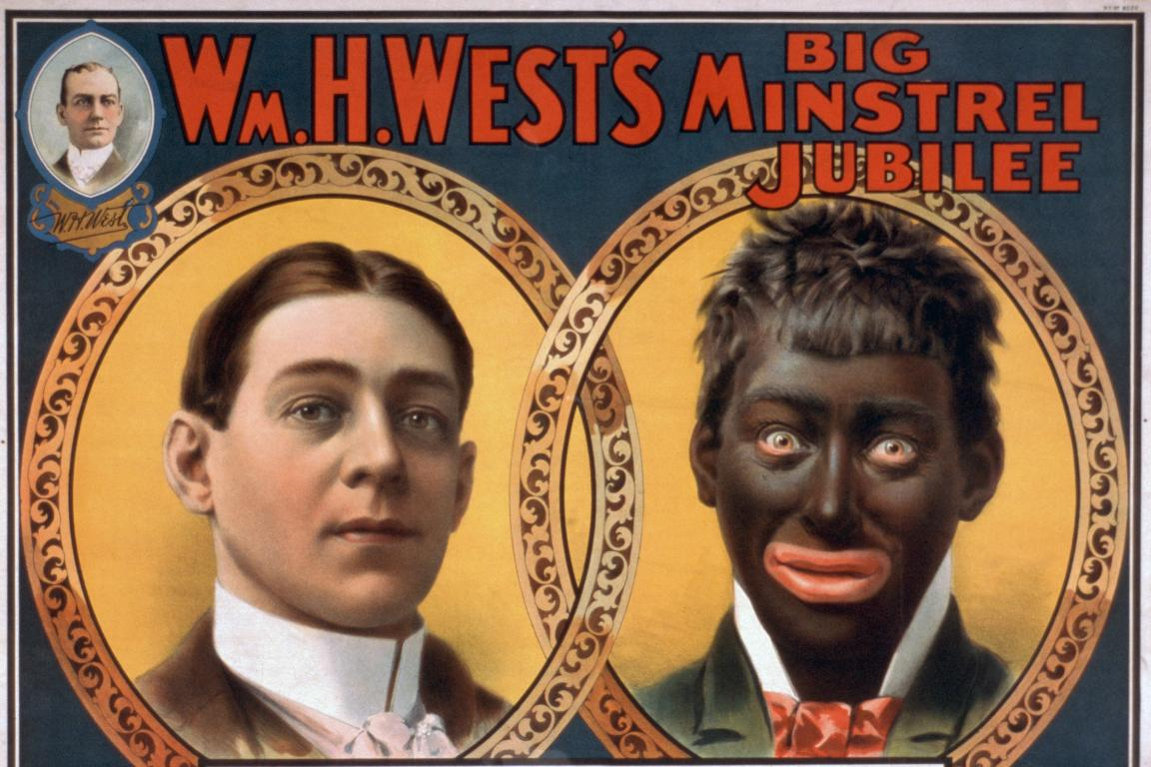

Slide 12
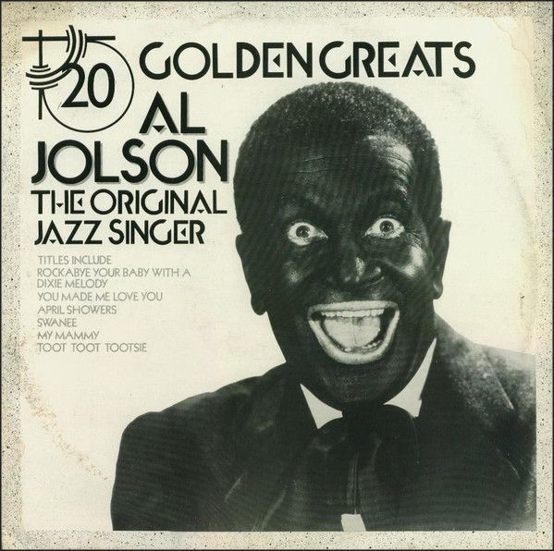

Slide 13
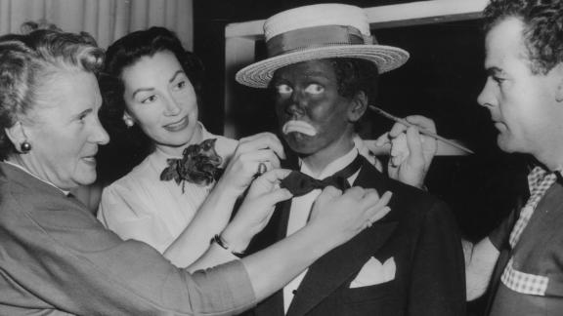

Slide 14
POP MUSIC OF THE DECADES: TAKE HOME SURVEY
Take-Home Survey: Top Ten Songs of the Decades
The Top 10 songs for the decades between 2010 - 1950 are listed. Students are asked to survey older people to see how familiar they are with “pop music” of various time frames. This data will be sorted by age, sex/gender identity, and race just to see what kinds of correlations can be made. Also, students can listen to the top most familiar songs across demographics to “check them for cultural appropriation” by doing a listening study that examines “black elements” performed by non-black artists.

