Slide 1
Chicago Public Schools Stimulus Budget
What values does a pandemic school budget reflect?

Slide 2
Unit Overview
Lesson 1: What would you do with $2 billion?
Lesson 2: Creating my school’s stimulus budget
Lesson 3: Advocacy and organizing
Lesson 3.5: Graphing your efforts

Slide 3
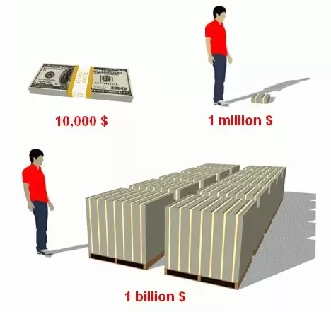
Bellringer Day 1
Recently, the organization Public Citizen found that 40% of all US Covid deaths, which currently total over 600,000 people, were a result of a lack of medical insurance. Students and families are dealing with depression, lack of internet access, threats of eviction, and loss of income.
If you learned that suddenly you had $2 billion to help students and families in the Chicago Public Schools, what would you do with it? How would you spend it?

Slide 4
Introduction/Lesson 1: What would you do with $ 2 billion?
How much are schools getting from federal stimulus? Chalkbeat
What kind of spending is eligible for stimulus support? (See next slide)
Break into teams of 2-3 and review BLM at School demands
Discuss your top demands as a whole class
Take the Google Form Survey to get budget backgrounds and prioritize your demands
Closing: Generate at least one question for the Mayor, CPS CEO Janice Jackson and the Board of Education

Slide 5
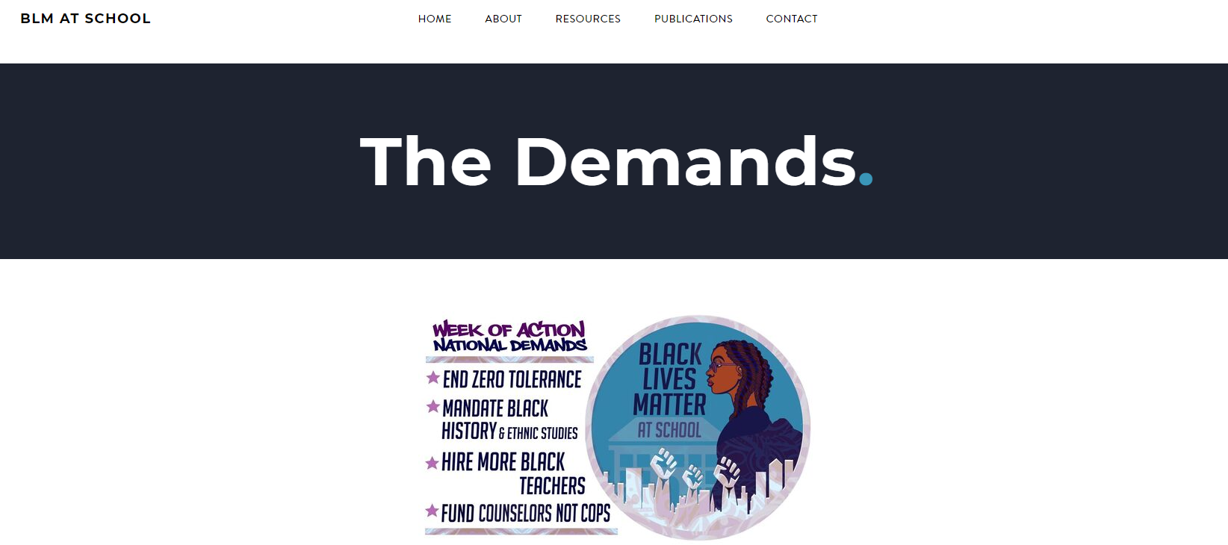
What demands resonate the most with you? Why? Share with 2 other classmates

Slide 6
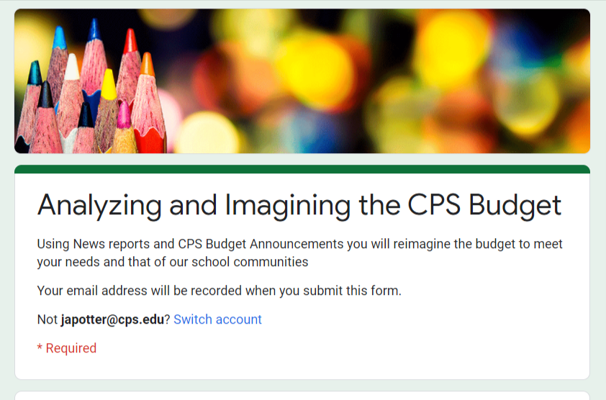

Slide 7
Post Survey Discussion
What trends and patterns did you notice?
What is your prediction on what you and your classmates think are the main priorities we should address with this new money?
How do your priorities compare and contrast with the Mayor’s the School Board, the Teachers Union, and community organizations?

Slide 8
Chicago Public Schools Stimulus Budget Areas
Sustainable Community Schools
Parent outreach and programming
Parent Mentors
Counseling and mental health services
Homeless Services
Transportation, job and housing services, housing vouchers for Students in Temporary Living Situations
School Resource Officers
Costs each school $150k
Mental Health Clinics and Services
Lighting, street resurfacing, bridges, water projects
Nursing
Planning and development, housing
Counseling
Rodent control, tree trimming, garbage and recycling pick-up
Home visit program
Stipends for PSRPs and Teachers for summer home visits
Libraries and Librarians
Central Office and Network Administration
Summer Jobs
$1000 stipends for 10,000 students
Arts and Music

Slide 9
Bellringer: Day 2
Looking at your class’ top 3 priorities from yesterday (use a graph from the google form summary tool), what patterns and discrepancies do you notice from your own preferences? Do you think we can win these investments if we work together?

Slide 10
Lesson 2 - Spreading the Love -- Building your CPS Stimulus Budget
Percents Brainpop & Ratios Brainpop
Google Classroom Assignment - Chicago Public Schools stimulus budget tab 2
Determine your school budget
Plug in your top preferences and priorities by ranking them and creating your own CPS stimulus budget
Explain your choices and outcomes
Closing: Generate at least one question for the Mayor, CPS CEO Janice Jackson and the Board of Education

Slide 11
Rank your Concerns

Slide 12
Lesson 3 - Organize and Advocate
Youth Activist Catyln Savado
Practice creating different graph types of your budget
Pie Chart
Bar or Column Graph
What graph type(s) help you explain your school budget?
Closing: Generate at least one question for the Mayor, CPS CEO Janice Jackson and the Board of Education

Slide 13
Bellringer Lesson 3: Advocacy and Organizing
After reviewing Alderman Jeanette Taylor’s critique of Mayor Lightfoot’s budget, what resonated with you?
How can you make your own voice heard throughout the decision-making process about how to spend the CPS stimulus money?

Slide 14
Lesson 3/4 - Take Action bellringer
How will you influence decision makers with your budget proposal?
How can you share this knowledge and information with other students across CPS? With parents and community?
What tools for outreach and activism will you use?
Some options: Social media / online petition / speak at a CPS meeting / submit a letter to your Local School Council / Op-Ed
Who are 2-3 others in class you would like to work with to advance your advocacy?

Slide 15
Share out!
This is a crowd-sourced summary of how our class thought they could do outreach and take action on our budget ideas. Do these still apply for you? Have your ideas and thoughts changed since you created your budget?

Slide 16
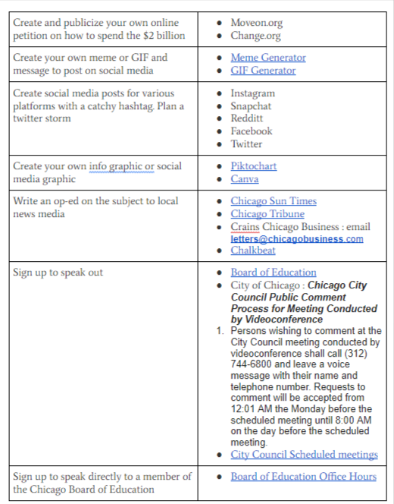
How will you take action?

