Slide 1
The Carlisle Indian Industrial School
1879-1918

Slide 2
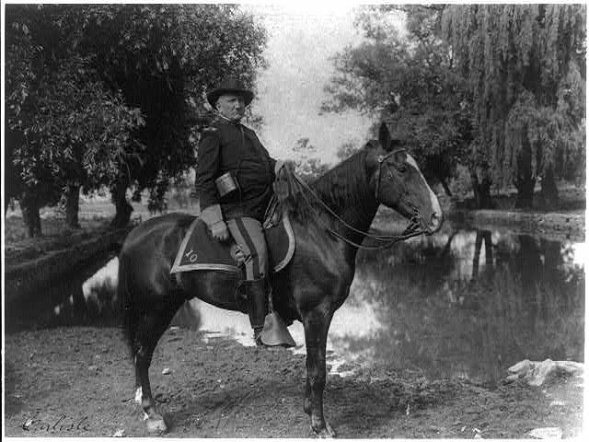
Richard Pratt
Richard Pratt in 1901
Notes:
Image retrieved from the Library of Congress: https://www.loc.gov/item/2008675529/

Slide 3
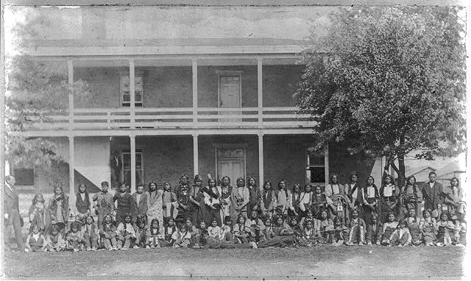
The Carlisle School
“Sioux boys as they arrived at the Indian Training School at Carlisle Barracks”
October 5, 1897
Notes:
Image retrieved from the Library of Congress: https://www.loc.gov/item/2012646816/

Slide 4
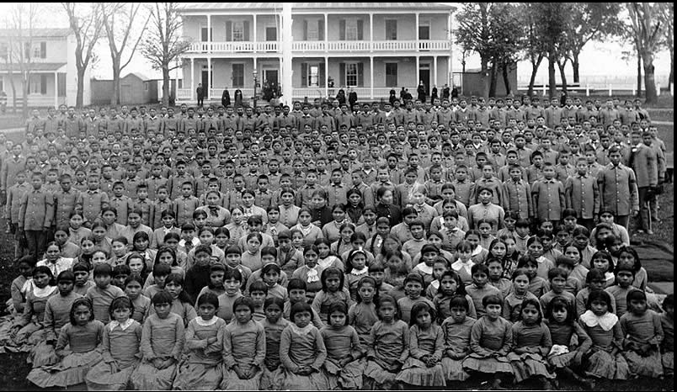
The Carlisle School
Class photo from 1900
Notes:
Image retrieved from http://commons.wikimedia.org/wiki/File:Carlisle_pupils.jpg

Slide 5
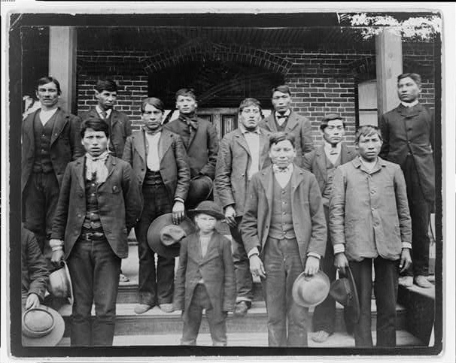
The Carlisle School
Group of Carlisle School students in 1890
Notes:
Image retrieved from the Library of Congress: https://www.loc.gov/item/99471846/

Slide 6
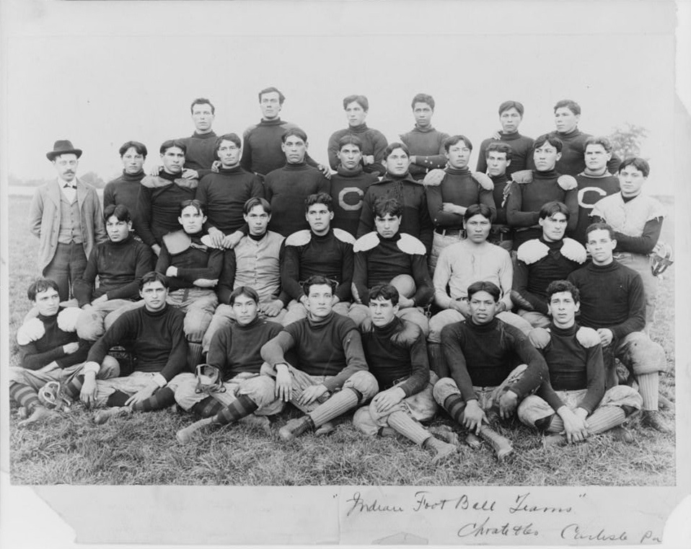
The Carlisle School
The Carlisle football team, 1899
Notes:
Image retrieved from the Library of Congress: https://www.loc.gov/item/00650437/

Slide 7
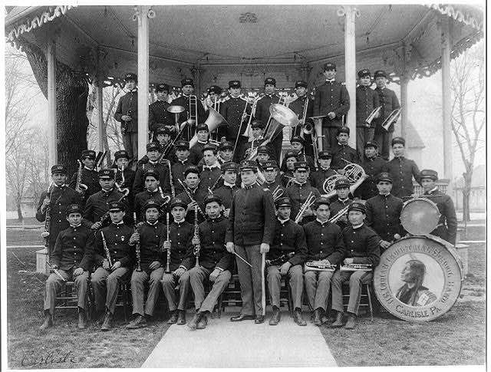
The Carlisle School
The Carlisle band, 1901
Notes:
Image retrieved from the Library of Congress: https://www.loc.gov/item/2008675520/

Slide 8
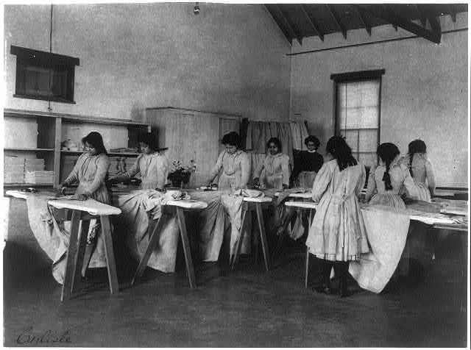
The Carlisle School
Ironing Class, 1901
Notes:
Image retrieved from the Library of Congress: https://www.loc.gov/item/2008675525/

Slide 9
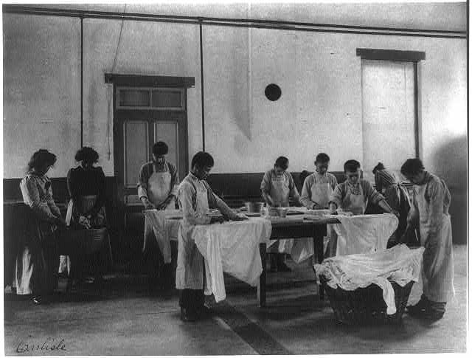
The Carlisle School
Laundry Class, 1901
Notes:
Image retrieved from the Library of Congress: https://www.loc.gov/item/98503026/

Slide 10
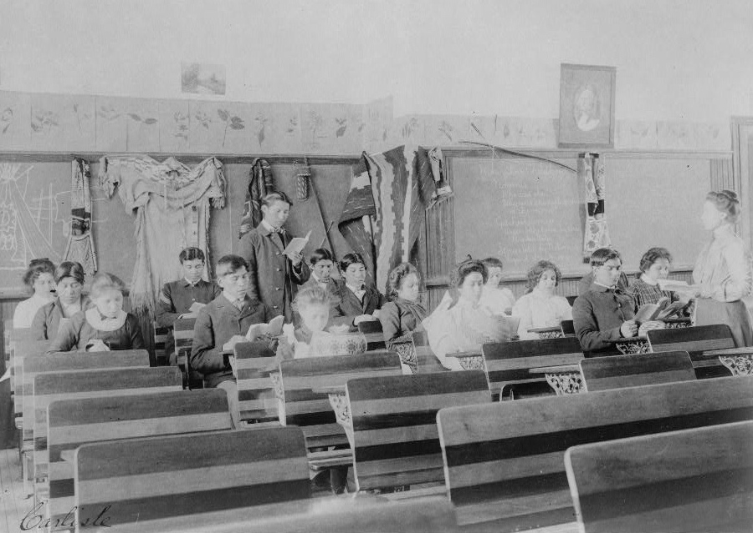
The Carlisle School
Teacher observing students as they read, between 1901 and 1903
Notes:
Image retrieved from the Library of Congress: https://www.loc.gov/item/97503299/

Slide 11
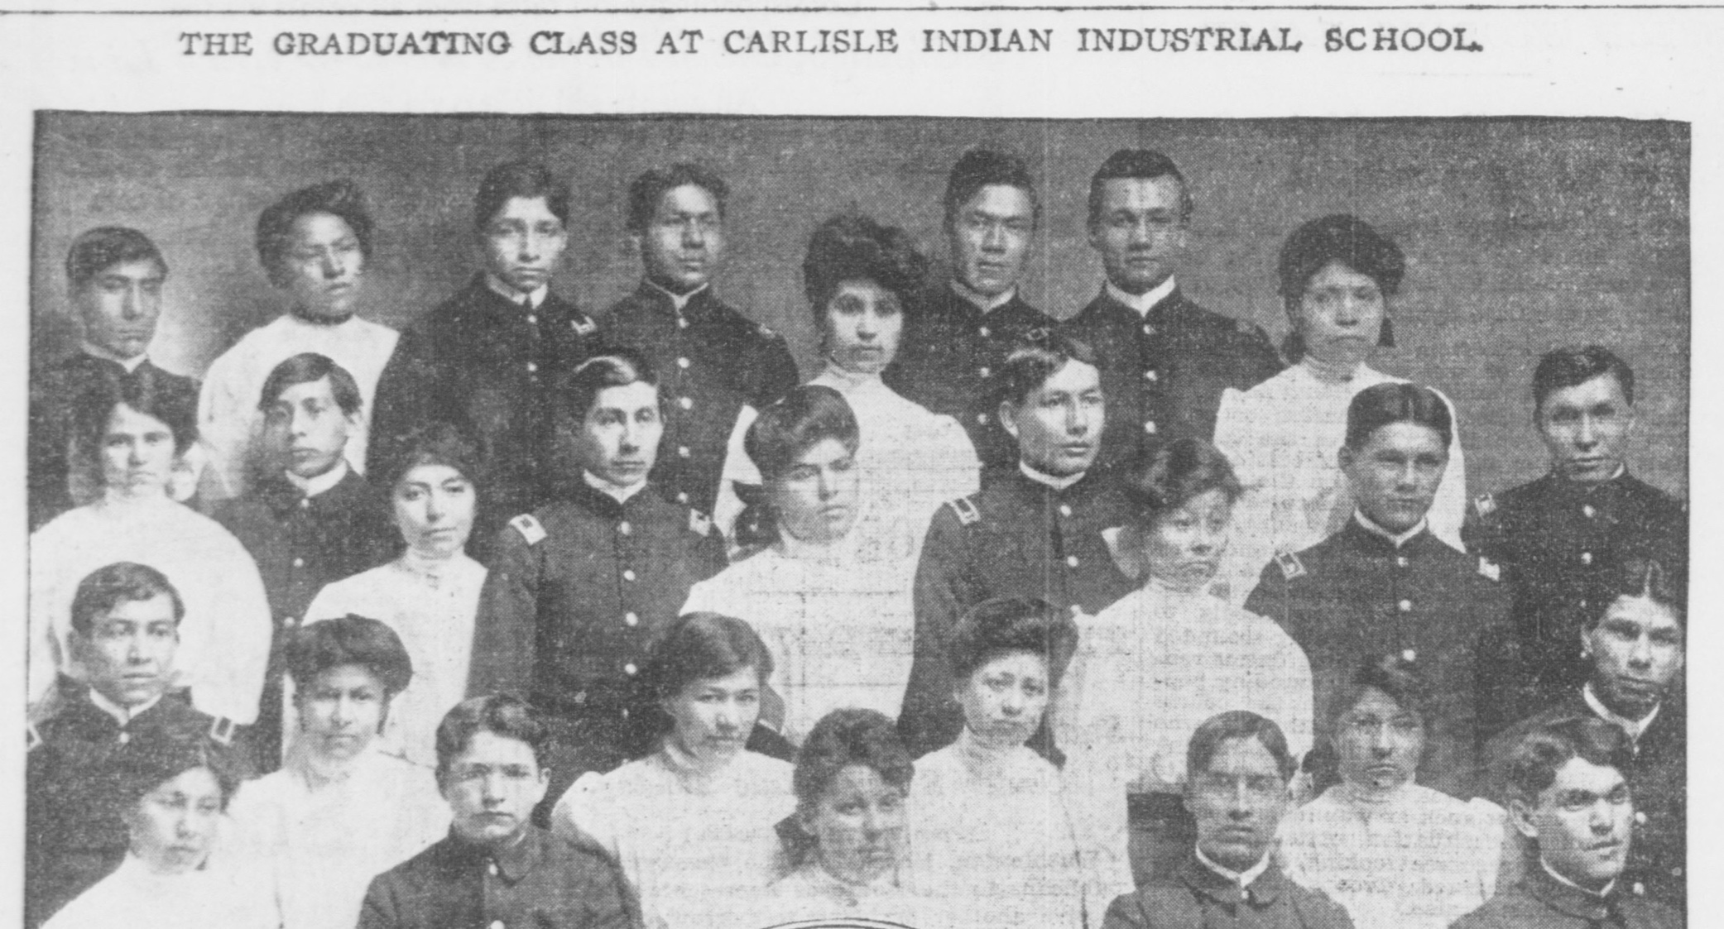
The Carlisle School
Graduating class of 1906
Notes:
Image retrieved from the Library of Congress: http://chroniclingamerica.loc.gov/lccn/sn83030214/1906-03-21/ed-1/seq-4/

Slide 12
Central Historical Question
What was the purpose of the Carlisle Indian Industrial School?

