Slide 1
Pre-Survey
Let’s start with a quick pre-workshop survey:
https://bit.ly/2lMKfxN

Slide 2
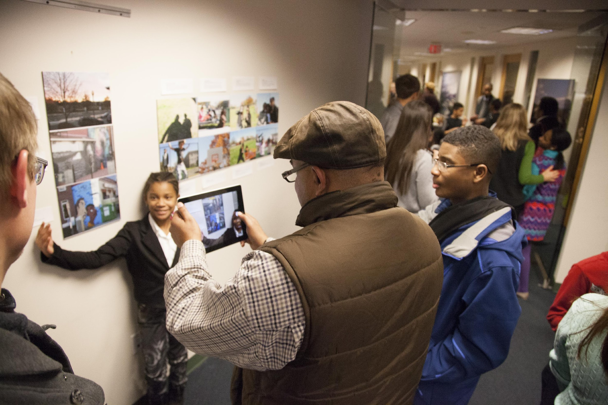
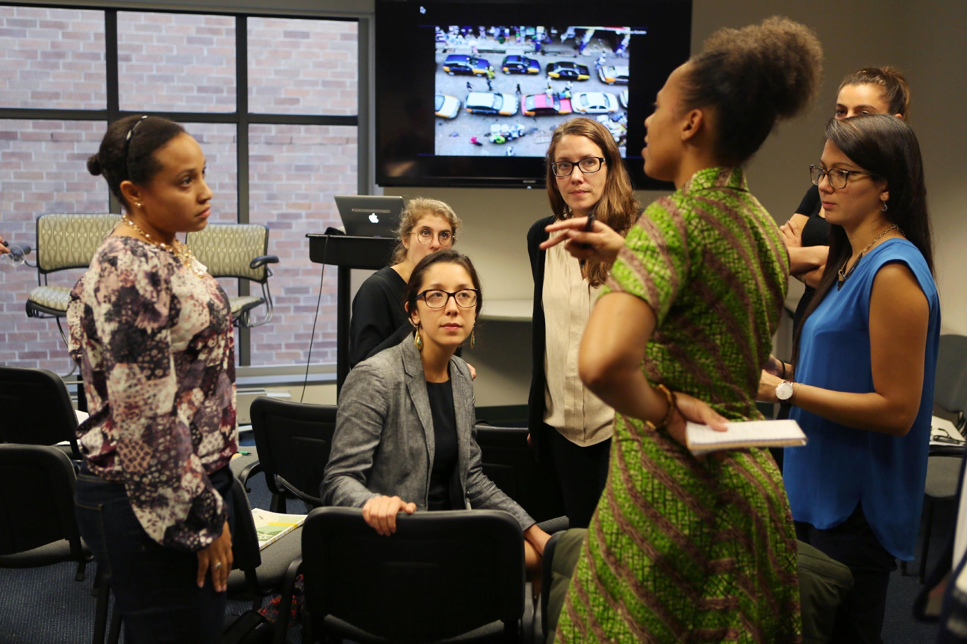
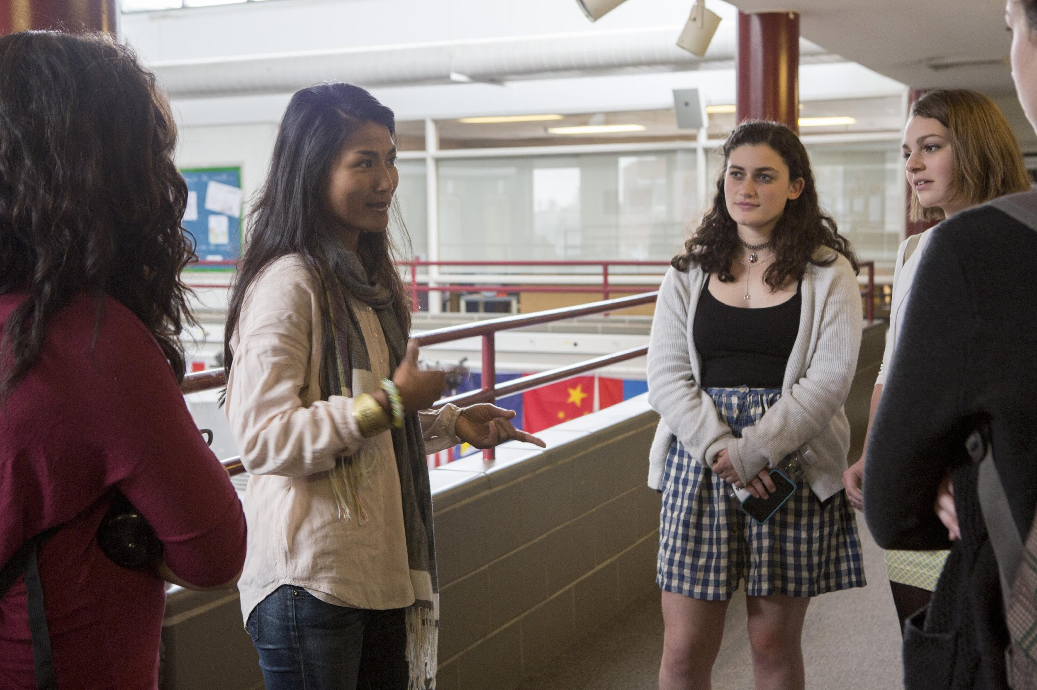
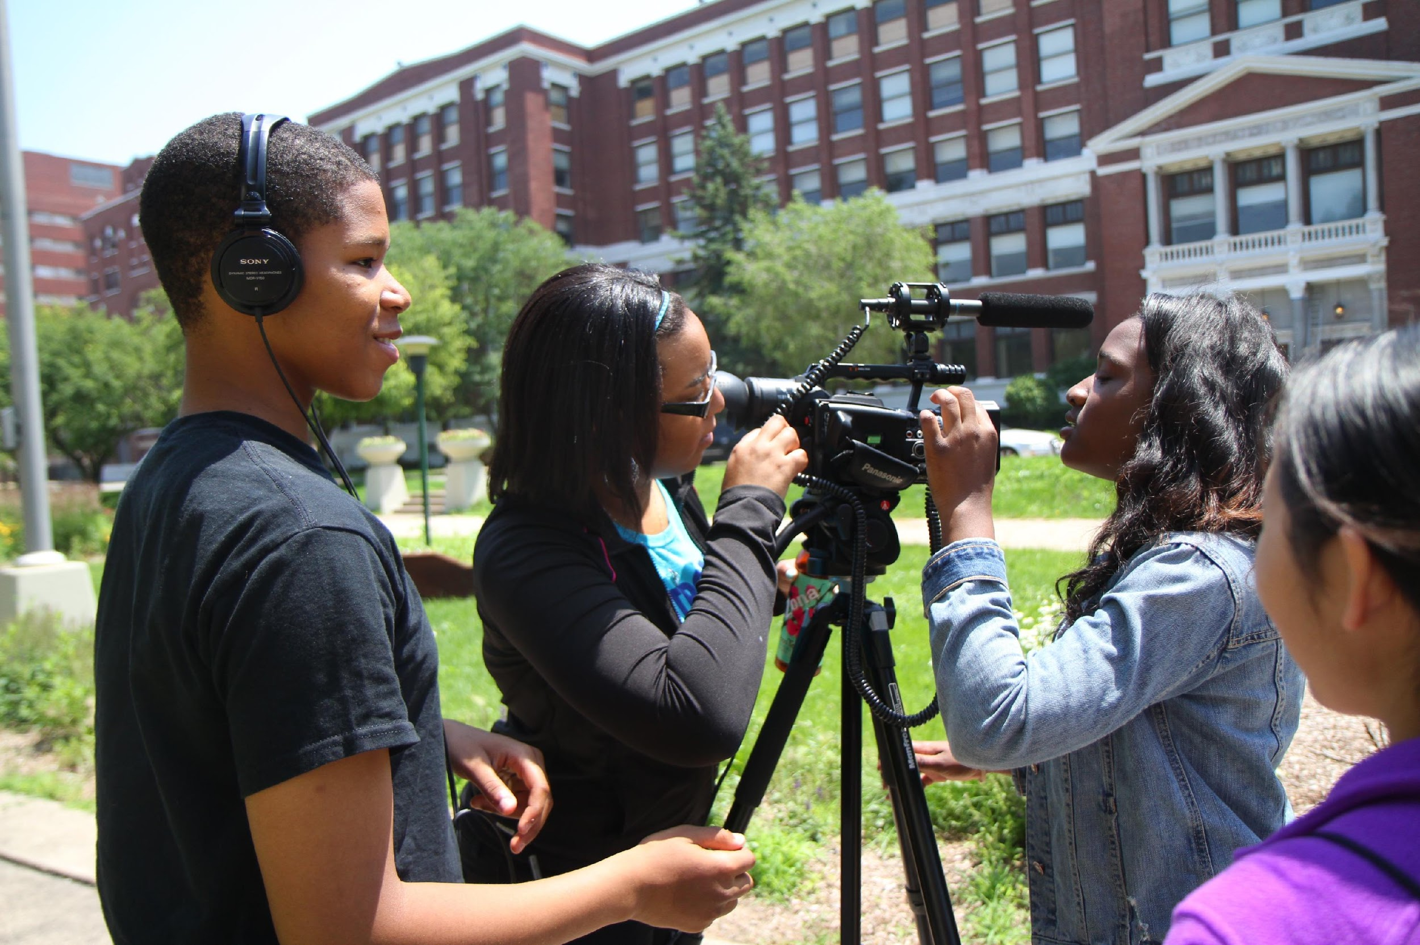
Contact: education@pulitzercenter.org
Sign-up for our weekly education newsletter:
pulitzercenter.org/education-newsletter

Slide 3
Warm up
On one post-it, respond to the following:
Where do you get your news?
On a second post-it, respond to the following
What news stories do you look for?

Slide 4
Welcome!
Name
Respond to one of the following:
Where do you get your news?
What news stories do you look for?
Notes:
Take note of the news outlets and stories. You can add to these lists after students complete their independent activity to demonstrate the new outlets they learned about through the workshop, and the new stories they identified as interesting.

Slide 5
Contact: education@pulitzercenter.org
Sign-up for our weekly education newsletter:
pulitzercenter.org/education-newsletter

Slide 6
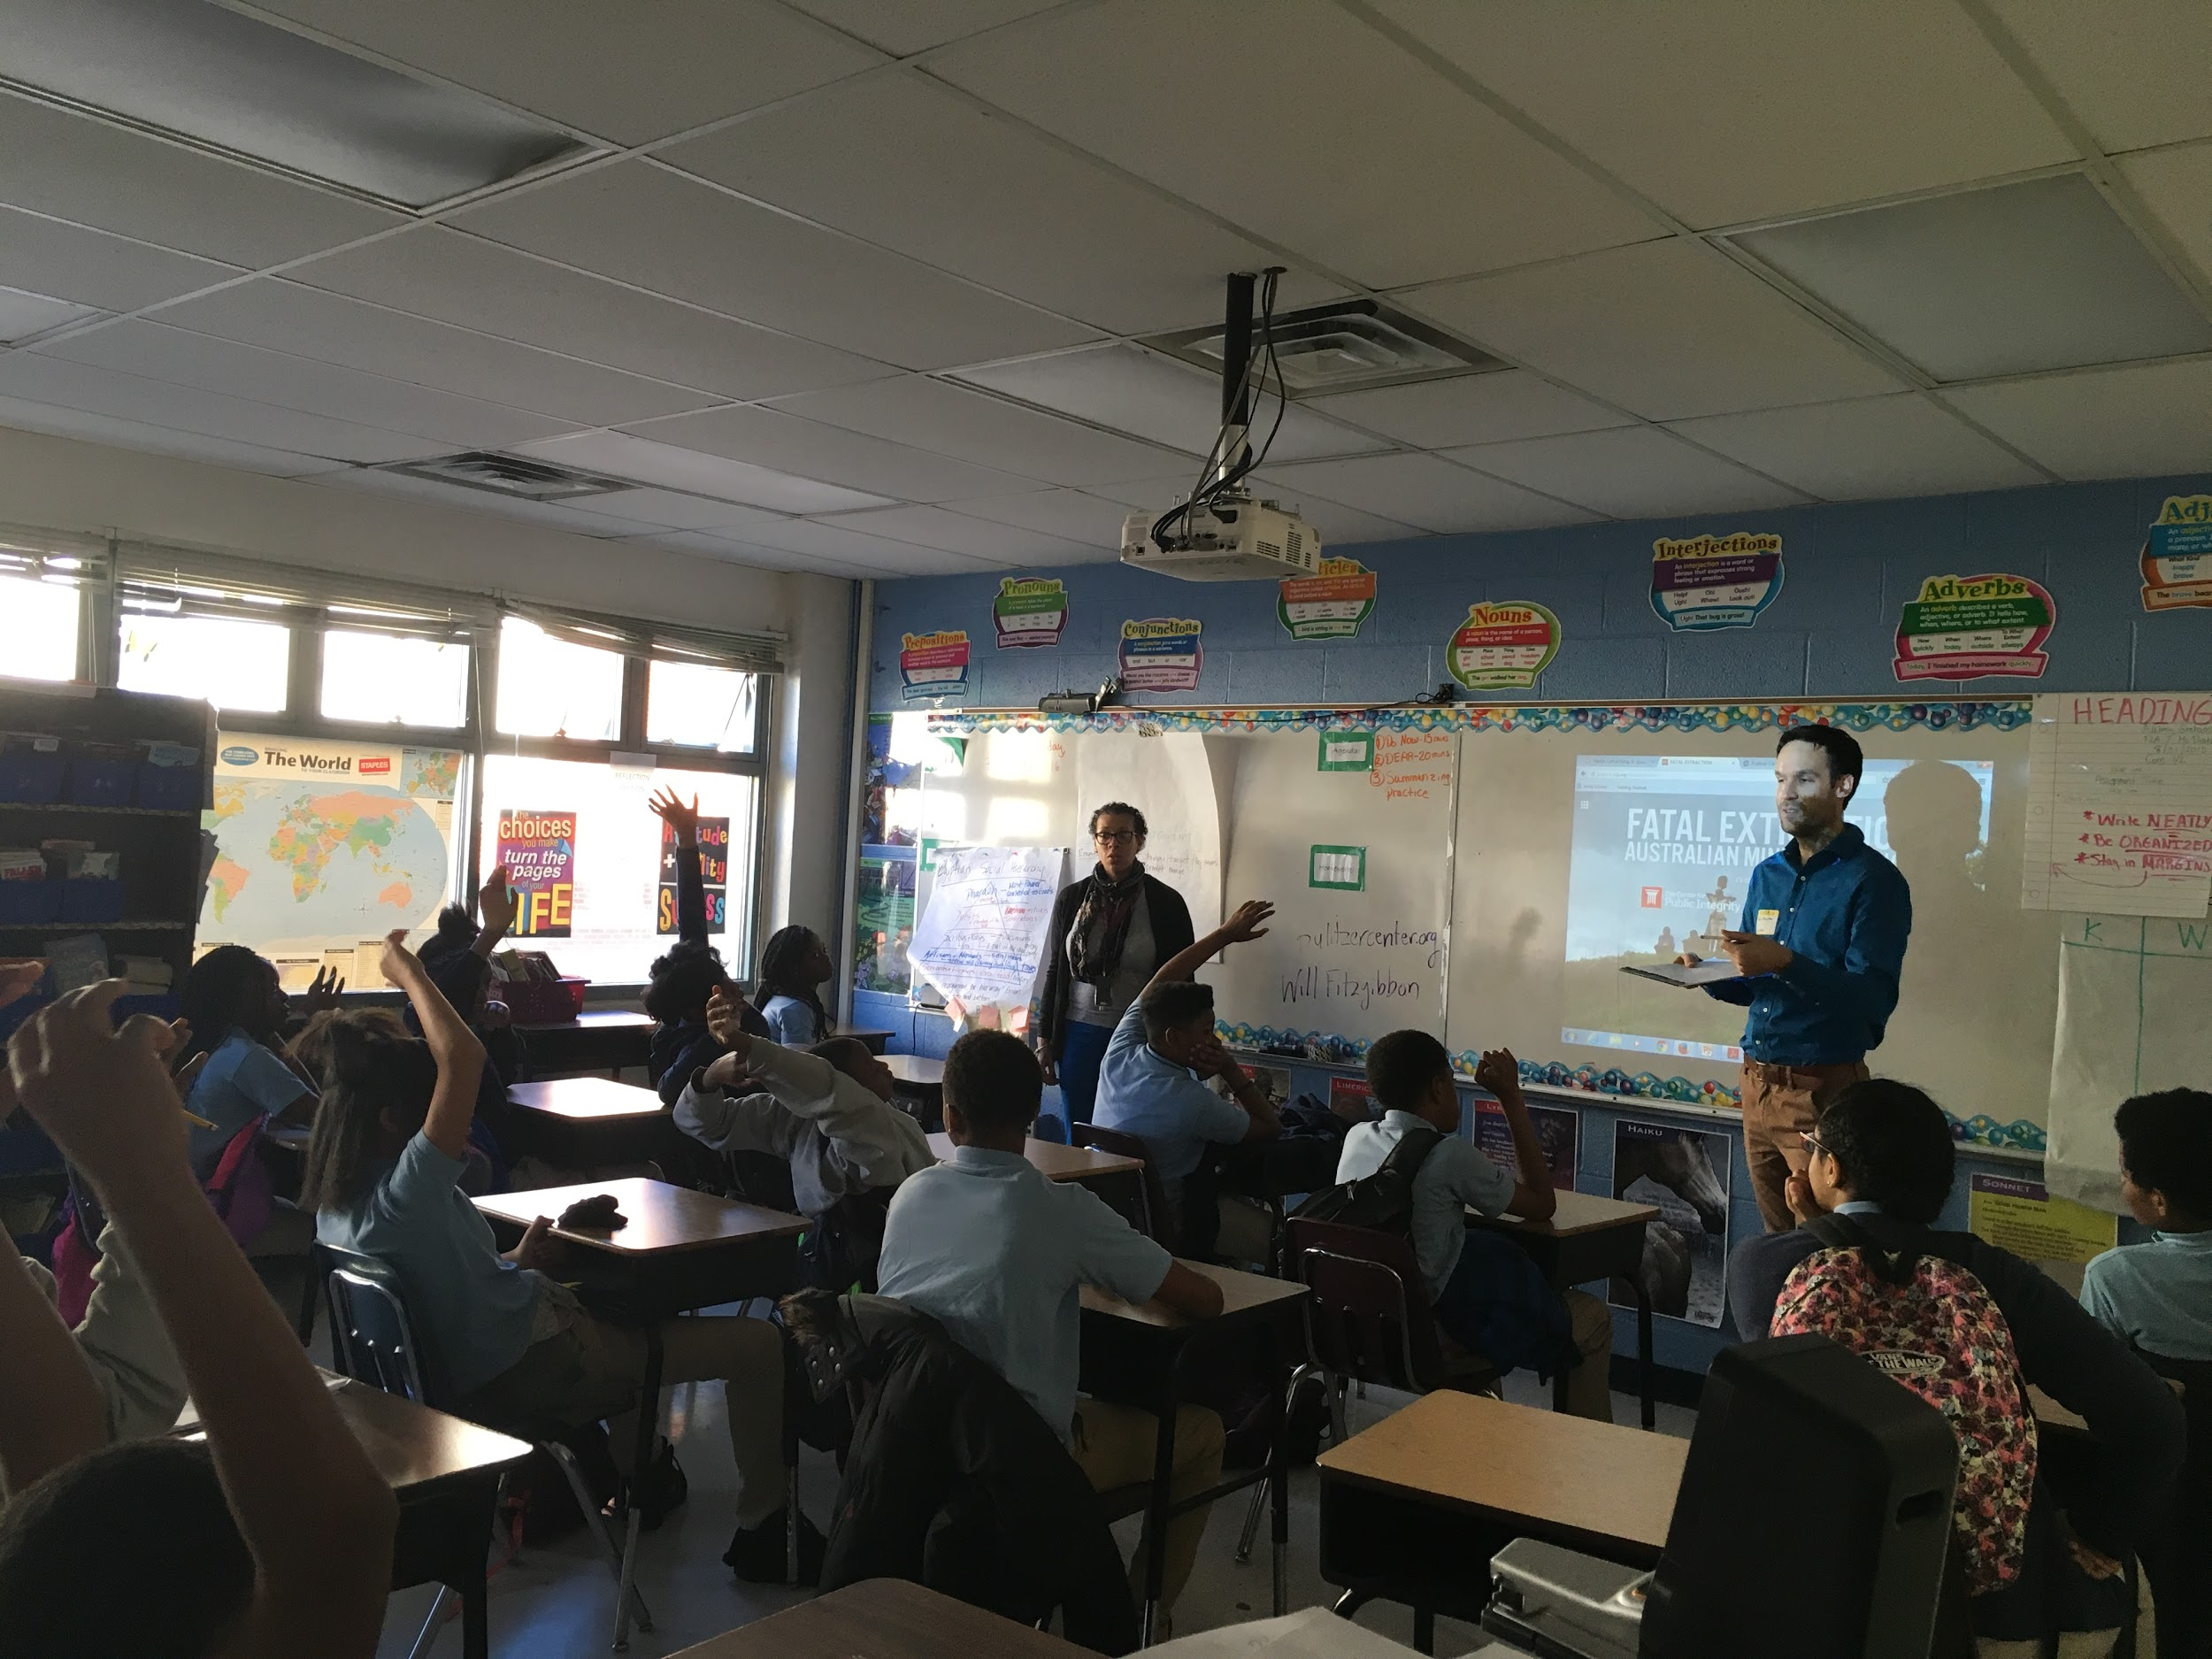
Key Terms:
Journalist
News
@pulitzercenter

Slide 7
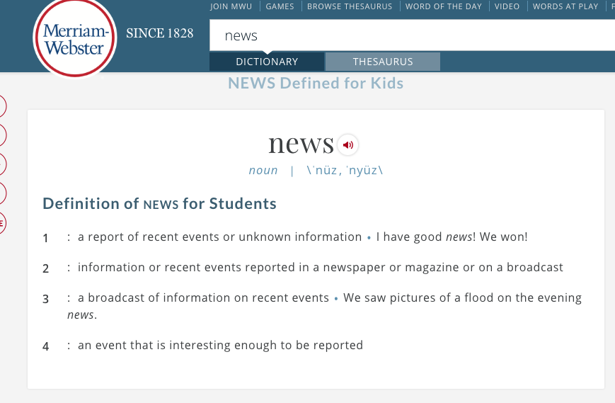
News
News is...
News isn’t...

Slide 8
Key Terms:
Journalist
News
Under-reported story
Headline
Outlet/Publication
@pulitzercenter

Slide 9
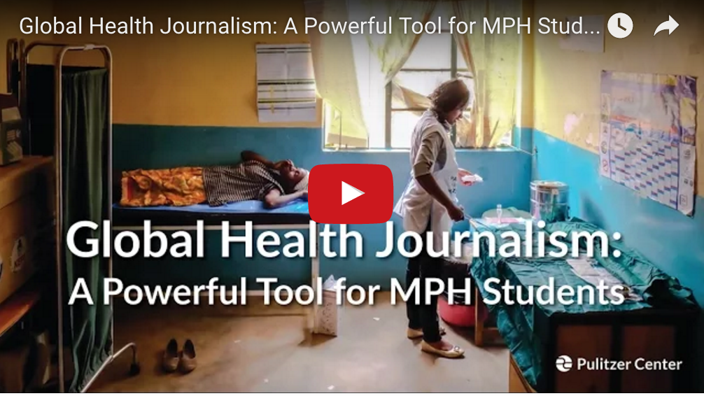
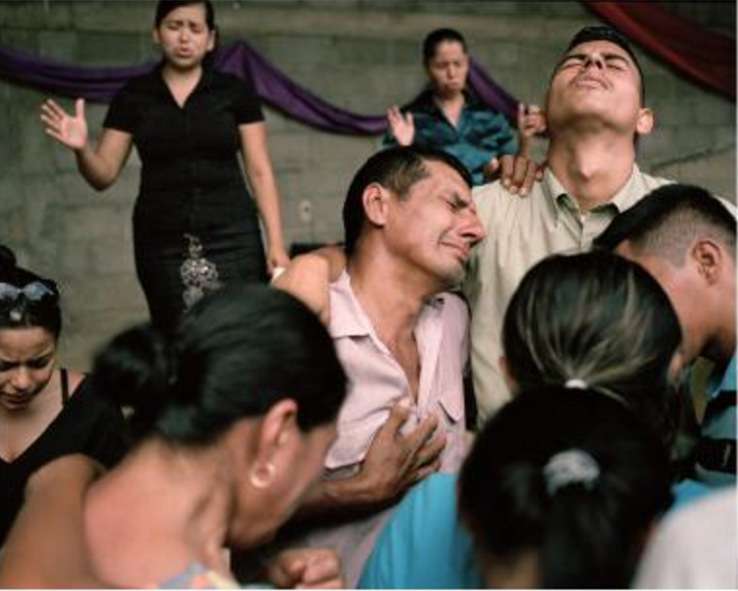
The Pulitzer Center on Crisis Reporting is an innovative award-winning non-profit journalism organization dedicated to supporting in-depth engagement with underreported global affairs through our sponsorship of quality international journalism across all media platforms and a unique program of outreach and education to schools and universities.
• Over 100 projects each year, featuring print series, documentaries, data interactives, and e-books
• Nearly $1.5 million in direct support of journalists
• Partnerships with outlets ranging from The New York Times and PBS NewsHour to The New Yorker, NPR, and many more
• More than 400 events each year for K-12 schools and college audiences, including lectures, panel discussions, film screenings, and photography exhibits
@pulitzercenter
@pulitzercenter

Slide 10
Agenda: Today, we will…
Describe what a journalist does, how news gets published, and what the Pulitzer Center is (5 minutes)
Explain what under-reported stories are and why we don’t hear about them (5 minutes)
Make observations and predictions and come up with questions about images and headlines from international news stories (15 minutes)
Explore an international news story YOU choose to investigate (20 minutes)
Devise and articulate a plan for seeking out international news and why that is important to you (5 minutes)
Notes:
FAREED’S SLIDES
Guiding Questions for Teachers:
1) How interested are my students in global issues?
2) Why is it important for students to investigate global issues? What are the barriers to connecting students with global issues, and how do we overcome those barriers?
3) How are my students accessing the news?
4) How can my students positively contribute to the global media landscape as both consumers and producers of online content?

Slide 11
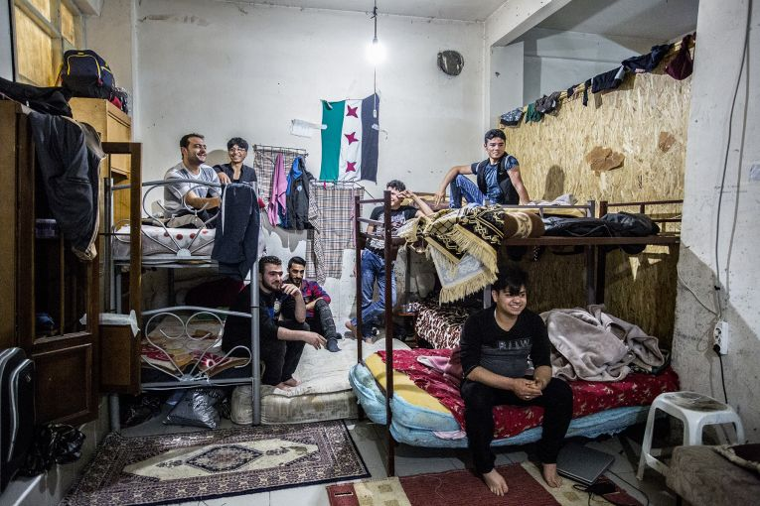
Imagine this image pops up on social media.
On a scale from 1-5, how likely are you to click to read the story?
1=not interested at all
5=I will definitely click.

Slide 12
3 Observations: What do you see?
Notes:
Ask students to name what they see in the image, only things that are visible. Students may be tempted to predict the story, but they should be encouraged to focus on only naming what is in the picture.

Slide 13
2 Questions: What do you want to know?

Slide 14
1 Prediction: What is this story about?
Who are they?
What are they doing?
Where does this story take place?
Why is this news?

Slide 15
Check in: How interested are you now?
On a scale from 1-5, how likely are you to click to read the story?
1=not interested at all
5=I will definitely click.
Notes:
If there are more students interested in the story, this is an opportunity to notice how looking closely at images can increase our interest. “Think, how many images might be be interested in that we skip because we think we aren’t interested.”

Slide 16
“How the Refugee Crisis Is Changing the World Economy” By Malia Politzer and Emily Kassie
Refugee sleeping quarters in Istanbul. Image by Emily Kassie. Turkey, 2016.
“In Turkey, there is a booming market in Syrian child workers, and an entire shadow economy of Syrian refugee-entrepreneurs, whose businesses are essentially keeping their war-torn homeland afloat.”
Notes:
Ask students to check their predictions. How accurate were they? How many would be interested in continuing to read the story now that they’ve clicked on it?

Slide 17
“How the Refugee Crisis Is Changing the World Economy” By Malia Politzer and Emily Kassie
Notes:
The outlet for this story is The Huffington Post.

Slide 18
Connect: Why does this story matter to you?
How do this story and its subjects connect with you and your community?

Slide 19
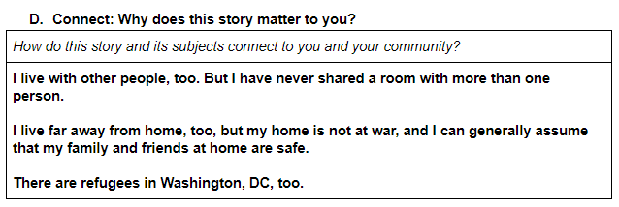
Example: Why does this story matter to you?
How do this story and its subjects connect with you and your community?

Slide 20
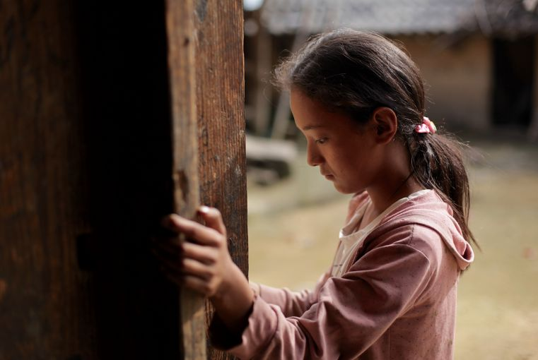
Imagine this image pops up on social media.
On a scale from 1-5, how likely are you to click to read the story?
1=not interested at all
5=I will definitely click.

Slide 21
3 Observations: What do you see?

Slide 22
2 Questions: What do you want to know?

Slide 23
1 Prediction: What is this story about?
Who is she?
What is happening?
Where does this story take place?
Why is this news?

Slide 24
Check in: How interested are you now?
On a scale from 1-5, how likely are you to click to read the story?
1=not interested at all
5=I will definitely click.
Notes:
If there are more students interested in the story, this is an opportunity to notice how looking closely at images can increase our interest. “Think, how many images might be be interested in that we skip because we think we aren’t interested.”

Slide 25
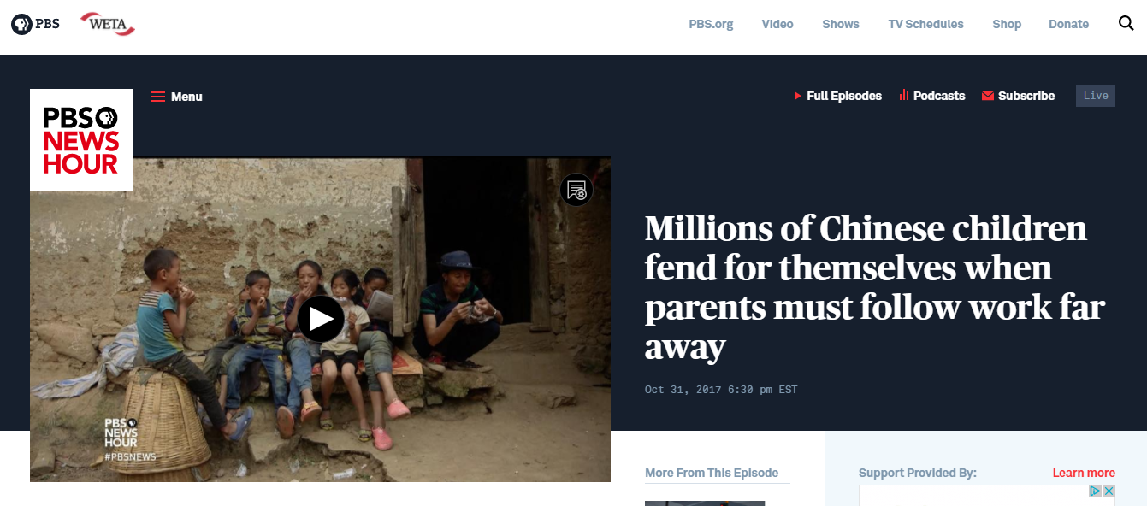
Check your prediction:
“Millions of Chinese children fend for themselves when parents must follow work away” by Max Duncan
Notes:
At least view the first three minutes. Ask students to check their predictions while they watch.

Slide 26
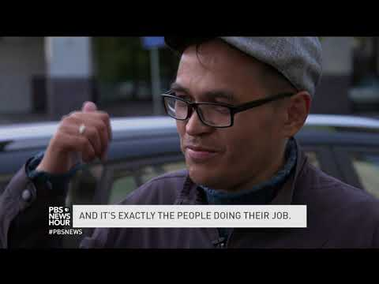
Check your prediction:
Notes:
Play at 27:33

Slide 27
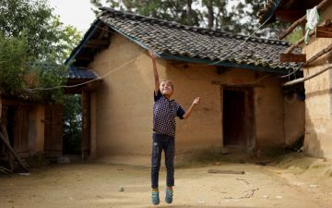
Connect!

Slide 28
EXPLORE
1

Slide 29
GO
Take 30 seconds to explore every headline and image

Slide 30
STOP
Select one image

Slide 31
EXPLORE
1. Three observations | 2. Two questions | 3. One prediction (What is the story about?)

Slide 32
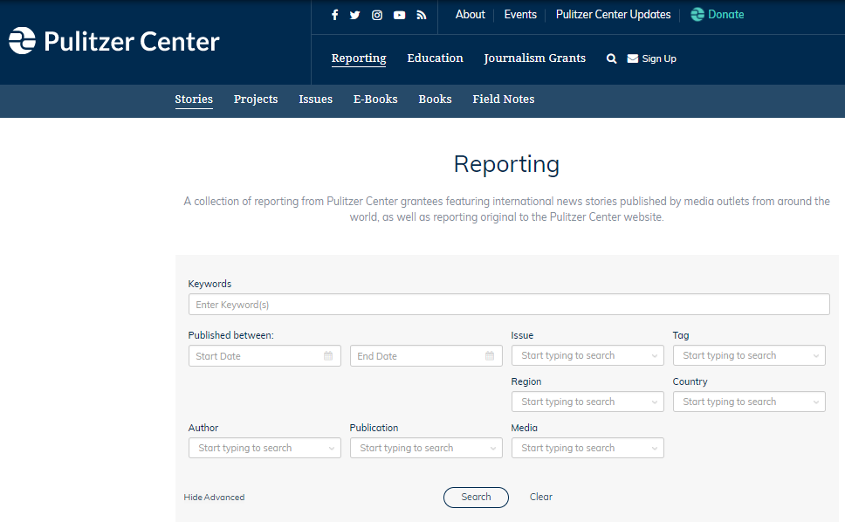
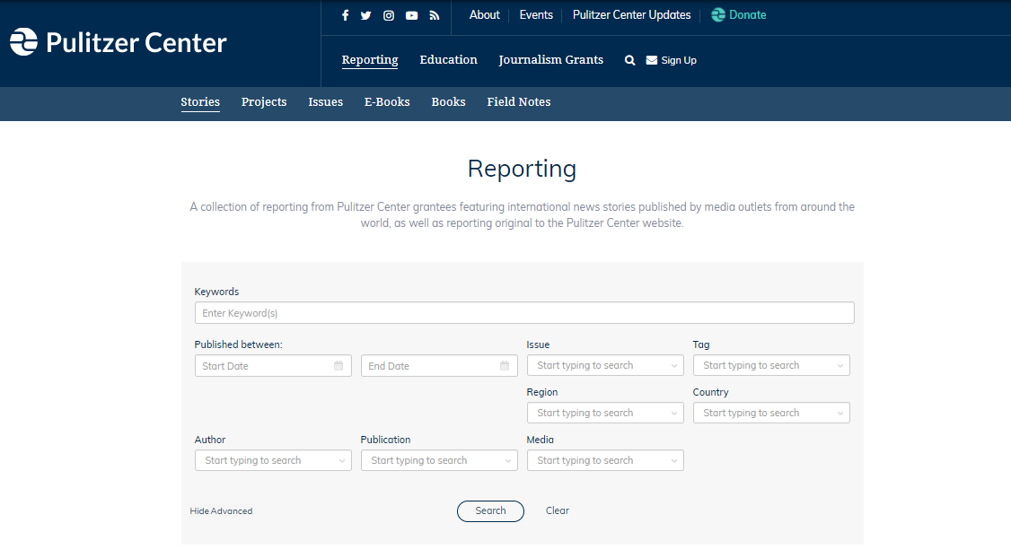
Notes:
We note here that the images and headlines students are seeing come from Pulitzer Center journalists. All reporting can be searched on this page.

Slide 33
MORE EXPLORING!
2

Slide 34
EXPLORE
Take 5 minutes to review the full story and consider the following:
What details stick with you?
What is the main idea of the story? How could you explain it to someone else?
How does this story connect to you?

Slide 35
REPORTING

Slide 36
SHARE
3

Slide 37
SHARE
Take 5 minutes to share the following with another person:
What was the headline of your story?
Who was the journalist?
What was the outlet? (Where was it published?)
What was the story about?
What connections did you make to the story?

Slide 38
CONNECT
Imagine you could create a newspaper for your community that highlights underreported stories:
Which story from your group would you highlight on the front page?
What underreported local story could you also include on that same page?
What would you title your newspaper?

Slide 39
REFLECT
5

Slide 40
Raise Your Hand:
Who learned something new?
2. Who learned something that they think others should know?
3. Who explored something published in an outlet they don’t often read?
Notes:
As students mention the stories that interested them, they can be added to the list of stories students made at the start of the session. I often use a different color to differentiate these new stories. I also add outlets named by the students in response to the third question to the list of outlets they named at the start of the workshop.

Slide 41
Discuss
The stories you read were all published in the last year. How did we miss them?
What can we do to more regularly access stories like the ones we just explored?
How can we better access global news that interests us in the ways that make sense for us?
What might be barriers to accessing global news that interests us? What can we do to overcome those barriers?
Notes:
One way to process this conversation is to post two large sticky notes: one reads “challenges” and the other reads “ideas.”

Slide 42
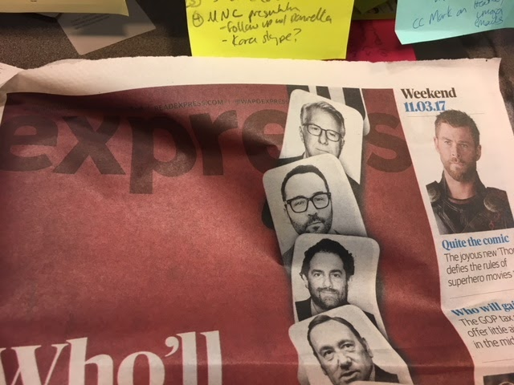
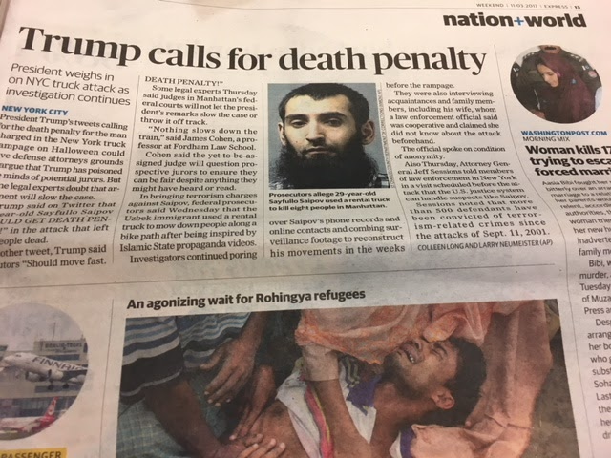
Check Free Local Papers

Slide 43
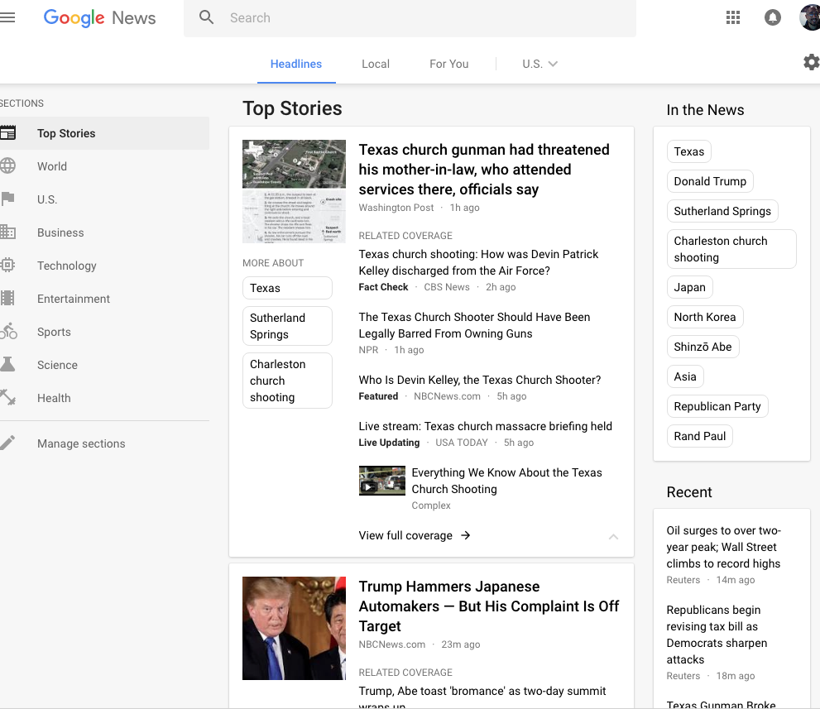
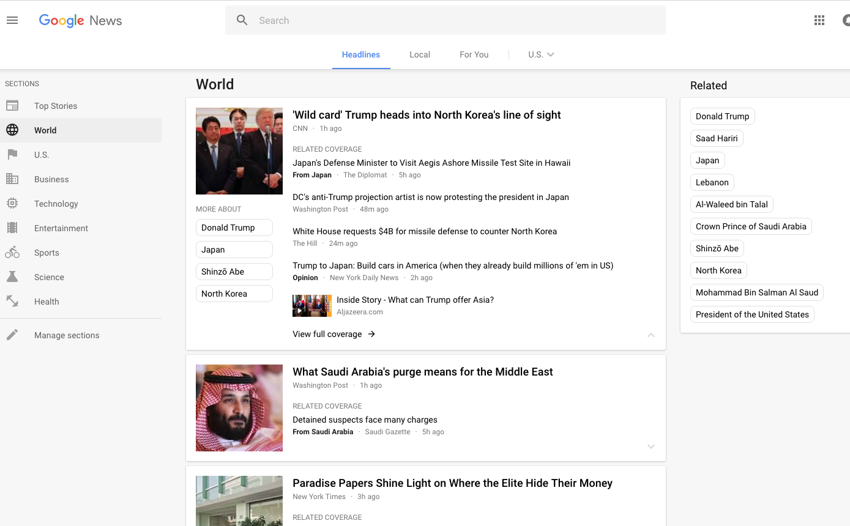
Use Google News! (Check outlets!)

Slide 44
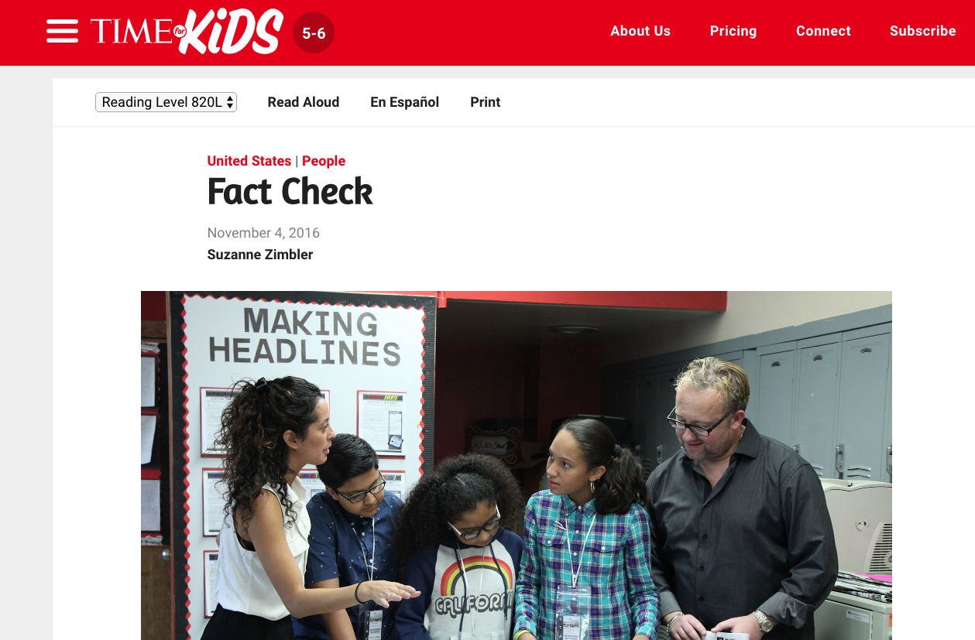
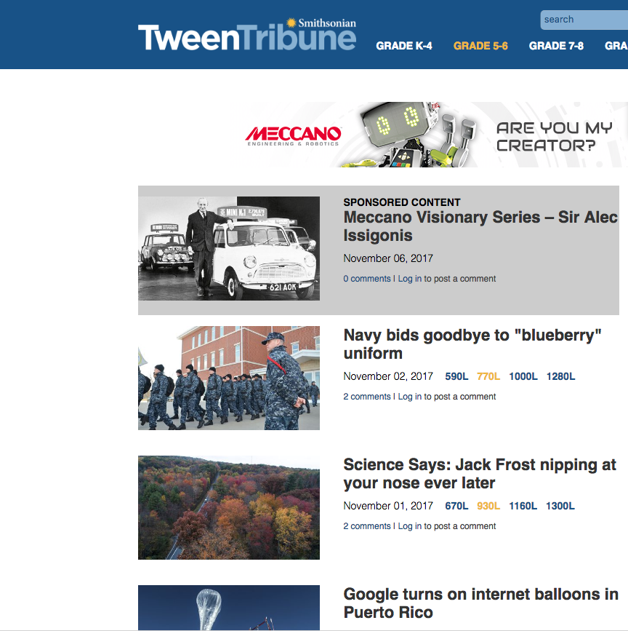
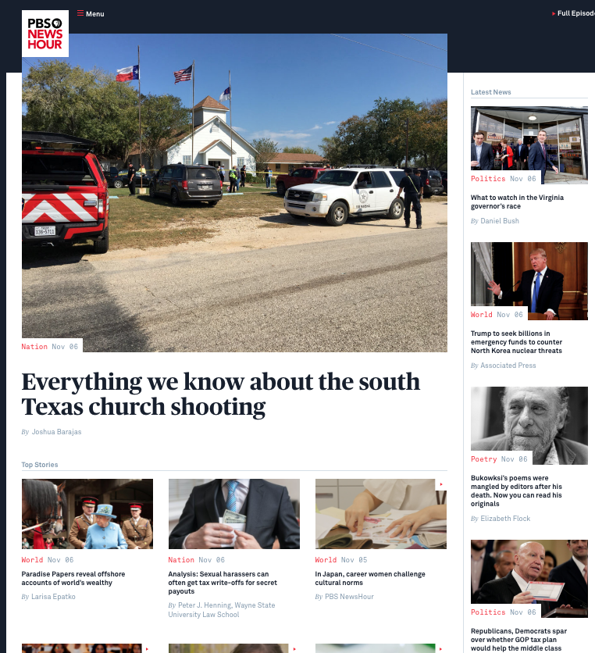
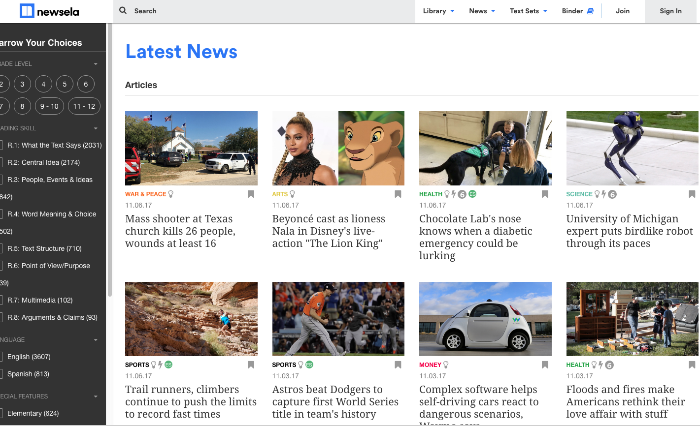
Search News Outlets Online
TIME for Kids
Newsela
TweenTribune
NPR
KidsPost

Slide 45
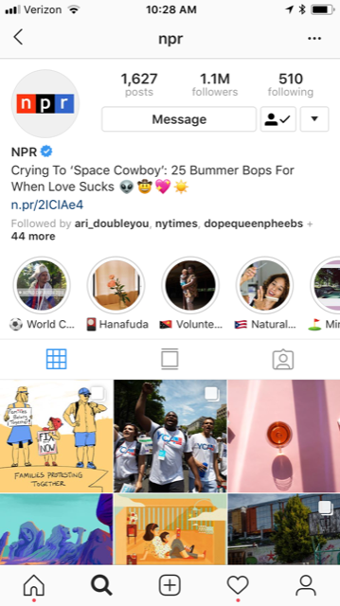
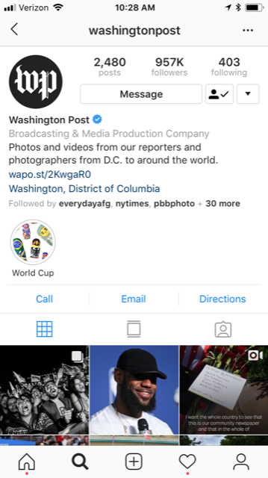
Follow News Outlets on Social Media
TIME for Kids
Newsela
TweenTribune
NPR
KidsPost

Slide 46
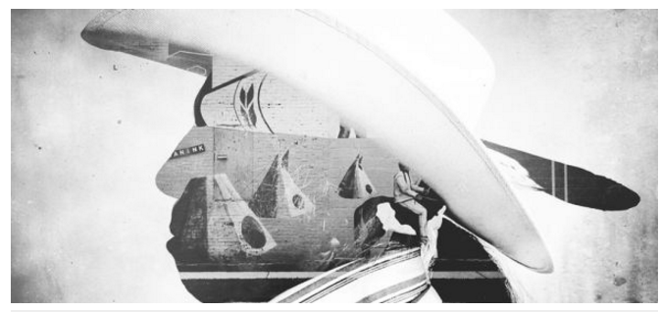
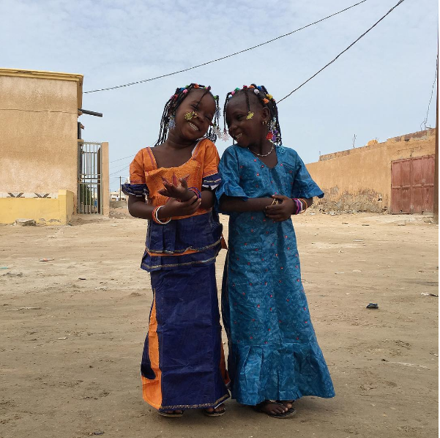
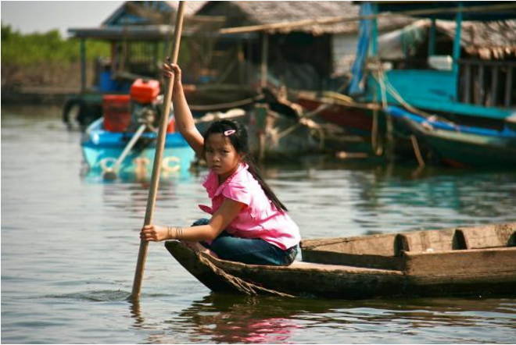
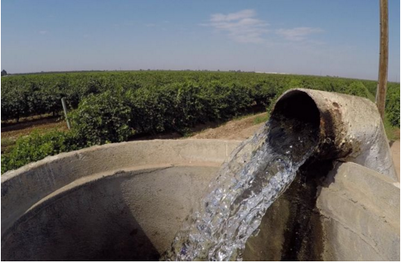
Connect with Pulitzer Center!
Visit www.pulitzercenter.org
Follow @pulitzercenter on Twitter, Instagram and Facebook
Ask your teacher to schedule a journalist visit to your class

Slide 47
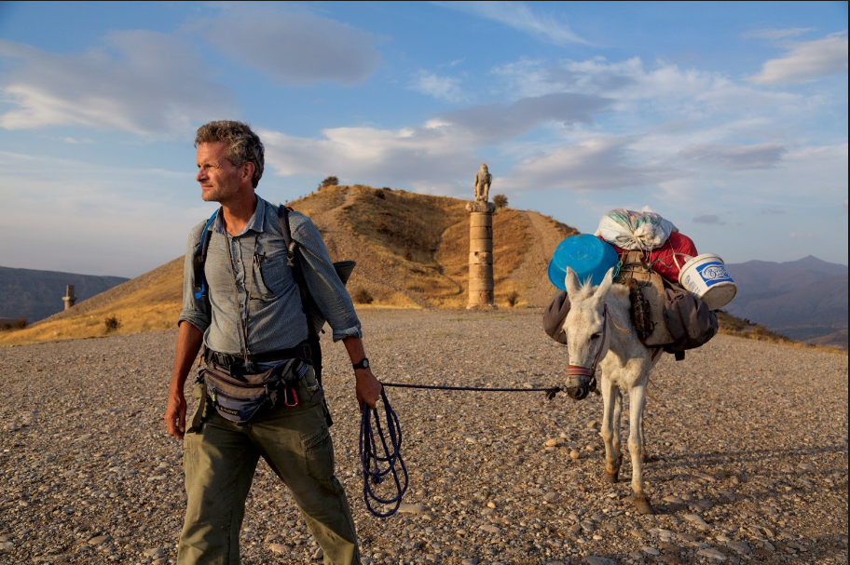
Closing:
Please complete the closing survey:
https://bit.ly/2NjOduu
Prepare to share one word inspired by your experience of the workshop.
Questions?
education@pulitzercenter.org
@pulitzercenter

