Slide 1
SOCIAL DETERMINANTS:
FACTORS THAT AFFECT YOUR HEALTH
AND WHAT YOU CAN DO TO LIVE A HEALTHIER LIFE
INCOME
HOUSING
EDUCATION
TRANSPORTATION
Student Names:

Slide 2
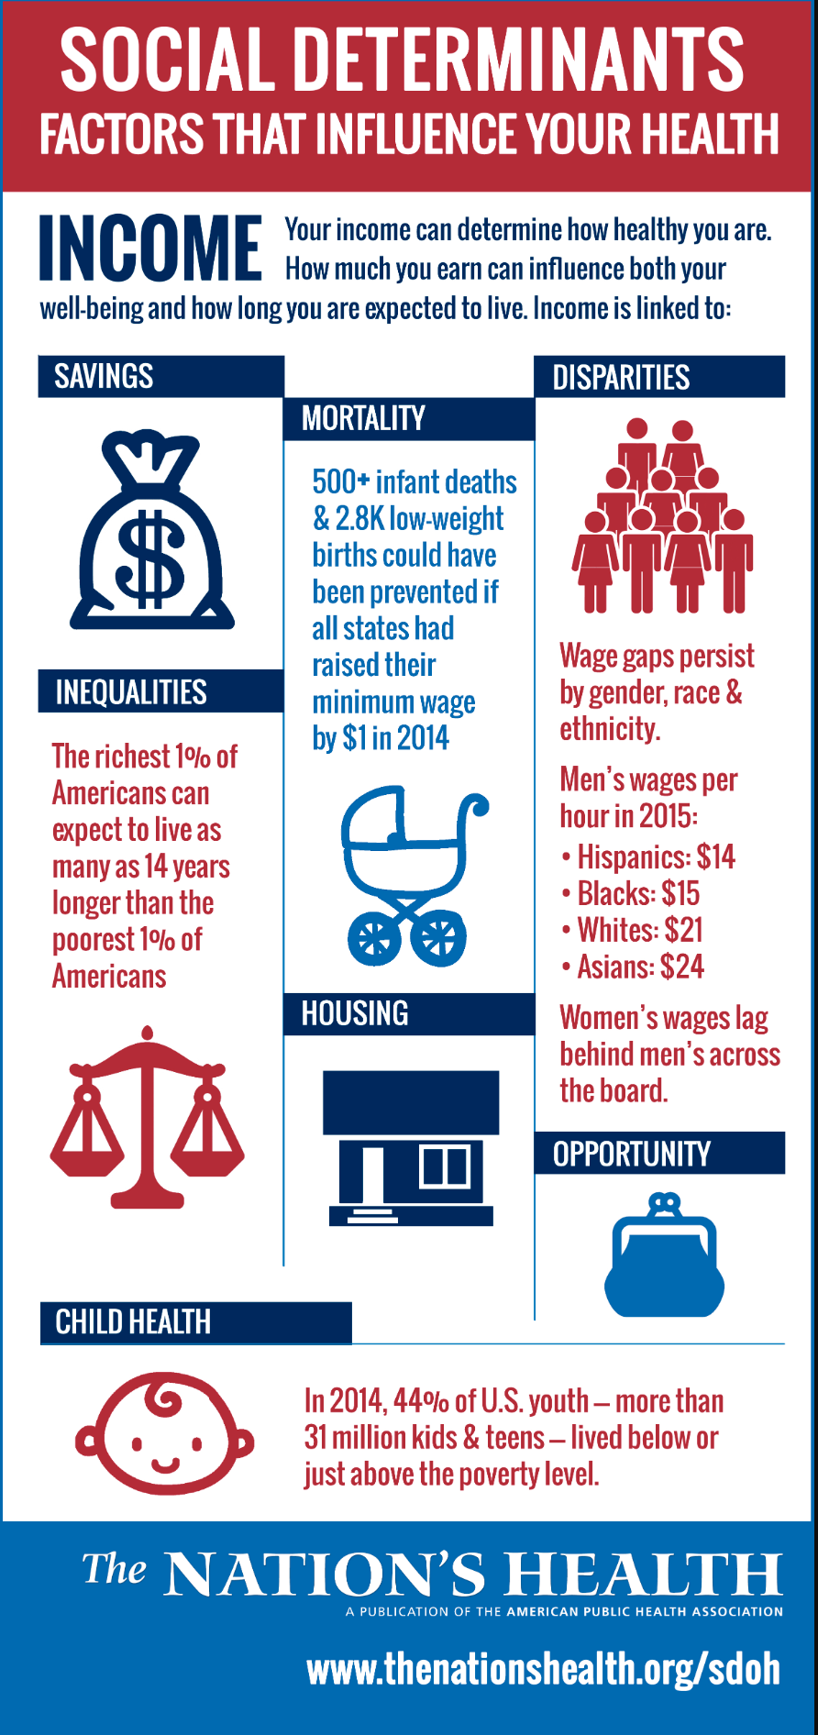
INCOME
1.How does Income affect your health?
The financial decision people and how much they make can physically and mentally affect your help from the streets to the products you are able to buy
2.What can you do in relation to this factor to improve your health?
There should be free hygiene product and people should get paid more to live a financially stable life.

Slide 3
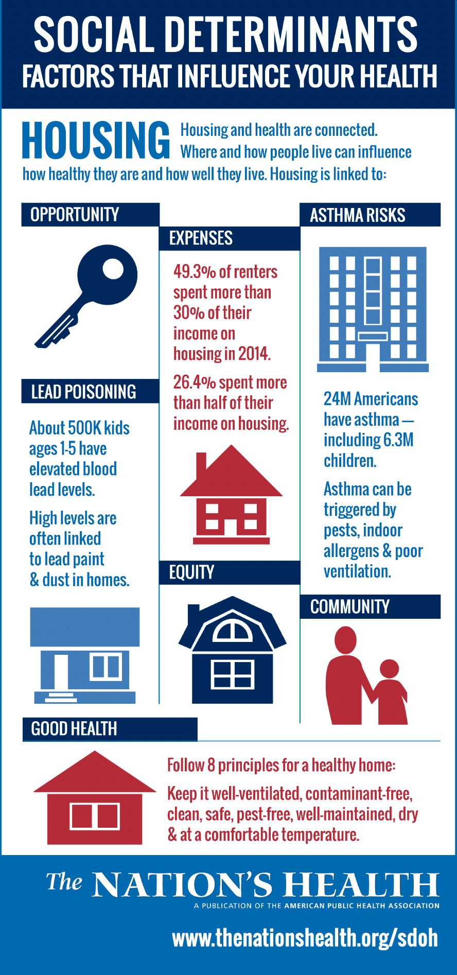
HOUSING
1.How does HOUSING affect your health?
Being in a environment that facilitates not only a positive mood but also a place where you have access to daily essentials like
2.What can you do to counteract this?
Keep your home clean, well-maintained, make sure the house is contamination-free, make sure to look for anything that can harm the people living their etc.

Slide 4
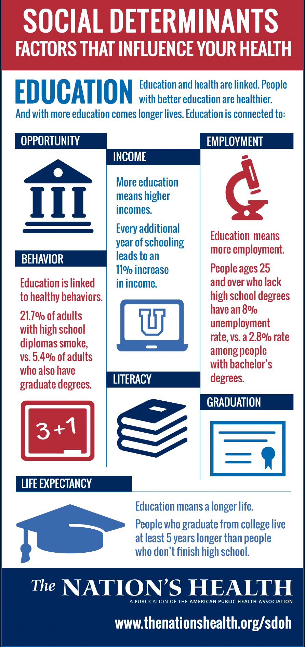
EDUCATION
1.How does EDUCATION affect your health?
Education can affect your health by not knowing about health risks in class. It can also interfere with their literacy and comprehension levels.
2.What can you do to counteract this?
We can enroll in college to learn more about the risks of diseases or illness that affect people

Slide 5
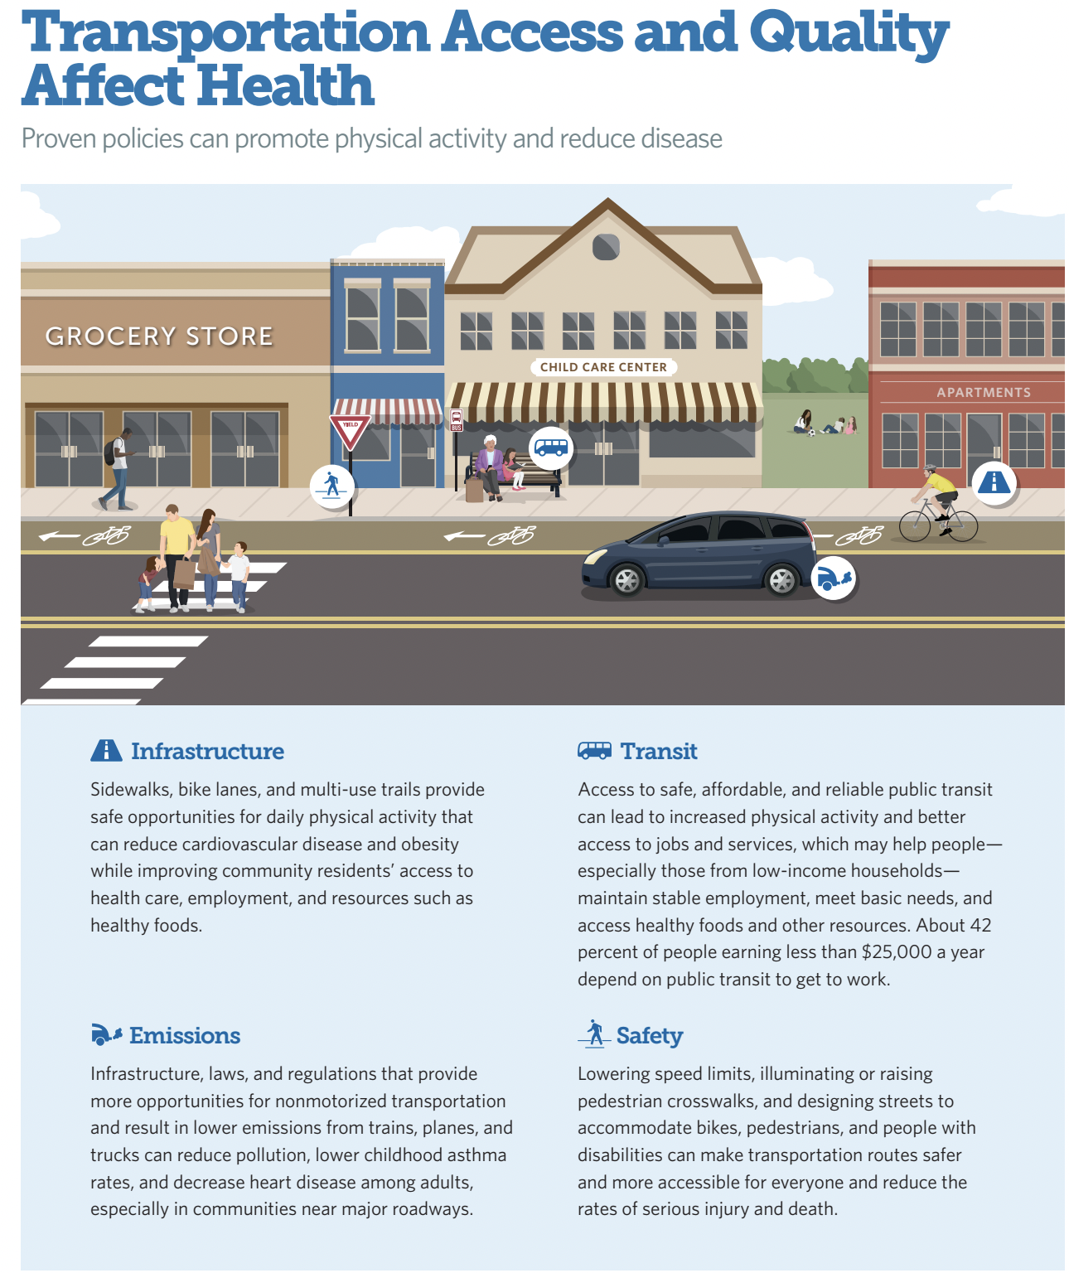
TRANSPORTATION
1.How does TRANSPORTATION affect your health?
Transportation can affect your health because if you’re driving a car every day, you might start to see yourself not walking or running as much anymore, and that's not good on the body as those two things are vital for exercise.
2.What can you do to counteract this?
You can try to balance the two. Drive only to far places and walk to close ones.

Slide 6
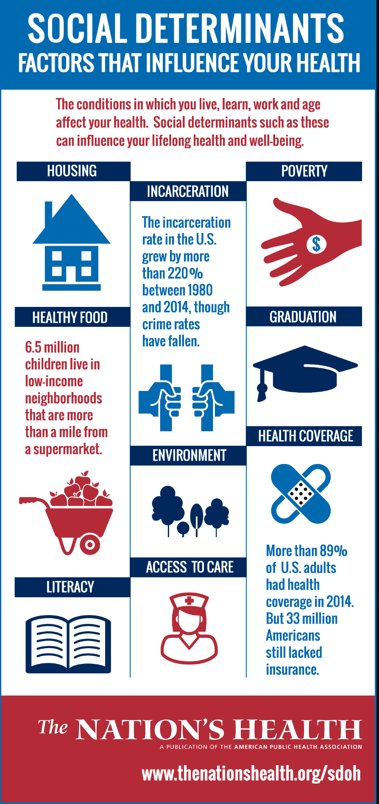
So, what?
1.What are the main takeaways from what you read? How is this relevant for us and our school community?
With what I read I can conclude that everything involved in this article can affect your health and well being. This involves us because new york works very differently compared to all other states.
2.What can we as journalists do?
We as journalist can spread awareness on these things and make many more people make better decisions for themselves and their health.

