Slide 1
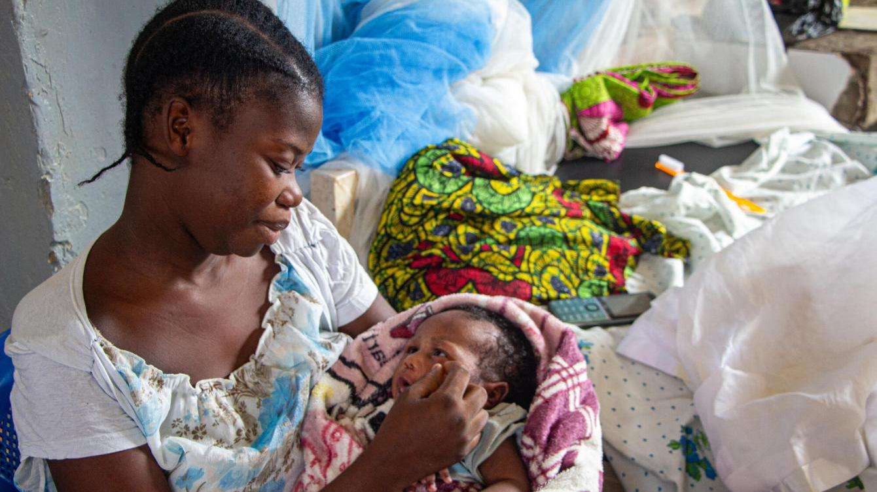
Babies Can’t Wait
In the Shadow of War, Life Begins Anew in a Congolese Maternity Ward
https://pulitzercenter.org/stories/shadow-war-life-begins-anew-congolese

Slide 2
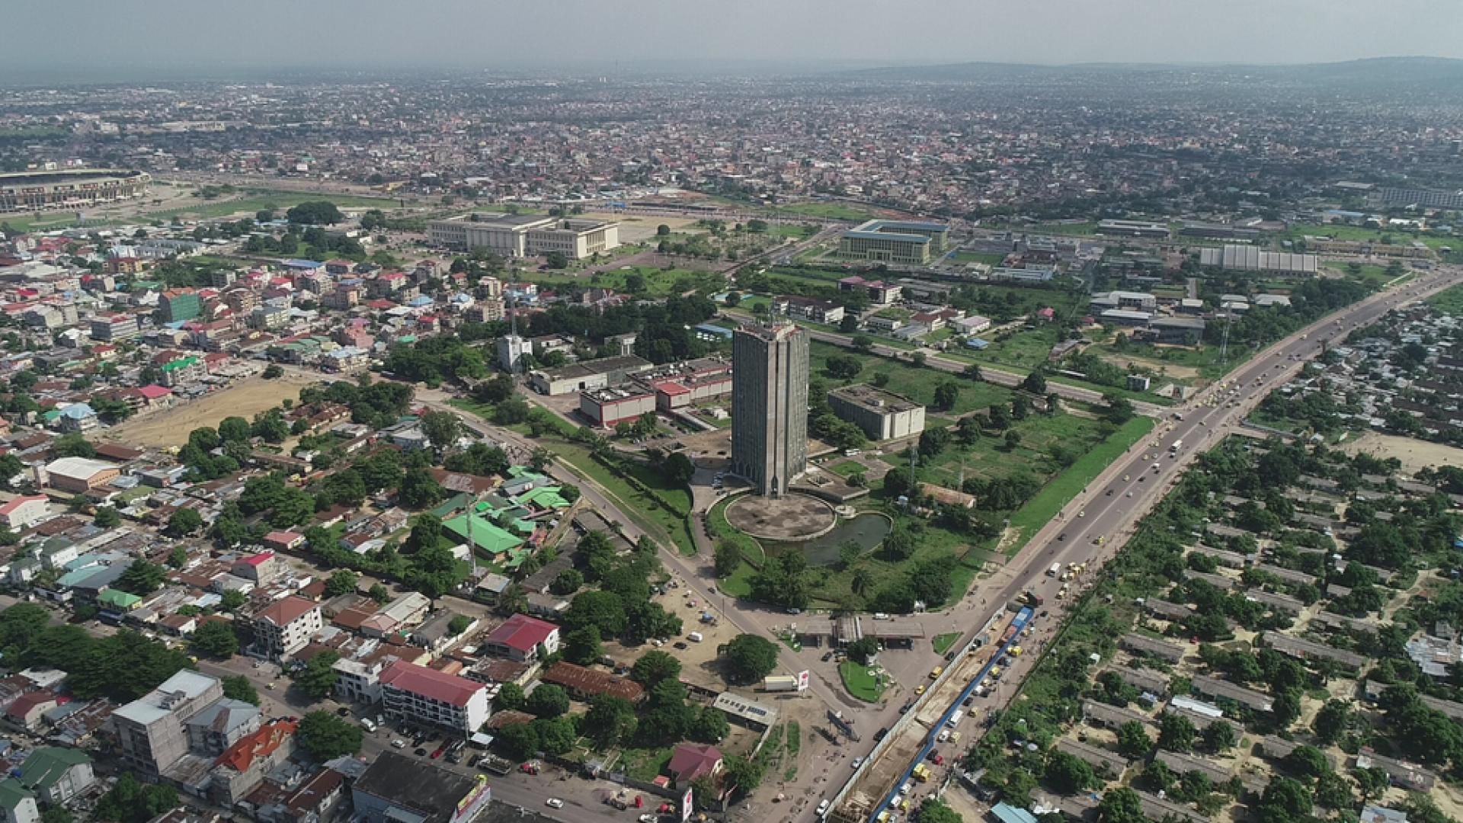
Kinshasa
Population: 17 million

Slide 3
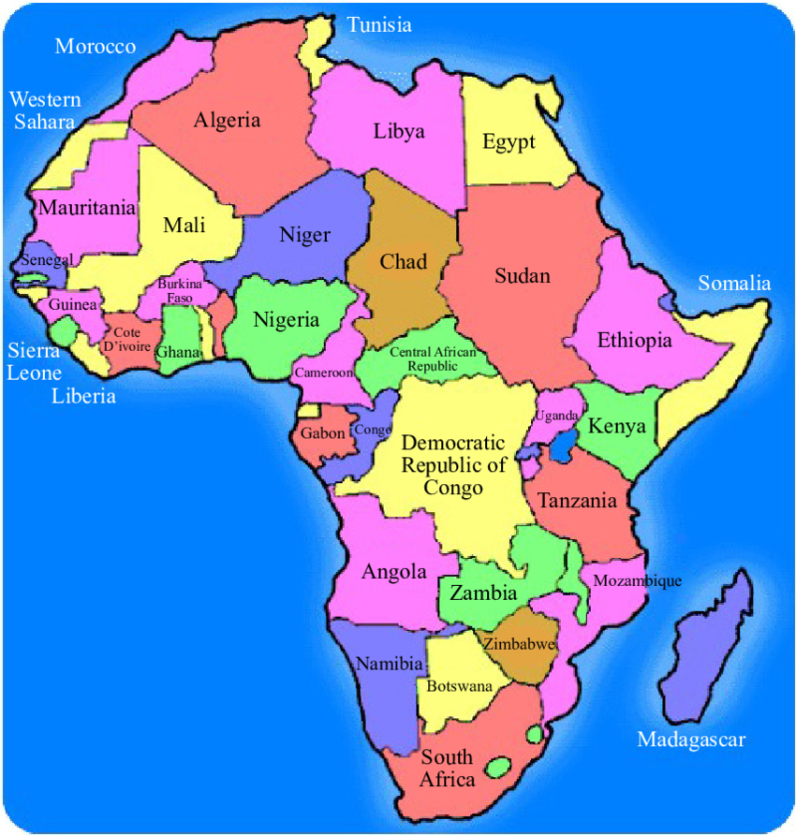
Where in the World
Where is the Democratic Republic of the Congo?
Located in Central Africa and is the 2nd largest country in Africa
11th largest country in the world
Population around 110 million
The most populous Francophone (French-speaking) country in the world
Kinshasa is the national capital and largest

Slide 4
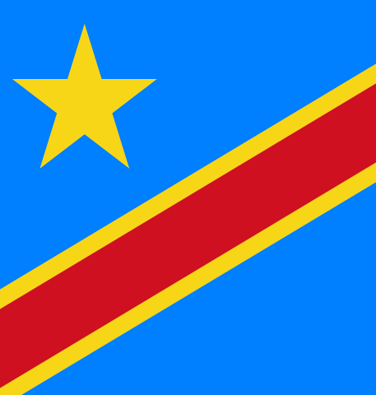
Who Has The Power
Kingdom of Kongo first controlled the territory of what is now modern-day Angola, DRC, and Republic of the Congo from the 14th to the 19th century
Later, King Leopold of Belgium colonized the country in 1884 until 1960
DRC gained independence from Belgium in 1960 and has continued to suffer political and social unrest
Today the DRC is a republic, with a parliament, prime minister, and president

Slide 5
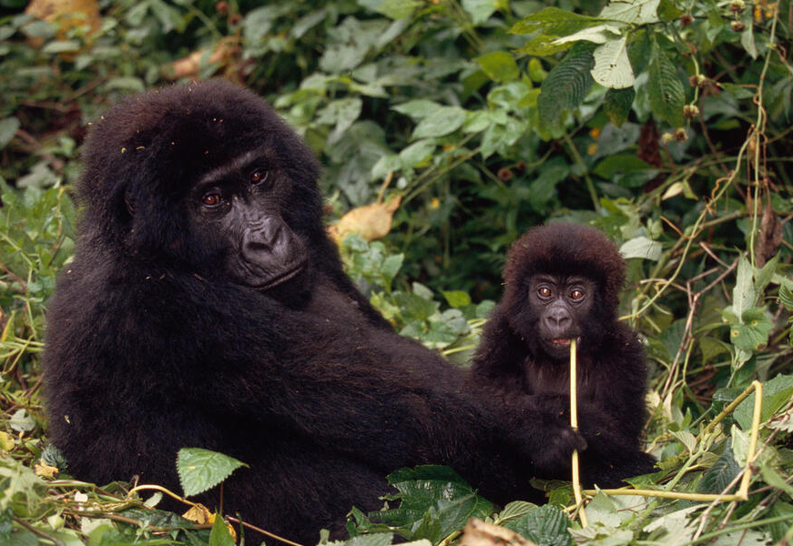
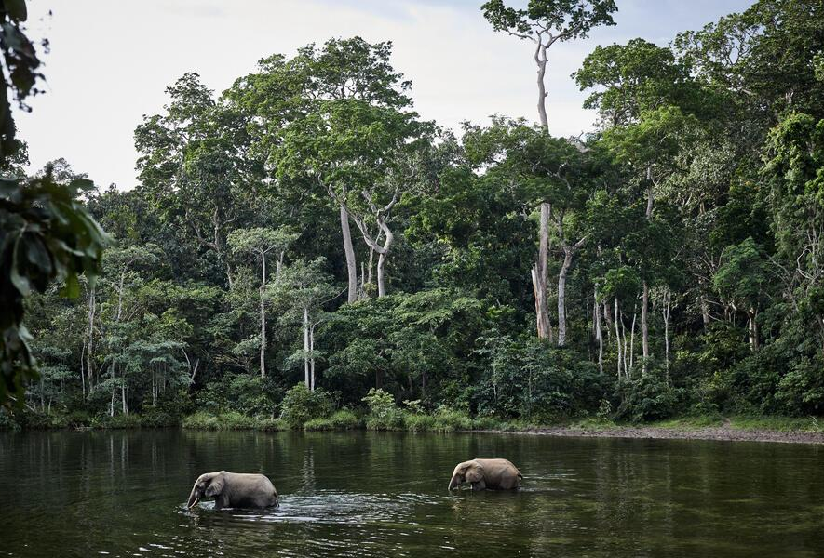
Geography
The DRC is located in central sub-Saharan Africa, bordered by 9 countries
The Congo Rainforest is the 2nd largest rainforest in the world
The Congo River has the 2nd largest flow and watershed river in the world

Slide 6
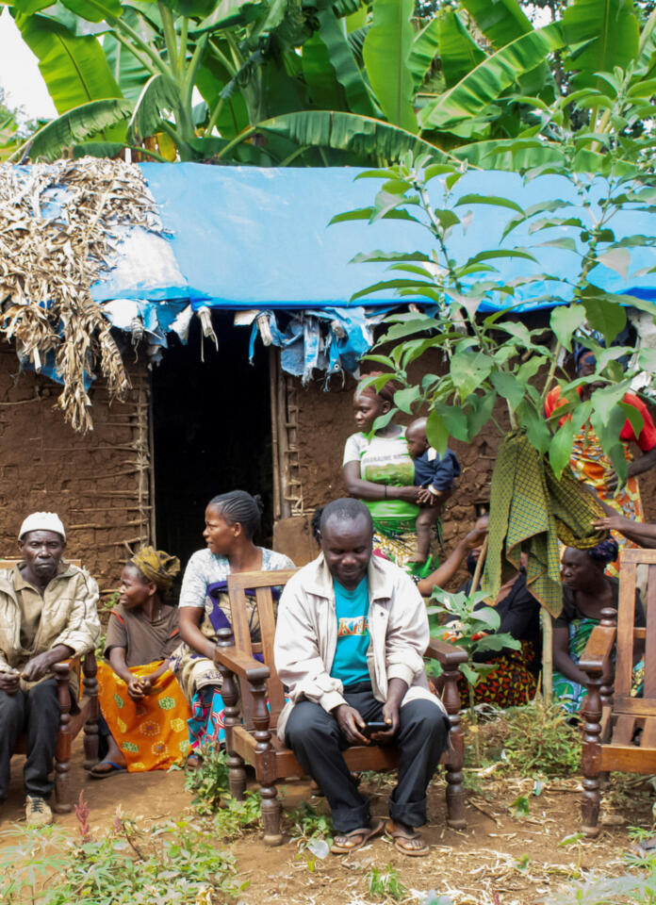
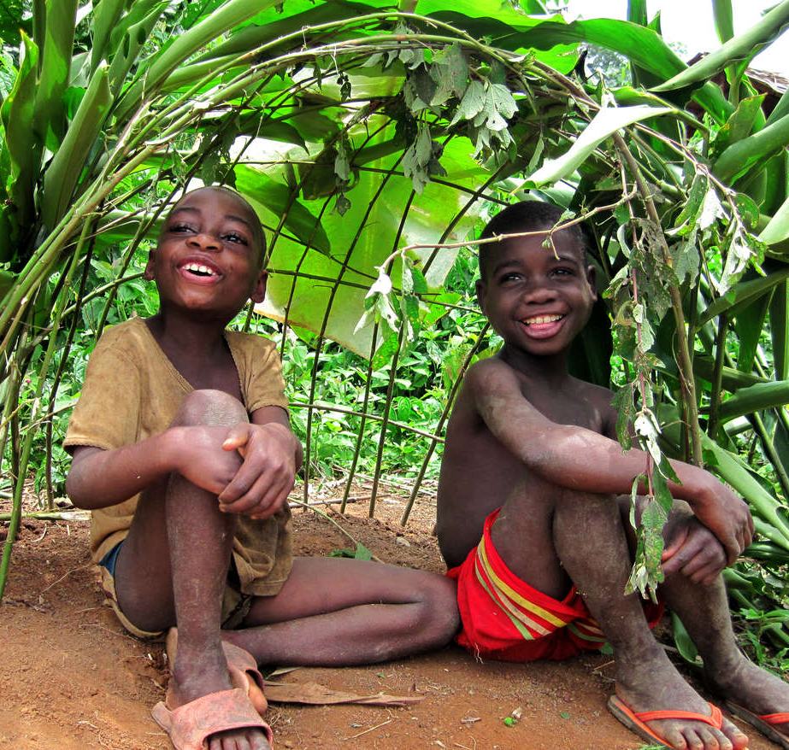
Language and Culture
Languages: French, Kituba, Lingala, Swahili, and Tshiluba
Religion: Christian (largest); Traditional spiritual practices; Islam
Ali vs. Foreman - Rumble in the Jungle
https://www.youtube.com/watch?v=PgRTMfYB57k

Slide 7
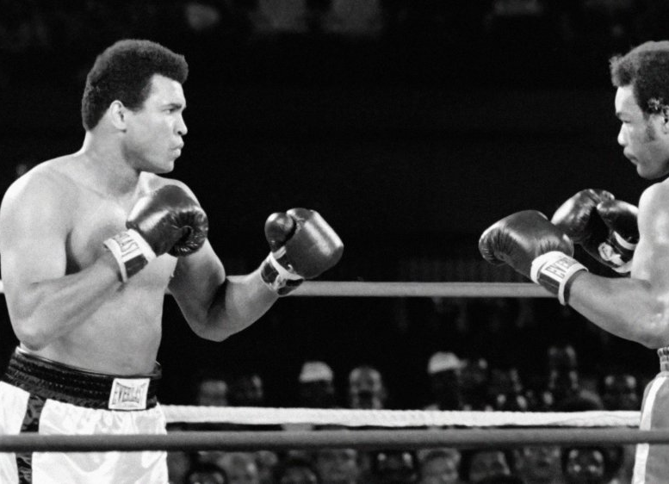
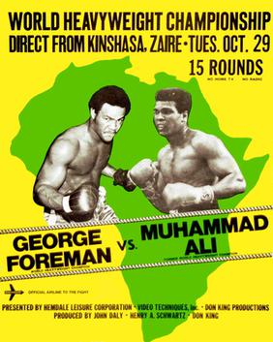
Rumble in the Jungle
Muhammad Ali vs. George Foreman
1974

Slide 8
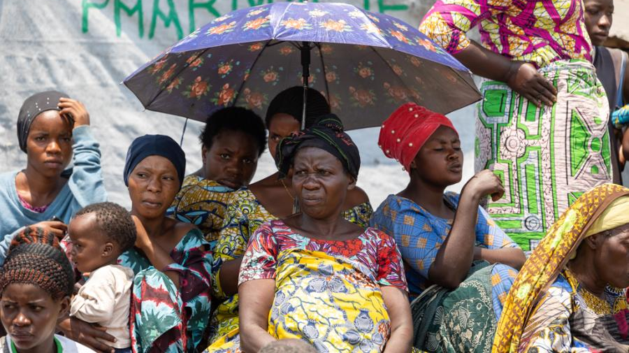

Slide 9
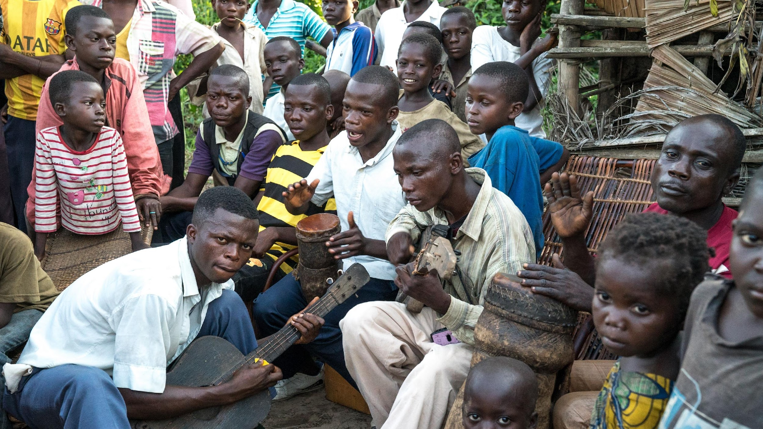

Slide 10
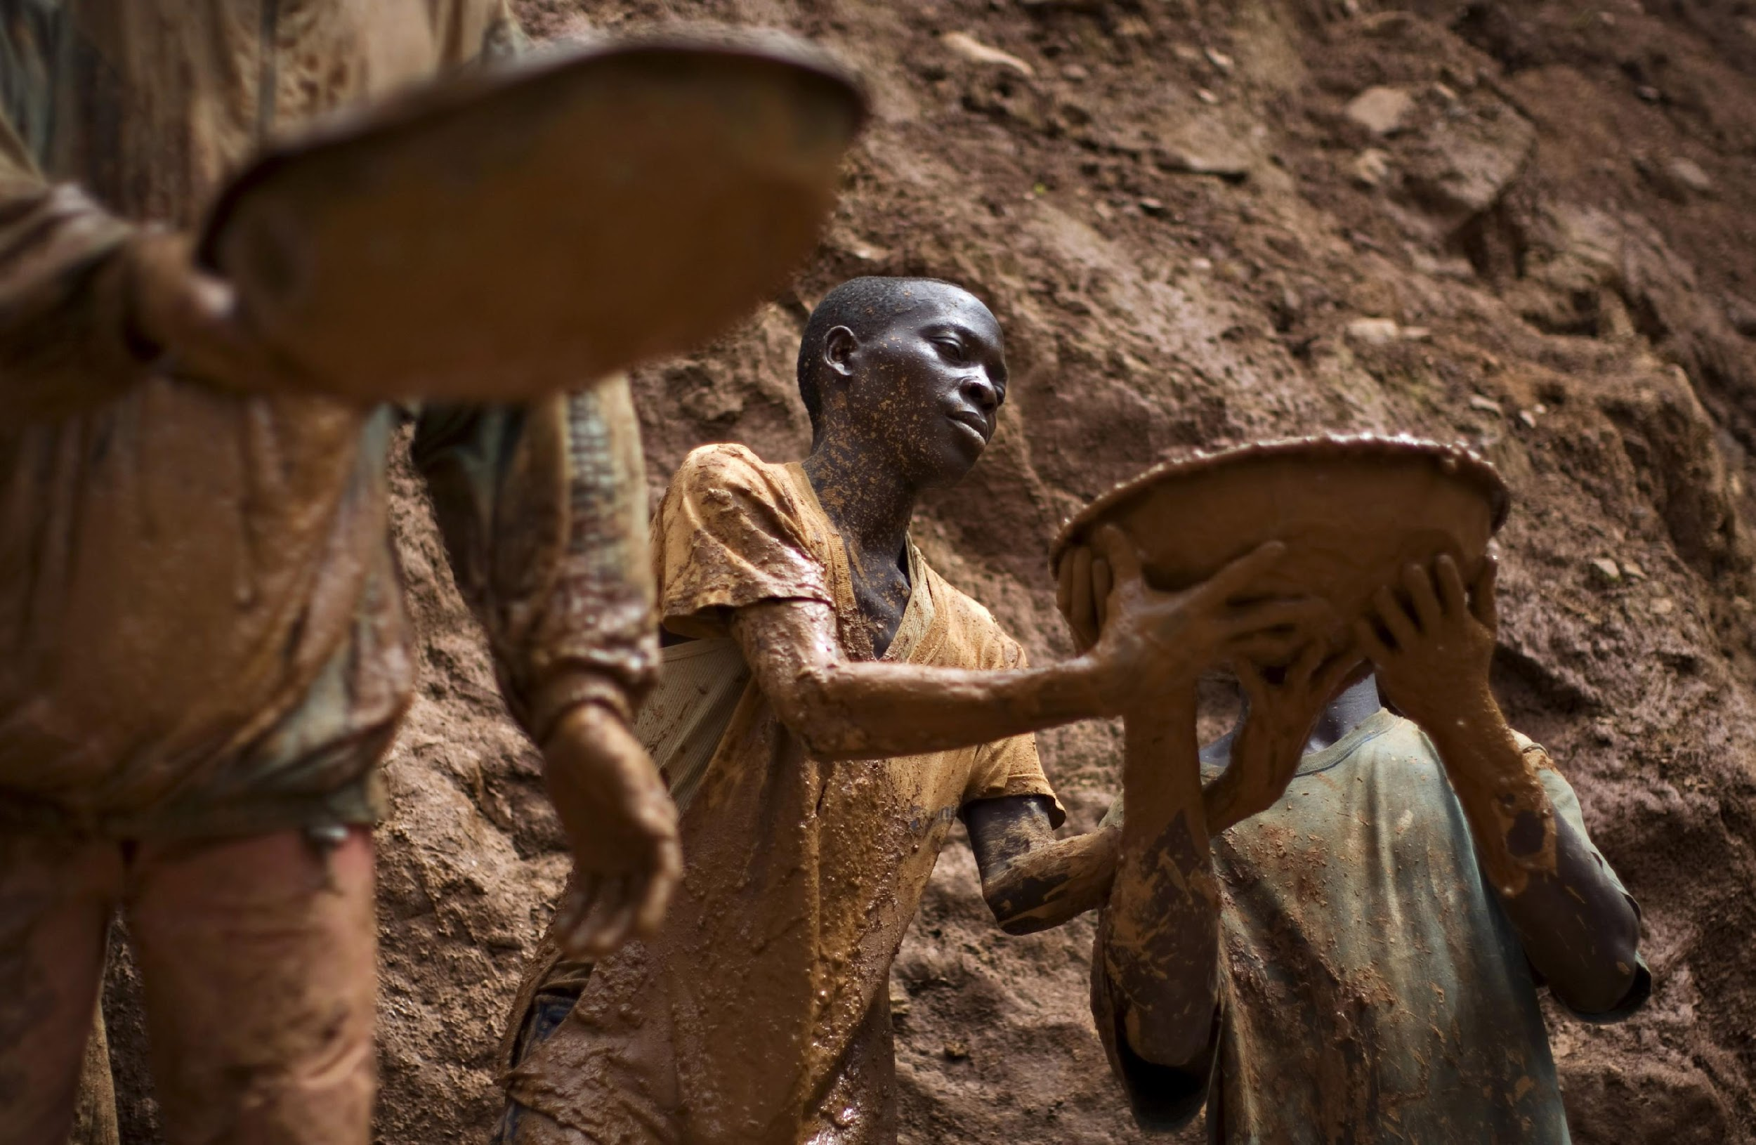
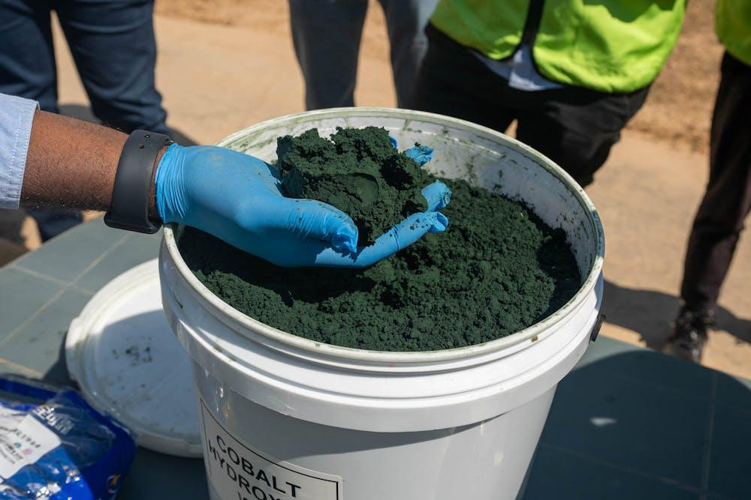
Natural Resources
Natural Resources: Tin, cooper, gold, cobalt, crude oil
Many of these natural resources have been labeled “conflict minerals” because armed groups use the profits from sales to fund their violent activities

Slide 11
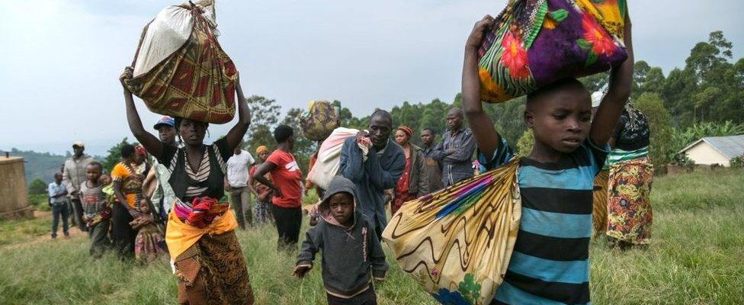
Where To Go?
More than seven million people have been displaced due to the constant threat of violence, extreme poverty and mining expansion
https://www.youtube.com/watch?v=tEOmI5bc3HU

Slide 12
Key Vocabulary
Infrastructure
Health disparities
Conflict Zone
Maternity Ward
Resilience

Slide 13
In the Shadow of War, Life Begins Anew in a Congolese Maternity Ward https://pulitzercenter.org/stories/shadow-war-life-begins-anew-congolese
In groups of 3 read the article
Underline/circle any words that are unfamiliar
Select 2 individuals mentioned in the article and complete the chart for the individuals selected
Role of Interviewee | Key Quote | Theme (Resilience, Community, Healthcare Challenges, etc.)
Nurse | “Push. Breathe,” she tells them. “It will be all right.” | Resilience – telling the mother that it will be alright; hope during hard times and suffering

Slide 14
Reflection Poem
Inspired by "In the Shadow of War, Life Begins Anew in a Congolese Maternity Ward"
Directions: Write a thoughtful and creative poem that reflects the themes, emotions, and imagery from the article. Use your own words to explore hope, struggle, and new beginnings
Step 1: Choose a poem structure:
  Free Verse: no rules about rhyming or line length
  Rhyming Poem: use words that rhyme at the end of lines
  Acrostic Poem: write the word HOPE or LIFE vertically, and begin each line with a letter from the word.
Step 2: Writing :
  Start with an image or feeling
  Use descriptive language: use your senses! What might you see, hear, or feel?
  Include themes: write about the struggle (the war) and conflict zones, resilience, and hope (new life)
  End on a high note: leave the reader with a feeling of hope or peace

Slide 15
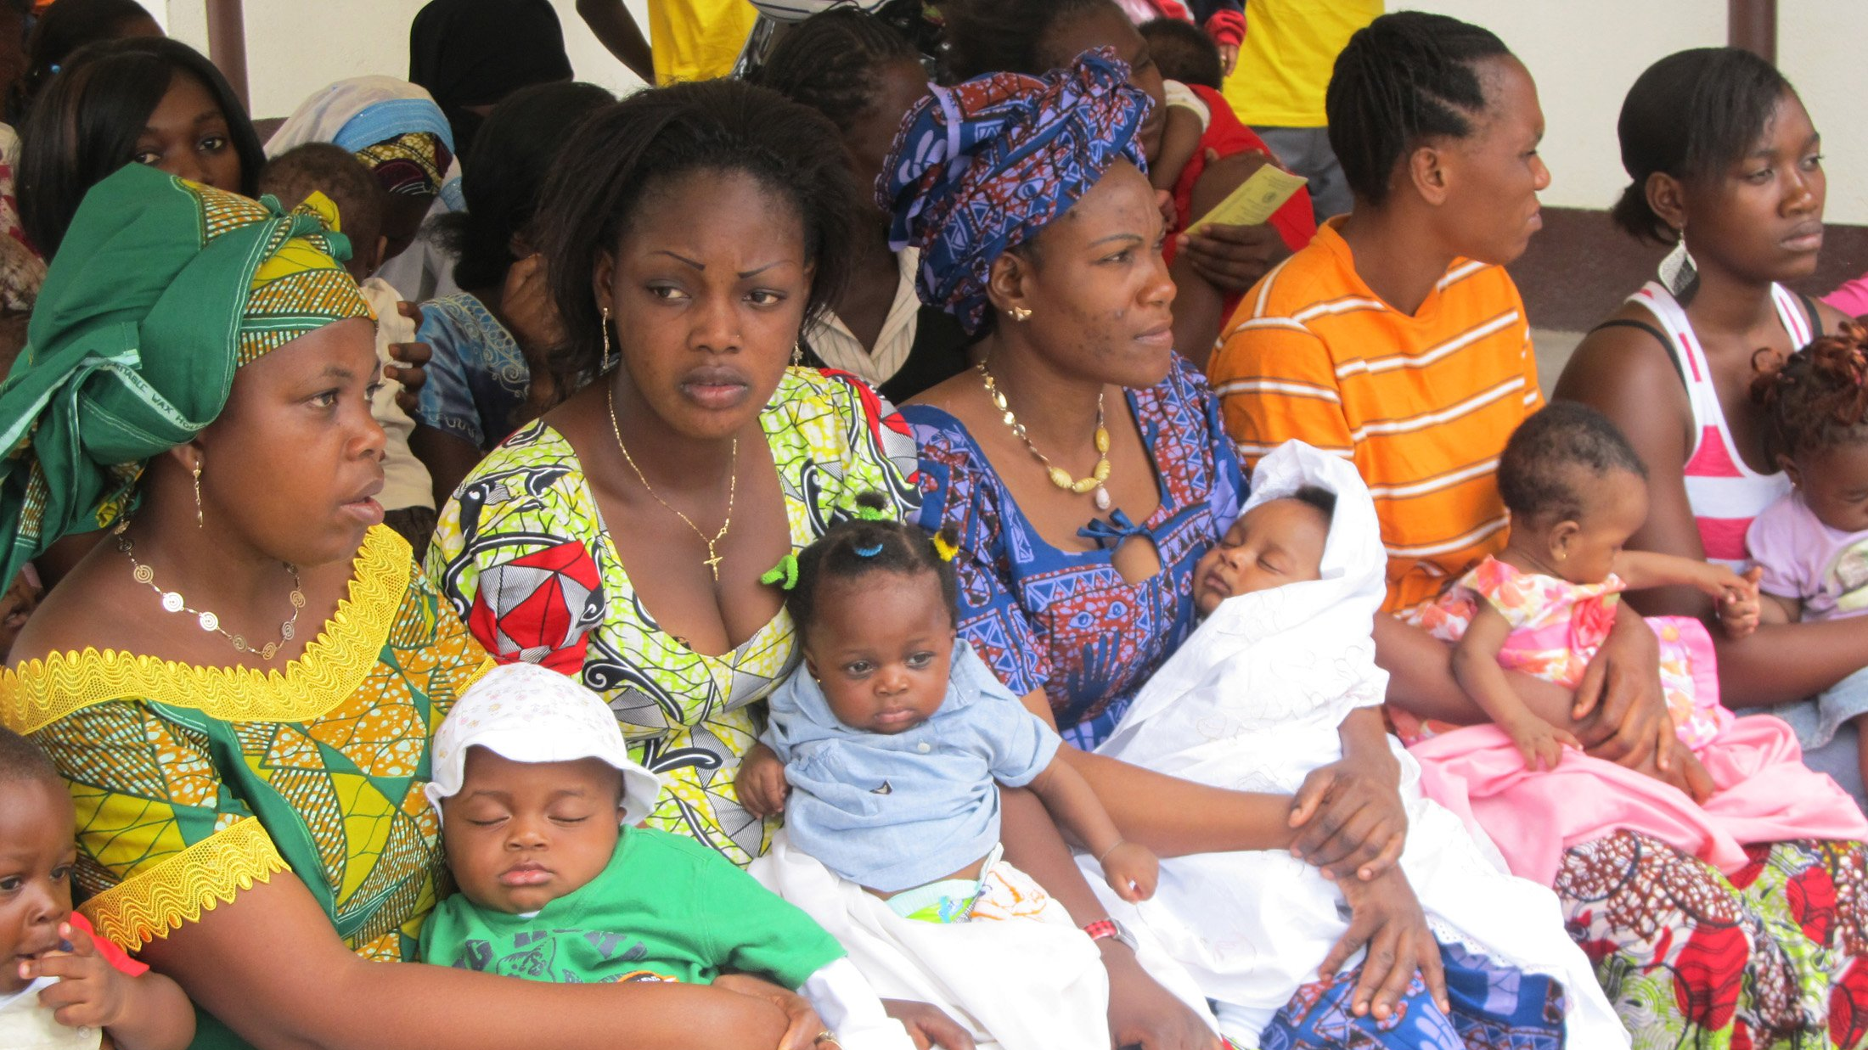

Slide 16
Babies Can’t Wait
The babies can’t wait
What’s the due date?
Now! It’s time; it’s time
Everyone gather around
A new life has made it town
We’ve been waiting for you
You’re bringing joy to ease our pain
Your cooing and cries are sweet as drops of rain
Be strong, young Black prince
Mama is tired and Daddy must go fight
For justice, for peace and freedom
We can, we will, we must - WIN!!

Slide 17
References and Resources
https://news.bahai.org/story/1233/
https://www.amnesty.org/en/location/africa/east-africa-the-horn-and-great-lakes/democratic-republic-of-the-congo/report-democratic-republic-of-the-congo/
https://www.cfr.org/global-conflict-tracker/conflict/violence-democratic-republic-congo
https://www.bbc.com/news/world-africa-13283212

