Slide 1


Lesson Agenda
Between Shades of Gray:
This Week’s Underreported Lens: Global Health - Day 2
A Global World News Story
Essential Questions - Quick Review
Pulitzer Center Underreported Story
  Finish Questions
  Group Discussion
Advocating for Global Health: A Mini-Advocacy Project
  Intro to Mini-Project
  Worktime
Notes:
https://docs.google.com/document/d/143tnnkf66RJiOVC1dGcKhFDImiUUYXEF_SXjU_rXHA4/edit?tab=t.0#heading=h.6tjhjo43j3om

Slide 2
Today’s Lesson Goals
Lesson Title “Objects in the Mirror are Closer Than They Appear”: The Global Health Threat of International Conflict - DAY 2
Content Goal
Language Goal
Students will explore how an international conflict can impact global health and explore advocacy approaches to raise awareness about this issue. They will connect their reading of BSG to a more contemporary global health issue.
Students will read an under-reported story and use Harvard Project Zero thinking routines to reflect on and discuss the story. They will also draft an advocacy piece to explain the significance of their findings.
Notes:
1

Slide 3
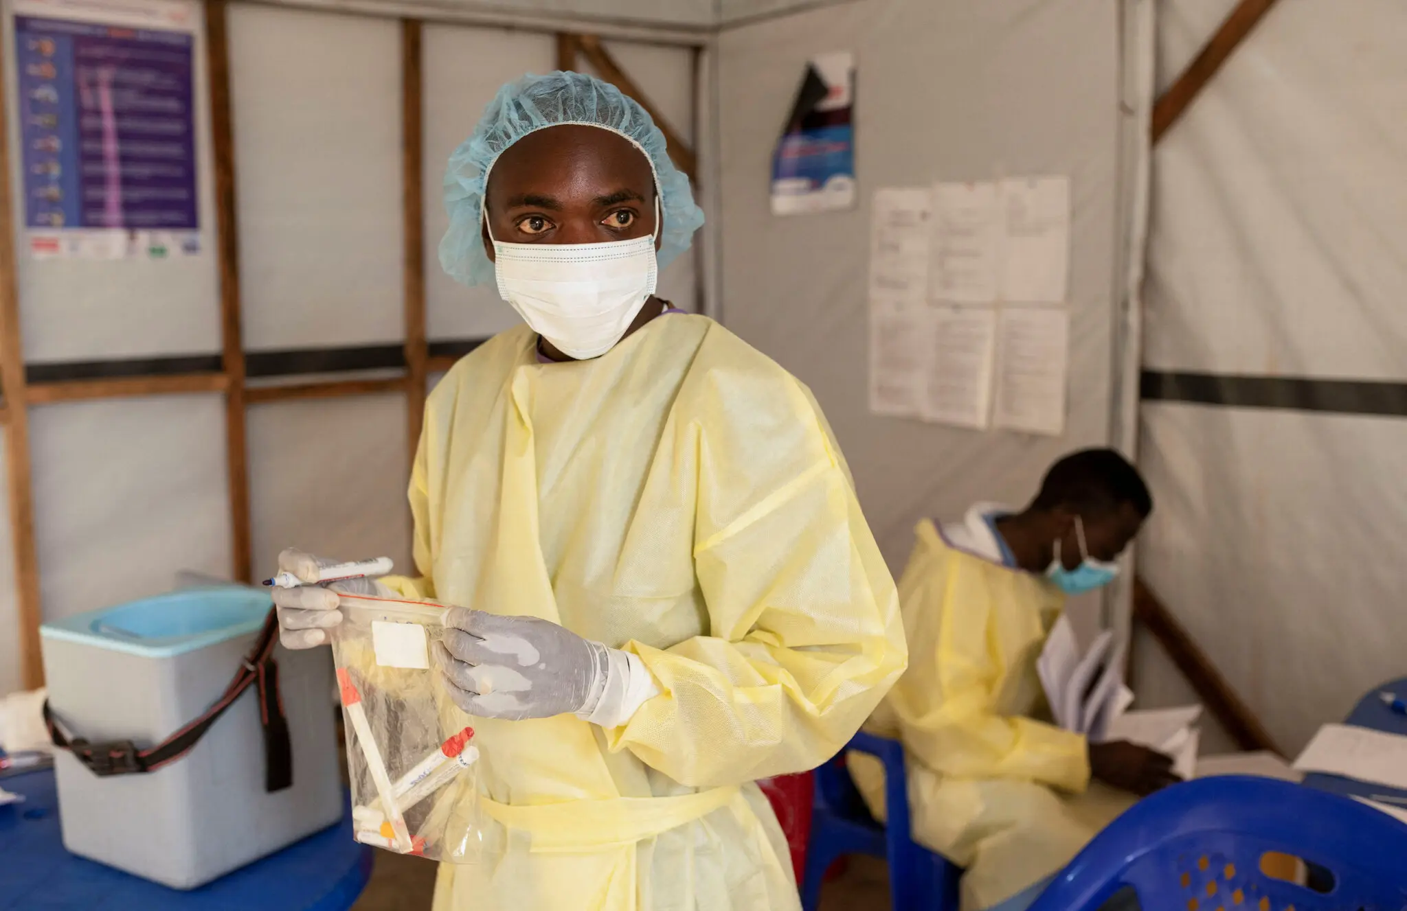
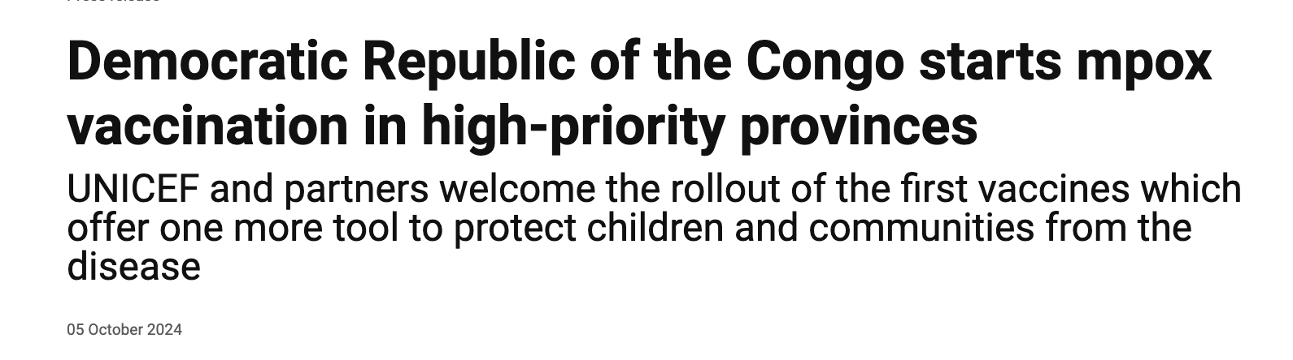
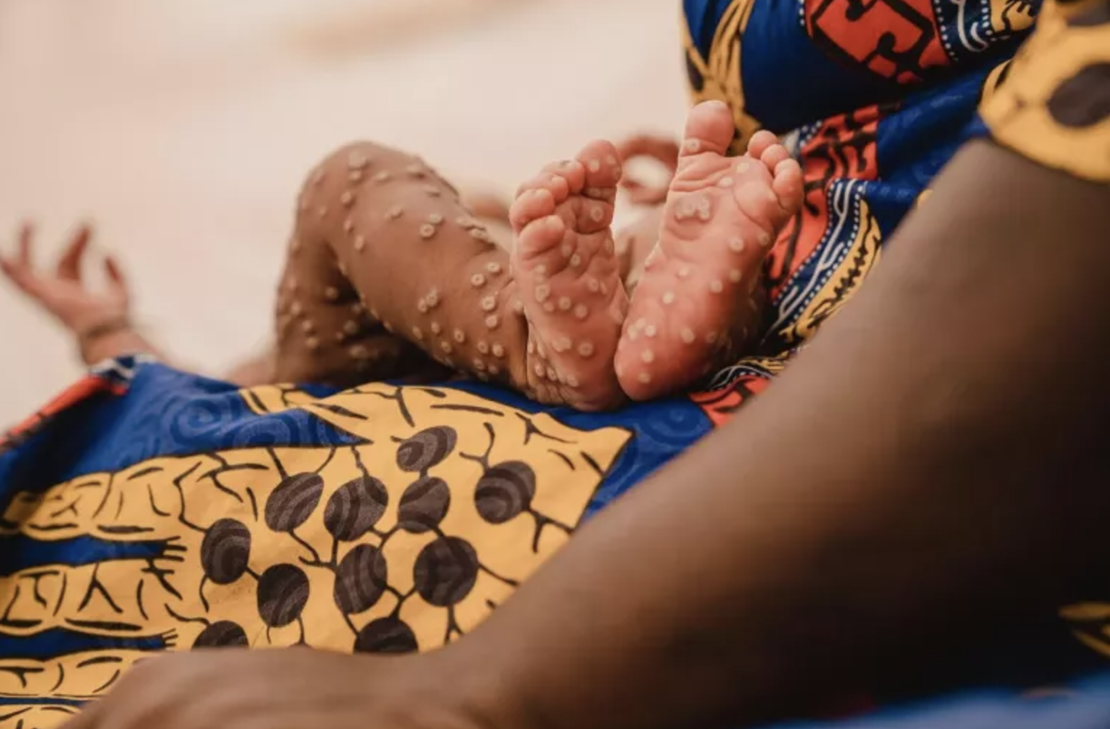
The rapid spread of mpox, formerly called monkeypox, in African countries constitutes a global health emergency, the World Health Organization declared [in August].
True or False:
There is an mpox vaccine.
A person in California has tested positive for a form of mpox causing a widespread epidemic in Africa, the state’s Department of Public Health reported on Saturday. It is the first known case in the United States.
In
World
News
This is the second time in three years that the W.H.O. has designated an mpox epidemic as a global emergency. It previously did so in July 2022. That outbreak went on to affect nearly ______ people, primarily gay and bisexual men, in _____ countries, and killed about 200 people.
There is no evidence that this version of the mpox virus, called Clade Ib, is circulating in communities in the United States, C.D.C. officials said.
100,000
116
A total of 265,000 doses of the MVA-BN mpox vaccine arrived in Kinshasa in September, donated by the EU, the US, and Gavi - the Vaccine Alliance - with support from Africa CDC. UNICEF organized the shipment, customs clearance and delivery of the vaccines to DRC. Gavi provided valuable funds towards the costs for vaccination readiness and delivery undertaken by the Ministry of Health, UNICEF and WHO.
The threat this time is deadlier. Since the beginning of this year, the Democratic Republic of Congo alone has reported 15,600 mpox cases and 537 deaths. Those most at risk include women and children under 15.
Infections in people returning from Africa, however, have been found in Germany, Sweden, Thailand and the United Kingdom, among other countries. A case in India was reported in a person returning from the United Arab Emirates.

Slide 4

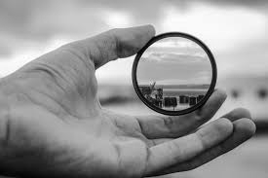
Today’s Lens: Global Health in Between Shades of Gray

Slide 5
Global Health Lens - Essential Questions
What are the public health impacts of war on soldiers and refugees in regions of conflict?
How can disease emerging in war zones have a global health impact?
How can we raise awareness about the potential for a global health crisis resulting from disease borne out of war and conflict?

Slide 6
Connecting Between Shades of Gray and Global Health Issues
Finish & Discuss Today!
Read the underreported story: Could a Conflict-Borne Superbug Bring on our Next Pandemic? and answer the questions posted in Schoology..
What connections can you draw between this story and personal experience or previous knowledge? How is this story connected to specific texts you have read?
What concepts will you take away from this story?
What challenges or concerns emerge for you as you reflect on this story?
How has your thinking or worldview changed after reading the story?
Notes:
Handout: https://docs.google.com/document/d/1ybwSeeZiAjF_MIf-H5t3Te8S8hq6l7EBdcdDsNyO594/edit?tab=t.0

Slide 7
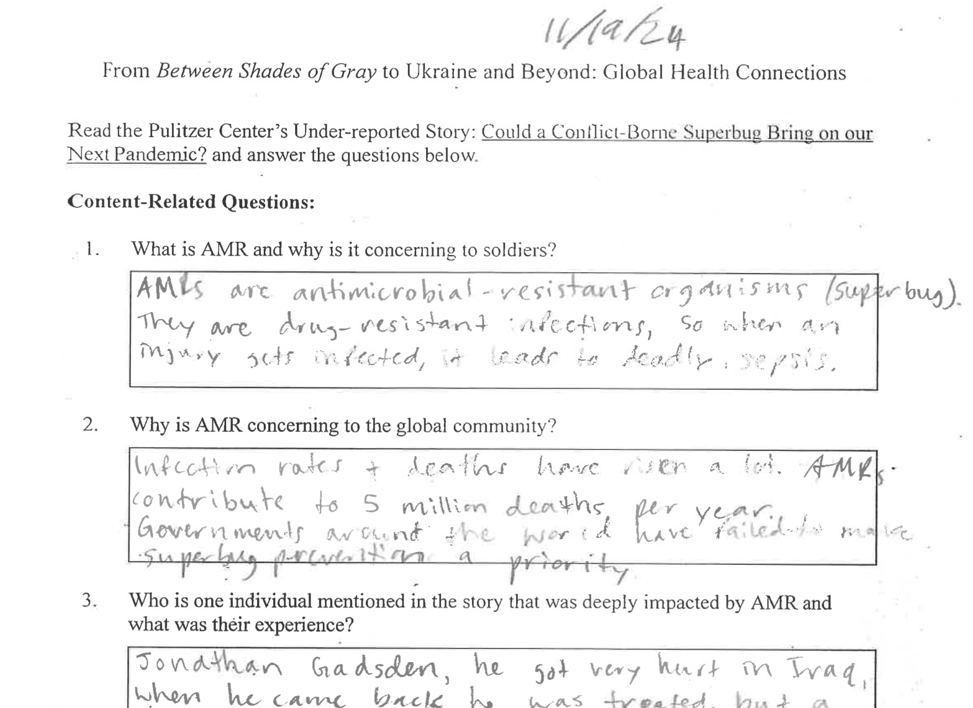
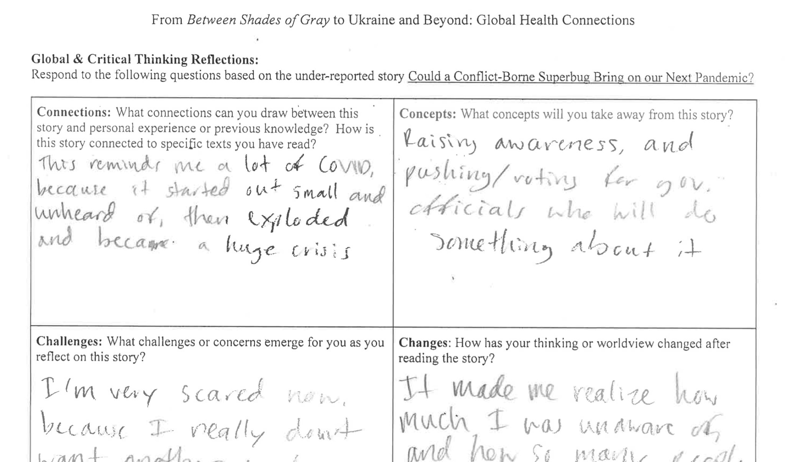
Connecting Between Shades of Gray and Global Health Issues
Read the underreported story: Could a Conflict-Borne Superbug Bring on our Next Pandemic? and answer the questions posted in Schoology..
Student Models!
Notes:
Handout: https://docs.google.com/document/d/1ybwSeeZiAjF_MIf-H5t3Te8S8hq6l7EBdcdDsNyO594/edit?tab=t.0

Slide 8
Advocating for Global Health - Mini-Project!
Draft an advocacy piece to synthesize content from Between Shades of Gray, the global health story Could a Conflict-Borne Superbug Bring on our Next Pandemic?, your critical thinking reflections, and ideas from any other sources you choose. Your piece should allude to historical conflicts, stories of war, and the ways that a changing world demand more attention to this global health threat. Post your final piece on Padlet. You may work with a partner or on your own! Assignment details and resources HERE.
OPTION A: Draft a 1-page letter or email to an appropriate recipient to advocate that more attention be given to the global threat of AMR, especially those originating in conflict zones.
OPTION B: Draft an infographic-style flyer with text, graphics, quotes, and images to raise awareness about the ways that wartime conflict in far-away places is contributing to the spread of AMR and how your peers can take action to alert appropriate people in power.
OPTION C: Draft a 2.5 minute “talking head” video to inform others about AMR, share that it is an increasing global threat, and explain what your audience can do to raise awareness and combat this problem before it becomes a crisis.
Notes:
Assignment details: https://docs.google.com/document/d/1JjAFdy8V6U5WNjDFJqVL1Q9nhTZIqiCSKrEXz8ApVL4/edit?tab=t.0
Add to Padlet!

Slide 9
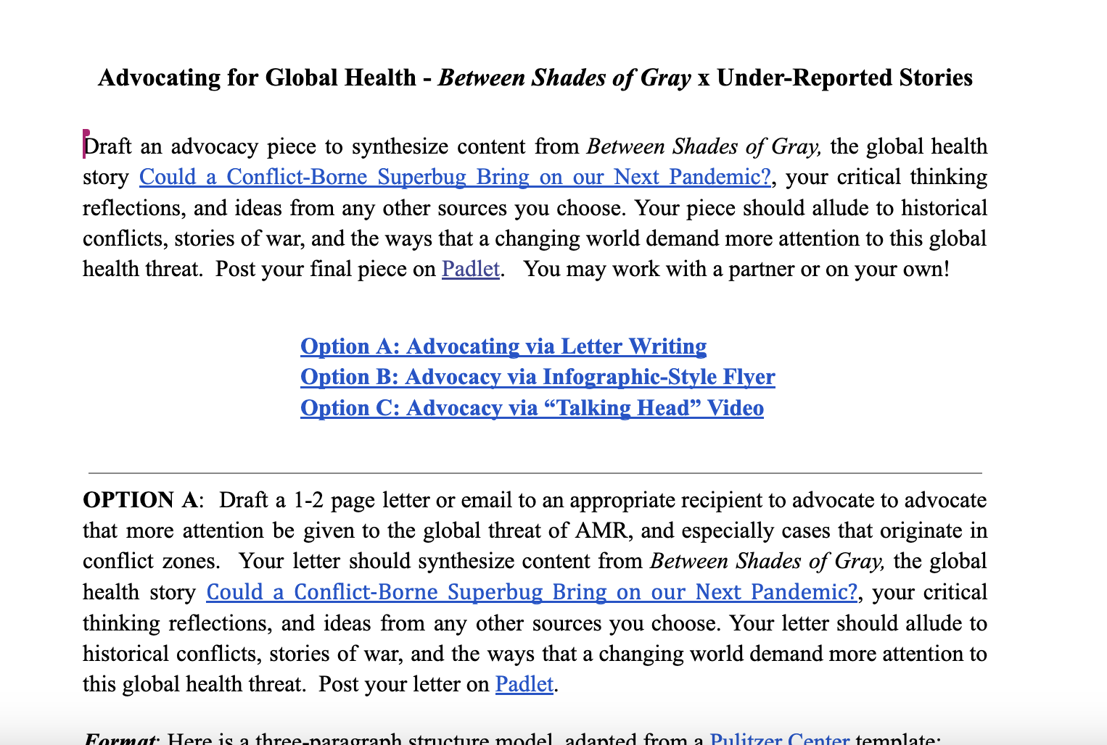
Advocating for Global Health - Mini-Project!
Explanation and Resources in Schoology!
Notes:
Assignment details: https://docs.google.com/document/d/1JjAFdy8V6U5WNjDFJqVL1Q9nhTZIqiCSKrEXz8ApVL4/edit?tab=t.0
Add to Padlet!

Slide 10
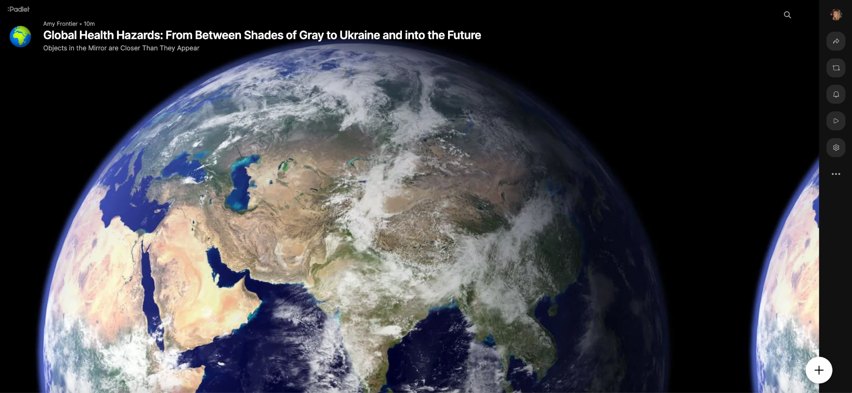
Advocating for Global Health - Padlet Post!
Post your letter, flyer, or video to Padlet!
Like & Comment on 3 “Most Effective” Advocacy Projects.
Notes:
PADLET

Slide 11
Homework
Finish and Post your Advocacy Project on Padlet.
Like and Comment on 3 “Most Effective” Advocacy Projects!

