Slide 1


Lesson Agenda
Between Shades of Gray:
This Week’s Underreported Lens: Global Health!
A Global World News Story
Essential Questions
The Global Health Impacts of War and Conflict
  Background + Brainstorm
  Between Shades of Gray - Chapters 48-50
  A Contagion Map
Intro to Pulitzer Center Underreported Story
  Read + Q & A
  Discussion
Notes:
https://docs.google.com/document/d/143tnnkf66RJiOVC1dGcKhFDImiUUYXEF_SXjU_rXHA4/edit?tab=t.0#heading=h.6tjhjo43j3om

Slide 2
Today’s Lesson Goals
Lesson Title “Objects in the Mirror are Closer Than They Appear”: The Global Health Threat of International Conflict
Content Goal
Language Goal
Students will explore how an international conflict can impact global health and explore advocacy approaches to raise awareness about this issue. They will connect their reading of BSG to a more contemporary global health issue.
Students will read an under-reported story and use Harvard Project Zero thinking routines to reflect on and discuss the story. They will also draft an advocacy piece to explain the significance of their findings.
Notes:
1

Slide 3

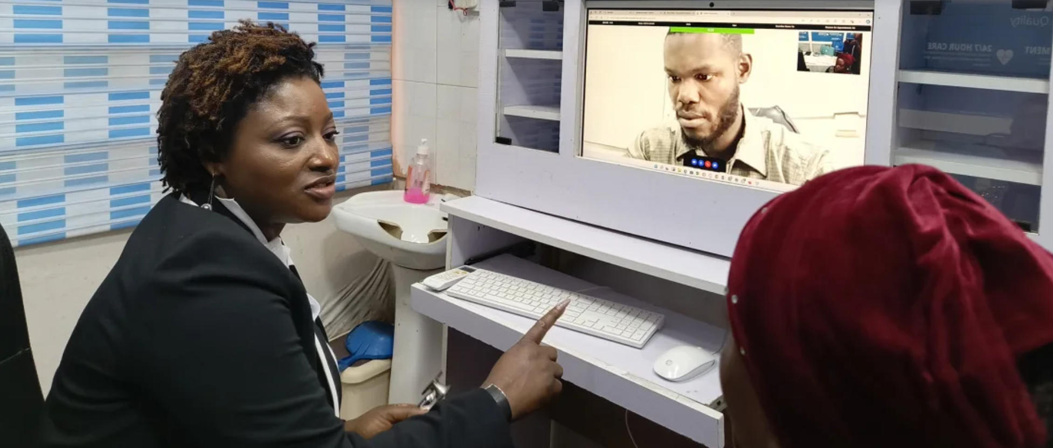
Nigeria
As a child growing up in northern Nigeria, Dr. Funmi Adewara experienced a severe hand injury that required multiple surgeries and frequent hospital visits. These visits exposed her to the harsh realities of the country’s healthcare system. “I remember sitting in overcrowded waiting rooms, watching doctors stretched thin, unable to meet the needs of so many patients,” Adewara recalls..
Located primarily in _________, these clinics are accessible to patients through various subscription plans, and are often financed through partnerships with global donor organizations and private donors.
“I knew early on that healthcare wasn’t a privilege — it was a necessity, and I wanted to be part of changing the system,” she explains.
In
World
News
Mobihealth is driving a telemedicine revolution in Africa
Adewara worked for 15 years in the UK’s National Health Service before founding the telemedicine platform Mobihealth in 2017.

Slide 4


Today’s Lens: Global Health in Between Shades of Gray

Slide 5
Global Health Lens - Essential Questions
What are the public health impacts of war on soldiers and refugees in regions of conflict?
How can disease emerging in war zones have a global health impact?
How can we raise awareness about the potential for a global health crisis resulting from disease borne out of war and conflict?

Slide 6
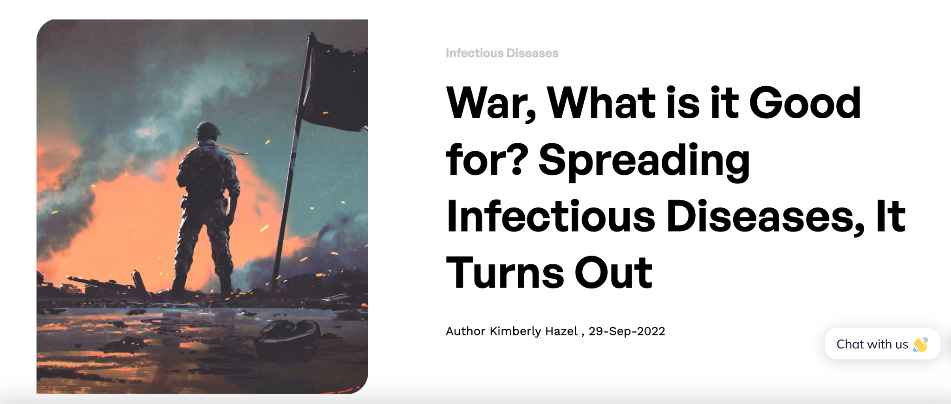

Health Impacts of War, Deportation, and Work Camps
Infectious diseases have played a role in some of the most significant wars in history. Some historians and infectious disease specialists refer to infectious diseases as the “third army” of any war. Poor living conditions, increased stress levels, and close quarters all contribute to the spread of disease.
Notes:
https://www.gideononline.com/blogs/infectious-diseases-in-war/

Slide 7

Health Impacts of Deportation and Work Camps
What key plot events highlight the negative health impacts of deportation and work camps?
Section 2: Maps and Snakes

Slide 8
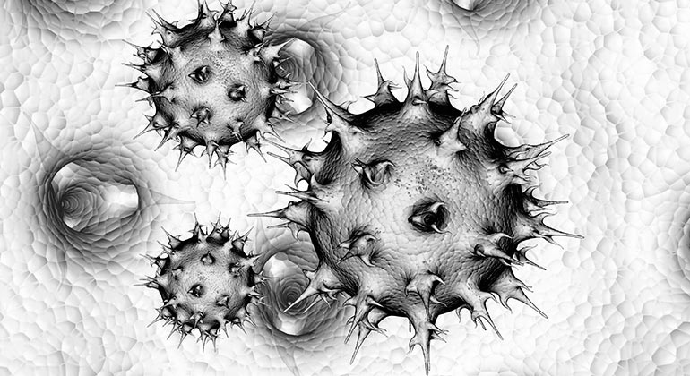
Infectious Diseases in Conflict Zones
As a table:
Record infectious and non-infectious diseases you believe are most common during wars, conflicts, and in refugee camps. Come up with a longlist.
Choose one that you are most confident will appear on a global health expert’s list of seven “most commonly spread during war.”
Notes:
Follow up questions:
Which are likely to spread outside the conflict zones?
Why do you think so?
How might they spread?
Who is impacted? Who is MOST impacted?

Slide 9
Health Impacts of Deportation and Work Camps
What Diseases are Most Commonly Spread During War?
Several diseases are commonly spread during wartimes. Here are some of the most common diseases spread during wars:
Cholera: a waterborne bacterial infection that causes severe diarrhea and dehydration.
Dysentery: an intestinal infection caused by bacteria or parasites. It causes severe diarrhea and can be fatal if untreated.
Malaria: a mosquito-borne parasitic infection that causes fever, chills, and flu-like symptoms.
Pneumonia: a serious lung infection caused by bacteria, viruses, or fungi. Symptoms include coughing, chest pain, shortness of breath, rapid breathing, and sweating.
Tuberculosis: a bacterial infection that affects the lungs and can lead to death if left untreated. Symptoms include coughing blood, weakness, weight loss, fever, and night sweats.
Typhoid Fever: an illness caused by a bacteria called Salmonella typhi with Symptoms that include high fever, fatigue, headache, stomach pain, and loss of appetite.
Dengue Fever: a virus that causes high fever, headache, pain behind the eyes, muscle and joint pain, rash, and bleeding gums.
- Kimberly Hazel, Global Health Professional, GIDEON blog entry
Notes:
https://www.gideononline.com/blogs/infectious-diseases-in-war/
https://www.reddit.com/r/MapPorn/comments/9upcyq/map_of_3_deadly_diseases_their_origins_and/

Slide 10
Disease in Between Shades of Gray + Global Impact
Which disease does Sepetys depict in Chapters 48-50?
(pp192-3)
What other symptoms/diseases do you predict may appear?
Step Outside the Story…
Do those outside of this conflict zone or camp need to be concerned about disease spread? Why or why not?
What about today? Should we worry about infectious diseases in conflict zones becoming global health threat?
Notes:
“What is it?” I asked, kneeling beside her.
“I don’t know.” She pulled up Jonas’s pant let. His shin was convered in spots. “It may be some sort of infection. He has a fever,” she said.
“Did you notice how irritable and tired he has become?”
“Honestly, no. We’re all irritable and tired,” I said. I looked at Jonas. How could I not have noticed? Sores lined his bottom lip, and his gums looked purple. Red sports dotted his hands and fingers.”
The bald man arrived. He loomed over Jonas. “Is it contagious
Who is impacted? Who is MOST impacted?
LATER: Chp 78-80 - 78- Fever, rash, delirium. Mother;s illness.

Slide 11
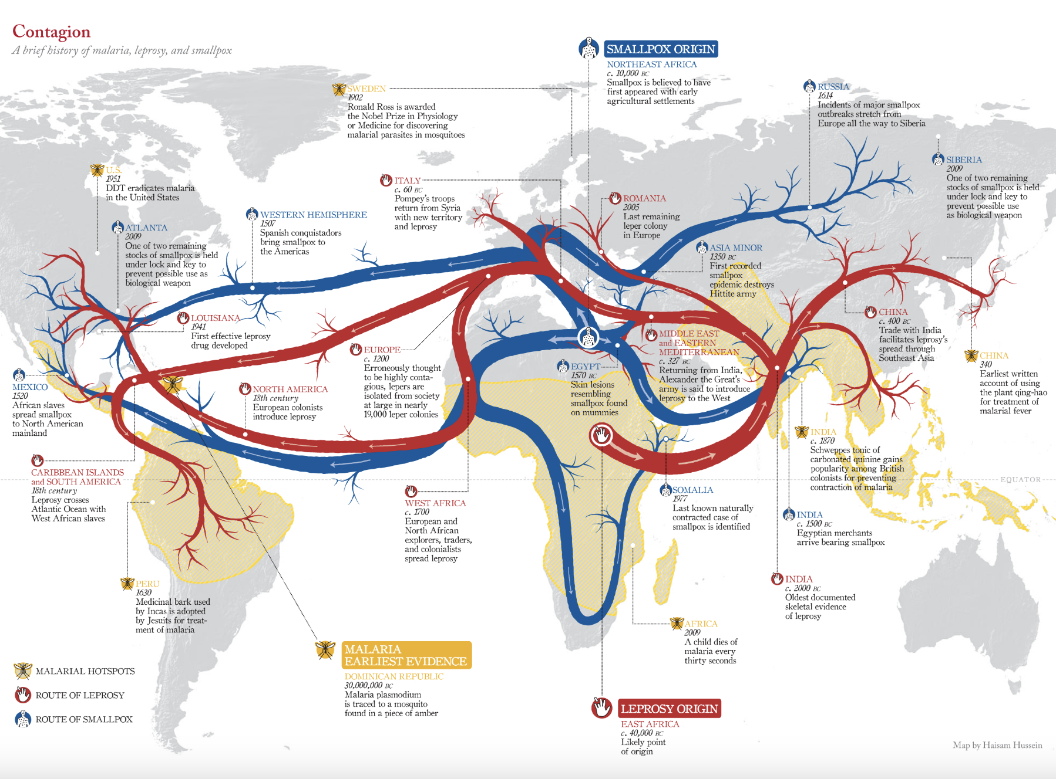
Geography of Infectious Diseases & Spread
From Lapham’s Quarterly
Map by Haisam Hussein
Notes:
https://www.laphamsquarterly.org/sites/default/files/images/maps/08_medicine.png
https://www.haisam.com/
https://pmc.ncbi.nlm.nih.gov/articles/PMC7152081/
(maybe blank out labels?)
https://www.reddit.com/r/MapPorn/comments/9upcyq/map_of_3_deadly_diseases_their_origins_and/
https://www.gideononline.com/blogs/infectious-diseases-in-war/

Slide 12
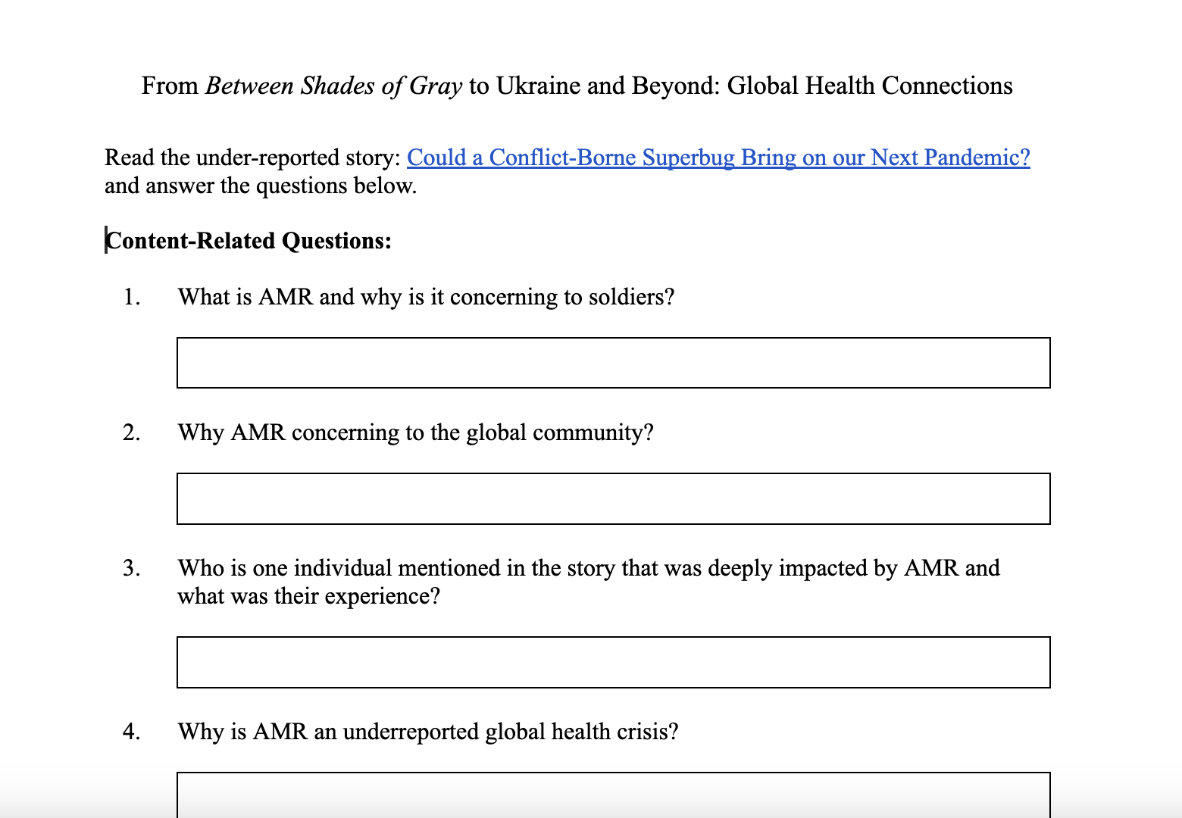
Connecting Between Shades of Gray and Global Health Issues
Read the under-reported story: Could a Conflict-Borne Superbug Bring on our Next Pandemic? and answer the questions posted in Schoology..
Notes:
Handout: https://docs.google.com/document/d/1ybwSeeZiAjF_MIf-H5t3Te8S8hq6l7EBdcdDsNyO594/edit?tab=t.0

Slide 13
Processing /Thinking Critically - Pulitzer Center Story
What connections can you draw between this story and personal experience or previous knowledge? How is this story connected to specific texts you have read?
What concepts will you take away from this story?
What challenges or concerns emerge for you as you reflect on this story?
How has your thinking or worldview changed after reading the story?
Continue / Discuss Tomorrow!

Slide 14
Homework
Finish and submit your questions on the Pulitzer Center’s under-reported story: Could a Conflict-Borne Superbug Bring on our Next Pandemic?

