Slide 1
What is a podcast anyway?

Slide 2
A digital audio file made available for downloading on the computer and mobile devices

Slide 3
Why are Podcast Important????
Write your reply here:

Slide 4
Your PBL project topic is the topic you will discuss on your podcast...
What is your topic? Write it here with your

Slide 5
Meagon- My topic is air pollution.

Slide 6
Now that you know your topic. It is time to pick a platform
https://anchor.fm/
https://www.buzzsprout.com/?referrer_id=219855
https://transistor.fm/?via=adam

Slide 7
Planning Prompts to Answer
1). What is your topic about?
2). What is your topic not about?
3). How will you make the topic interesting to the listeners?
4). What is the purpose and goal of your podcast?
5). Who will you interview?
6). Write a script.

Slide 8
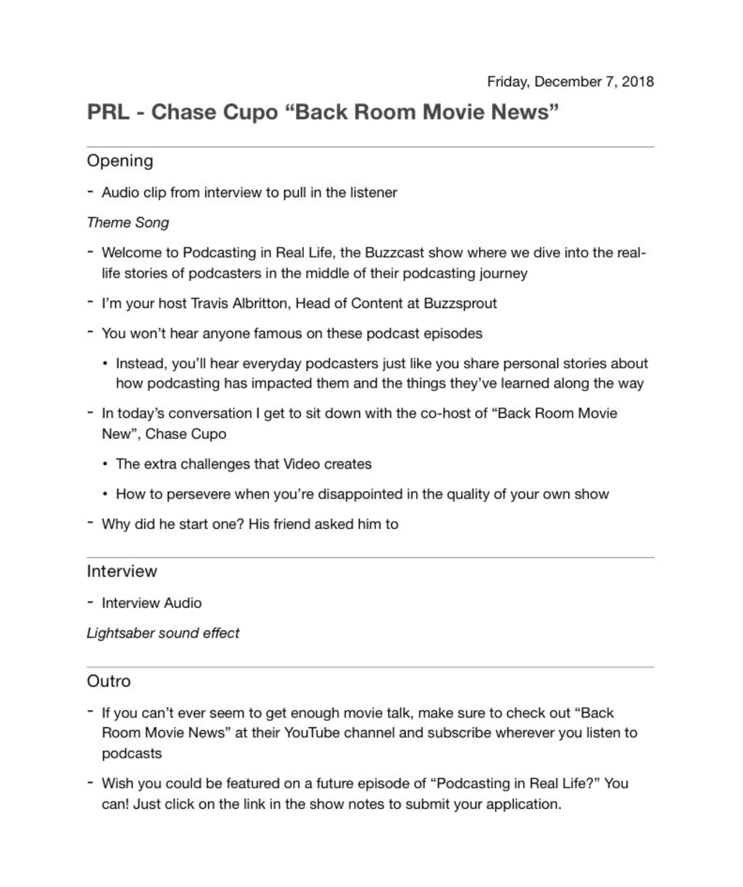
Script

