Slide 1
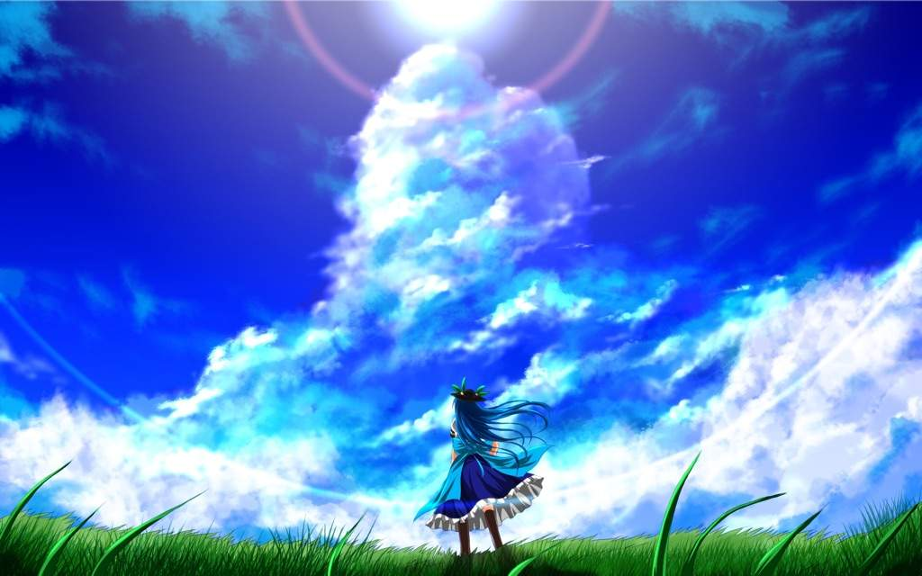
RPG
Echoes of Nature: Quest for Environmental Justice
Play
More(Beta)
Credit
Quit

Slide 2
Select Your Character
->

Slide 3
Creator: Timothy Tran
Credit: Danganronpa, Genshin impact, Himura Kenshin, Rpg game maker, Touhou
<-

Slide 4
Coming Soon
<-

Slide 5
NAH AH
<-

Slide 6

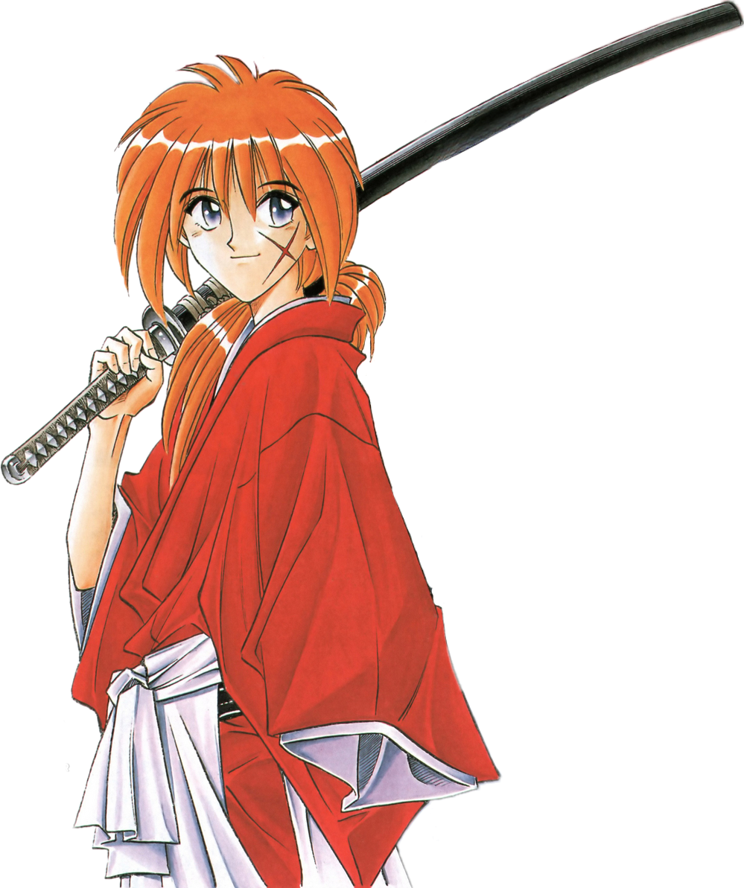
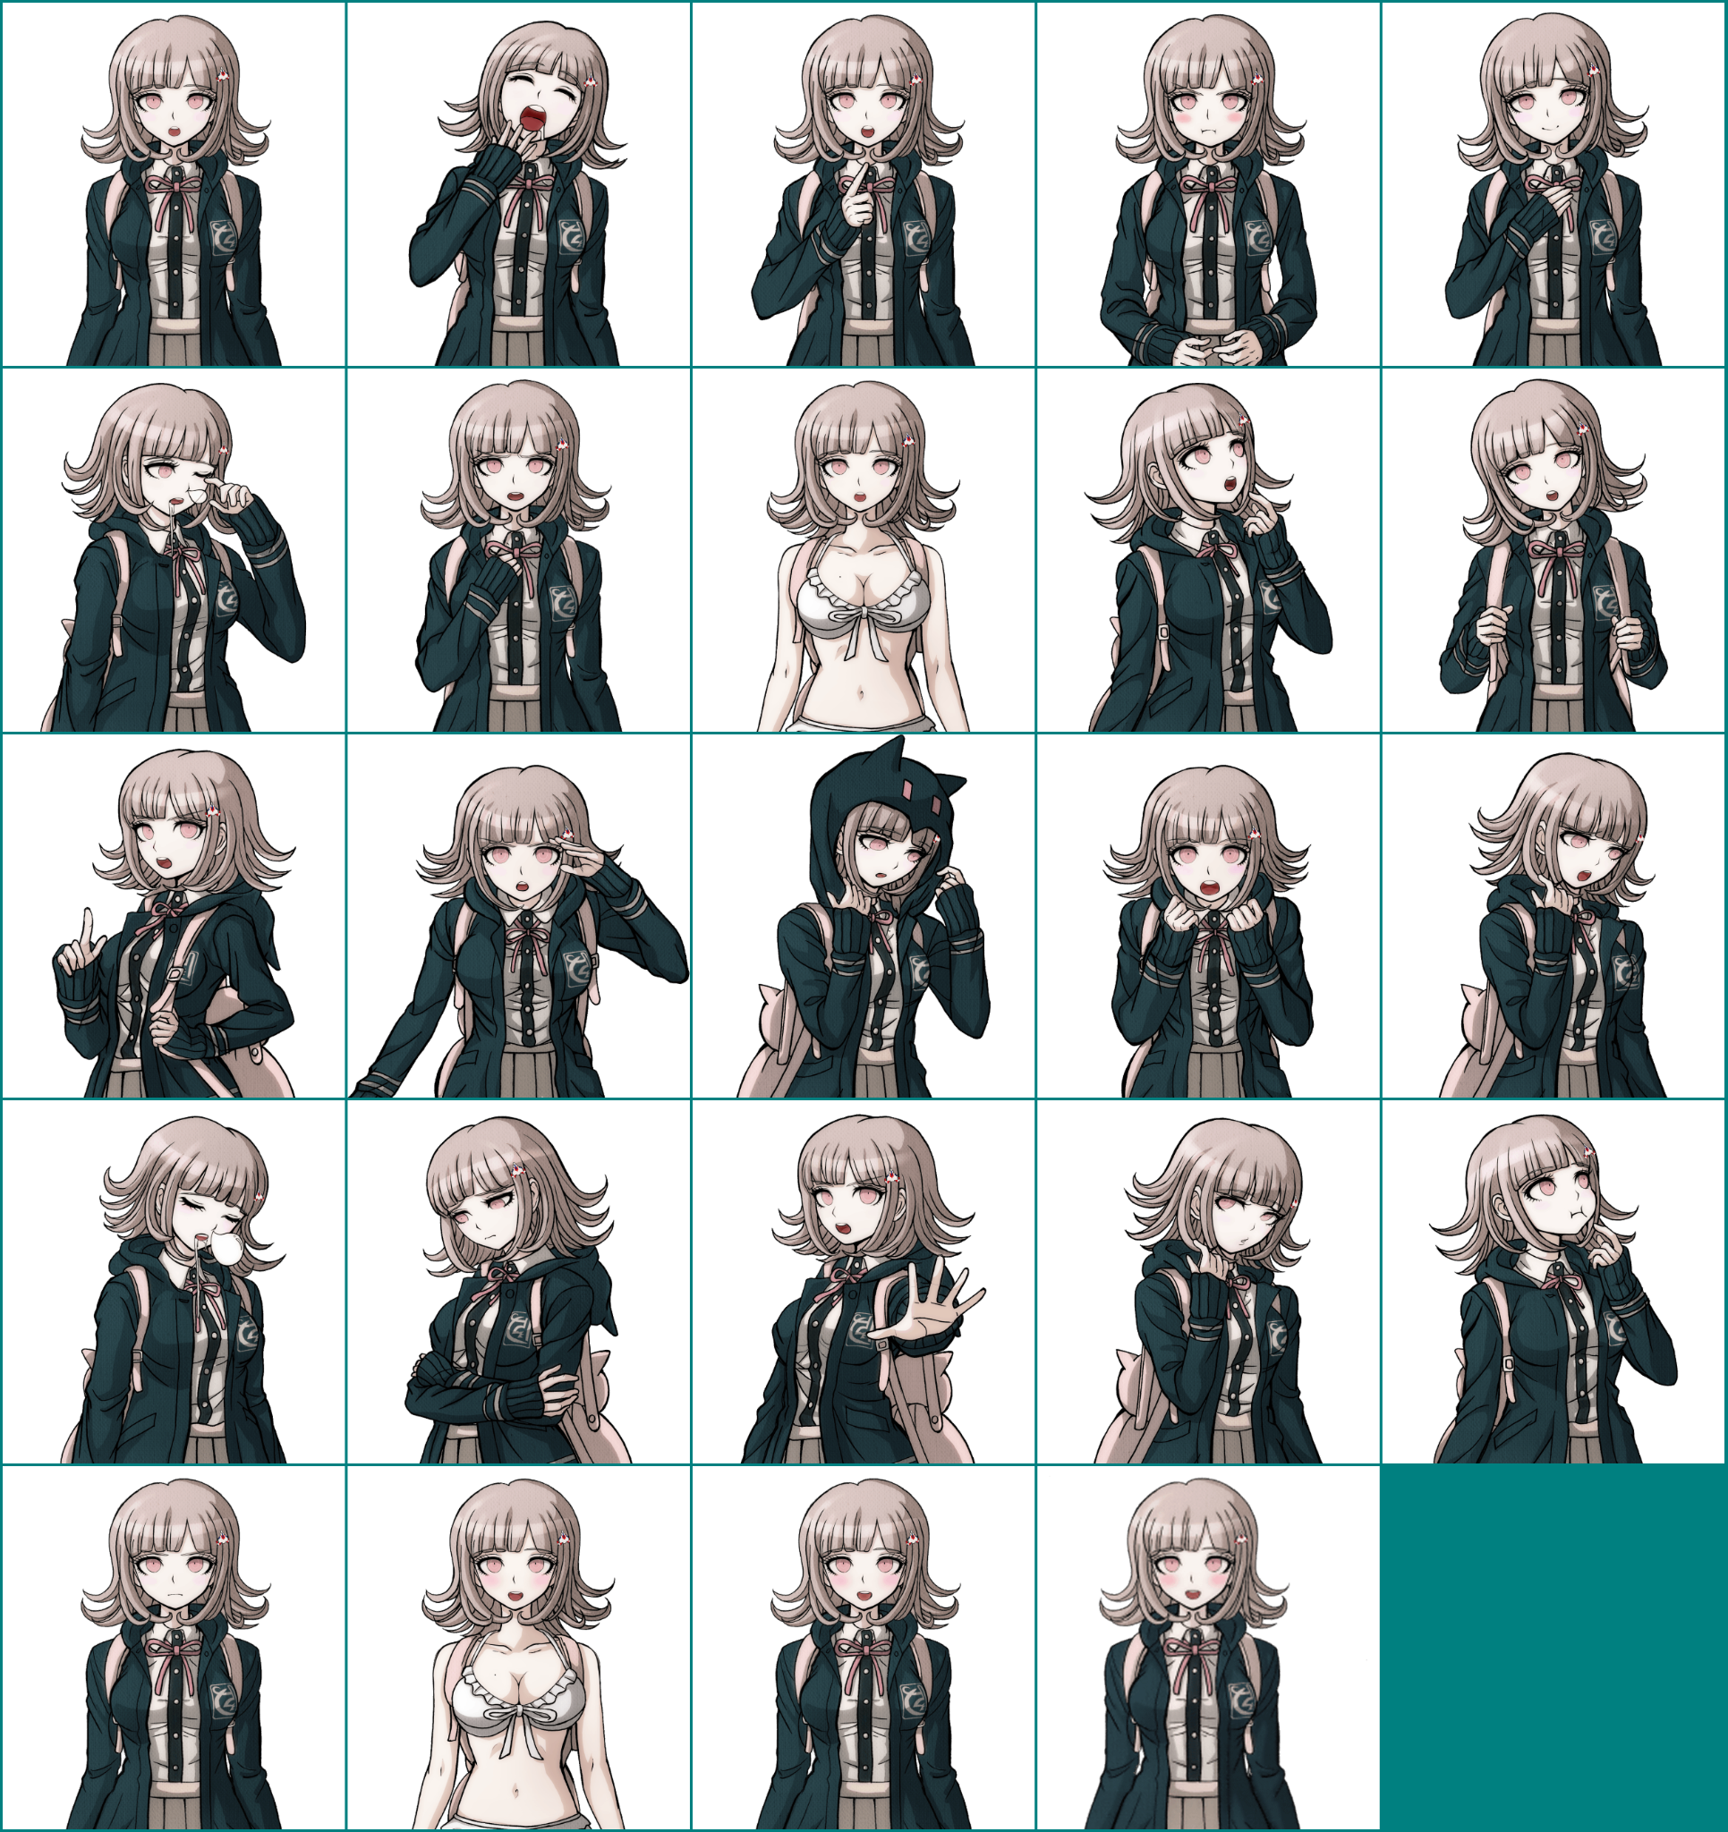


Slide 7
Profile:
Age: 17-18
School: Hope Peak High Academy
Description
A calm and quiet individual. Though being asocial, she’ll eventually opens up and becomes more talkative when discussing games. Quite analytical and enjoys learning new things, leading her to ask questions often.
Continue
Back
Quit

Slide 8
One afternoon, through the waste land and rundown place of many old homes, rusted stands, and much more. The traveler came by to check out for their research. However, this traveler is different from amongst the others. Known as the best tactician and analyzer of the best, the genius traveler.
Next

Slide 9
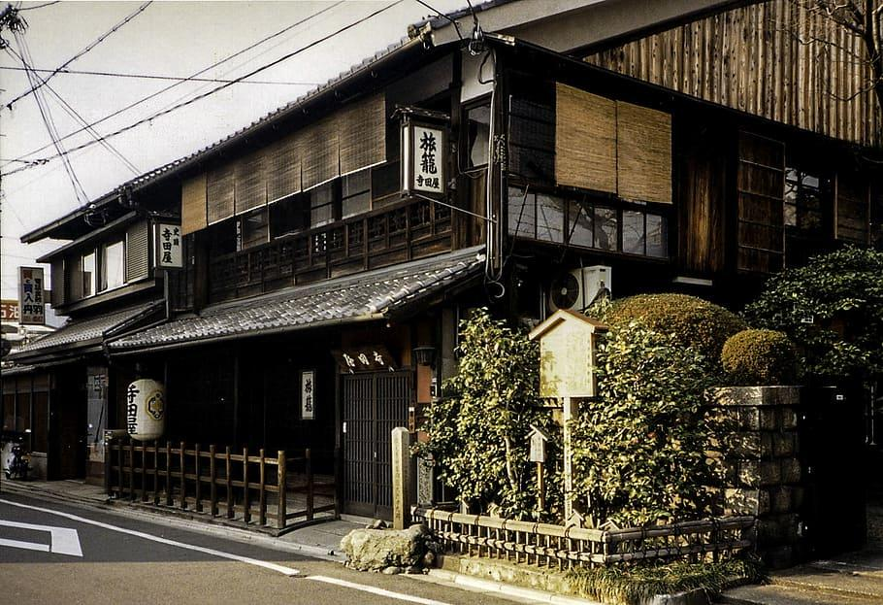
.
Chiaki
Oh wow. This place seem quite deteriorated, though it still looks alright and stable a little. Let’s check around.
Next

Slide 10
.
Chiaki
Before we travel, let’s check our map to see what location are available to seek.
Next

Slide 11
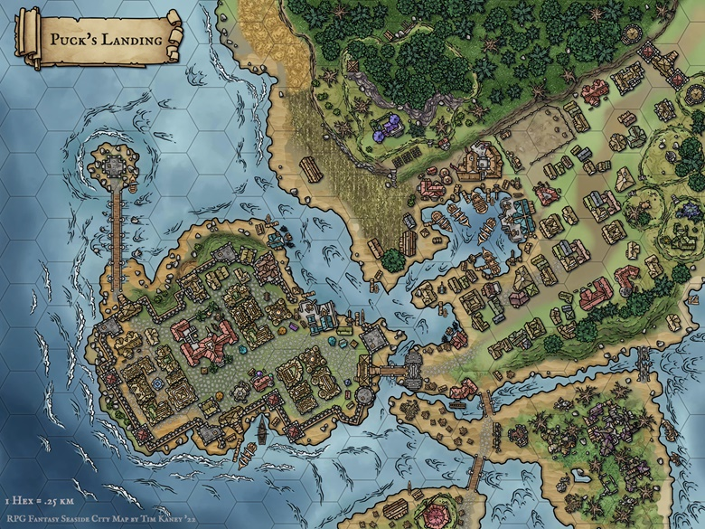

???
.
Here
???
Next

Slide 12
???
.
Here
Chiaki
Whoo.. there isn’t much to arrive to. But this still checks out on places that are critical.
???
Next

Slide 13
???
.
Here
Chiaki
Where should I go?
???
Next

Slide 14
???
.
Here
Chiaki
Where should I go?
???
Next

Slide 15
???
.
Here
Chiaki
Where should I go?
???
Next

Slide 16

???
.
Here
???
Next

Slide 17
???
.
Here
???

Slide 18
???
.
Here
Chiaki
Seem like that’s all I’ve encountered. Let’s head back to the Academy.
???
Next

Slide 19
After the encounter, you went back to the Academy shortly after to report back about the experience. What you heard from the teacher wasn’t as you were expecting from just a praise & the pat on the back after returning.
.
Next

Slide 20
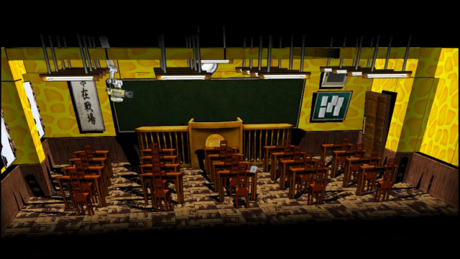
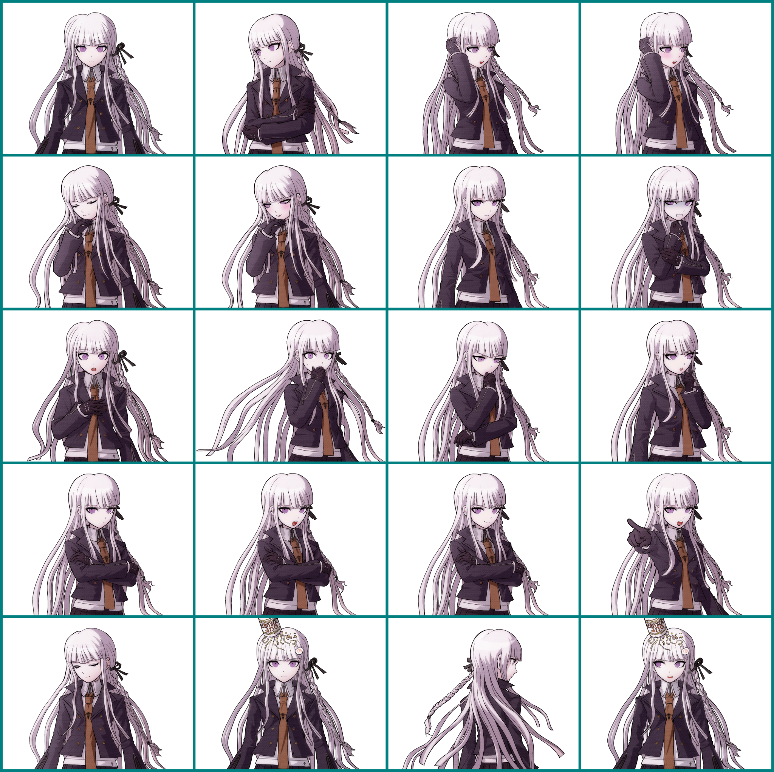
.
Ms. Kirigiri
To conclude this, the future missions for environmental justice will get difficult from here on out. However we managed to capture a lead in our goal. Continue to do well for the school Ms. Chiaki. I’ll make sure to supply-
Next

Slide 21
.
Ms. Kirigiri
Chiaki..
Next

Slide 22
.
Chiaki
…
Next

Slide 23
.
Ms. Kirigiri
Chiaki! Wake up this instant!
Next

Slide 24
.
Chiaki
H-huh, yeah! I was listening!
Next

Slide 25
.
Ms. Kirigiri
Right.. You were really listening Chiaki…
Next

Slide 26
.
Ms. Kirigiri
But I’ll let you off the hook this once since you did perform well on your trip. However, for sleeping and being rude as I was talking. You’ll have to write a 5 page essay of an apology
Next

Slide 27
.
Chiaki
W-wait teacher! You can’t be serious right!?
Next

Slide 28
.
Ms. Kirigiri
…
Next

Slide 29
.
Chiaki
Awwww come on teach! Say something!!
Next

Slide 30
The End
Go Back

Slide 31
???
.
Here
???

Slide 32
???
.
Here
???

Slide 33
Upon settling to the place, the traveler would take a look around their surroundings that was once a healthy and safe environment. Taking many pictures with her camera in gathering evidence to report back to her club that she participated in back at her Academy.
Back
Next
Next

Slide 34
Arriving to the next destination, the valley seemed more better. A more collective and cleaner place. Although the valley was a bit misty since it was high up on the mountains- with some property across the ground as if there was a rush in evacuation. You’re still confused on how such a place could be dethroned. Making a move, you decided to check around the valley of the area.
Back
Next
Next

Slide 35
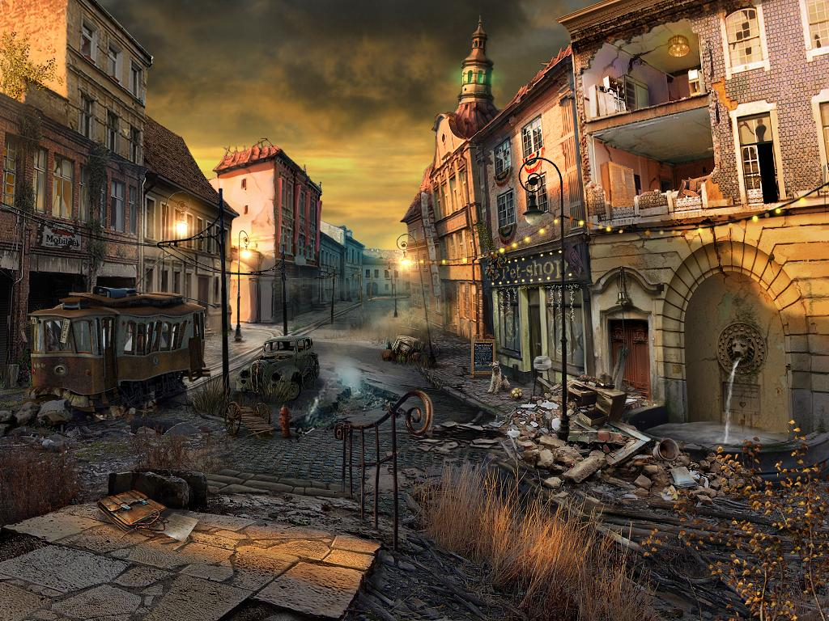
.
Chiaki
Woah! This place is truly a hazard. Just what has happened here.
Next
Next

Slide 36
.
Chiaki
Let’s go and see what can be stopped in fixing this area to the way it used to be. The healthy and nice environment for those who lived here
Next
Next

Slide 37
Walking along the place, cleaning the small huddle city. A strange figure came by. Hungry with the eyes of survival-use of force against our dear researcher. However, our researcher didn’t come without being prepared herself. In this case, the next will come.
Next

Slide 38
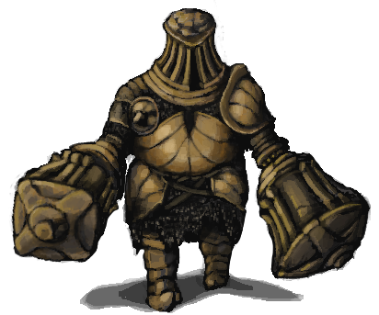
.
???
…
Next
Next

Slide 39
.
Chiaki
Oh my! What is that thing!? It’s not some sort of organism that you’ll likely see on earth.. As if it’s a horror game monster.
Next
Next

Slide 40
.
Chiaki
Let’s see what I should do to even get rid of this thing..
Next
Next

Slide 41
.
Attack
Skill
What Will you like to do?
Item
Run
Next

Slide 42
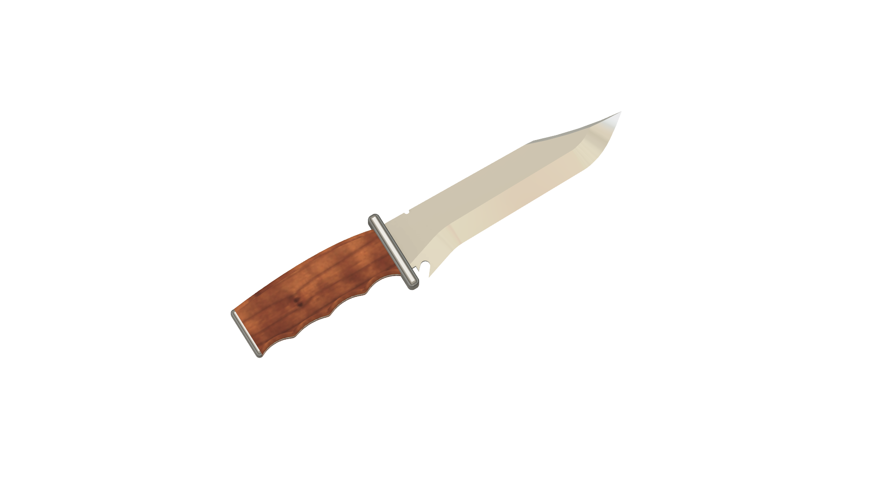


.
Item
Back
Next

Slide 43
.
Attack
Skill
What Will you like to do?
Run
Next

Slide 44
.
Attack
Skill
What Will you like to do?
Run
Next

Slide 45
.
Attack
Skill
What Will you like to do?
Run
Next

Slide 46
You chose to use your knife skills at the unknown entity. To no avail, it broke making contact a couple of time because of it’s hard shell like almost as if the skin is armour itself. The entity raised its boulderly arms and crushes you. Leading to your death.
You Died
Restart
Quit

Slide 47
You chose to use your knife skills at the unknown entity. To no avail, it broke making contact a couple of time because of it’s hard shell like almost as if the skin is armour itself. The entity raised its boulderly arms and crushes you. Leading to your death.
You Died
Restart
Quit

Slide 48
Since the entity was large with many spots that are possible to tie around. Along with the incredible game analyzation you have, you utilize your agility and technique to trap the creature. You manage to tightly trap the entity and it works. You survive
You Survive
Continue
Quit
Restart

Slide 49
Since the entity was large with many spots that are possible to tie around. Along with the incredible game analyzation you have, you utilize your agility and technique to trap the creature. You manage to tightly trap the entity and it works. You survive
You Survive
Continue
Quit
Restart

Slide 50
You chose to use the weapon for range. Good choice but as the bullet cross path with the unknown entity, the entity felt the pain. Sadly enough it didn’t pierce the entity only to enrage it even more. Gruesomely ending you.
You Died
Restart
Quit

Slide 51
You chose to use the weapon for range. Good choice but as the bullet cross path with the unknown entity, the entity felt the pain. Sadly enough it didn’t pierce the entity only to enrage it even more. Gruesomely ending you.
You Died
Restart
Quit

Slide 52
You chose to use the weapon for range including your skill. With swift analyzing and weak points to the monster you manage to impact damage against it, wearing the entity down. You survive
You Survive
Continue
Quit
Restart

Slide 53
You chose to use the weapon for range including your skill. With swift analyzing and weak points to the monster you manage to impact damage against it, wearing the entity down. You survive
You Survive
Continue
Quit
Restart

Slide 54
You chose to use your knife skills at the unknown entity. To no avail, it broke making contact a couple of time because of it’s hard shell like almost as if the skin is armour itself. The entity raised its boulderly arms and crushes you. Leading to your death.
You Died
Restart
Quit

Slide 55
You chose to run as far and fast you can. With each step through the unwavered and quiet valley, the lost of stamina & draining sweats flourishing down, loud & heavy stomps were heard closer & closer. The sound of it reaching to the destination. Ended of the result of death as the unknown creature caught you.
You Died
Restart
Quit

Slide 56
You chose to ran as far and fast you can. With each step through the unwavered and quiet valley, the lost of stamina & draining sweat flourishing and ran down. It appeared to be strange,no stomps, no trembles through the granite floor, by far you stopped. To check behind you, your eyes widen in fear as the entity was just right there before you. Without letting a sound, you disappeared
You Died
Restart
Quit

Slide 57
…It did nothing, you died…
You Died
Restart
Quit

Slide 58
…It did nothing, you died…
You Died
Restart
Quit

Slide 59
You chose to attack the unknown creature. Without thinking, you decided to use your bear hands to attack the entity. To no avail, the entity raised its boulderly arms and crushes you. Leading to your death.
You Died
Restart
Quit

Slide 60
You chose to attack the unknown creature. Without thinking, you decided to use your bear hands to attack the entity. To no avail, the entity latches on and crushes you. Leading to your death.
You Died
Restart
Quit

Slide 61
.
Chiaki
Woah… That was really scary. Could this be the reason for this place to be so deserted… Luckily there was only one roaming around. I hope there isn’t any more.
Next
Next

Slide 62
.
Chiaki
Since this is finished let’s go check our map shall we.
Next
Next

Slide 63
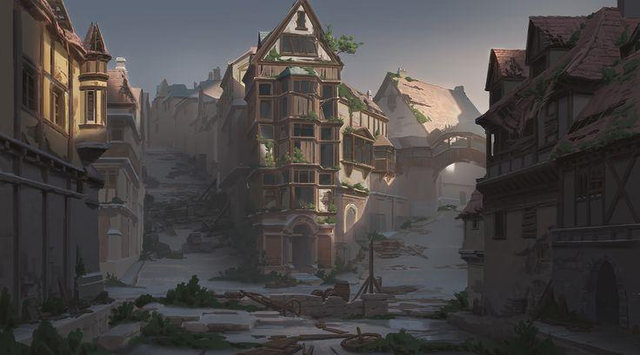
.
Chiaki
WAH! This place is just as wasted as the last one. I hope there isn’t any creature like before
Next
Next

Slide 64
.
Chiaki
I know the rules. Gotta find out the cause of this place to be in abandonment as it is.
Next
Next

Slide 65
As you still strolled along the valley. From afar of the foggy mist, there - stand an entity. As it seemed to close the distance, the entity looked different. This entity looked rather slimmer and its skin appeared thin. The shed of different skin was different from the last you encountered, the presence was still a hassle to deal with. Even than, you were prepared as ever, being the best tactician and analyzer you are.
Next

Slide 66
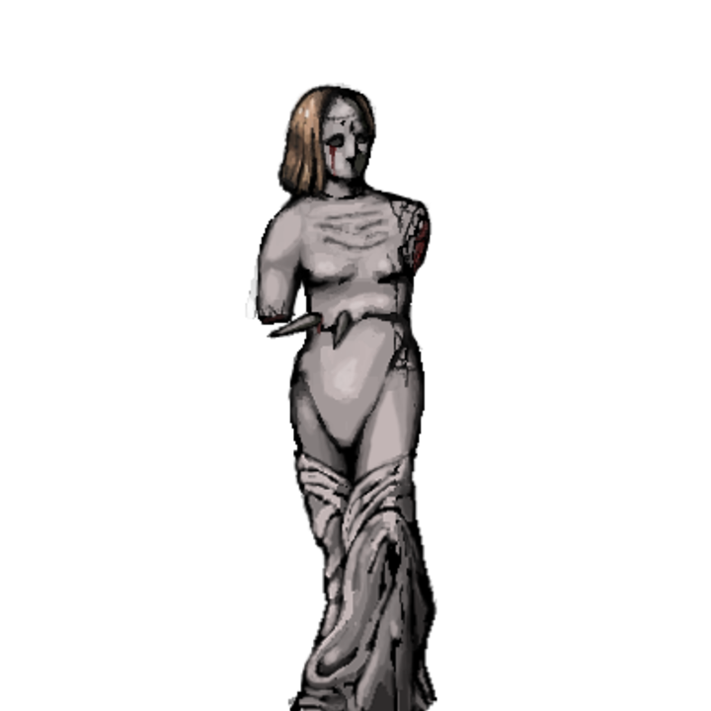
.
???
…
Next

Slide 67
.
Chiaki
Oh come on! Why is there another one? This better not be some sort of simulated horror game or dream that I was up all night playing…
Next

Slide 68
.
Chiaki
Let’s see how I should defeat this level!
Next

Slide 69
.
Attack
Skill
What Will you like to do?
Item
Run

Slide 70
.
Attack
Skill
What Will you like to do?
Run

Slide 71
.
Attack
Skill
What Will you like to do?
Run

Slide 72
.
Attack
Skill
What Will you like to do?
Run

Slide 73
.
Item
Back

Slide 74
.
Chiaki
Woah… That was really scary. Could this be the reason for this place to be so deserted… Luckily there was only one roaming around. I hope there isn’t any more.
Next

Slide 75
.
Chiaki
Since this is finished let’s go check our map shall we.
Next

