Slide 1















Write-Empower
Persausive Writing
World Literature

Slide 2
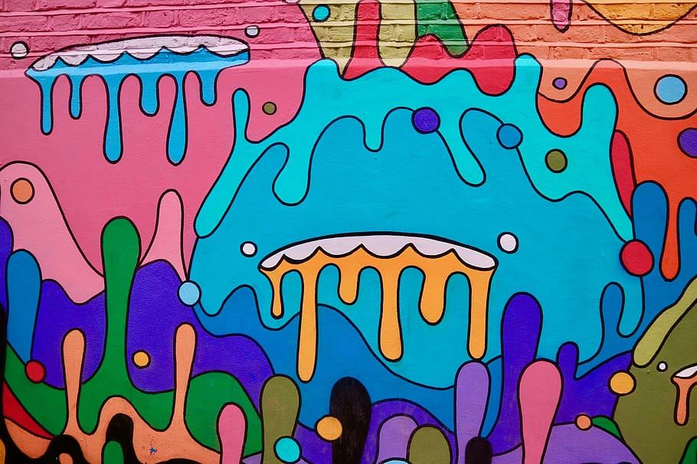
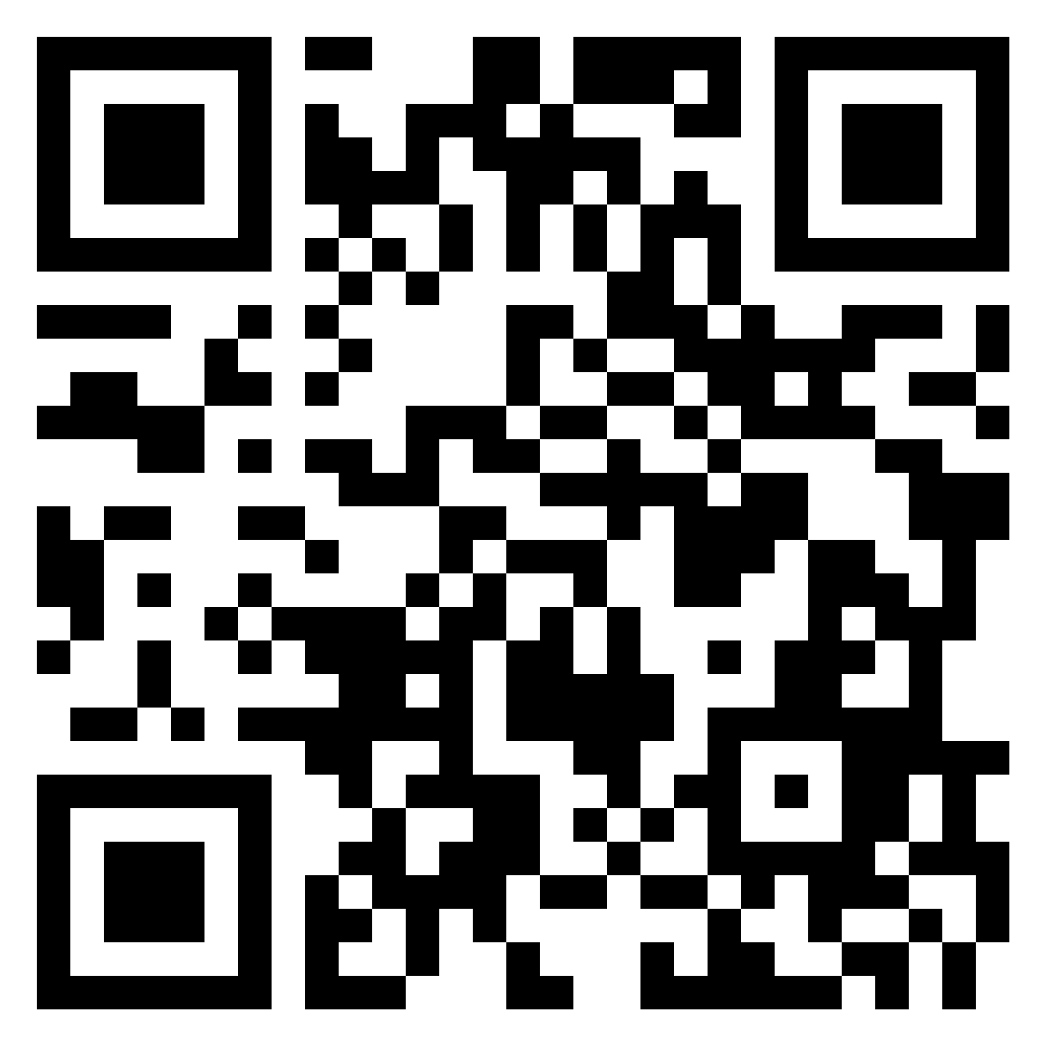

What do you know about the topic? Go to the padlet link
5 minutes to COMPLETE
SCAN QR CODE
Environmental Injustices

Slide 3
Lesson Focus
ESSENTIAL QUESTIONs:
How can we analyze and use multi-disciplinary information to create a persuasive advocacy campaign in support of eradicating environmental injustices and negative impacts experienced by marginalized groups of people during natural disasters.
Content Specific Essential Question: How do we utilize multiple resources including personal testimony to enhance persuasive writing and support arguments?
Standards: E
ELAGSE9-10RI1:
Cite strong and thorough textual evidence to support analysis.
ELAGSE9-10RI4:
Determine the meaning of words and phrases as they are used within the text, including figurative, connotative, and technical meanings; analyze the cumulative impact of specific word choices on meaning and tone ( how the language of a court opinion differs from that of a newspaper).

Slide 4






Unit Vocabulary
Daily Workout Section
Disproportionate Impact (of minority populations)
Environmental Justice
Fair Treatment
Meaningful Involvement
Climate resilience
Colonialism
Environmental Racism
Equity
Intersectionality
Neocolonialism
Systemic racism
White supremacy
Instructions: Get into groups of four and
Define each word in three ways!
Definition from a dictionary
Put it in your own words
Find an image to represent the word!

Slide 5
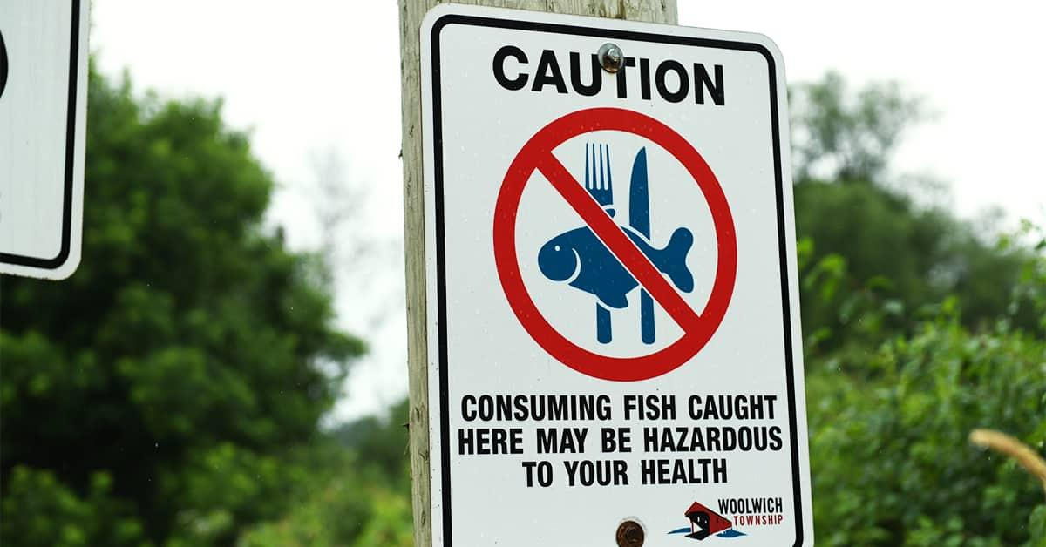
Unit Vocabulary
Reflect
Disproportionate Impact (of minority populations)
Definition: Refers to communities of low income and/or color and in the presence of high-risk environmental hazards.
Those communities in the presence of environmental and human health hazards are more at risk of developing chronic health problems or experiencing environmental racism due to their surroundings than other parts of the country.

Slide 6
Unit Vocabulary
Reflect
Environmental Justice
Definition: Environmental Justice is the fair treatment and meaningful involvement of all people regardless of race, color, culture, national origin, income, and educational levels with respect to the development, implementation, and enforcement of protective environmental laws, regulations, and policies.
Acronym: EJ

Slide 7
Unit Vocabulary
Reflect
Fair Treatment
Definition: Fair treatment, in regards to EJ, means, no person or group should bear a greater share of negative environmental impacts that result from environmental programs.

Slide 8
Unit Vocabulary
Reflect
Meaningful Involvement
Definition: The National Environmental Justice Advisory Council (NEJAC) suggestions for public involvement include: (1) Encourage public participation in all aspects of environmental decision making. (2) Encourage active community participation. (3) Institutionalize public participation. (4) Recognize community knowledge. (5) Utilize cross-cultural formats and exchanges.

Slide 9
Unit Vocabulary
Reflect
Climate resilience
The climate crisis hits some communities harder than others. The worst affected are often people of colour and those in the global South. Climate justice movements recognise the unequal effects of the climate crisis. And that any solutions must address it. In a climate justice approach, decisions on what action looks like must include those most affected.
Climate justice focuses on climate issues. It sits under the broader term of environmental justice.

Slide 10
Unit Vocabulary
Reflect
Colonialism
The process of taking political and economic control over an area, people or country. Colonisers do this by defeating people or a country, then ruling them in a way that gives them no freedom. They may use force, such as from an army.
Usually, the dominant country will exploit a colonised country. They’ll introduce settlers and force their own cultural values on its people. This often involved slavery, indentured or forced labour, and the extraction of natural resources.

Slide 11
Unit Vocabulary
Reflect
Colonialism
The process of taking political and economic control over an area, people or country. Colonisers do this by defeating people or a country, then ruling them in a way that gives them no freedom. They may use force, such as from an army.
Usually, the dominant country will exploit a colonised country. They’ll introduce settlers and force their own cultural values on its people. This often involved slavery, indentured or forced labour, and the extraction of natural resources.

Slide 12
Unit Vocabulary
Reflect
Neo- Colonialism
Colonialism is the direct control over a group of people or area. Neocolonialism involves indirect control. It allows a country with strong political power and influence to indirectly control an area or group of people.

Slide 13
Unit Vocabulary
Reflect
Systemic racism
Social structures that combine to harm people of colour, in ways not experienced by their white counterparts. This means society’s laws, practices, customs and beliefs set up racial hierarchies. These impact where people of colour stand in a social and economic order. For example, access to health care, housing, education, clean air, water and employment.

Slide 14
Unit Vocabulary
Environmental racism
Describes how environmental problems unfairly affect people of colour. Usually because of policies and practices that harm their health and the places they live, and leave them out of decision-making.
Civil rights leader, Benjamin Chavis coined the term in 1982. He included examples like:
placing toxic waste sites next to communities of colour
allowing harmful poisons and pollution into the air, water or food of communities of colour.
Reflect

Slide 15
Unit Vocabulary
Intersectionality
How someone’s different characteristics “intersect” with one another and overlap. These include race, class, age, gender, disability, sexual orientation and more. Intersectionality is also about inclusion in feminist and liberation movements.
American scholar and civil rights advocate Kimberlé Crenshaw introduced the term in two essays published in 1989 and 1991. She describes how Black women exist at an intersection of identity, facing oppression as women and black people. However, ideas of intersectionality have existed within feminism for a long time. For example, it is present in Sojourner Truth’s Ain’t I a Woman? speech in 1851.
Reflect

Slide 16

Activity Time !!!
Instructions: If you agree move to the side of the room that has Yes on the wall. If you disagree move to the side of the room that has No written on the wall. Be honest and have two reasons to support your decision.

Slide 17
Activity Time !!!
Everyone should have access to clean water.

Slide 18
Activity Time !!!
Everyone should access to organically grown fruits and vegetables

Slide 19
Activity Time !!!
Is it okay to discard toxic waste in communities.

Slide 20
Activity Time !!!
It is okay to build plant that emit toxic fumes into the air in communities.

Slide 21
Activity Time !!!
It is okay to use toxic fertilizers that cause cancer to grow food and reap a maximum profit .

Slide 22
Activity Time !!!
It is okay to deny federal funding for natives living on reservations when their homes are destroyed because of a natural disasater?

Slide 23

Unit Introduction
Goal: To cultivate your persuasive writing, speaking and media skills while learning about environmental injustices and how to be informed and equipped with the skills to use your voice to make meaningful change within the community.
Tasks: Performance Task
A Choice Board of assessments to choose from…
Podcast
Website Design
Graphic Novel
Social Media Campaign
Argumentative Essay
Photo Gallery

Slide 24
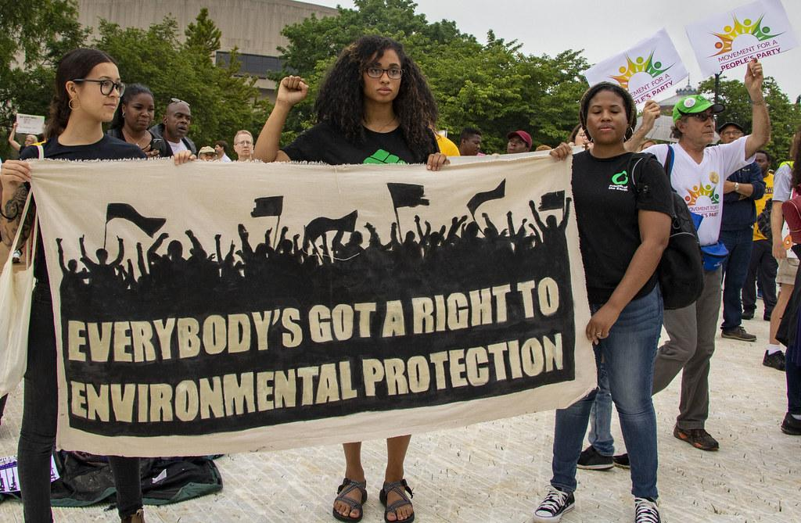
No Justice-No Peace:
Exploring how voices and art are used to build community and advocate against injustices.
CLICK IMAGE FOR VIDEO
After viewing the video: Prepare to discuss.
Fill out the music analysis graphic organizer as you are listening.
Click here for organizer
Song: What’s Going On? Artist: Marvin Gaye

Slide 25
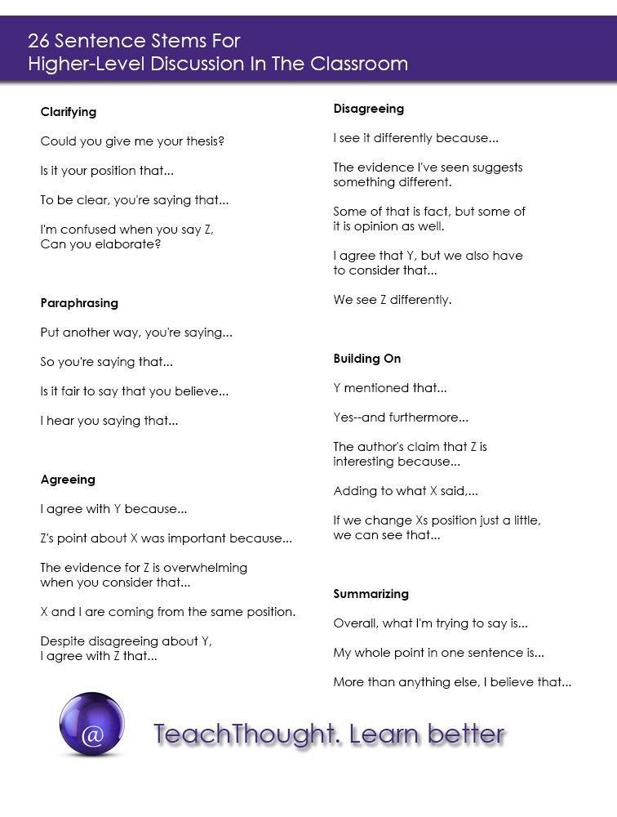
After viewing the video lets discuss!
What do you think?
How does this connect to our units theme?
How does this connect to your community?

Slide 26
Article Exploration
1st Read
Instructions: Pull out your annotation guide and follow along.
Article: Environmental Racism access on CANVAS
Close Reading Guide
1st Read Guiding Questions
What is it about? Who wrote it? Why did they write it?

Slide 27
Ticket out the Door Assessment
Imagine that you were tasked with explaining what you learned today by creating an advertisement flyer. What would you include? Create a flyer using canva.

Slide 28






Welcome Back
Education is the passport to the future, for tomorrow belongs to those who prepare for it today.
-Malcolm X
Read the quote and write a two paragraph reflection

Slide 29
Lesson Focus
ESSENTIAL QUESTIONs:
How can we analyze and use multi-disciplinary information to create a persuasive advocacy campaign in support of eradicating environmental injustices and negative impacts experienced by marginalized groups of people during natural disasters.
Content Specific Essential Question: How do we utilize multiple resources including personal testimony to enhance persuasive writing and support arguments?
Standards: E
ELAGSE9-10RI1:
Cite strong and thorough textual evidence to support analysis.
ELAGSE9-10RI4:
Determine the meaning of words and phrases as they are used within the text, including figurative, connotative, and technical meanings; analyze the cumulative impact of specific word choices on meaning and tone ( how the language of a court opinion differs from that of a newspaper).

Slide 30





Ballot or the Bullet
Analyze the speech and explain why the evidence helps or hinders the argument
You are amazing!!!!!

Slide 31
Thesis
Daily Workout
How would you setup your argumentative essay?
Write a THESIS statement for the essay topic listed below.
Should public k-12 schools be required to recycle?
Use the THESIS FORMULA: Topic+1 reason+2reasons=THESIS

Slide 32
‘Argumentative essay lesson links

Slide 33
Walk through an Argumentative Essay with me!
Click here..

