Slide 1
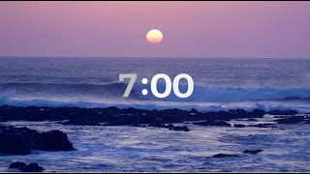
World Studies - Monday - Bell Ringer
Open up your computer and go to last Friday’s Current Events Assignment.
Join your color group.
Take turns doing the following:
Summarize your article
Discuss why you think it’s important for people to know about your topic
Answer any questions your teammates have
Choose a person to summarize your discussion for the class.

Slide 2

World Studies - Monday, 5/13/2024 - Bell Ringer
Respond to the following questions in your notebook:
What did we learn last week about Chicago’s sources of drinking water?
What questions do you still have about Chicago’s sources of drinking water?

Slide 3
How long are the pipes connecting Chicago pipes to Lake Michigan?
Are there any lead pipes in Chicago?
Where can I learn more about Chicago's history of water problems?
How long does it take to purify Lake Michigan water?
What if we only had the Chicago River and not Lake Michigan?
Why is there so much waste in the river?
How exactly is water purified?

Slide 4
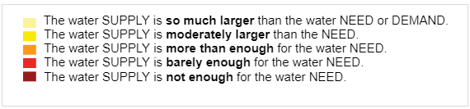
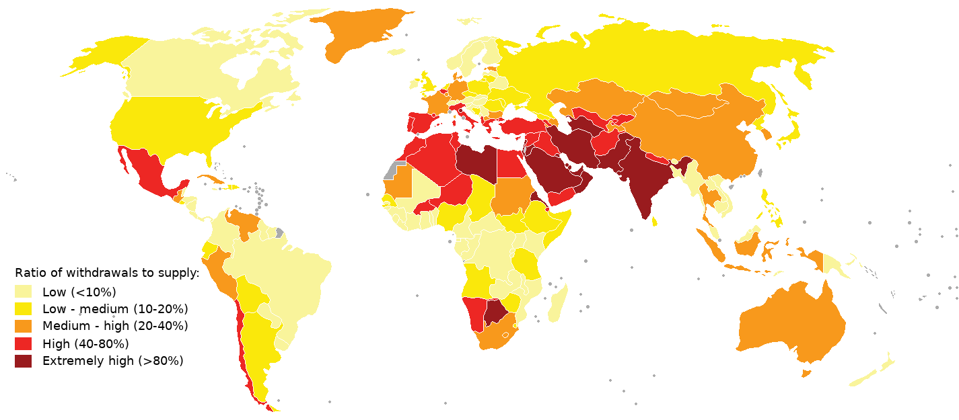
Global Water Supply Map
Remember this map? It shows the GLOBAL scale of the water crisis.
What color is the United States? What does that color mean?

Slide 5
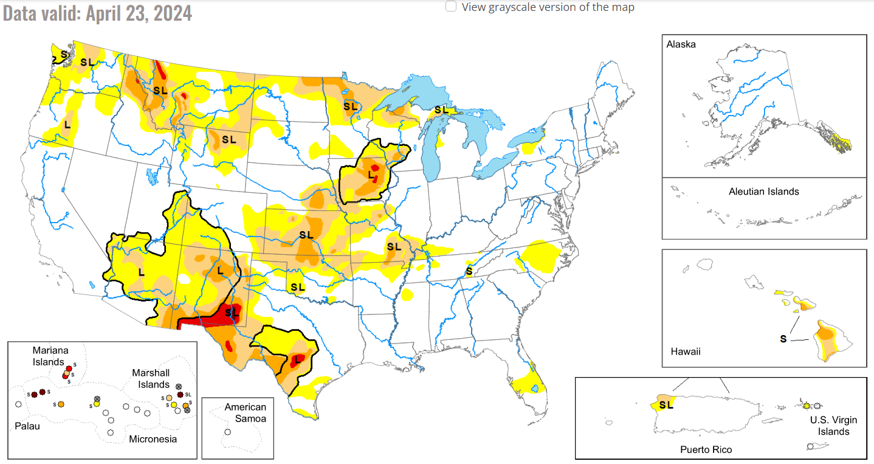
United States Drought Map
Minor drought
Major drought
This is just one map we can use to look at water access across the US. It shows droughts.
Drought - a period of low rainfall which leads to a water shortage
What areas of the US seem to be experiencing drought? Where is it worst?

Slide 6
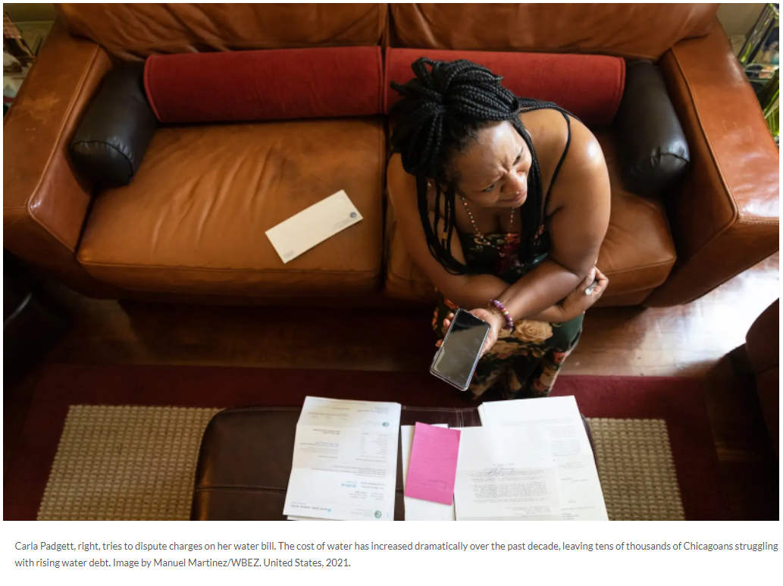
Local Issue: Water Debt
This week we’ll look at a local water supply issue.
Renters and homeowners pay utilities bills. Utilities include:
Water
Sewer
Garbage
Many Chicagoans struggle to pay their utility bills and are in debt.
Debt - something that is owed or due
Above: Carla Padgett, tries to dispute charges on her water bill. The cost of water has increased dramatically over the past decade, leaving tens of thousands of Chicagoans struggling with rising water debt.

Slide 7
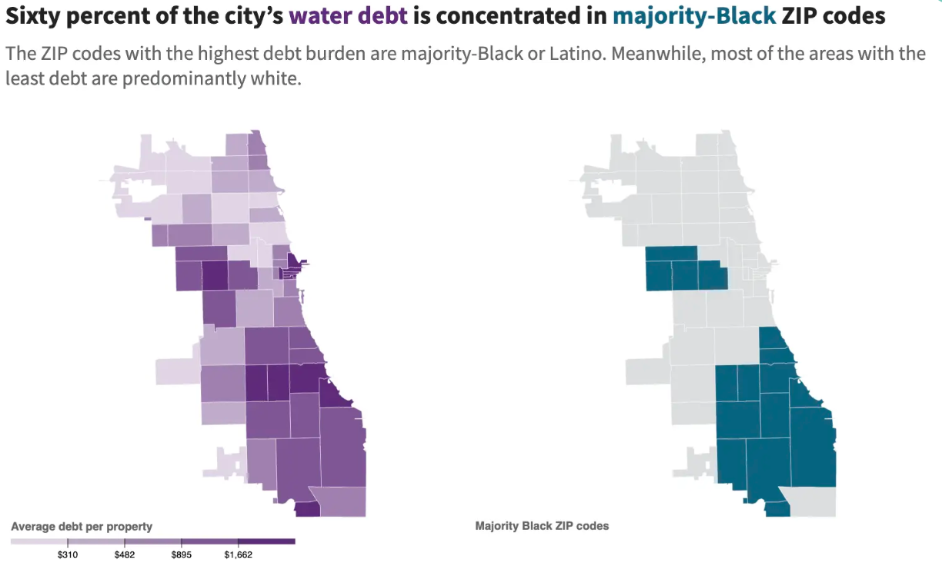
Water Debt in Chicago
Examine the maps to the left. Create and complete a see, think, wonder chart like the one below.
See | Think | Wonder

Slide 9
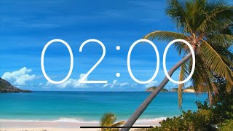
World Studies - Tuesday - Bell Ringer
Respond to the following in your notebook:
As we learned from the map at the end of yesterday’s class, Chicago’s historically Black neighborhoods on the South and West sides are the ones most likely to experience water debt.
Why might it be important for us to investigate this idea?

Slide 10
This Week’s Driving Questions
How much should drinking water cost?
How can government actions impact the accessibility of water to individuals and communities?
How can individuals and communities try to influence actions taken by elected officials?
We will examine sources this week so we can create a mini project responding to these questions!

Slide 11
Reading: Drowning in Debt
We will read the Pulitzer Center article Drowning in Debt this week to help us answer our driving questions.
You will be assigned to a reading group.
For each section of the article, your group will be responsible for:
Reading Logs (2-column notes)
After-reading tasks
Follow along with the class example for a reading log so you can make sure you do it successfully!

Slide 12
Head to Google Classroom to Open the Article
Open to a blank page in your notebook.

Slide 13
Reading Groups 306
Squares | Victor, Sylvia, Will, Li
Triangles | Gianis, Fidel, Valentina, Xavier
Circles | Sidney, Kosta, Lulu, Eli
Diamonds | Aayla, Joey, Aleks, London, Amia
Stars | Tianny, Angelo, Rebeca, Ashton
Ovals | Dayanara, Devin, Chanel, Danylo
Rhombuses | Camila, Carlos, Emilio, Milana, Tristan

Slide 14
Reading Groups
REVIEW THE READING GUIDE ONE-PAGER
Read Chapter 1 of Drowning in Debt
Reading Logs:
4 entries
  Entry = Text/Idea/Evidence + Page No. + Thoughts
  Core Vocabulary
  1 key point for EACH chapter
After reading tasks:
Complete the after reading tasks
Remember to use your time wisely
Group leaders:
Keep your group on task and accountable

Slide 16

World Studies - Wednesday - Bell Ringer
Respond to the following in your notebook:
What detail from yesterday’s reading has stuck with you or surprised you?

Slide 17
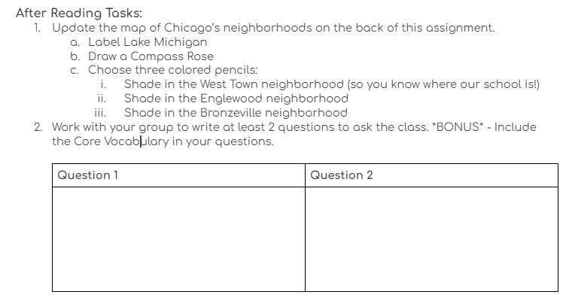
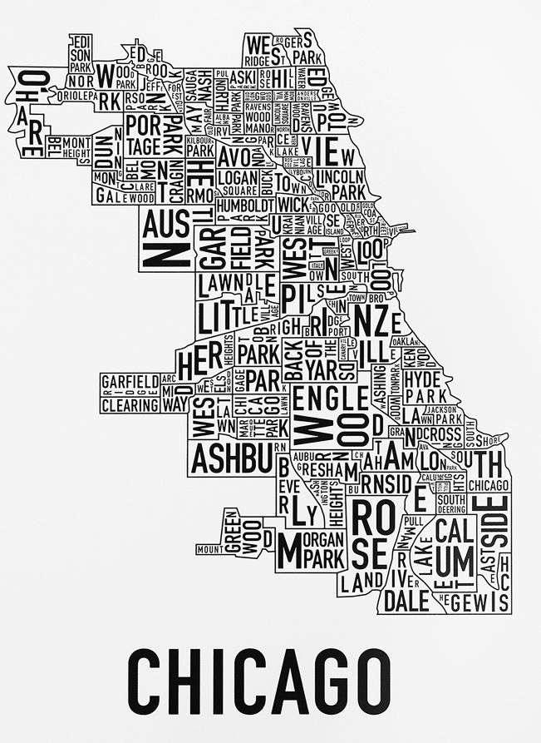
Preview After Reading Task

Slide 18
Reading Groups 306
Squares | Victor, Sylvia, Will, Li
Triangles | Gianis, Fidel, Valentina, Xavier
Circles | Sidney, Kosta, Lulu, Eli
Diamonds | Aayla, Joey, Aleks, London, Amia
Stars | Tianny, Angelo, Rebeca, Ashton
Ovals | Dayanara, Devin, Chanel, Danylo
Rhombuses | Camila, Carlos, Emilio, Milana, Tristan

Slide 19
Reading Groups
Finish Chapter 1 of Drowning in Debt
Reading Logs:
4 entries
  Entry = Text/Idea/Evidence + Page No. + Thoughts
  Core Vocabulary
  1 key point for EACH chapter
After reading tasks:
Complete the after reading tasks
Turn in Shaded Map & Questions
Remember to use your time wisely
Group leaders:
Keep your group on task and accountable

Slide 20
Exit Ticket
Be ready to respond to this question based on your reading and the notes you took today:
What did you learn about water debt in Chicago?
What do you want to learn more about?
Finish Chapter 1 by class tomorrow!
Complete the after reading tasks
Turn in Shaded Map & Questions

Slide 22
World Studies - Thursday - Bell Ringer
Chapter 2 - Concept Preview:
“implemented a water-sewer tax”
“unfunded employee pension debt”
“shoring up the city’s finances”
“utility taxes are particularly regressive”
“structural imbalances and the sort of the draconian result that was produced on Black and brown people under the present system”
“administrative hearing where the judgment was rendered.”
Interesting Words
Fueled
Reeling
Suspended
Steward
Punitive
Subsequent
Destabilizing

Slide 23
Reading Groups
REVIEW THE READING GUIDE ONE-PAGER
Finish Chapter 2 of Drowning in Debt
Reading Logs:
4 entries
  Entry = Text/Idea/Evidence + Page No. + Thoughts
  Core Vocabulary
  1 key point for EACH chapter
After reading tasks:
Complete the after reading tasks
Remember to use your time wisely
Group leaders:
Keep your group on task and accountable

Slide 24
Reading Groups 306
Squares | Victor, Sylvia, Will, Li
Triangles | Gianis, Fidel, Valentina, Xavier
Circles | Sidney, Kosta, Lulu, Eli
Diamonds | Aayla, Joey, Aleks, London, Amia
Stars | Tianny, Angelo, Rebeca, Ashton
Ovals | Dayanara, Devin, Chanel, Danylo
Rhombuses | Camila, Carlos, Emilio, Milana, Tristan

Slide 26
World Studies - Monday - Bell Ringer
Clear your desk except for your red notebook and a pen or pencil.
Open your red notebook to your notes on Ch. 2 of Drowning in Debt.
Be ready to show your completed notes to Mr. Ramin or Ms. Antonelli for a homework grade.
Read silently while you wait for your notes to be checked!

Slide 27
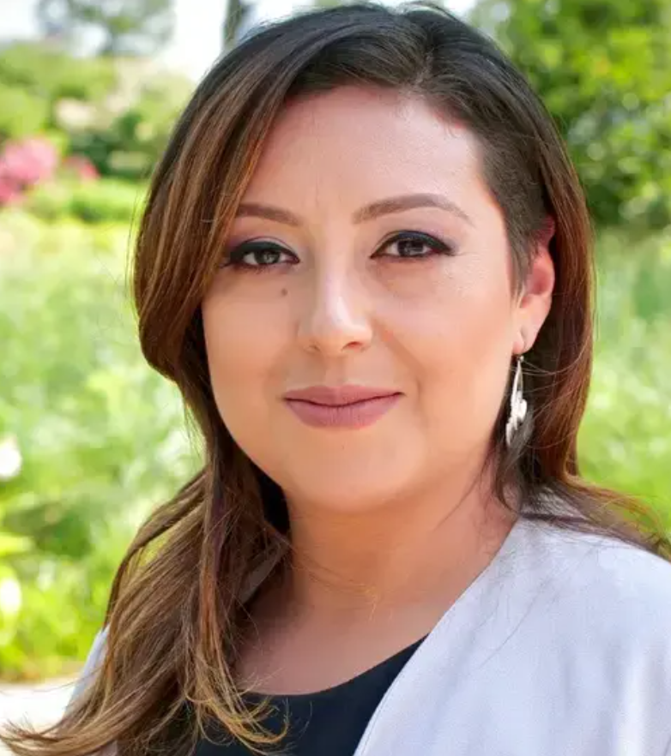
Guest Speaker - María Inés Zamudio
María Inés Zamudio covers immigration for WBEZ. She is an award-winning investigative reporter who is now part of the race, class, and communities team.
In 2015, Zamudio and a team of reporters from NPR's Latino USA received a Peabody National Award for their coverage of Central American migrants. Zamudio's story was reported from the Mexico-Guatemala border and it focused on the danger women from Central America face while traveling through Mexico as they try to reach the United States.

Slide 30
World Studies - Friday - Bell Ringer
Sit with your reading group. Arrange your desks into a 4-square.
Place your mini-poster in the middle of your 4-square so that other students can see it.
Take out a pen or a pencil.
Put away all other materials.

Slide 31
After Reading Task - Mini-Poster
Create a mini-poster communicating the impact of former Chicago Mayor Rahm Emanuel’s tax increase on homeowners across Chicago.
Your mini-posters should:
Define the tax
take a position on the tax
briefly explain the impact of the tax
consider the disproportionate impact on Black and Brown homeowners
give ideas on what viewers can do to help solve the problem
Make sure you check out the rubric!

Slide 32
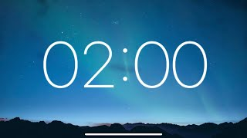
Gallery Walk
It’s time to view other groups’ posters!
Bring:
your writing utensil
some post-it notes
You will have 2 minutes at each table.
Write at least one reaction and learning for each poster on your post-it note.
Leave the note on the table for the group to see.

Slide 33
Gallery Walk Reflection
Return to your group’s table.
Review the reactions and learnings your classmates left for you.
Choose a speaker to summarize what other students said about your mini-poster.

Slide 35
World Studies - Monday - Bell Ringer
Open up your computer and go to last Friday’s Current Events Assignment.
Join your color group.
Take turns doing the following:
Summarize your article
Discuss why you think it’s important for people to know about your topic
Answer any questions your teammates have
Choose a person to summarize your discussion for the class.

Slide 36
Reading Groups
Read Chapter 3 of Drowning in Debt
Reading Logs:
Take notes that help you answer these questions:

Slide 37
Reading Groups 306
Squares | Victor, Sylvia, Will, Li
Triangles | Gianis, Fidel, Valentina, Xavier
Circles | Sidney, Kosta, Lulu, Eli
Diamonds | Aayla, Joey, Aleks, London, Amia
Stars | Tianny, Angelo, Rebeca, Ashton
Ovals | Dayanara, Devin, Chanel, Danylo
Rhombuses | Camila, Carlos, Emilio, Milana, Tristan

Slide 38
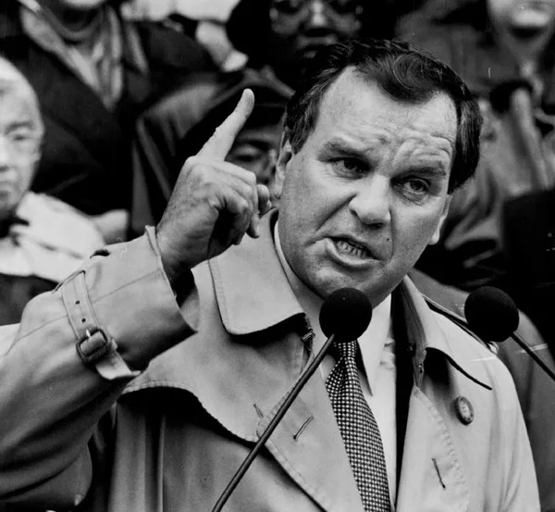
After Reading Task - Yes or No on Daley
Former Chicago Mayor Richard M. Daley said the following (paraphrased):
“I am putting a stop to the idea that the city of Chicago is not serious about collecting money it is owed. No business can stay open if it doesn’t collect on debt. Chicago is a business. Chicago’s government cannot ask taxpayers to pay for poor people’s debt.”
Work with your group to decide whether you would vote YES or NO to support Daley’s idea.
Write a short response explaining your position.
Include evidence from Chapter 3 of Drowning in Debt.
Choose a speaker to share your ideas with the class.

Slide 40
World Studies - Thursday - Bell Ringer
We’ll start class by holding a mock election!
Think back to yesterday’s quote from former Chicago Mayor Richard J. Daley.
Decide: Would you vote for Daley based on his decision to force people experiencing financial difficulty to pay off water debt?
Get ready to cast your ballot!
“I am putting a stop to the idea that the city of Chicago is not serious about collecting money it is owed. No business can stay open if it ignores it doesn’t collect on debt. Chicago is a business. Chicago’s government cannot ask taxpayers to pay for poor people’s debt.”

Slide 41
Reading Groups
Read Chapter 4 of Drowning in Debt
Reading Logs:
Take notes that help you answer these questions:

Slide 42
Reading Groups 306
Squares | Victor, Sylvia, Will, Li
Triangles | Gianis, Fidel, Valentina, Xavier
Circles | Sidney, Kosta, Lulu, Eli
Diamonds | Aayla, Joey, Aleks, London, Amia
Stars | Tianny, Angelo, Rebeca, Ashton
Ovals | Dayanara, Devin, Chanel, Danylo
Rhombuses | Camila, Carlos, Emilio, Milana, Tristan

Slide 43
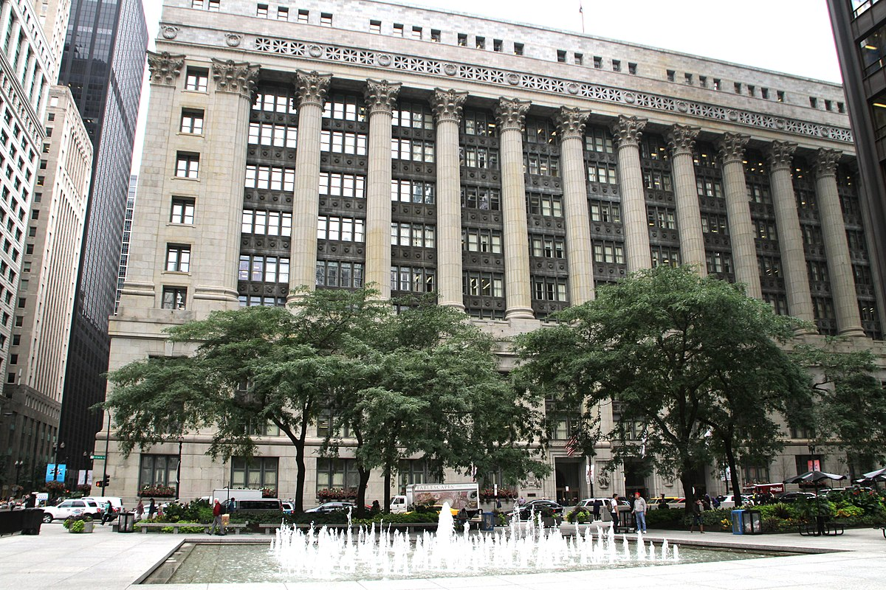
After Reading Task - Toolkit for Beating City Hall
In the US, government is designed to represent the people and provide for their needs. BUT, people must be ready to advocate for themselves and tell the government what they need it to do!
Follow Sylvia Taylor’s example to create a “Toolkit for Beating City Hall.”
Identify the steps Taylor took to advocate for herself and resolve her issue.
Create a mini-poster describing those steps for other people.
Include a title and images that will help your audience understand Taylor’s success.

Slide 45
World Studies - Friday - Bell Ringer
Today we will do the following:
Finalize our mini-posters
Take part in a gallery walk to share our posters
Take part in a seminar-style discussion to reflect on this week’s driving questions:
  How much should drinking water cost?
  How can government actions impact the accessibility of water to individuals and communities?
  How can individuals and communities try to influence actions taken by elected officials?

Slide 46
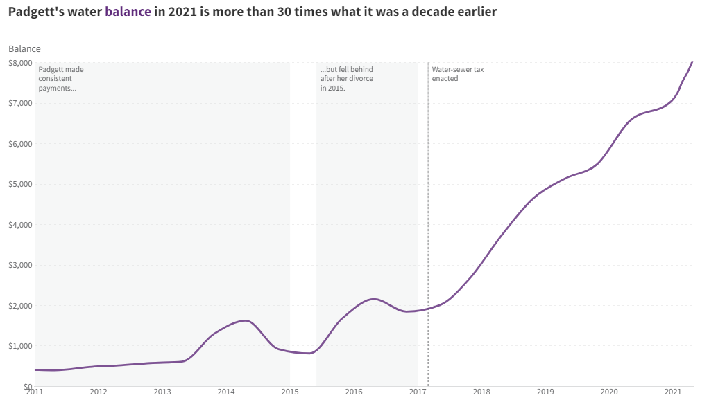
World Studies - Thursday - Bell Ringer
Examine the chart to the left. Create and complete a see, think, wonder chart like the one below.
See | Think | Wonder

Slide 47
Reading Groups
Read Chapter 2 of Drowning in Debt
Reading Logs:
Take notes that help you answer these questions:
How did Mayor Rahm Emanuel’s actions increase water debt across Chicago?
What did Emanuel say would be the benefits of his decision?
How did Emanuel’s decision impact Padgett?
What did the group Blacks in Green do to help Chicagoans without water?

