Slide 1
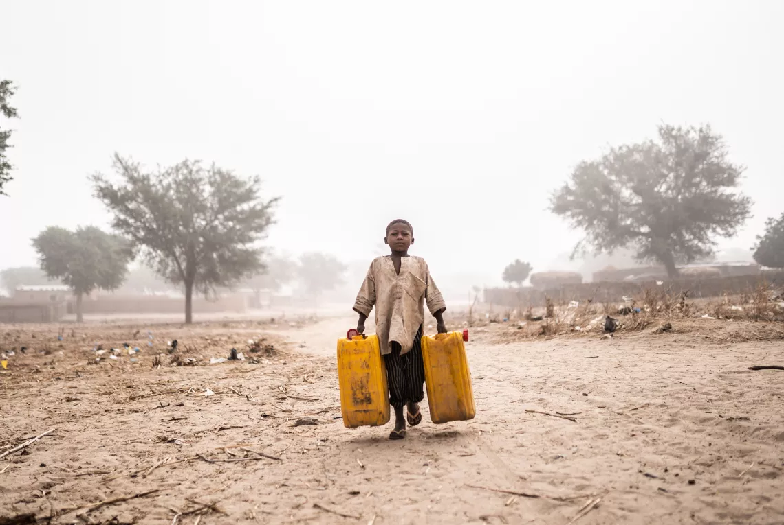

World Studies - Monday - Bell Ringer
Today we start a new unit!
Let’s start by analyzing a photo.
Draw a chart like the one below in your notebook. Fill in the chart.
See | Think | Wonder

Slide 2
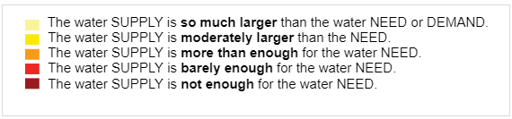
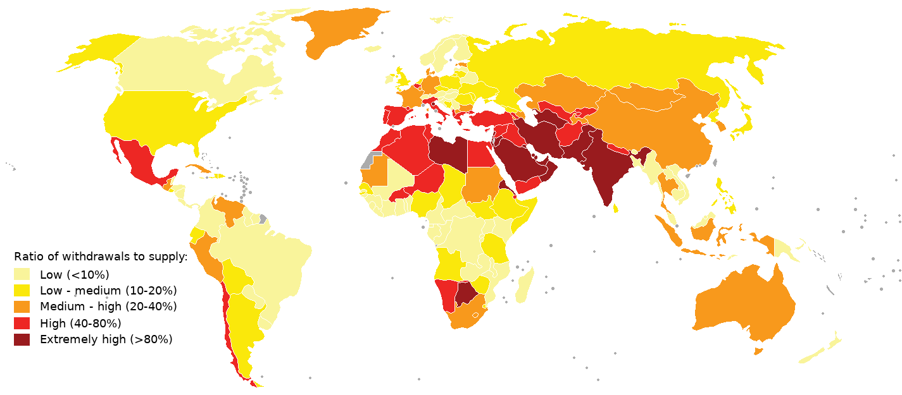
Water Supply Map
This map tracks how much water people use in each country vs. how much water the country has. Countries that have less water access often have difficulty providing water for citizens.
What parts of the world seem to have the most trouble providing water to people?
What parts of the world seem to have the least trouble providing water to people?

Slide 3
Unit 4 - Our Water, Our Ways - Introduction
In Unit 4 - Our Water, Our Ways, you will use the historical thinking skills you developed studying ancient and medieval history to study a modern problem: the global water crisis.
At the end of the unit, you will be able to answer questions like these:
Where does our water come from?
How can decisions made by people impact our water supply?
What should Chicagoans know about the water crisis?
How can we “bring home” underreported stories related to the global water crisis?
Local water issues
National water issues
Global water issues

Slide 4
Chicago’s Fresh Water Supply
Know (or THINK you know) | Want to Know | Learned
We have water. We get our water from Lake Michigan. Chicago has a lot of lead pipes; issue. Emilio can drink water. Amia can get water from her fridge. People shower using water. | How much water does the average person in Chicago uses/consumes. Do we solely get water from Lake Michigan? Is it possible for us to run out of water? Does water affect others? If so, how? How does water get to the sink? How do you purify water? How many gallons of water is taken from Lake Michigan daily? | Water in the early 1900s only went to wealthy countries In 1885 people mostly drank water from fire hydrants Chicago used to sell bonds If you give the government money, over time you may get more money. Part of land outside the city of chicago became part of chicago The chicago sanitary district reversed the flow of the chicago river and it helped the water become cleaner. People that lived closer to water got better water acces than people who didnt. When people didn't have clean water, alot of people got sick. People sold things just to get water. Wealth affected how people got water.

Slide 5
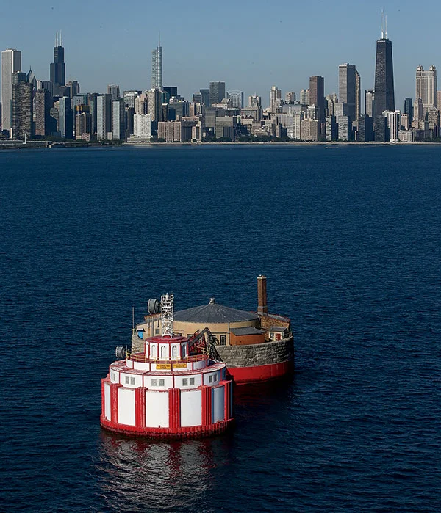
Today’s Text
In order to understand the global water crisis, we need to start by thinking about our local water sources.
Read the text from the Encyclopedia of Chicago about Chicago’s water supply (accom).
Be ready to discuss the text with the class.
What even is this????

Slide 6
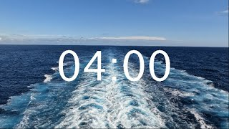
Homework
Answer the question at the bottom of the page.
Write at least one idea in the learned column of your KWL chart.

Slide 8
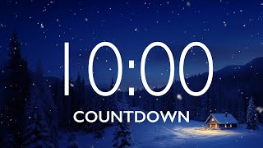
World Studies - Tuesday - Bell Ringer
Today we’ll learn more about Chicago’s sources of drinking water.
Add these items to the map of the United States you received at the door.
You can use colors and symbols if you want - get creative!
Star Chicago
Label Midwestern States
  Illinois
  Indiana
  Wisconsin
  Michigan
  Iowa
  Ohio
  Minnesota
  Missouri
  Kentucky
Why might we need to label these locations on a map?
How might knowing these locations help us answer questions about water?
Label the Great Lakes
  Lake Huron
  Lake Ontario
  Lake Michigan
  Lake Erie
  Lake Superior
Label the Mississippi River

Slide 9
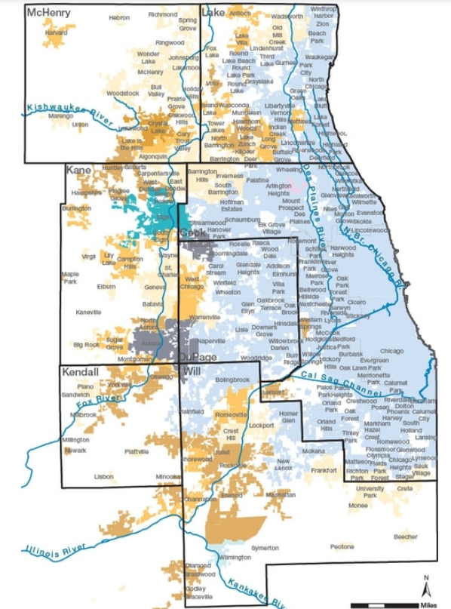
Mapping Northeastern Illinois Drinking Water
Go to the resource titled “Meet Your Water” on Google Classroom.
Scroll down until you find the map titled “Northeastern Illinois Drinking Water.
Create and complete the See, Think, Wonder chart below.
See | Think | Wonder

Slide 10
See | Think | Wonder

Slide 11
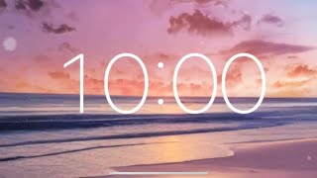
Expert Group - A Deep Dive into Chicago’s Water
With your small group, create a slide that summarizes what you learned from your assigned section on Chicago’s water supply.
Surface water sources (Kosta)
Fox and Kankakee Rivers (Fidel)
Groundwater sources (Victor)
Lake Michigan drinking water permittees and suppliers (Emilio) (Camila)
Making water drinkable (Gianis)
Infrastructure: Delivering water to the tap (Aayla) (Will)
Your slide should include:
Title
Bullet point info
An image
A caption

Slide 12
Exit Ticket
Complete the “L” column of your KWL chart.
Be ready to share with the class!

Slide 14
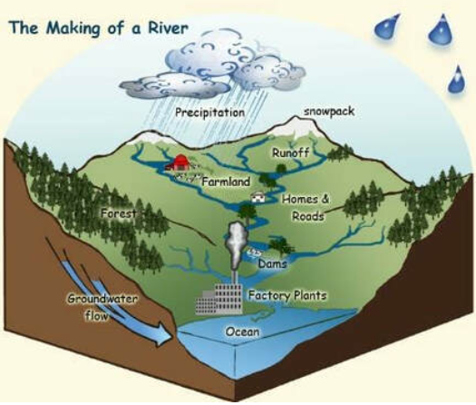
World Studies - Wednesday - Bell Ringer
As you saw yesterday, many people get their drinking water from rivers.
Look at the diagram to the right.
Where do most rivers begin?
Where do most rivers end?
Bonus: What causes rivers to flow in a specific direction?

Slide 15
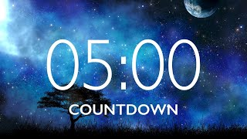
Teaching - A Deep Dive into Chicago’s Water
Meet with your “Meet Chicago’s Water” group.
Prepare to present your information to the whole class. Practice what you’ll say. Make sure everyone is ready!
Be prepared to receive questions from your classmates! Spend a couple of minutes predicting what they will ask you.

Slide 16
Small Group Discussion
Return to your expert group.
Discuss the following question:
What do people in Chicago and the surrounding area need to know about their drinking water sources?
Choose one person to summarize what your group said for the whole class.

Slide 17
Exit Ticket
Complete the “L” column of your KWL chart.
Be ready to share with the class!

Slide 19
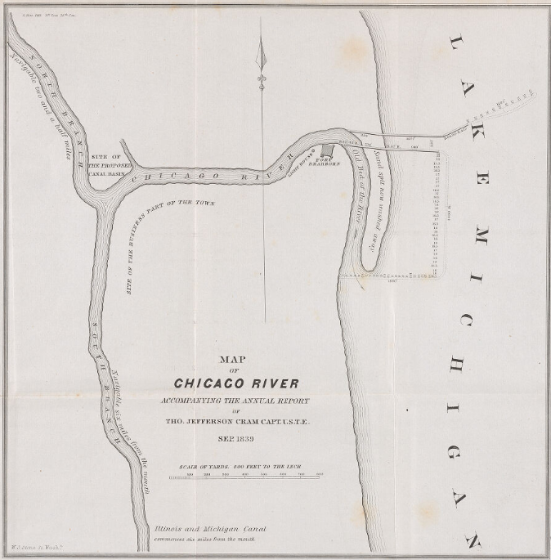
World Studies - Thursday - Bell Ringer
Draw and complete a see, think, wonder chart in your notebook for the map to the left.
See | Think | Wonder

Slide 20
Today’s Driving Questions
Old: What do people in Chicago and the surrounding area need to know about their drinking water sources?
New: How did the reversal of the Chicago River impact the quality of fresh water as far away as St. Louis?

Slide 21
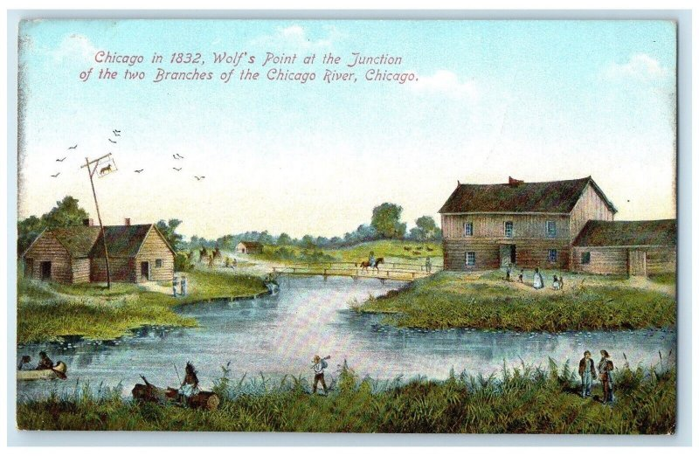
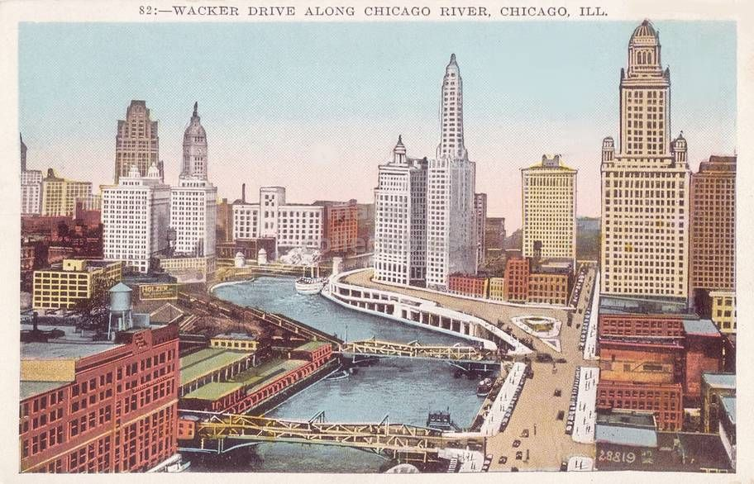
The Chicago River
The Chicago River is weird.
Most rivers flow downhill towards large bodies of water, the Chicago River flows away from Lake Michigan.
Today we’re going to learn why.

Slide 22
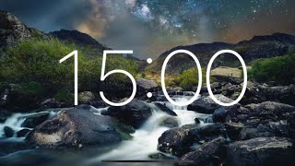
The Chicago River
Examine the source “How Chicago Reversed its River.”
Write this question in your red notebook:
How did the reversal of the Chicago River impact the quality of fresh water as far away as St. Louis?
Take notes that help you answer the question. Be ready to share what you wrote in your color group.

Slide 23
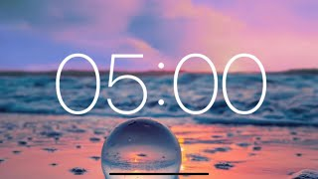
The Chicago River
Meet in your reading group. Using your notes, discuss today’s driving question.
How did the reversal of the Chicago River impact the quality of fresh water as far away as St. Louis?
Choose a speaker to summarize your discussion for the class.

Slide 24
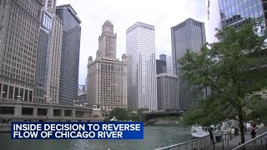
Re-Reversing the River?
Last July, Chicago officials decided to briefly re-reverse the Chicago River, causing it to flow towards Lake Michigan.
Answer the following in your notebook:
Why did they decide to re-reverse the river?
What are some possible impacts of the decision?

Slide 25
Exit Ticket
Go back to the KWL chart you created at the start of this unit.
Add onto the “L” column.
Be ready to share with the class!

Slide 27
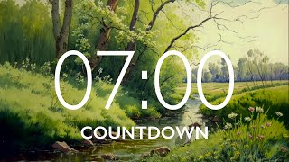
World Studies - Friday - Bell Ringer
Take out your sources from this week and look back over them.
Complete the Socratic Seminar preparation sheet.
Prepare to answer this question during Seminar today:
What do people in Chicago and the surrounding area need to know about their drinking water sources?
M | Seated
V | Level 0
P | Writing in your notebook

Slide 28
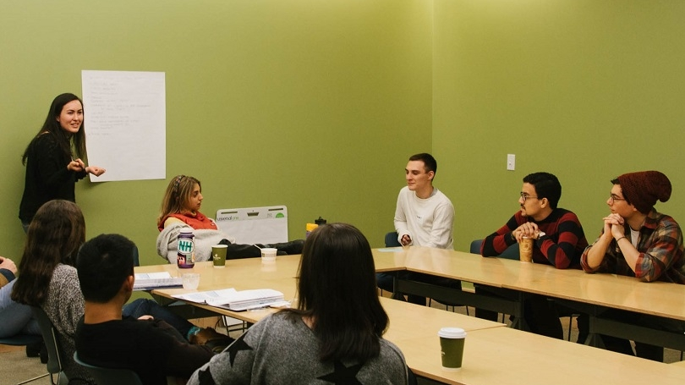
Seminar - Facilitator
The facilitator is an
important role in Seminar.
The facilitator reads the question, calls on students to participate, and makes sure students follow the norms.

Slide 29
Seminar Groups & Roles
We will create a chart on the board showing who will start in the INSIDE and who will start in the OUTSIDE circles.
She will also need volunteers for 2 roles:
Facilitator (2 students)
Point Tracker (2 students)

Slide 30
Positive Seminar Participation
Respectfully respond to another person’s point.
Cite textual evidence - and start by telling students where they can find it in the text (under what heading, etc.)
Keep conversation flowing with a new INTERESTING question.
Connect the text to your life experience.
Active Listening! Track the speaker, snap in agreement.
Let other students talk first.

Slide 31
Scoring Guidelines - Seminar
Student Name:
Positive Participation (4 points): Each time you positively participate, you earn 1 point.
Seminar Norms (6 points): The norms are to the right. Did you follow them?
Co-Created Norms (Both Circles!)
Remember - we worked together as a class to set these.
Did you follow them?
Respect Each Other
  Active Listening
  One Mic
  Challenge ideas, not persons
Respect the Circle
  Not engaging in side conversations, arguing, interrupting, or causing disruptions.
Patience: Pause Before Speaking
  Listening, processing, thinking… then responding
Mindfulness: Step Up, Step Back
  Give space to those who still need to participate.
  Each person MUST have an opportunity to speak
Body Language:
  Sitting upright
  Tracking the speaker
  Limiting movement
Teacher Notes:
Score: _____/10

Slide 32
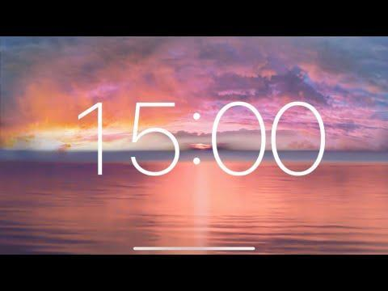
Agree I agree with what _____ said, because... Adding on to what ____ said, I think that… There is evidence for what ____ is saying on Page __. Let me read it: … My idea is related to _______’s idea: … | Using Evidence I have some evidence from the text for what _____ was saying. Let me read it: … According to… In “City upon a Hill”, Winthrop states… For example, in Cotton’s speech he said…
Disagree I interpreted things differently. What I think is... _____ made a good point, but I see it a little differently. The way I see it is… That’s an interesting point _____, but I have a different opinion. My opinion is… | Questioning Why do you think that _____ did/said/wrote _____? To what extent is it the case that _____? Would you all agree with the statement _____? Why or why not?
Clarifying Questions I think I understand what you are getting at, but can you explain it a little bit more? What part of the text made you think that? Could you explain a little more about ____? Can you explain your thinking?

Slide 33
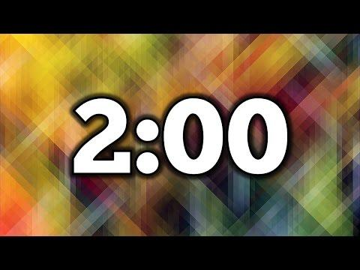
Coaching Break!
Meet with your partner in the outside circle.
Discuss what went well in the first round of seminar.
Get ready to take part in Seminar Round 2!

Slide 34
Exit Ticket
Look at the participation tracker on the board.
Re-read the requirements on the rubric.
Give yourself a score on today’s Socratic Seminar rubric. Explain why you gave yourself that score.
Try to include a GLOW and a GROW.

