Slide 1
Seminar Roles and Norms
For Successful Student-Led Discussion

Slide 2

Seminar Prep - Reading & Annotating
You have 20 minutes to…
Read and Annotate your article
Make sure Part 1-3 of your Seminar Prep packet is COMPLETE (due tomorrow)
Prepare what you’re going to say in the Seminar OR do additional research
Listen & read the directions carefully!
Remember - you get a 10 pt. grade for your annotations!
M | Seated, working solo
V | Level 0
P | Read, annotate, complete Part 1-3
Driving Questions:
How can we stop the next pandemic?

Slide 3
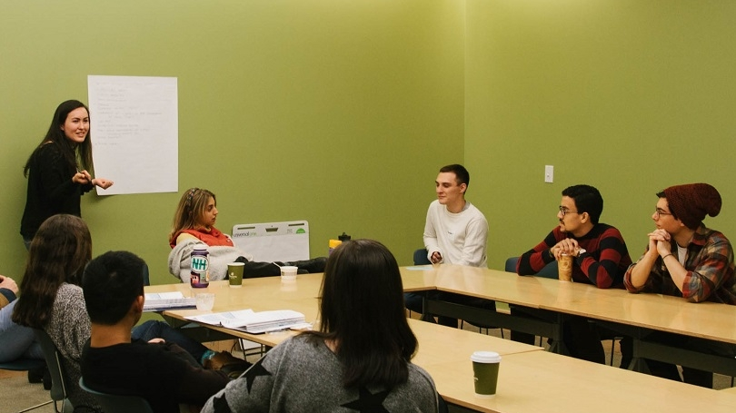
Seminar - Facilitator
The facilitator is an
important role in Seminar.
The facilitator reads the question, calls on students to participate, and makes sure students follow the norms.

Slide 4
Seminar Groups & Roles
We will create a chart on the board showing who will start in the INSIDE and who will start in the OUTSIDE circles.
She will also need volunteers for 2 roles:
Facilitator (2 students)
Point Tracker (2 students)

Slide 5
Positive Seminar Participation
Respectfully respond to another person’s point.
Cite textual evidence - and start by telling students where they can find it in the text (under what heading, etc.)
Keep conversation flowing with a new INTERESTING question.
Connect the text to your life experience.
Active Listening! Track the speaker, snap in agreement.
Let other students talk first.

Slide 6
Scoring Guidelines - Seminar
Student Name:
Positive Participation (4 points): Each time you positively participate, you earn 1 point.
Seminar Norms (6 points): The norms are to the right. Did you follow them?
Co-Created Norms (Both Circles!)
Remember - we worked together as a class to set these.
Did you follow them?
Respect Each Other
  Active Listening
  One Mic
  Challenge ideas, not persons
Respect the Circle
  Not engaging in side conversations, arguing, interrupting, or causing disruptions.
Patience: Pause Before Speaking
  Listening, processing, thinking… then responding
Mindfulness: Step Up, Step Back
  Give space to those who still need to participate.
  Each person MUST have an opportunity to speak
Body Language:
  Sitting upright
  Tracking the speaker
  Limiting movement
Teacher Notes:
Score: _____/10

Slide 7

Agree I agree with what _____ said, because... Adding on to what ____ said, I think that… There is evidence for what ____ is saying on Page __. Let me read it: … My idea is related to _______’s idea: … | Using Evidence I have some evidence from the text for what _____ was saying. Let me read it: … According to… In “City upon a Hill”, Winthrop states… For example, in Cotton’s speech he said…
Disagree I interpreted things differently. What I think is... _____ made a good point, but I see it a little differently. The way I see it is… That’s an interesting point _____, but I have a different opinion. My opinion is… | Questioning Why do you think that _____ did/said/wrote _____? To what extent is it the case that _____? Would you all agree with the statement _____? Why or why not?
Clarifying Questions I think I understand what you are getting at, but can you explain it a little bit more? What part of the text made you think that? Could you explain a little more about ____? Can you explain your thinking?

Slide 8

Coaching Break!
Meet with your partner in the outside circle.
Discuss what went well in the first round of seminar.
Get ready to take part in Seminar Round 2!

Slide 9

CERC Paragraph Structure
Paragraph - 6+ sentences
Claim - restate the question. "We can stop the next pandemic by…"
Evidence 1 - According to Document… quote…
Reason 1 - This supports my claim because…
Evidence 2
Reason 2
Conclusion - At the end of the day, we can/cannot…
When you're done…
Grade yourself using the rubric.
Re-read your paragraph.
Check - did you actually answer the question?

