Slide 1
Fake News + Text Analysis
An analysis of our relationships with news and social media.

Slide 2
Day 1
SWBAT determine main points and form initial opinions on reporting by reading and annotating a section of The Black Box.
Agenda
Bellringer: see, think, wonder
Introduce unit and complete issue choice Google form
Begin jigsaw of The Black Box
Close read section individually
Exit slip: initial reaction and screen time tracker

Slide 3
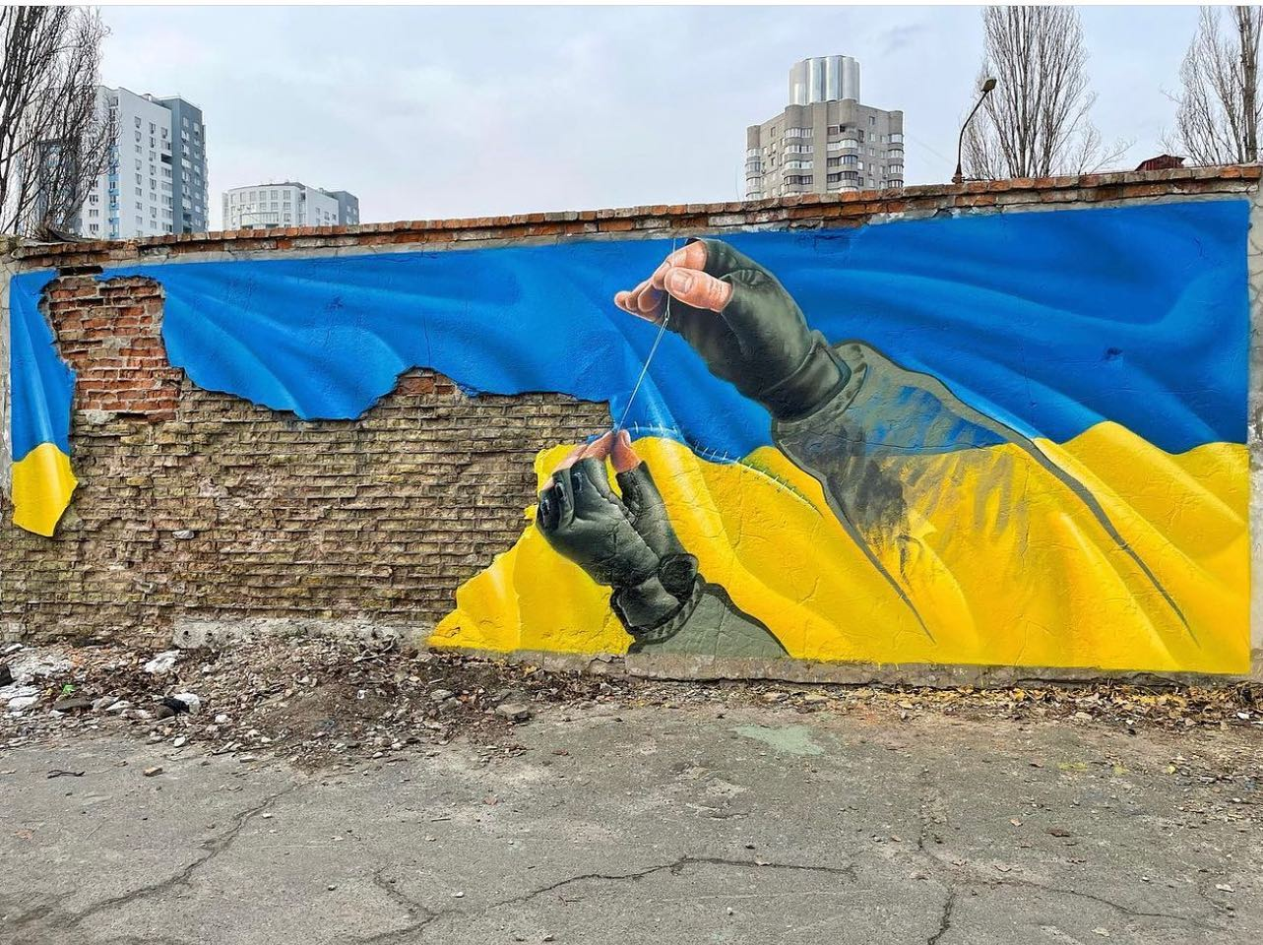
See - Think - Wonder
+ Free Write
Write for 5 minutes without stopping.
What is the:
Message
Audience
Speaker
Purpose
Context
Is bias or an imperative in this picture?

Slide 4
Unit Goals
Identify and analyze the source of a text and its message for an intended audience.
Present findings of their analysis and research.
Reflect on their own relationship with news, technology, and social media.
MYP Statement of Inquiry
The presentation of commonality, diversity, and interconnection are communicated with a specific purpose and impacts audience reactions.

Slide 5

Bias = prejudice in favor of or against one thing, person, or group compared with another, usually in a way considered to be unfair.
Social Imperative = a requirement for the survival of any social system, as communication, control of conflict, or socialization.
Copy these definitions.

Slide 6
Text & Image Analysis Questions
Message: What is the author trying to say?
Purpose: Why was this article created?
Context: What background information is needed to understand this article?
Speaker: Who is saying this?
Audience: Who is this article for?
Underline the most important sentence in this section.
Identify a word that is repeated several times.
ON THE BACK: What would you share about this section to a group that did not read it. Write 1-2 sentences.

Slide 7
Day 2
Agenda:
Bellringer: see, think, wonder
Complete expert group of the Jigsaw of The Black Box
Complete note catcher
Exit slip: What social imperative is present in this reporting?
SWBAT analyze a section of The Black Box by identifying and determining the significance of the message, audience, purpose, context, and speaker.

Slide 8

See - Think - Wonder
What is the:
Message
Audience
Speaker
Purpose
Context
+ Free Write
Write for 5 minutes without stopping.
Is bias or an imperative in this picture?

Slide 9
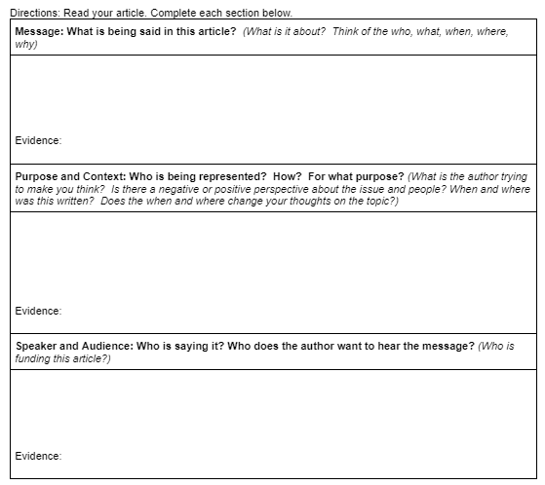
Text & Image Analysis Questions
Message: What is the author trying to say?
Purpose: Why was this article created?
Context: What background information is needed to understand this article?
Speaker: Who is saying this?
Audience: Who is this article for?

Slide 10
Reading Rubric:
MYP Language Acquisition: Criterion B: Reading: iii.analyse connections.
Score | 1-2 | 3-4 | 5-6 | 7-8
Level descriptor | iii.identifies basic connections in complex authentic texts. | iii.identifies basic connections in complex authentic texts. | iii.interprets connections in complex authentic texts. | iii.analyses connections in complex authentic texts.
% | 69%-50% | 79%-70% | 89%-80% | 100%-90%
On this task | iii. Identifies the basic meaning of social media posts using MAPS-C = analysis is completed with summaries. | iii. Identifies the basic meaning of social media posts using MAPS-C = complete analysis of some speculations without evidence. | iii. interprets social media posts using MAPS-C =complete analysis includes both interpretations with evidence and some speculations without evidence. | iii. Analyzes a news article using MAPS-C = complete analysis includes interpretations with evidence in all sections.

Slide 11
Writing Rubric:
MYP Language Acquisition: Criterion D: Writing: i.use a wide range of vocabulary
Score | 1-2 | 3-4 | 5-6 | 7-8
Level descriptor | i.uses a limited range of vocabulary | i.uses a basic range of vocabulary | i.uses a range of vocabulary | i.uses a wide range of vocabulary
% | 69%-50% | 79%-70% | 89%-80% | 100%-90%
On this task | i. Limited range - does not connect textl analysis to evidence from a news article.. | i. Basic range - connects text analysis to evidence from a news article with little explanation | i. Range = connects text analysis to evidence from a news article post with some complete explanations | i. Wide range = connects text analysis to evidence from a news article with complete explanations

Slide 12
Article Jigsaw: Expert Groups
Be ready to share with other groups tomorrow!
Individually:
Read and annotate your section
Complete the text analysis form for your section
In your group:
Share you answers with other group members who read your section.
Agree on what to tell the other groups.
Article link Jigsaw note catcher

Slide 13
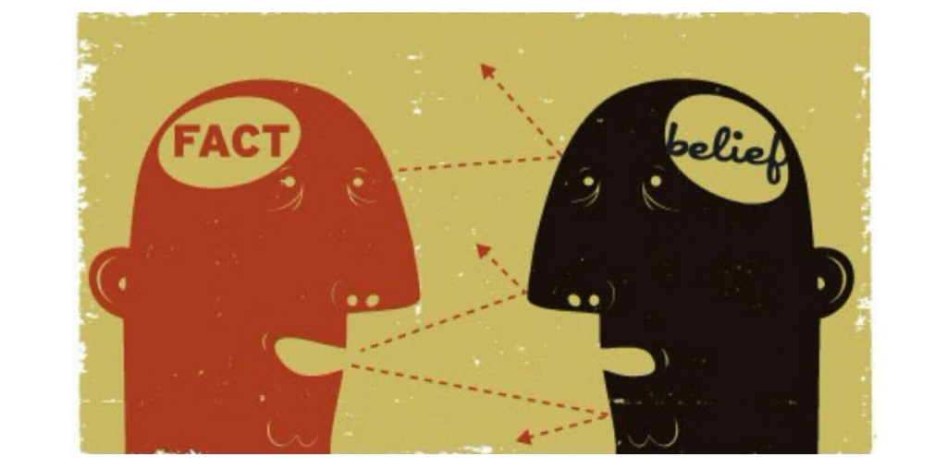
Exit Slip, part 1: The So, what…
Is this reporting asking the reader to do something?
Is this reporting trying to change the reader's opinion?

Slide 14
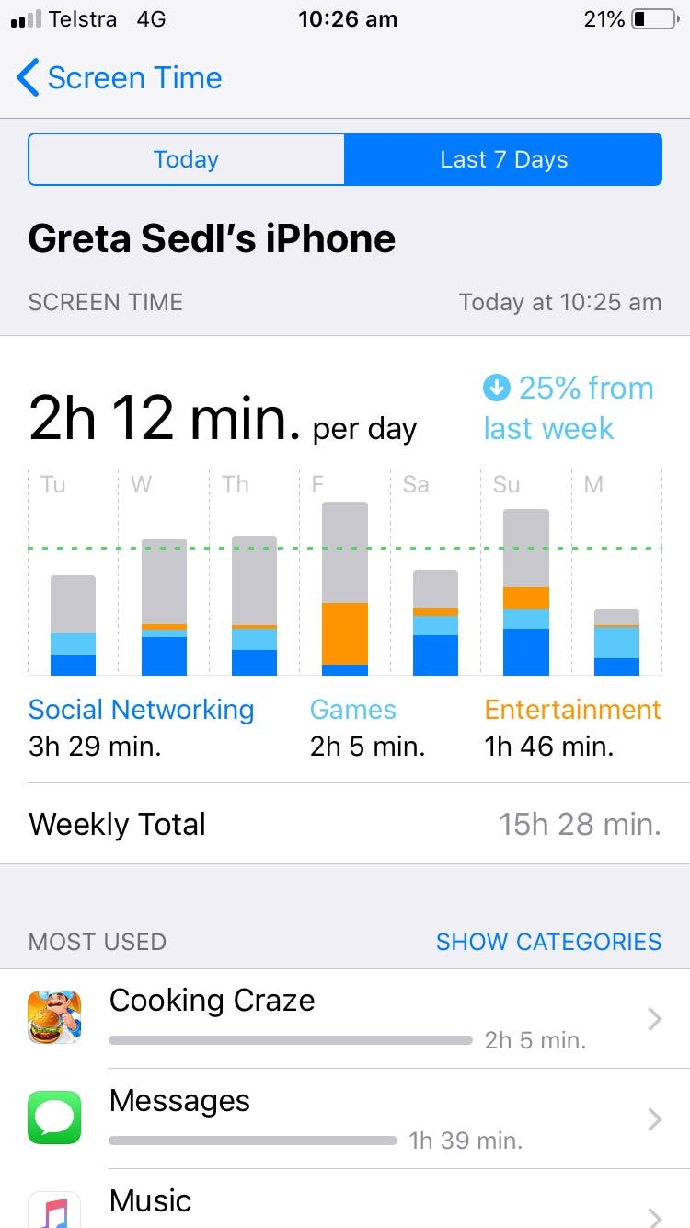
Exit Slip, part 2: Screen Time Reflection
List your screen time for today.
List the top two apps.
Has your phone been a tool or a distraction today?

Slide 15
Day 3
Agenda:
Bellringer: see, think, wonder
Complete mixed group of the Jigsaw of the Black Box
Complete note catcher for other sections.
Exit slip: What does this make you think about the role of AI and technology in our society? How does this impact you personally?
SWBAT synthesize all sections of The Black Box to other groups by presenting expert group analysis.

Slide 16
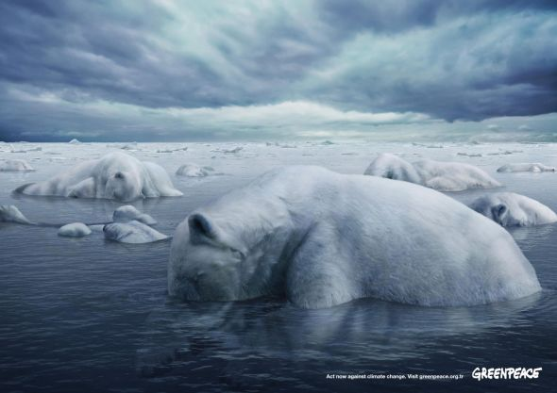
See - Think - Wonder
What is the:
Message
Audience
Speaker
Purpose
Context
+ Free Write
Write for 5 minutes without stopping.
Is bias or an imperative in this picture?

Slide 17
Article Jigsaw: Group Directions
Expert Groups:
Review your work, and decide what the other groups need to know.
Mixed Groups:
Share: Tell people from other groups the main points of your section.
Record: Records 1-2 sentences for every section except your own section.
Record: What is your response or opinion of each section
Article link Jigsaw note catcher

Slide 18
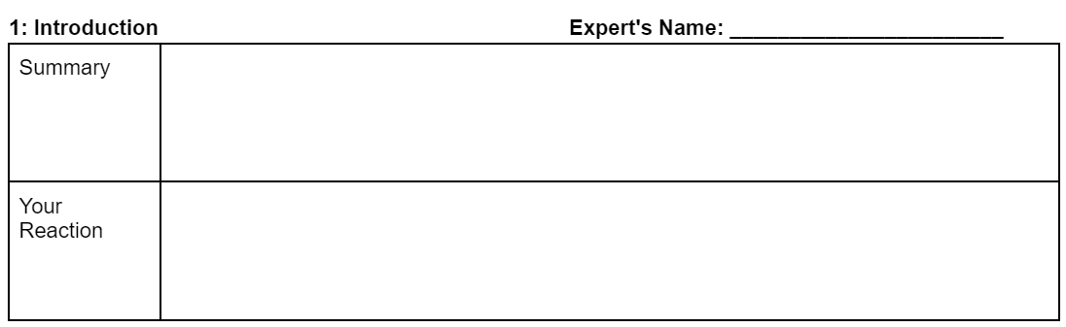
Article Jigsaw: Mixed Groups
sample response
Social Sentinal is an AI program sold to schools to help reduce the threat of school shootings and student suicide. Some people don't think it is accurate and others have concerns about student privacy.
I would want to see how they got this information about this and also people like teens should be more careful about what they post.
Article link Jigsaw note catcher

Slide 19
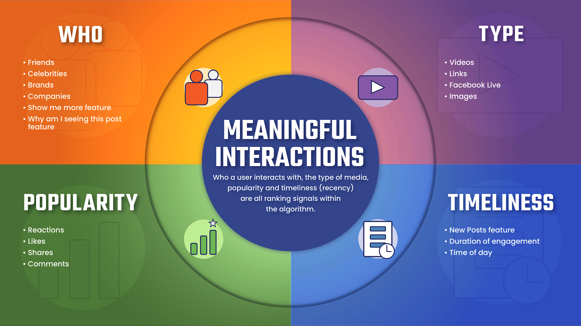
The Social Media Algorithm: Shows you information based on…

Slide 20
Exit Slip, part 1: The So, what…
What does this make you think about the role of AI and technology in our society? How does this impact you personally?

Slide 21
Day 4
Agenda:
Bellringer: see, think, wonder
Search a topic from The Black Box in social media.
Analyze posts using social media analysis note catcher.
Introduce bias and reliability
Complete group choice google form
SWBAT analyze and compare a social media post by identifying and determining the significance of the message, audience, purpose, context, and speaker.

Slide 22
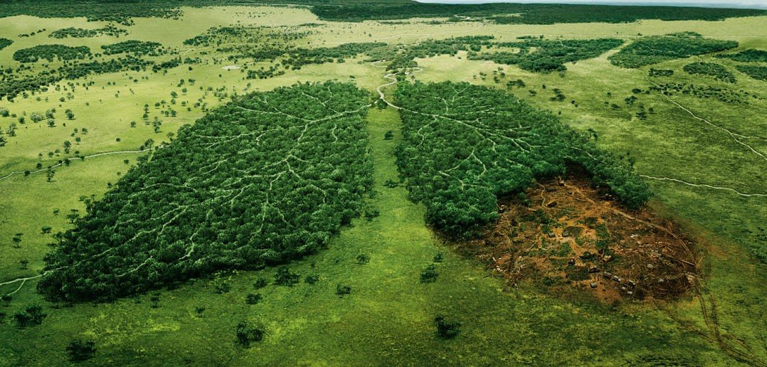
See - Think - Wonder
+ Free Write
Write for 5 minutes without stopping.
Is bias or an imperative in this picture?
What is the:
Message
Audience
Speaker
Purpose
Context

Slide 23
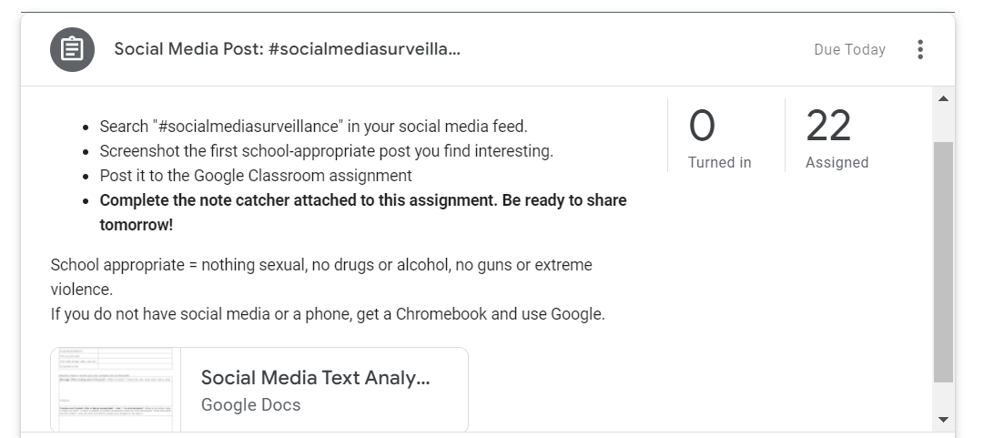
Social Media Research + Analysis
Search "year of the dragon" in your social media feed.
Screenshot the first school appropriate post you find interesting.
Post it to the google classroom assignment.
School appropriate = nothing sexual, no drugs or alcohol, no guns or extreme violence.
If you do not have social media or a phone, get a chromebook and use google.
Now we are going to use our phones at a TOOL!

Slide 24
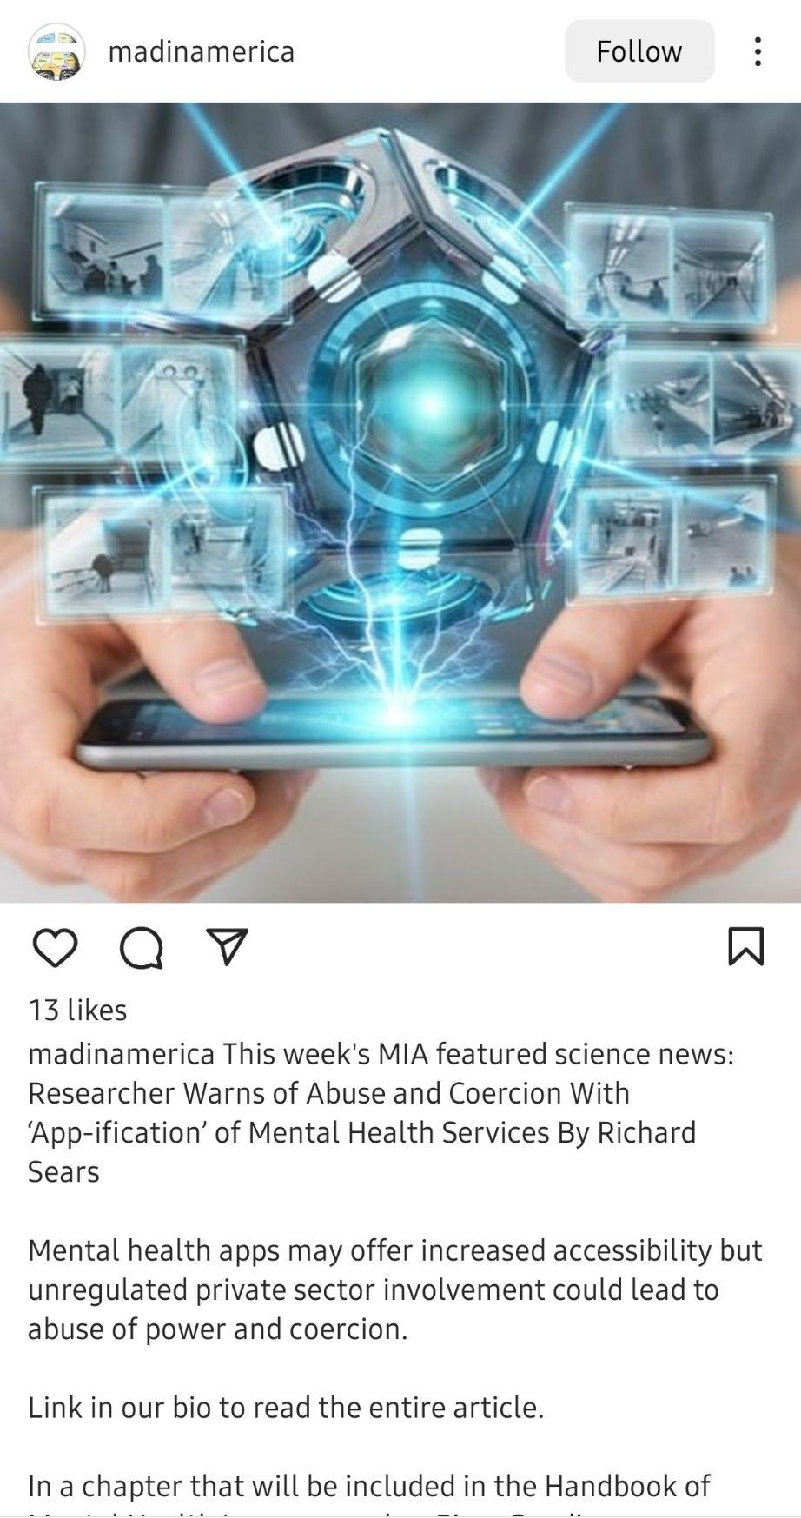
Social Media note catcher
Social Media Platform | Instagram
Post account name | @madinamerica
Post media (image, video, text, etc) | Image of a 3d pentagram over a person holding a phone. Electricity connecting the phone with the images above. The caption warns about the dangers of AI mental health apps.
Screenshot or link
1. Get a screenshot from your social media by searching "Social Media Surveillance"
2. Link it to the google classroom
3. Complete the analysis worksheet ON THE GOOGLE CLASSROOM.

Slide 25
Choice Google Form
I will use your answers to create groups.
Rank the top 3 topics you find most interesting.
Artificial Intelligence and Surveillance: Do surveillance monitors keep us safer and create new dangers?
Indigenous Communities and Rainforests: Can preserving indigenous plants save the world?
Censorship and Books: Who decides which books should be in schools and the library?
Medicine: Do you trust your grandma's remedy or what the doctor prescribes?
Migration and Refugees: What do people find and how do they get by when they get to the other place?
Youth and the Environment: What can you do to help with climate change?

Slide 26
Day 5
SWBAT collaborate to determine group norms build group relationships.
Agenda
Bellringer
See, think, wonder
Introduce summative presentation
Team building: group drawing and norms agreement.
Exit slip
Sample presentation slides

Slide 27
Bellringer: Free Write
Write about group work. How do you feel about it? What works? What doesn't? How do you feel about this group project?
Free write directions:
Write down everything that comes to your mind without stopping for 5 minutes
You can draw, make a list, timeline, write a paragraph…

Slide 28
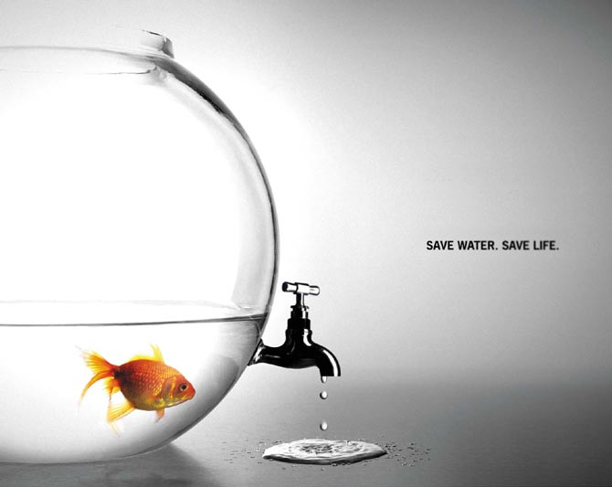
See - Think - Wonder
What is the:
Message
Audience
Speaker
Purpose
Context
Is bias or an imperative in this picture?
+ Free Write
Write for 5 minutes without stopping.

Slide 29
The Presentation:The Slides
PART 1: A summary of your group's Pulitzer Center news article including:
message
purpose and context
speaker and audience
reflection on the credibility.
PART 2: A summary of YOUR social media post on the issue.
The analysis should include:
message
purpose and context
speaker and audience
reflection on the credibility
One per group
One per person
Sample presentation slides

Slide 30
The Presentation: Infographic
PART 3: An analysis of the bias and imperative on the issue. Each group member makes a suggestion of what can be done about the issue you researched.
PART 4: A slide citing ALL sources include the title, author, and link.
One per group
One per group
Sample presentation slides

Slide 31
Reading Rubric:
MYP Language Acquisition: Criterion B: Reading: iii.analyse connections.
Score | 1-2 | 3-4 | 5-6 | 7-8
Level descriptor | iii.identifies basic connections in complex authentic texts. | iii.identifies basic connections in complex authentic texts. | iii.interprets connections in complex authentic texts. | iii.analyses connections in complex authentic texts.
% | 69%-50% | 79%-70% | 89%-80% | 100%-90%
On this task | iii. Identifies the basic meaning of social media posts using MAPS-C = analysis is completed with summaries. | iii. Identifies the basic meaning of social media posts using MAPS-C = complete analysis of some speculations without evidence. | iii. interprets social media posts using MAPS-C =complete analysis includes both interpretations with evidence and some speculations without evidence. | iii. Analyzes a news article using MAPS-C = complete analysis includes interpretations with evidence in all sections.

Slide 32
Writing Rubric:
MYP Language Acquisition: Criterion D: Writing: i.use a wide range of vocabulary
Score | 1-2 | 3-4 | 5-6 | 7-8
Level descriptor | i.uses a limited range of vocabulary | i.uses a basic range of vocabulary | i.uses a range of vocabulary | i.uses a wide range of vocabulary
% | 69%-50% | 79%-70% | 89%-80% | 100%-90%
On this task | i. Limited range - does not connect textl analysis to evidence from a news article.. | i. Basic range - connects text analysis to evidence from a news article with little explanation | i. Range = connects text analysis to evidence from a news article post with some complete explanations | i. Wide range = connects text analysis to evidence from a news article with complete explanations

Slide 33
The Presentation: Speaking & Listening
Speaking:
uses academic language while
spoken clearly and loudly all of the time.
Appropriate presentation body language and eye contact
Listening:
You are taking notes on the feedback form
No phones are visible
No talking over the presenters.

Slide 34
Listening Rubric:
MYP Language Acquisition: Criterion A: Listening: iii.analyse connections
Score | 1-2 | 3-4 | 5-6 | 7-8
Level descriptor | iii.identifies basic connections in complex authentic texts. | iii.identifies basic connections in complex authentic texts. | iii.interprets connections in complex authentic texts. | iii.analyses connections in complex authentic texts.
% | 69%-50% | 79%-70% | 89%-80% | 100%-90%
On this task | iii. basic = reflects on the bias and imperative in a way that shows understanding of the issue in less than half of presentations OR shows frequent misunderstanding of the issue. | iii. basic = reflects on the bias and imperative in a way that shows understanding of the issue some presentations OR shows some misunderstanding of the issues. | iii. interprets = reflects on the bias and imperative in a way that shows understanding of the issue in most presentations OR shows limited misunderstanding of the issues. | iii. Analyzes = reflects on the bias and imperative in a way that shows understanding of the issue in all presentations

Slide 35
Speaking Rubric:
MYP Language Acquisition: Criterion C: Speaking: i.use a wide range of vocabulary
Score | 1-2 | 3-4 | 5-6 | 7-8
Level descriptor | i.uses a limited range of vocabulary | i.uses a basic range of vocabulary | i.uses a range of vocabulary | i.uses a wide range of vocabulary
% | 69%-50% | 79%-70% | 89%-80% | 100%-90%
On this task | i. Limited range - uses academic language while speaking clearly, and loudly less than half of the time. | i. Basic range - uses academic language while speaking clearly, and loudly some of the time. | i. Range = uses academic language while speaking clearly, and loudly most of the time. | i. Wide range = uses academic language while speaking clearly, and loudly all of the time.

Slide 36
Collaborative Photo
Today' theme is Peace & Calm
Each person will get 1 minute to draw
The first person starts the drawing
The next person adds on…
The next person adds on…
Your group shares with the rest of the class

Slide 37
Group Norms and Agreements
So…What do you need to work together as a group?
What works for you during group work?
What doesn't work for you during group work?
Form an agreement on how your group will function.
Write an agreement, and sign it.

Slide 38
Day 6
Agenda:
Bellringer
See, think, wonder
Read individually
Complete text analysis
Share with group, if time allows
SWBAT individually read and analyze the choice Pulitzer Article by identifying and determining the significance of the message, audience, purpose, context, and speaker.

Slide 39
Bellringer: Free Write
1. What is your reaction to The Black Box reporting? How does this affect your life?
2. Discuss social media surveillance. Should it be allowed? Does it have benefits? Who does it harm? Who does it help?
Free write directions:
Write down everything that comes to your mind without stopping for 5 minutes
You can draw, make a list, timeline, write a paragraph…

Slide 40

See - Think - Wonder
What is the:
Message
Audience
Speaker
Purpose
Context
Is bias or an imperative in this picture?
+ Free Write
Write for 5 minutes without stopping.

Slide 41
Text & Image Analysis Questions
Message: What is the author trying to say?
Purpose: Why was this article created?
Context: What background information is needed to understand this article?
Speaker: Who is saying this?
Audience: Who is this article for?
Underline the most important sentence in this section.
Identify a word that is repeated several times.
ON THE BACK: What would you share about this section to a group that did not read it. Write 1-2 sentences.

Slide 42
Day 7
Agenda:
Search group topic in social media.
Analyze posts using social media analysis tool.
Submit results to google classroom
SWBAT research and analyze a social media post by identifying and determining the significance of the message, audience, purpose, context, and speaker.

Slide 43
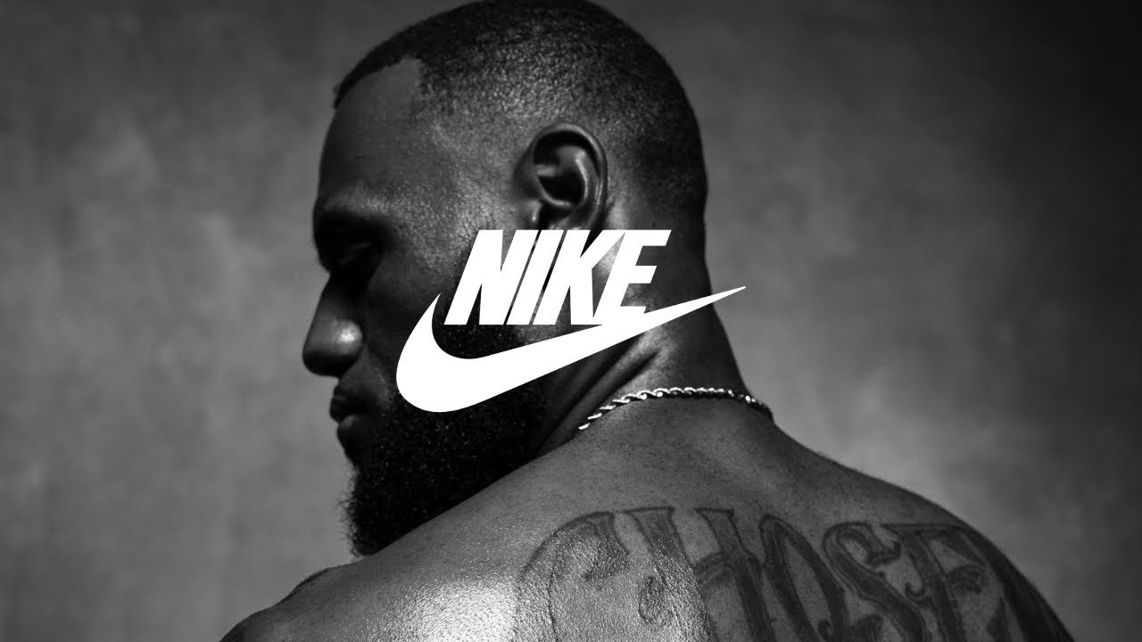
See - Think - Wonder
What is the:
Message
Audience
Speaker
Purpose
Context
+ Free Write
Write for 5 minutes without stopping.
Is bias or an imperative in this picture?

Slide 44
Research on social media
Search AI and mental health into one of your social media accounts.
(If you do not have social media, use google on your chromebook)
Choose the first post that pops up.
Complete the social media text analysis tool.

Slide 45
Social Media Research + Analysis
Now we are going to use our phones at a TOOL!
Search "year of the dragon" in your social media feed.
Screenshot the first school appropriate post you find interesting.
Post it to the google classroom assignment.
School appropriate = nothing sexual, no drugs or alcohol, no guns or extreme violence.
If you do not have social media or a phone, get a chromebook and use google.

Slide 46
Social Media note catcher
Social Media Platform | Instagram
Post account name | @madinamerica
Post media (image, video, text, etc) | Image of a 3d pentagram over a person holding a phone. Electricity connecting the phone with the images above. The caption warns about the dangers of AI mental health apps.
Screenshot or link
1. Get a screenshot from your social media by searching "Social Media Surveillance"
2. Link it to the google classroom
3. Complete the analysis worksheet ON THE GOOGLE CLASSROOM!

Slide 47
Day 8
Agenda:
Bellringer: see, think, wonder
Compare results from social media to other group members - social media sharing note catcher
Determine bias reliability in each group member's post - reflection questions.
Exit Slip: Is bias or an imperative present in this reporting?
SWBAT analyze and compare a social media post by identifying and determining the significance of the message, audience, purpose, context, and speaker.

Slide 48
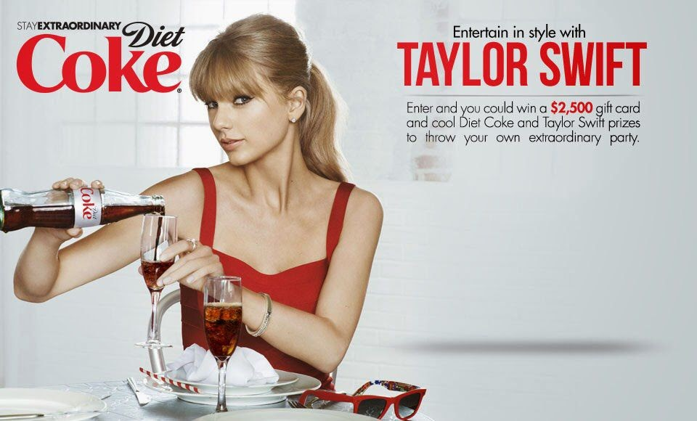
See - Think - Wonder
What is the:
Message
Audience
Speaker
Purpose
Context
+ Free Write
Write for 5 minutes without stopping.
Is bias or an imperative in this picture?

Slide 49
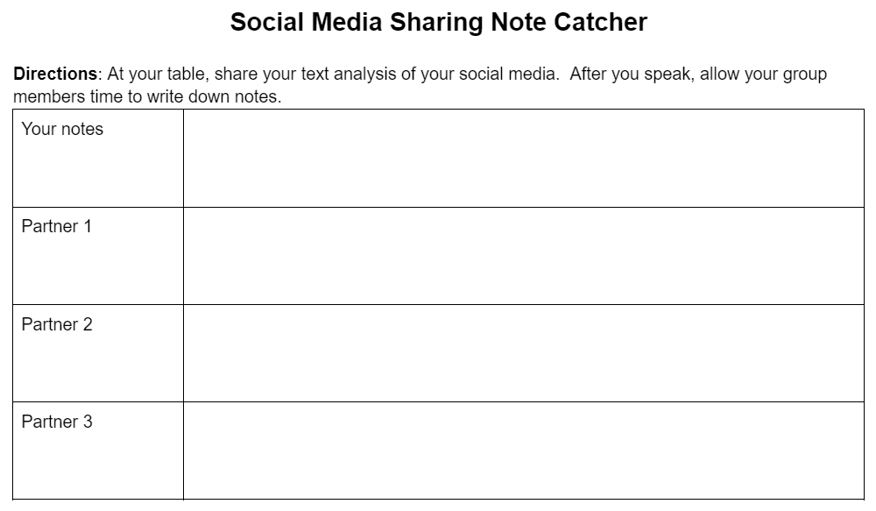
The So, what…
Individually:
Is this reporting asking the reader to do something?
Is the social media post asking the viewer to do something?
Was anything you read this week trying to change your mind? Did it work?

Slide 50
The So, what… Share out

Slide 51
The So, what… Reflection
Evaluate the quality of information. Did you learn something new?
Evaluate bias in the posts presented. Could you trust them? Why or why not?
Evaluate the imperative. Does this post ask the viewer to do something? If yes, what?

Slide 52
Day 9
Agenda:
Bellringer: see, think, wonder
Review summative assessment and sample presentation
Work on presentation
SWBAT collaborate to create a presentation on group article and social media post analysis.

Slide 53
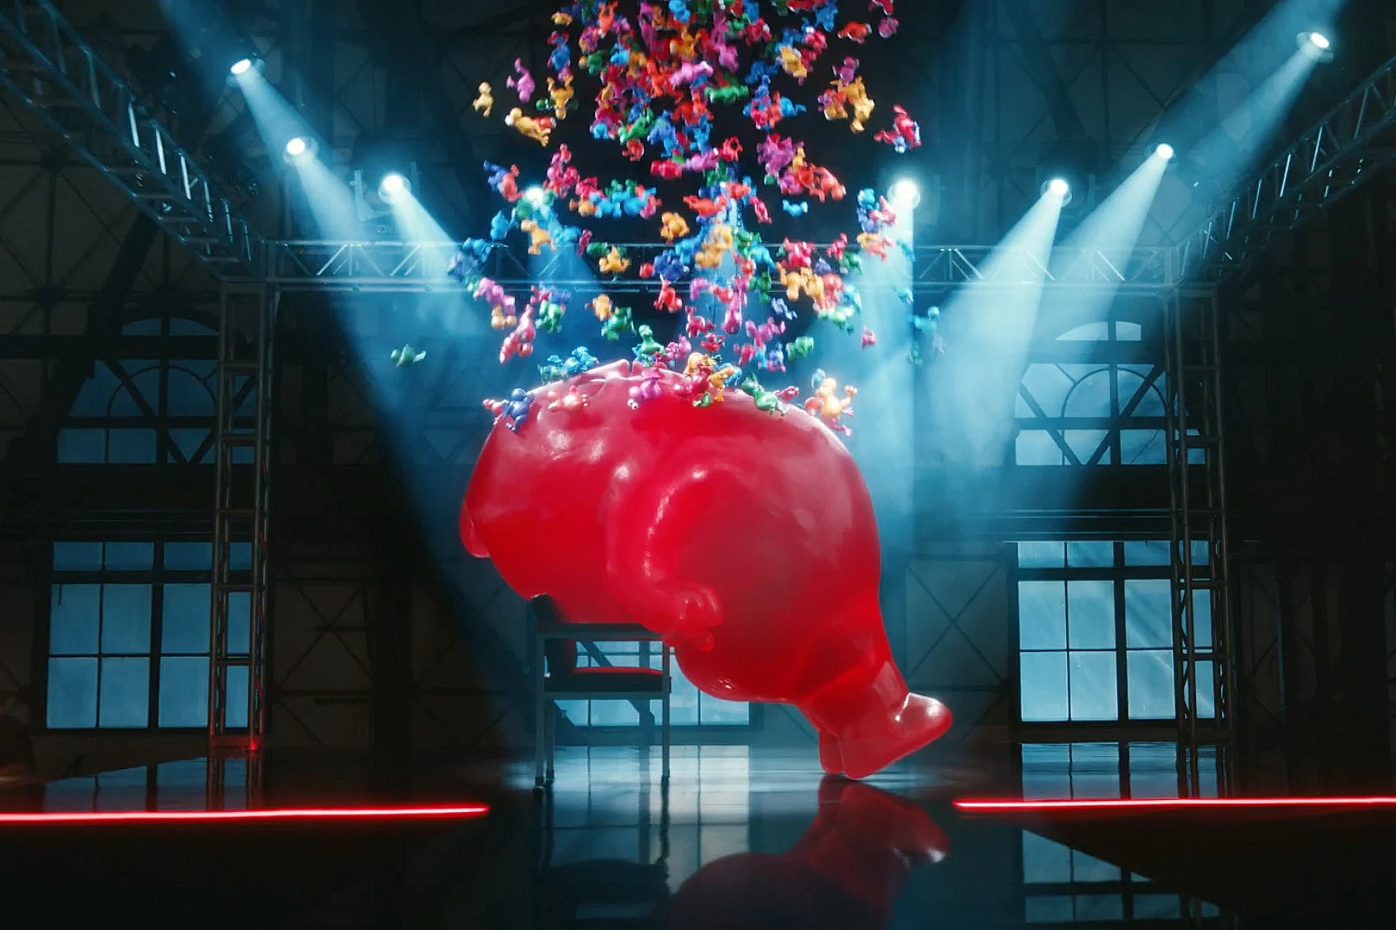
See - Think - Wonder
What is the:
Message
Audience
Speaker
Purpose
Context
+ Free Write
Write for 5 minutes without stopping.
Is bias or an imperative in this picture?

Slide 54
Bellringer:
Get a chromebook
Open the sample presentation I posted earlier today. (It is on the assignment from yesterday.)
Take your earbuds out and be prepared for me to explain things for 4 minutes.

Slide 55
Expectations
Teacher Check-in
Follow your groups norms.
Distribute the work so everyone contributes.
Keep conversations on task.
Keep your checklist and rubric nearby.
As you work, I will check-in with each group. I will look your your content and visual layout.
Be prepared to share!

Slide 56
Day 10
Agenda:
Bellringer: see, think, wonder
Groups work on presentations
Teacher check-ins
SWBAT collaborate to create a presentation on group article and social media post analysis.

Slide 57

See - Think - Wonder
What is the:
Message
Audience
Speaker
Purpose
Context
Is bias or an imperative in this picture?
+ Free Write
Write for 5 minutes without stopping.

Slide 58
Expectations
Teacher Check-in
Follow your groups norms.
Distribute the work so everyone contributes.
Keep conversations on task.
Keep your checklist and rubric nearby.
As you work, I will check-in with each group. I will look your your content and visual layout.
Be prepared to share!

Slide 59
Day 11
Agenda:
Groups complete and revise presentations
Practice presentations with a partner
Provide feedback - formative #2
SWBAT prepare for presentation by practicing with another group and provide feedback to another group

Slide 60
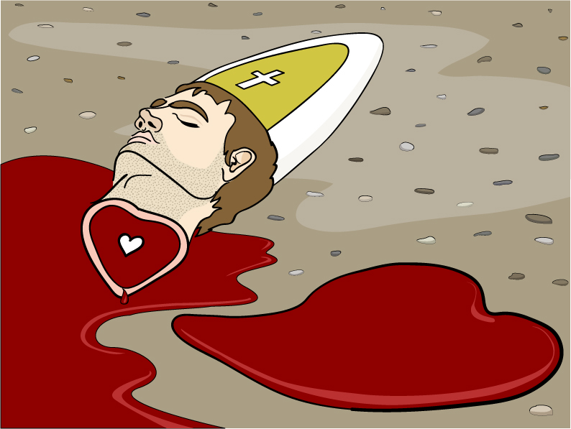
See - Think - Wonder
+ Free Write
Write for 5 minutes without stopping.
What is the:
Message
Audience
Speaker
Purpose
Context

Slide 61
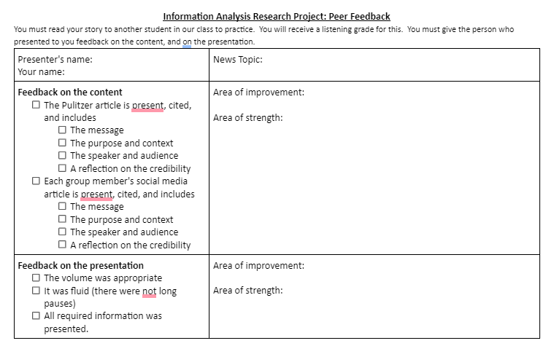
Practice Presentations
Go to your assigned partner.
Practice speaking your presentation
Give your partner feedback.
After peer reviews, make final revisions to your presentations.

Slide 62
Day 12
Agenda:
Final group meeting to finalize presentations
Begin presentations
Complete feedback listening form
Note: rubrics and listening form in summative assessment.
SWBAT present group articles and provide feedback for other groups.

Slide 63
Listening Rubric:
MYP Language Acquisition: Criterion A: Listening: iii.analyse connections
Score | 1-2 | 3-4 | 5-6 | 7-8
Level descriptor | iii.identifies basic connections in complex authentic texts. | iii.identifies basic connections in complex authentic texts. | iii.interprets connections in complex authentic texts. | iii.analyses connections in complex authentic texts.
% | 69%-50% | 79%-70% | 89%-80% | 100%-90%
On this task | iii. basic = reflects on the bias and imperative in a way that shows understanding of the issue in less than half of presentations OR shows frequent misunderstanding of the issue. | iii. basic = reflects on the bias and imperative in a way that shows understanding of the issue some presentations OR shows some misunderstanding of the issues. | iii. interprets = reflects on the bias and imperative in a way that shows understanding of the issue in most presentations OR shows limited misunderstanding of the issues. | iii. Analyzes = reflects on the bias and imperative in a way that shows understanding of the issue in all presentations

Slide 64
Speaking Rubric:
MYP Language Acquisition: Criterion C: Speaking: i.use a wide range of vocabulary
Score | 1-2 | 3-4 | 5-6 | 7-8
Level descriptor | i.uses a limited range of vocabulary | i.uses a basic range of vocabulary | i.uses a range of vocabulary | i.uses a wide range of vocabulary
% | 69%-50% | 79%-70% | 89%-80% | 100%-90%
On this task | i. Limited range - uses academic language while speaking clearly, and loudly less than half of the time. | i. Basic range - uses academic language while speaking clearly, and loudly some of the time. | i. Range = uses academic language while speaking clearly, and loudly most of the time. | i. Wide range = uses academic language while speaking clearly, and loudly all of the time.

Slide 65
Text Analysis Presentations
On the day of your presentation - TODAY!
Your assigned day is at the end of this slideshow or poster.
Your whole group comes to the front of the class.
If you slide is incomplete on the day of your presentation, you still have to present what you have.
People who are not presenting, will have to take notes for the listening grade.

Slide 66
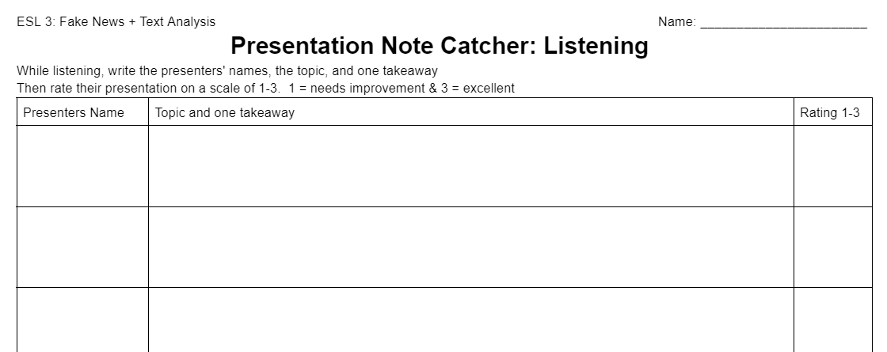
Peer Feedback Form
Names
Topic
1 Takeaway
Rating

Slide 67
Day 13
Agenda:
Complete presentations
Listening forms
Unit Reflection (google form)
Group work feedback & grade
Note: rubrics and listening form in summative assessment.
SWBAT present group articles and provide feedback for other groups.

Slide 68
Peer Feedback Form
Names
Topic
1 Takeaway
Rating

Slide 69

Unit Reflection Form
Get a chromebook, and complete the Pulitzer Center Research Reflection Form.

Slide 70
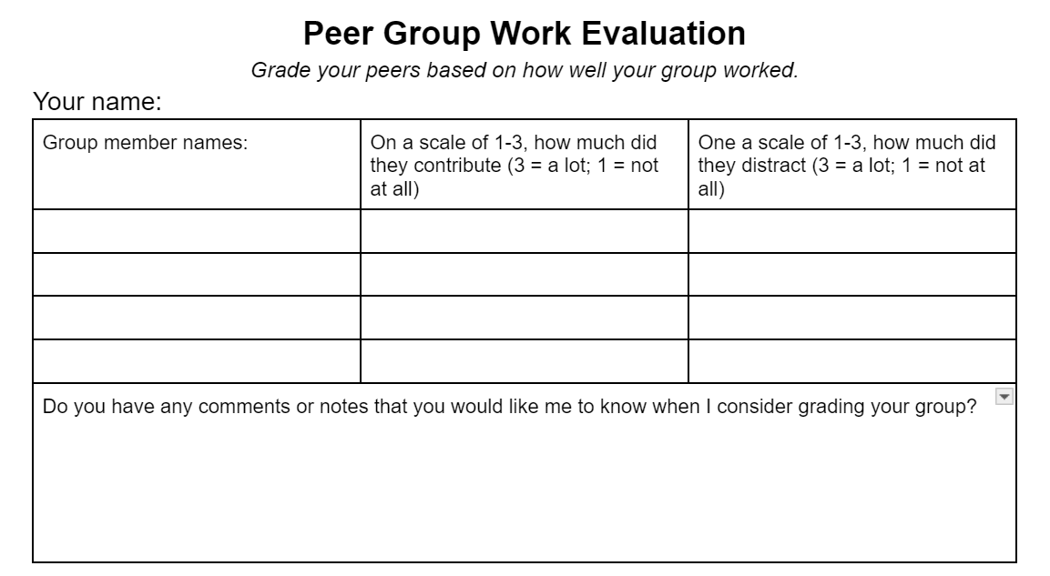
Group Member Feedback and Grades

