Slide 1

ARRIVAL: COMING TO AMERICA by Mario Delgado

Slide 2

A Conversation with my Mother
How did you Initially arrive to the United States?
What was your reason(s) for coming to the United States?
Could you describe your living arrangement when you arrived?
What was the biggest obstacle(s) you faced?
Could you describe your experience becoming a U.S Citizen?
What are your plans for the future?

Slide 3
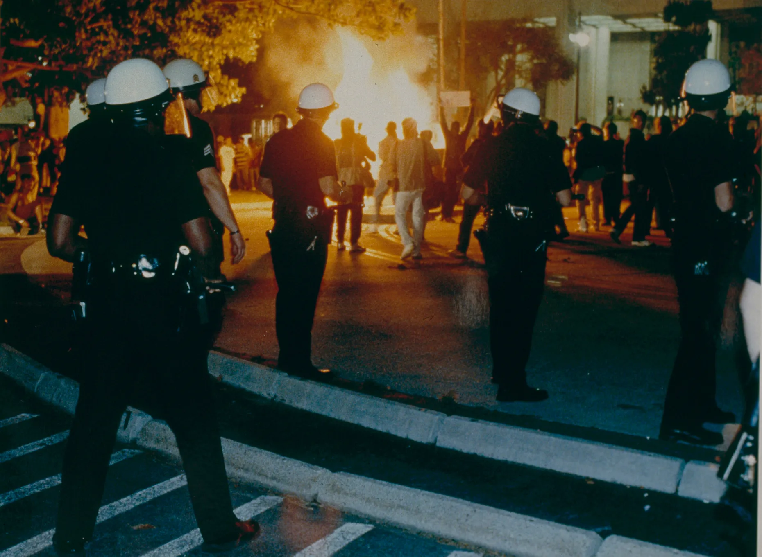
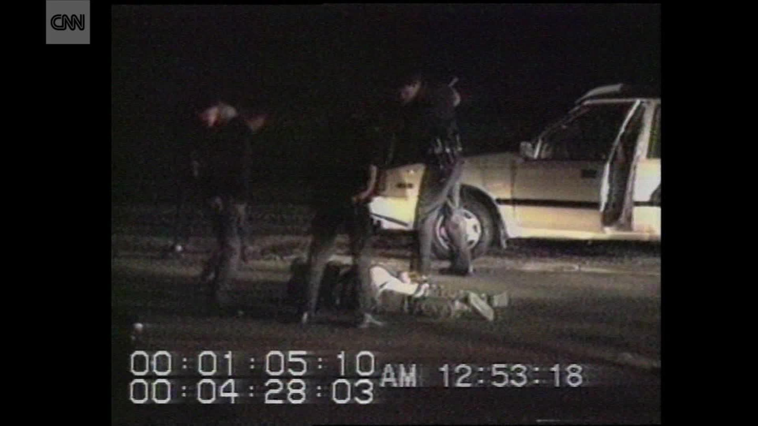
1990’s California
RODNEY KING
Victim of Police Brutality
Video Footage of LAPD beating King
Riots break out in Los Angeles in 1992

Slide 4
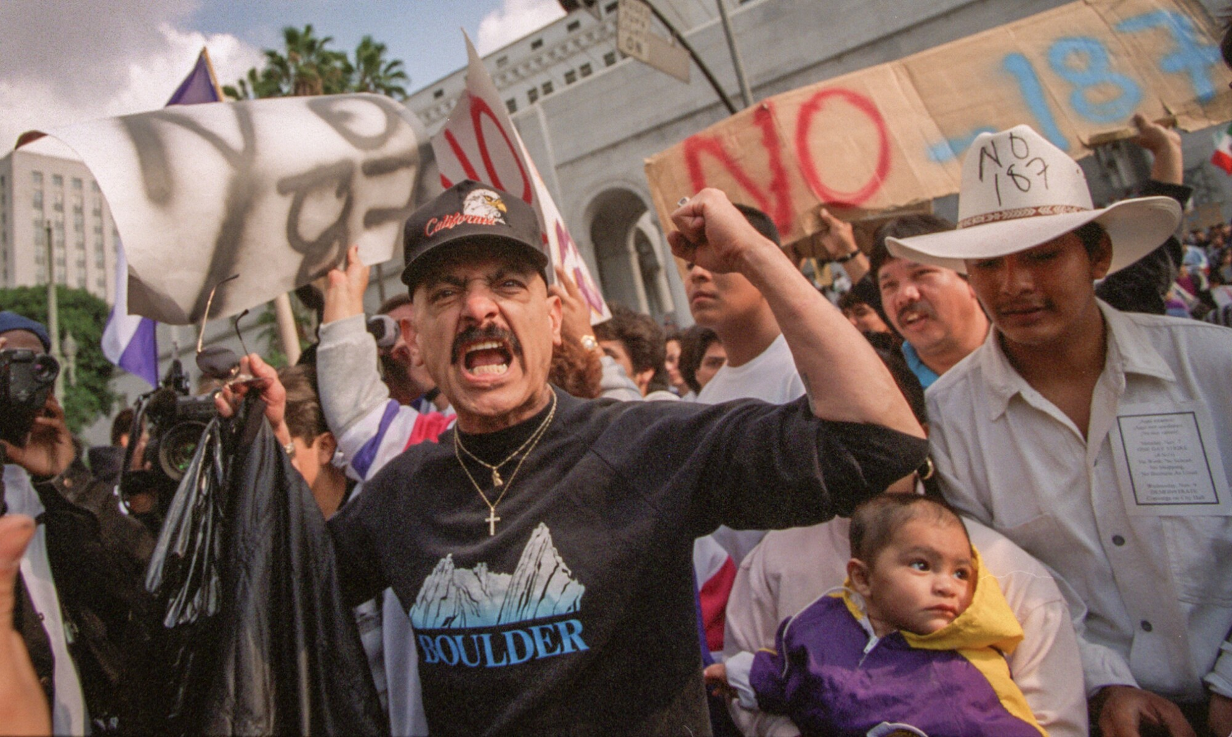
1994: California’s Proposition 187
California’s voters passed Proposition 187, a ballot initiative proposed by anti-immigrant organizations, which restricted undocumented immigrants from the state’s public services, including access to public education and healthcare. In addition, the proposition directed teachers and healthcare professionals to report any individuals suspected of being undocumented to the Immigration and Naturalization Services (INS)
Used as a scapegoat, during a time of Economic recession, placing blame on those who were undocumented.
Deemed Unconsitional under the 14th amendement

Slide 5
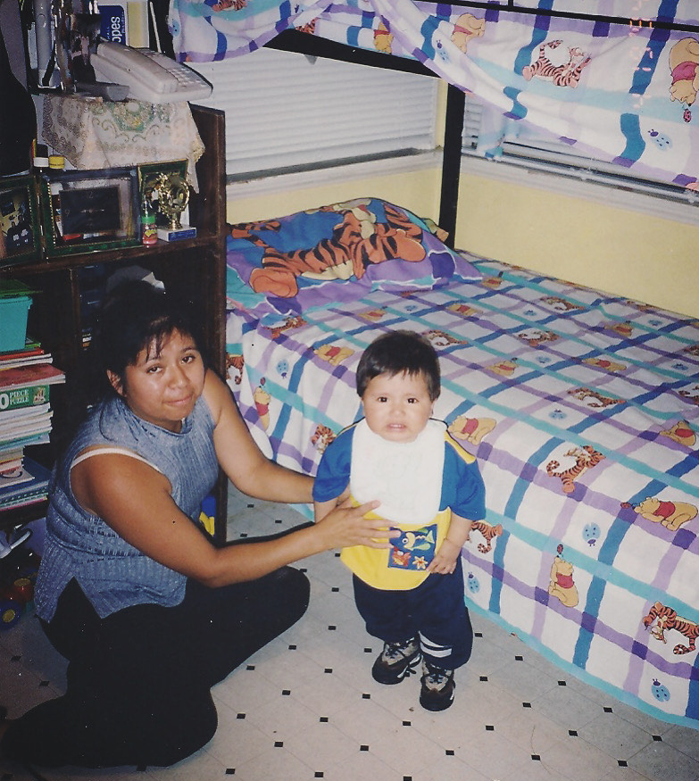
Living Arrangements
3 Bedroom House,
1 Bathroom
Households, with multiple families,
10-15 Individuals
Small living spaces

Slide 6
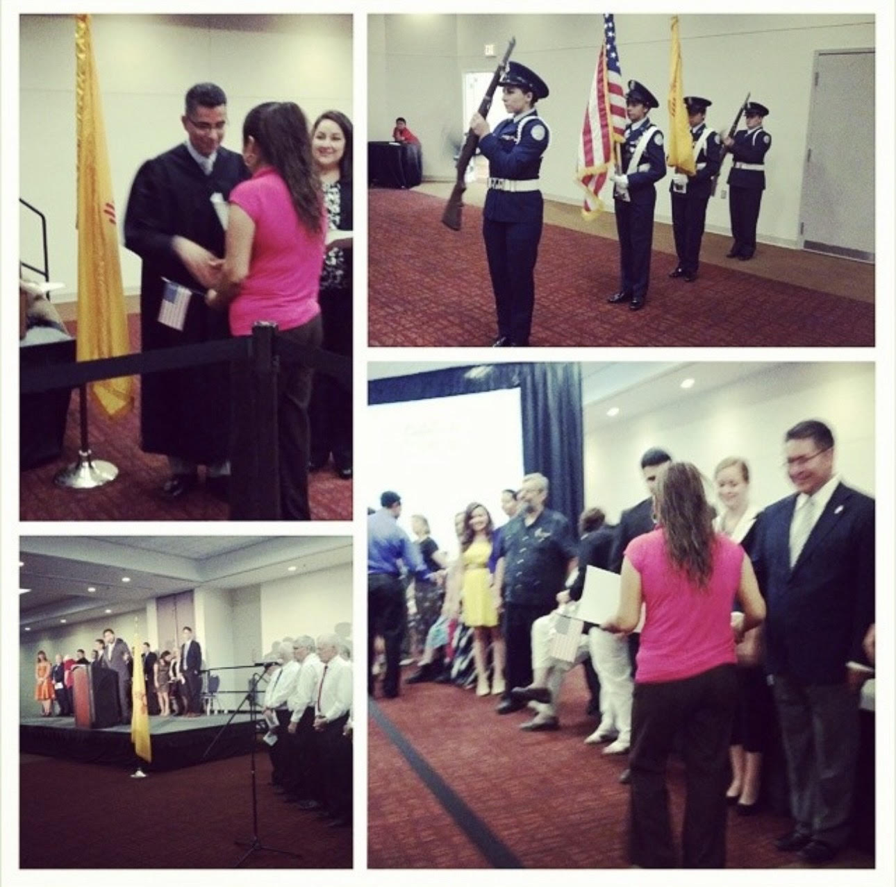
Citizenship (2014)
The Civics Test
Language Barrier
Flash Cards
Rosetta Stone

Slide 7
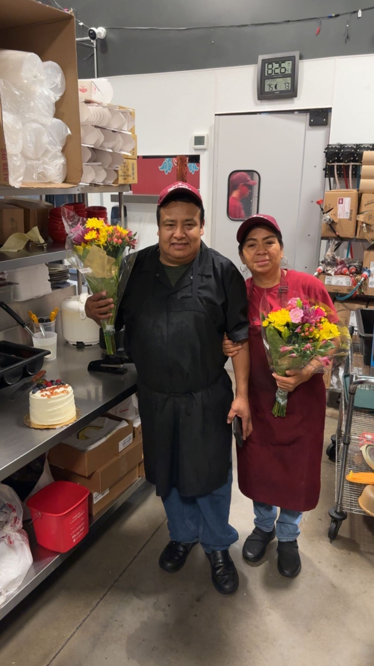
The American Dream
Restaurant Owners
34 Years of Marriage
5 Children

Slide 8
Cited Resources
Interview
https://www.history.com/this-day-in-history/police-brutality-caught-on-video
1994: California's Proposition 187 - A Latinx Resource Guide: Civil Rights Cases and Events in the United States - Research Guides at Library of Congress (loc.gov)

