Slide 1

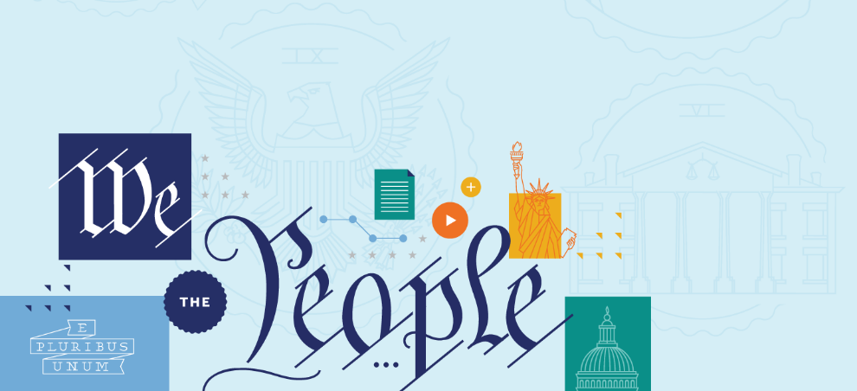

FIRST AMENDMENT:
SPEECH AND PRESS
First Amendment: Speech and Press

Slide 2
BIG QUESTIONS
What was the Founding generation’s vision for the First Amendment’s protection of free speech and a free press?
What are some of the key periods in history that have tested the nation’s commitment to free speech?
How has the Supreme Court interpreted the First Amendment’s commitment to free speech and a free press over time?
How does the Supreme Court analyze free speech and free press cases today?
First Amendment: Speech and Press

Slide 3
BIG IDEA
Today, the Supreme Court protects free speech rights more strongly than at any time in our nation’s history—and American free speech protections are among the strongest in the world. Generally speaking, the government may not jail, fine, or punish people or organizations based on what they say or write, and the Court protects speech unless it is likely to cause immediate lawless action. (A standard rarely met in practice.) At the same time, there are certain contexts when the government has more leeway to regulate speech—for instance, with low-value speech like defamation or when speakers (like public school students) have a special relationship with the government.
First Amendment: Speech and Press

Slide 4
THE FIRST AMENDMENT
RELIGION
SPEECH AND PRESS
ASSEMBLY AND PETITION
First Amendment: Speech and Press
ESTABLISHMENT CLAUSE
FREE EXERCISE CLAUSE

Slide 5
THE FIRST AMENDMENT
Congress shall make no law respecting an establishment of religion, or prohibiting the free exercise thereof; or abridging the freedom of speech, or of the press; or the right of the people peaceably to assemble, and to petition the Government for a redress of grievances.
First Amendment: Speech and Press

Slide 6
THE FIRST AMENDMENT
Congress shall make no law…
abridging the freedom of speech, or of the press…
First Amendment: Speech and Press

Slide 7
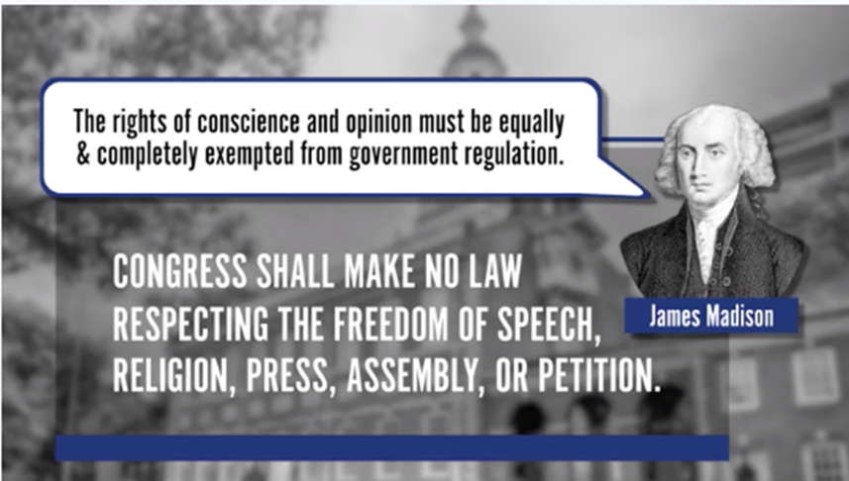
THE FIRST AMENDMENT
First Amendment: Speech and Press

Slide 8
WHAT IS COVERED?
The Supreme Court has interpreted “speech” and “press” broadly as covering not only talking, writing, and printing, but also broadcasting, using the Internet, and other forms of expression.
First Amendment: Speech and Press

Slide 9
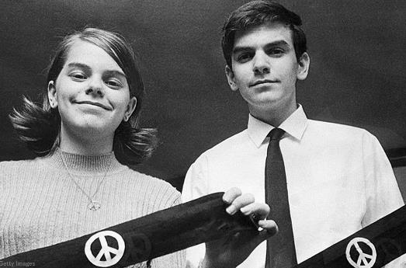
WHAT IS COVERED?
The freedom of speech also applies to symbolic expression, such as displaying flags, burning flags…wearing armbands, and the like.
First Amendment: Speech and Press

Slide 10
WHAT IS NOT COVERED?
The First Amendment does not protect speakers against private individuals or organizations, such as private employers, private colleges, or private landowners. The First Amendment restrains only the government.
First Amendment: Speech and Press

Slide 11
THE FIRST AMENDMENT
The Supreme Court has frequently declared that the very core of the First Amendment is that the government cannot regulate speech based on its content. Thus, the Supreme Court has held that restrictions on speech because of its content—that is, when the government targets the speaker’s message—generally violate the First Amendment.
First Amendment: Speech and Press

Slide 12
BIG IDEA
The government may not jail, fine, or punish people or organizations based on what they say or write, except in exceptional circumstances.
First Amendment: Speech and Press

