Slide 1
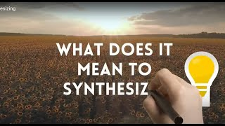
Notes:
Your students may or may not need a refresher on synthesizing. If they do, this is an easily understandable two-minute video.

Slide 2
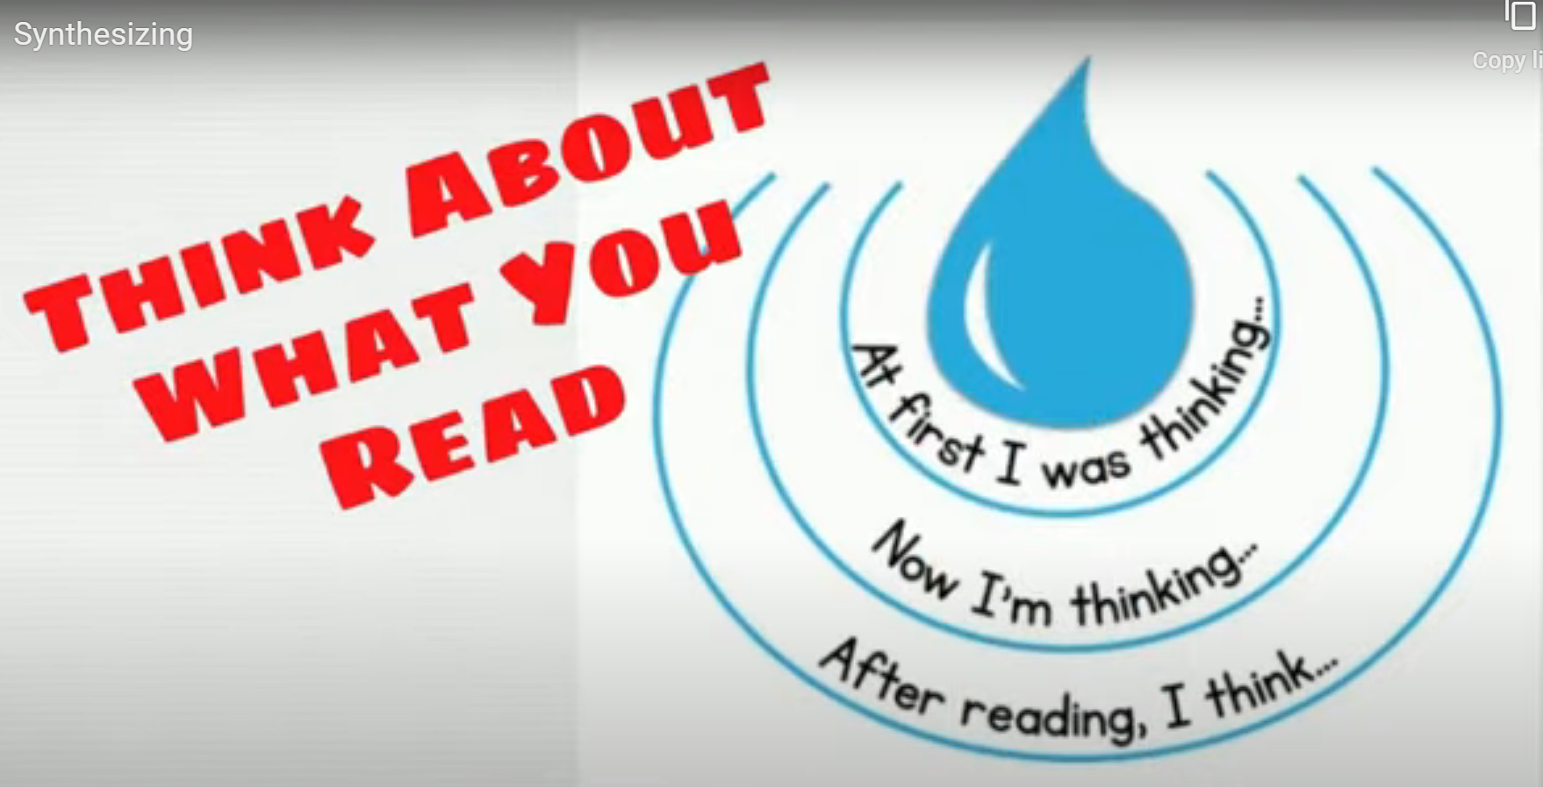
Synthesizing Your Reading
Look back at your journal responses from last week and use them to answer these questions:
At first, what did you know or think about immigration in America?
What did you think about it after we read a few articles together?
Now, after reading more information about global migration, what do you think?
Notes:
Have students think-pair-share or work with a small group to discuss their responses. After about 3 minutes, consider moving to full class to hear some prevalent thoughts.

Slide 3
Putting it All Together
Practice summarizing and synthesizing, as well as writing an effective claim and call to action for a specific audience.
You will be asked to do this in your unit summative - this is practice!
Notes:
Have students complete this exit ticket on a post-it note or index card, then collect them so you can understand current thoughts and questions.

Slide 4
Reflection Questions:
How did investigating the reporting on migration change a perspective you held or give you a new understanding? Explain the change.
How did the specific reporting you read change your perspective or give you a new understanding about news? Explain.
Discuss one element of the reporting you studied that stood out to you as being helpful, new, or interesting.
Notes:
Provide about 5 minutes for students to search for information and jot down thoughts in their journals.

Slide 5
Thanks!
Do you have any questions?
youremail@freepik.com
+34 654 321 432
yourwebsite.com
Please keep this slide for attribution

Slide 6


