Slide 1
Sit in your new group - you are sharing a topic of common interest
Warm-Up: As a group, list everything you already know about your topic.

Slide 2
Exploring Your Topic
For the rest of class and for the next two days, you will become experts on your assigned topic by exploring reporting on the topic both in America and globally. Use your topic map to access your reporting and complete an article analysis for each text.
All of that leads to…

Slide 3
Summative Assessment:
Informing and Influencing Using Social Media
Investigate your topic using reporting from The Pulitzer Center.
Become well-informed on the topic in America and globally.
Summarize and synthesize the information you find from the reporting.
Create an Instagram carousel. The posts will be directed at American teenagers. They must explain the issue, inform the audience about the most important facets of the issue, AND include a call to action that can influence the audience.

Slide 4
Let’s look at some examples.
An Instagram Carousel should
Have up to 10 graphics (may be text, photos, and/or videos (recent statistics show that a combination yields a higher engagement rate)
Begin with a strong visual impact
Tell your audience a story
Include a call to action
Use captions, hashtags, and tag accounts as appropriate
Maintain a consistent color scheme and visual layout

Slide 5
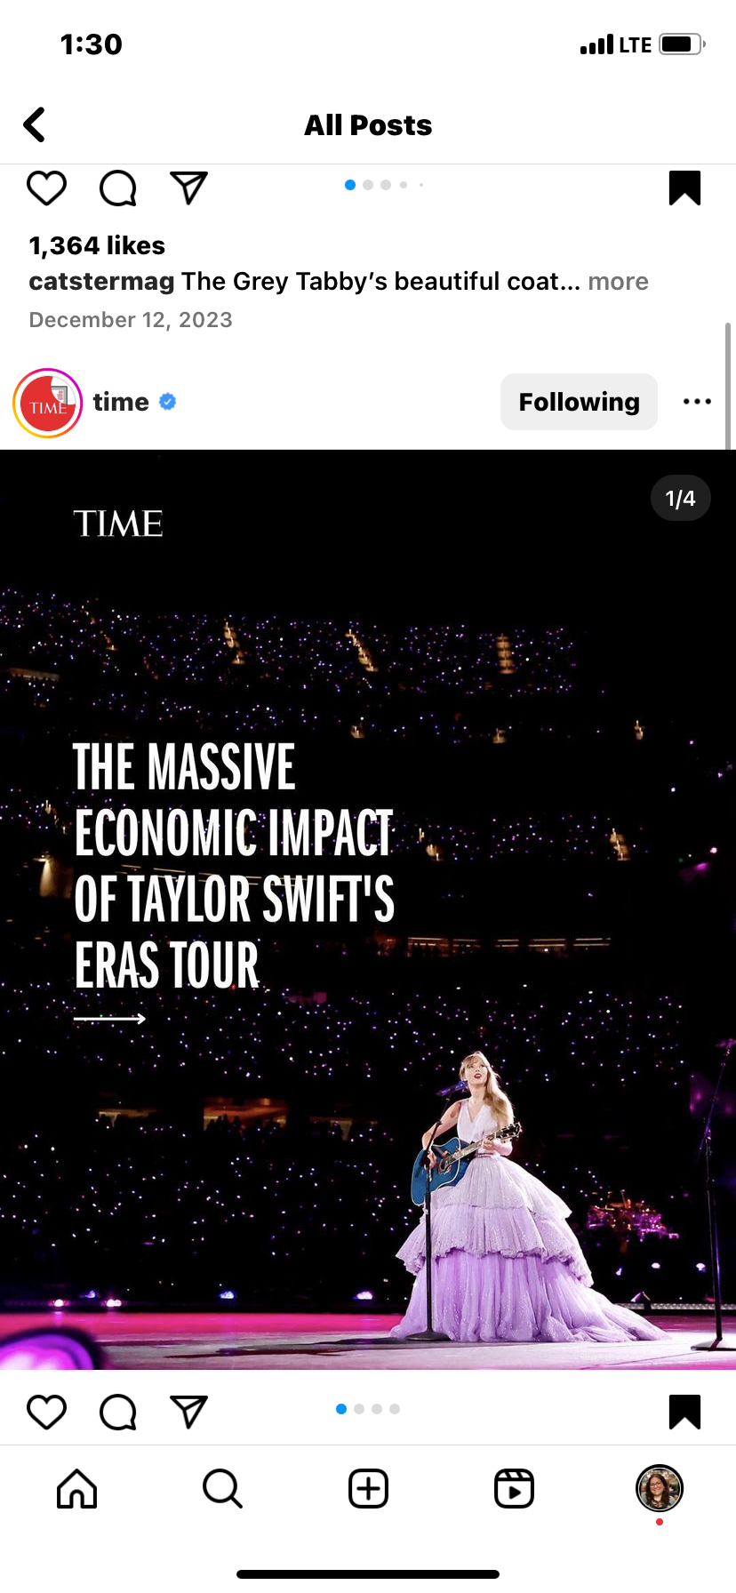
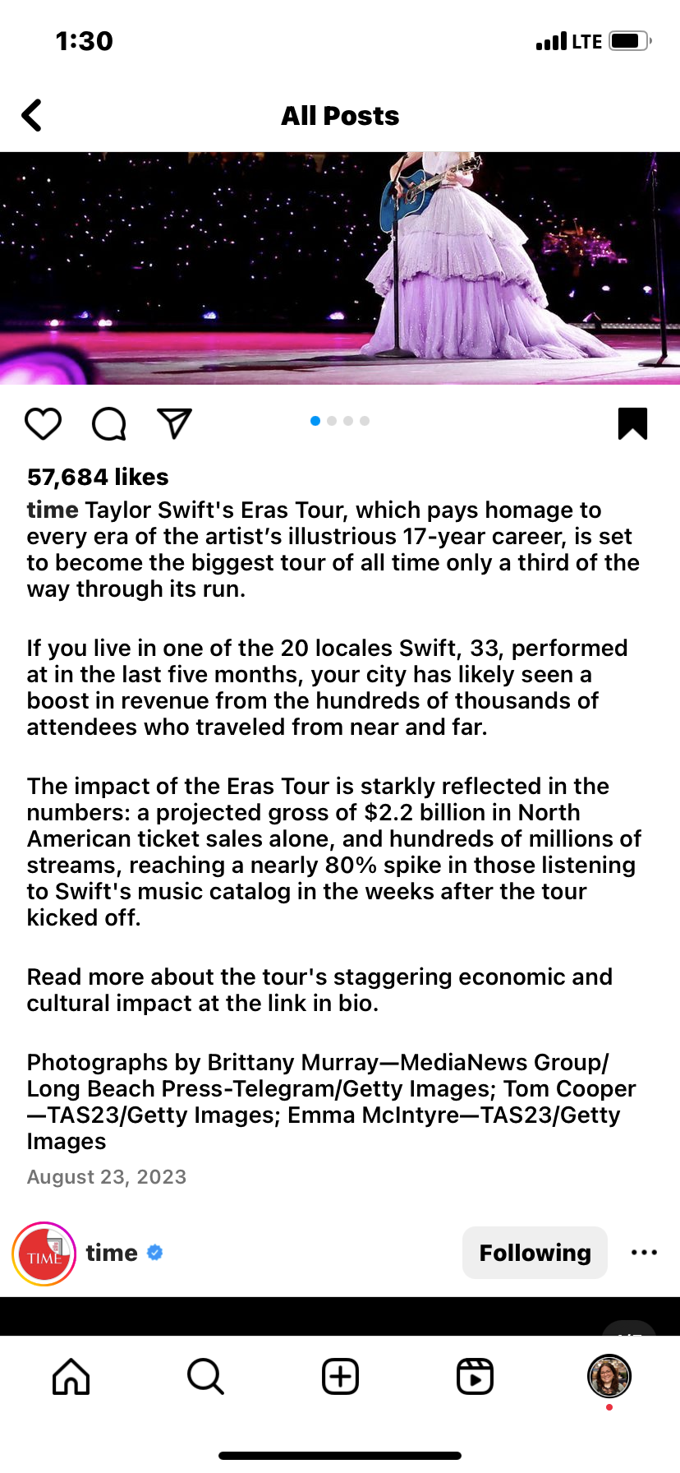

Slide 6
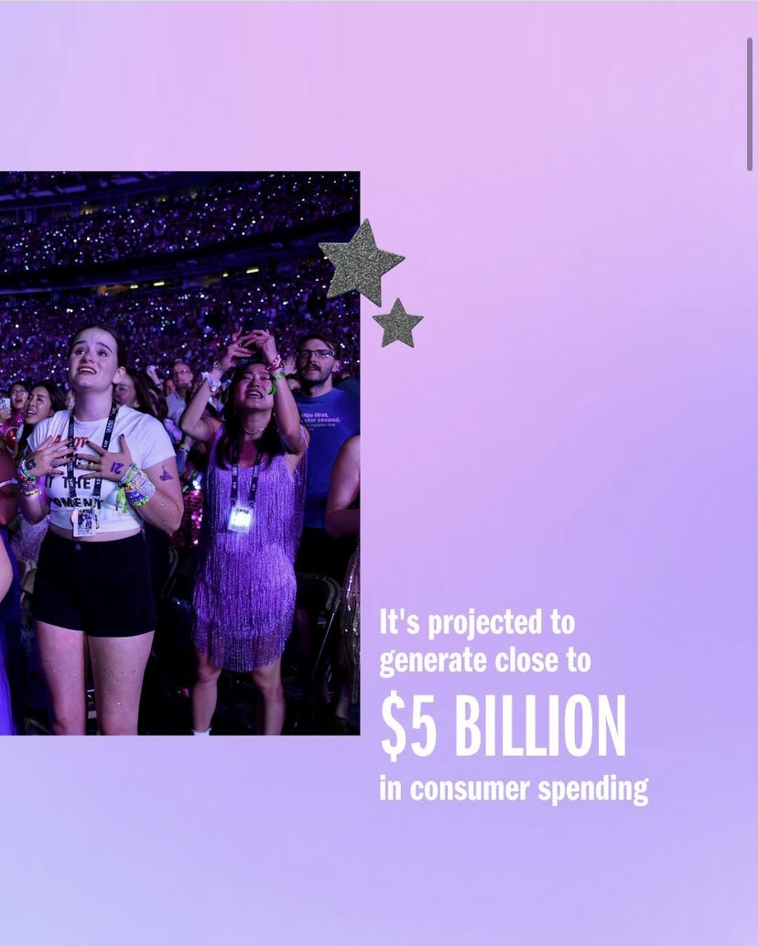
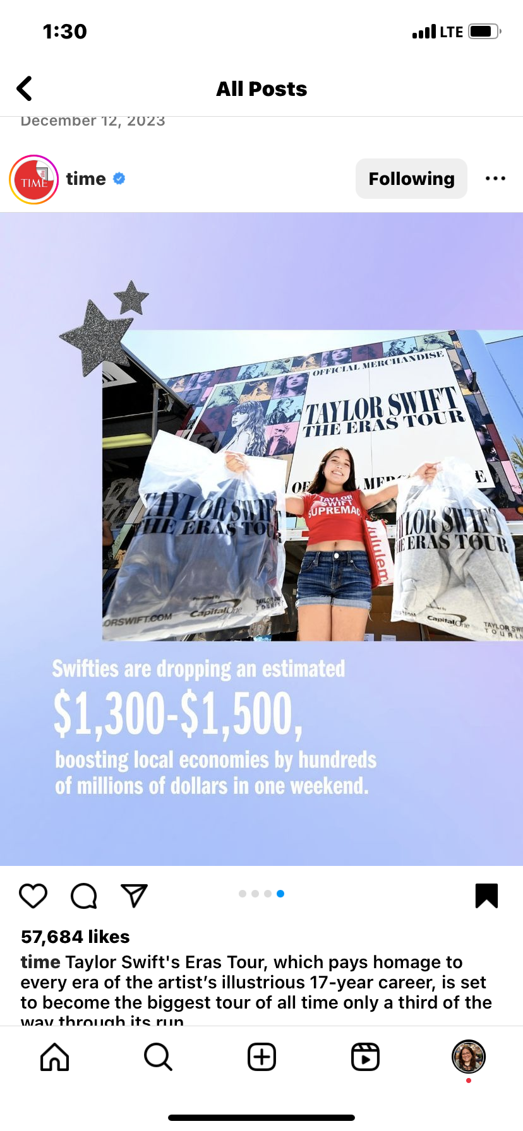
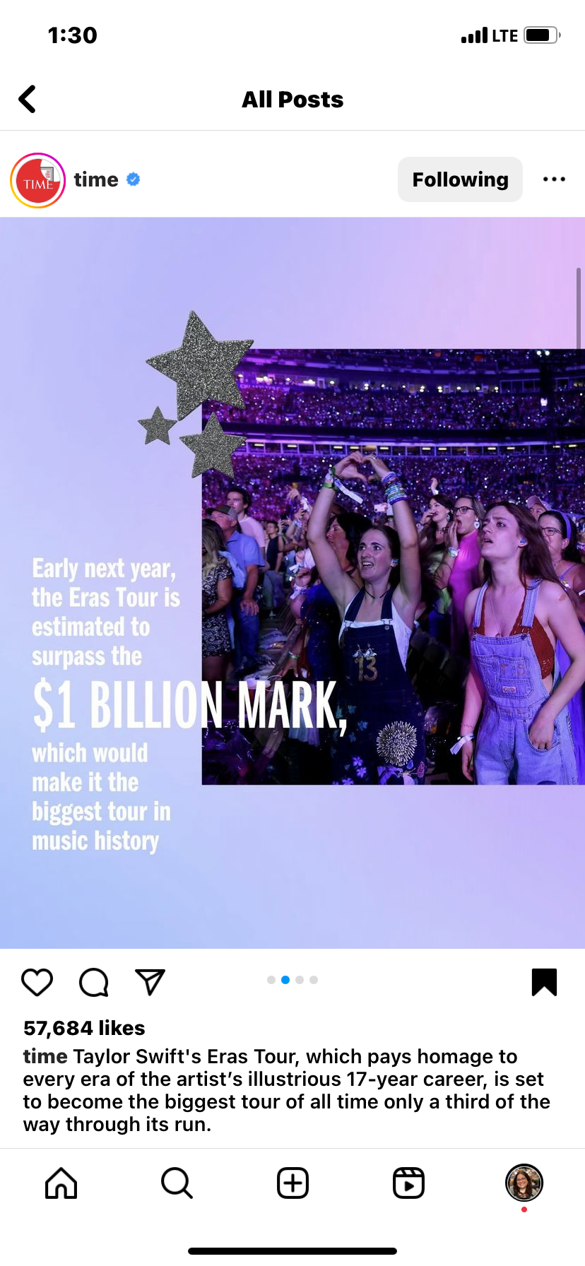

Slide 7
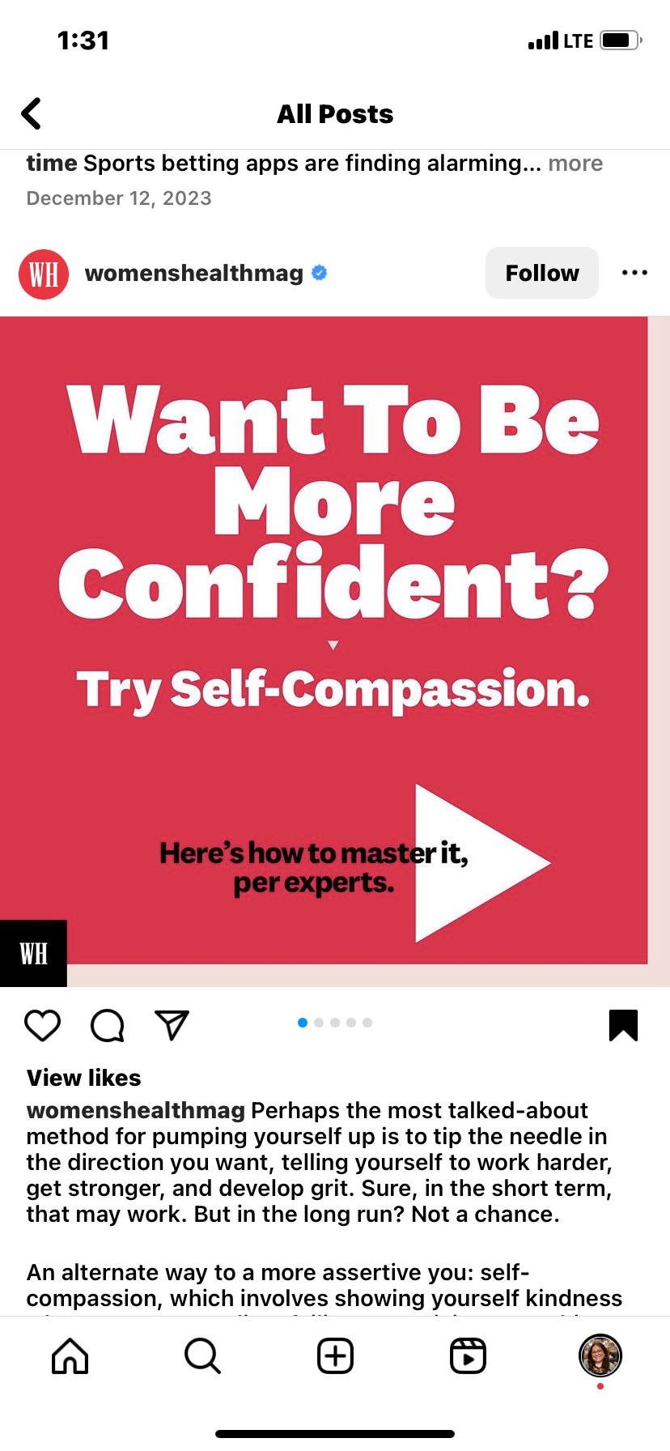
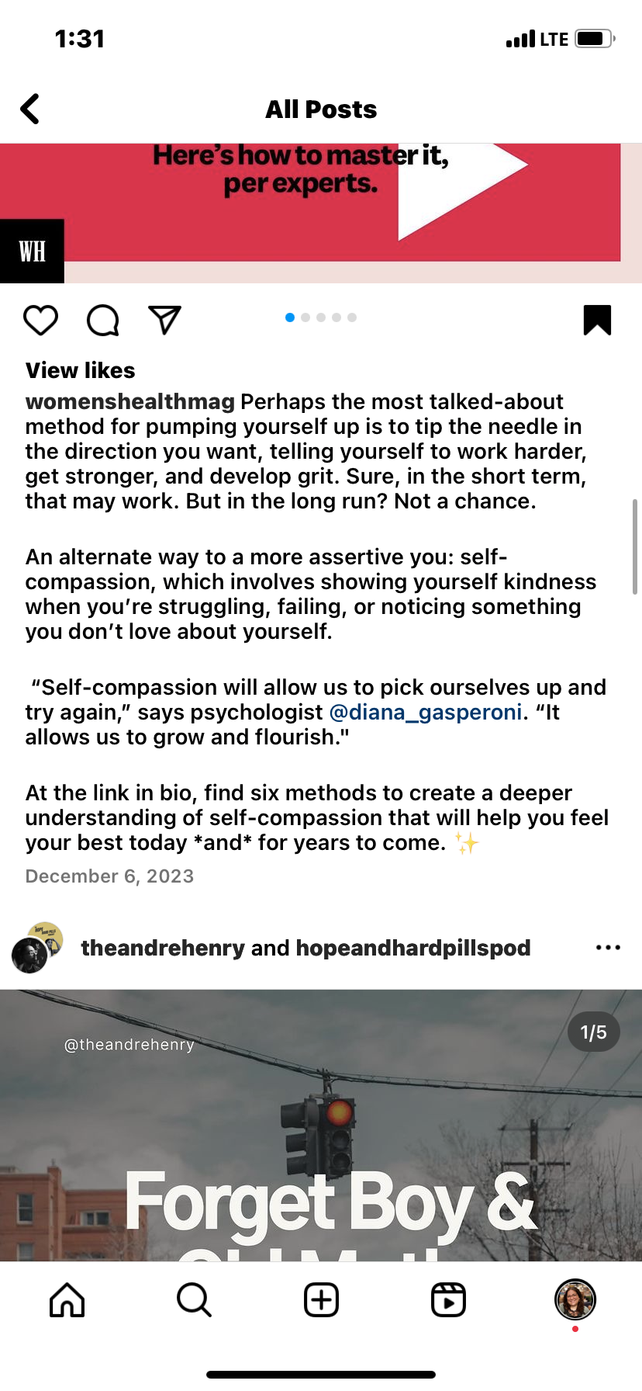

Slide 8
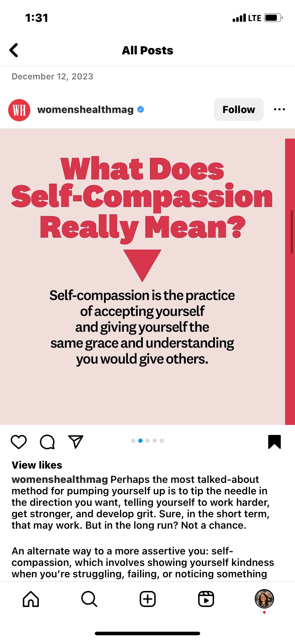
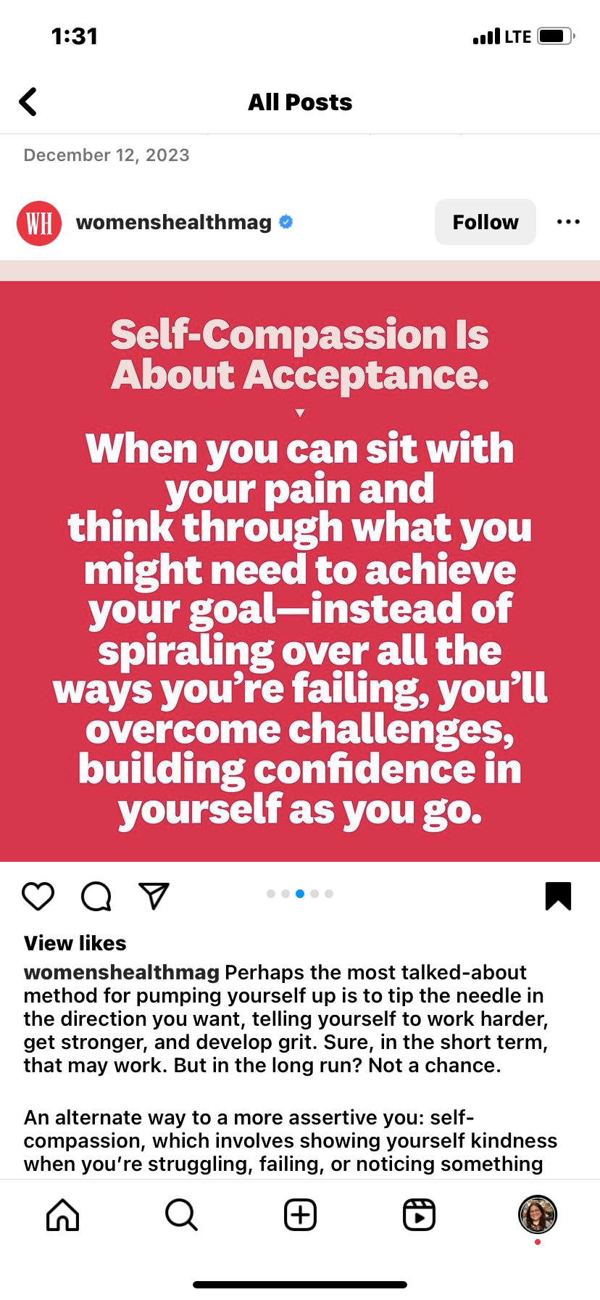
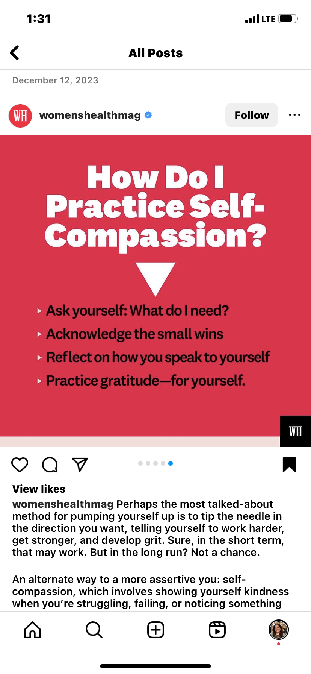

Slide 9
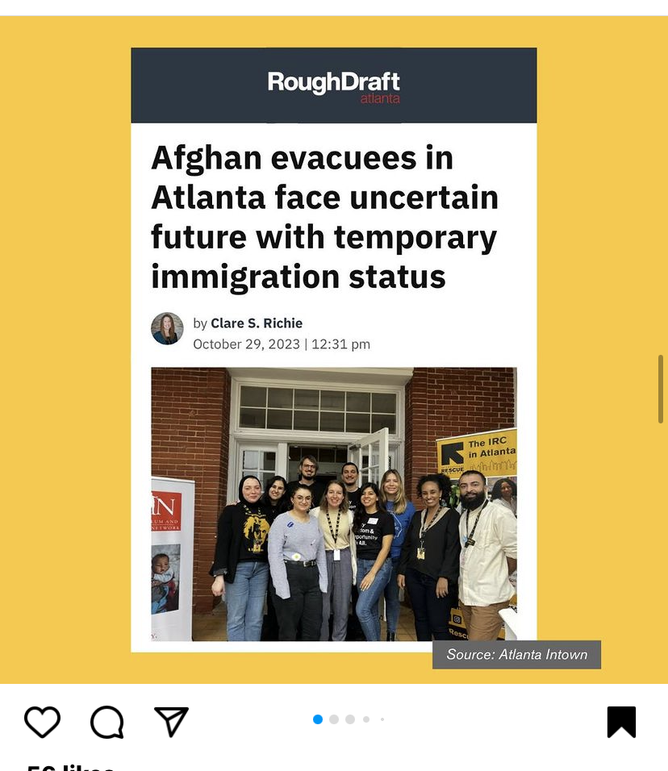
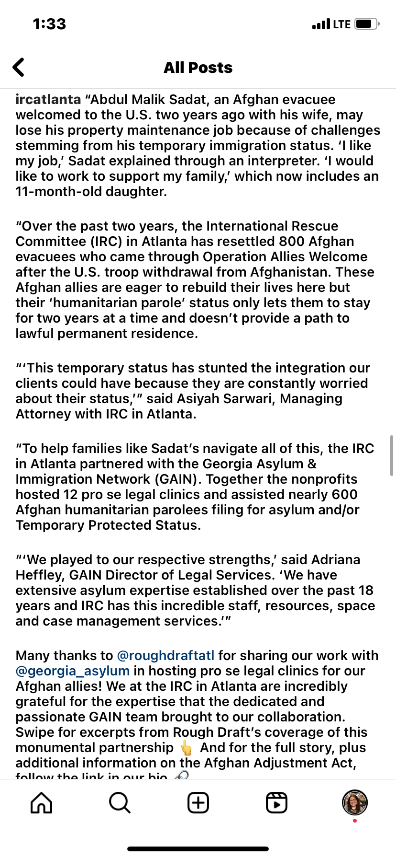

Slide 10
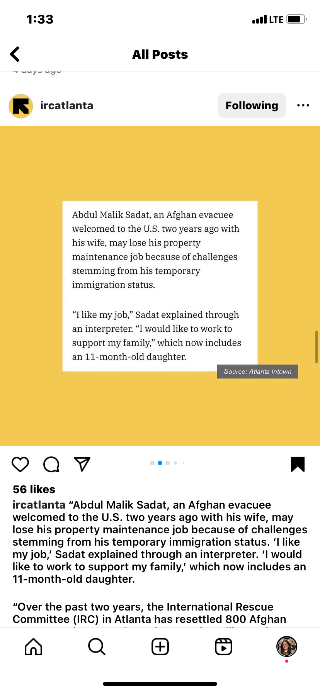
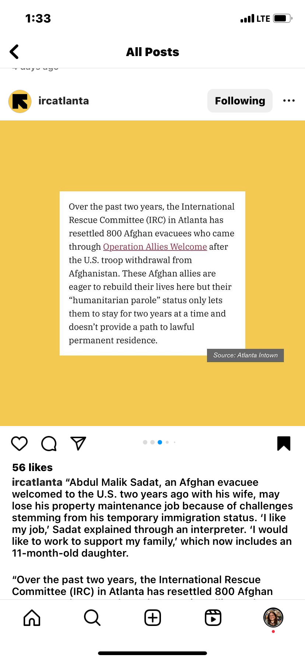
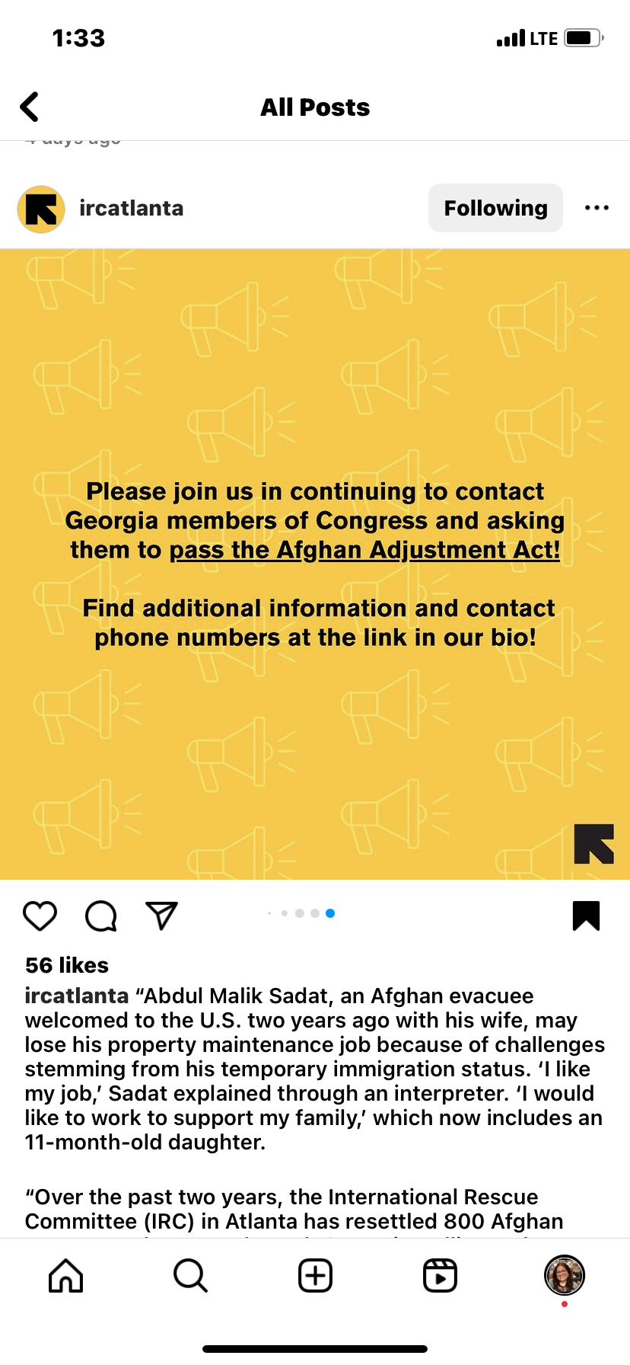

Slide 11



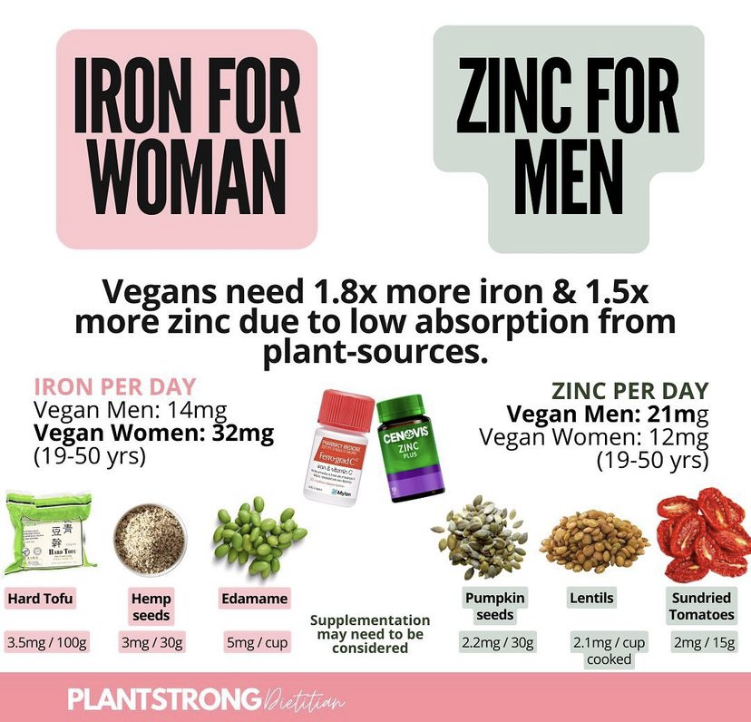


Slide 12
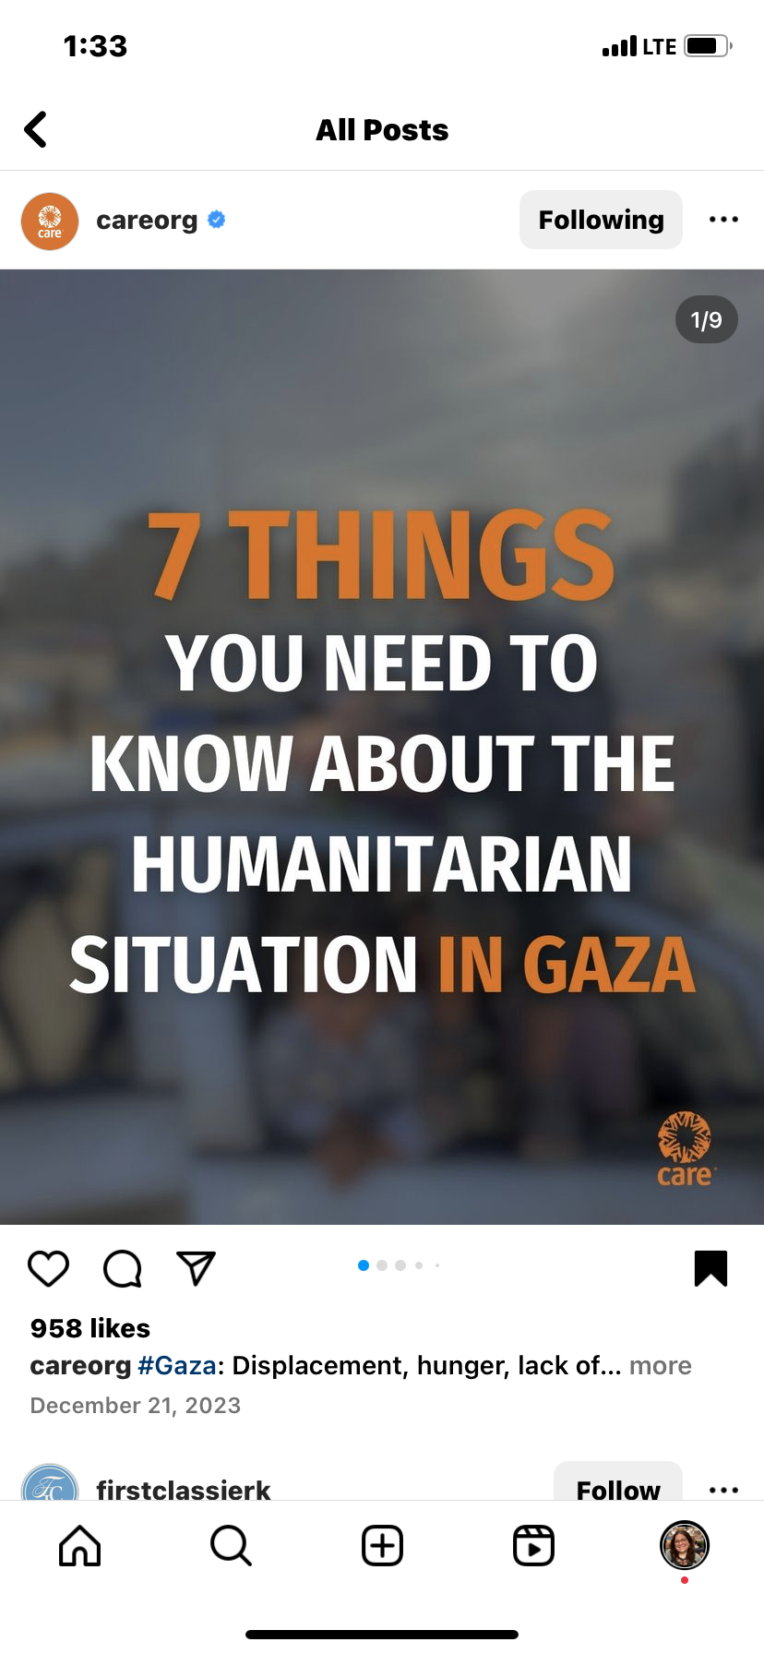
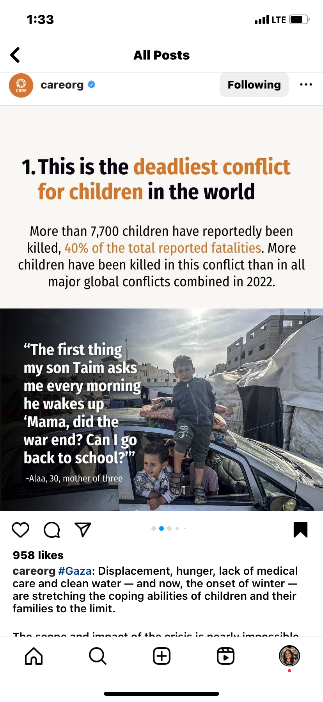
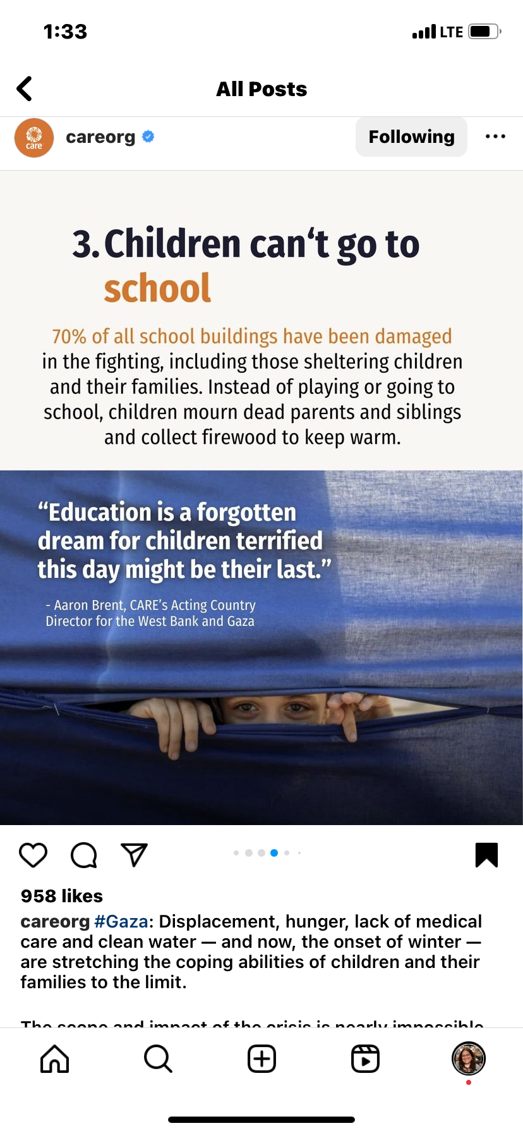
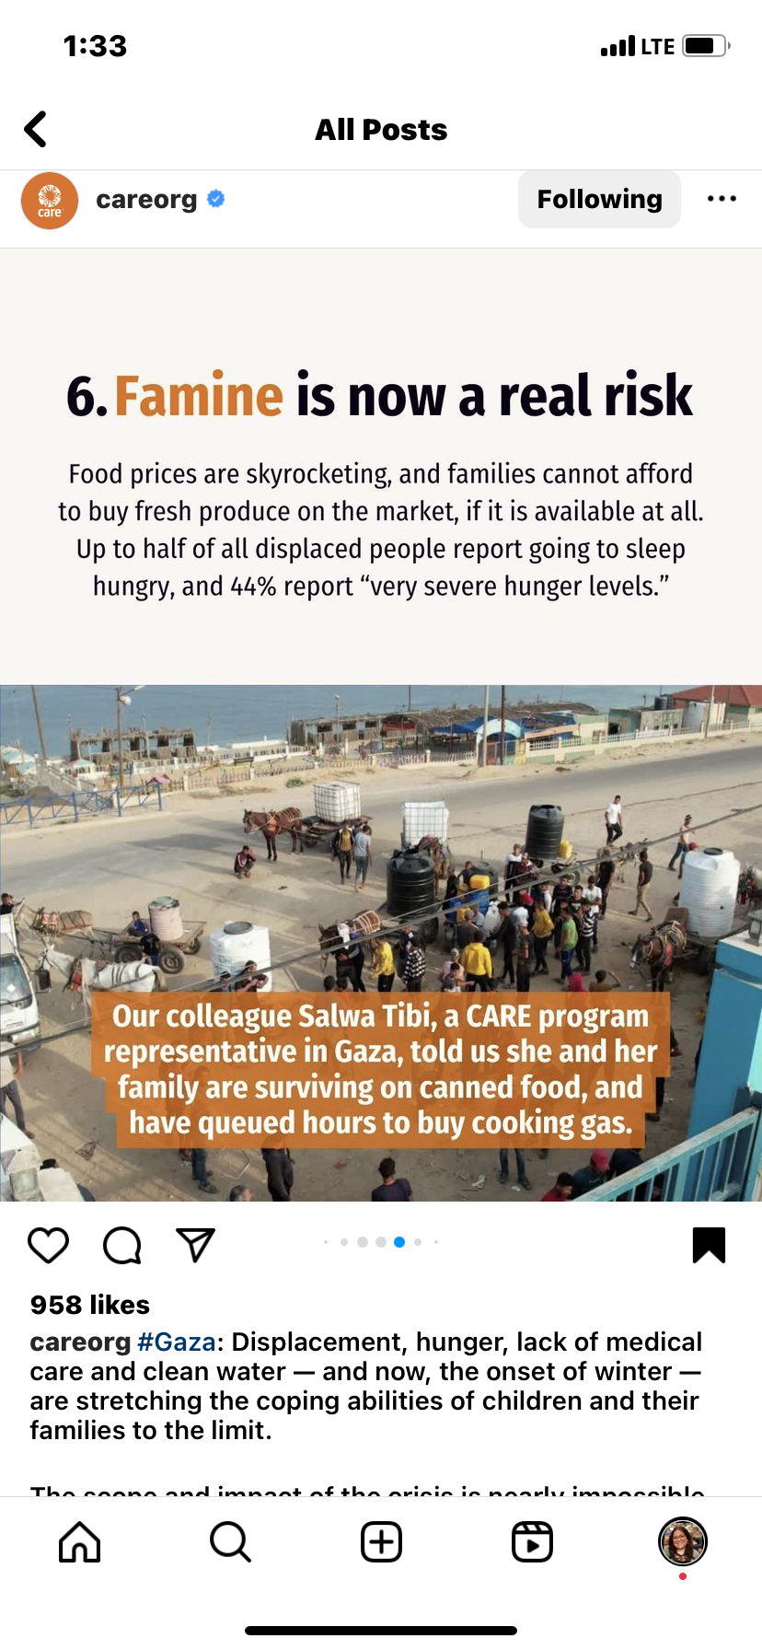
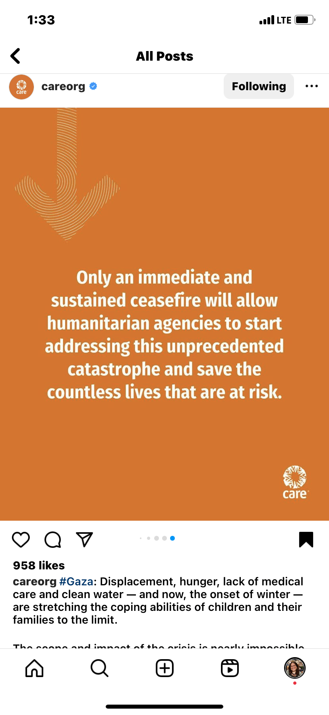
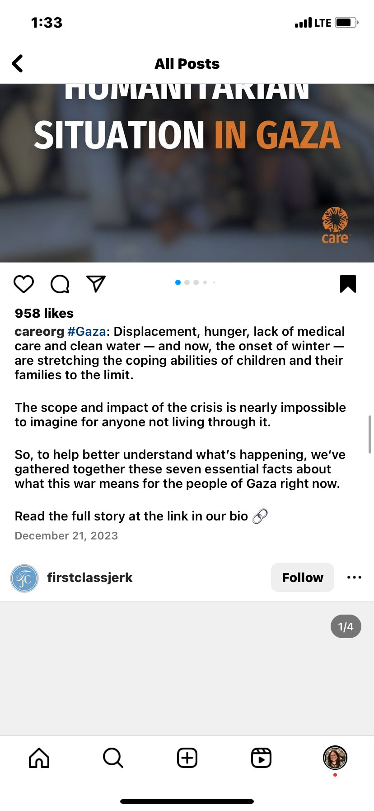

Slide 13
Topic Maps
Click on your topic to access your map and reporting.
Justice
Environment and Climate Change
Mental Health
Public Health
Women/Women’s Rights
Poverty/Homelessness
Indigenous People
Article Analysis Handout
[.pdf][.docx]
Be sure you complete an article analysis for each text! Keep up with them all; you’ll be turning them in when you finish your research.

Slide 14
Thanks!
Do you have any questions?
youremail@freepik.com
+34 654 321 432
yourwebsite.com
Please keep this slide for attribution

Slide 15


