Slide 1
Reflect and Respond:
Why do we need news?
Where and how do you get your news?
To what extent do news sources matter?
What are some of the main news stories in America right now that matter to you or interest you?
Notes:
Day One: Begin by having students independently respond to these questions in a journal or on post-it notes. Give about 5 minutes.

Slide 2
Discuss
Share your responses with your group.
Notes:
Have students think-pair-share or work with a small group to discuss their responses. After about 5 minutes, consider moving to full class to hear some prevalent thoughts.

Slide 3
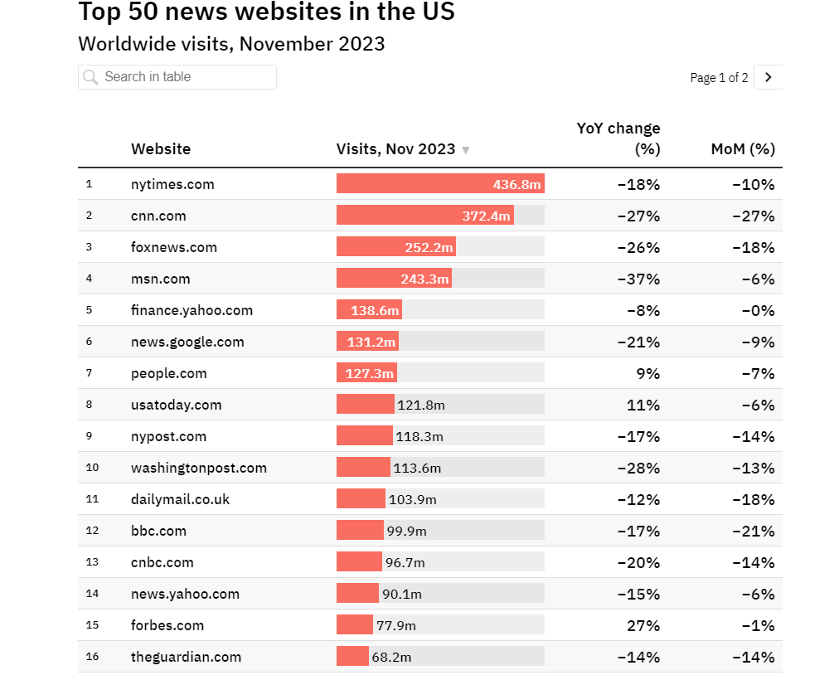
Source: PressGazette, Dec 31 2023
Notes:
Take a moment to look at this graphic, which shows the top 15 of the 50 most used news websites in America. Note that #5 is financial news only, #6 compiles news from all other sources rather than reporting on their own, #7 is mostly entertainment, #11 and 12 are British. Compare these results to what students discussed.

Slide 4

Source: AllSides, Dec 31 2023
Notes:
My students already know this graphic because they took AP Seminar in 10th grade. However, if yours are unfamiliar with it, this is a great resource to examine PERSPECTIVE - note in the subtitle that it is not about accuracy or credibility, only perspective. A quick discussion about how this bias chart aligns with top news sources and/or what students use could be interesting.

Slide 5
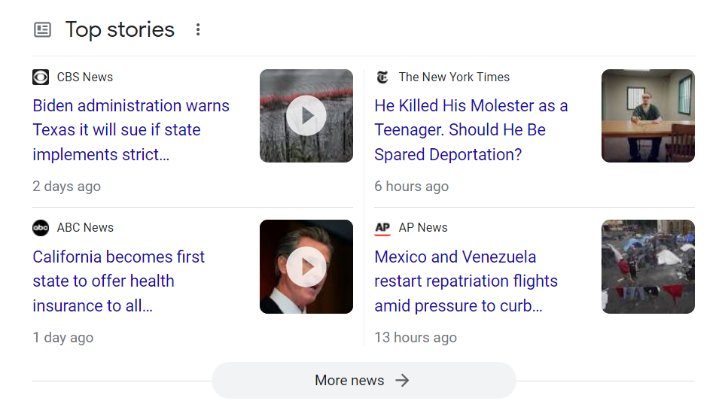
Immigration
Notes:
Hopefully immigration came up in the discussion as a top news story. Transition by explaining to students that this is the topic we will be starting with and discuss the relevancy to our course and what we have studied so far. Explain that students will be examining the coverage of immigration news in multiple ways.

Slide 6
Evaluating News about Immigration
Search
Explore
Search your assigned news source for “immigration” or “migration.”
Review your source’s headlines and reporting on the topic.
Record
Create
Answer these questions while you explore.
Use this slide deck to create a slide with your group’s findings.
Notes:
Divide students into eight small groups and assign each group one of the following news sources: NY Times, CNN, Fox News, MSN, USA Today, NY Post, Washington Post, CNBC. Distribute copies of the handout. Explain that students will be working together to look at the reporting on immigration from their assigned platform. They will complete the questions on their handout and then use that information to collaborate on a slide that will be presented to the class. (Note: when creating your own slide deck, you must set it to give everyone access to edit.)
This process should take about 40 minutes - 20 minutes to explore and record, 20 minutes to determine what to present and create their slide.

Slide 7

Reviewing the News
Take notes on your graphic organizer while each group presents their findings.
Notes:
Each group should have approximately two minutes to present their findings. Students use the graphic organizer to jot down main points.

Slide 8
Reflection Questions
What overall trends do you notice in American media’s reporting on immigration?
How do you think news sources may affect Americans’ viewpoints on immigration?
What is one new thought or question you have now?
Notes:
I suggest displaying these after presentations are done, to help keep students focused on the information being shared. You could have students respond to all or some of the questions. Allow students 3-4 minutes to respond, then collect the papers and/or have students share in a small group or full class discussion.

Slide 9
What qualities could make news better?
Notes:
Day Two: Ask students to brainstorm this question. Hopefully some of their responses include making it engaging, relevant, human, unbiased, and meaningful. Use the conversation to segue into sharing that there are platforms that focus on telling important stories in new ways, such as the Pulitzer Center.

Slide 10
-The Pulitzer Center
“Our mission is to champion the power of stories to make complex issues relevant and inspire action”
Notes:
Invite students to click on the link for the Pulitzer Center and spend a few minutes exploring their mission, model, and reporting. Ask students what stands out to them and what is different from the mainstream media news they explored earlier.

Slide 11
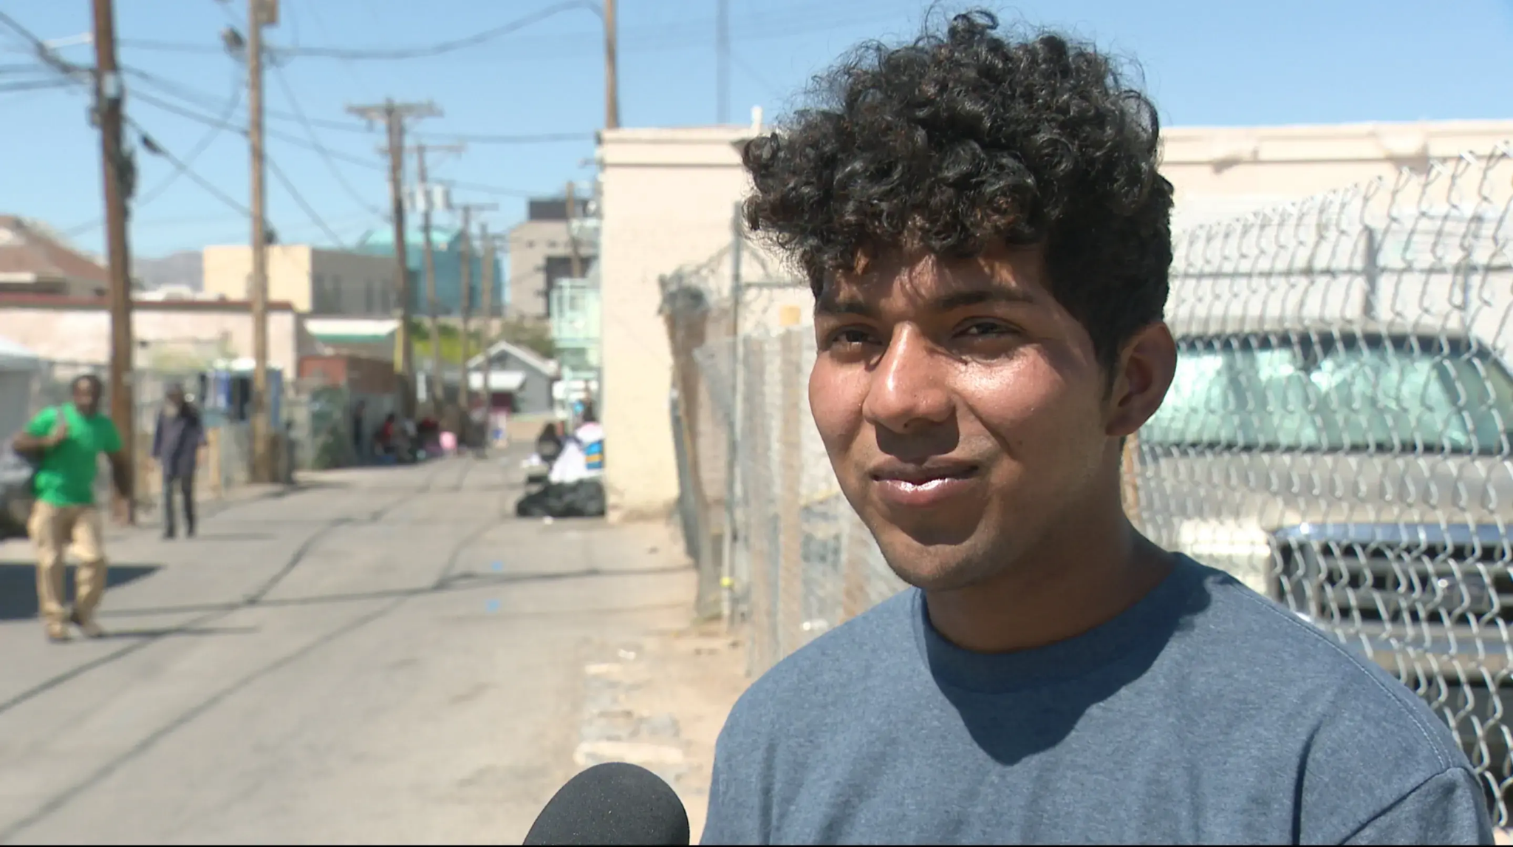
“Migrants Face Uncertainty Throughout Journey—Even in the United States”
by Madison Powers - Nov 20, 2023
As we read this piece, identify three words, phrases,
or lines that stand out to you.
Notes:
Tell students that we will now look at a recent piece of reporting on immigration from The Pulitzer Center. We will read and look at the multimedia together, but their job while reading is to pull out three words, phrases, or lines that stand out to them (for any reason - but tell them they have to be able to explain). Students can do this in a journal or on a post-it note. I would suggest displaying the article and also having students following along on their devices (it is linked above). After reading, invite students to share what they selected and why.

Slide 12
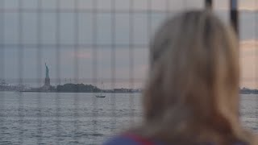
A Trailer for “After Landing” Documentary
by Beibei Liu and Mayara Teixeira - 2023
As we watch this piece, think about how this story compares or contrasts to the types of stories presented in mainstream media.
Notes:
This is a documentary that will be released in full in 2024. Currently this trailer is what is available. It is 2:40 long. Project the trailer and have students watch it, thinking about how this story compares or contrasts to other immigration reporting.

Slide 13
Evaluate the Reporting
How do these pieces…
Elevate marginalized human voices?
Analyze the impact of immigration?
Make the issue relevant and/or help us make connections?
Inspire action or feel informed about action we could take?
Notes:
Use these questions to guide discussion of the article and documentary trailer. Throughout this conversation, look at similarities or difference between this reporting and the coverage from mainstream news media.

Slide 14
Where We Are Going
National
Explore stories about immigrants to and in the United States of America
Global
Explore stories about global migration
Notes:
Discuss the big picture of this unit by previewing that we will be looking at immigration (and other issues) in both America and around the world.

Slide 15
Thanks!
Do you have any questions?
youremail@freepik.com
+34 654 321 432
yourwebsite.com
Please keep this slide for attribution

Slide 16


