Slide 1
Reflect and Respond:
What do you know about the Deferred Action for Childhood Arrivals (DACA) program and the DREAM Act?
If you don’t know much, put your investigative skills to use and research it quickly!
Notes:
Provide about 5 minutes for students to search for information and jot down thoughts in their journals or on a post-it note.

Slide 2
Discuss
Share your responses with your group.
Notes:
Have students think-pair-share or work with a small group to discuss their responses. After about 3 minutes, consider moving to full class to hear some prevalent thoughts.

Slide 3
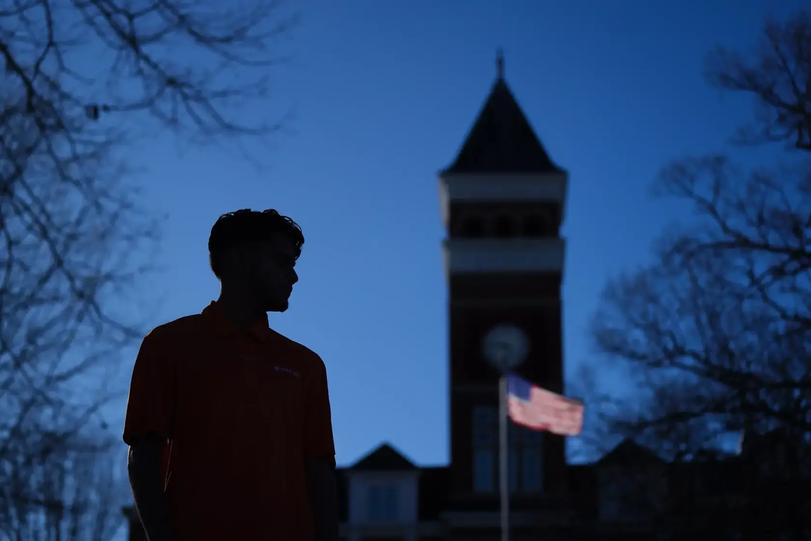
“Dreams Derailed”
by Marcela Rodrigues - Mar 22, 2023
As we read this piece, complete the article analysis handout. You will be completing several of these and they will be turned in at the end of the unit.
Notes:
Tell students that we will now look at a recent piece of reporting on immigration from The Pulitzer Center. We will read and look at the multimedia together and work through the article analysis handout together, since they will be doing this analysis again independently later. I suggest active reading, stopping to discuss, examine text features, and be sure to point out the number of hyperlinked resources throughout the article and how those add to the information.

Slide 4

Win arguments and influence people with a strong call to action. After reading “Dreams Derailed,” use the handout to practice calls to action for different scenarios.
Notes:
Review the call to action with students as needed - most students should already have a solid grasp on this skill but if not it may help to show some examples. Explain that part of the focus of this unit is looking at how we can inspire action and effective calls to action help with that. Distribute the call to action practice handout.

Slide 5
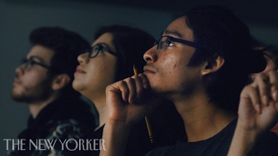
“Georgia’s Underground University for Undocumented Students”
The New Yorker - 2017
Notes:
If you have additional time, this 10 minute video is about Freedom, the underground college discussed in the article.

Slide 6
Thanks!
Do you have any questions?
youremail@freepik.com
+34 654 321 432
yourwebsite.com
Please keep this slide for attribution

Slide 7


