Slide 1
Under-reported story
M. Gonzalez

Slide 2
Motivation is success

Slide 3
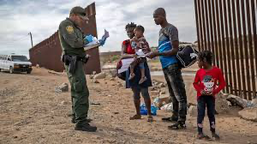
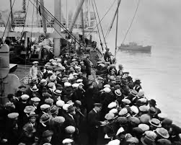
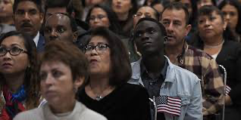
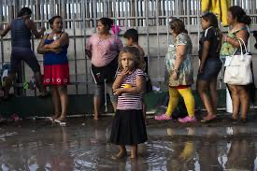
What is a immigrant:
A person who comes to live permanently in a foreign country.

Slide 4
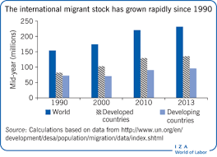
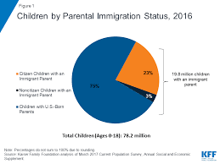
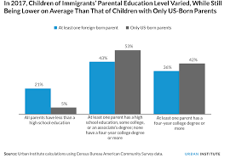
why is this a problem to me ?
This is a problem for me because in some situation kids grow up with out parents at least 21-22% due to immigration…

Slide 5
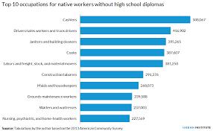
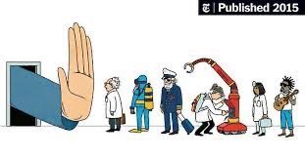
harder to get A job
due to having no papers immigrant have a harder time finding jobs

Slide 6
language barrier is the main challenge as it affects the ability to communicate with others. …

Slide 7
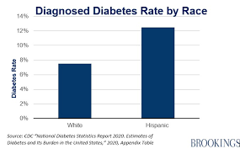
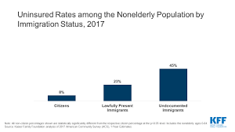
Access to Medical Services can be limited access to private coverage

Slide 8
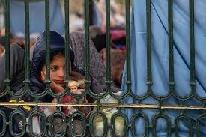
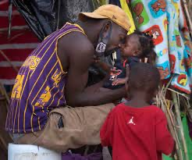
Raising Children can be hard and may lead to them feeling lonely or unwanted

Slide 9
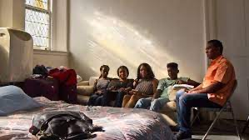
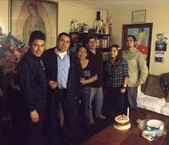
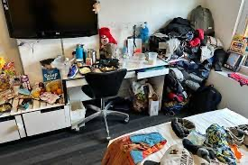
Housing and finding a home can be hard which can lead you to living in rooms or may not even have a Home

Slide 10
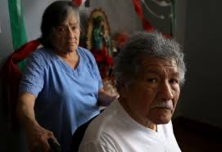
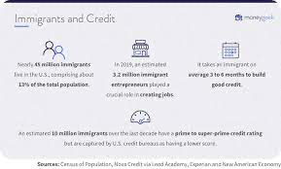
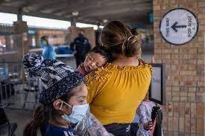
undocumented immigrants have a harder time building credit due to not having a Social Security number

Slide 11
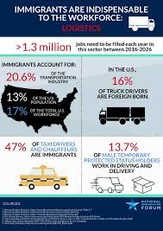
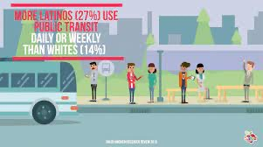
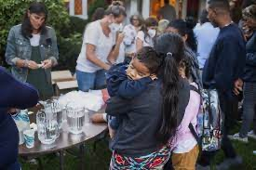
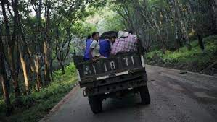
transportation issues also scared to drive and get pulled over due to not wanting to get sent back to their country

Slide 12
A long walk to the USA
Kendar G walked from Colombia to Panama.
A trail from Colombia to Panama where you could get sick, And possibly lose your child. Deep in the wood’s in between both Colombia and panama is a 5-hour walk where you experience torture, run out of food supply, and possibly run out of water. Kids all of ages suffer this. Some even end up without parents. In worse cases, parents end up left behind. Kendar
G walks with her daughter, who takes medicine for down syndrome who also ran out of money paying these medicine. 2 days of Extreme chaos from my point of vision. This 5-day walk is all ran by a drug gang in Colombia who you have to pay in order to have shelter and even for the nights you stay. This gang is a deadly one to anything you do and cause your death some make it to the United States of America and some stay left behind.

Slide 13
My name is Miguel and this is my presentation
Motivation is success And we are all equal

