Slide 1
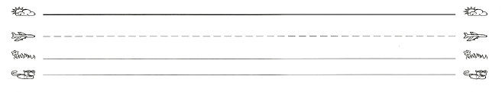
Name:___________
Write a response to The Year We Learned to Fly. Write a text-to-self response. Tell something you learned from one of your ancestors.
Something I learned from one of my ancestors is……

Slide 2
Name:___________
Write a response to The Oldest Student: How Mary Walker Learned to Read. Mary worked hard to learn to read. Write about a part of her life that made an impression on you.
Mary made me feel ________________ when she……

Slide 3
Name:___________
Write a response to Your Legacy: A Bold Reclaiming of Our Enslaved History. Choose one of the values in the book and write about why it is important.
The value of________________ is important because……

Slide 4
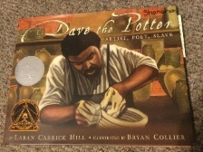
Name:___________
Write a response to Dave the Potter: Artist, Poet, Slave. Write about something interesting that you learned about Dave’s life.
Something that interested me in Dave’s story was…

Slide 5
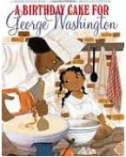
Name:___________
Write a response to A Birthday Cake for George Washington. Write about one thing that you found interesting in the story.
One thing I found interesting in the story was……

Slide 6
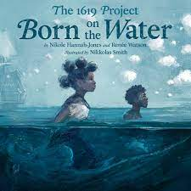
Name:_______________
Write a response to Born on the Water. Describe your first thoughts about the Ndongo people’s lives in Africa before they were born on the water.
The Ndongo people’s lives in Africa...

Slide 7
Name:___________
Write a response to Born on the Water. Write about something you learned about the people’s language, hands, or bodies.
The people were good at many things. Write about one thing.

Slide 8
Name:___________
Write a response to Born on the Water. Write about the trip people made across the ocean.
The trip across the ocean was hard. Write about one thing.

Slide 9
Name:___________
Write a response to Born on the Water. Write about the changes for the people born on the water. Talk about anything positive in today’s reading.
The people born on the water were hopeful because...

Slide 10
Name:___________
Write a response to Born on the Water. Write about the end of the story. How does the girl feel about her origin story?
Write about how the girl feels after hearing Grandma’s story.

