Slide 1


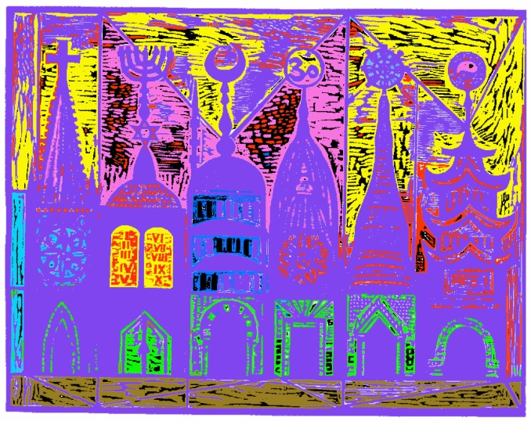
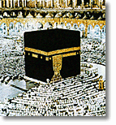
Introduction to Geography
People, Places, and Environment, 3e
Edward F. Bergman
William H. Renwick
Chapter 7: The Geography of Languages and Religions
Holly Barcus, Morehead State University
And Joe Naumann, UMSL

Slide 2
Language & Religion
Two most important forces that bond and define human cultures
Two most important factors defining culture regions
‹#›

Slide 3
Defining Language
Pronunciation and combination of words used to communicate within a group of people
Important cultural index
Structures individual perception of world
‹#›

Slide 4
Language Regions
Dialects
  Minor variations within a language
Standard language
  Following formal rule of diction and grammar
Official language
  Primary language for any given country
  Defacto or Dejure?
Lingua franca
  Current language of international discourse
‹#›

Slide 5
Linguistic Geography
The study of different dialects across space
Speech community
  a group of people who speak together
Isoglosses
  Frequently parallel physical landscape features
Geographical dialect continuum
‹#›

Slide 6
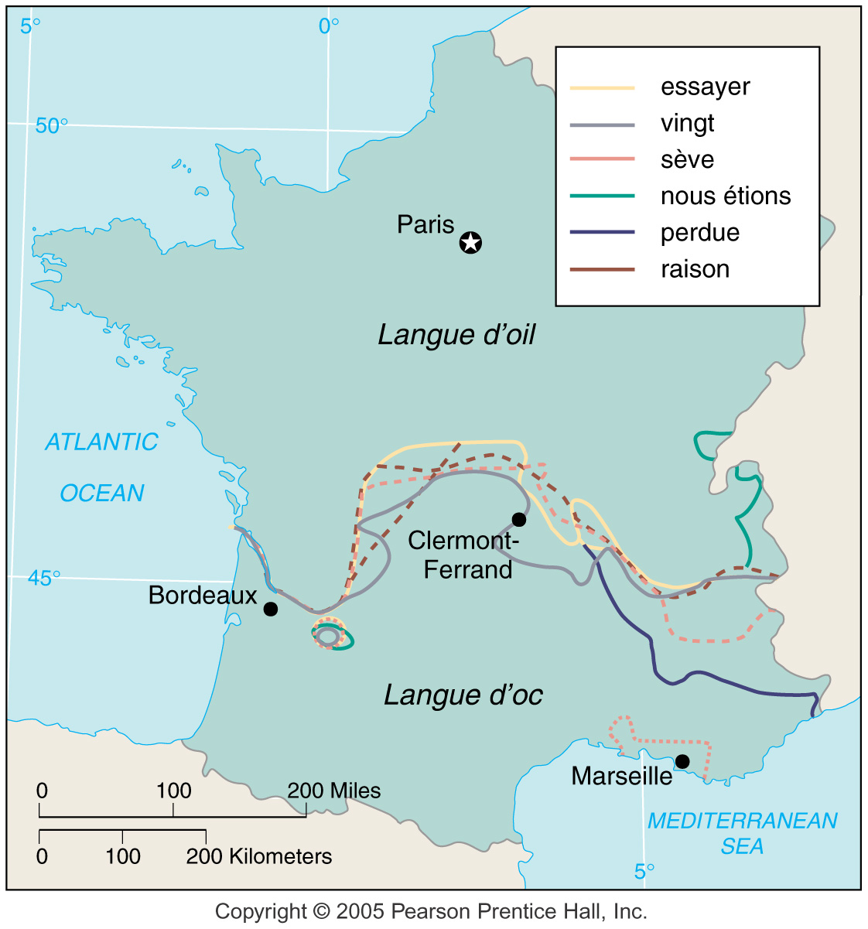
ISOGLOSS

Slide 7
World’s Major Languages
3,000 distinct languages
50% of world population speak one of 12 major languages listed
Mandarin Chinese is largest with 885 million
English is the primary language of 350 million and is the official language of about 50 countries
‹#›

Slide 8
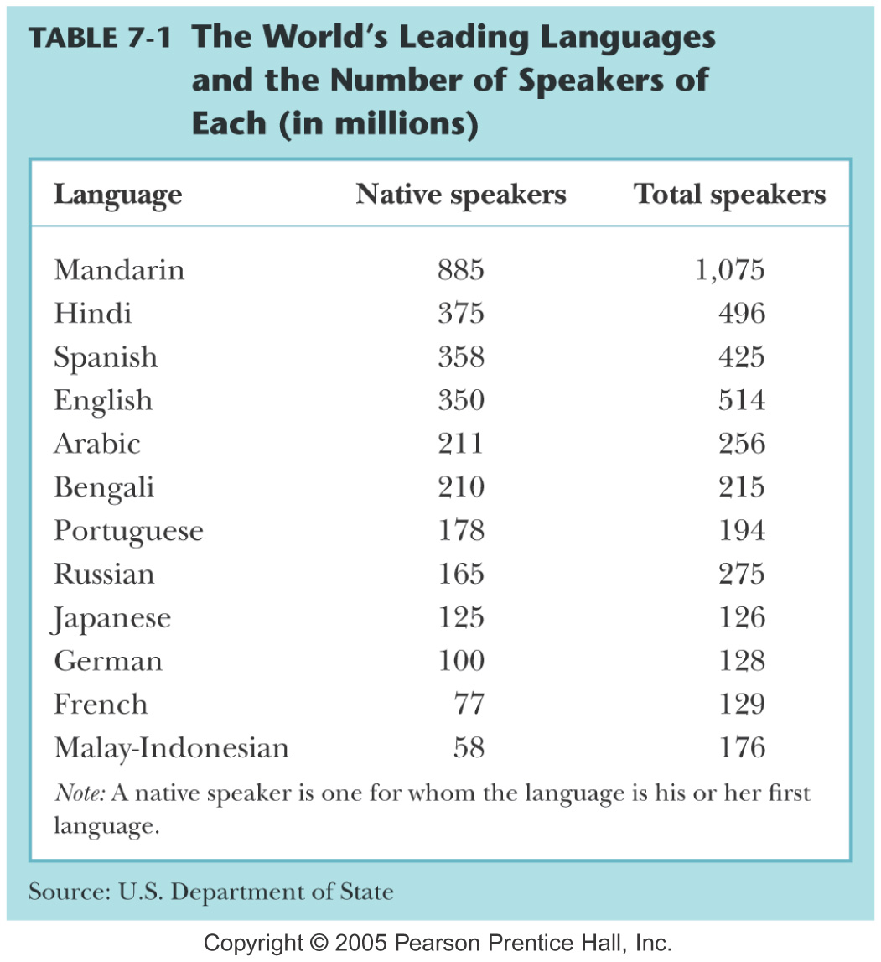

Slide 9
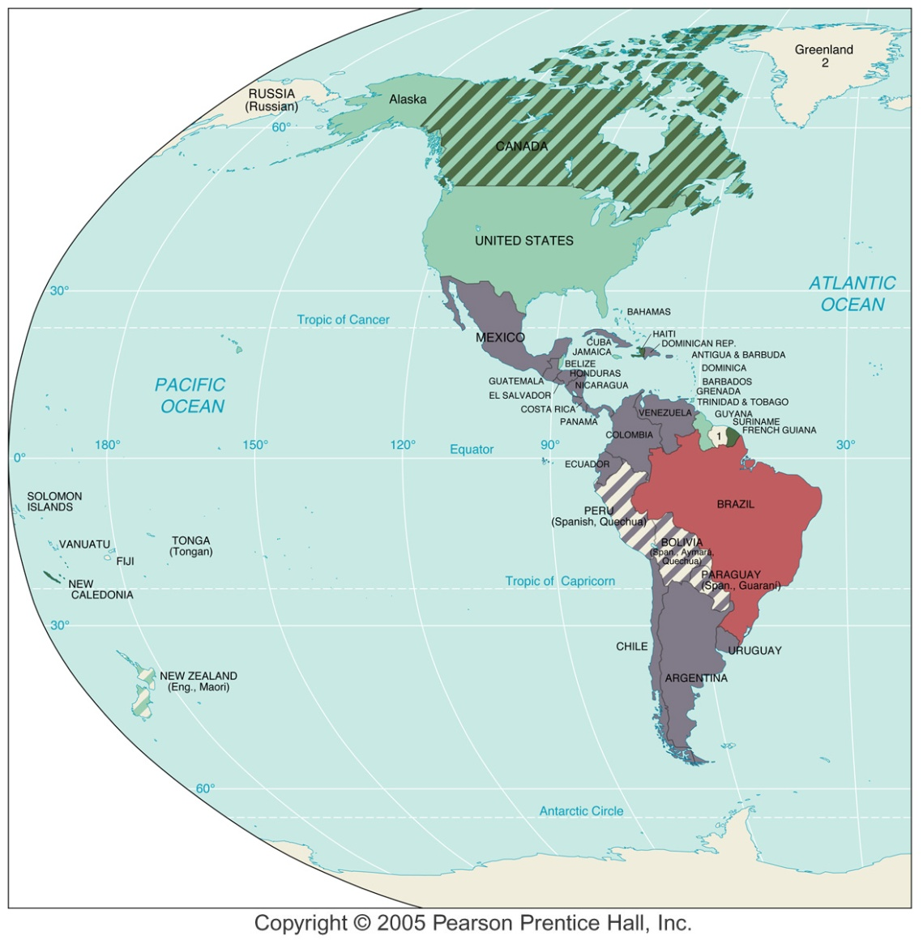
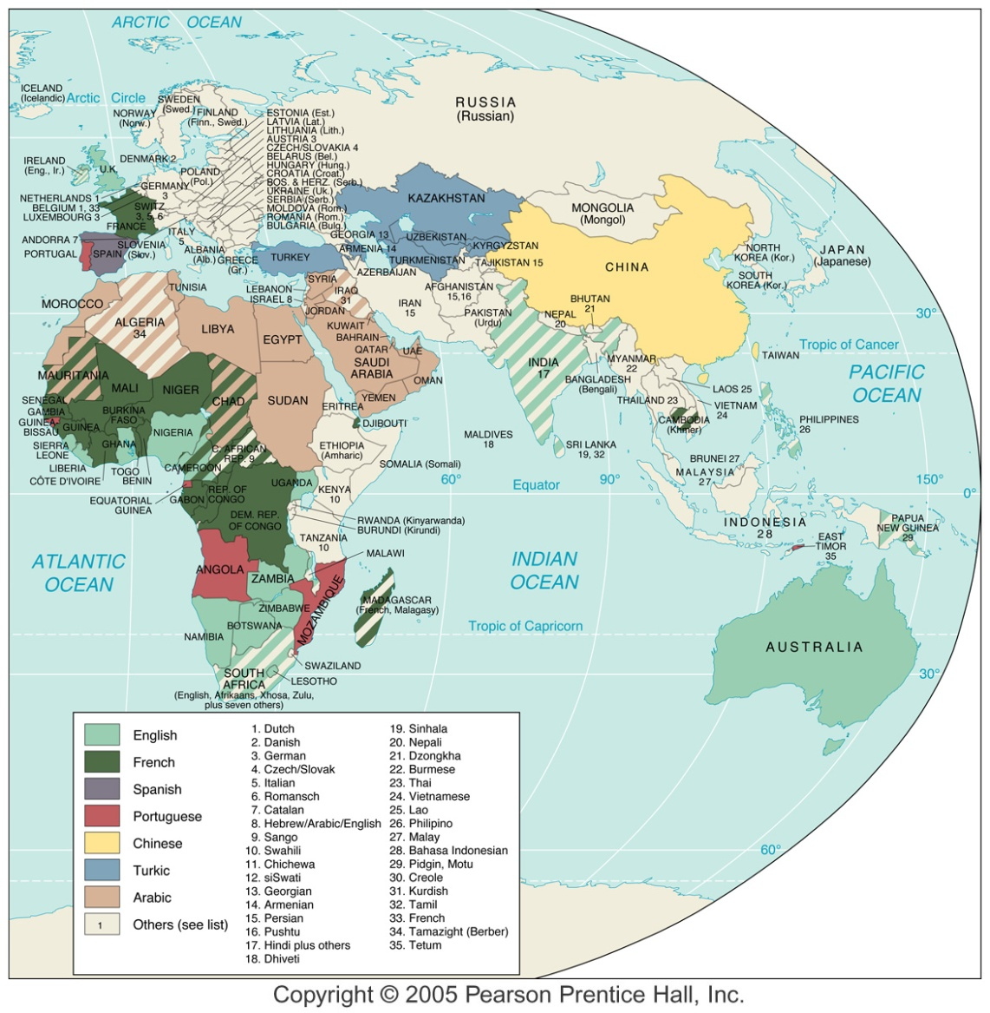
Official Languages of Countries

Slide 10
Language Development
Protolanguage
  Common ancestor to any group of today’s languages
Language family
  Languages related by descent from a common protolanguage
  Members of the same language family may not be mutually intelligible
Cognates – words related somewhat like cousins
  i.e. reign or royal (English) & Rajah (Hindi)
Etymology – study of word origins
‹#›

Slide 11
Indo-European Language Family
Identified by Sir William Jones, 1786
  Proto-Indo-European
    Common ancestor of many modern languages
Grimm’s Law
  Set forth by Jacob Grimm of the Brothers Grimm
  Accounts for sound shifts as language family differentiated.
‹#›

Slide 12
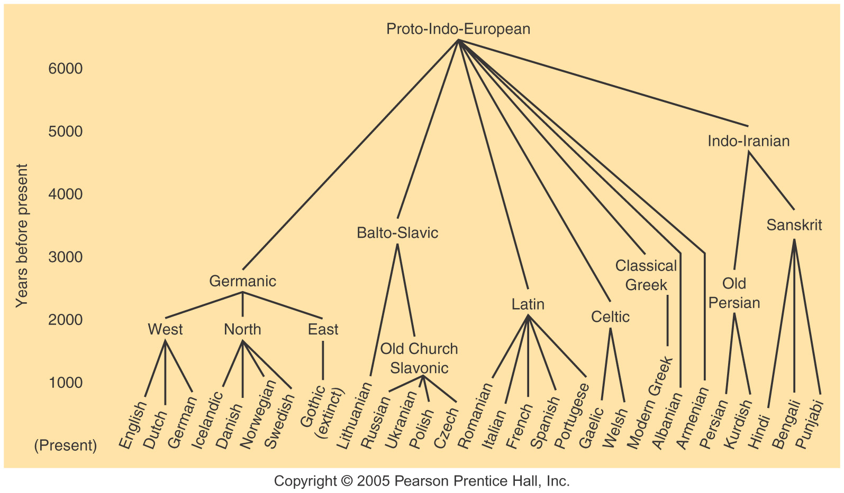
Language Family – “extended family”

Slide 13
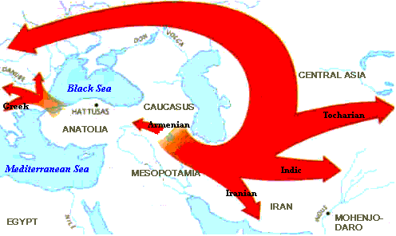
Indo-European Hearth?
Hearth in vicinity of Turkey (Anatolia)
Likely diffusion routes
‹#›

Slide 14
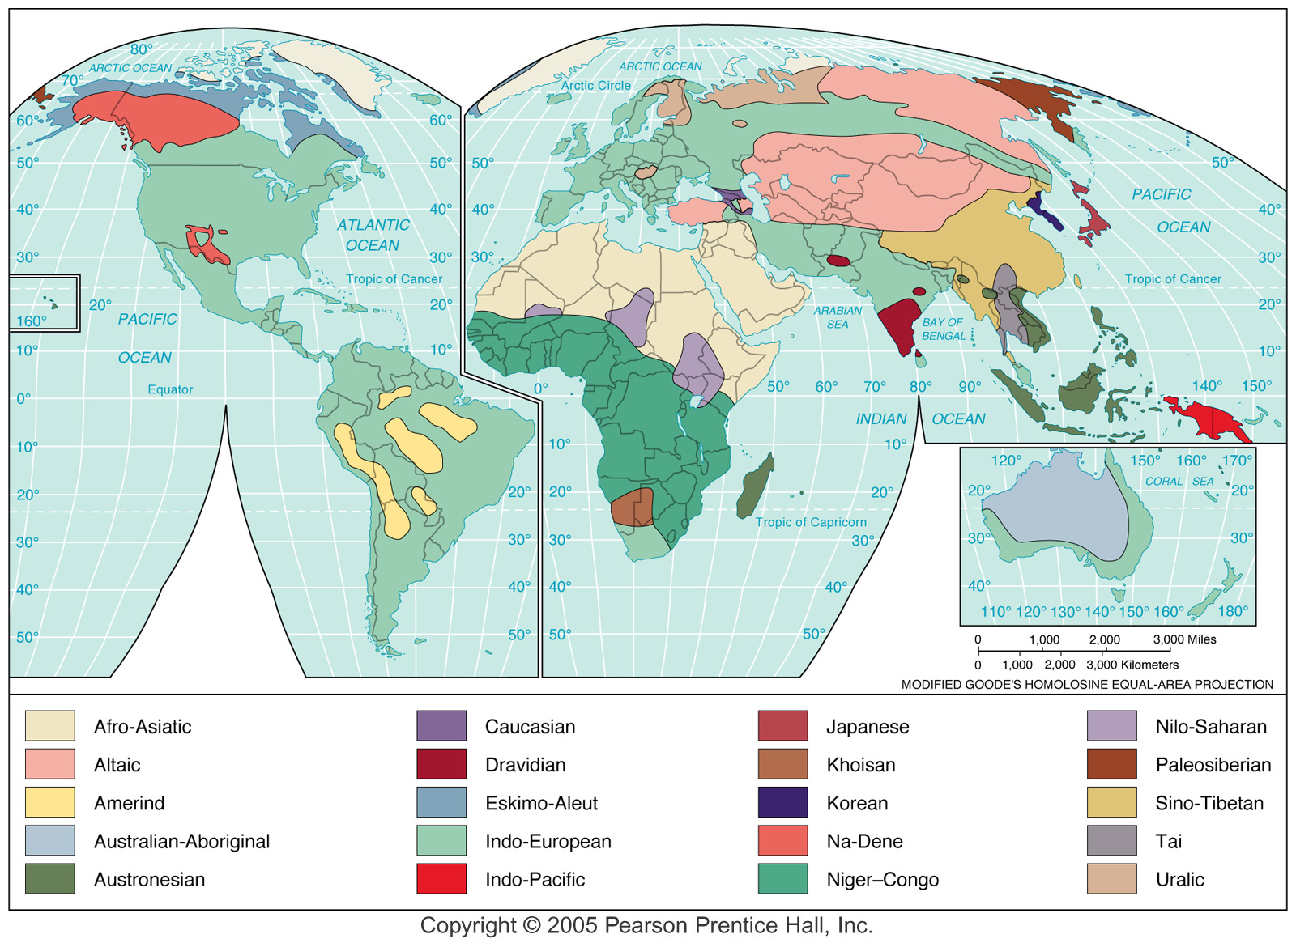
Language Families

Slide 15
Geography of Writing
Orthography – has spatial characteristics
  System of writing
    Sumerians
    Olmec
Alphabets
  Roman
  Cyrillic
  Arabic
  Sometimes the same spoken language is written in different scripts
Non-alphabetic - pictographic
  Chinese, Japanese, Korean
‹#›

Slide 16
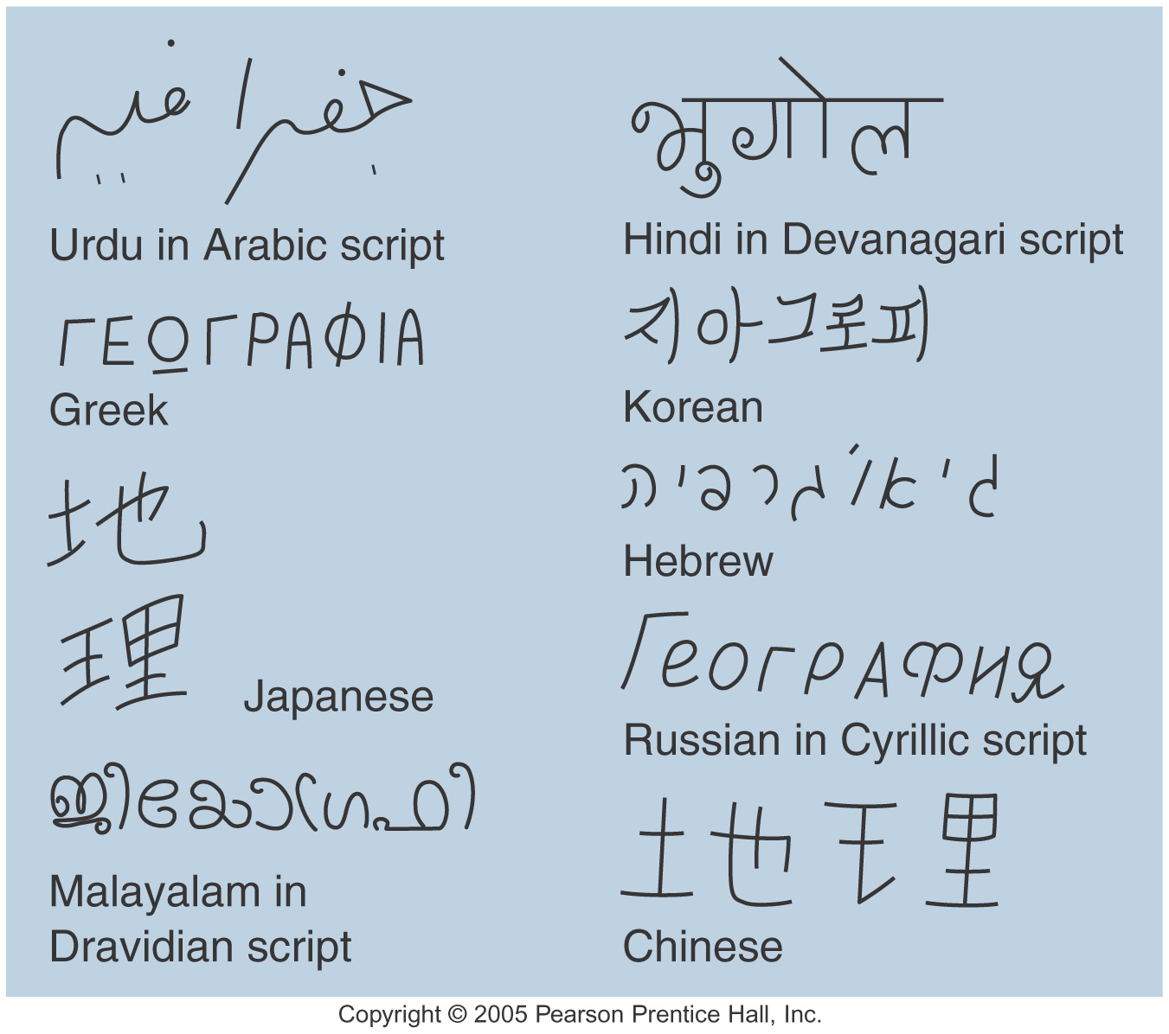
The same spoken language but different scripts
Related
script

Slide 17
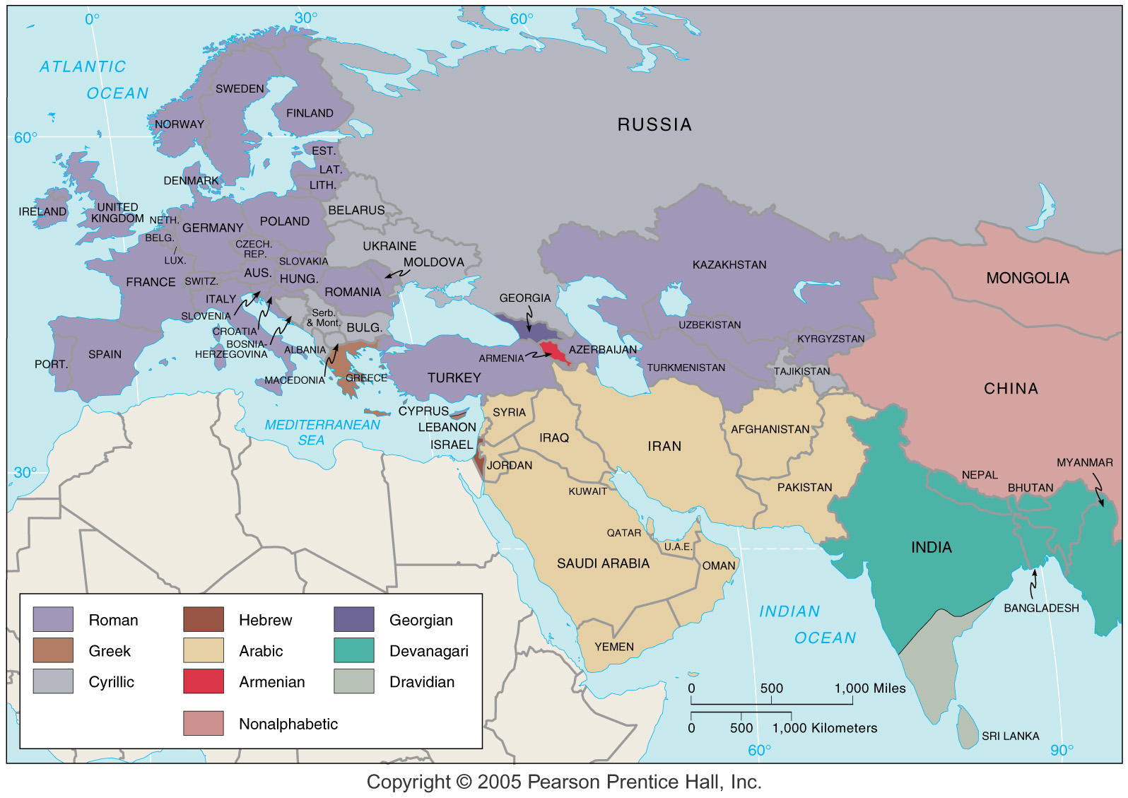
Language Groups

Slide 18
Toponymy
The study of place names
Consists of:
  Natural features
  Origins/values of inhabitants
  Belief structures, religions
  Current or past heroes
‹#›

Slide 19
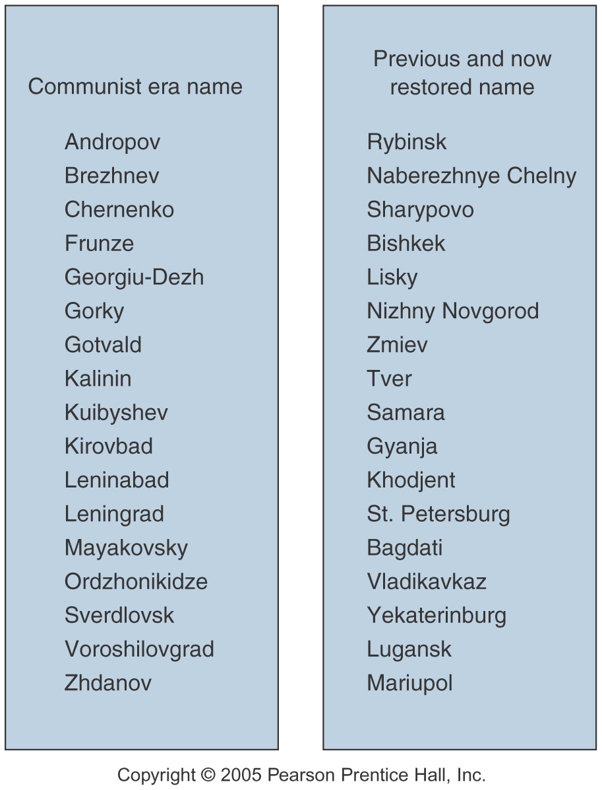
Political Change & Name Change

Slide 20
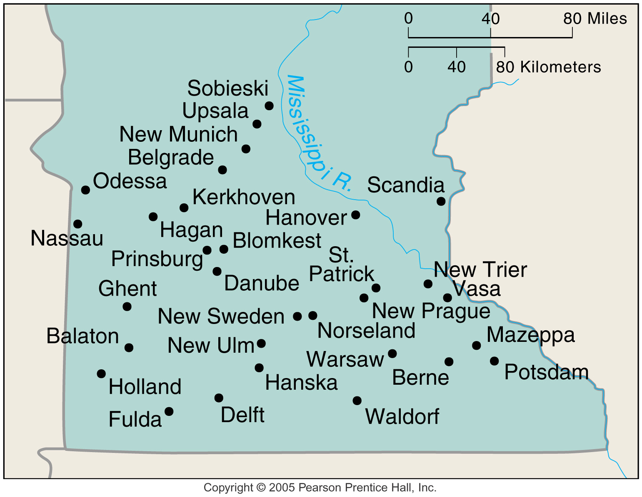
Names Indicate Origins

Slide 21
Linguistic Differentiation
National languages
  Imposed or encouraged by government with varying success
  De facto or de jure
Nation building
  Philological nationalism
    Belief that mother tongues have given birth to nations.
Postcolonial societies
  Imposed official languages by colonial ruler
    Not spoken by locals
‹#›

Slide 22
Multiple Language States
Polyglot states
  Having multiple official languages
  Can promote political devolution
United States
  English always lingua franca
  Three major dialects in 13 colonies
  Non-English languages
  English is de facto official language, not de jure
‹#›

Slide 23
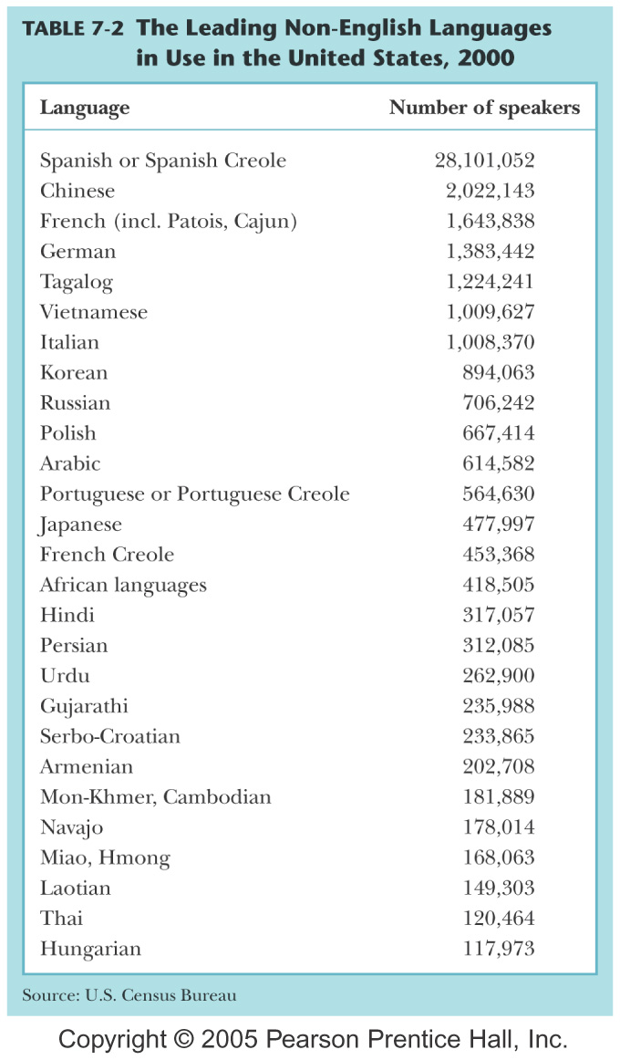

Slide 24
World’s Major Religions
Systems of beliefs guiding behavior
  Orthopraxy (correctness of action or practice)
    Behavior oriented
  Orthodoxy (“correctness” of belief or verbal expression)
    Theological/philosophical
Fundamentalism -- the strict maintenance of the ancient or essential doctrines of any religion or ideology.
Secularism -- a philosophy or world view that stresses human values without reference to religion or spirituality
‹#›

Slide 25
Religions
Classification and Distribution of Religions
  Universalizing: Christianity, Islam, Buddhism all proselytize
  Christianity is the most widespread
  In Africa, Islam is the fastest growing
    In SubSaharan Africa - Christianity
  Ethnic: Judaism, Hinduism, Shintoism
    Tribal (traditional) – small-size ethnic
‹#›

Slide 26
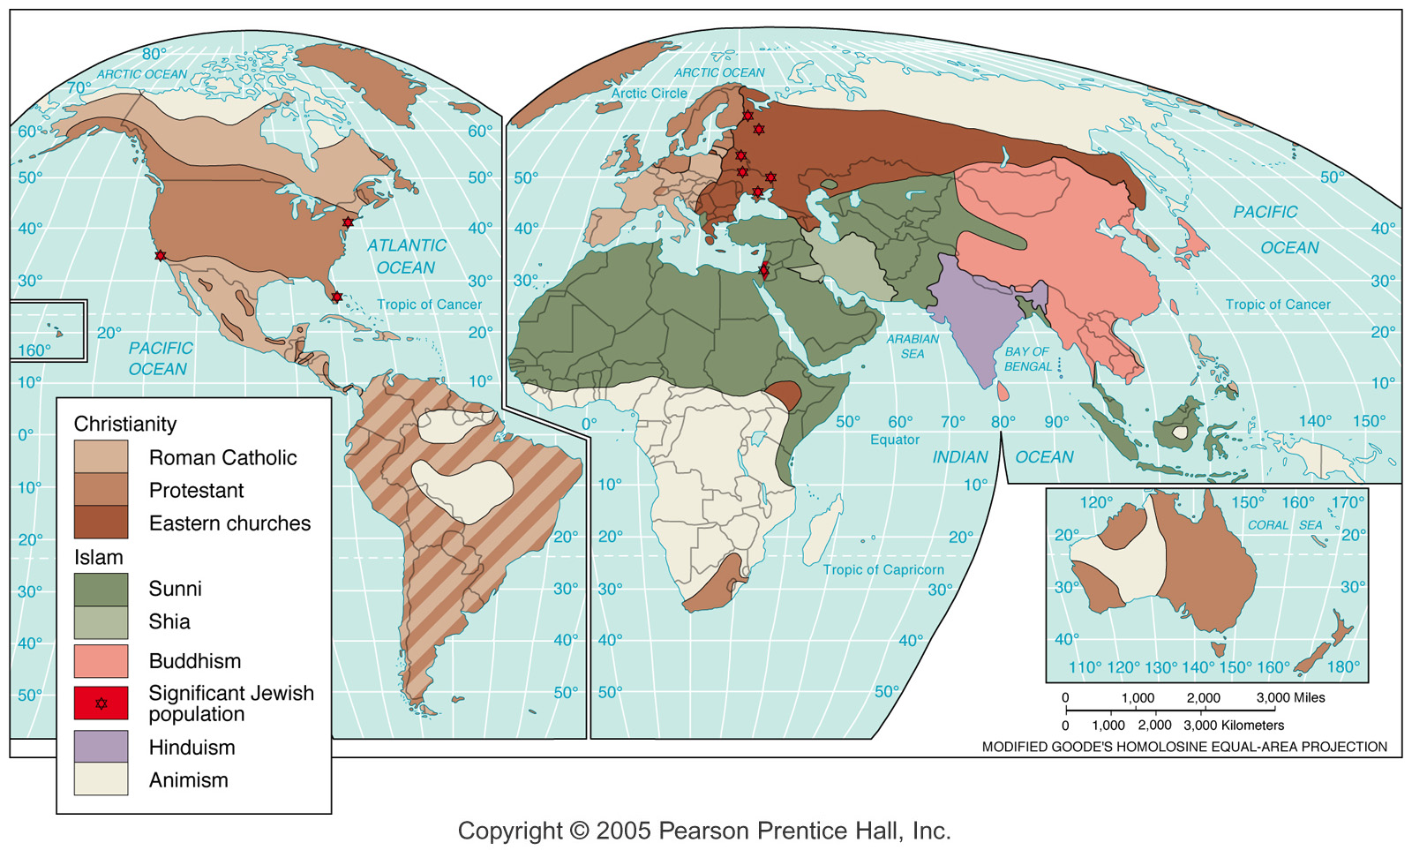
Religion Regions

Slide 27
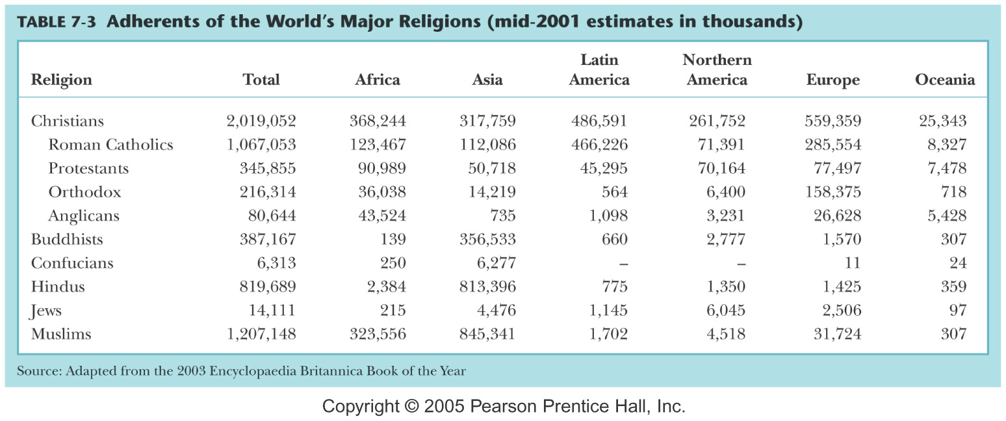

Slide 28
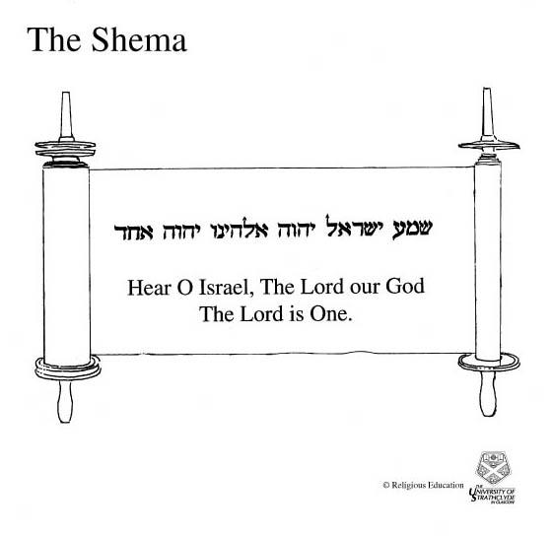
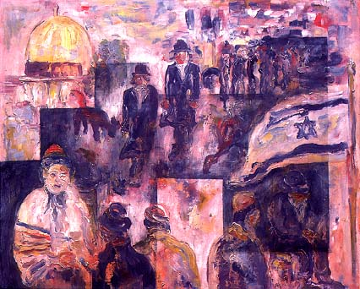
Judaism
‹#›

Slide 29
Judaism
14 million adherents
Monotheistic (claims to the oldest one)
Based on covenant with Abraham
Scriptures: Torah – 5 books of the “Law”
  Genesis, Exodus, Leviticus, Numbers, Deuteronomy
Sects
  Orthodox, Conservative, Reform
Israel – More Jews in New York City than in Isreal
  Homeland for Jewish people
  Created 1948
  Conflict between Israel and Palestine
‹#›

Slide 30
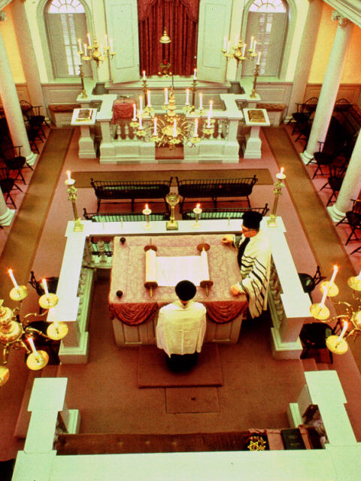
Jewish Worship
Synagogue came into existence during exile after the temple, which had previously been the center of worship, had been destroyed and many Jews had been taken to Babylon as captives.
‹#›

Slide 31
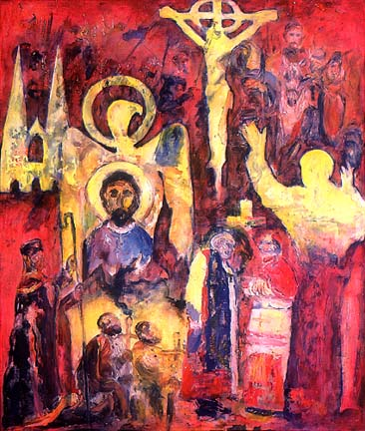
Christianity
‹#›

Slide 32
Christianity
Emerged from Judaism – Jesus was a Jew!
Coptic Church
  Founded in Alexandria in CE 41
  Still present in Egypt and Ethiopia
Official religion of Roman Empire – 312 CE
  Facilitated geographical spread
  Model for its bureaucratic structure
Split with Eastern Orthodox 11th century CE
Dark Ages – preserver of European culture
Protestant Reformation 1517 CE
Significant growth in Africa, Asia and Latin America
‹#›

Slide 33
Christian Fundamentals
Areas of almost complete agreement
  Sacraments of Baptism & Matrimony
  Monotheism involving one God in a trinity of persons (referred to as a mystery)
  Blessing and sharing bread and wine at least in memory of Jesus sacrifice
  Jesus was/is 100% God and 100% human
  Salvation comes from belief in and acceptance of Jesus as one’s savior
  There will be a second coming at the end of time
‹#›

Slide 34
Christian Denominations
Coptic
Eastern Orthodox
  Greek, Serbian, Russian, Armenian, etc.
Roman Catholic – Latin Rite & Greek Rite
  Largest single denomination in the USA
Protestant – hundreds of denominations
  Luther, Calvin, Zwingli, etc.
Peripheral – significant differences from the mainstream Christian denominations
  Mormon, Jehova Witnesses, etc.
‹#›

Slide 35
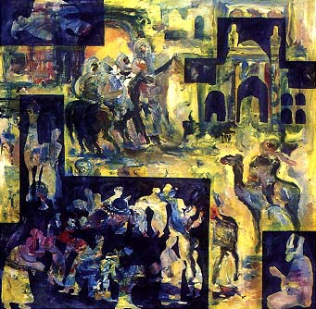
Islam
‹#›

Slide 36

Islam
Muhammad the final prophet– 622 CE
Allah (word for God)
Monotheistic
Major Sects: Sunni – 85% and Shiite – 15%
Koran is sufficient to direct all aspects of life
No clergy or building required
Jews & Christians – people of the book
‹#›

Slide 37
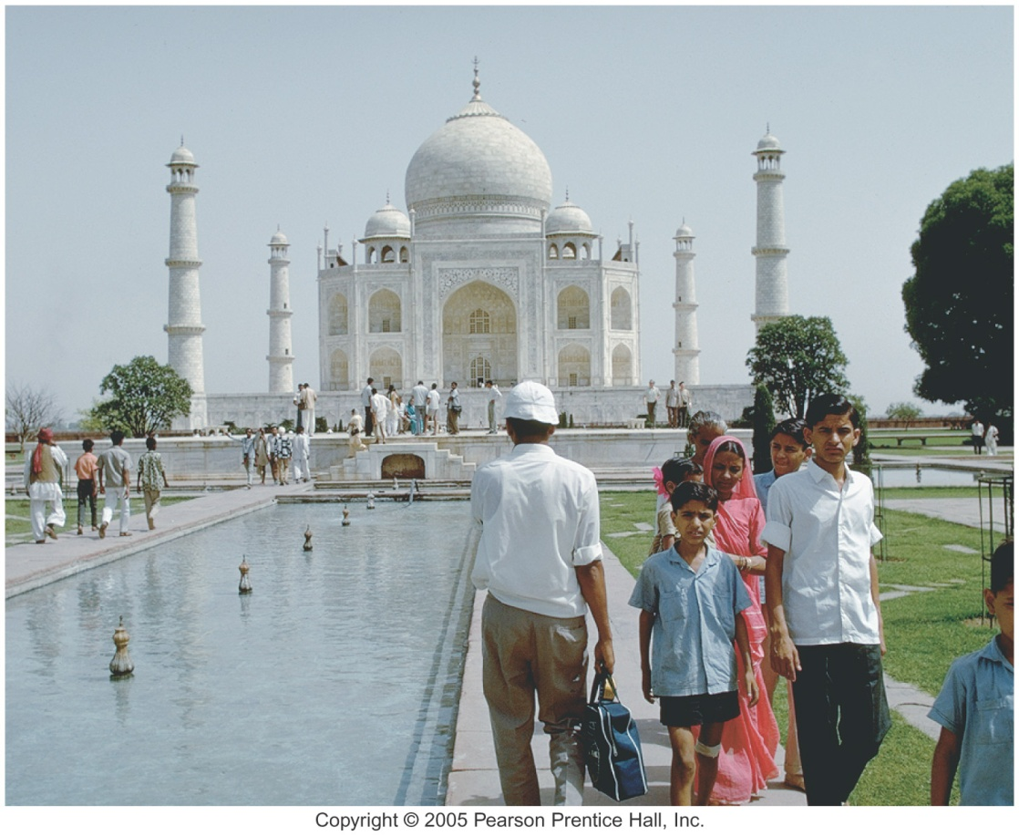
Five Pillars
Five Pillars of Islam
  Belief in one God
  Five daily prayers facing Mecca
  Generous alms (help to poor)
  Fasting during the holy month of Ramadan
  Pilgrimage to Mecca (hajj)
‹#›

Slide 38
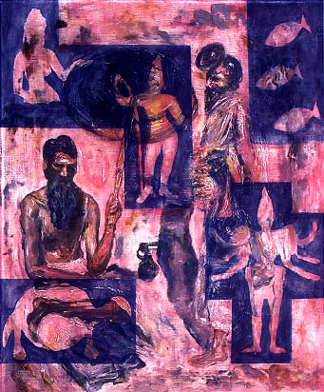
Hinduism
‹#›

Slide 39
Hinduism
Hinduism
  Most ancient religious tradition in Asia (world?)
  Vedas – Hindu sacred texts
  May be viewed as monothestic
  Castes
    Brahman, priestly
    Kshatriya, warrior/ruler
    Vaisya, tradesman and farmer
    Sudra, servant and laborer
  Untouchables (de facto 5th caste)
  Central belief is in reincarnation
    Transmigration of the soul
    Cycles of creation – birth to death to birth
    Role of dharma & karma
    Effect on diet
‹#›

Slide 40
Characteristics of Hinduism
No clergy or religious requirements –
No real splintering or sects
  Can be practices in many ways & at many levels so there was no need to “split off.”
No concept of a personal God
Each individual is seeking to comprehend the ultimate reality while living out his/her dharma with the goal of union with Brahman once the cycle of reincarnation is ended.
‹#›

Slide 41
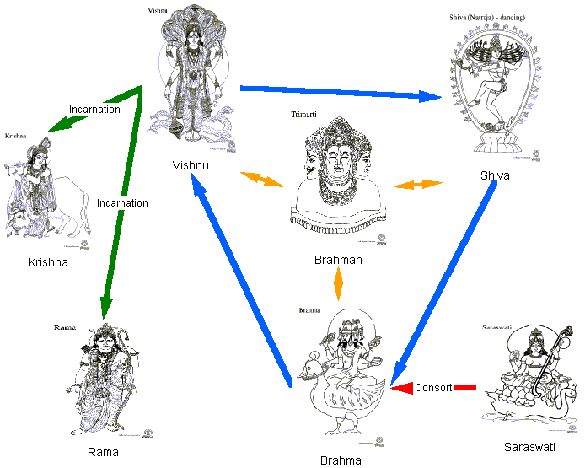
Monotheism?
‹#›

Slide 42
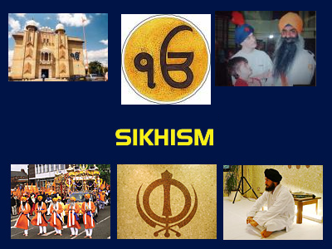
Sikhism
‹#›

Slide 43
Sikhism
Sikhism (attempt to reconcile Islam & Hinduism)
  Offshoot of Hinduism
  Centered around the Punjab area
  Guru Nanak
‹#›

Slide 44

Buddhism
‹#›

Slide 45
Buddhism
Siddhartha Gautama – Kshatriya Caste
Buddha – Enlightened One
Four Noble Truths
  Life involves suffering
  Cause of suffering is desire
  Elimination of desire ends suffering
  Right thinking and behavior eliminate desire
Diffused from India
‹#›

Slide 46
Buddhism
Nirvana
  Buddhism is a way of living that achieves release from reincarnation and suffering
God is not knowable, so is, therefore, not a major concern in Buddhism
Buddha (Siddhartha Gautama) rejected the caste system
‹#›

Slide 47
Buddhism
Scriptures: Vinaya (discipline) – expanded later
Branches:
  Theravada (south) – monk seeks own deliverance
  Mahayana (north) – role of bodhisattvas & ritual
  Tibetan Lamaism – example of syncretism
‹#›

Slide 48
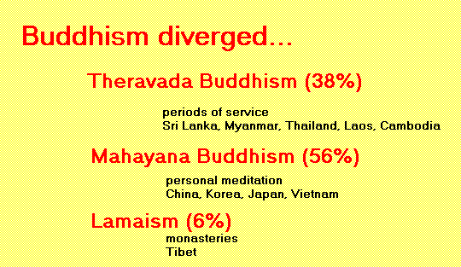
Branches of Buddhism
‹#›

Slide 49
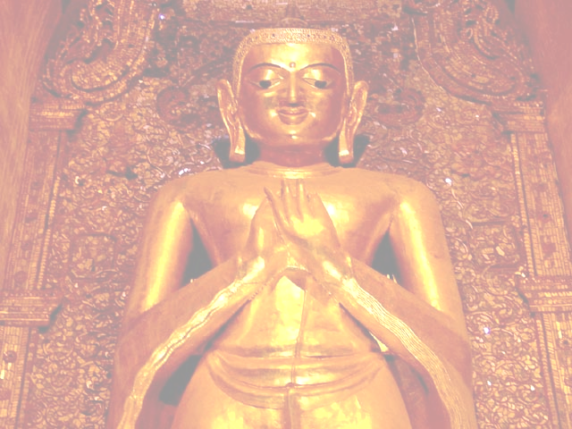
The Eight-Fold Path
The Way (the 8-Fold Path)
The threefold scheme of morality
1. Right understanding
2. Right thought
Faith
(initially)
Wisdom: III
(ultimately)
3. Right speech
4. Right bodily action
5. Right livelihood
Morality: I
6. Right moral effort
7. Right mindfulness
8. Right concentration
Meditation: II
‹#›

Slide 50
Other Religions
Eastern Religions
  Confucianism – China
  Taoism – China
  Shinto – Japan
  Zoroastrianism – Iran
  Baha'i – Iran
Animism and Shamanism
  Animism
    Belief in influence of spirits or spiritual forces in all creation
  Shamanism
    Shaman
‹#›

Slide 51
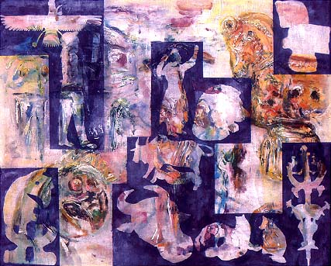
Zoroastrianism
‹#›

Slide 52
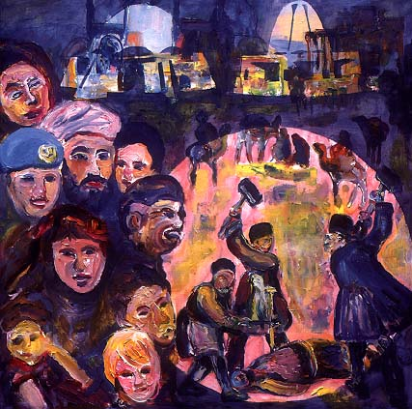
Baha'i
‹#›

Slide 53
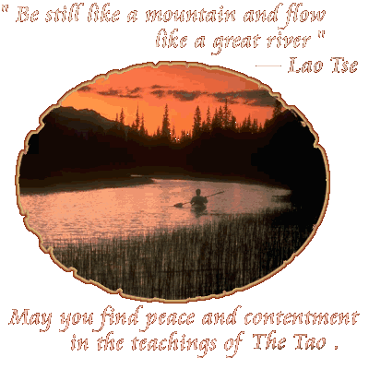
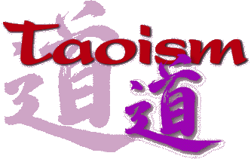
Taoism
The natural is the essence
of all that must be known,
and the place
where all must return
‹#›

Slide 54

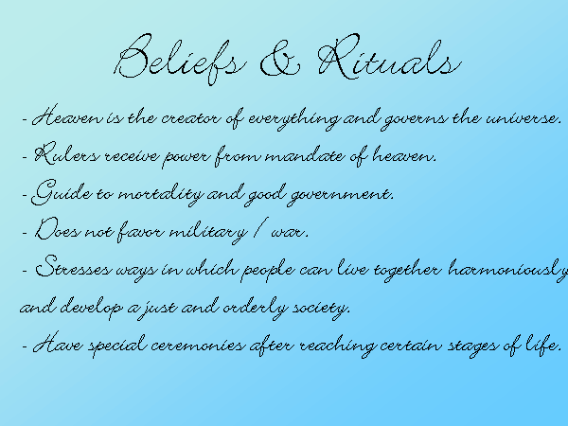
Confucianism
‹#›

Slide 55

Shintoism
‹#›

Slide 56
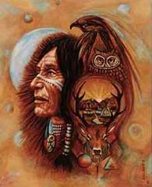
Animism and Shamanism
Animism
    Belief in influence of spirits or spiritual forces in all creation
    Characteristic of many African & Native American religions
Shamanism
    the religion of certain peoples, esp. some indigenous to N Asia, based on a belief in good and evil spirits who can be influenced only by the shamans
‹#›

Slide 57
Religion & Politics
Freedom of religion
  Historically the exception rather than the “rule.”
Theocracy
  Church rules directly – government based on “scriptures.”
Separation of church and state
  Islamic fundamentalists oppose it – favor theocracy
  Instituted by United States Constitution to preserve religious freedom.
Terrorism – unacceptable resort of those who feel marginalized – usually more about power than it is about religion (emotional excuse for violence)
‹#›

Slide 58
Social Impact of Religion
Gender roles
  Women’s rights, duties, obligations, opportunities, etc.
  Patriarchal or matriarchal societies
Diet and food preparation restrictions
  Kosher – ruled relate to how acceptable food is prepared
  Pork – forbidden to Jews & Muslims
  Beef – unacceptable to Hindus – many are vegetarians
  Alcohol – forbidden to Muslims
Ethics and morals
  Guidelines for the “good” life
Schools and social and medical institutions
‹#›

Slide 59
Economic Impact
Burial practices – costs
  Time constraints
  Disposal methods & preparations
Protestantism and capitalis
  “Protestant work ethic.” – version of Calvinism
Catholic Church and capitalism
  Usury was considered sinful in the early church
  Individualism with a social conscience
Confucianism verses individualism
‹#›

Slide 60
Religion and Environment
Burial practices
  Health considerations in India
Origin of the world
  All have some creation story which usually indicates the place of humans in that creation
Relationship with nature
  Exploitive approach – Christianity in practice rather in teaching
  Adaptive approach – Animism and most “Eastern” religions
‹#›

Slide 61
Other Differences
Nature of God
  Diest
  Personal
Relation to others
  Naturally ecumenical
  Universalizing – emphasis on proselytizing
  Ethnic – no emphasis on proselytizing
‹#›

Slide 62
Multi-religious State
Where two religions compete to write the laws, a means of working together is needed to avoid possible conflict
  N. Ireland & Canada
  Lebanon
  Philippines
  Nigeria, Sudan,
  Division of India in 1948
  Sri Lanka
‹#›

Slide 63
End of Chapter 7
‹#›

