Slide 1
Sequent Occupance

Slide 2
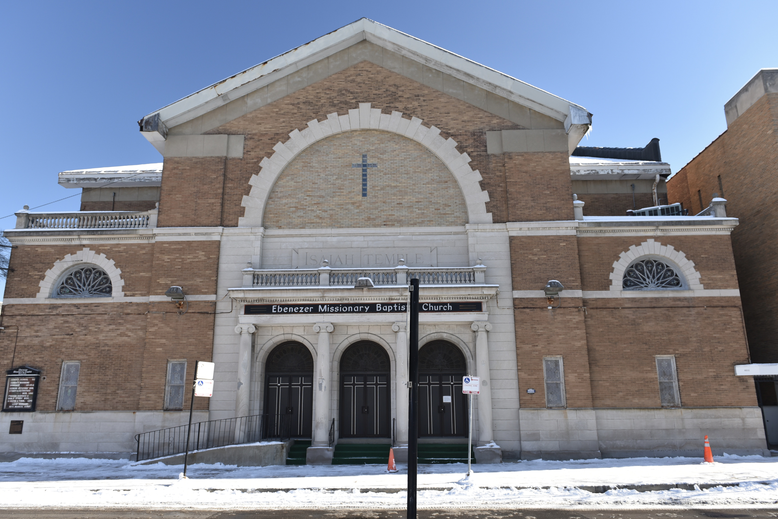
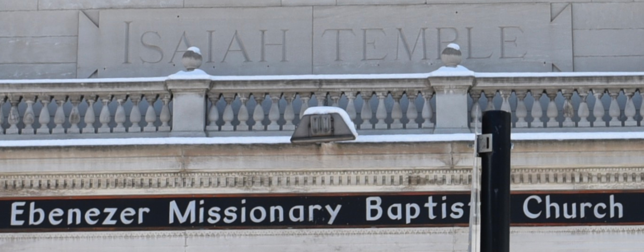
https://ebenezerbronzeville.org/

Slide 3
WHAT IS AN UTBAPH? WHERE DO WE FIND THEM?
USED TO BE A PIZZA HUT.

Slide 4
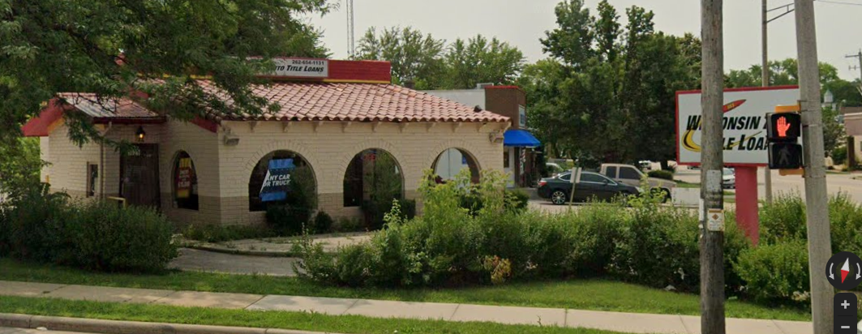

Slide 5

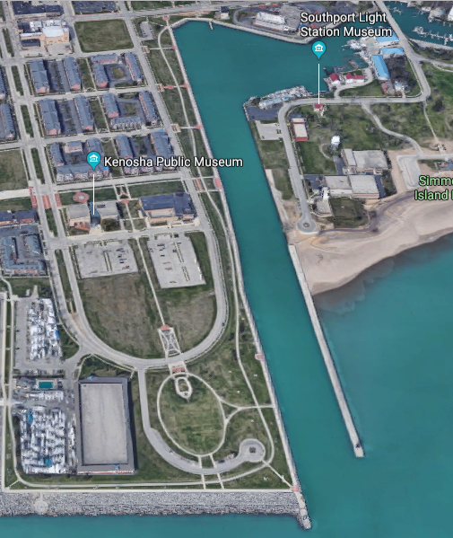
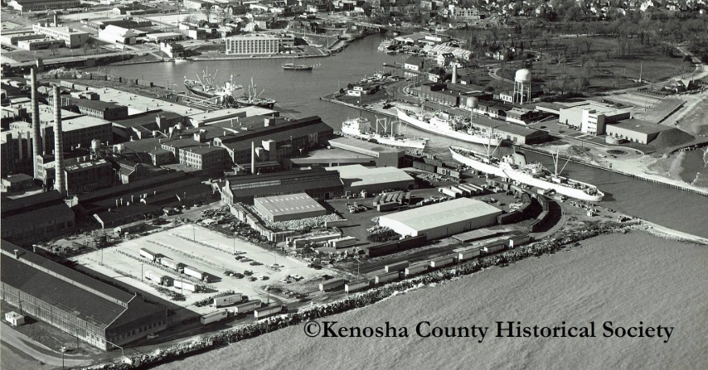

Slide 6
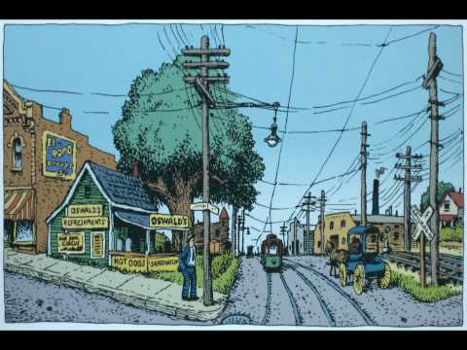

Slide 7
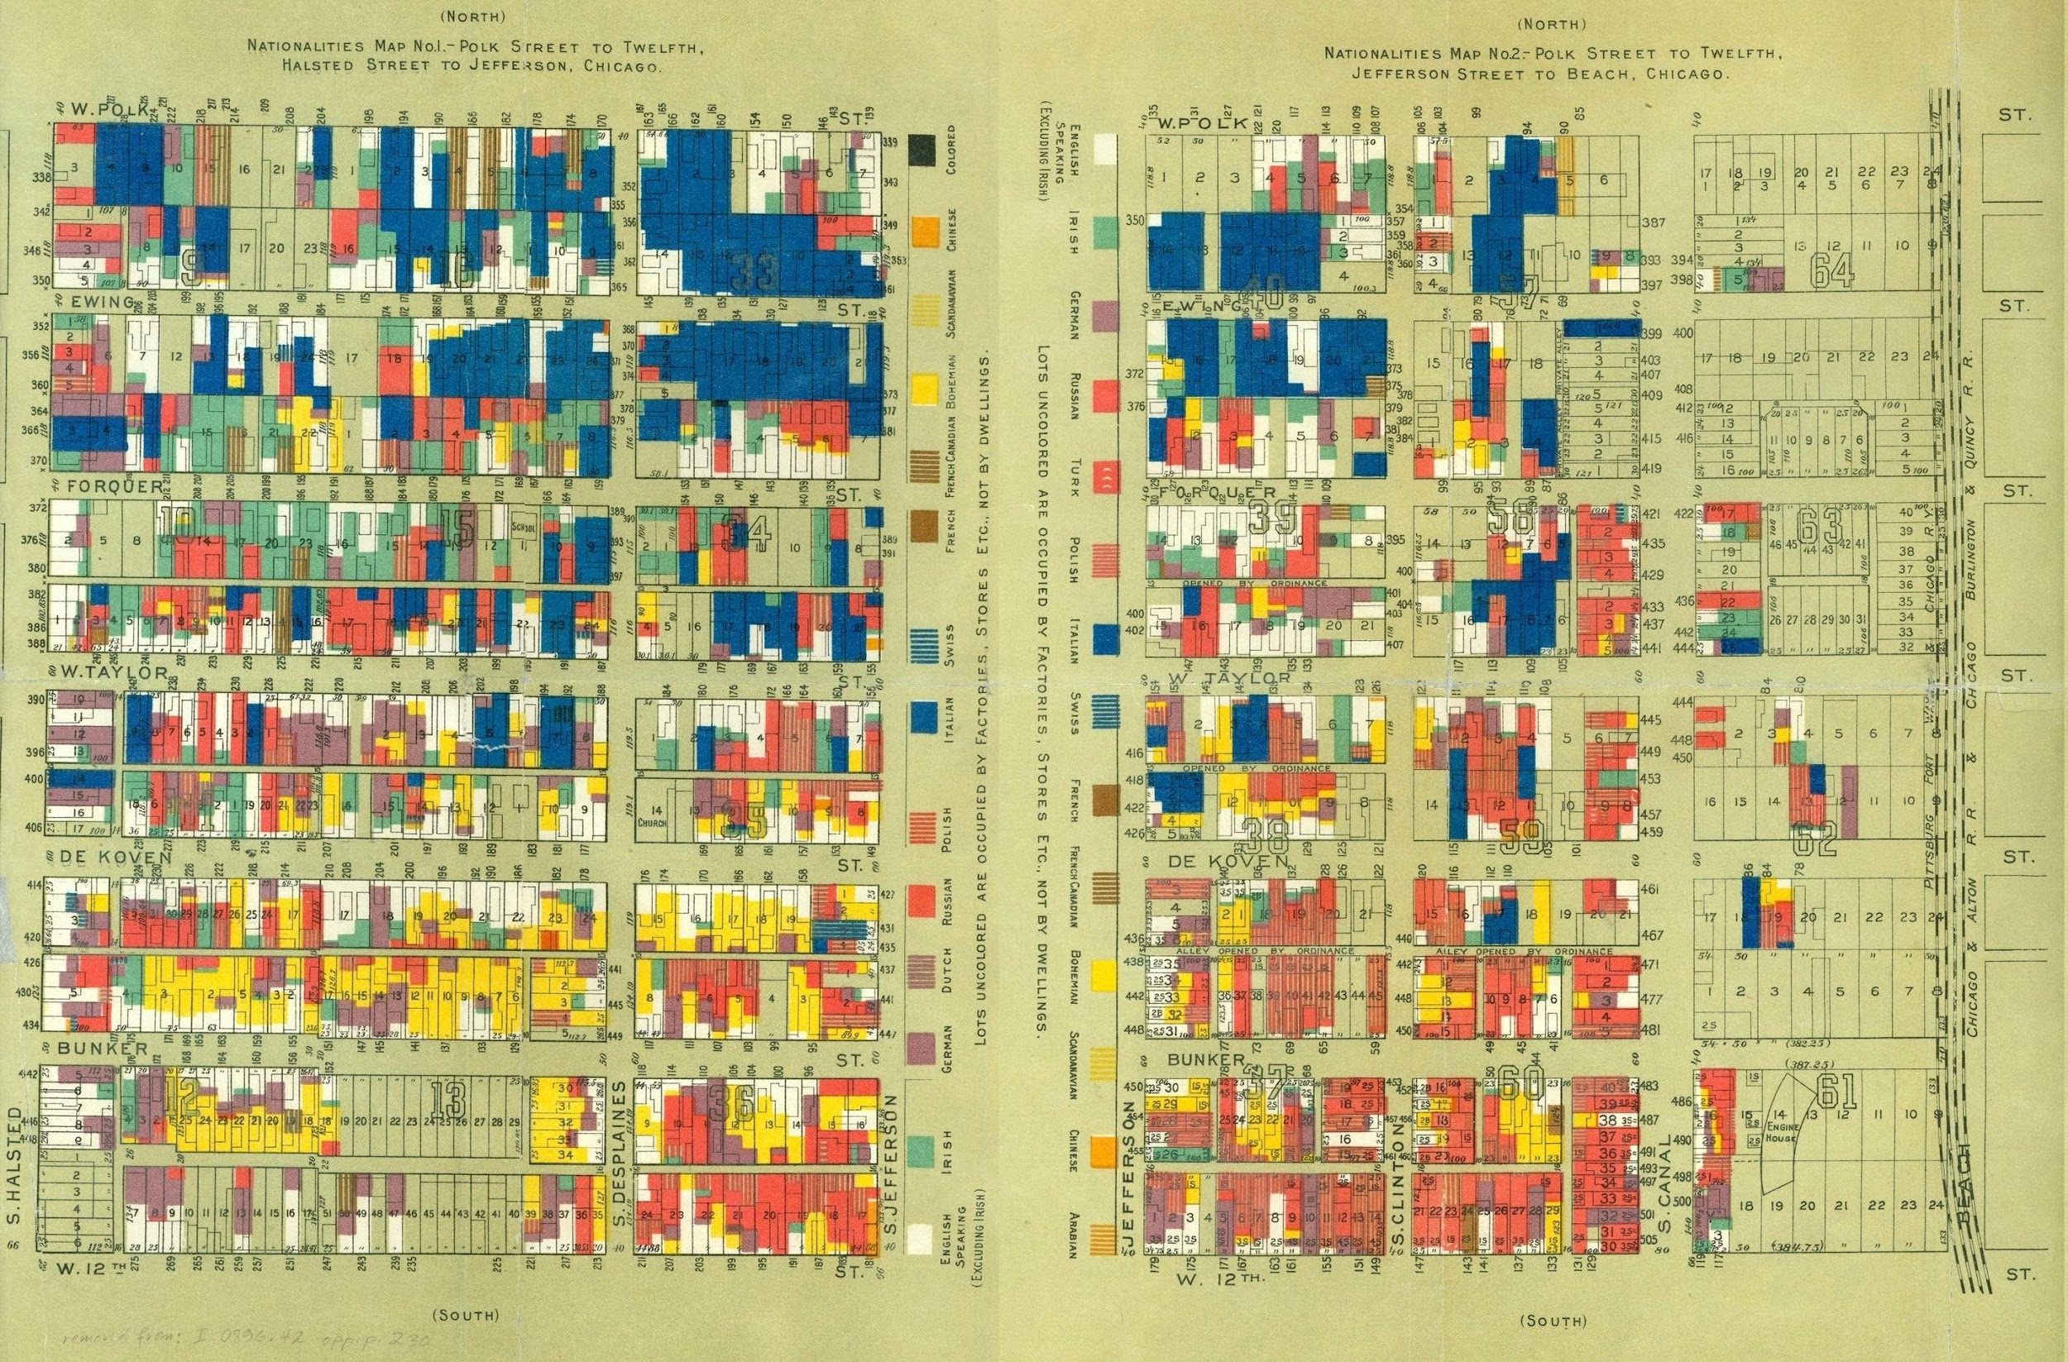
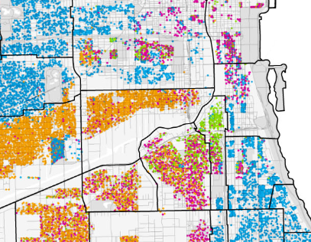

HULL HOUSE MAPS of Ethnic enclaves
Radical Cartography.net

Slide 8
