Slide 1
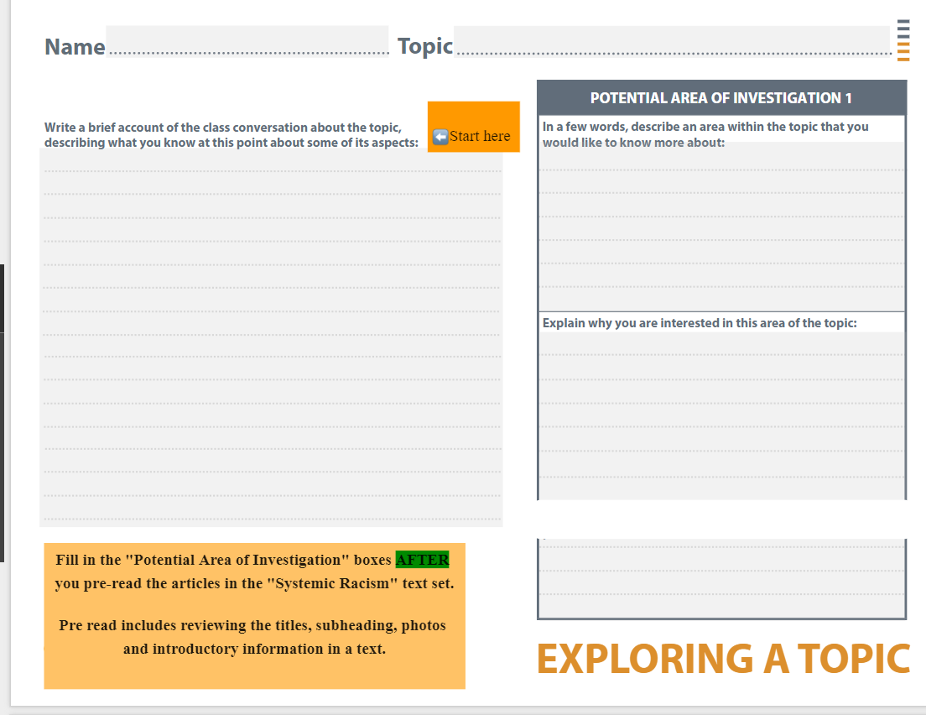
The topic of the article you are interested in goes here.
What do you know about systemic racism.
Resistance, helping to fight against ystemic racism

Slide 2
