Slide 1
Black Women and Their Bodies: How Slavery Laid the Groundwork for Healthcare Disparities for Women of Color
By Hanover High School Social Studies
part of the 2022 cohort of The 1619 Project Education Network

Slide 2
Aftershock
Initial reactions to trailer - turn and talk
What stereotypes did you recognize?
What is meant by “aftershock?”
Questions?

Slide 3
Unit Objectives:
Engage in class discussions that focus on challenging concepts.
Analyze historical documents to draw conclusions about the legacy of matrilineal slavery and its implications for the expansion of the slave economy.
Point out the contradiction in white doctors using enslaved women’s bodies for medical experimentation, while at the same time relying on enslaved women’s medical expertise in midwifery.
Argue how stereotypes and abuse that stem from the legacy of slavery have had lasting effects on Black female advancement, as well as healthcare practices and outcomes.
Articulate forms of advocacy and resistance to abuse and stereotyping that people of color have practiced.
Notes:
Villarosa - Medical Inequality

Slide 4
Unit Essential Questions
Why is it important to engage in a specific focus on Black women’s experiences in the context of American History?
How were Black women’s role in slavery unique due to their race, sex, and commodification?
What does slavery have to do with healthcare inequities in the 21st century?
How did enslaved women’s experiences factor into the story of reproductive research?
How do stereotypes of Black bodies developed during slavery continue to influence contemporary medical practices and outcomes?
Does shifting the historical narrative to reflect Black women’s stories change the way we understand the history of healthcare?

Slide 5
Creating an open space for challenging conversations about race
Discussion protocols:
Stay engaged
Expect to experience discomfort
Speak your truth
Assume best intentions
Maintain focus on ideas
Validate multiple experiences and perspectives
Practice self-care.
Communicate with your teacher privately if uncomfortable to speak out in class.
Notes:
https://drive.google.com/drive/u/0/search?q=challenging%20conversations

Slide 6
Engage in inquiry
Can you tell me what you mean when you say
Is it possible for you to say more about ...?
Have the thoughts you shared been shaped by others, or is this your own personal perspective?
Why do you think others might want to challenge your perspective?

Slide 7
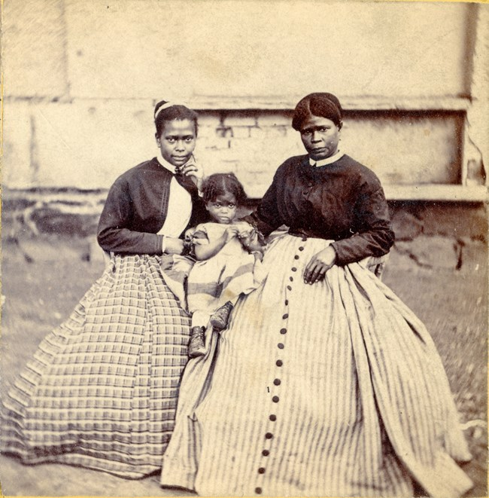
Lesson 1: Matrilineal Slavery and the Capitalized Womb
Why is it important to engage in a specific focus on Black women’s experiences in the context of American History?
How were Black women’s role in slavery unique due to their race, sex, and reproductive potential?
Notes:
https://encrypted-tbn0.gstatic.com/images?q=tbn:ANd9GcScDv8LtouMlFnxkLwATsMrTeC2JQBpkMB0oTrbaucPdIpEfAU&s

Slide 8
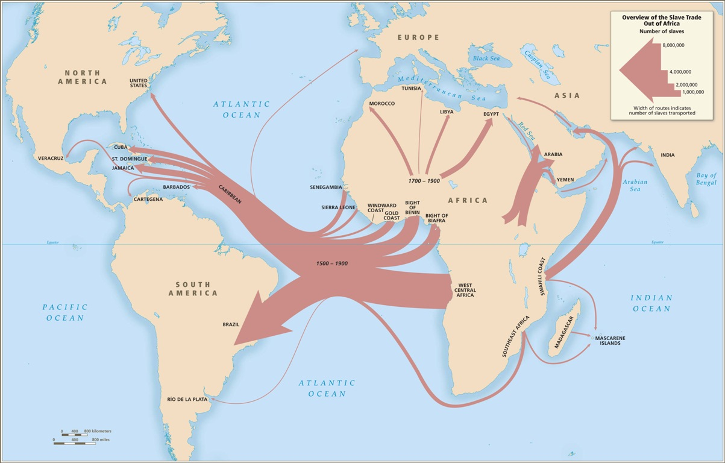

Slide 9
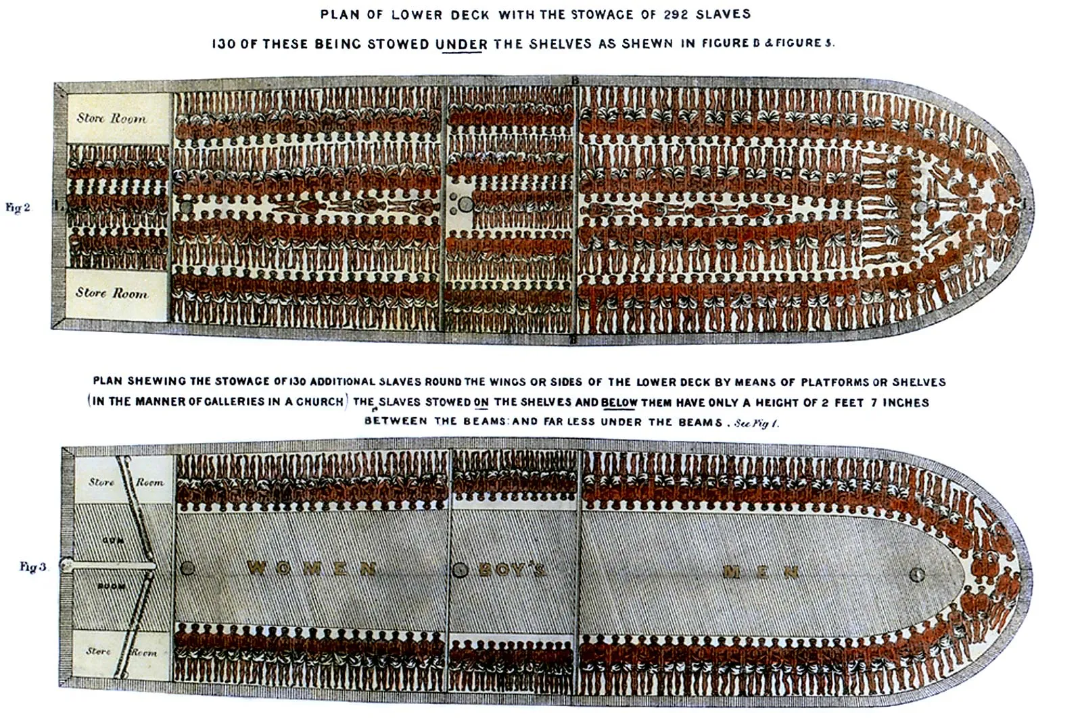
Image credit: Encyclopedia Britannica

Slide 10
Partus sequitur ventrem: Law, Race, and Reproduction in Colonial Slavery
Jennifer L. Morgan
“From the moment of its introduction into the Atlantic world, hereditary racial slavery depended on an understanding that enslaved women’s reproductive lives would be tethered to the institution of slavery. At the same time, few colonial slave codes explicitly defined the status of these children. The presumption that their children would also be enslaved produced a visceral understanding of early modern racial formations for enslaved women.”
Notes:
https://blogs.law.columbia.edu/abolition1313/files/2020/08/Morgan-Partus.pdf

Slide 11
Complete Primary Document Analysis - Legislating Reproduction
Discussion Questions:
Why was the differentiation between white and Black women in the 1643 tax code an important moment in history?
Why were the planters of Virginia concerned about the birth of mixed-race children?
Why did laws about racial difference center on women? What implications would these laws have for the entire society?
Why did women bear the brunt of punishments for breaking these laws?
Notes:
Homework: Read and annotate Linda Villarosa article “Medical Inequality” from The 1619 Project

Slide 12
Article 1, Section 9 of the Constitution stated that Congress could not prohibit the "importation" of persons prior to 1808. Twenty years later, the Act "to prohibit the importation of slaves in any port or place within the jurisdiction of the United States, from and after the first day of January [1808.]" was passed.
Speculate:
Review Database Images from the Slave Voyages website.
Set filter to view ships in USA only.
Predict: Why does the graph show a drastic increase in voyages in 1807?
Notes:
Capitalized Wombs

Slide 13
Small Group Discussion
How are the hereditary slave laws connected to the American economy after 1808?
How do you think this constitutional change impacted the lives of enslaved women?

Slide 14
The Capitalized Womb
In their book The American Slave Coast: A History of the Slave Breeding Industry, Ned and Constance Sublette, “have managed to coin the brutal economic system that kept the institution of slavery alive as the “capitalized womb” (p. 24). They argue that the “capitalized womb” illustrates how enslaved women’s bodies served as the engine of the slave breeding industry and powered a global economy for cotton consumption. Their new book ties the violent experiences of enslaved women directly to the market. It tells the brutal story of how the slave industry made the reproductive labor of the people it referred to as “breeding women” essential to the country’s expansion. They contend: “In a land without silver, gold, or trustworthy paper money, enslaved women’s children and their children’s children into perpetuity were used as human savings accounts that functioned as the basis of money and credit.”
In her book The Price for their Pound of Flesh: The Value of the Enslaved from Womb to Grave in the Building of a Nation, historian Daina Ramey Berry specifies the differences between the meaning of the word “breeding” and how in the late eighteenth century and early nineteenth century “breeding” meant “pregnant or nursing women,” who were not highly valued. By the mid-nineteenth century, however, Ramey Berry found that the term had shifted to mean “reproduction for profit,” signifying a distinct shift in the commodification of sex and reproduction.
Notes:
Look at https://raunerlibrary.blogspot.com/2010/03/power-of-satire.html for satirical ad in Hanover.

Slide 15
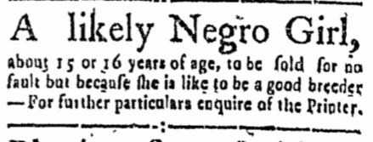
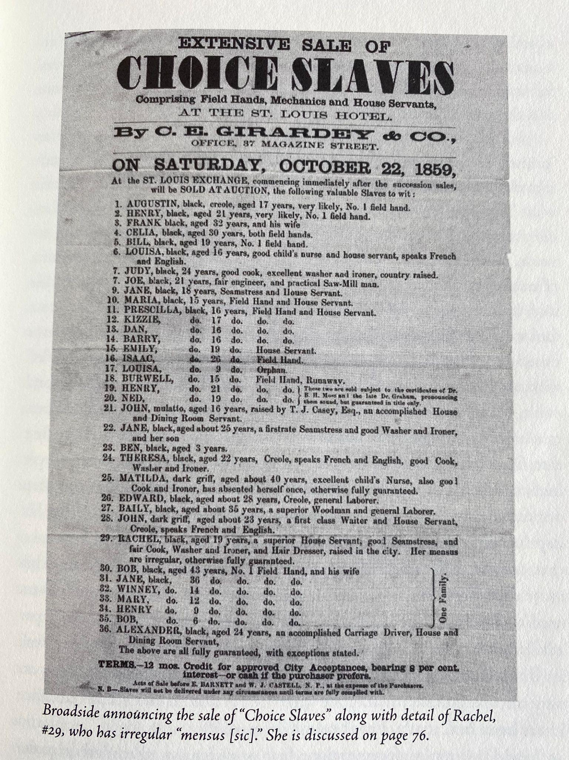
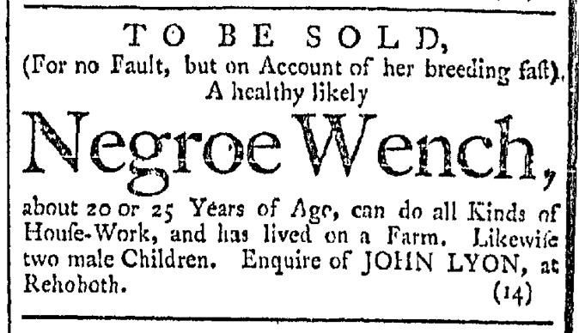
Primary Source Analysis: The Capitalized Womb
Using the sources below, what inferences can be drawn about how the lives of enslaved women changed after 1808?
Notes:
The enslaved were ranked based on their health and body conditions (notice #29). The scale was 5 points with .25 increments. “Prime” hands had a rating of 1 or A1, which projected the amount of work a person could do.

Slide 16
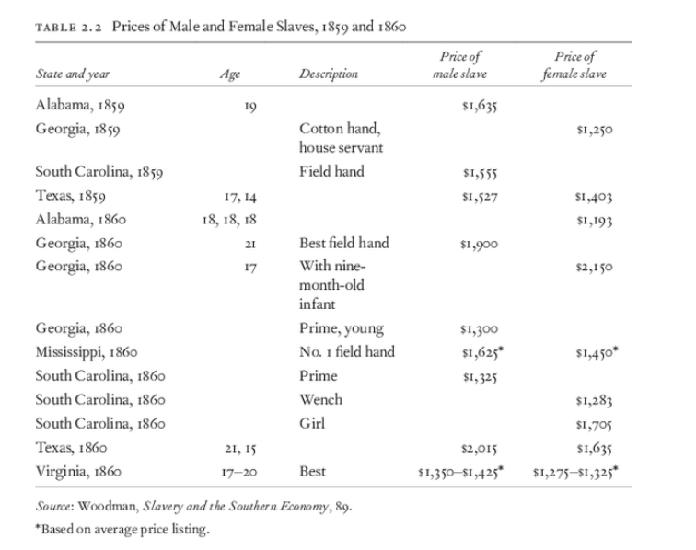

Slide 17
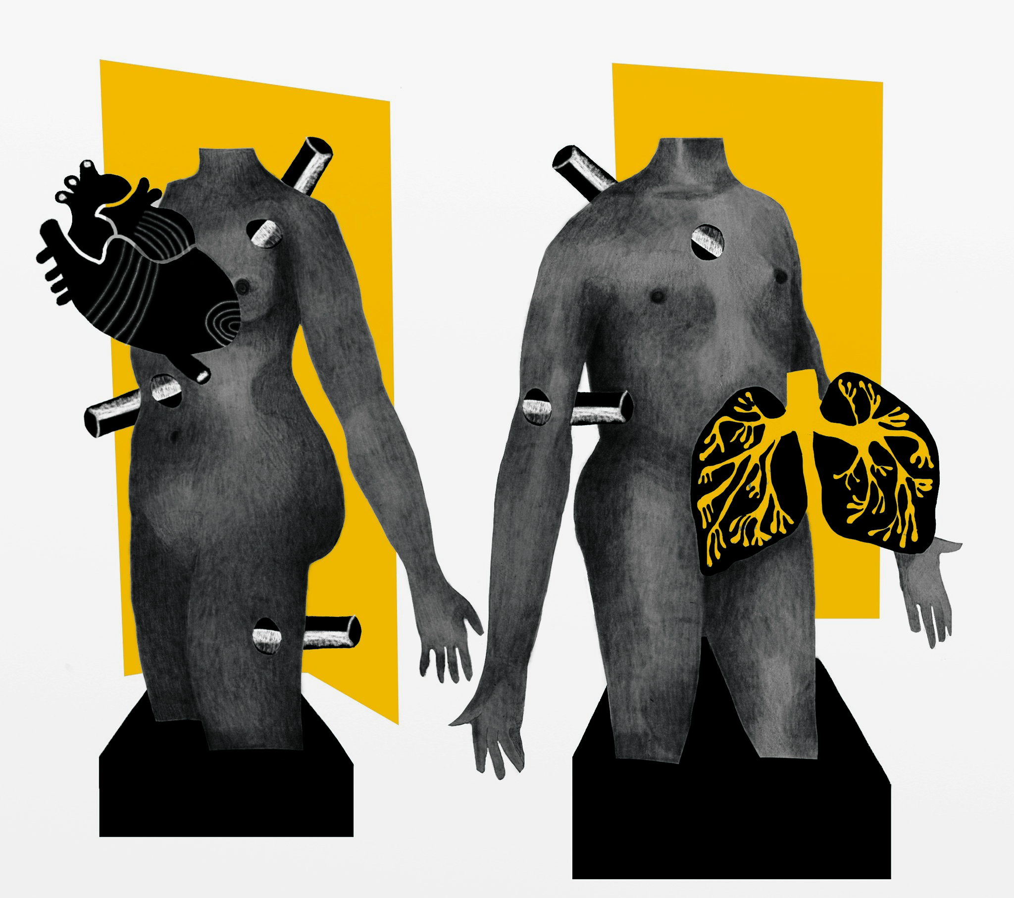
Reading assignment for Lesson 2
Read and annotate “Medical Inequality” by Linda Villarosa from The 1619 Project

Slide 18
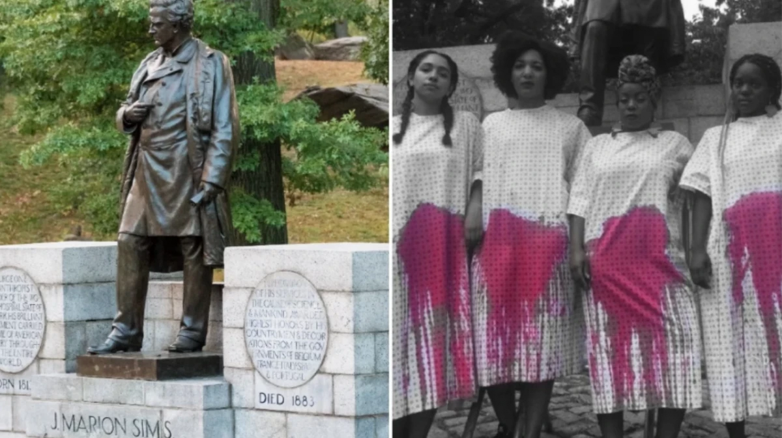
Lesson 2: History of Medical Racism
Why is it important to engage in a specific focus on Black women’s experiences in the context of American History?
How have stereotypes of Black bodies developed during slavery become embedded in our social construct?
How did enslaved women’s experiences factor into the story of reproductive research?
What does slavery have to do with health care inequities in the 21st century?

Slide 19
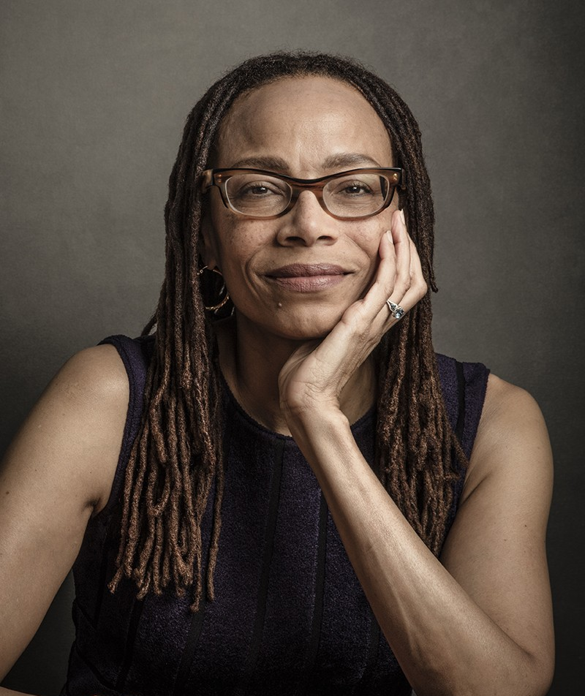
Linda Villarosa.
“Medical Inequality” Author, NYT Reporter
Listen here: Dorothy Roberts “What’s Race Got to Do with Medicine?”
Sociologist, University of Pennsylvania

Slide 20
Journal/Discussion on “Medical Inequality” and “What’s Race Got To Do With Medicine?”
In your journals, write a response to the following questions, then discuss in small groups.
1. What inaccurate and unfounded assumptions have doctors made throughout history about the bodies of enslaved Black people, and how did they attempt to prove those assumptions?
2. How have racist medical practices and attitudes influenced the medical treatment that Black Americans have received throughout history, and continue to receive today?

Slide 21
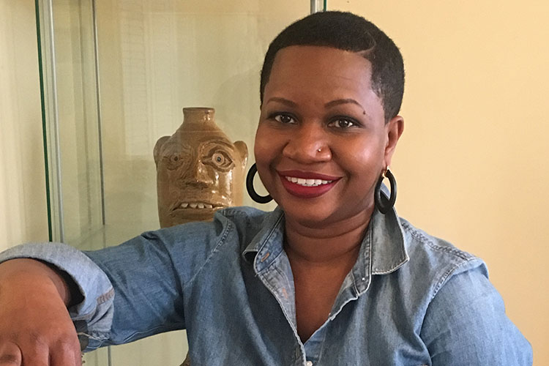
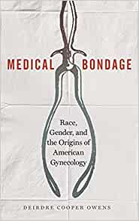
Deirdre Cooper Owens Lecture
As you listen, think about the question: How are the history of enslaved bodies and contemporary health inequities connected? Be prepared to discuss the question.
Deirdre Cooper Owens Lecture: 5:51-21:44
EDUCATIONAL BACKGROUND
Ph.D., UCLA (History), 2008
M.A., Clark Atlanta University (African American Studies, History Concentration), 2001
B.A., Bennett College, 1994
EXPERTISE/AREAS OF STUDY
History of Medicine;Slavery;
19th Century U.S. History;Women's History

Slide 22
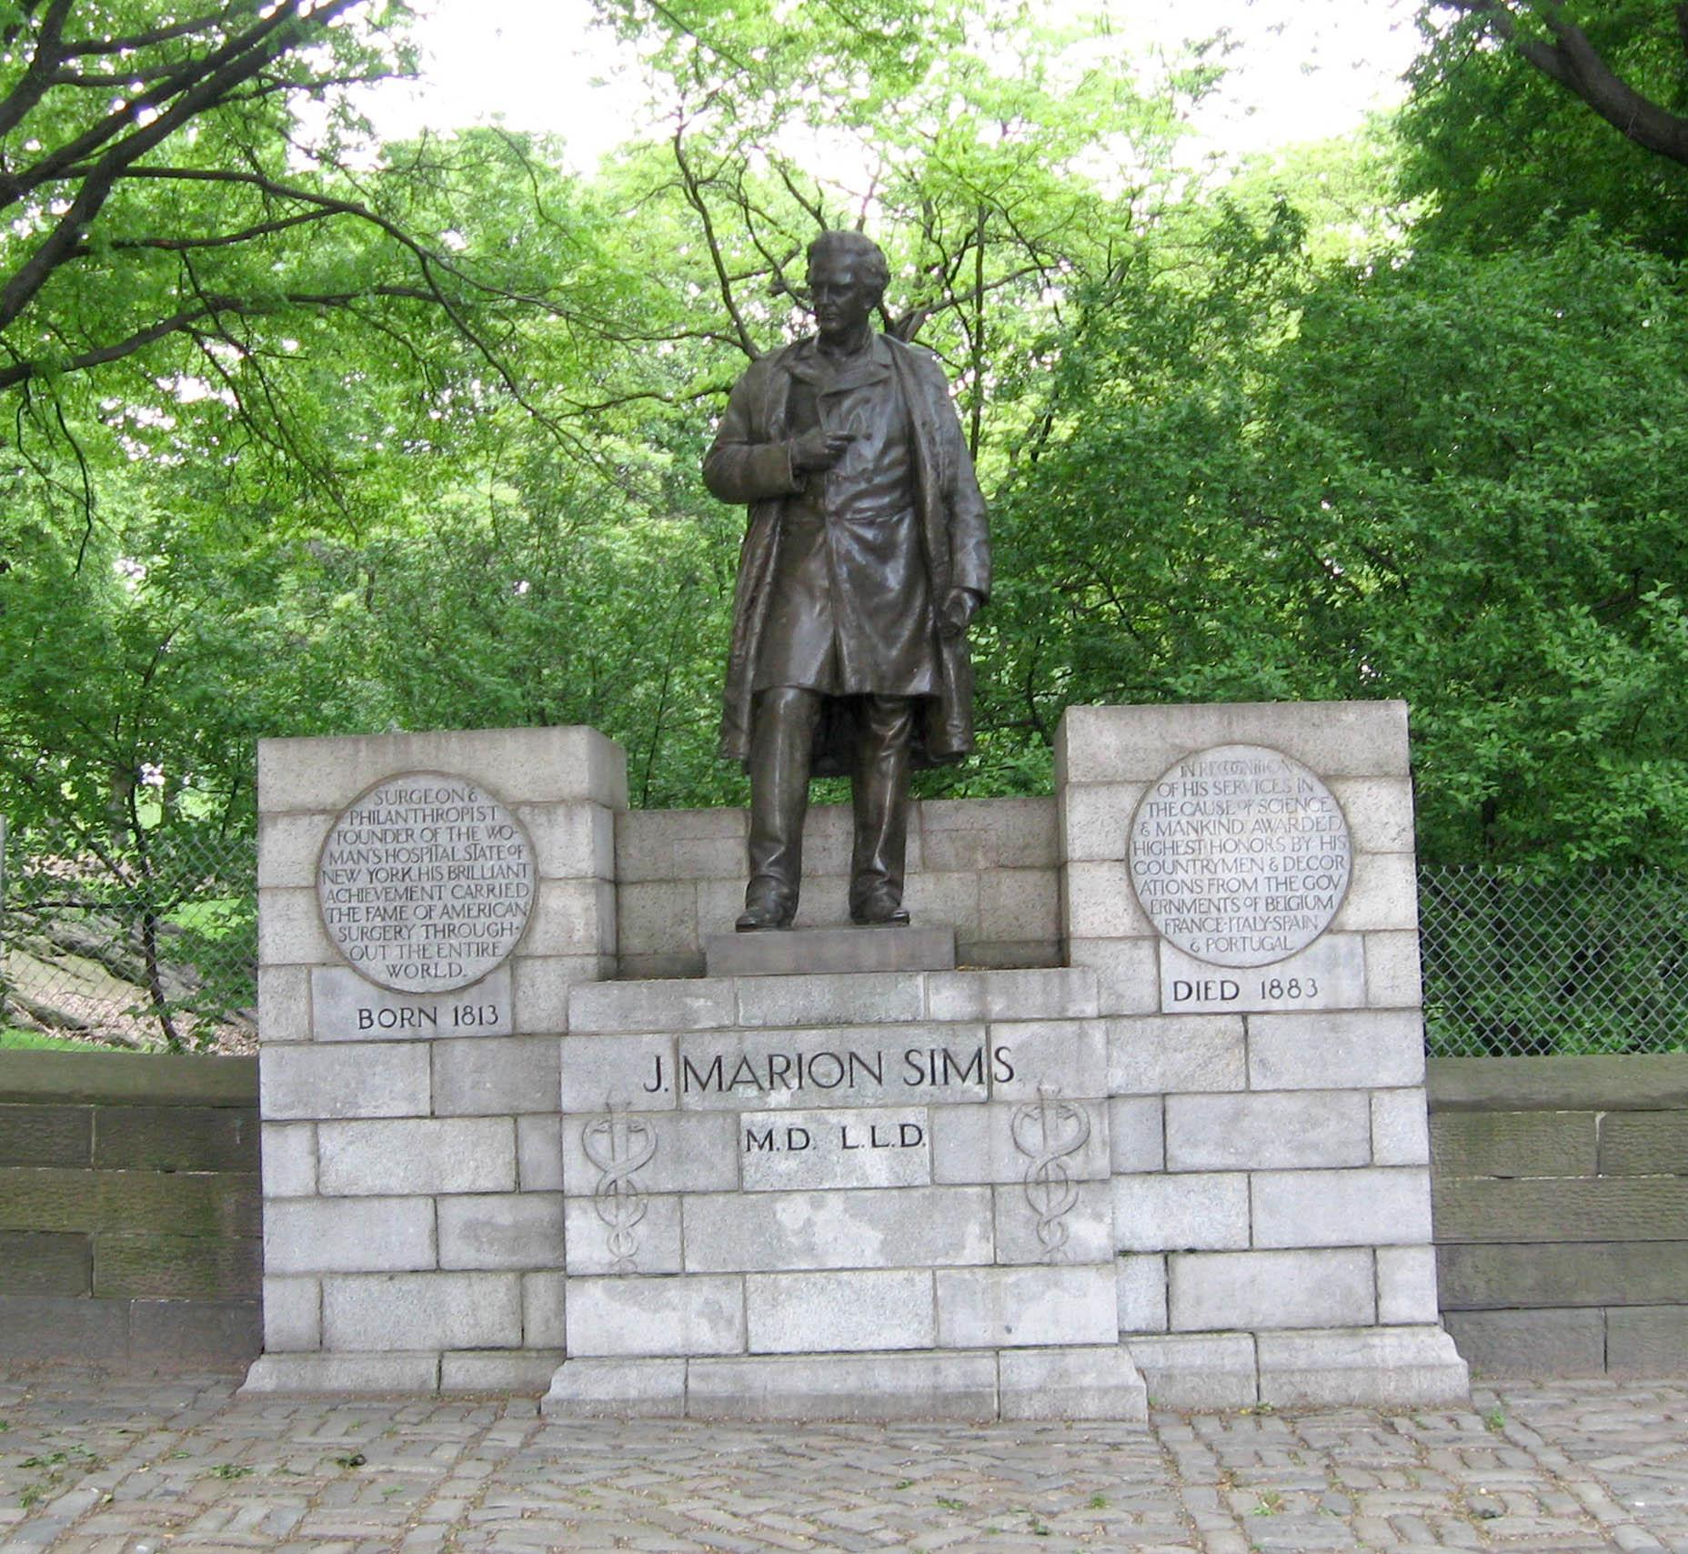
The U.S. Medical System is Still Haunted by Slavery
Who is J. Marion Sims?
How did he come to be known as father of modern gynecology?
Watch VOX Video: “The US Medical System Is Still Haunted by Slavery.”

Slide 23
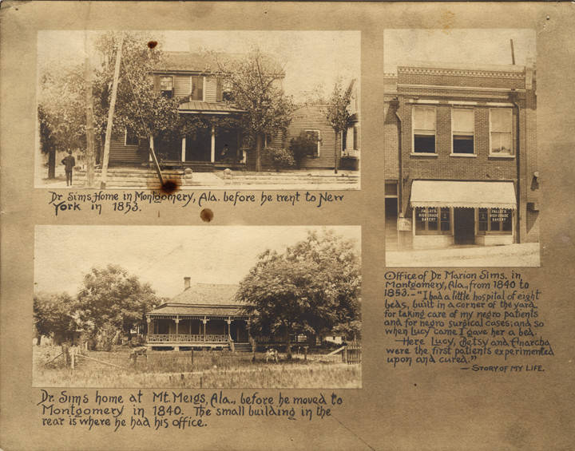
Deirdre Cooper Owens Lecture:
43:45-49
Reiterate what Cooper Owens means by “racial cognitive dissonance”? Where do you see these examples in her lecture? Where do you see examples in the document on the next page?
J. Marion Sims Home in Montgomery County, 19th century. Courtesy of Alabama Department of Archives and History.

Slide 24
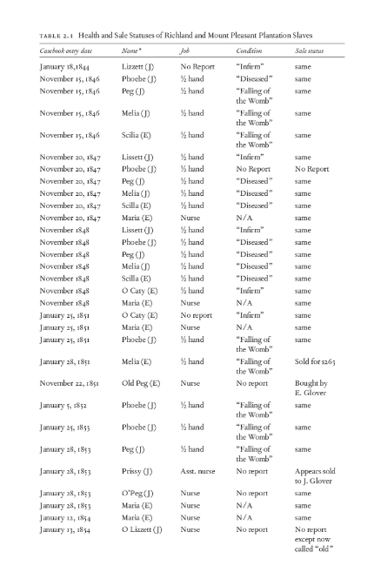
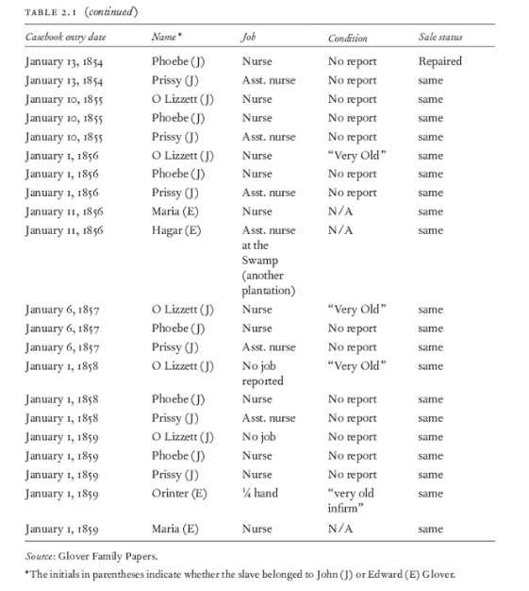
Notes:
What contradictions are brought to light?

Slide 25
Lesson 3: Enslaved Women: Mothers of Modern Gynecology
Why is it important to engage in a specific focus on Black women’s experiences in the context of American History?
How did enslaved women’s experiences factor into the story of reproductive research?
Does shifting the historical narrative to reflect Black women’s stories change the way we understand the history of healthcare?

Slide 26
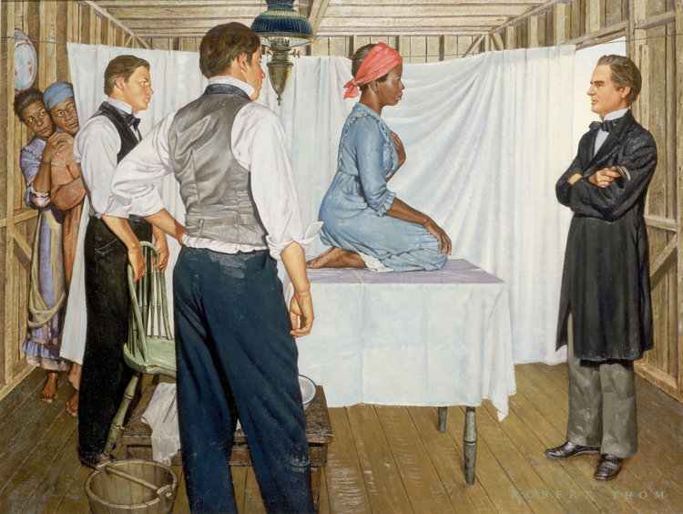
"J. Marion Sims: Gynecological Surgeon," from “The History of Medicine,” by Robert Thom, circa 1952. Archived at the University of Michigan.
Image is purportedly the only depiction of Lucy, Anarcha and Betsy in the twentieth century
See/
Think/
Wonder
Notes:
https://historyofyesterday.com/the-myth-of-black-people-not-feeling-pain-is-still-believed-to-this-day-ddc73e0b8428
Lucy, Betsy and Anarcha: https://wams.nyhistory.org/a-nation-divided/antebellum/anarcha-betsy-lucy/#teaching

Slide 27
Who are Anarcha, Betsy, and Lucy, and why are their stories important?
Read and be ready to discuss the questions below.
Why was Sims able to experiment freely on Anarcha, Betsy, and Lucy?
Why are Sims’s experiments still lauded as a major achievement in medical science?
Why is it important to acknowledge Anarcha, Betsy, and Lucy’s role in Sims’s advancements?
Where do you see evidence of Cooper-Owens’ idea of “racial cognitive dissonance?”

Slide 28
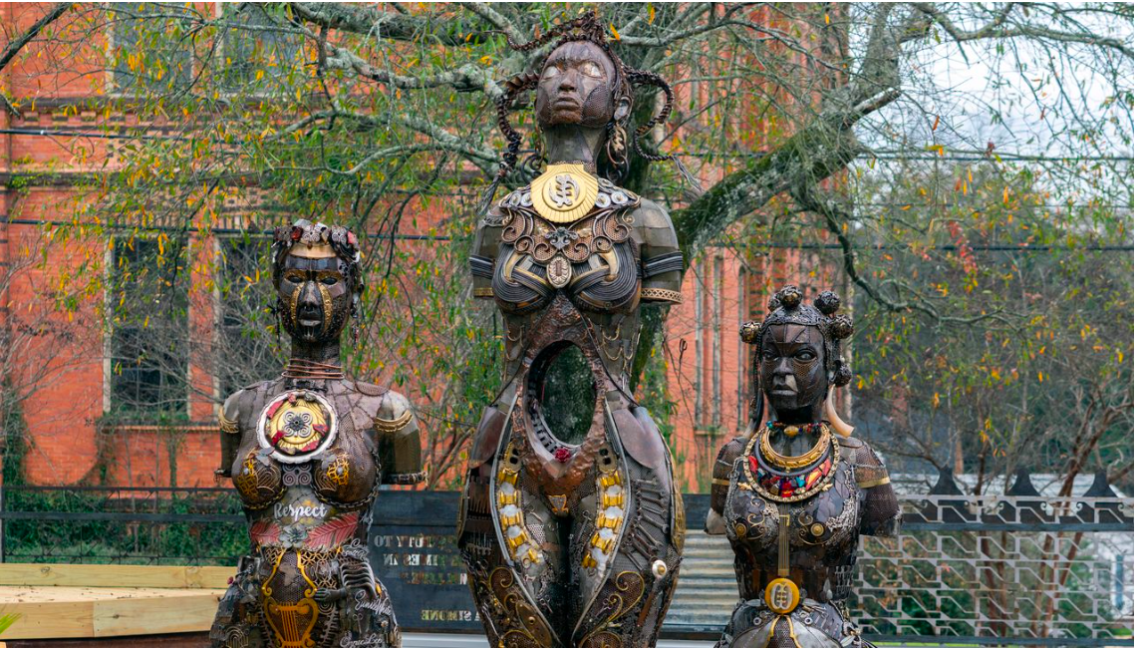
Mothers of Gynecology Monument
Spend a few minutes looking at the images of Betsy, Lucy and Anarcha.
As you look at the images, and consider these questions:
What details can you identify on these statues?
What examples of symbolism has the artist included?
Why do you think the artist made these choices?
What is your reaction to these statues?
What title would you give to this monument?
How does shifting the historical narrative to reflect Black women’s stories change the way we understand the history of healthcare?
Watch this video as a class
Watch film and respond to the prompt: I used to think______, now I think ______.
Notes:
http://kenmarch.com/2022/04/mothers-of-gynecology-monument/
https://www.atlasobscura.com/articles/midwives-gynecology-gulf-south

Slide 29
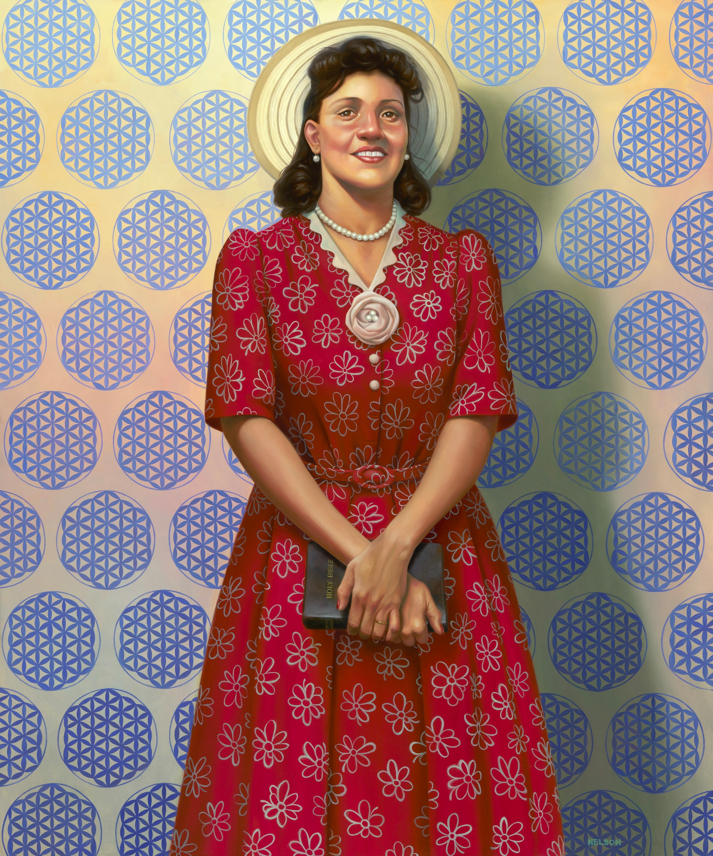
Lesson 4: Linking Legacy of Slavery to Healthcare Today - Guiding Questions
What does slavery have to do with health care inequities in the 20th and 21st century?

Slide 30
Other examples of this legacy throughout history
What does slavery have to do with health care inequities in the 20th century?
As a table, read/watch about your assigned example. Make one google slide to include in a shared class presentation with an image and bullet points. Be prepared to share the details of your findings with the class.
Henrietta Lacks
Tuskegee Study
Fannie Lou Hamer and Forced Sterilization
As you listen to presentations, take notes on this Note Catcher.
Notes:
PDF note catcher / Word doc note catcher

Slide 31
Reading assignment
Read and annotate
“America is Failing its Black Mothers” by Amy Roeder from Harvard Public Health

Slide 32
Final Assessment
What does slavery have to do with health care inequities in the 21st century?
How do stereotypes of Black bodies developed during slavery continue to influence contemporary medical practices and outcomes?
Option 1: Analyze how current inequities in medical practices and outcomes for women of color today can be traced to slavery.
Option 2: Examine how the narrative around medical racism is shifting and what evidence suggests this shift.
Create a presentation on one of the topics in the assignment description.

Slide 33
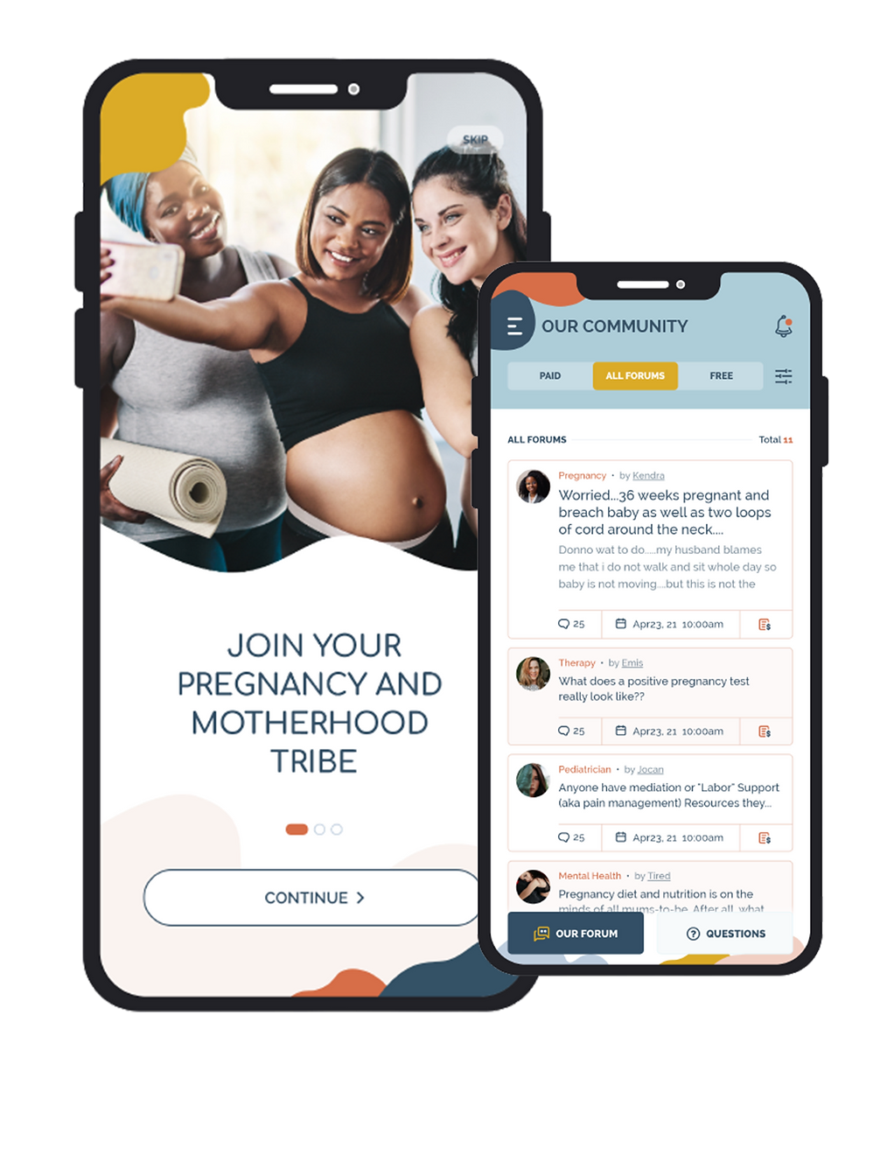
Advocacy Organizations and Resources for Black mothers
Ariah Foundation
Irth - Maternal Care App
Wolomi - Maternal Care App

Slide 34
Unit Closing: Watch “Aftershock” (available on Hulu).

