Slide 1


HARMFULLY RELEVANT HISTORY
Brittany Goldsby _ 2023 _ Pulitzer Center Fellow
This Photo by Unknown Author is licensed under CC BY

Slide 2
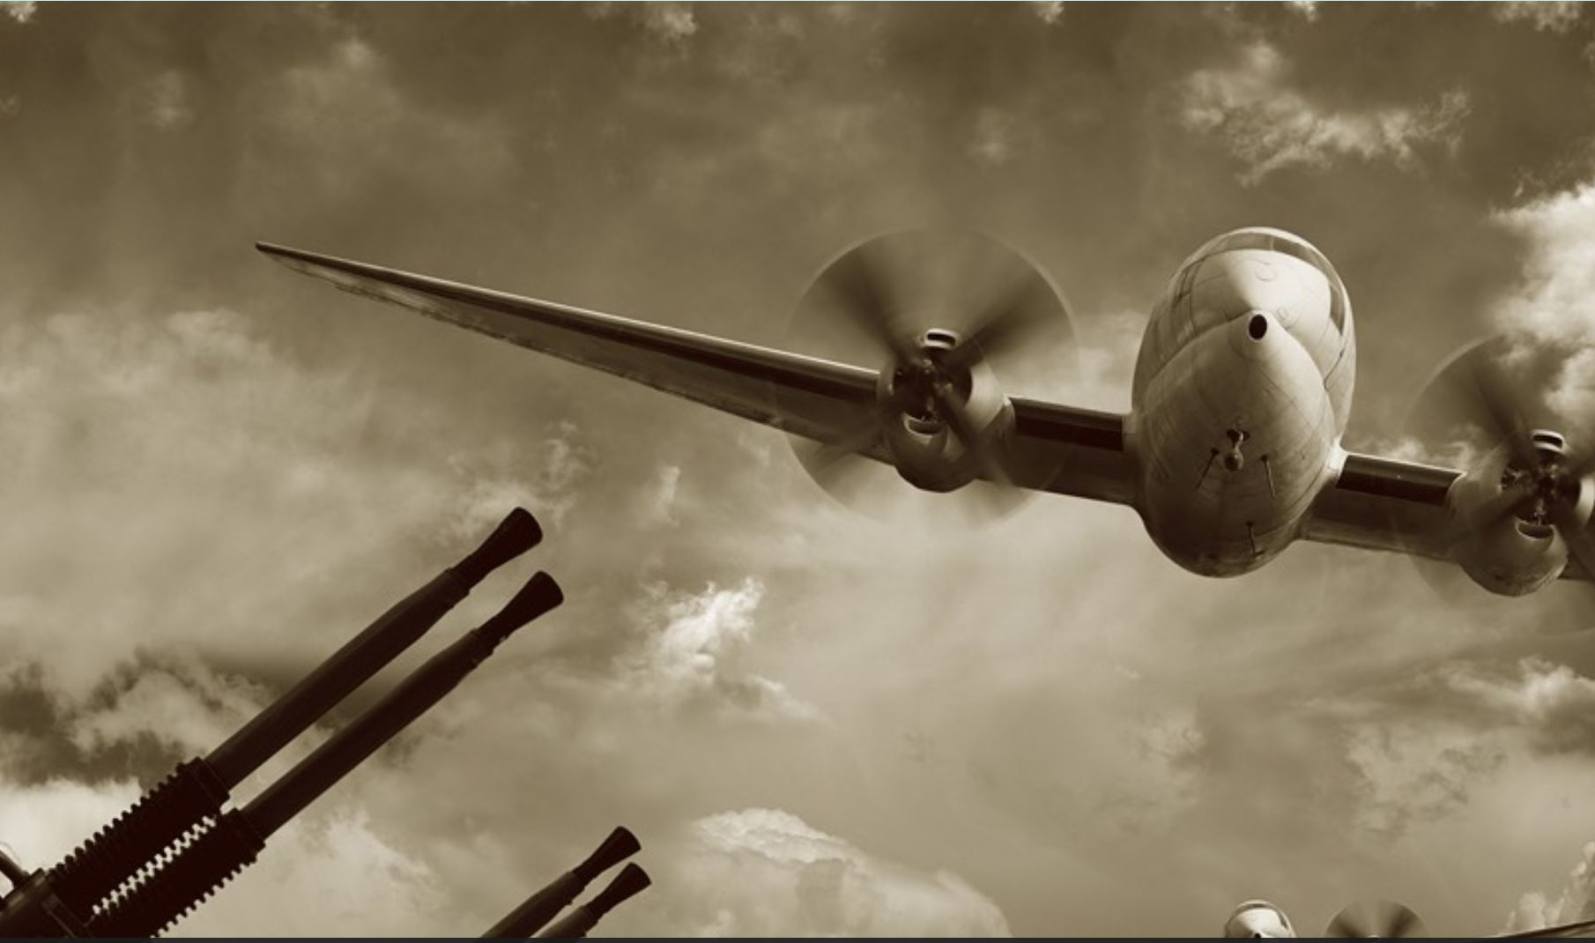
TITLE: “WORLD WAR II IS STILL KILLING PEOPLE IN THE SOLOMON ISLANDS”
-BY THOMAS HEATON
React to the above headline in writing: make predictions, connections, and/or describe your personal feelings upon reading the title. 5 or more sentences
This Photo by Unknown Author is licensed under CC BY-SA

Slide 3
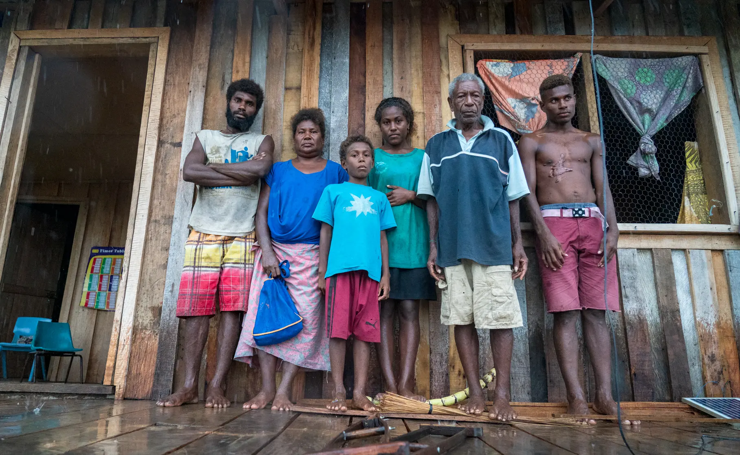
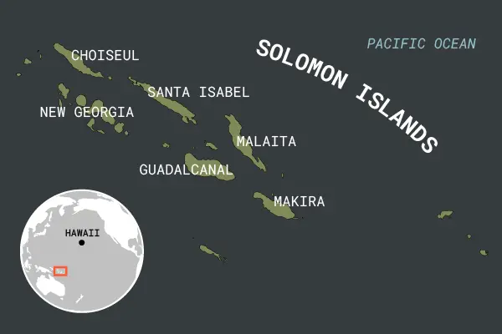
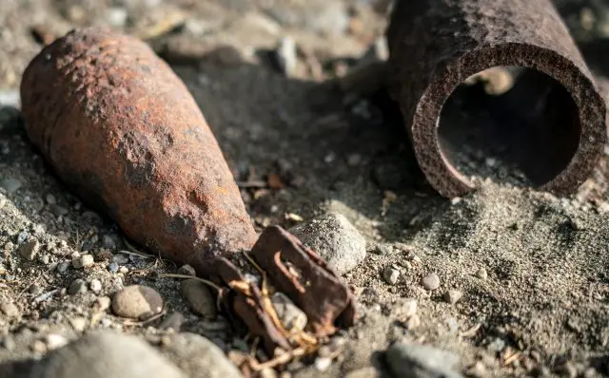

“WORLD WAR II IS STILL KILLING PEOPLE IN THE SOLOMON ISLANDS”
-BY THOMAS HEATON
1) What is the central theme of the article and how is it developed in this reporting? Provide textual evidence for support.
2) How does the speaker use the persuasive rhetorical devices of ethos, logos, and pathos to advance their purpose?
3) What is the most effective supporting detail for you while engaging with this story?

Slide 4

HW: “PSA POSTER”
Create a public service announcement (PSA) on white paper on a social issue, locally or globally, that you care about personally. Use ethos, logos, and pathos as rhetorical devices to engage your audience. Include a clear call to action centered around the topic.
bring them back by the next class period for submission.

Slide 5


RESEARCH PROJECT: “LIFT EVERY VOICE”
Research and report on an underreported issue that relates to the residual effects of historic events on underprivileged and/or marginalized groups or any other reporting that amplifies the voice of a marginalized group through a multimedia presentation.
Refer to the rubric handout for the specifics, as well as the due date!
Find a report from the Pulitzer Center archive and expand on the topic through two relevant, credible sources. Use rhetorical strategies to help engage your audience. Your presentation must have visual and written components that you submit physically or electronically at the end of your assigned presentation date. Pick your article/topic TODAY!
This Photo by Unknown Author is licensed under CC BY-NC
Key Article Source

Slide 6
VOLUNTEERS:
SHARE YOUR PSA ALOUD FOR EXTRA CREDIT. AUDIENCE: SUMMARIZE THEIR PERSPECTIVE AND CALL TO ACTION WITH THE SPEAKER’S NAME FOR EXTRA POINTS.
EVERYONE:
ANSWER THE TWO QUESTIONS TO THE LEFT IN COMPLETE SENTENCES.
PSA Extra Credit & Journal Prompt:
“How To Lift a Voice”
What does it take to get an audience to care about an issue they aren’t personally facing?
How do you navigate discussing sensitive topics in groups with differing opinions?

Slide 7


“ARTICLE ANALYSIS GROUP WORK”
Assigned Articles:
“Revisiting the Widows of Duterte’s Deadly ‘War on Drugs’ – In Pictures” by James Whitlow Delano
“Navajo Women Make Historic Gains in Elections, Increase Influence on Tribal Council” by Arlyssa Becenti
“Far From Home” by Amie Ferris-Rotman & Zahra Joya
What is the central theme of the article and how is it developed in this reporting? Provide textual evidence for support.
How does the speaker use one or all of the persuasive rhetorical devices of ethos, logos, and pathos to advance their purpose?
Roles:
Everyone reads and writes the answers in their notebooks.
Select one person to provide the class with a brief synopsis of your group’s article plus the answer to one of your questions as the speaker.
What is the most effective supporting detail for you while engaging with this story?

Slide 8

RESEARCH PROJECT REMINDER
Get the instruction/rubric handout if you need it.
Submit your anchor article/topic choice for approval. No one in this class period can have the same article selection as someone else. You may use the same topics or subject matter, but you may not use the same key text. All key articles must come from the Pulitzer Center grantee Story archives. Follow the link on the screen here or on your handout to access the listing. Whoever submits their article first gets to keep it in the event of repeats.

Slide 9
SOCRATIC SEMINAR: “MARGINALIZATION IN THE MEDIA”
Rules:
Everyone must answer/respond/inquire aloud at least once for a “C” and twice for a “B” and with at least 1 out of 2 responses being original and non-reactive for a perfect 100%.
Use Standard English grammar and appropriate, respectful language.
Speak one at a time, knowing that everyone will get a chance to speak.
Remain focused, even when not speaking and keep all distractions minimal.
Question 1:
What is the role and responsibility of the media in society?

Slide 10
SOCRATIC SEMINAR: “MARGINALIZATION IN THE MEDIA”
Rules:
Everyone must answer/respond/inquire aloud at least once for a “C” and twice for a “B” and with at least 1 out of 2 responses being original and non-reactive for a perfect 100%.
Use Standard English grammar and appropriate, respectful language.
Speak one at a time, knowing that everyone will get a chance to speak.
Remain focused, even when not speaking and keep all distractions minimal.
Question 2:
How can the media elevate marginalized voices?

Slide 11

PRESENTATION DAY!
Audience:
Complete the Peer Review for at least 5 different speakers for full credit. Extras go towards extra credit points.
Be specific and detailed in your responses. Attach another sheet to the form if needed.
Be silent and respectful during each presentation, keeping distractions minimal.
Presenters:
Speak loudly & Clearly. Be willing to repeat or answer questions for clarity.
Share your visual and you speak/read from your written component.
Stay on task and remain non-confrontational with your peers.

Slide 12

DISCURSIVE ESSAY ASSESSMENT
Essay Topic: To What Extent Should Nations Be Held Accountable for the Impact of Their Historic Actions?
Use the entire period to plan, write, and proofread your essay.
Use the insight from our recent studies and discussions to inform your analysis.
Submit your work at the end of the period.
This draft will be scored for a grade.

Slide 13

THANK
YOU
Goldsby 2023

