Slide 1

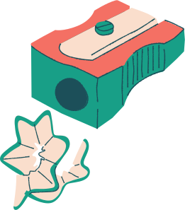



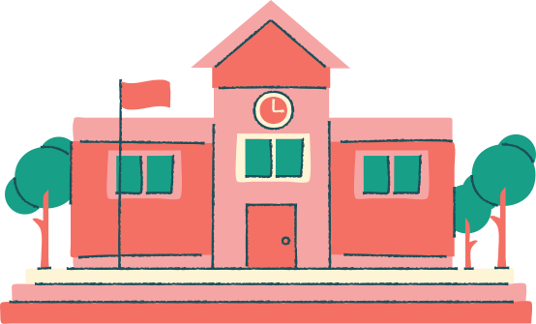
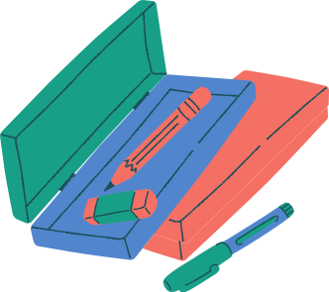
Rhetorical Strategies
Ms. B. Goldsby '20-'21

Slide 2
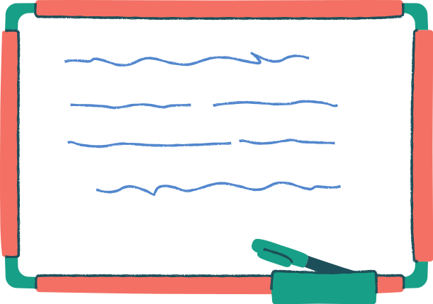

What is Rhetoric?
Strategies that help make a speaker/author more effective at influencing the audience
  Makes the message memorable
  Connects the speaker to the audience
  Promotes a specific tone
  Emphasizes certain details
AICE General Paper l

Slide 3


The Rhetorical Triangle
Key to Effective Use of Language:
Speaker
In order for a speaker or writer to speak or write, they MUST consider both the audience and purpose.
Audience
Purpose
AICE General Paper I

Slide 4


All These Things Change Depending on the Target Audience
Topic- The general subject matter or central message the speaker is trying to deliver
Diction- Deliberate word choice of the author
  Tone- The attitude of the speaker about the topic
AICE General Paper l

Slide 5



Rhetorical Devices for Persuasion
ETHOS
Using ethics, morals, and law to persuade an audience. Relying on the speaker's credibility and trustworthiness to gain the audience's trust.
LOGOS
PATHOS
Using logic, facts, and other concrete evidence that can be tested or proven to persuade an audience. Relying on the credibility of the cited sources to gain the audience's understanding
Using relatable content that evokes an emotional response from the audience in order to persuade that audience. Relying on the interests, experiences, and concerns of an audience to connect with them on a personal level.
AICE General Paper I

Slide 6



Look at these Examples!
PATHOS
ETHOS
LOGOS
Children
Family/Friends/Love
Animals
War/Peace
Sickness/Health
Safety
Music
  Fun
Laws
Years of Experience
Expert Testimony
Cultural Values
Educational Background
Reviews
  Reputation
Statistics
Percentages
Price/Sale
Nutrition Facts
Biology
Scientific Facts
Reasoning
AICE General Paper l

Slide 7


Let's Discuss and Analyze Together
Question 1
Question 2
Question 3
Which is the most reliable source of "Input" for a speaker that is trying to persuade an audience?
Why is it important for a persuasive speaker to use all three rhetorical persuasive devices to reach an audience effectively?
Which of these three devices is most effective on you and why?
AICE General Paper l

