Slide 1

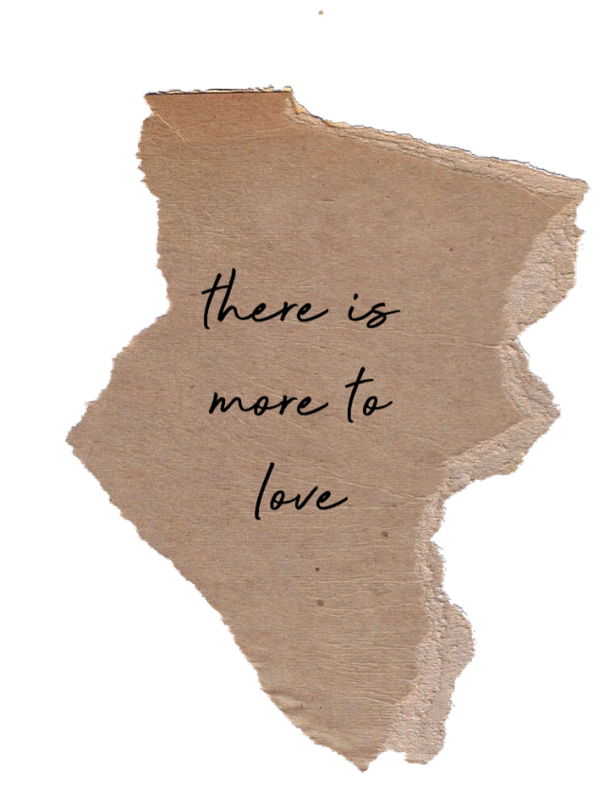

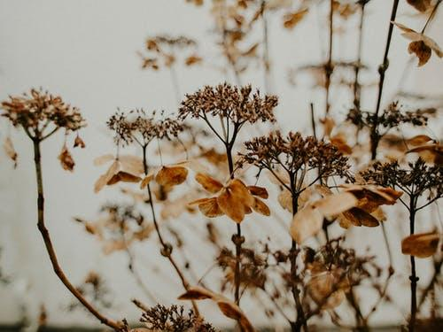

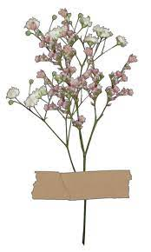


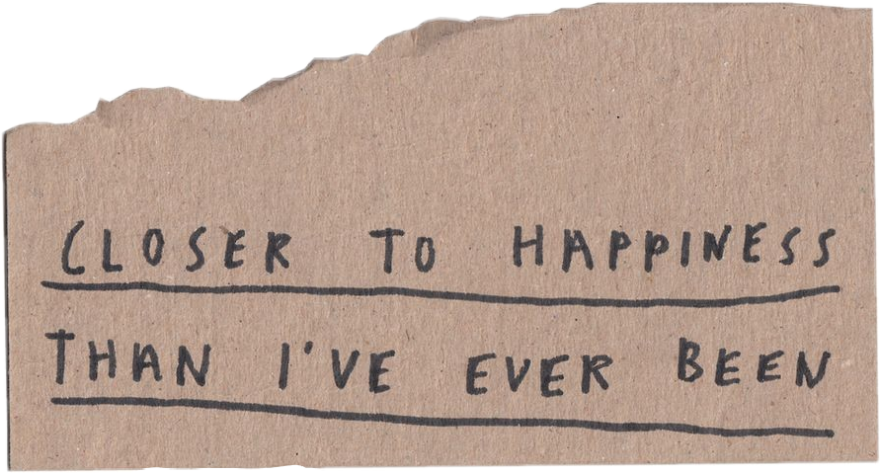
Friends and Family
Photo
Collage

Slide 2
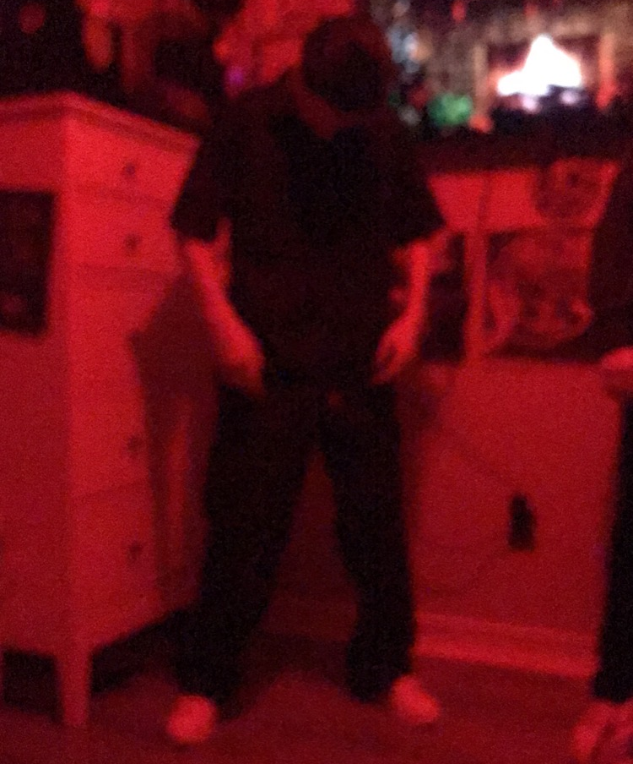
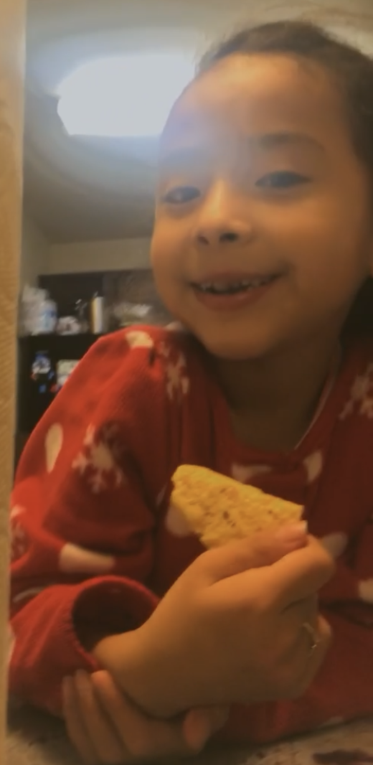
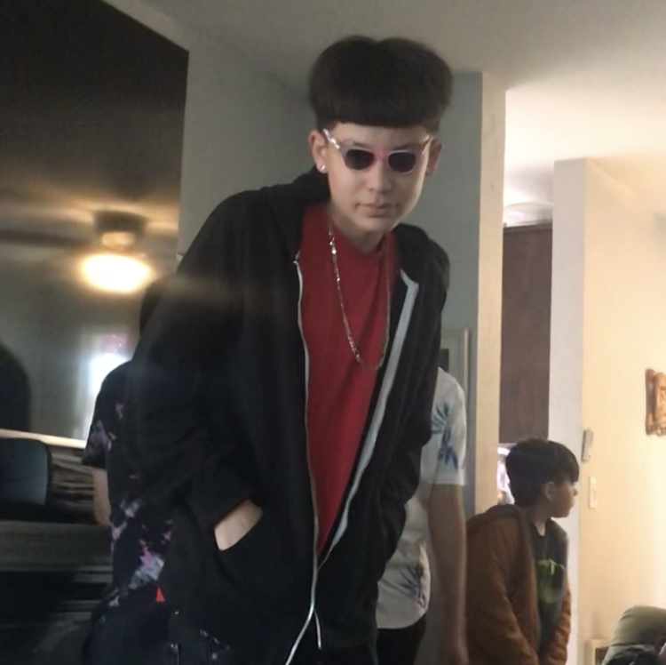
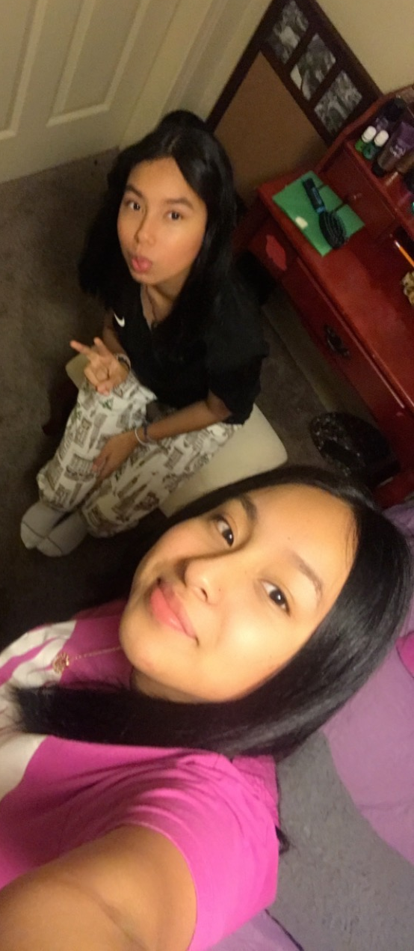
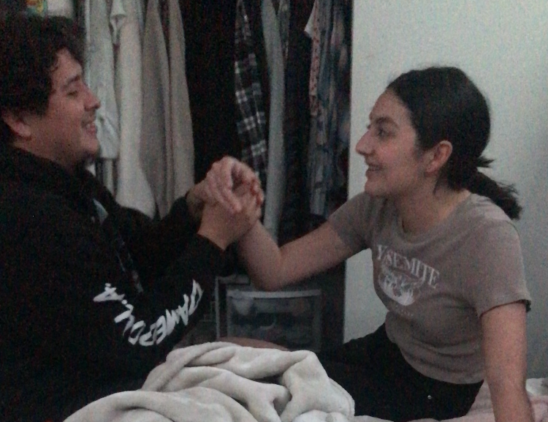
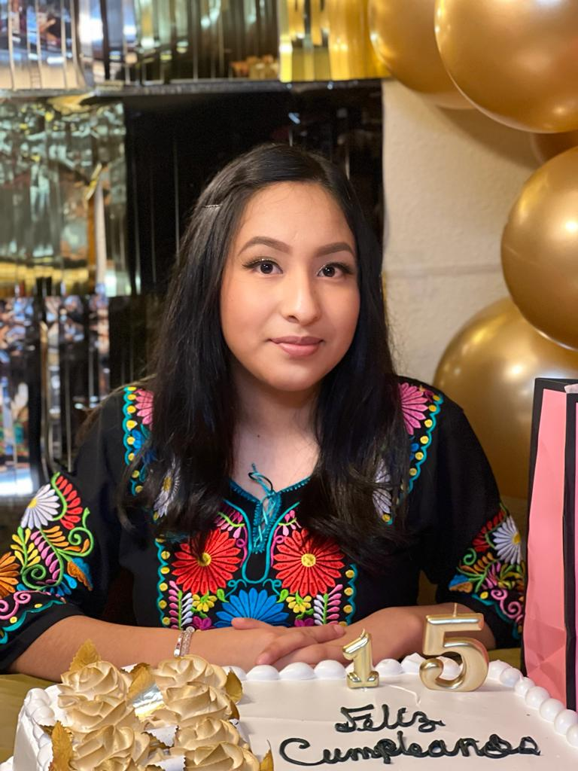
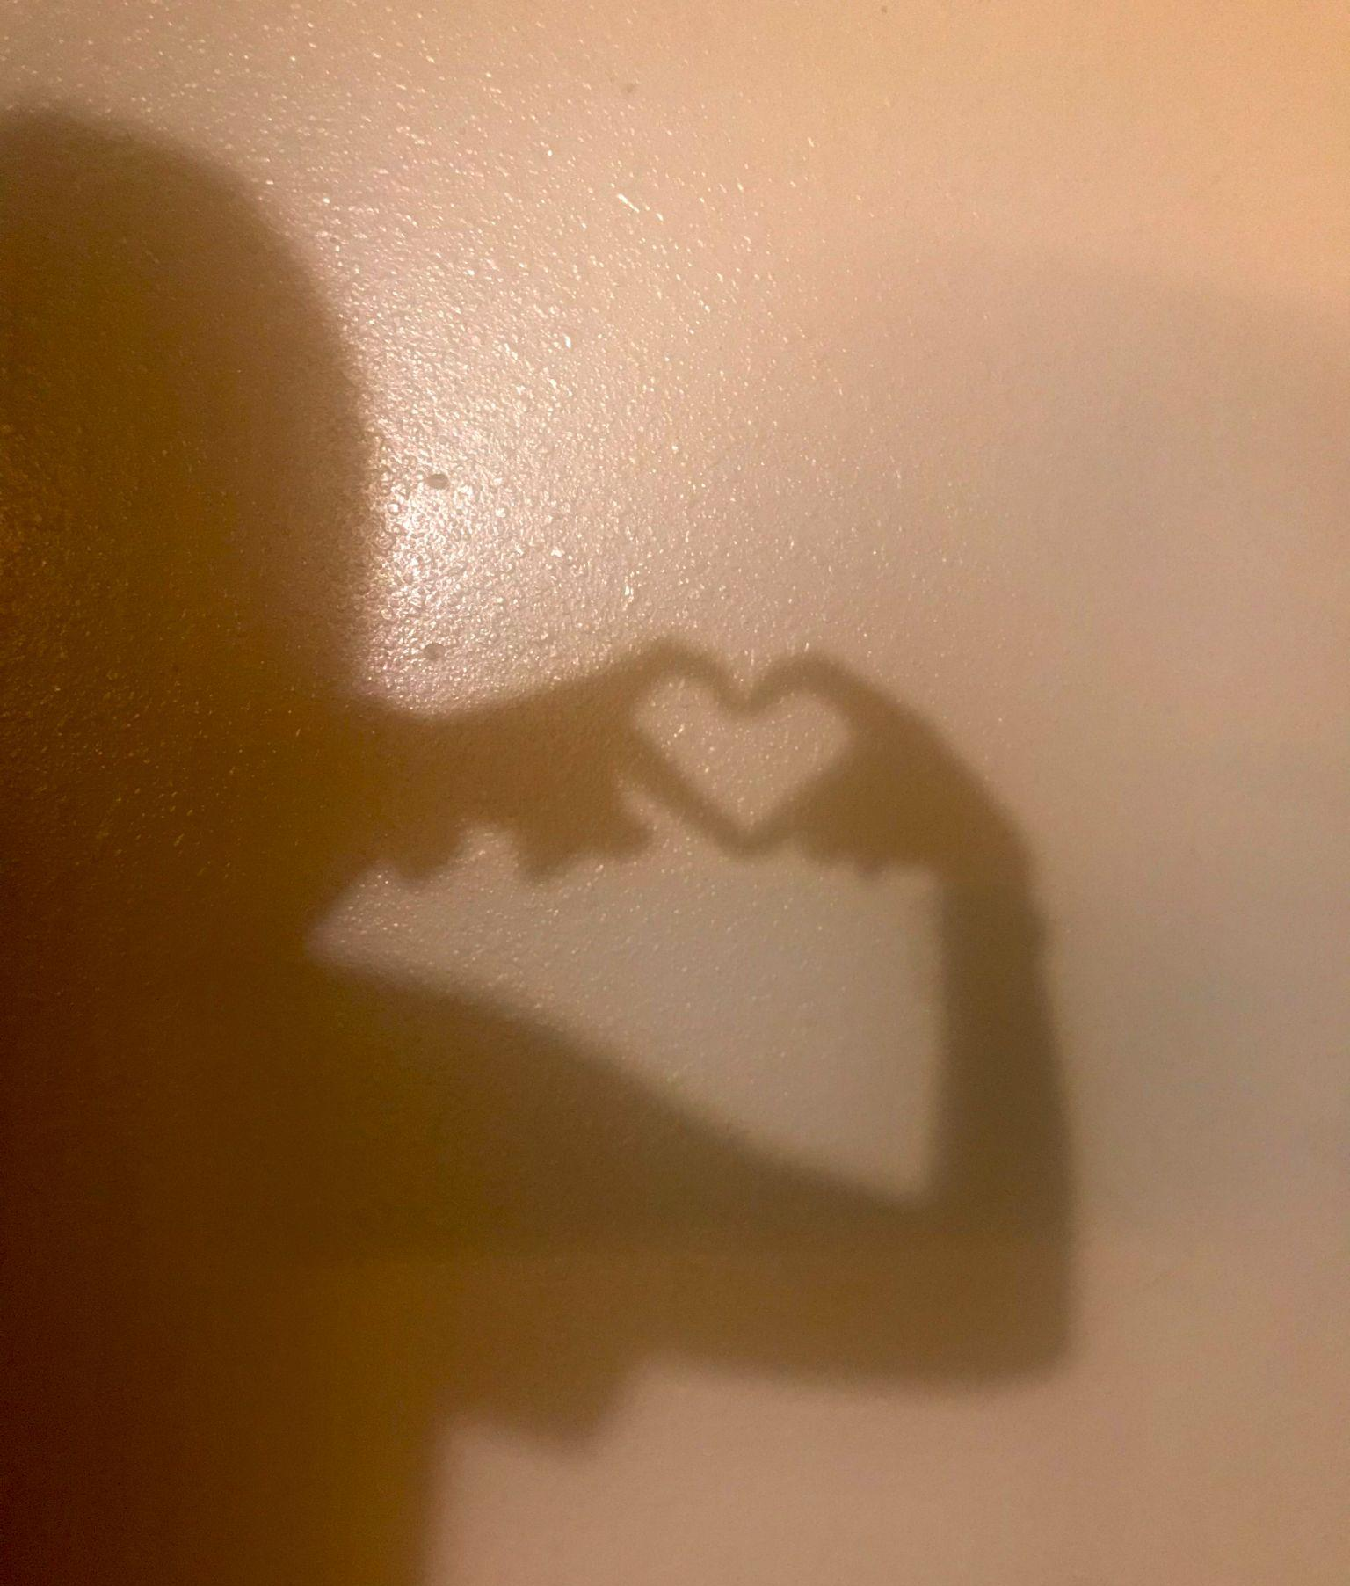
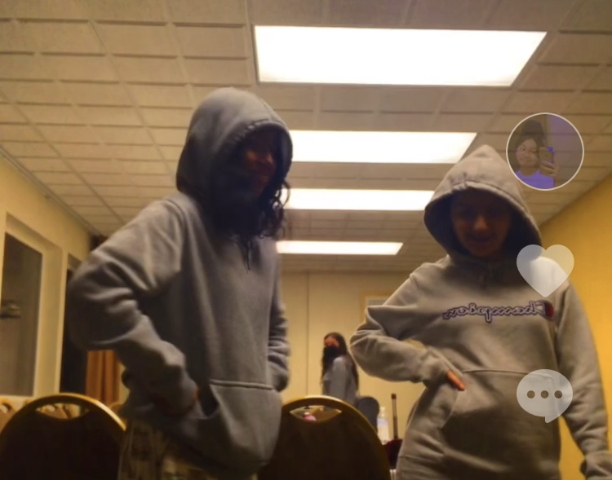
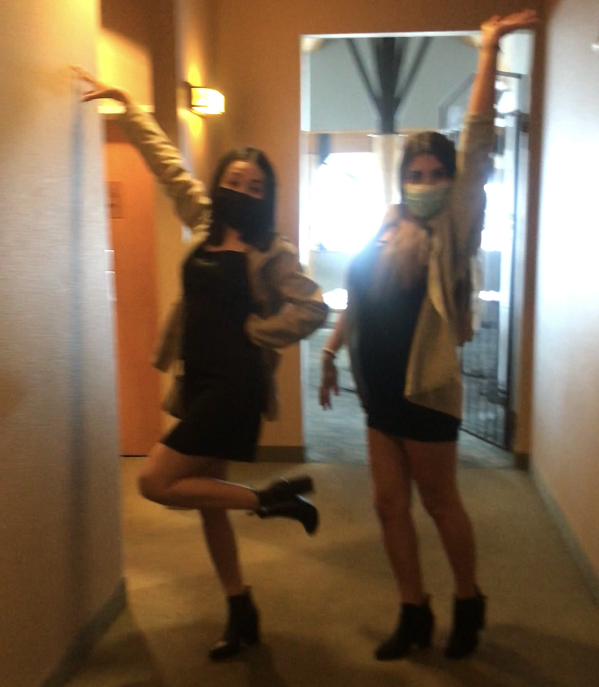
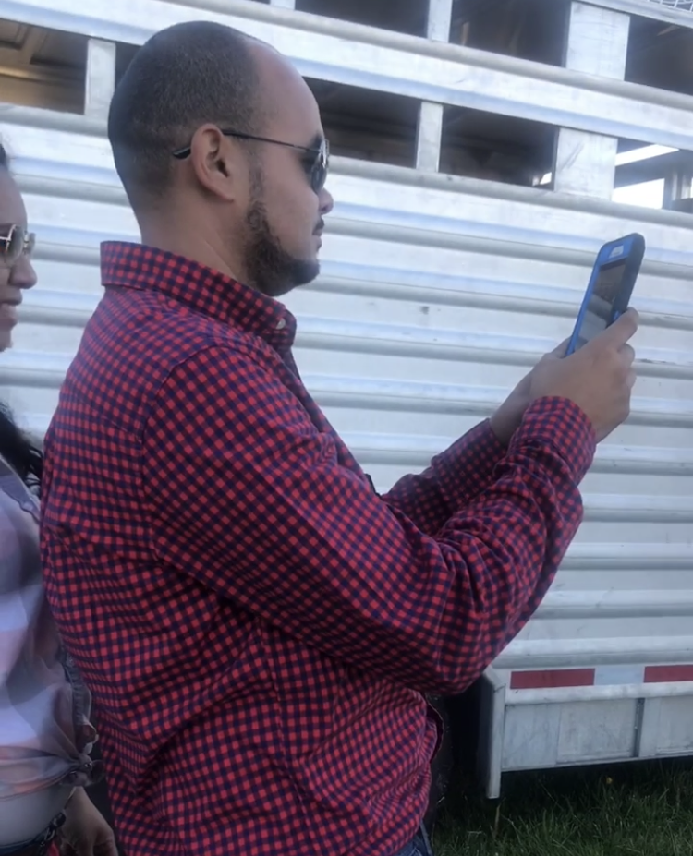
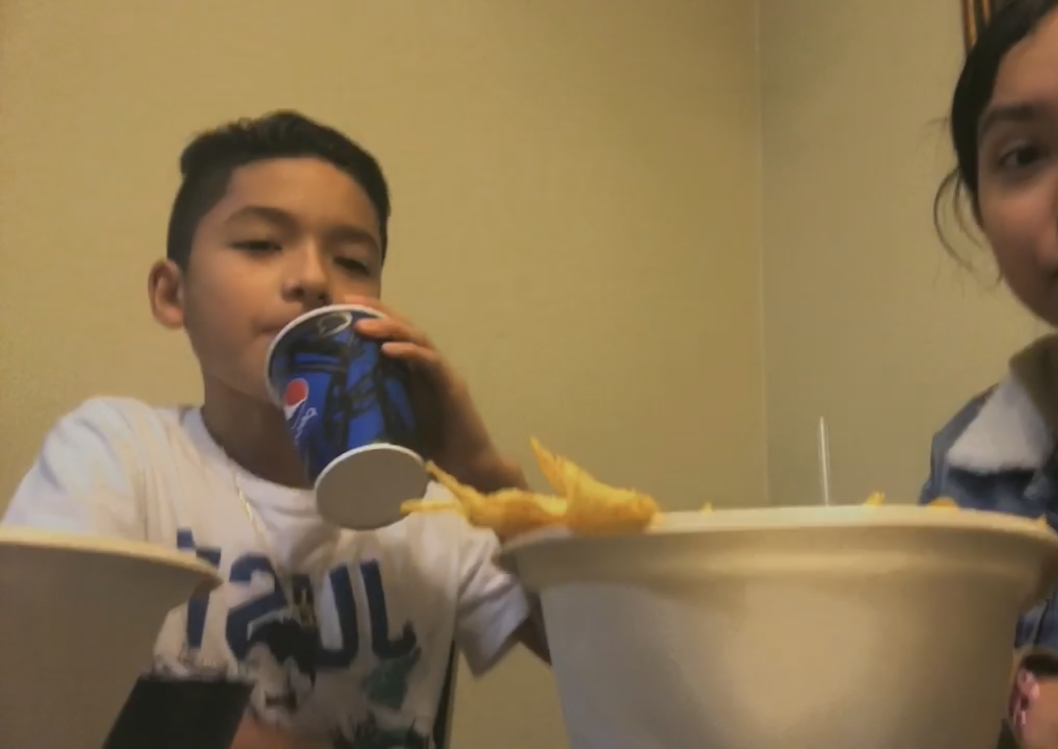
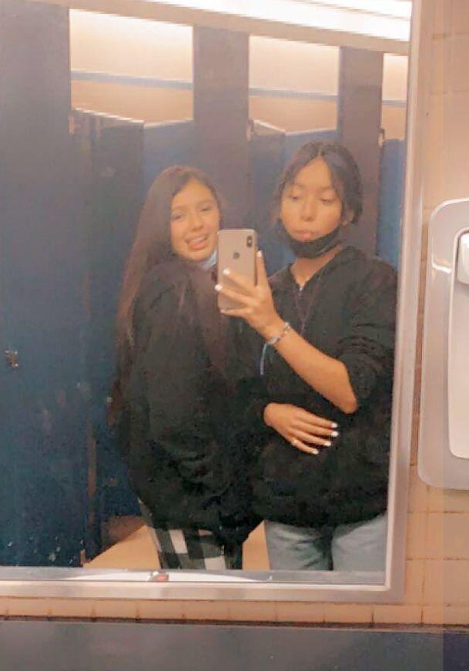
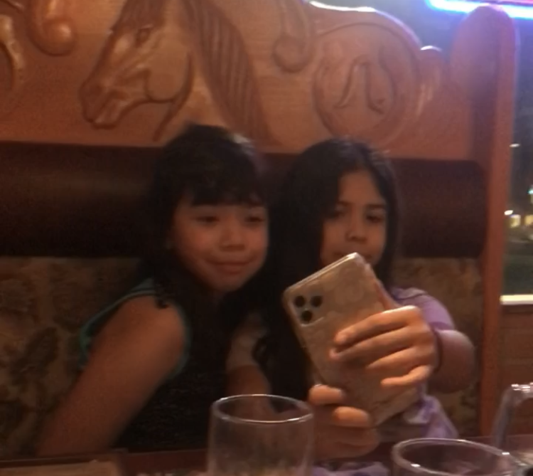
Notes:
Most of these people have helped me at my lowest, they have made me laugh and forget about everything for a little while. I am extremely thankful for each one of them. They have helped me to achieve many of my goals and have also helped me improve in many ways throughout my journey. Although I’ve met some of them last year I’ve felt and instant connection with them I am also glad I’ve gotten close with my cousins from my dad’s side of the family. And even though I am the youngest one out of my friend group, a 14 year old hanging out with people who are 16 thru 22, years old, but we still act very immature sometimes and have a good laugh everywhere we go. I feel happy and very joyful when I am around them, they also have influenced many of decisions when it comes to a problem I am having in my life. They create a sense of hope and pride because they are some of the most talented people I’ve met. They also take pride in many of the talents they have like my friend Eddie he is the most talented piano player I’ve ever met. And my friend and his girlfriend Stephanie has such a beautiful voice when it comes to singing, she is also the mom of the group for always taking care and putting up with our childish stuff.These are the kind of people I want to make proud and I want them to be with me along the way. Since Eddie and Stephanie are dating and they are the oldest they are the ones always organizing everything.These are the people I want to have with me and make many more memories with.

