Slide 1
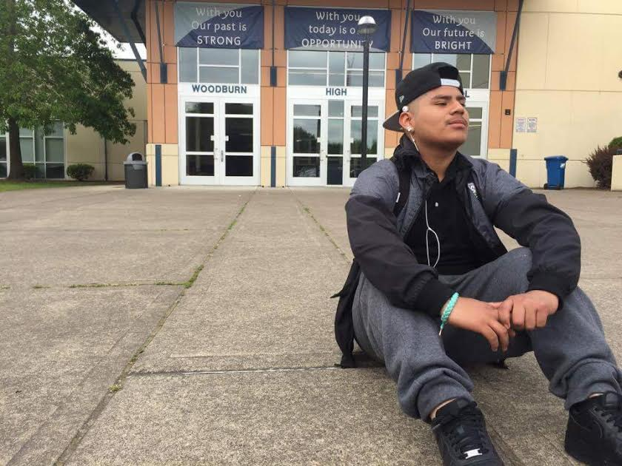
De Donde Yo Soy: Cultivating Stories of
Hope, Pride,
and…

Slide 2
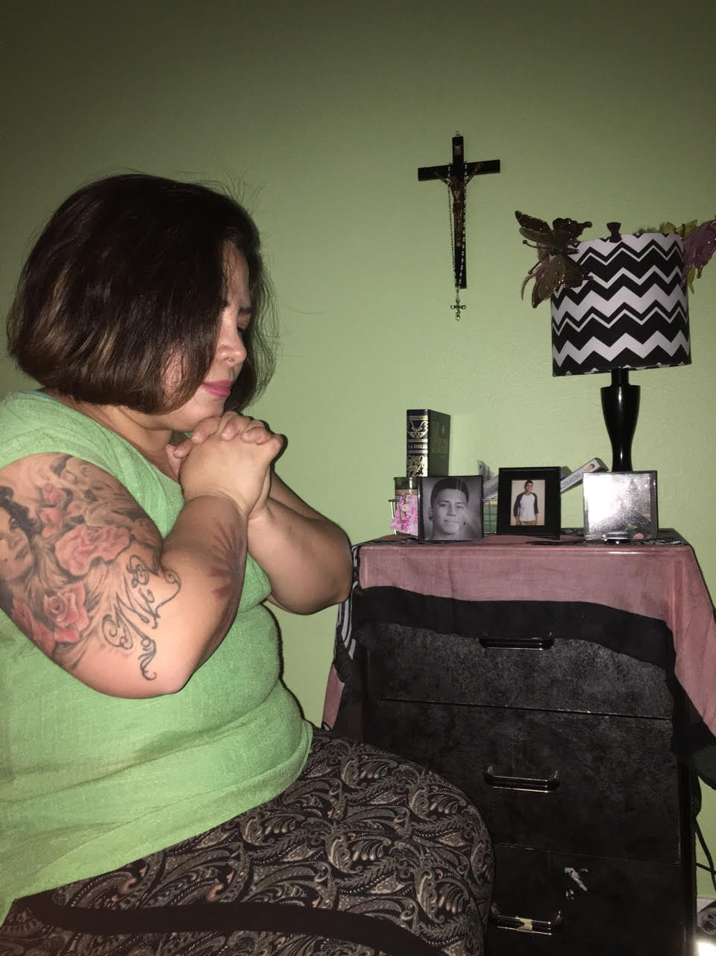
Lesson One
My People:
My Strength

Slide 3
What do young people need most right now?

Slide 4
My People: My Stories Photo Collage
Create a photo collage of the people who matter most to you. (Use photos and/or symbols)
Include the people that cultivate a sense of hope and pride in our community.
In the speaker notes, explain:
What you like best about these people.
How they have influenced you.
How you feel when you are around them.
How they create a sense of hope and pride.
How they help you feel stronger.

Slide 5
Exit Ticket
What is one strength I have that someone in my community helped cultivate.
What is one of my peers’ strengths that a community member helped cultivate.
Which person in my collage would I like to honor and celebrate in a deeper way.

Slide 6
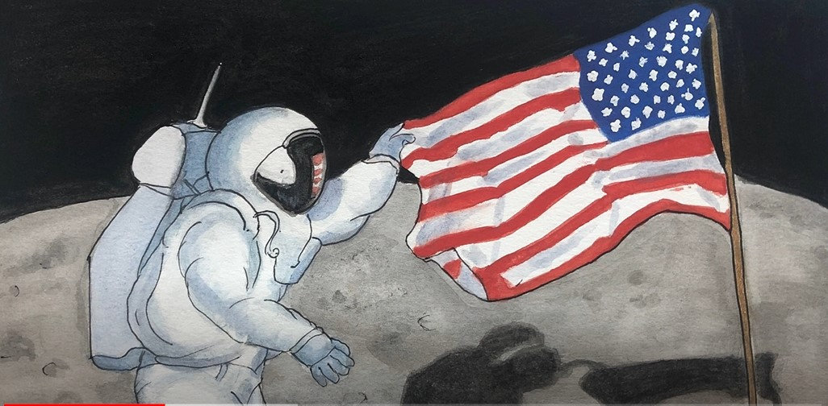
Lesson Two:
Storyboarding & B-roll
With
Abby Dreams of Space
Modified from the work of Noreen Nasir
Video Journalist, The Associated Press

Slide 7
Storyboarding
A visual outline or road map to frame your story and arrange all the elements you need to tell it

Slide 8
To start, you’ll need:
A THESIS OR QUESTION YOU WANT ANSWERED
CHARACTER TO HIGHLIGHT AND INTERVIEW
MULTIPLE PERSPECTIVES
FACTS/DATA or Historical Context
IDEAS FOR B-ROLL
Notes:
The question we are considering is how do we highlight those in our community who cultivate hope and pride.

Slide 9
A THESIS OR QUESTION Sindya Bhanoo, Hélène Goupil, Molly Oleson, and Lydia Chávez WANT ANSWERED
Explore how the pandemic has exacerbated and brought attention to issues of inequity in public education.
Highlight the unseen hurdles that students in underserved communities face throughout the school year.

Slide 10
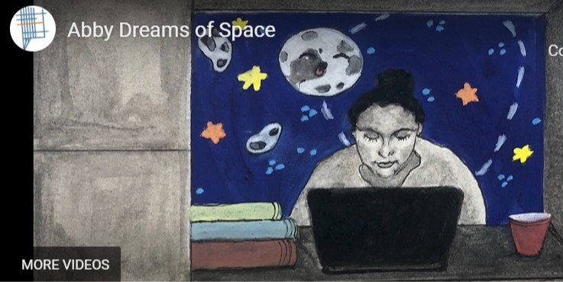
CHARACTER TO HIGHLIGHT AND INTERVIEW: Abby

Slide 11
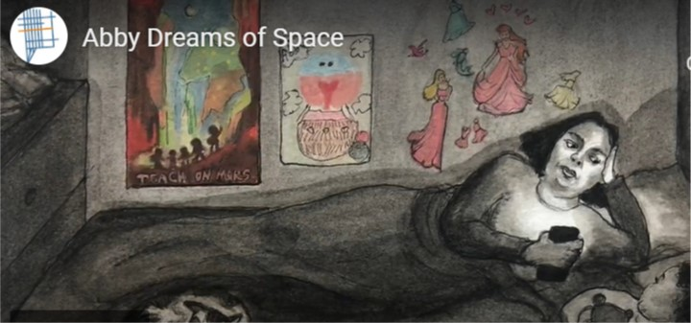
MULTIPLE PERSPECTIVE: Abby’s Mom

Slide 12
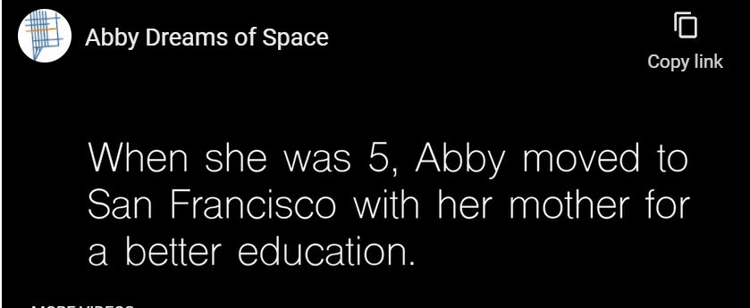
Facts/Data or Historical Context

Slide 13
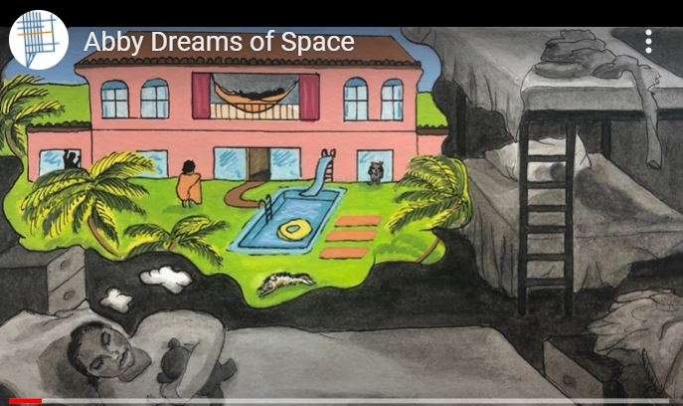
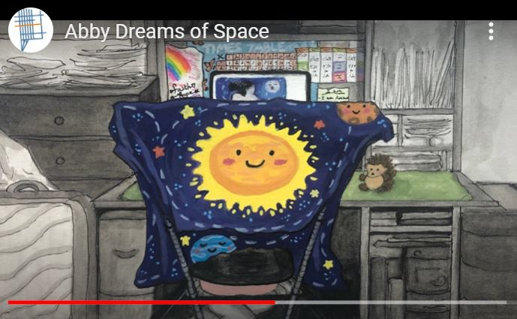
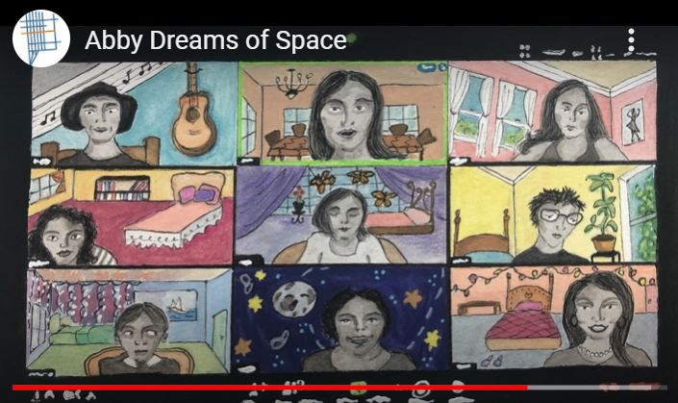
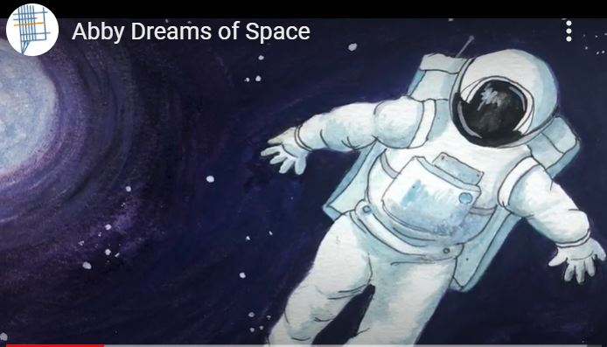
Ideas for B-Roll
Notes:
Ok if you don’t know how it will end yet - your reporting, interviewing and footage/information gathering will guide you!

Slide 14
Think of your story in non-linear terms
You’re not going to tell a story chronologically
Begin arranging your story into different parts
Lead
Profiles/perspectives of main characters
Point of conflict or tension
Facts/data and historical context
Other issues raised by story
Notes:
Chronological storytelling is just a timeline

Slide 15
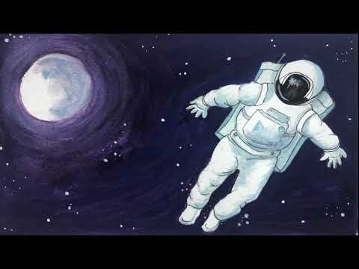

Slide 16
Collaborative Discussion
In what ways can you relate to Abby’s story?
What elements of Abby’s story are the most powerful?
What emotions did Abby’s story convey?
In what ways can we find hope or pride in Abby’s story?
Write your question and response at the top of the page. Then pass your paper to a peer. Now, respond to both the original question and your peer’s response to it.
Ways to respond include: connect, expand, provide an additional example, illuminate a different point of view, ask a question.
Notes:
Split the class into groups of four, so each group member begins with a different question. Once every student has responded, return discussions to the original owner and facilitate a discussion. What do you learn from your peer responses? In what ways do you see something that you hadn’t thought of before?

Slide 17
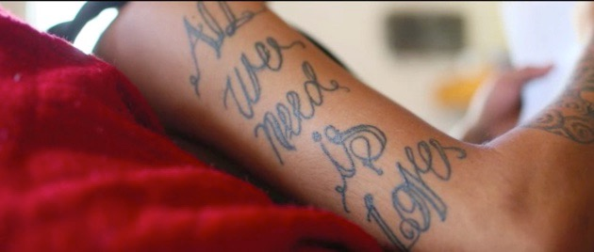
Lesson Three
Analyzing Visual Storytelling with Diego’s Rebirth

Slide 18
Visual Storytelling Planner
A Roll
List images of Diego that stand out
List things that Diego says that stand out
B Roll
List other images that stand out

Slide 19
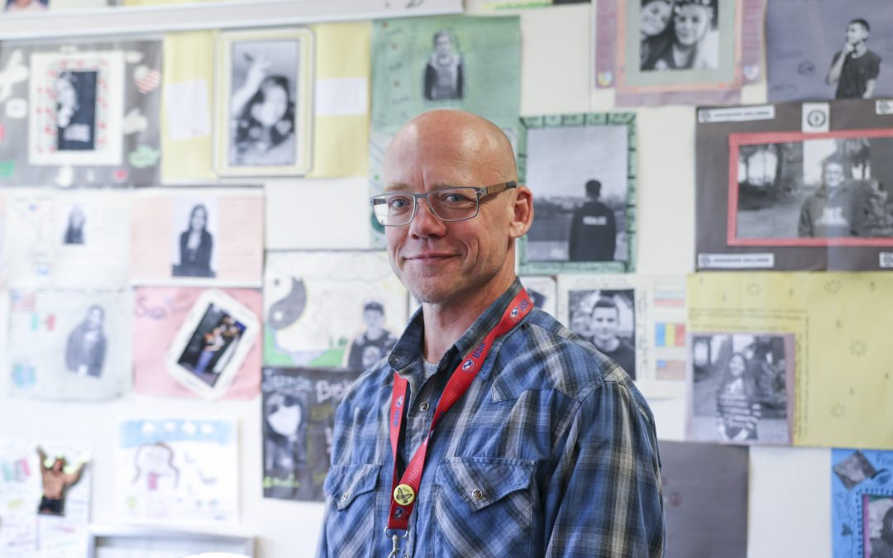
Lesson Four
Interview Planning
Notes:
Update with photograph of subject of practice interview

Slide 20
Tips for a Great Interview
Plan your interview.
Ask warm up questions
Ask open-ended questions
Ask follow-up questions
Think of it as a conversation
(go with the flow)

Slide 21
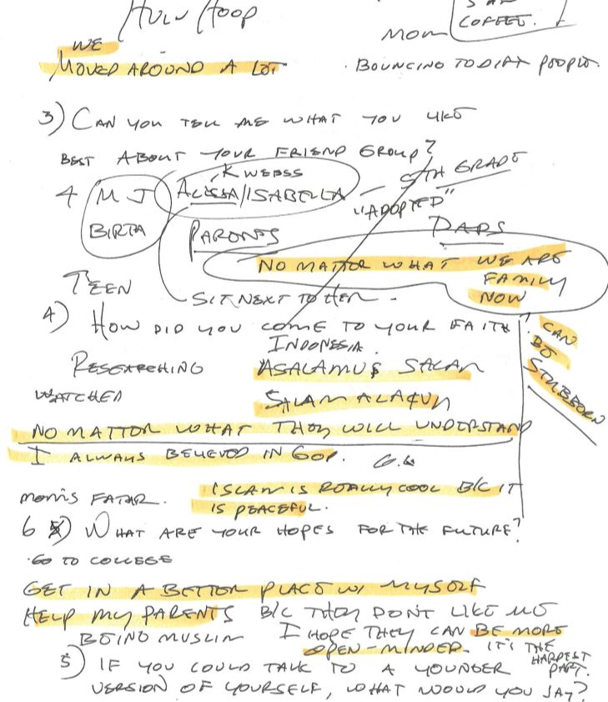
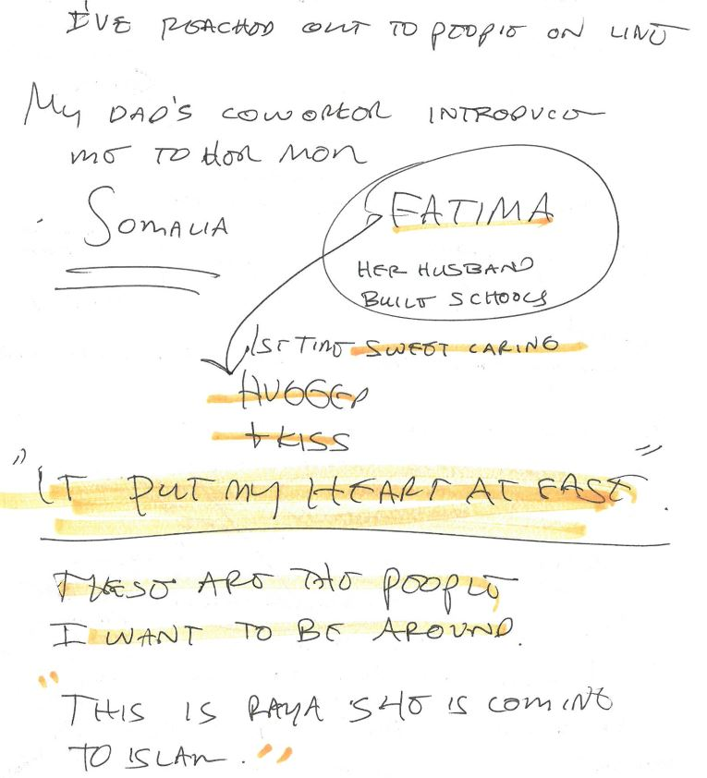
Highlight Your Favorite Lines–This is your A Roll

Slide 22
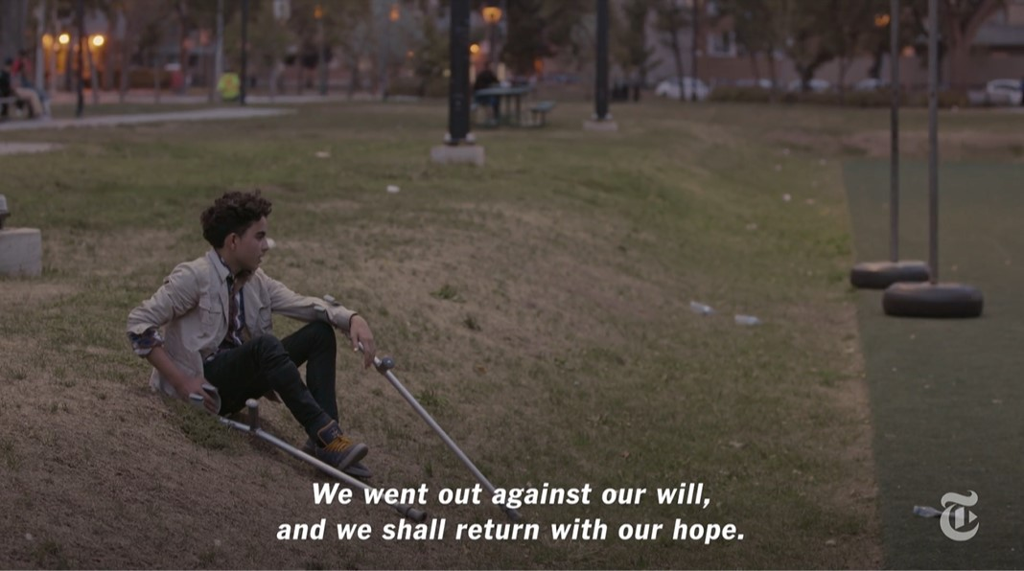
Lesson Five
Building Your B Roll with Ibraheem, A Teenage Boy in Canada

Slide 23
On your Visual Storytelling Planner, record powerful text that stands out and the image that is juxtaposed.
Why do you think the visual storytellers juxtaposed those words and image?

Slide 24
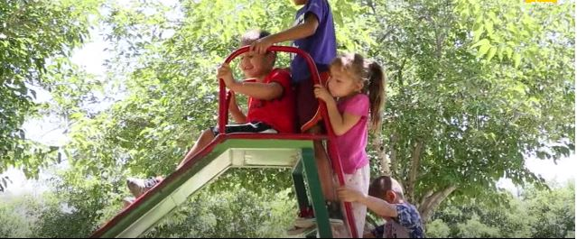
Incorporating B-roll
Visually compelling
Enhances story
Amplifies themes & emotions

Slide 25
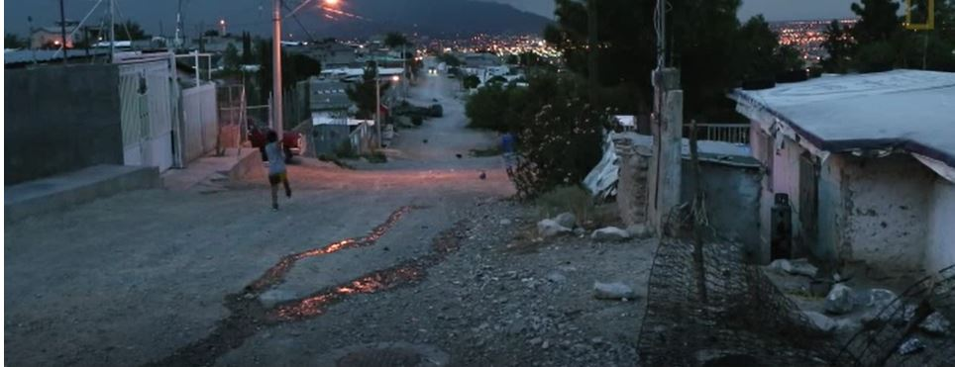
B-roll tips
Variety
Tight, medium and wide shots
Overshoot B-roll

Slide 26
Return to your interview.
Highlight the most powerful and important things that your person said.
For each, brainstorm B roll images that you could shoot to enhance meaning.

Slide 27
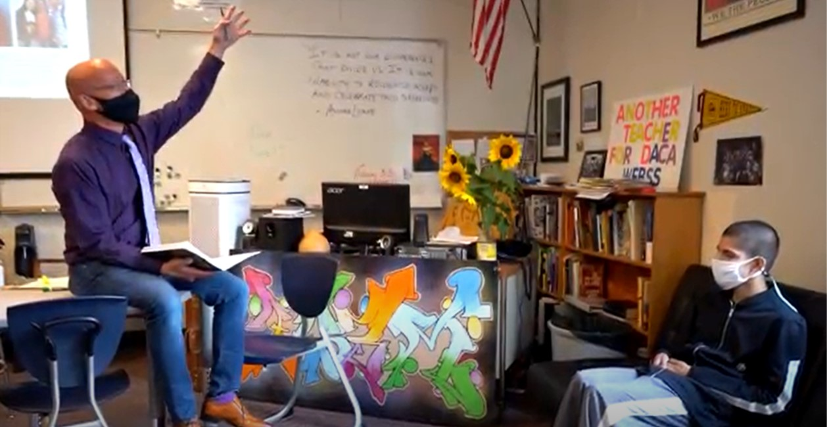
Lesson Six
Planning Your Supporting Interview

Slide 28
Supporting Interview Questions
Decide who you will interview to enhance the story of your subject.
Plan your interview questions.
Homework: conduct your interview.

Slide 29
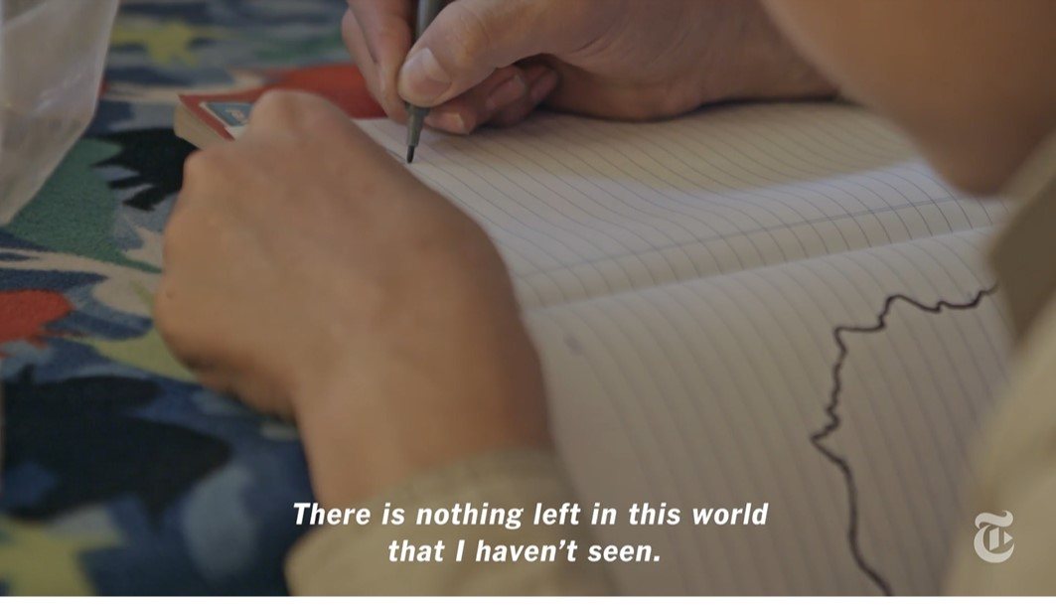
Lesson Seven
Building Your Story by Juxtaposing
Image and Text

Slide 30
Begin juxtaposing different text and images:
Voice of main character
Voice of support interview
Moments that cultivate hope and pride
Now arrange your slides considering:
Lead image/text
Moments of tension/conflict
High points
Final image/text
Suggestion–print out all of your slides and then move them like puzzle pieces in order to tell the most powerful story.
Notes:
Chronological storytelling is just a timeline

Slide 31
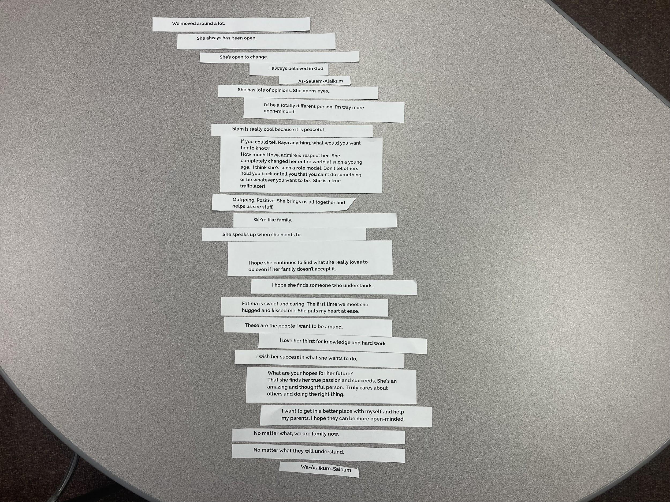
Notes:
Chronological storytelling is just a timeline

Slide 32
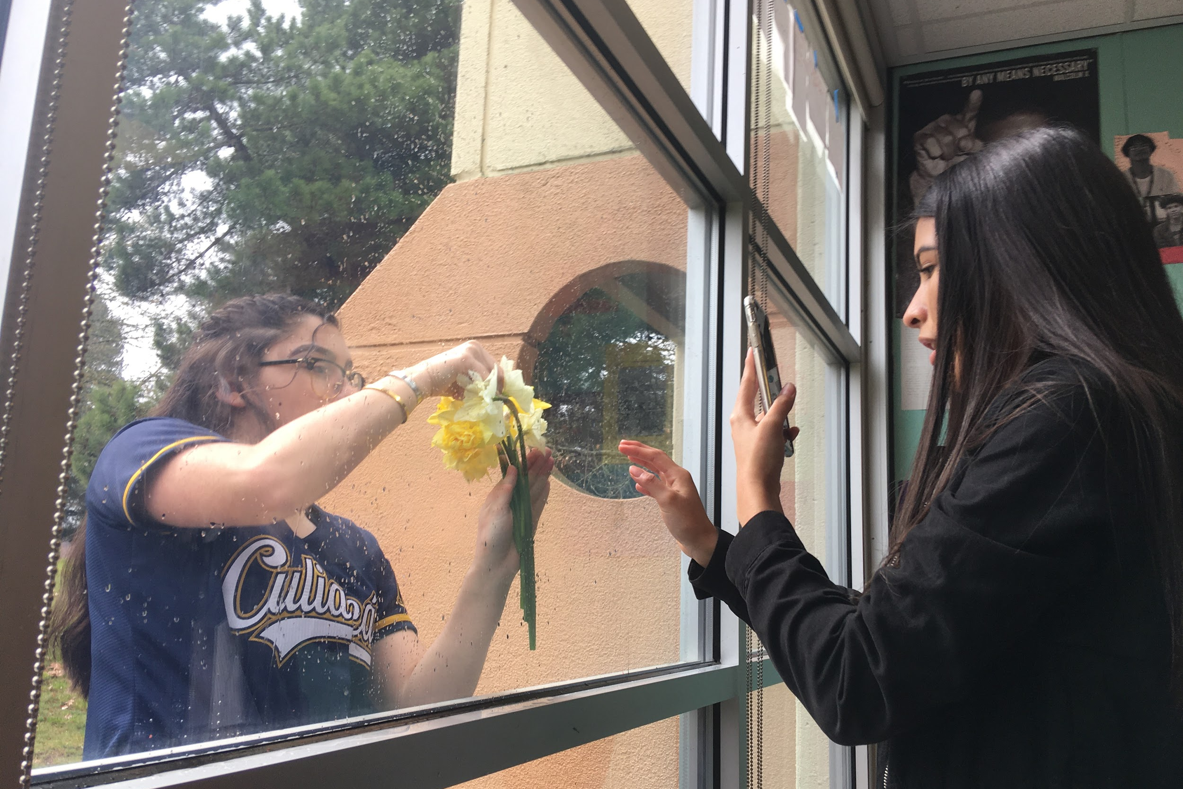
Lesson Eight
Collaboration
& Revision

Slide 33
DUE TODAY!
Finish and print out at least one slide.
If you haven’t interviewed, then YOUR VOICE IS B ROLL.
If you don’t have any pictures, find one on your phone or take one now.
Exit Ticket
Notes:
Chronological storytelling is just a timeline

Slide 34
Share your Visual Storytelling Planner:
Who do you want to highlight?
What do you appreciate most about them?
How do they cultivate hope and pride?
Share your storyboards.
Provide suggestions for:
Additional interview questions for the subject or someone else. What are you curious about?
Additional images of the subject.
Additional B roll images.
Options for sequencing. (Great OPENING and ENDING.)
Notes:
Chronological storytelling is just a timeline

Slide 35
Stories that Cultivate Hope and Pride Criteria
Purpose–you have a clear purpose.
Your project cultivates hope, pride, or something else that young people need in their lives at this moment.
Text--you have excerpts from at least two interviews that amplify how your subject creates hope and pride in your community.
Images--you have A and B roll images that amplify your subject’s story.
Juxtaposition--You have juxtaposed text and images in meaningful and powerful ways.
Structure--You have ordered your slides to enhance the impact of your story. You have a great title, opening, and ending.
Style--you have a consistent and effective style that doesn’t distract your audience.

Slide 36
Celebration
Cultivating Hope and Pride

