Slide 1
Yellow Fever Epidemic
Our nation’s first (but certainly not last) epidemic

Slide 2
Last Week, We Learned...
Slavery and racism are older than America and deeply a part of America.
You cannot understand America without understanding the slavery of the past and the racism of the present.
1619: Slavery begins
1776: America begins. Slavery continues.
1619: kidnapping, selling, and enslavement of African people in North American colonies begins.
1776: 13 English colonies rebelled against the British Empire and won, forming the United States. Americans would expand the system of slavery for another 90 years.

Slide 3
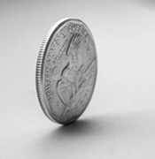
Two Sides, Same Coin
America is revolutionary concept: transitioned from monarchy (rule by king) to a democracy (rule by elected representatives).
America is oppressive, unequal society:
Society built on enslaved labor of black people. Women, indigenous, and African Americans are not included in the freedoms promised by the Constitution.

Slide 4
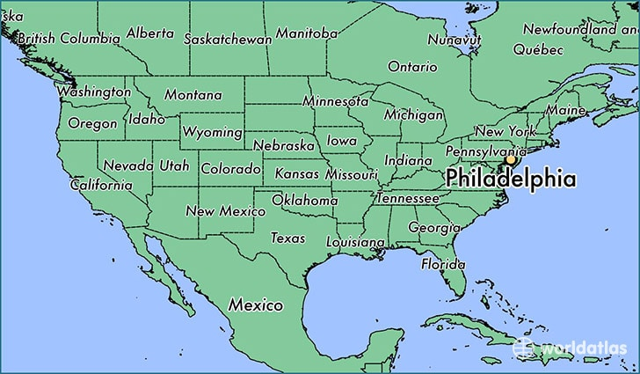
Philadelphia, summer 1793.

Slide 5
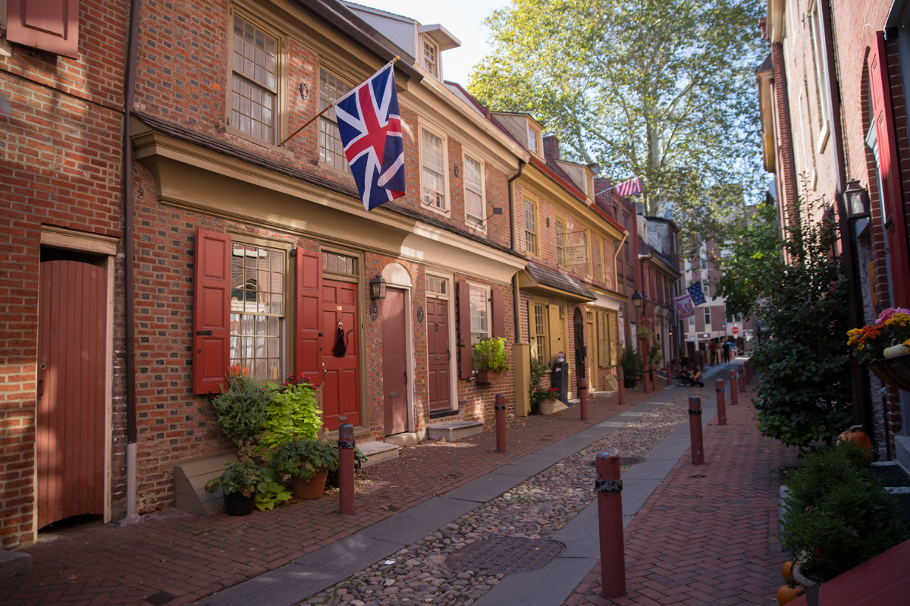
“All was not right in our city.” Dr. Benjamin Rush
America has been an independent country for less than 20 years. Philadelphia is the capital, city of 55,000.
Imagine: incredible heat. Piles of garbage, human waste, and dead animals fill the streets. Flies and mosquitos everywhere. Cramped living conditions. People stink.
Elfreth’s Alley is a National Historic Landmark located in Philadelphia’s Old City neighborhood. It’s known as “Our nation’s oldest residential street.”

Slide 6
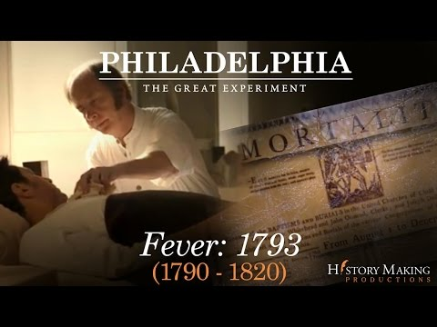
Haiti To Philadelphia (2:11 - 4:52)
As you watch, focus on these questions:
What happens in Haiti?
Who arrives in Philadelphia? Why is that important?

Slide 7
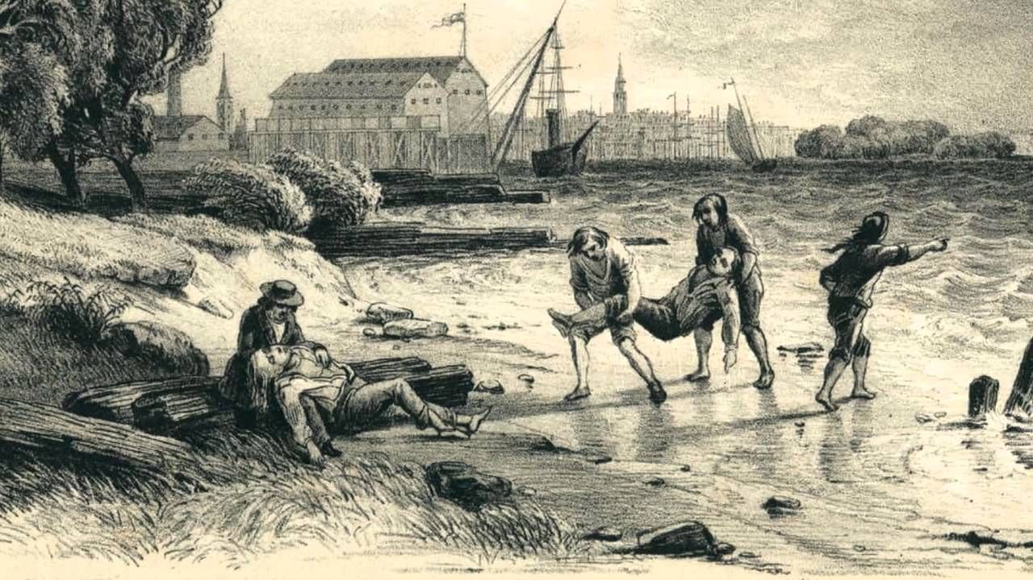
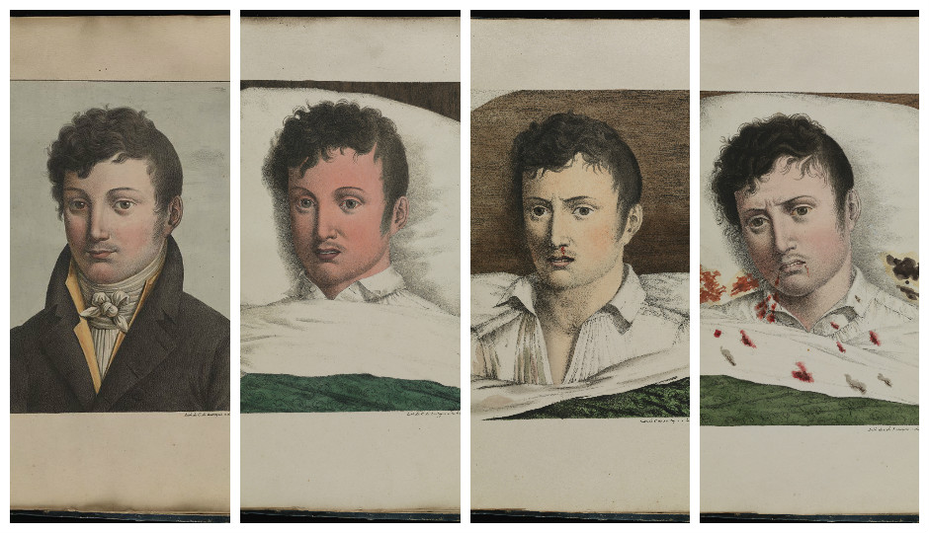
Yellow Fever Spreads
In August 1793, a few people start to get sick with these symptoms. Some die.
Symptoms:
Yellow Skin
Muscle Pain
Fever
Liver failure
Vomit blood
In just a few weeks, thousands are infected. The disease known as Yellow Fever is spreading through Philadelphia.

Slide 8
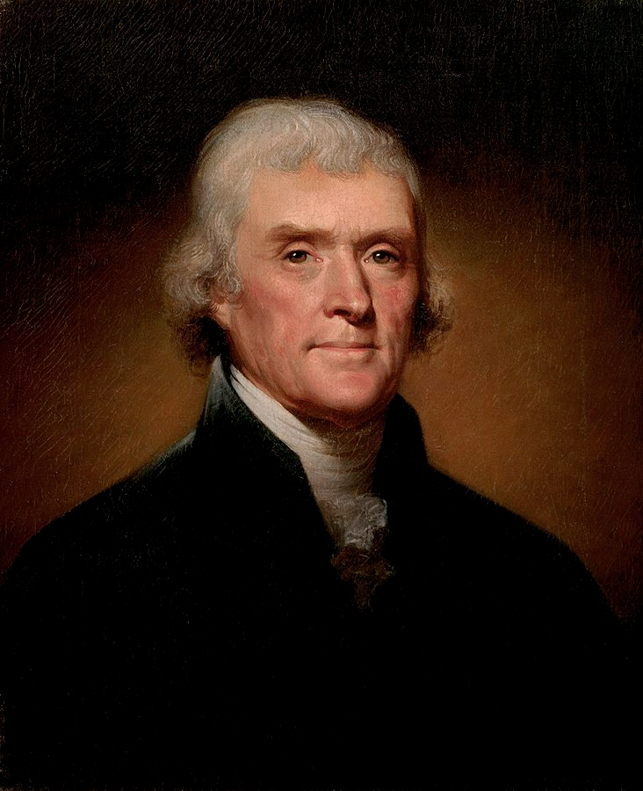
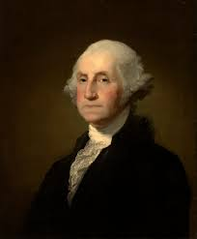
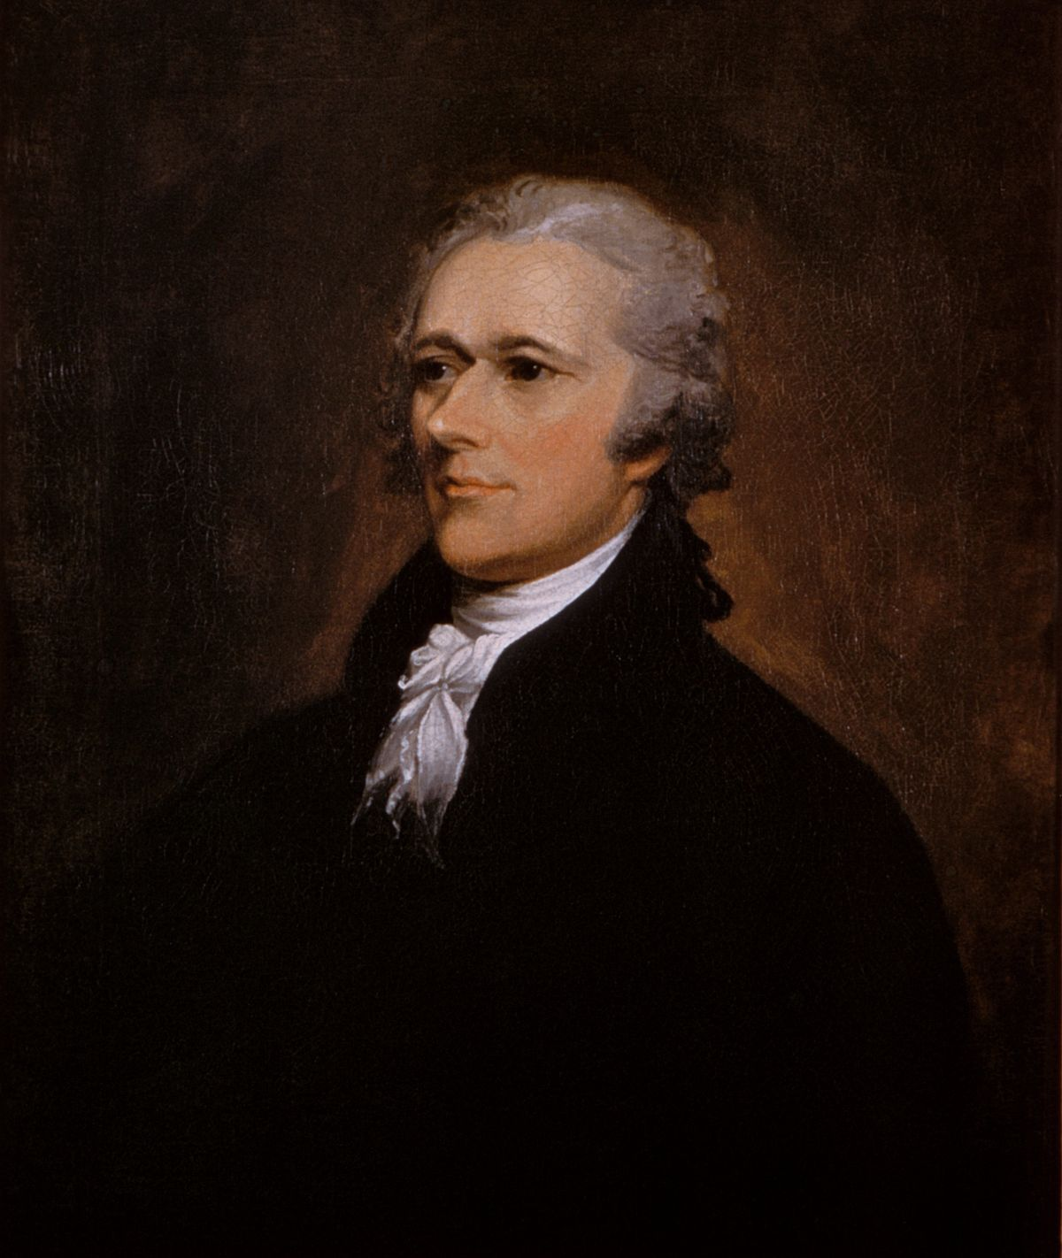
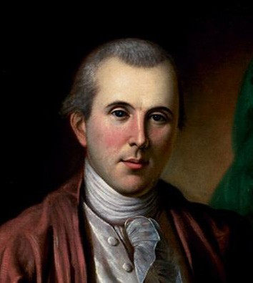
Turn and Talk: What did the nation’s leaders think?
“It is called a yellow fever, but is like nothing known or read of by the Physicians”
--Thomas Jefferson, Secretary of State, Sept. 11th 1793
“[Philadelphia is] now almost depopulated by removals & deaths”
--President George Washington
"I have myself been attacked with the reigning putrid fever."
--Alexander Hamilton
“All that can move, quit the city."
--Benjamin Rush

Slide 9
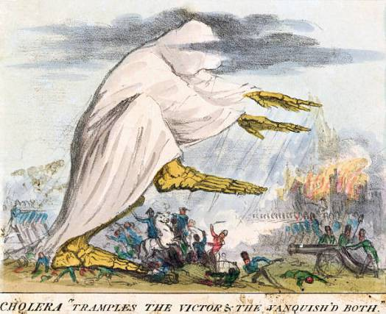
Mass Panic
People at the time wondered where it came from:
‘Bad air’ of the city
Refugees from Haiti/Caribbean
People were terrified. They tried to prevent getting it by...
Social distancing and quarantining from sick people
Wearing handkerchiefs over faces soaked in vinegar or smoked tobacco
Chewing garlic and smoking cigars
Fleeing the city (if you were wealthy enough)

Slide 10
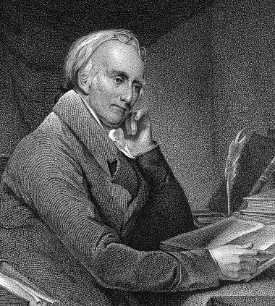
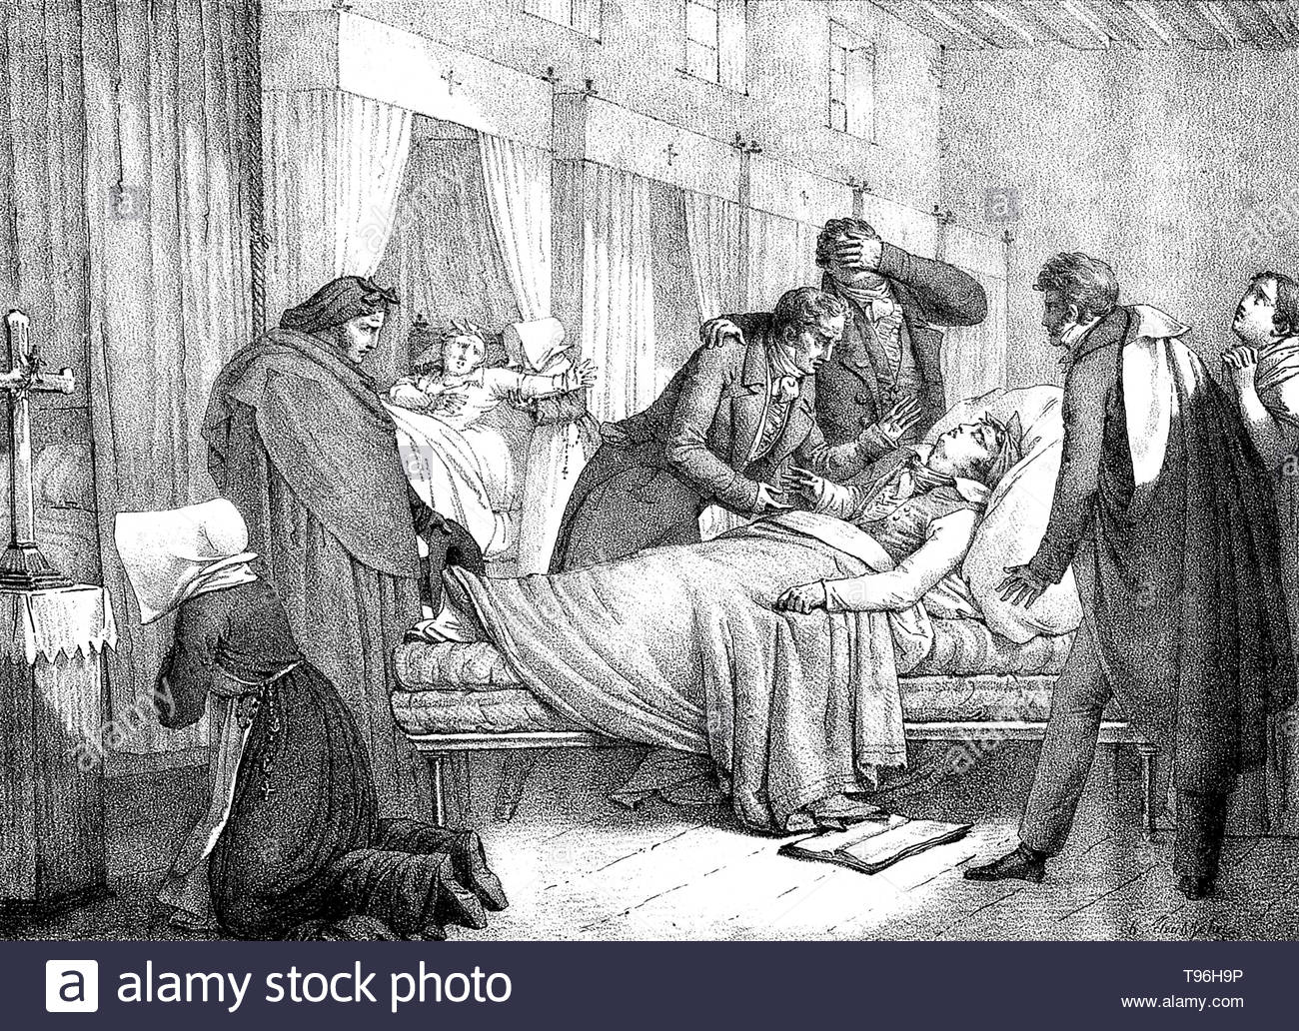
Treatment
Dr. Benjamin Rush was the most famous doctor in America. He signed the Declaration of Independence. But no doctors understand germs.
Dr. Benjamin Rush treats patients by bloodletting and forced vomiting--this doesn’t help.
Hamilton promotes treating it with cold baths and drinking brandy--also doesn’t help.

Slide 11
Mass Exodus
20,000 people flee the city, roughly half of the population including the country’s leaders. The government of the city quickly collapses.
Thomas Jefferson flees the city
President George Washington flees, blaming his wife for being too worried about him
Alexander Hamilton and his wife get Yellow Fever, they flee to New York
Dr. Benjamin Rush stays and treats the sick.
Turn and Talk:
Do you think these leaders did the right thing?

Slide 12
3 Problems with Stopping Yellow Fever
Problem #1:
No one knows the origin of the disease or how to treat it.
Problem #2:
The people and their leaders are panicking.
Problem 3:
There is no organized system for nursing the sick, burying the dead, or maintaining order.

Slide 13
Philadelphia’s Free Black Community (11:50-12:53)
Who was Richard Allen?
Mutual aid society: an organization that helps its members in times of difficulty.

Slide 14
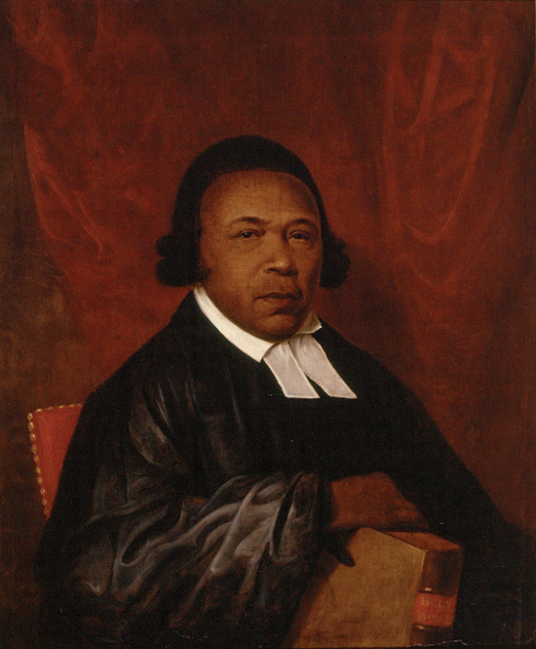
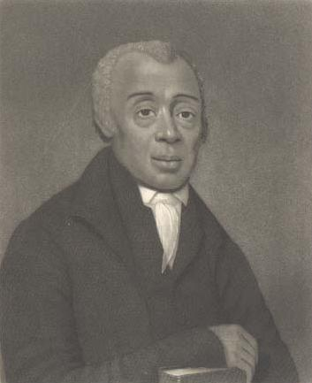
Philadelphia’s Free Black Community
Absolam Jones
Richard Allen
Across the nation, the system of black slavery was widespread. In Philadelphia, there was a small community of freed black people who lived segregated from the rest of the city.

Slide 15
Dilemma: What would you do?
A racist and incorrect belief at the time was that black people were immune to Yellow Fever. Dr. Rush begs ministers Richard Allen and Absolam Jones to help the sick and dying.
As others fled, they led a massive volunteer effort of free black Americans to treat the sick and dying.

Slide 16
How did African Americans respond to the Yellow Fever Epidemic? How were they treated?

Slide 17
Aftermath
In November, after months of the outbreak, the Yellow Fever mysteriously vanished. 11,000 people got Yellow Fever, and 5,000 died. That’s 1/10 of the whole population of Philadelphia.
240 of the roughly 2,000 black residents died.

Slide 18
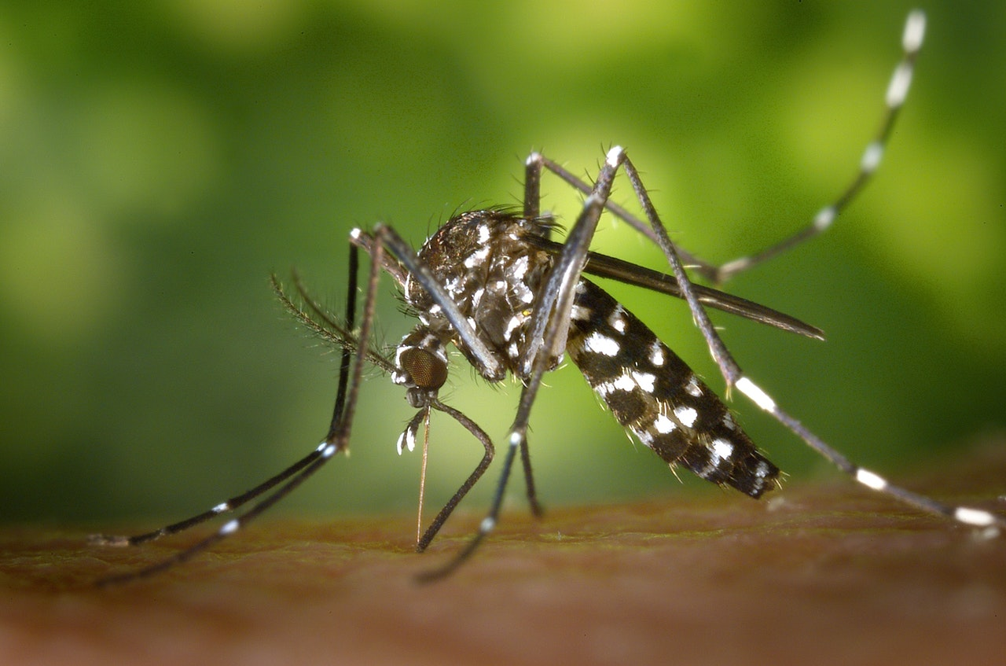
Yellow Fever Today
Yellow Fever would continue to plague the U.S. for another 100 years, killing over 100,000 people in North America and millions worldwide.
PAST: How was Yellow Fever stopped?
PRESENT: Is Yellow Fever something we should be worried about?

