Slide 1
Week 5, Day 19

Slide 2
Do Now
Welcome! Take your seat and begin the Do Now. Class has begun.

Slide 3
Agenda:
Objective: I will be able to explain the summative and craft my thesis statement
Language Objective: I will be able to identify relevant evidence to support my thesis statement
Do Now
Current Events Swap
DBQ Roll Out
Context and Sourcing Mini-Teach
DBQ Evidence Gathering
Exit Ticket #5: Thesis

Slide 4
Announcements
Exit Ticket #4 was due last night at 11:59pm. Half of you need to turn it in.

Slide 5
Leave Day 16 Packet on your table
Mr. Jue will be checking and grading your Day 16 Packet.

Slide 6
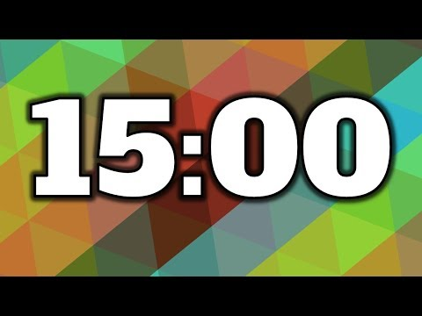
Current Events Swap!
Read your article as a pair.
Answer questions in your packet.
Be ready to share out and learn from a different pair!

Slide 7
What is a DBQ?
DBQ stands for Document Based Question.
There are 7 documents total. You have read ALL of them already!
Use what you learned in class and these documents to answer the DBQ question in a 5 paragraph essay.

Slide 8
Past Present
Medical Crises
Yellow Fever Epidemic of 1793 | Covid-19 Pandemic
Healthcare
Freedmen’s Bureau | Affordable Care Act
Medical Myths
Scientific Racism | Modern Scientific Racism

Slide 9
DBQ Question
Given the history of racism we have learned about so far, to what extent should people of color have trust and faith in the US healthcare system?

Slide 10
As You Read, Answer These Questions:
When is the DBQ due?
How is the DBQ broken into steps?
When are Mr. Jue’s Office Hours this week?
What skills am I going to be graded on most?

Slide 11
Week Calendar
Tuesday | Wednesday | Thursday | Friday
DBQ Roll Out, Context Mini Teach, Work Time CAR Thesis Due at end of class | Writing and Skill Review Outline due at 11:59pm | Writing All Class Rough Draft due at 11:59pm | Writing and Peer Feedback Final Draft due at 11:59pm

Slide 12
Before our Brain Break...
Using phones is a privilege. We are not:
Calling/facetiming people.
Recording or taking photos in class. Privacy and consent matter.
Playing music loudly or distracting others
Doing anything inappropriate
Devices and airpods need to be out of sight by the time the timer ends. Any extra time we spend waiting for someone is time we lose for our break tomorrow.

Slide 13
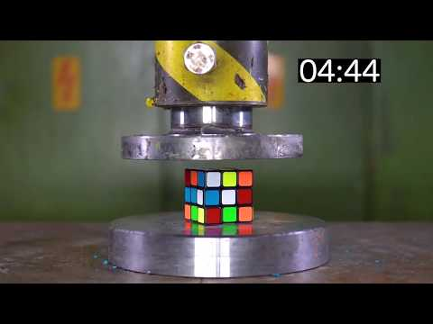
Brain Break!

Slide 14
Writing Paragraphs In Humanities
Typical Paragraph Format:
This is my CAR Claim. Document #3 says “this is a super long quote” (Author). This shows that my CAR claim is right. Nuff said.
Name at least two things that are wrong or could be improved about this paragraph.

Slide 15
Essays are like Lazy Rivers...
When we write essays, we want to make the reader do the least amount of mental work as possible. The reader should float calmly through our argument. Everything should be explained smoothly.

Slide 16
Essays can also be like white water rapids...
Jumping from the claim right to our evidence skips a TON of information! The reader can’t read your mind. You have to explain each step of your thought process.

Slide 17
So what should go in between the CAR claim and our evidence?

Slide 18
Context and Sourcing Sentences
Here is how you should write paragraphs in this DBQ:
CAR Claim: Tells the reader what you will argue in this paragraph
Context Sentence: Briefly explains the topic/time/place in more detail
Sourcing Sentence: Provides important info about source and author
Evidence: Quote that is no longer than three lines
Analysis: Explains the quote and why it is important to the CAR claim.

Slide 19
Context (Zoom Out)
Important background information about topic
When are we in history? (date/name of historical event)
Where are we? (region of world)
What are we learning about the reader should know?
Sourcing (Zoom In)
Important background information about source
Who is the author and why are they important?
What is the POV/bias of the source?
What is the type and purpose of the source?

Slide 20
Paragraph Sort
Arrange and label the sentences in the correct order!

Slide 21
Sourcing (3)
WebMD, a popular medical information website, provides a detailed description of the physical harms a heat wave can bring.
During a heat wave, it is too hot to go outside because the sun can be harmful to skin.
What this medical fact demonstrates is that during heat waves, the sun is a serious threat to human skin and must be avoided by staying inside.
According to WebMD, “Sunburn can occur in just 15 minutes on days with intense heat and sun exposure.”
A heat wave is a period of unusually high heat and occurs due to high pressure in the atmosphere.
CAR Claim (1)
Analysis (5)
Evidence (4)
Context (2)

Slide 22
Why does this matter?
Each body paragraph in your DBQ must have context and sourcing sentence before EACH quote.
CAR claim
Context
Sourcing
Evidence
Analysis

Slide 23
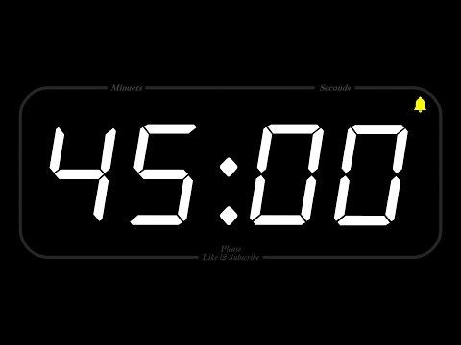
DBQ Evidence Gathering
Review the evidence. Select the most convincing and powerful documents.
Construct your answer to the DBQ Question: Given the history of racism we have learned about so far, to what extent should people of color have trust and faith in the US healthcare system?
Begin building your DBQ Outline, due tomorrow at 11:59pm
Your rough draft thesis statement is due at the end of class today!

Slide 24
Exit Ticket #5
Write your rough draft CAR thesis statement in Exit Ticket #5!

Slide 25
Week 5, Day 20

Slide 26
Do Now
Welcome! Take your seat and begin the Do Now. Class has begun.

Slide 27
Contrasting Words: Great way to make a complex thesis!
Subordinating Conjunctions
While
Despite
Although
In spite of
Even though
Use contrasting words and phrases
While Twix and Reese's are delicious because of their chocolatey shells, Red Vines and Swedish Fish are not delicious because they lack chocolate.
Despite being told no, Mr. Jue’s dog Daisy did achieve her social and political goal of jumping on the bed because of her persistence and cute looks.

Slide 28
Before
After
people of color should have should have faith in the healthcare system because as time as gone on the healthcare system has tried to cater to colored communities.

Slide 29
Before
After
people of color should have should have faith in the healthcare system because as time as gone on the healthcare system has tried to cater to colored communities.
While people of color have historically been mistreated and dehumanized in medicine, the modern healthcare system should earn people of color’s trust because it has made great progess in serving communities of color.

Slide 30
Agenda:
Objective: I will be able to craft the CAR claims, context, and sourcing sentences of my outline.
Language Objective: I will be able to write accurate context and summary sentences in each paragraph
Do Now
Rubric Review
Reviewing Context/Sourcing
DBQ Outline Work Time

Slide 31
Rubric Review
What does it take to get a B (3) on the DBQ?
Set a personal goal for yourself using the rubric. What do you want to do well on specifically?

Slide 32
Context and Sourcing Review
What does a context sentence do again?
What does a sourcing sentence do again?

Slide 33
Context and Sourcing Sentences
Here is how you should write paragraphs in this DBQ:
CAR Claim: Tells the reader what you will argue in this paragraph
Context Sentence: Briefly explains the topic/time/place in more detail
Sourcing Sentence: Provides important info about source and author
Evidence: Quote that is no longer than three lines
Analysis: Explains the quote and why it is important to the CAR claim.

Slide 34
Why does this matter?
Each body paragraph in your DBQ must have context and sourcing sentence before EACH quote.
CAR claim
Context
Sourcing
Evidence
Analysis

Slide 35
Write a Context Sentence!
Claim: Virtual learning is harmful for teenage students because it keeps them from having important social interactions.
Missing Context Sentence:
When are we in history? Where are we? What is going on during this time?
Sentence Starter: During (when) in (where), (what).....
Sourcing: Dr. Elena Martyn, a renowned child psychologist, shared her medical perspective in the February issue of the Child Health Journal.
Evidence: Dr. Martyn’s research reveals that “during the pandemic, children’s social interactions have reduced by over 80%” (Martyn).

Slide 36
Write a Context Sentence!
Claim: Virtual learning is harmful for teenage students because it keeps them from having important social interactions. Missing Context Sentence: During the covid pandemic in the U.S., students started having online classes because covid cases started going up. Sourcing: Dr. Elena Martyn, a renowned child psychologist, shared her medical perspective in the February issue of the Child Health Journal. Evidence: Dr. Martyn’s research reveals that “during the pandemic, children’s social interactions have reduced by over 80%” (Martyn).

Slide 37
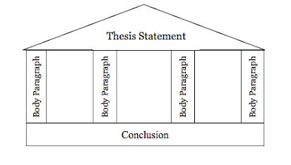
How are the thesis statement and CAR claims related?
Thesis Statement: A CAR claim that states the whole argument of the essay
CAR Claim/Topic Sentence: the main argument of a paragraph. Part of the whole argument of the thesis.

Slide 38
Thesis and Claims Example
Thesis: Ice cream is the best dessert because it is affordable, good at many events, and comes in many appealing flavors.
CAR Claim #1: Ice cream is affordable, making its greatness accessible to all.
CAR Claim #2: Ice cream is the best dessert because it is suited for casual and fancy occasions.
CAR Claim #3: Finally, what makes ice cream the best dessert is that its limitless flavors ensure everyone can enjoy ice cream.

Slide 39
DBQ Question
Given the history of racism we have learned about so far, to what extent should people of color have trust and faith in the US healthcare system?

Slide 40
Past Present
P #1: Introduction
P #2: Medical Crises
Yellow Fever Epidemic of 1793 | Covid-19 Pandemic
P #3: Healthcare
Freedmen’s Bureau | Affordable Care Act
P #4: Medical Myths
Scientific Racism | Modern Scientific Racism
P #5: Conclusion

Slide 41
Check Out Helpful Sentence Starters

Slide 42
DBQ Questions??

Slide 43
Brain Break!
Grab a chromebook
3A: -40 seconds
3B: -15 seconds

Slide 44
Week Calendar
Tuesday | Wednesday | Thursday | Friday
DBQ Roll Out, Context Mini Teach, Work Time CAR Thesis Due at end of class | Writing and Skill Review Outline due at 11:59pm | Writing All Class Rough Draft due at 11:59pm | Writing and Peer Feedback Final Draft due at 11:59pm

Slide 45
DBQ Outline Work Time
Stay focused and productive. Let others around you be successful.
DBQ Outline is due tonight at 11:59pm

Slide 46
Week 5, Day 22

Slide 47
Do Now
Grade paragraph using rubric.
Welcome! Take your seat and begin the Do Now. Class has begun.

Slide 48
Agenda:
Objective: I will be able to use peer feedback to revise my essay.
Language Objective: I will be able to improve my essay using the rubric.
Do Now
DBQ Help
Work Time
Peer Feedback
Formatting Instructions
Work Time

Slide 49
Your Feedback
Yes I finished my rough draft and had the time to revise.
i added a lot more to my dbq but didn’t finish yet.
NO CLASS WAS BORING
I accomplished my goal and more. I did all my paragraphs and conclusion and the only thing I had left was to add transition words.
no i didn't accomplish my goal i got the majority of it done though, i just need to do analysis for all my quotes and do a conclusion
no i didnt

Slide 50
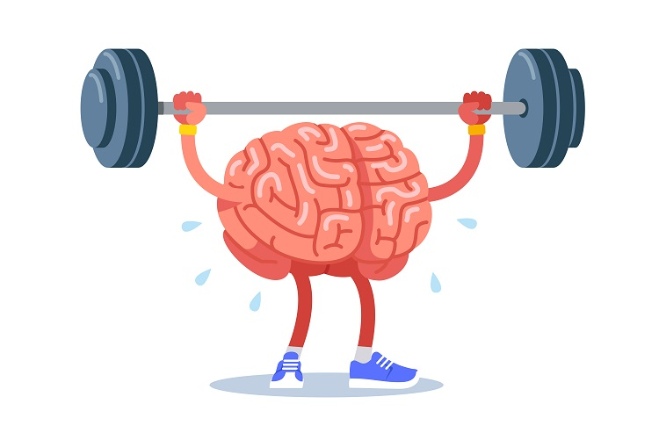
You are doing something really difficult.
Productive Struggle: pushing through challenging problems makes you better at future, bigger problems.

Slide 51
Week Calendar
Tuesday | Wednesday | Thursday | Friday
DBQ Roll Out, Context Mini Teach, Work Time CAR Thesis Due at end of class | Writing and Skill Review Outline due at 11:59pm | Writing All Class Rough Draft due at 11:59pm | Writing and Peer Feedback Final Draft due at 11:59pm

Slide 52
Announcements
DBQ Final Draft is due tonight at 11:59pm!

Slide 53
DBQ Help
Q: How am I supposed to put evidence from the past and present together in this essay?

Slide 54
TRUST
Present has improved and should be trusted.
Racist healthcare system created distrust
Yellow Fever
Freedmen’s Bureau
Scientific Racism
Past and present are different
SOME TRUST
There is reason to be somewhat trustful, but not fully.
It’s complicated
NO TRUST
Present system is similarly racist and should be distrusted.
Past and present are similar

Slide 55
How to Approach a Paragraph
I need to write Body Paragraph #2: Freedmen’s Bureau and Obamacare
I know my argument: People of color should NOT trust the healthcare system. I need to show how the past is similar to the present.
I reviewed Freedmen’s Bureau documents (Day 11 Packet) : I remember that Freedmen’s Bureau lacked resources to treat everyone and was shut down quickly.
I reviewed Obamacare documents (Day 13 Packet) I remember that people of color still have higher uninsured rates than white people
I notice a connection: In the past AND present, African Americans don’t have equal access to healthcare.

Slide 56
Structure of My Paragraph (same as outline structure)
CAR Claim: People of color today should not trust the healthcare system because under Obamacare, just like under the Freedmen’s Bureau, African Americans do not have equal access to healthcare.
Context + Sourcing about Freedmen’s Bureau
Quote about Freedmen’s Bureau and unequal access to healthcare
Analysis
Context and Sourcing about Obamacare
Quote about Obamacare and unequal access to healthcare
Analysis describing the similarity across time

Slide 57
DBQ Help
Q: Where do I find the historical information and context?
A: 3 Places!
Notes you took from your packets
Mini Lecture Slides on Google Classroom
Context Paragraphs before historical sources (in Italics)

Slide 58
DBQ Help
Q: What if I need help on my CAR claims?
A:
Highlight CAR parts and see what’s weak
Review CAR slides under Humanities Skills
Use contrast words like (While, Although, Despite)

Slide 59
DBQ Help
Q: Is it too late to request a 24 hour extension?
A: Our class policy is that you must request an extension by emailing Mr. Jue at least 24 hours in advance.
But for this certification, you may email me right now to request an extension.

Slide 60
DBQ Questions??

Slide 61
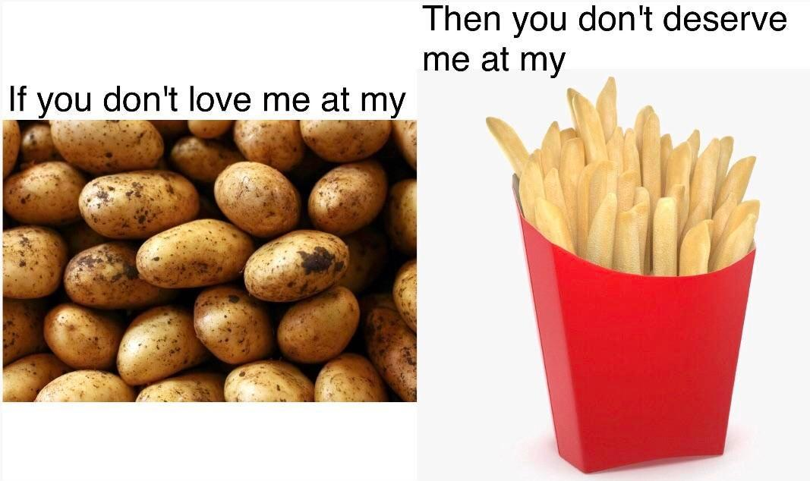
Drafts are messy. Sharing your incomplete writing requires a lot of vulnerability and bravery.
Feedback today is about creating a safe environment to reflect and improve.
Notes:
(5) Frame the messiness/ugliness of drafts.

Slide 62
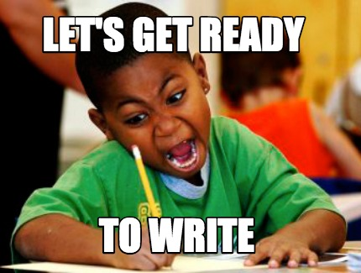
Grab a chromebook!

Slide 63
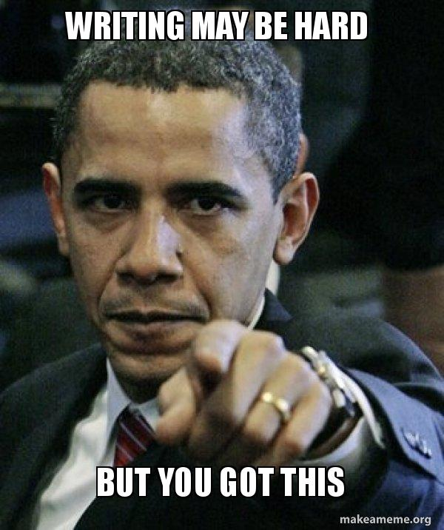
DBQ Work Time
We will be peer grading in...
Write, Write Write!!!

Slide 64
Brain Break!

Slide 65
How to Give Effective Feedback
Turn and Talk: What are effective ways to give someone feedback? What does good feedback look like? Bad feedback?

Slide 66
Why is “it’s good” TERRIBLE feedback?
You’re lying and it’s not actually good because...
You are afraid to be honest.
You are lazy.
You don’t know.
You are being honest and it is good…
They don’t know what makes it good
They don’t know how they can improve
END RESULT: You’ve wasted their time.

Slide 67
Effective Feedback Sentence Frames
Start Positive:
“One thing I really liked about your paragraph is…
Move to Growth:
“One thing that was not clear to me / could be improved upon is…”
Focus on Solutions:
“One idea to improve your rubric score would be…”

Slide 68
Formatting Your Essay
Select your strongest body paragraph. Highlight it in a pleasant, but noticeable color.
Mr. Jue will focus grading on this paragraph.
Underline your thesis statement and CAR claims
Bold any vocabulary words you use.

Slide 69
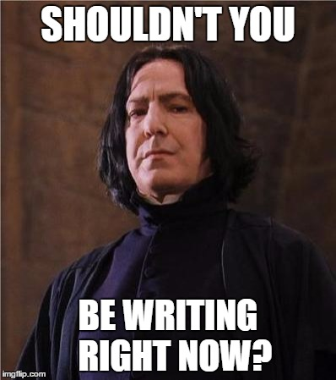
DBQ Work Time
You are going to keep working hard for
Use peer feedback to improve your DBQ.
Use the Rubric Checklist to review your DBQ.

