Slide 1
Week 4, Day 15

Slide 2
Do Now
Welcome! Take your seat and begin the Do Now. Class has begun.

Slide 3
Agenda:
Objective: I will be able to reflect on my writing and practice CAR claims
Language Objective: I will be able to craft a precise CAR claim and share my understanding of a news article
Do Now
CAR Claim Review
Yellow Fever/COVID Paragraph Reflection
Healthcare CAR Claim
Current Events Swap
Exit Ticket

Slide 4
CAR Claim Review
Because we all can benefit from practice!

Slide 5
CAR Claims
Context - Argument - Reasons
C | Context: The who and where. What is your issue? When and where did it happen?
A | Argument: The what. What are you fighting for, what’s your solution? What is your main answer to the question?
R | Reasons: The why. What examples do you have to prove your argument? What are the specific arguments that you’ll be making?

Slide 6
Example Claim
During the Age of Exploration, Christopher Columbus was not a hero because he brutalized Native Americans and was not even the first European to arrive in the Americas.

Slide 7
CAR Claims
Key background about who, when, what you are talking about.
How you are answering the question
Context - Argument - Reasons
During the Age of Exploration, Christopher Columbus was not a hero because he brutalized Native Americans and was not even the first European to arrive in the Americas.
Examples that support your argument and connect to your evidence!

Slide 8
Label the CAR Parts
It is too hot to go outside during a heatwave because the sun can quickly damage skin and cause the body to overheat.

Slide 9
Label the CAR Parts
Key background about who, when, what you are talking about.
How you are answering the question
It is too hot to go outside during a heatwave because the sun can quickly damage skin and cause the body to overheat.
Examples that support your argument and connect to your evidence!

Slide 10
Common mistakes
Missing context: tell the reader who and what you are talking about!
Starting claims with ‘Yes because…’ or ‘They connect because…’
Argument is too vague: Be specific about what you are arguing!
COVID and Yellow Fever are the same...
Reasoning is too vague: Be specific about why your argument is right!
COVID and Yellow Fever are the same because they were both deadly.

Slide 11
Fix Its!
For each claim below, explain what needs to be improved. Then, rewrite the claim to fix it!

Slide 12
Fix It!
Before:
While the wildfires are bad. Prevent them with controlled burning and forest management.
After:
While the wildfires in California are malignant, forest rangers can prevent them with controlled burning and forest management.

Slide 13
Fix It!
Before:
Covid is spreading fastest among unvaccinated people. But the vaccine is effective.
After:

Slide 14
Fix It!
After:
The adults in Life Academy believe gratittude is a positive thing in a community beause it helps students interact with each other.
Before:
Gratitude is a good thing in a community.

Slide 15
Fix It!
After:
The coronavirus and the Yellow Fever epidemic of 1793 were very similar because they were both malignant.
Before:
The Coronavirus which we are currently living through and The Yellow Fever which started in 1648 are both very similar situations because the people took actions that are very similar to each other.

Slide 16
CAR Thesis Statement Checklist
Subordinating Conjunctions
While
Despite
Although
In spite of
Even though
Use contrasting words and phrases
While Twix and Reese's are delicious because of their chocolatey shells, Red Vines and Swedish Fish are not delicious because they lack chocolate.
Despite being told no, Mr. Jue’s dog Daisy did achieve her personal goal of jumping on the bed because of her persistence and cute looks.

Slide 17
Yellow Fever/Covid-19 Paragraphs
Each is graded on Aeries. This is a formative assignment (30% of grade)
Everyone received comments on their paragraphs. Don’t resolve comments!
1 - D Beginning Mastery | 2 - C Approaching Mastery | 3 - B Meeting Mastery | 4 - A Exceeding Mastery
CAR Claim may not be present or recognizable CAR parts are missing Missing evidence or analysis | CAR Claim is present, but may not respond clearly to prompt CAR parts are incorrect or unclear Evidence from sources present, analysis may be incomplete or incorrect | CAR Claim begins paragraph and responds to prompt CAR parts are present and logical Evidence from sources present and analyzed | Context, Argument, and Reasoning are thorough and clear Minimal to no grammar errors At least two connections are discussed in detail Use of vocabulary

Slide 18
Review and Reflect
REVIEW: Review comments on Google Classroom. Check grade on Aeries. Reread your paragraph.
REFLECT: Write a private comment on the assignment answering: Why did I receive my score? how can I improve my paragraph? How can I improve as a writer?
1 - D Beginning Mastery | 2 - C Approaching Mastery | 3 - B Meeting Mastery | 4 - A Exceeding Mastery
CAR Claim may not be present or recognizable CAR parts are missing Missing evidence or analysis | CAR Claim is present, but may not respond clearly to prompt CAR parts are incorrect or unclear Evidence from sources present, analysis may be incomplete or incorrect | CAR Claim begins paragraph and responds to prompt CAR parts are present and logical Evidence from sources present and analyzed | Context, Argument, and Reasoning are thorough and clear Minimal to no grammar errors At least two connections are discussed in detail Use of vocabulary

Slide 19
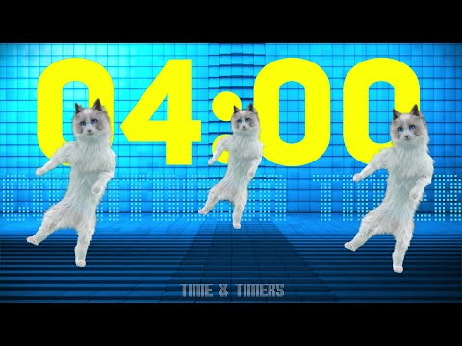
Brain Break!

Slide 20
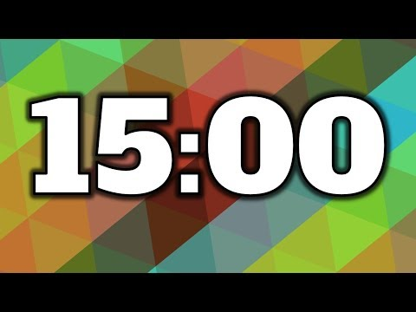
Current Events Swap!
Read your article as a pair.
Answer questions in Day 14 Packet from Friday
Be ready to share out and learn from a different pair!

Slide 21
Work Time!
Tomorrow, we will take our second vocabulary quiz on the ten words below.
Use this time to revise your Yellow Fever/Covid-19 Paragraph OR study for the vocabulary quiz!
Compromise Agriculture Amend Abolish Secede | Disparity Ambivalence Onerous Legislate Unequivocal

Slide 22
Week 4, Day 16

Slide 23
Do Now
Welcome! Take your seat and begin the Do Now. Class has begun.

Slide 24
Agenda:
Objective: I will be able to explain the role of scientific racism in our history
Language Objective: I will be able to summarize the main idea of historical sources
Do Now
Vocabulary Quiz #2
Scientific Racism Mini Lecture
Scientific Racism Inquiry
Exit Ticket

Slide 25
Vocabulary Review!
In 7 minutes, we will be taking a vocabulary quiz on the following ten words. Study up!
Compromise Agriculture Amend Abolish Secede | Disparity Ambivalence Onerous Legislate Unequivocal

Slide 26
Grab a Chromebook!

Slide 27
Vocabulary Quiz
This is a formative assignment (worth 30% of your grade)
Eyes on your own laptop.
Voice is a level 0. No talking.
Using Phone or Airpods will result in immediate 0.

Slide 28
Brain Break!

Slide 29
So far, we have examined...
Week 1: Facing Our Racist Past
What is the idea of America? How should we remember our past?
Week 2: African Americans in Medical Crises
Compared Yellow Fever and Covid-19
Week 3: Healthcare for African Americans
Compared the Freedmen’s Bureau and Obamacare
Week 4: Evolution of Racist Ideas

Slide 30
What do you think of when you think of science?

Slide 31
Science is responsible for so many incredible achievements and successes. However, it also has a dark history of manipulation and control.
As a school of health and bioscience, we have a responsibility to understand this history and face it.

Slide 32
Scientific Racism
The false, disingenuous attempt to use science to support/justify ideas of racial superiority and racism.
Pseudoscience: fake science that doesn't follow the scientific method
Pseudo: false, pretend, phony
To be clear, there is NO scientific evidence to support biological differences or superiority of races.
Humans share 99.99% of DNA with each other. There is no scientific evidence to support race. Race is NOT a scientific concept.

Slide 33
Clearing Up Any Confusion
Race is NOT a scientific concept. But race IS a social concept.
Race is a human-invented category used to place people into various social groups based on characteristics like skin color, physical features, and genetic heredity.
Scientific racism is the attempt to make race SEEM like a scientific concept based in facts. It’s not.

Slide 34
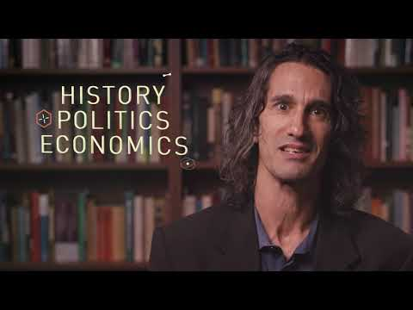
Scientific Versus Social
Why is race NOT a scientific concept?
Why IS race a social concept?

Slide 35
Why might white scientists have wanted to scientifically prove that people of color were inferior or ‘less than’ white people?
To justify or explain their oppression, enslavement, and torture of POC.

Slide 36
We are going to read about theories of scientific racism today. They advocate for false, hateful beliefs about race.
These are deeply harmful and offensive ideas. This is our history. You might feel a whole range of emotions. That’s okay.
If you feel overwhelmed or unsafe by these sources, please talk to me and we will build a support plan.

Slide 37
Guiding Question
What has been the historical relationship between science and racism?
Read the sources with your partner and work together to answer the questions. Summarize each paragraph as you go.

Slide 38
Debrief and Reflection
Guiding Question: What has been the historical relationship between science and racism?
What is my own emotional, personal reaction to reading this?
Is science objective? How can we make sure science is objective?
Why did these scientists believe these things?
Do you think these people were doing science? Why or why not?
How do you see these ideas affecting our society and POC today?

Slide 39
Week 4, Day 17

Slide 40
Do Now
Welcome! Take your seat and begin the Do Now. Class has begun.

Slide 41
Agenda:
Objective: I will be able to explain the role of scientific racism in our history
Language Objective: I will be able to summarize the main idea of historical sources
Do Now
Announcements
Close Reading Review
Scientific Racism Inquiry
Debrief and Reflection

Slide 42
What do you do when you reach a question you don’t understand?
Don’t skip it!
Strategies:
Reword the question--what is this asking me?
Go back to the text--is the answer in the text or my annotations?
Connect to other texts--how does this relate to other ideas and texts?
Ask another student, then Mr. Jue
Ask a question--What is confusing about this question?

Slide 43
Jefferson Teacher Modeling

Slide 44
Brain Break!

Slide 45
Guiding Question
What has been the historical relationship between science and racism?
Read the sources with your partner and work together to answer the questions. Summarize each paragraph as you go.

Slide 46
Debrief and Reflection
Guiding Question: What has been the historical relationship between science and racism?
What is my own emotional, personal reaction to reading this?
Is science objective? How can we make sure science is objective?
Why did these scientists believe these things?
Do you think these people were doing science? Why or why not?
How do you see these ideas affecting our society and POC today?

Slide 47
Healthcare CAR Claim
Between the Freedmen’s Bureau and the Affordable Care Act, to what extent has healthcare for African Americans changed?
Based on your group poster/slides, how is healthcare today similar to healthcare during Reconstruction?

Slide 48
Week 4, Day 18

Slide 49
Do Now
Welcome! Take your seat and begin the Do Now. Class has begun.

Slide 50
Agenda:
Objective: I will be able to explain the role of scientific racism today.
Language Objective: After summarizing textual evidence, I will be able to craft a CAR claim.
Do Now (10)
Scientific Racism Debrief (10)
Chewing Gum (10)
Brain Break (5)
Modern Scientific Racism Inquiry (40)
Debrief and Reflection (15)
Exit Ticket: Paragraph (20)

Slide 51
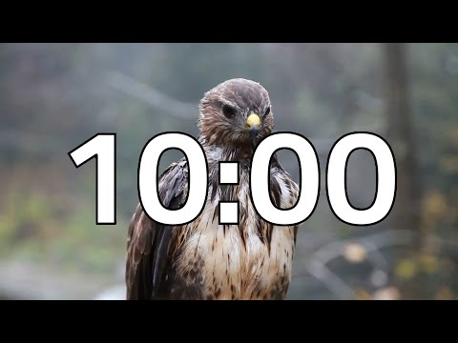
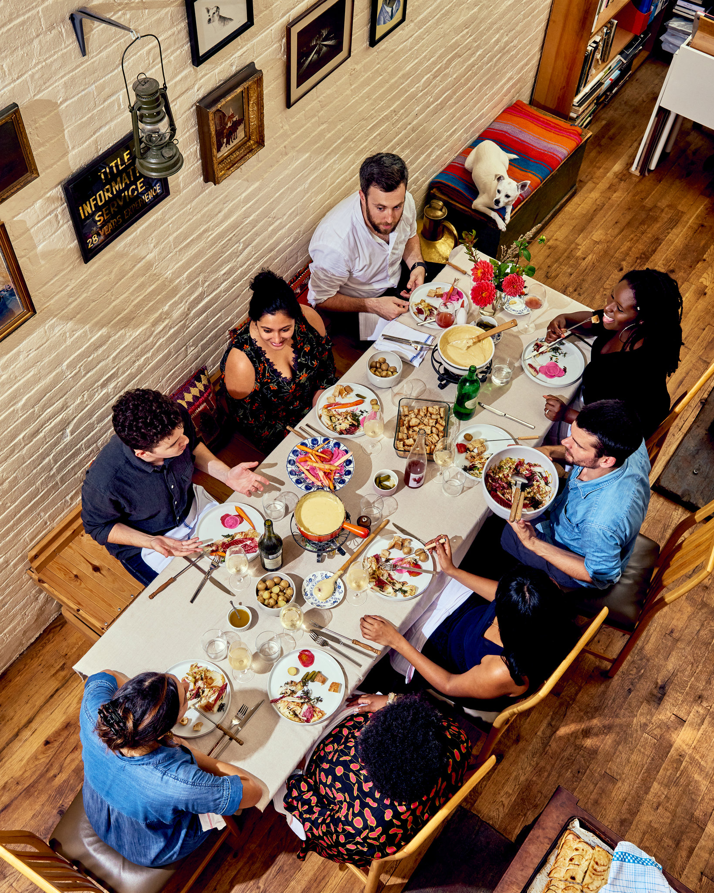
Dinner Table Discussion
Take out your Day 16 Packet and go to the Debrief (last page).
In groups of 8, discuss the five questions.
How can I be successful?
Participate actively
Include others and live out our norms
Cite the text when you share

Slide 52
Debrief
Is science objective? How can we make sure science is objective?

Slide 53
Debrief
Do you think there is racism in science today?

Slide 54
Leave Day 16 Packet on your table
Mr. Jue will be checking and grading your Day 16 Packet.

Slide 55
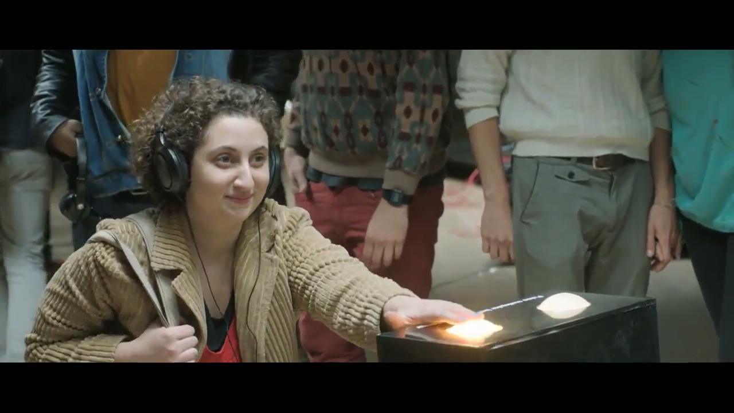
Chewing Gum

Slide 56
Preparing for Today
Today’s readings and videos involve descriptions of human suffering and scientific racism. We are all accountable to creating a respectful, kind environment for each other and taking this seriously.
Please advocate for your learning needs. If you feel unsafe by what we read today, please communicate with me. Taking a break is okay.

Slide 57
What Do I Underline?
WHO: Who are the main people in this paragraph?
Enslaved man John Brown and Dr. Thomas Hamilton
The excruciatingly painful medical experiments went on until his body was disfigured by a network of scars. John Brown, an enslaved man on a Baldwin County, Ga., plantation in the 1820s and ’30s, was lent to a physician, Dr. Thomas Hamilton, who was obsessed with proving that physiological [biological, physical] differences between black and white people existed. Hamilton used Brown to try to determine how deep black skin went, believing it was thicker than white skin. Hamilton tortured Brown for 9 months until Brown escaped and published an autobiography about his experiences.
WHAT: What is this paragraph about (main events)?
Dr. Hamilton torturing Brown in medical experiments until he escaped
WHY? HOW? What reasoning or analysis is there in the paragraph?
Hamilton’s experiment was an example of scientific racism.

Slide 58
1 Sentence Summary
Who?
What?
Why? How?
The excruciatingly painful medical experiments went on until his body was disfigured by a network of scars. John Brown, an enslaved man on a Baldwin County, Ga., plantation in the 1820s and ’30s, was lent to a physician, Dr. Thomas Hamilton, who was obsessed with proving that physiological [biological, physical] differences between black and white people existed. Hamilton used Brown to try to determine how deep black skin went, believing it was thicker than white skin. Hamilton tortured Brown for 9 months until Brown escaped and published an autobiography about his experiences.
John Brown, an enslaved man, was tortured in pseudoscientific medical experiments by Dr. Thomas Hamilton in the 1830s until he escaped and told his story.

Slide 59
Modern Scientific Racism Inquiry
In what ways do the racist beliefs and attitudes of the 19th century persist in the medical system today?
Read the sources with your partner and work together to answer the questions. Summarize each paragraph as you go.

Slide 60
Brain Break!

Slide 61
Exit Ticket #4
What does racism in the medical and scientific community look like today?
In what ways do the racist beliefs and attitudes of the 19th century persist in the medical system today?

