Slide 1
Week 2, Day 5

Slide 2
Do Now
Do we have a responsibility to others during a medical crisis (emergency)?
If so, what does that responsibility look like? Do we have a duty to serve others, even at our own risk?

Slide 3
Agenda:
Objective: I can explain the context of the 1793 Yellow Fever epidemic and practice sourcing documents
Language Objective: I can learn to source historical documents and practice summarizing them
Do Now
Note Taking Skill Teach
Yellow Fever Mini Lecture
Yellow Fever Inquiry
Exit Ticket

Slide 4
Finding (and summarizing) the main idea
We practiced this skill with every paragraph we read last week!
Find the main idea by:
Reread: Read paragraph twice
Annotate: Underline key terms, contrasting words and important statements
Ask Question: what is the point of this paragraph?
Summarize: Write a summary sentence in our own words

Slide 5
We will summarize the main idea in a different way today: by taking notes!
Taking notes effectively requires you to summarize effectively.

Slide 6
Turn and Talk: What is the purpose of taking notes? How do you take notes?

Slide 7
Taking Notes in Humanities
While you may want to write EVERYTHING down, this is not practical.
In higher level classes, you will have to take notes on your own on a LOT of material.
How can you take notes in a way that is quick, helpful, and will actually make you learn better?

Slide 8
Note-taking Steps
Read slide and listen to speaker
Identify what’s most important (argument, fact, term)
Summarize main idea in one sentence or phrase. Include key terms and definitions.
At the end:
Write down questions you have
Underline/highlight most important ideas, then summarize the WHOLE lecture in a sentence or two

Slide 9
Cornell Notes
Questions:
What questions do you have?
Notes:
Main ideas of each slide go here!
Lecture Summary:
The point of this lecture was to teach me how to take Cornell Notes.

Slide 10
Yellow Fever Epidemic
Our nation’s first (but certainly not last) epidemic

Slide 11
Last Week, We Learned...
Slavery and racism are older than America and deeply apart of America.
You cannot understand America without understanding the slavery of the past and the racism of the present.
1619: Slavery begins
1776: America begins. Slavery continues.
1619: kidnapping, selling, and enslavement of African people in North American colonies begins.
1776: 13 English colonies rebelled against the British Empire and won, forming the United States. Americans would expand the system of slavery for another 90 years.

Slide 12
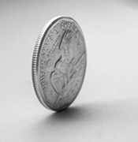
Two Sides, Same Coin
America is revolutionary concept: transitioned from monarchy (rule by king) to a democracy (rule by elected representatives).
America is oppressive, unequal society:
Society built on enslaved labor of black people. Women, indigenous, and African Americans are not included in the freedoms promised by the Constitution.

Slide 13
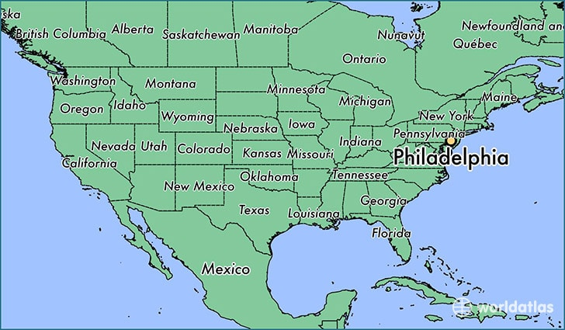
Philadelphia, summer 1793.

Slide 14
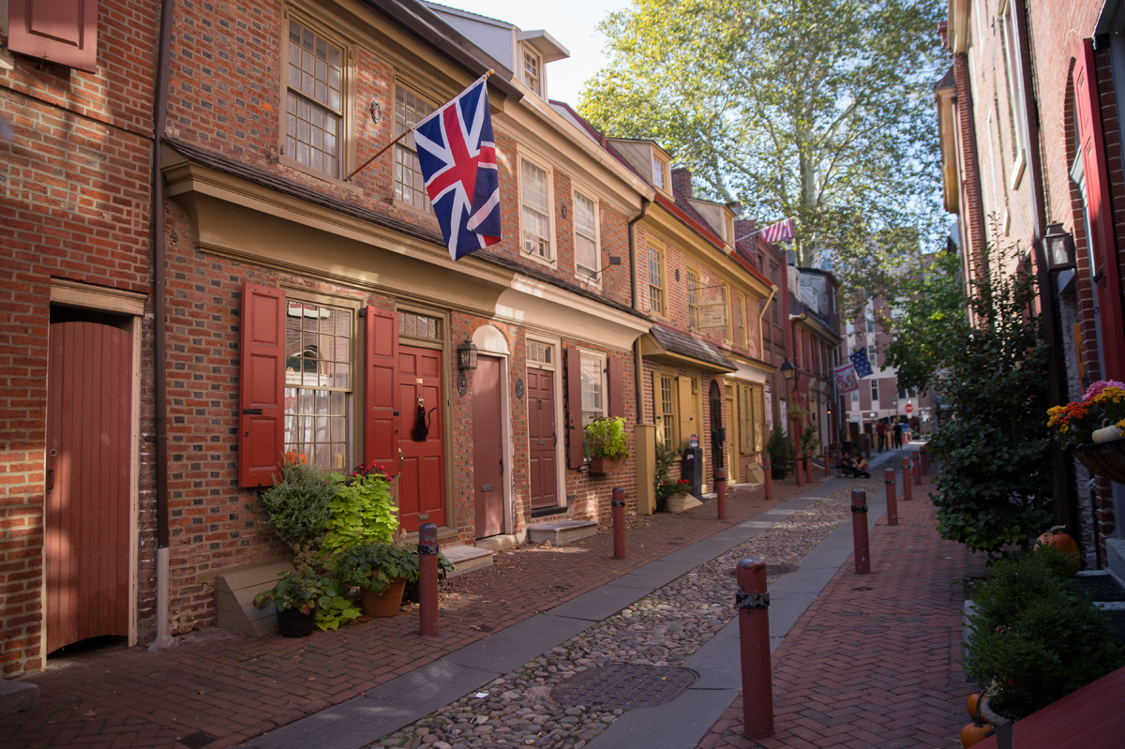
“All was not right in our city.” Dr. Benjamin Rush
America has been an independent country for less than 20 years. Philadelphia is the capital, city of 55,000.
Imagine: incredible heat. Piles of garbage, human waste, and dead animals fill the streets. Flies and mosquitos everywhere. Cramped living conditions. People stink.
Elfreth’s Alley is a National Historic Landmark located in Philadelphia’s Old City neighborhood. It’s known as “Our nation’s oldest residential street.”

Slide 15
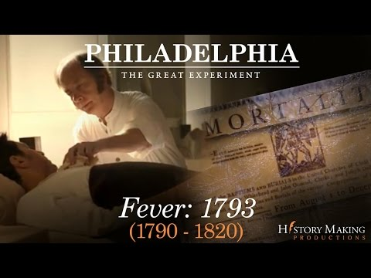
Haiti To Philadelphia (2:11 - 4:52)
As you watch, focus on these questions:
What happens in Haiti?
Who arrives in Philadelphia? Why is that important?

Slide 16
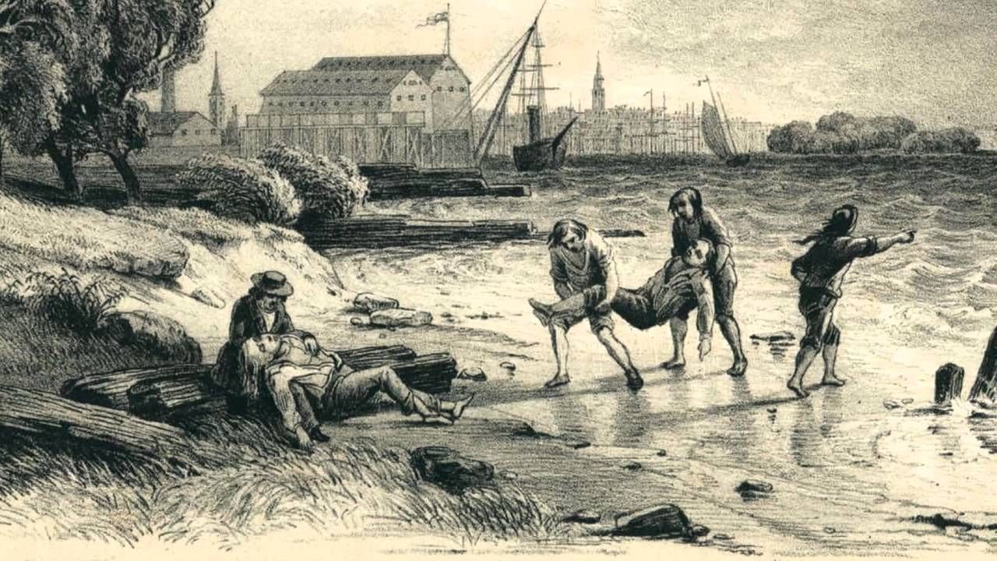
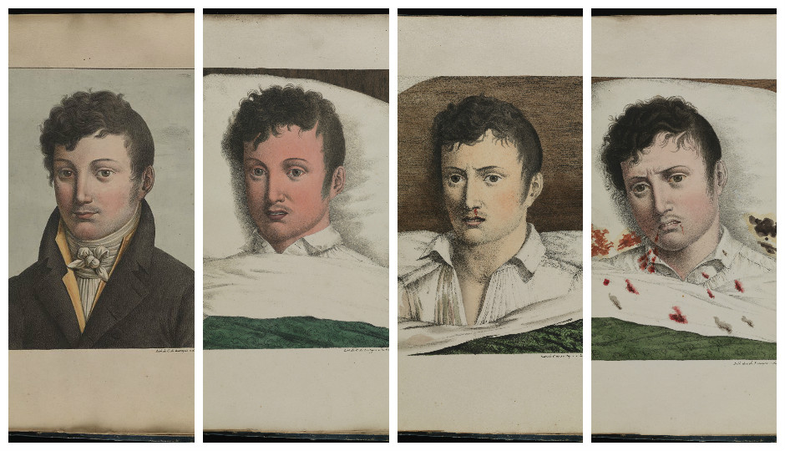
Yellow Fever Spreads
In August 1793, a few people start to get sick with these symptoms. Some die.
Symptoms:
Yellow Skin
Muscle Pain
Fever
Liver failure
Vomit blood
In just a few weeks, thousands are infected. The disease known as Yellow Fever is spreading through Philadelphia.

Slide 17
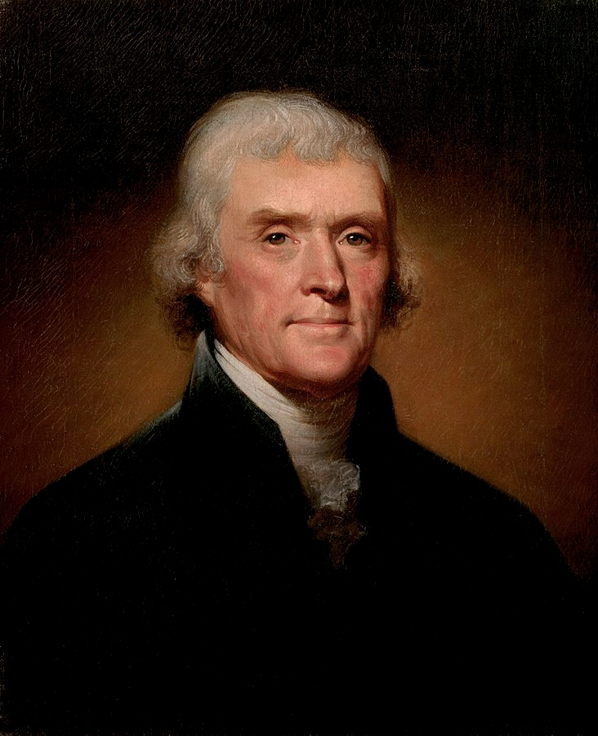
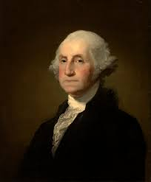
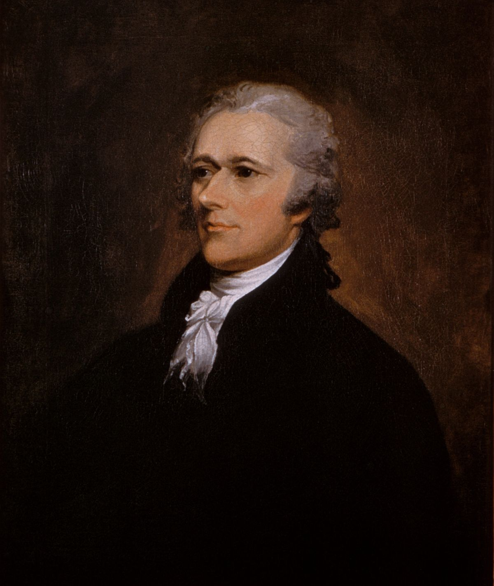
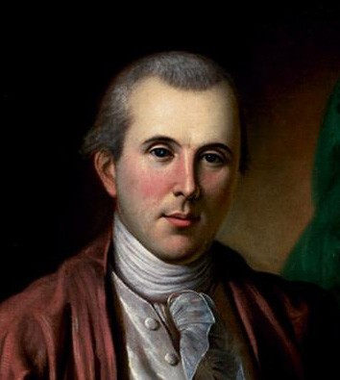
Turn and Talk: What did the nation’s leaders think?
“It is called a yellow fever, but is like nothing known or read of by the Physicians”
--Thomas Jefferson, Secretary of State, Sept. 11th 1793
“[Philadelphia is] now almost depopulated by removals & deaths”
--President George Washington
"I have myself been attacked with the reigning putrid fever."
--Alexander Hamilton
“All that can move, quit the city."
--Benjamin Rush

Slide 18
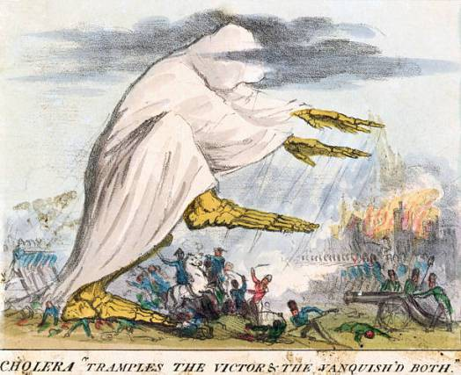
Mass Panic
People at the time wondered where it came from:
‘Bad air’ of the city
Refugees from Haiti/Caribbean
People were terrified. They tried to prevent getting it by...
Social distancing and quarantining from sick people
Wearing handkerchiefs over faces soaked in vinegar or smoked tobacco
Chewing garlic and smoking cigars
Fleeing the city (if you were wealthy enough)

Slide 19
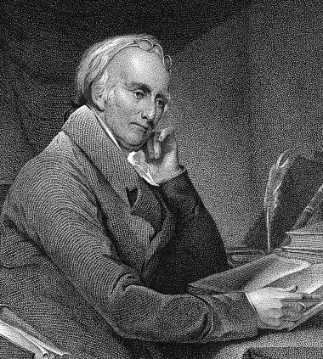
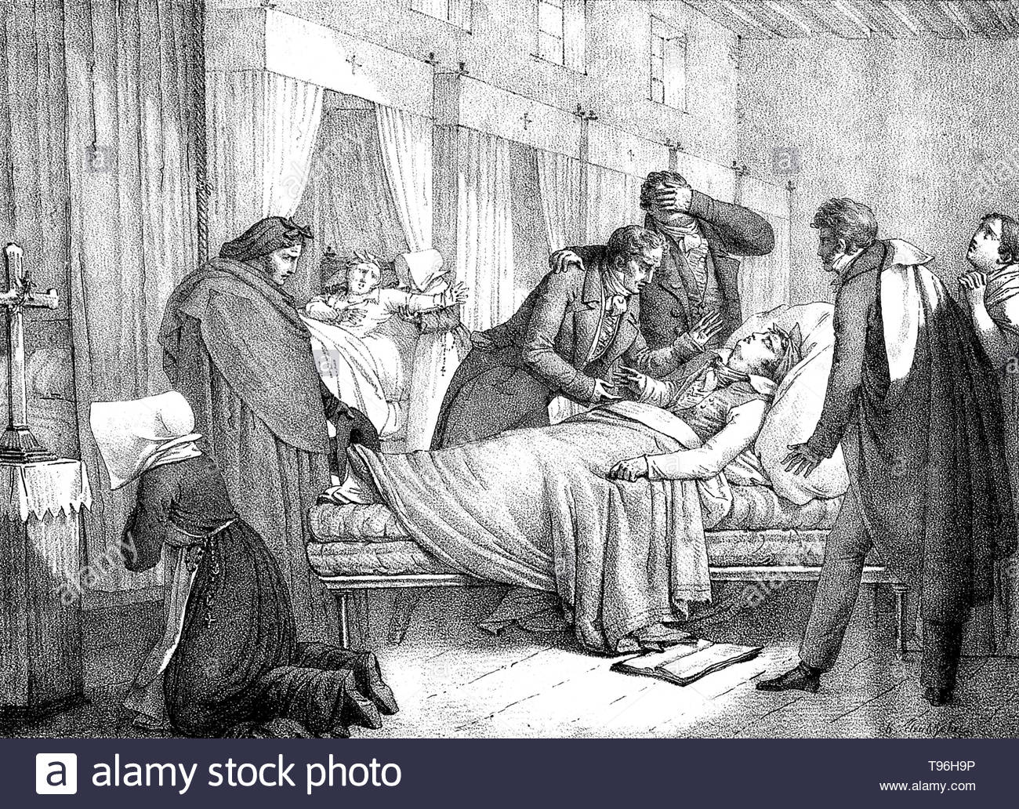
Treatment
Dr. Benjamin Rush was the most famous doctor in America. He signed the Declaration of Independence. But no doctors understand germs.
Dr. Benjamin Rush treats patients by bloodletting and forced vomiting--this doesn’t help.
Hamilton promotes treating it with cold baths and drinking brandy--also doesn’t help.

Slide 20
Mass Exodus
20,000 people flee the city, roughly half of the population including the country’s leaders. The government of the city quickly collapses.
Thomas Jefferson flees the city
President George Washington flees, blaming his wife for being too worried about him
Alexander Hamilton and his wife get Yellow Fever, they flee to New York
Dr. Benjamin Rush stays and treats the sick.
Turn and Talk:
Do you think these leaders did the right thing?

Slide 21
3 Problems with Stopping Yellow Fever
Problem #1:
No one knows the origin of the disease or how to treat it.
Problem #2:
The people and their leaders are panicking.
Problem 3:
There is no organized system for nursing the sick, burying the dead, or maintaining order.

Slide 22
Philadelphia’s Free Black Community (11:50-12:53)
Who was Richard Allen?
Mutual aid society: an organization that helps its members in times of difficulty.

Slide 23
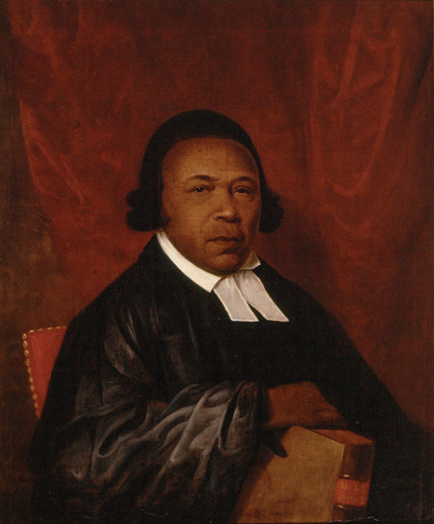
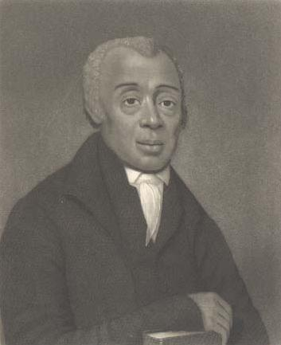
Philadelphia’s Free Black Community
Absolam Jones
Richard Allen
Across the nation, the system of black slavery was widespread. In Philadelphia, there was a small community of freed black people who lived segregated from the rest of the city.

Slide 24
Dilemma: What would you do?
A racist and incorrect belief at the time was that black people were immune to Yellow Fever. Dr. Rush begs ministers Richard Allen and Absolam Jones to help the sick and dying.
As others fled, they led a massive volunteer effort of free black Americans to treat the sick and dying.

Slide 25
How did African Americans respond to the Yellow Fever Epidemic? How were they treated?

Slide 26
Brain Break!

Slide 27
Pat it Down
To increase blood flow to your body and wake yourself up...
Stand up
Pat your left arm with your right arm
Pat your left shoulder with your right arm
Pat your left leg with your right arm
Switch sides and repeat steps 1-3
Pat your head (gently!) and neck with both arms
Now sit down… you look ridiculous!!!

Slide 28
Sourcing
Before we read a historical document, we source it.
Sourcing: to consider the author and their purpose in creating the document.
If we understand who is behind the document and their intentions, we can more deeply understand the source.

Slide 29
Document 1: Drinker Diary
Publication (type of source, date of source) | Point of View (who is the author, and what is their perspective?)
Intended Audience | Predicted Purpose (what is doc’s purpose?)

Slide 30
Elizabeth Sandwith Drinker, a white Philadelphia Quaker, began keeping a daily diary in 1758, when she was 23 years old. Drinker remained in the city during the Yellow Fever epidemic of 1793, recording news from her merchant husband, Henry (referred to as "H.D." or "H.S.D") and other visitors, as well as her own observations on the effects of the epidemic. Although no one in Drinker's immediate family succumbed [died] to the epidemic, four of her nine children died in childhood, an adult daughter died of cancer, and two others suffered from debilitating [crippling] illness. Drinker continued to chronicle [record] life in Philadelphia until her death in 1807.
Source: Extracts from the Journal of Elizabeth Drinker 1759 to 1807, edited by Henry D. Biddle. Philadelphia: J.B. Lippincott Company, 1889. Link.

Slide 31
Aug. 23. A Fever prevails in the City, particularly in Water St. between Race and Arch Streets. of ye malignant [deadly] kind; numbers have died of it. Some say it was occasioned [caused] by damaged Coffee and Fish, which were stored at Smiths'; others say it was imported in a Vessel from Cape Francois (city in Haiti), which lay at our wharf [dock], or at ye wharf back of our store. Doctor Hutchinson found, as 'tis said, upwards of 70 persons sick in that square of different disorders; several of this putrid [rotting] or bilious [vomiting] fever. 'Tis really an alarming and serious time.
Aug. 26. We have been rendered very uneasy this evening by news from the City of a great number of funerals that have been seen this day there. Hope and believe that the number is greatly exaggerated. We have not heard from home since seventh day when John Lamsback was taken ill and left the store.
Aug. 27. The Yellow Fever spreads in the City -- many are taken off with it, and many of other disorders. They have burnt Tar in ye Streets, and taken many other precautions; many families have left ye City.
Aug. 28. H. S. D. left us about 6 this morning. I gave him a small spoonful of Daffy's Elixir, and Vinegar in a sponge, and a sprig [stem] of wormwood. J. S. went after breakfast using the same precautions. The inhabitants [residents] are leaving the City in great numbers. Poor John Lamsback died yesterday.

Slide 32
Now You Try!
Take turns reading paragraph outloud
After each paragraph, reread on your own and underline main ideas
Share what you underlined and explain why
Summarize paragraph in your own words
Move onto the next paragraph

Slide 33
Week 2, Day 6

Slide 34
Do Now
Absolam Jones Richard Allen
If ministers Richard Allen and Absolam Jones were alive today, how might they respond to COVID 19?
Has your perspective changed since yesterday? Do we have a responsibility to others in a medical crisis? Why or why not?

Slide 35
Agenda:
Objective: I can identify the main ideas in texts to determine how African Americans experienced the Yellow Fever Epidemic
Language Objective: I can use context clues to determine the meaning of unknown words and concepts.
Do Now
Context Clues Skill
Yellow Fever Sources Part 2
Exit Ticket #2

Slide 36
Behavior in Humanities
Our norms are the best ways we can be in this space. But we are not always going to be our best selves everyday.
What happens when someone is disrespecting our norms?
First Step: Reminder
Second Step: Reminder, Quick Check In
Third Step: Hallway Conversation
Fourth Step: Leave the Space, Restorative Conversation, Family Contact
Advocate for Yourself!
If you are struggling in any way, please let me know.
Taking a break is often a great idea.

Slide 37
What Close Reading Strategies Have We Learned So Far?
When we read, we:
Reread and reading out loud
Annotate by circling unknown words, underlining main ideas
Summarize main idea in our own words

Slide 38
What To Do with Unknown Words?
When we circle unknown words, it is common to either:
Look up the word or ask Jue, which takes time
Move on without understanding the word

Slide 39
Context Clues
There is a better way! We can use context clues to better understand what a word means.
Context clues: nearby words or phrases that can help the reader determine the meaning of an unknown word.

Slide 40
Sometimes context clues include a synonym (word with similar meaning) in the same sentence!
The cheerleader appeared vapid— spiritless—as he delivered his pitiful performance in front of the stands.
Vapid: lacking flavor, zest, interest. Boring.

Slide 41
Sometimes context clues include an antonym (word with opposite meaning). Look for contrast words like but, unlike, or although.
Lions are solitary creatures that prefer to hunt alone, but hyenas are gregarious creatures that hunt in packs.
Gregarious: social, a liking for companionship

Slide 42
Sometimes context clues require you to draw from your own experience.
Television audiences are familiar with disingenuous ads that make grand promises.
Disingenuous: insincere or misleading

Slide 43
Sometimes context clues are in a nearby sentence.
Nanotechnology is becoming more widespread in society. As computer chips continue to shrink, manufacturers are placing them in everything from clothing, to building materials, to even the human body.
Nanotechnology: microscopic (tiny) technology built with individual atoms.

Slide 44
Context Clue Practice From Yesterday
With your partner, use context clues to determine the definitions of 4 different words from yesterday’s readings!

Slide 45
Definitions
Import: ship something into a country
Furnish: provide
Malignant: deadly, dangerous
Desert: abandon
Succumb: give up, submit

Slide 46
Finishing Yellow Fever Inquiry Part 1
Take out your Day 5 Packet from yesterday!
Let’s finish reading the sources and answering the debrief questions.

Slide 47
Reading Sources
Partner 1 read paragraph out loud, circling unknown words
Use context clues to determine meaning!
Partner 2 underlines main ideas and explains thinking out loud
Partners 1 and 2 create summary sentence together
Repeat!

Slide 48
Audio Tour (1:52)

Slide 49
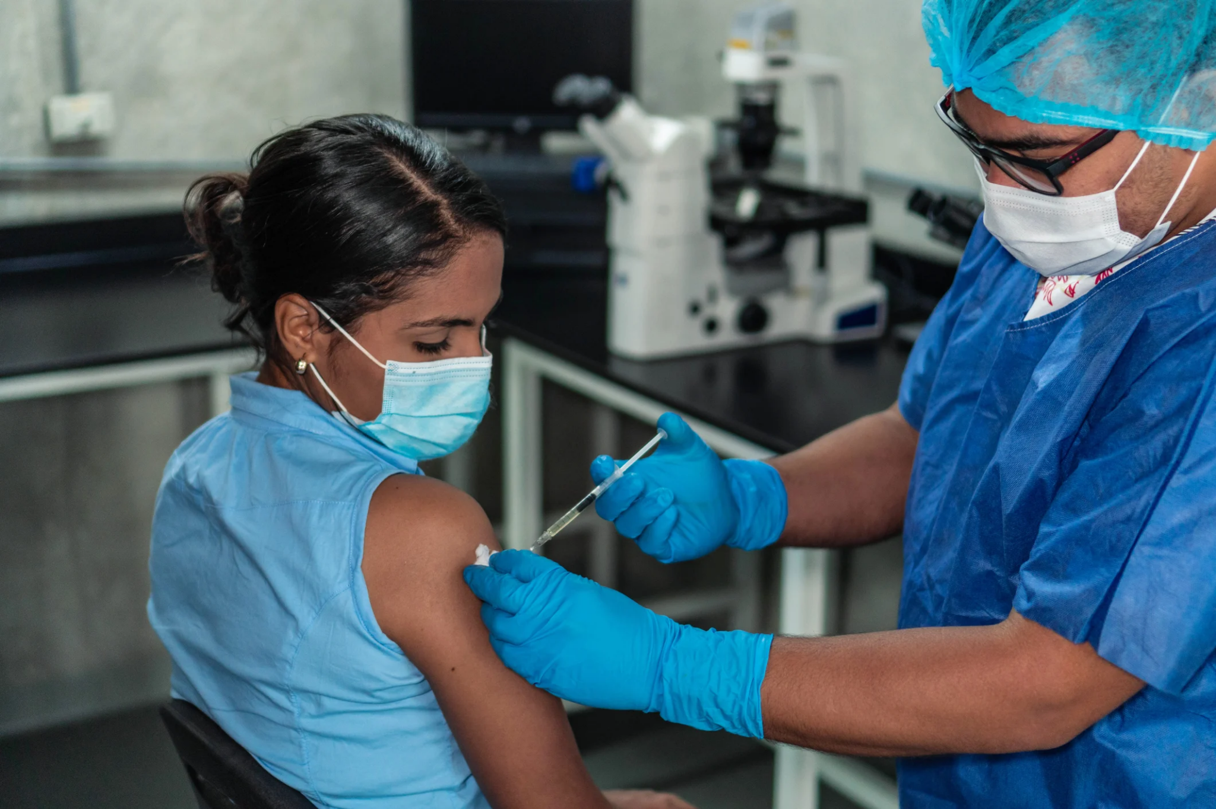
Week 2, Day 7

Slide 50
Do Now
Describe your day or week so far using at least three vocabulary words we learned yesterday. Or tell a story!
Furnish: provide
Malignant: deadly, dangerous
Desert: abandon
Succumb: give up, submit
Disingenuous: insincere or misleading
Gregarious: social, a liking for companionship
Vapid: lacking flavor, zest, interest. Boring.

Slide 51
Agenda:
Objective: I can make conclusions about the Yellow Fever epidemic.
Language Objective: I can use context clues to determine the meaning of unknown words.
Do Now (10)
Context Clue Review (10)
Yellow Fever Inquiry (25)
Exit Ticket #2 (5)
Yellow Fever Today (25)

Slide 52
Context Clue Review
What is a context clue again?
Context clues: nearby words or phrases that can help the reader determine the meaning of an unknown word.
For each example sentence, underline context clues to determine the meaning of the unknown word. Then, write your own sentence using that word.

Slide 53
Context Clue Review
It was an idyllic day - sunny, warm, and perfect for a walk in the park.
He knew his future was precarious and likely to fall apart.
Attempting to avoid the accident was futile; it was impossible for either of them to stop in time.
We know the dog has a kind disposition because we’ve never seen her bite or scratch anyone.
He continued to annoy me with his incessant line of questions.
Perfect, ideal
Likely to collapse
Pointless
Demeanor, mindset
constant

Slide 54
Finish Yellow Fever Inquiry! Open your Day 6 Packet!
Partner 1 read paragraph out loud, circling unknown words
Use context clues to determine meaning!
Partner 2 underlines main ideas and explains thinking out loud
Partners 1 and 2 create summary sentence together
Repeat!

Slide 55
Aftermath
In November, after months of the outbreak, the Yellow Fever mysteriously vanished. 11,000 people got Yellow Fever, and 5,000 died. That’s 1/10 of the whole population of Philadelphia.
240 of the roughly 2,000 black residents died.

Slide 56
Conclusions
What conclusions can we make about the Yellow Fever sources we read today?

Slide 57
Exit Ticket #2
Go to Google Classroom
Take Exit Ticket #2: Context Clues
Double check to see if you are missing any other exit tickets or assignments!

Slide 58
Week 2, Day 8

Slide 59
Do Now
Match the vocabulary word with their definitions, then answer the question on the Do Now

Slide 60
Precarious Futile Incessant Furnish Desert Gregarious Succumb Malignant Vapid Disingenuous | Provide Give up, submit Abandon Lacking flavor, zest, interest. Insincere or misleading Likely to collapse Pointless Constant Deadly, dangerous Social, a liking for companionship

Slide 61
Agenda:
Do Now
Yellow Fever: Past and Present
CAR Claim Skill Teach
Covid Inquiry
Exit Ticket #3
Objective: I can evaluate sources about COVID-19 and draw connections to Yellow Fever
Language Objective: I can practice crafting CAR claims

Slide 62
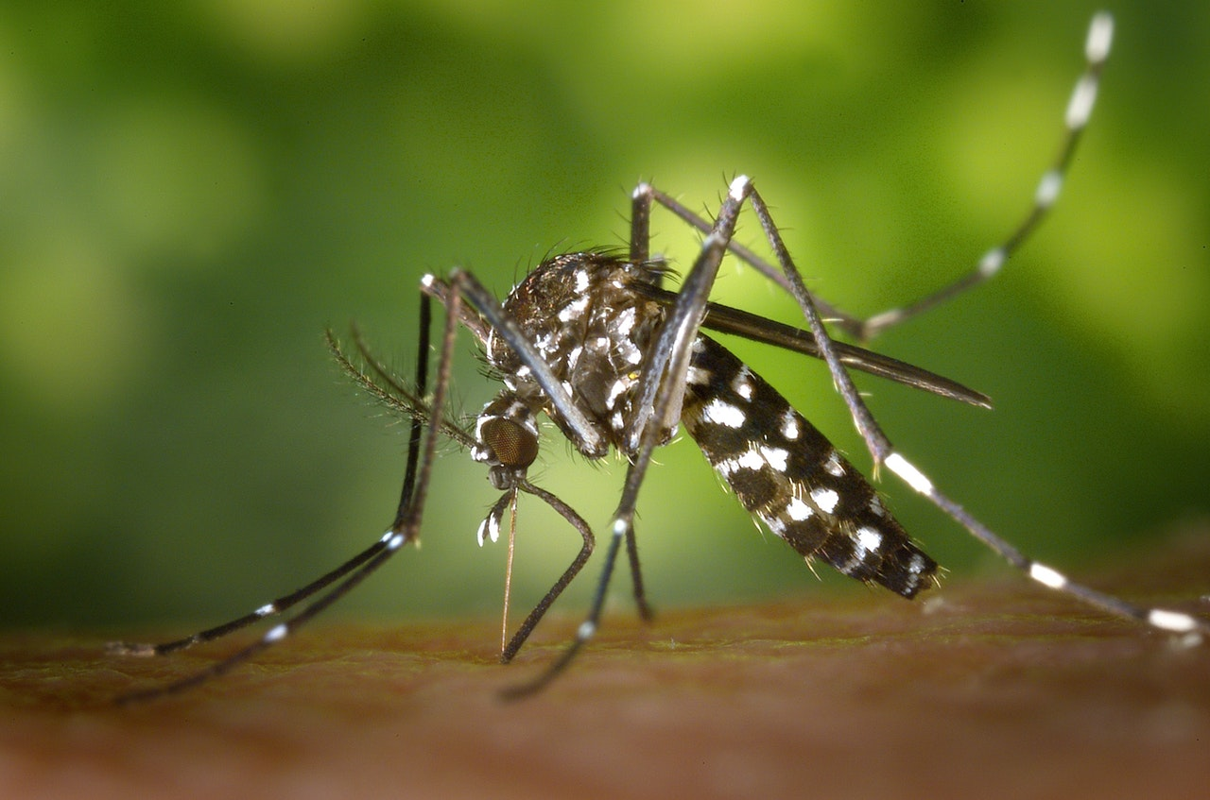
Yellow Fever Today
Yellow Fever would continue to plague the U.S. for another 100 years, killing over 100,000 people in North America and millions worldwide.
PAST: How was Yellow Fever stopped?
PRESENT: Is Yellow Fever something we should be worried about?

Slide 63
Yellow Fever Past and Present
You will either be in a ‘Past’ or a ‘Present’ group.
Your job is to learn as much as you can from your source, answer your packet questions, then teach others what you learned.

Slide 64
Teaching Each Other!
Pair 1 summarizes the article and shares their answers to their packet questions (2 min)
Pair 2 asks follow up questions, discuss (2 min)
Pair 2 summarizes the article and shares their answers to their packet questions (2 min)
Pair 1 asks follow up questions, discuss (2 min)

Slide 65
Yellow Fever Past and Present
Present Group: Share your answers to your questions and what you learned about Yellow Fever from your website. (1 min)
Past Group asks clarifying questions (1 min)
Past Group Share your answers to your questions and what you learned about Yellow Fever from your article. (1 min)
Present Group asks clarifying questions (1 min)

Slide 66
Share Out
PAST: How was Yellow Fever stopped?
PRESENT: Is Yellow Fever something we should be worried about?

Slide 67
Turn and Talk
Do you remember what a CAR claim is from last year?
Why do claims matter?

Slide 68
CAR Claims
Context - Argument - Reasons
C | Context: The who and where. What is your issue? When and where did it happen?
A | Argument: The what. What are you fighting for, what’s your solution? What is your main answer to the question?
R | Reasons: The why. What examples do you have to prove your argument? What are the specific arguments that you’ll be making?

Slide 69
What is the cutest animal in the world?
Key background about who, when, what you are talking about.
Context - Argument - Reasons
How you are answering the question
Daisy, Mr. Jue’s rescue puppy, is the cutest animal in the world because her face is gorgeous and she sighs like an old man when she’s tired.
Examples that support your argument and connect to your evidence!

Slide 70
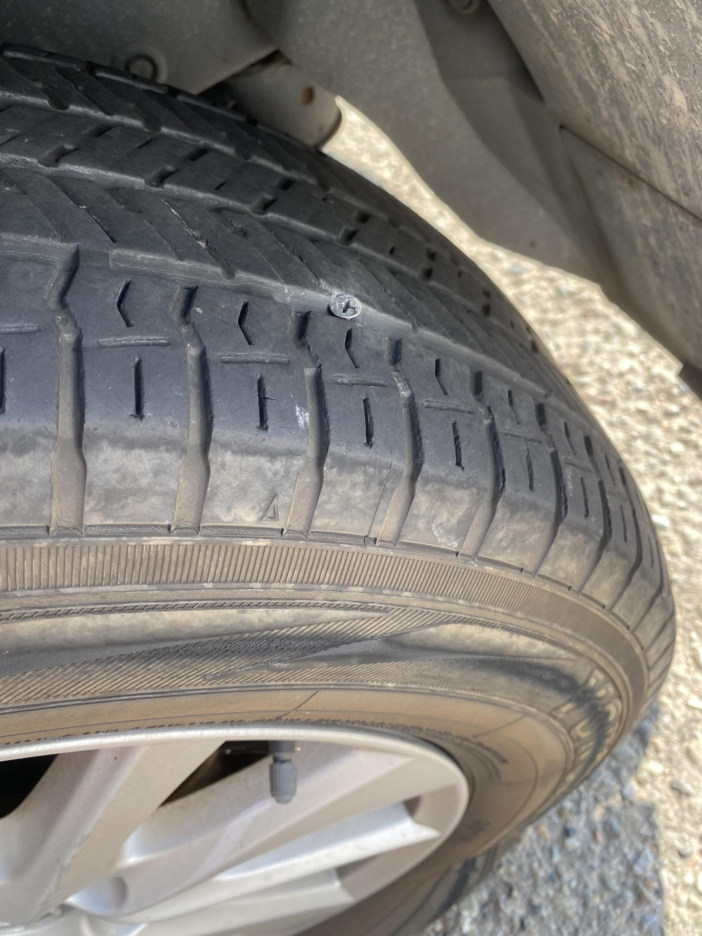
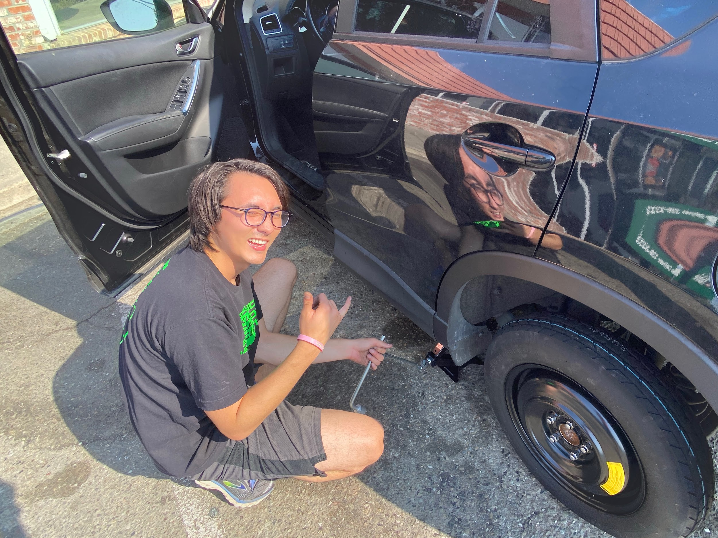
What does it take to be a prepared driver?
Key background about who, when, what you are talking about.
Context - Argument - Reasons
How you are answering the question
In order to be best prepared on the road,
it is always wise to have a spare tire in the car
because it may be the only way to get home.
Examples that support your argument and connect to your evidence!

Slide 71
Label the CAR Parts
During the Age of Exploration, Christopher Columbus was not a hero because he brutalized Native Americans and was not even the first European to arrive in the Americas.

Slide 72
CAR Claims
Key background about who, when, what you are talking about.
How you are answering the question
Context - Argument - Reasons
During the Age of Exploration, Christopher Columbus was not a hero because he brutalized Native Americans and was not even the first European to arrive in the Americas.
Examples that support your argument and connect to your evidence!

Slide 73
Matchmaker
During the coronavirus pandemic, everyone should wear a mask because it is safer. It is necessary because meat spoils so quickly. Doing push-ups everyday is good because it will improve upper-body strength in just a few weeks. This weekend, Mr. Jue had to change the tire of his car. Of all desserts, ice cream is the best tasting because at birthday parties it is always there. Call of Duty Warzone is not appropriate for children under 12. | Missing context Vague argument Vague reason Missing reason Reasons don’t match argument Not a claim
matches with C
matches with A
matches with B
matches with F
matches with E
matches with D

Slide 74
Write a CAR Claim in response to these questions
Challenge: Use a vocab word in each CAR claim!
Why is sleep important?
Should we care about the world besides the United States?
Are dogs better than cats?

Slide 75
COVID 19 Inquiry
We have faced our very own medical crisis over the past 1.5 years.
How has racism impacted our nation’s experience with COVID-19?

Slide 76
COVID 19 Inquiry
Partner 1 read paragraph out loud, circling unknown words
Use context clues to determine meaning!
Partner 2 underlines main ideas and explains thinking out loud
Partners 1 and 2 create summary sentence together
Repeat!

Slide 77
COVID Inquiry Debrief

Slide 78
Brain Break!

Slide 79
Exit Ticket #3: CAR Claims

Slide 80
Week 2, Day 9

Slide 81
Do Now
Welcome! Take your seat and begin the Do Now. Class has begun.
Write a definition next to each vocabulary word, then craft 3 CAR claims.

Slide 82
Agenda:
Objective: I can apply my knowledge to connect the Yellow Fever epidemic and COVID in writing.
Language Objective: I can craft a clear CAR claim that draws connections between Yellow Fever and COVID-19.
Do Now
COVID Source Review
Discussion Prep
Discussion
Formative Paragraph

Slide 83
Finish Covid Sources from Day 8 Packet
Partner 1 read paragraph out loud, circling unknown words
Use context clues to determine meaning!
Partner 2 underlines main ideas and explains thinking out loud
Partners 1 and 2 create summary sentence together
Repeat!

Slide 84
Jue Think Aloud
As I think aloud, make 3 observations about what I am doing as a reader.

Slide 85
Discussion Prep
Based on all of the sources we have explored this week, what connections can you make between Yellow Fever and Covid-19?
To have an awesome conversation and form our ideas for the paragraph later today, you will identify at least 4 connections.
Then, you will craft claims about those connections and provide evidence to support your claims. Be prepared to explain your thinking.

Slide 86
Discussion Prep
Based on all of the sources we have explored this week, what connections can you make between Yellow Fever and Covid-19?
Yellow Fever:
Day 5+6 Packets
Connections could be related to our response to the disease, the way we treat others in crisis, or inequalities...
Covid-19:
Day 8 Packet

Slide 87
Discussion!
First Person: Share your connection, evidence, and reasoning
Second Person: Paraphrase (repeat in your own words)
Third Person: Agree/Disagree
Fourth Person: Add On
Use the Placemat to help remind you!

Slide 88
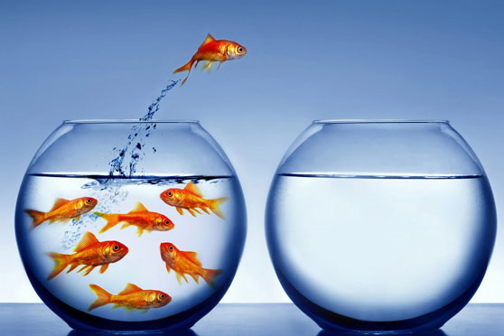
Fishbowl Example Discussion
We need 4 students to have one round of discussion for us.
As you listen, record 3 positive speaking moves you notice.

Slide 89
Discussion
Round 1: Connections 4 rounds where each person starts with a connection they made between Covid and Yellow Fever
Round 2: Takeaways
4 rounds where each person shares a takeaway from studying these two diseases this week.

Slide 90
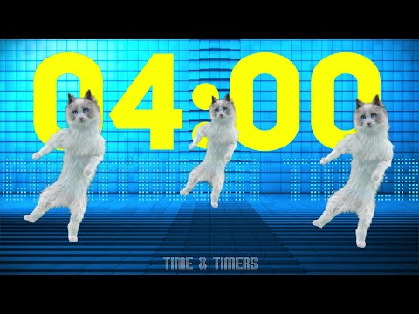
Brain Break!

Slide 91
Yellow Fever/COVID Paragraph
Formative Assignment (worth 30% of your grade)
Must Haves: 3 (B) Amazing: 4 (A)
CAR Claim begins paragraph and responds to prompt CAR parts are present and logical Evidence from sources present | Context, Argument, and Reasoning are thorough and clear 0-minimal grammar errors At least two connections are discussed in detail

Slide 92
Common mistakes
Missing context: tell the reader who and what you are talking about!
Starting claims with ‘Yes because…’ or ‘They connect because…’
Argument is too vague: Be specific about what you are arguing!
COVID and Yellow Fever are the same...
Reasoning is too vague: Be specific about why your argument is right!
COVID and Yellow Fever are the same because they were both deadly.

Slide 93
Yellow Fever/COVID Paragraph
Expectations:
Voice Level = 0 to whisper
Sustained effort
Technology supports, not distracts
If you finish your paragraph before the end of class, complete the Week 2 Feedback Form. Then you can choose to either do homework or read a book.

