Slide 1
Week 1, Day 1
Humanities 3

Slide 2
Do Now
As you enter: grab a Day 1 Packet from the table by the door and find a seat. Take out a pencil too!
Once seated: Quietly answer the Do Now questions in complete, thoughtful sentences. Class has begun!

Slide 3
Why Do Do Nows?
Do Nows are our chance to focus our mind on this class and be present.
When we start strong, we end strong. When we enter smoothly and get started quickly, we save time and YOU LEARN MORE.

Slide 4
1 Minute Turn and Talk
What do you miss about summer?

Slide 5
Agenda:
Objective: I will be able to learn classroom protocols and determine what makes something historic.
Language Objective: I will be able to use context clues to identify the meaning of news headlines
Do Now
Back to Back, Face to Face
Norms to Action
Historic or Not Historic
Exit Ticket

Slide 6
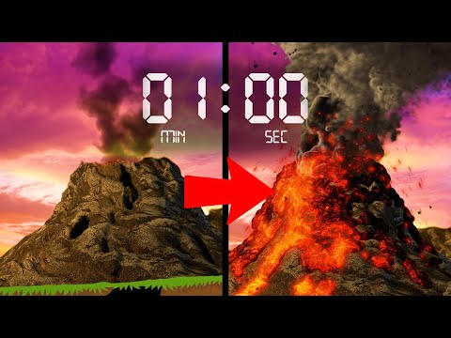
Name Tent!
In ONE MINUTE, turn the piece of paper in front of you into a name tent! Make sure your name is large and easy to read.

Slide 7
Back to Back, Face to Face
Stand up and find a partner in the room
Stand back to back.
Listen to the question. Think about your answer.
Turn face to face. Introduce yourself and share with your partner!

Slide 8
Back to Back, Face to Face
What do you miss about summer?
What is something interesting or important you learned last year in Humanities?
What has been your favorite class at Life, and what made it your favorite?
What do you want to do as an adult? Does it involve medicine?
How are race and medicine related, if at all?

Slide 9
Welcome to Humanities!
In this class, we will explore key themes of U.S. History. We will highlight untold, misunderstood narratives in our nation’s history.
We will debate and ponder questions like…
Can we have trust and faith in our healthcare system?
How has science shaped racism? How has racism shaped science?
What does progress mean in America?
What are the best ways to fight for our rights?
When is American military force necessary?
What responsibility do we have to our country?

Slide 10
What is the point of this class?
We are here to become better thinkers, writers, readers, and speakers.
We are here to push each other to grow and be ready for college-level academics.
I am here to help prepare you for the uncertain future.

Slide 11
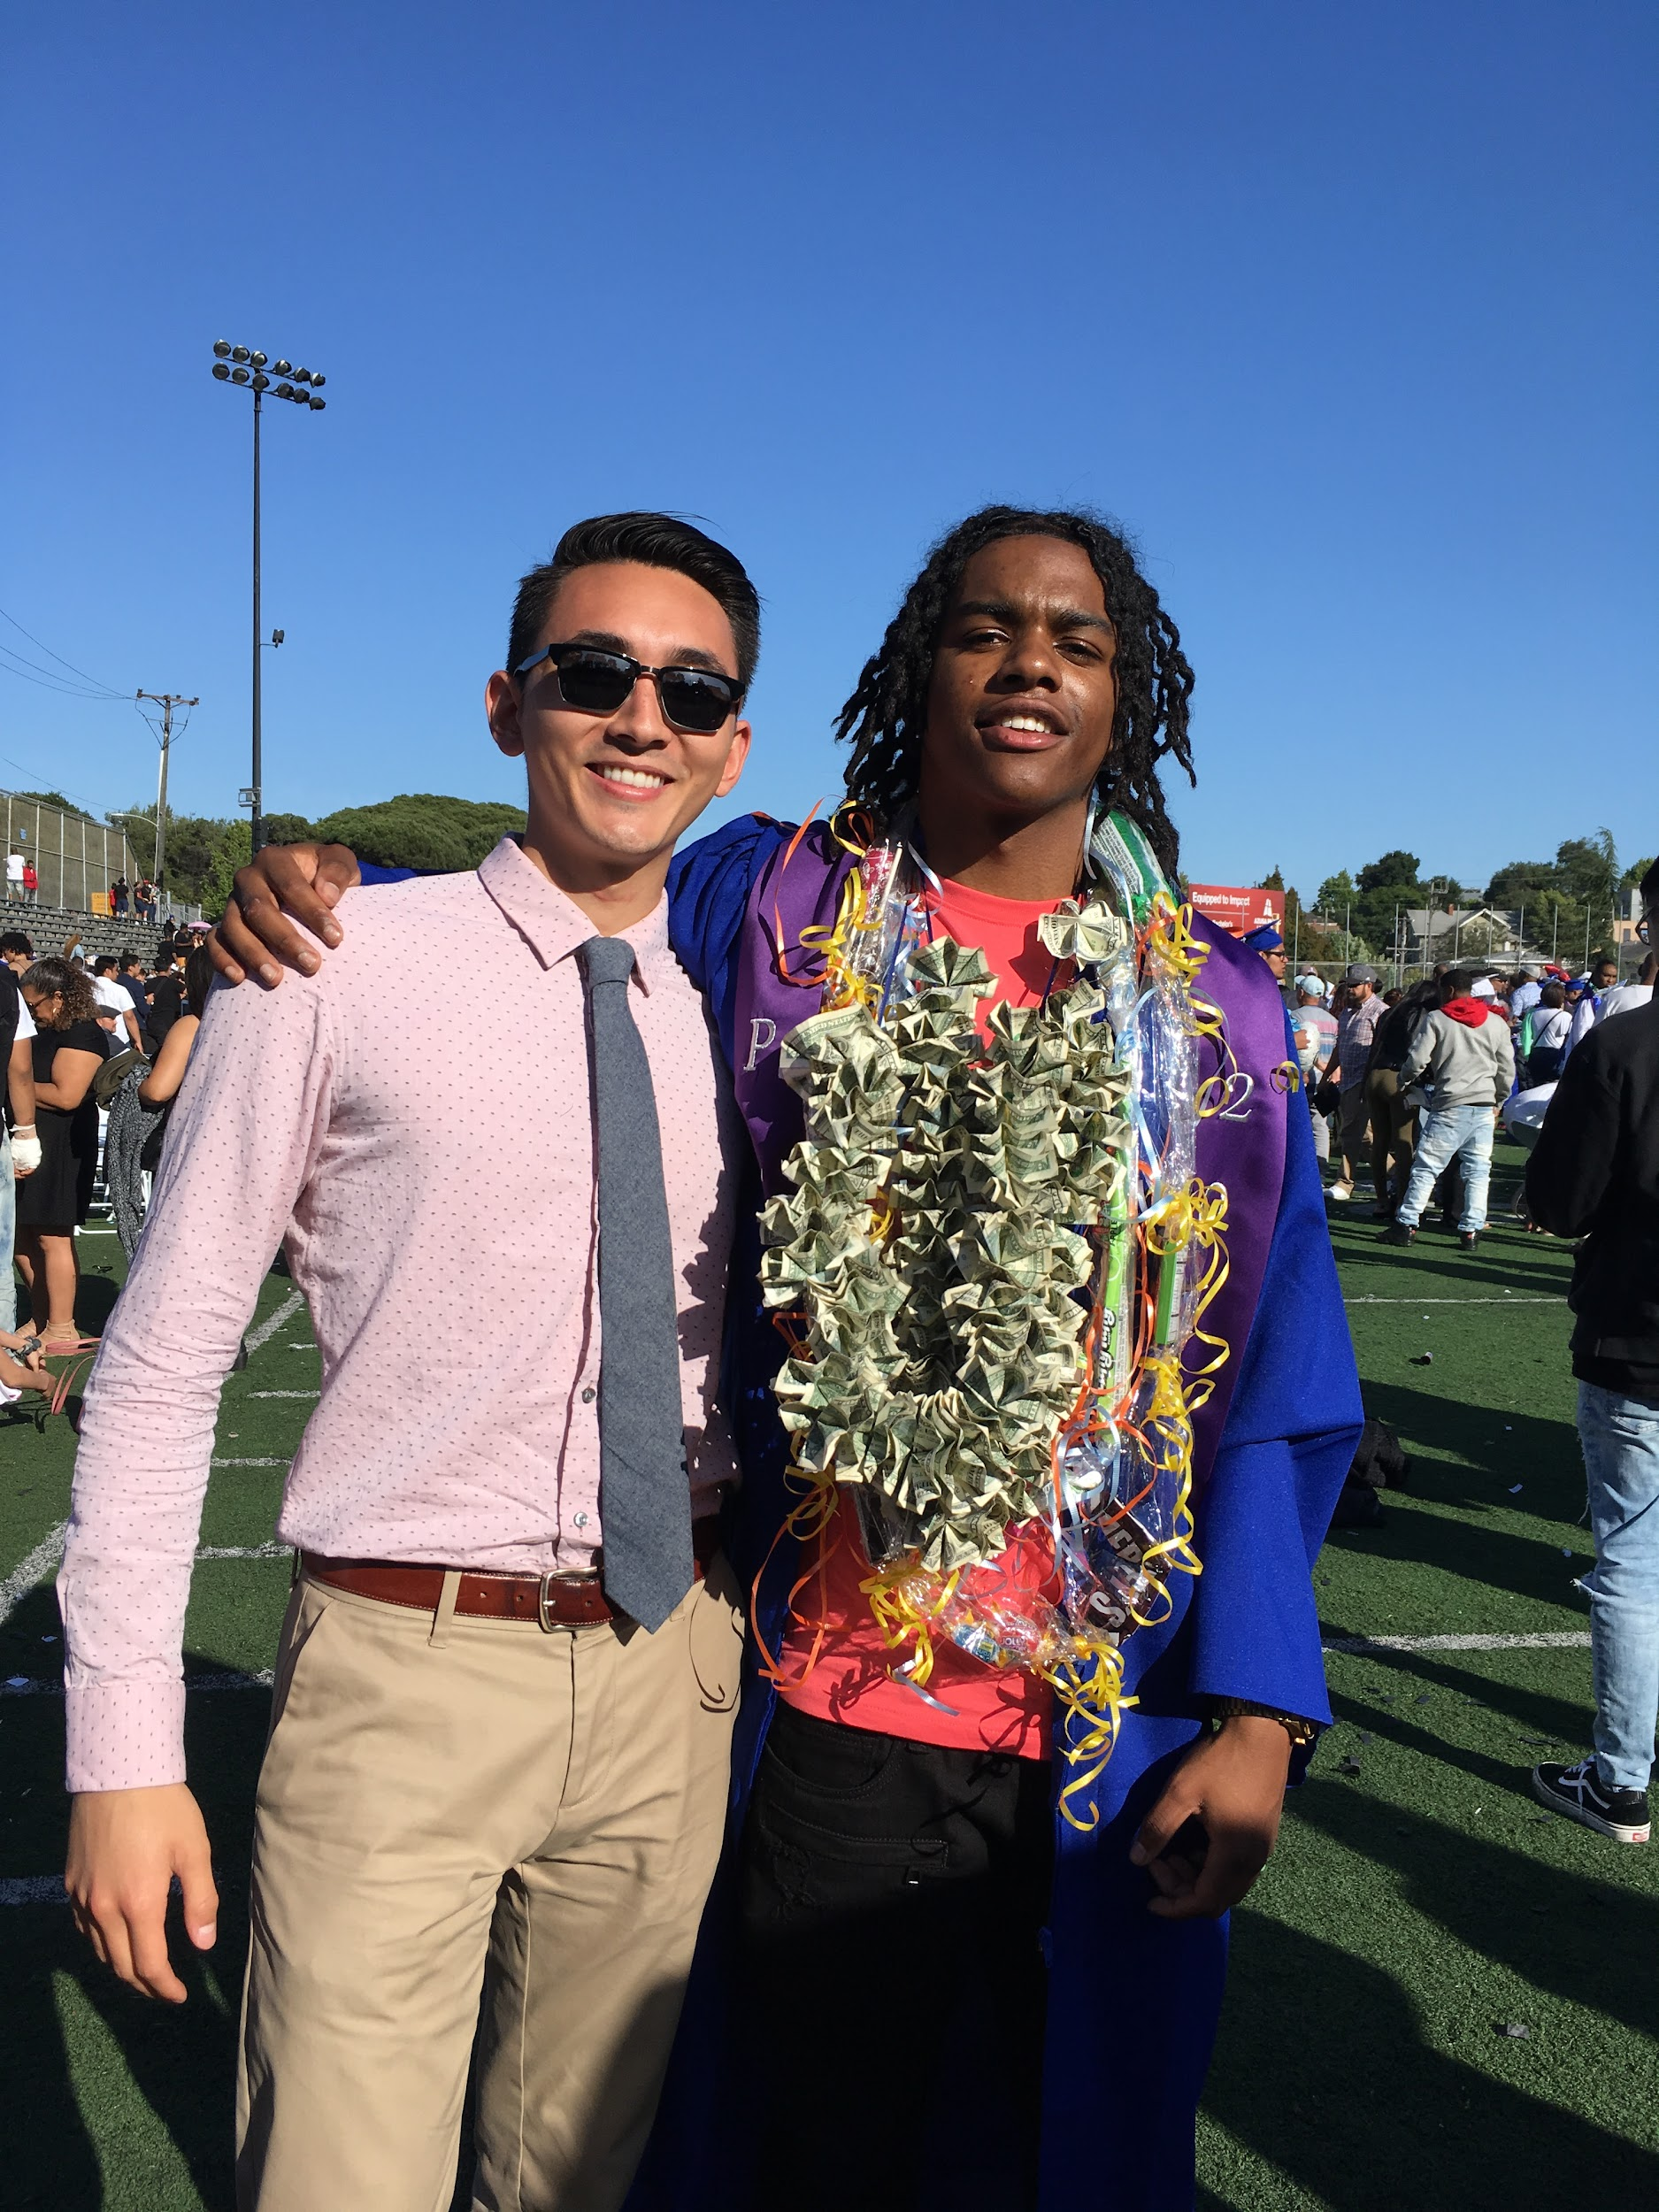
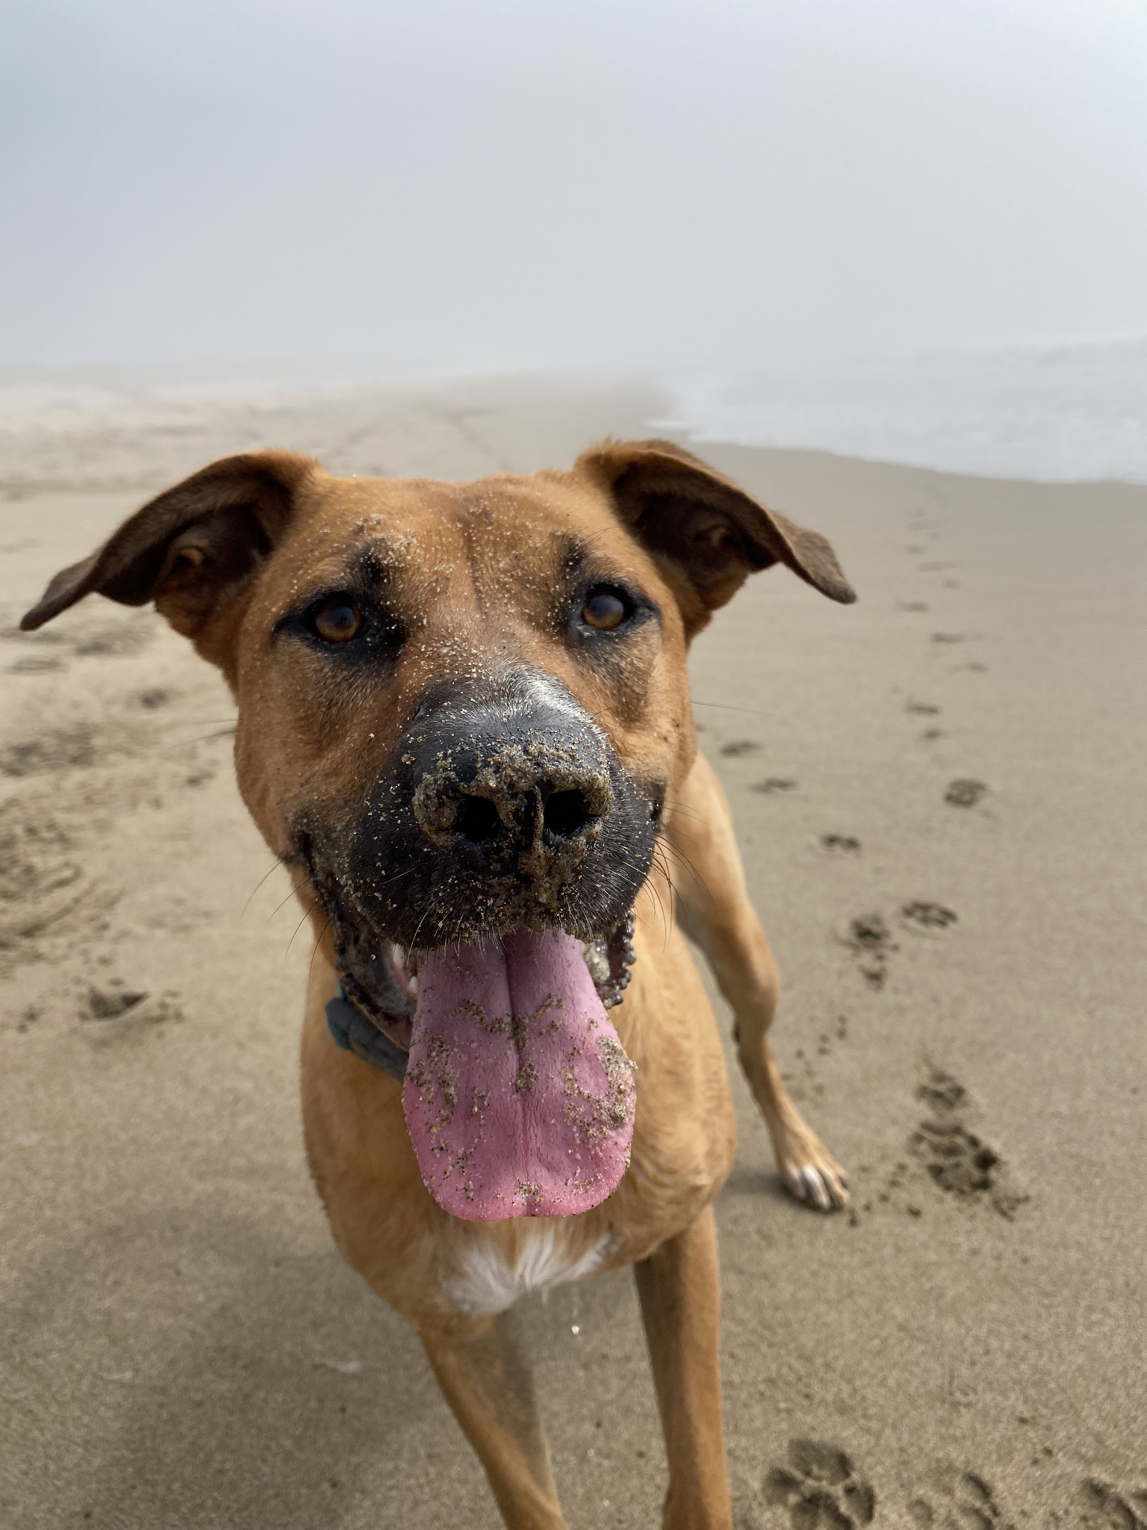
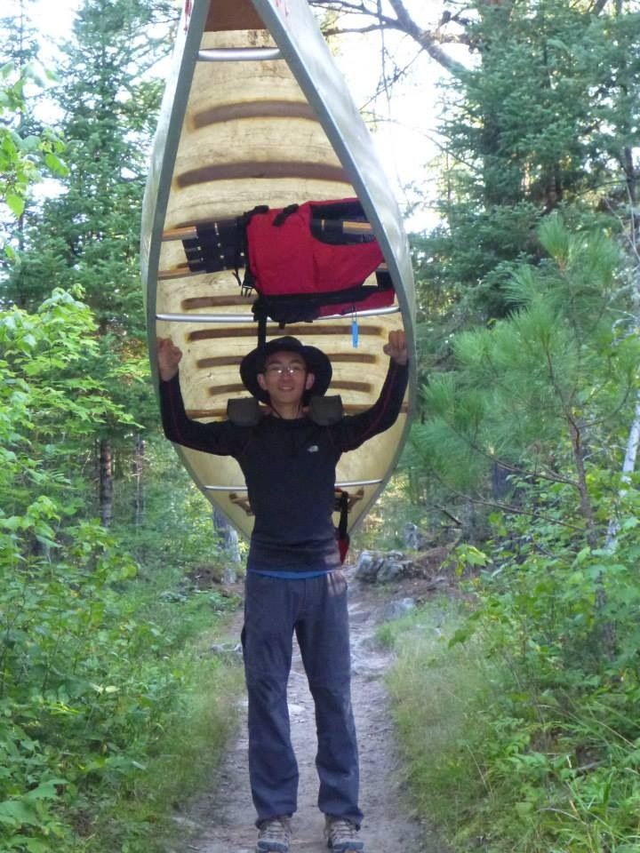
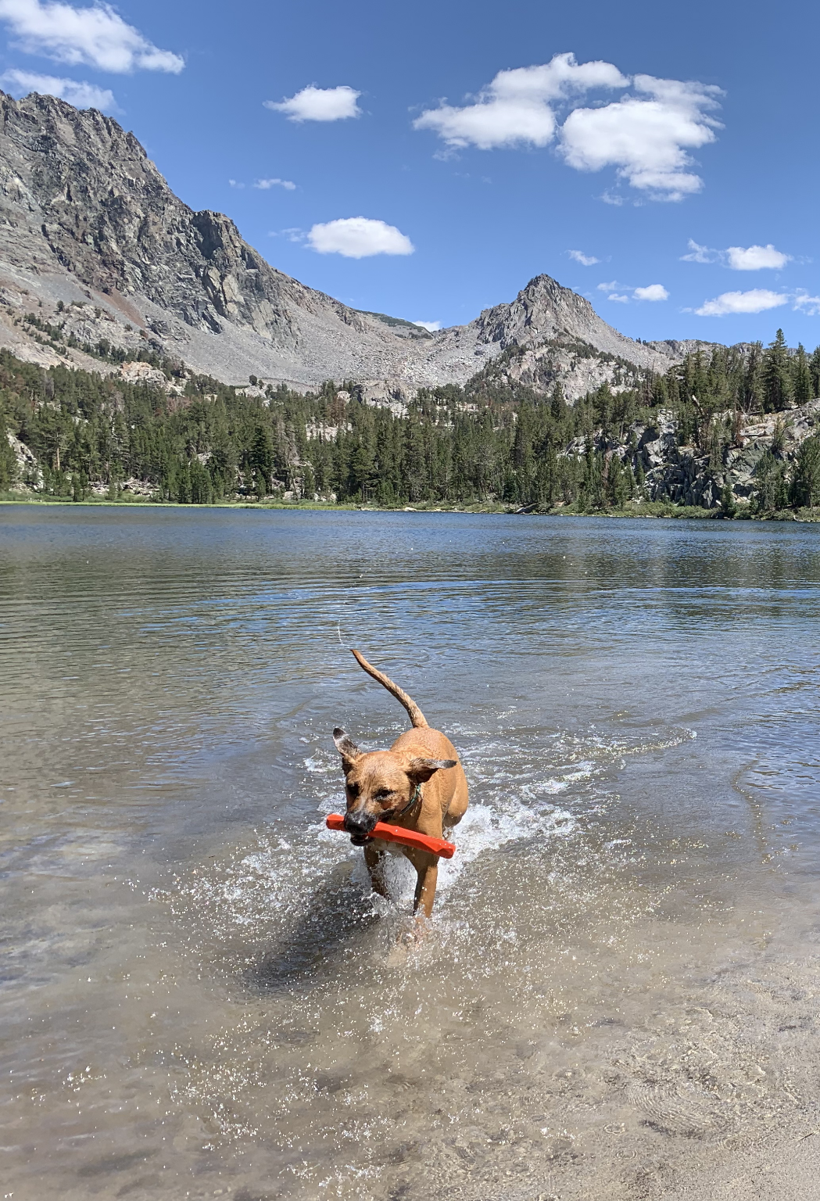
Who am I? Mr. Jue!
Hapa (half white, half Asian)
A brother, a son, a dog dad
Grew up in the Bay Area and the Midwest
Energetic, sarcastic, nerdy energy
I love history, movies, stand-up comedy, hiking, road trips
I like cooking, boxing, and board games
Fun fact: I’ve had part of a bone removed from my body.

Slide 12
Norms
We are going to be with each other for 100 minutes every single day for a year. We have to coexist and find joy in each other!
Norms clarify how we each deserve to be treated in this space. They are also about how we each have a responsibility to each other.
But, they only work if we honor them with our actions.

Slide 13
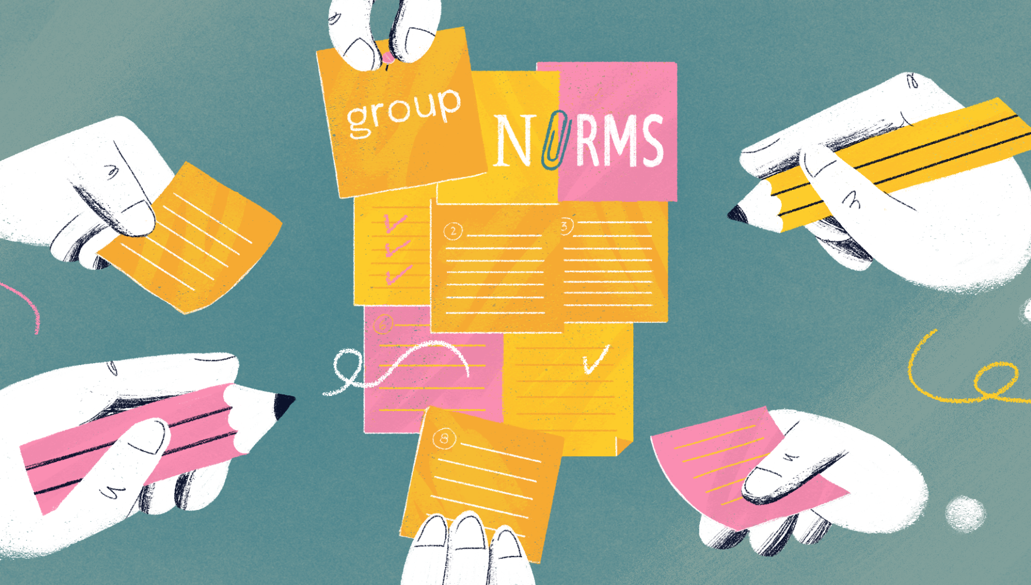
Norms
Each group of 4 will be assigned a norm. Your job is to brainstorm with your group AT LEAST 3 ways your norm looks in the classroom. How does this norm play out in school?
Write your answers in your
Day 1 Packet!

Slide 14
Norms Share Out!

Slide 15
Turn and Talk
Do you pay attention to the news? Why or why not?
If so, how?
Together, think of at least one important or historic event that happened this summer.

Slide 16
Historic or Not Historic
In your group of 4, you will read and rank news headlines from over the summer based on how ‘historic’ you think the event was.
You MUST come to an agreement with your group!
Historic: famous or important in history, or potentially so.

Slide 17
What does it mean for an event to be historic?
Decide on one speaker for your group who will share out!
How did your group rank your headlines? Why?

Slide 18
Exit Ticket
Before the end of class, complete the Exit Ticket in your packet.
When you exit, hand in your complete Day 1 Packet!

Slide 19
Week 1, Day 2

Slide 20
5x5x5
In your group of 4…
Turn and face each other. Say good morning! Share your names.
Each person shares their five words to the same question.
Pick one person to explain their five words. Feel free to ask questions!
Move onto the next question!

Slide 21
Agenda:
Objective: I will be able to identify the ways race and power are connected in a text.
Language Objective: I will be able to summarize the main ideas of academic paragraphs with my group
Do Now
Summarizing Texts
Summarizing Practice!
Google Classroom Sign Up
Reading Diagnostic

Slide 22
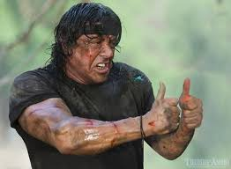
Thumbs Up If You Have Ever...
...read a page and forgot everything you just read.
...heard a story and got distracted by a random detail.
...watched a movie or show, but then can’t explain what it’s about to somebody.

Slide 23
If you had your thumb up, it means you are human. It also means you can improve your ability to summarize!
A summary is a short statement describing the main idea of something.

Slide 24
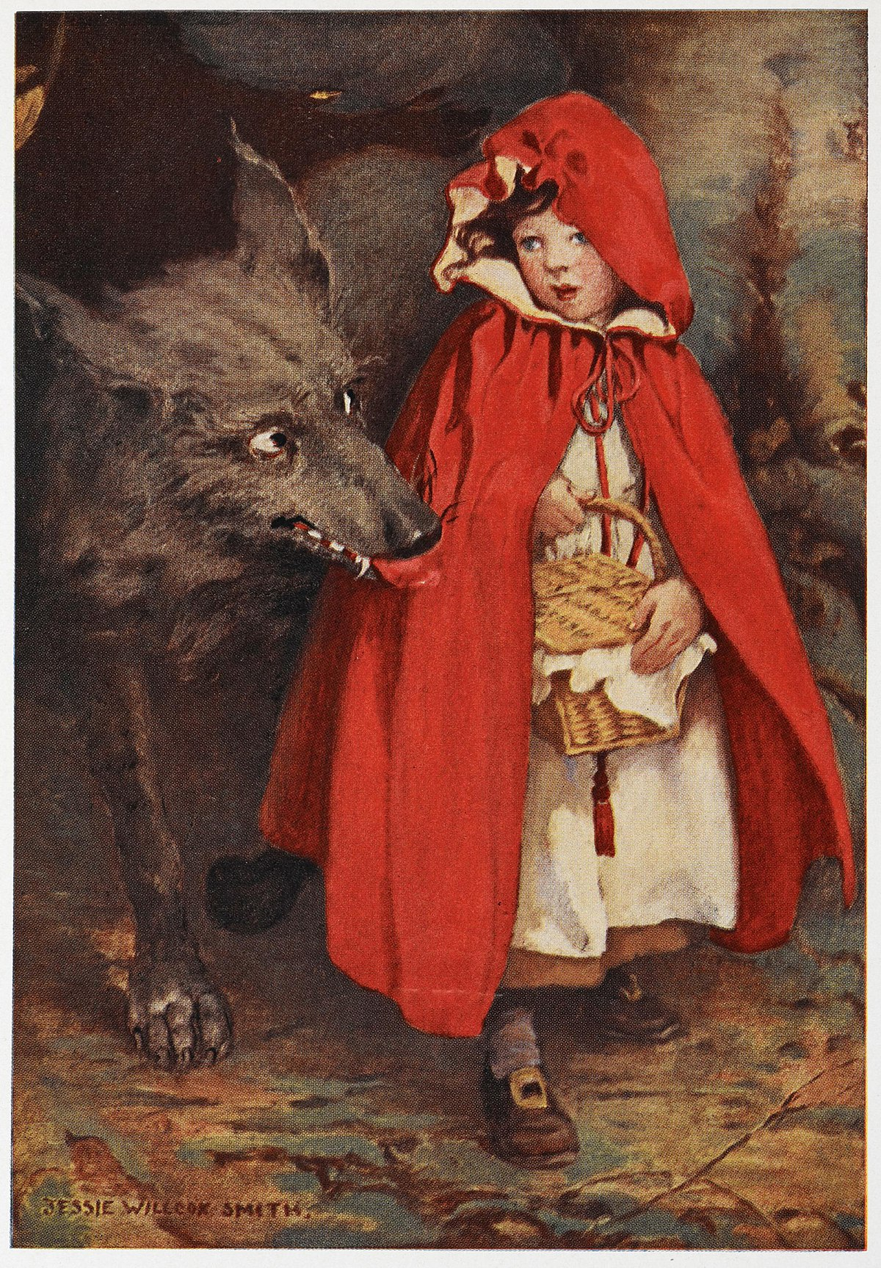
Little Red Riding Hood
Summary: An innocent girl is almost eaten by a sneaky wolf.

Slide 25
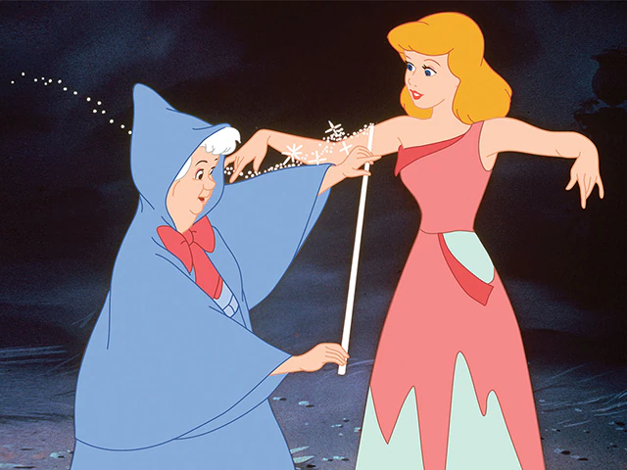
Cinderella
With your table partner:
Summarize Cinderella in 7 words or less!

Slide 26
Summarizing Texts
Follow These Steps!
Read paragraph. Circle any confusing words.
Read paragraph again. Underline main topics and arguments.
Write the main idea of the paragraph in your own words.

Slide 27
Summarizing!
Read paragraph. Circle any confusing words.
Sometimes a stressful situation just lasts a moment — like getting through a school play audition or making the foul shot that could win the game. But life also can bring situations that might keep us stressed for a few days, weeks, or months. Even if we're not always thinking about this stress, it can be like a background soundtrack playing in our lives.

Slide 28
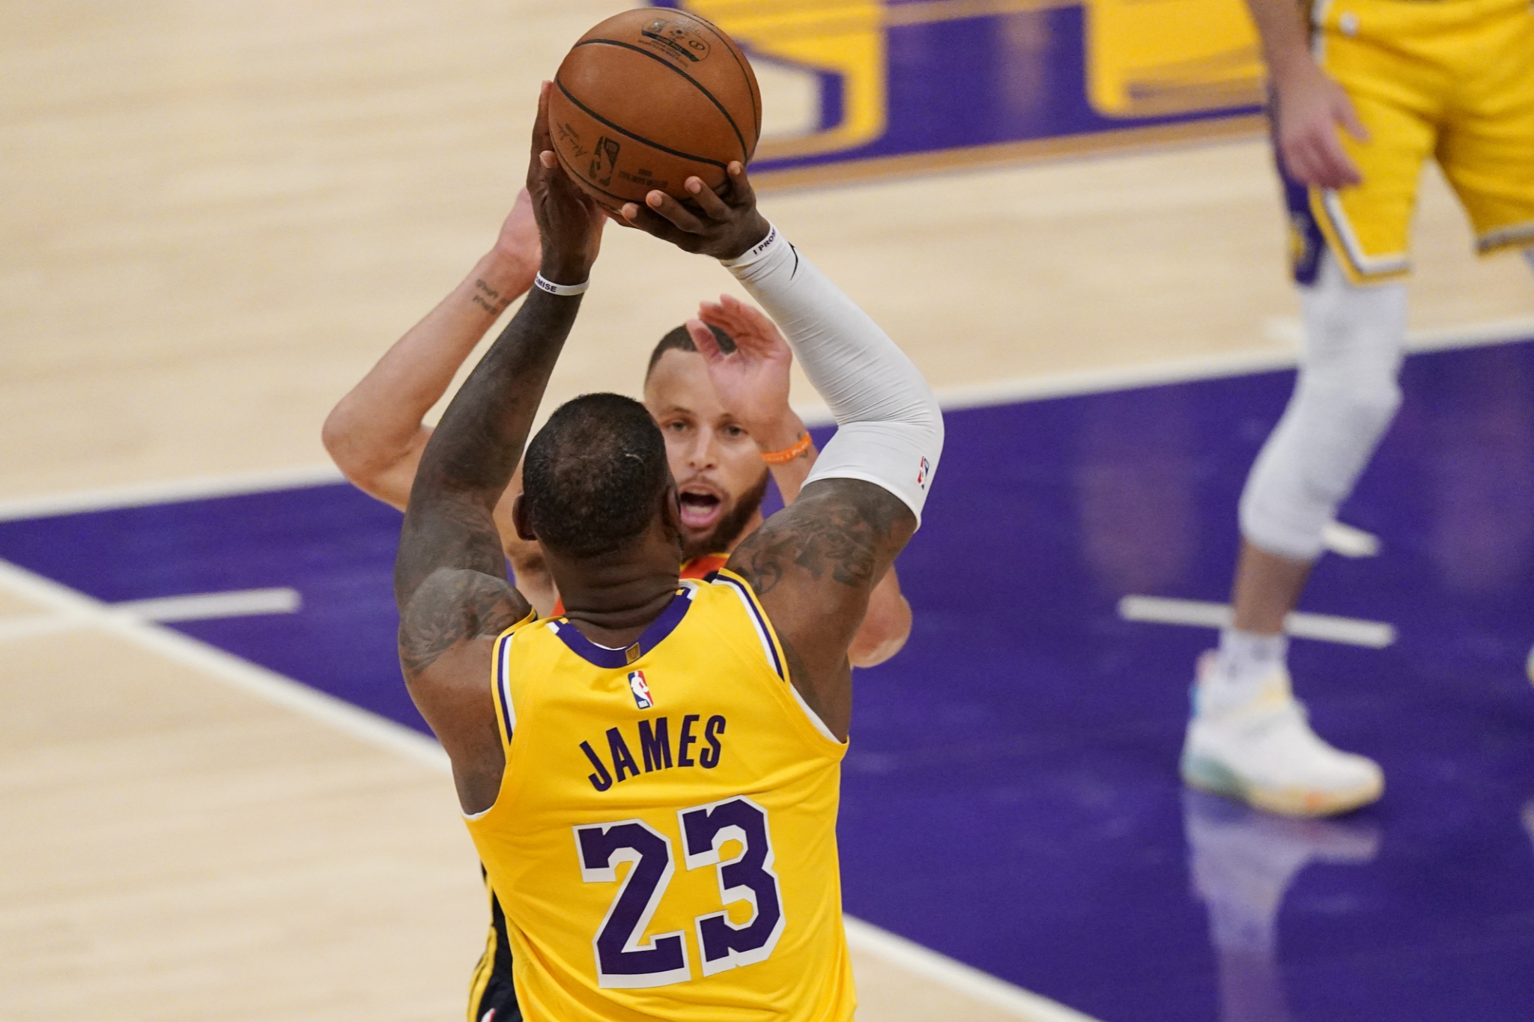
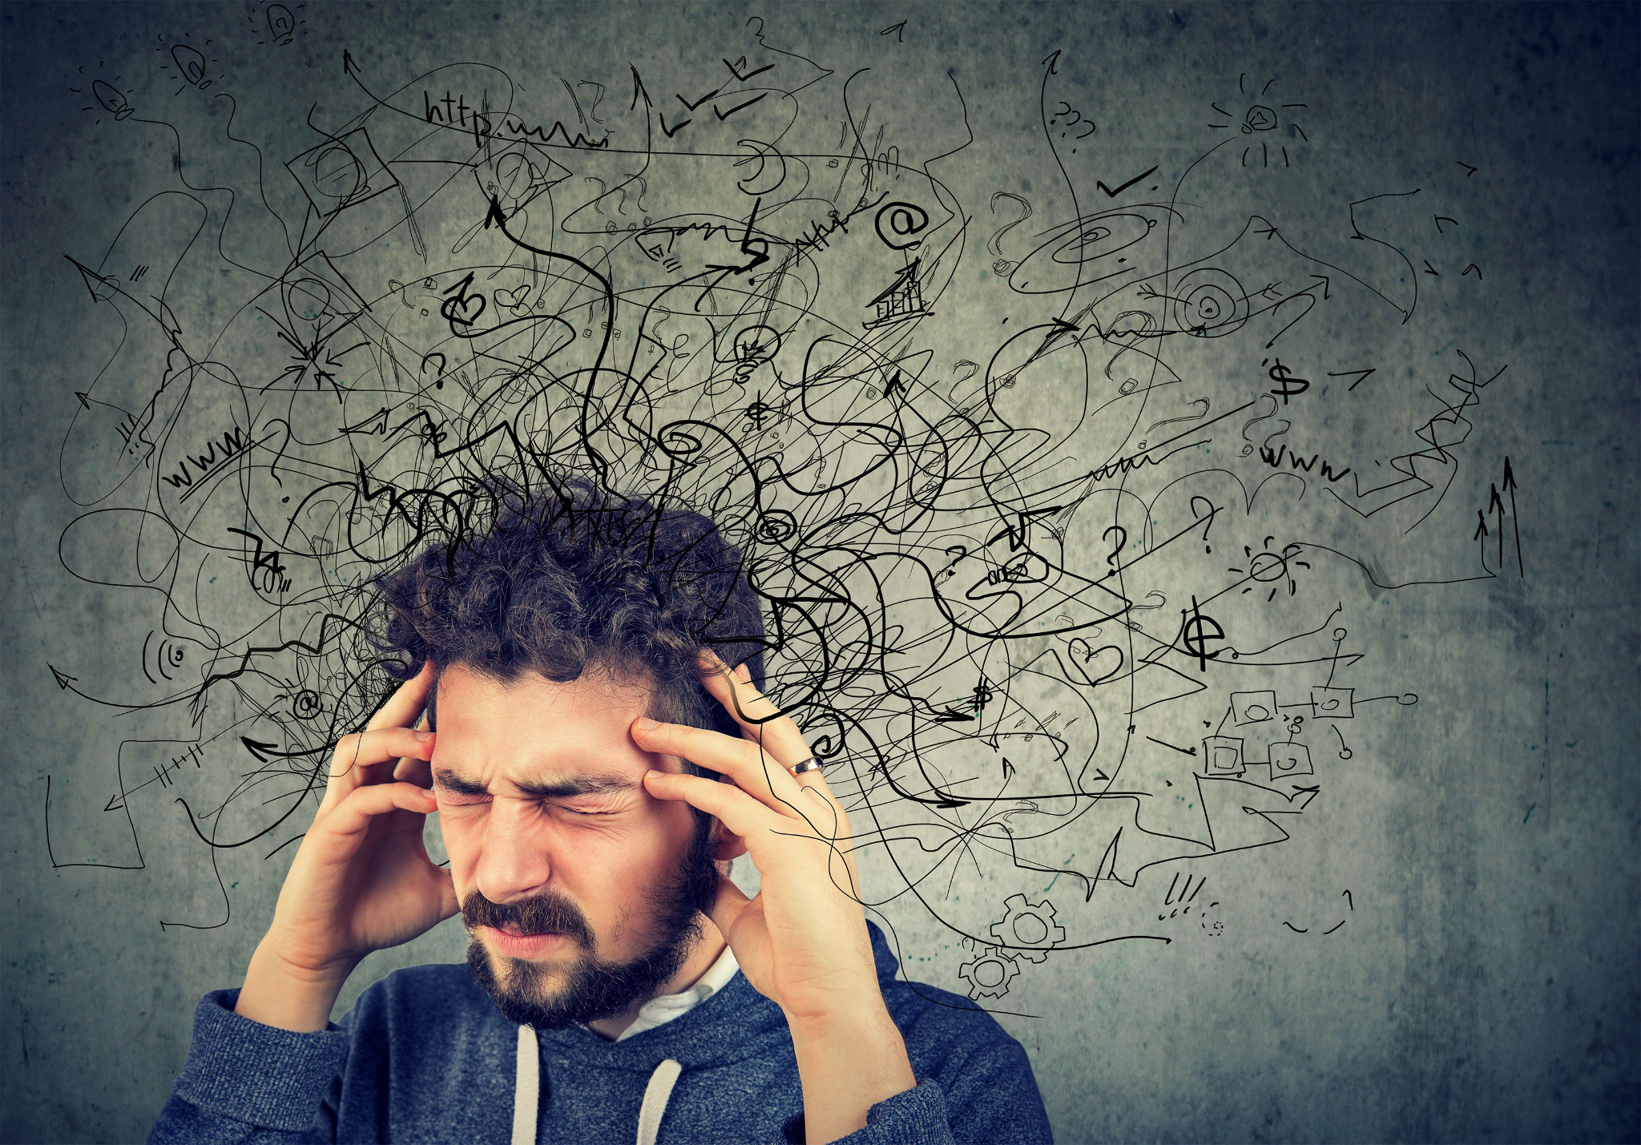
Summarizing!
2. Read paragraph again. Underline main topics and arguments.
Sometimes a stressful situation just lasts a moment — like getting through a school play audition or making the foul shot that could win the game. But life also can bring situations that might keep us stressed for a few days, weeks, or months. Even if we're not always thinking about this stress, it can be like a background soundtrack playing in our lives.

Slide 29
Summarizing!
3. Write the main idea of the paragraph in your own words.
Stress can be temporary or last a long time.
Sometimes a stressful situation just lasts a moment — like getting through a school play audition or making the foul shot that could win the game. But life also can bring situations that might keep us stressed for a few days, weeks, or months. Even if we're not always thinking about this stress, it can be like a background soundtrack playing in our lives.

Slide 30
Now You Try
Follow the 3 Steps to summarize the paragraph about the Dixie Fire.

Slide 31
Which answer best summarizes the paragraph?
Poor forest management is to blame for the Dixie Fire.
The Dixie Fire is located in northeastern California and has burned over 400,000 acres of land.
The August Complex Fire burned over a million acres last year.
The Dixie Fire has become the second largest wildfire in California history.

Slide 32
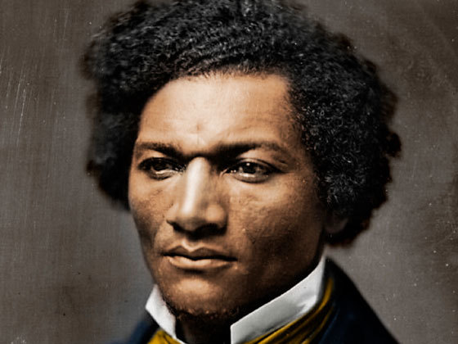
Our First Unit
Race, Power, and Health: Past and Present

Slide 33
The Ugly Reality of Our Past
In August of 1619, over 400 years ago, a ship appeared on the horizon of Virginia. It carried 20 kidnapped and enslaved Africans. These human beings were sold to the English colonists.
The institution of slavery would become the most toxic, destructive, and poisonous legacy in American history. No other event in American history has remained untouched by slavery.

Slide 34
The Ugly Reality of Our Present
The legacy of slavery CONTINUES to shape our country today. Racism remains a powerful and dangerous force in America and it affects ALL of us.
You have learned about racism in many ways in your education. You are on a journey of anti-racism: learning to fight against racism and create a better future.
To become better anti-racists, we must understand racism and its history.

Slide 35
QUESTIONS TO THINK ABOUT AS WE READ...
Why have people with power often assumed they are better or superior?
What is the relationship between power and race?

Slide 36
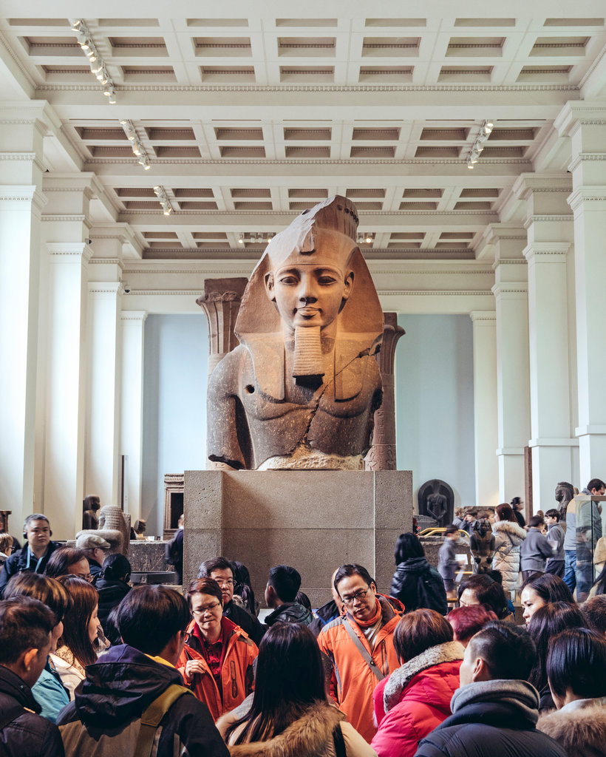
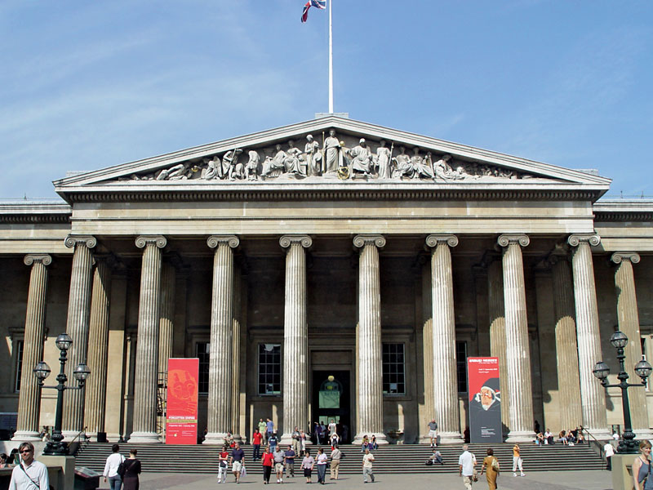
British Museum Fast Facts
Our next reading is about the British Museum.
Located in London, England.
One of the largest and oldest museums in the world.
It has objects from all over the world, many taken by the British Empire during colonialism 200-400 years ago.
It was created BEFORE the U.S. was even a country.

Slide 37
Summarizing Texts
With your table partner...
One partner reads paragraph out loud. Circle any confusing words.
Second partner reads paragraph again. Underline main topics and arguments.
Discuss what you think the main idea is, then write it in your own words.

Slide 38
Debrief
What is the author’s opinion of the British Museum?
What do dominant societies with power tend to do?
What does Saini mean when she says that ‘history is never over’?

Slide 39
Reading Diagnostic
In order to be the most helpful to you, I need to know more about your skills and your learning.
We are all different people, so we are all going to have different skills, beliefs, and attitudes about reading.
What is your relationship to reading?
This assignment will be graded on completion. You will get full credit if you do it!

Slide 40
Google Classroom 11A
Add class and use code:
Then open the Reading Diagnostic Assignment and begin working.
It is due at the end of class today.

Slide 41
Google Classroom 11B
Add class and use code:
Then open the Reading Diagnostic Assignment and begin working.
It is due at the end of class today.

Slide 42
Reading Diagnostic
If you finish early, return your computer to the cart and plug it in.
Then, you can decorate/stylize your name tent. Don’t disrupt others, they are still working on their assignment!

Slide 43
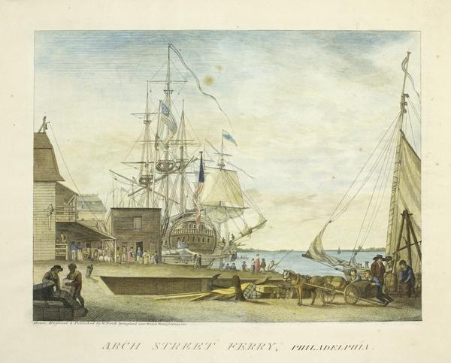
Week 1, Day 3

Slide 44
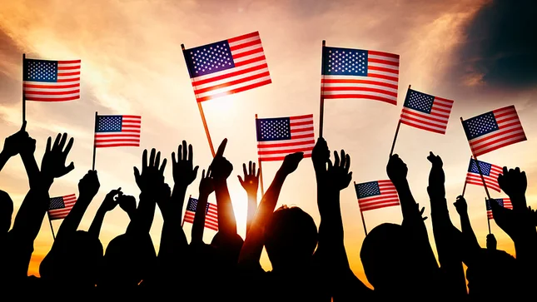
Do Now
Are you patriotic to America? Why or why not?
As people who live in America, do we owe America anything?
Patriotic: being devoted and loyal to one’s country.

Slide 45
Agenda:
Objective: I can explain the expectations of this class and identify the main ideas in “The Idea of America”.
Language Objective: I can accurately summarize the main ideas of paragraphs.
Do Now
Syllabus Drop
Idea of America Reading
Mindful Minute
Dinner Table Discussions

Slide 46
Syllabus Drop
In the margins,
Write at least 2 observations
Ask at least 1 question

Slide 47
4 Point Grading
4 | A | Exceeding Mastery of Skill
3 | B | Meeting Mastery of Skill
2 | C | Approaching Mastery of Skill
1 | D | Beginning Mastery of Skill
0 | F | Incomplete/Missing

Slide 48
4 Point Grading
40%
30%
15%
15%
Summatives (Tests, Certifications, Projects)
Formatives (Quizzes, Short Writing Assignments, Discussions)
Exit Tickets
Classwork/Homework

Slide 49
What If I am absent on a day of school?
Communicate with me and your other teachers as soon as possible.
All work will be posted in 2 places: on Google Classroom OR the Missing Work Bin.

Slide 50
When you see the American Flag, what do you think of?

Slide 51
Connecting Yesterday to Today
Yesterday, we discussed the way power can lead to feelings of superiority and entitlement. We can come to believe the inequalities we see around us are ‘natural’ and supposed to be this way--even though they were created by human beings!
Race is a tool that has been used by the powerful to dehumanize, control, and justify their power.

Slide 52
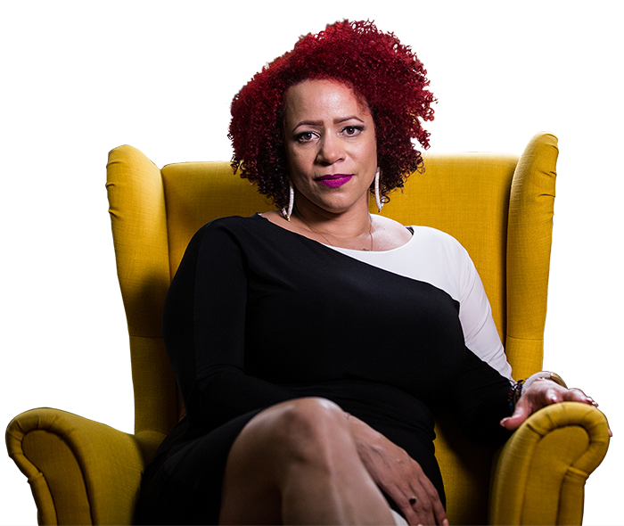
Connecting Yesterday to Today
Today, we will read an article about how race has been used as a tool of power.
We will learn about a writer’s own relationship with American history, and then we will begin to think about our own.
Nikole Hannah-Jones

Slide 53
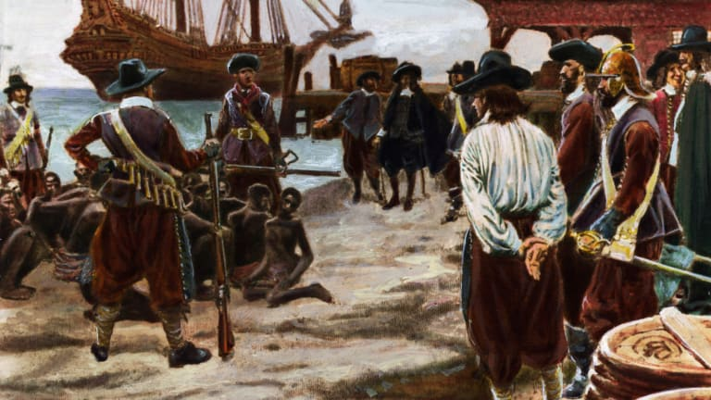
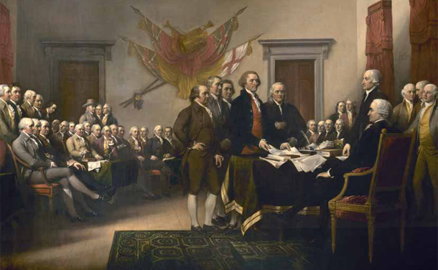
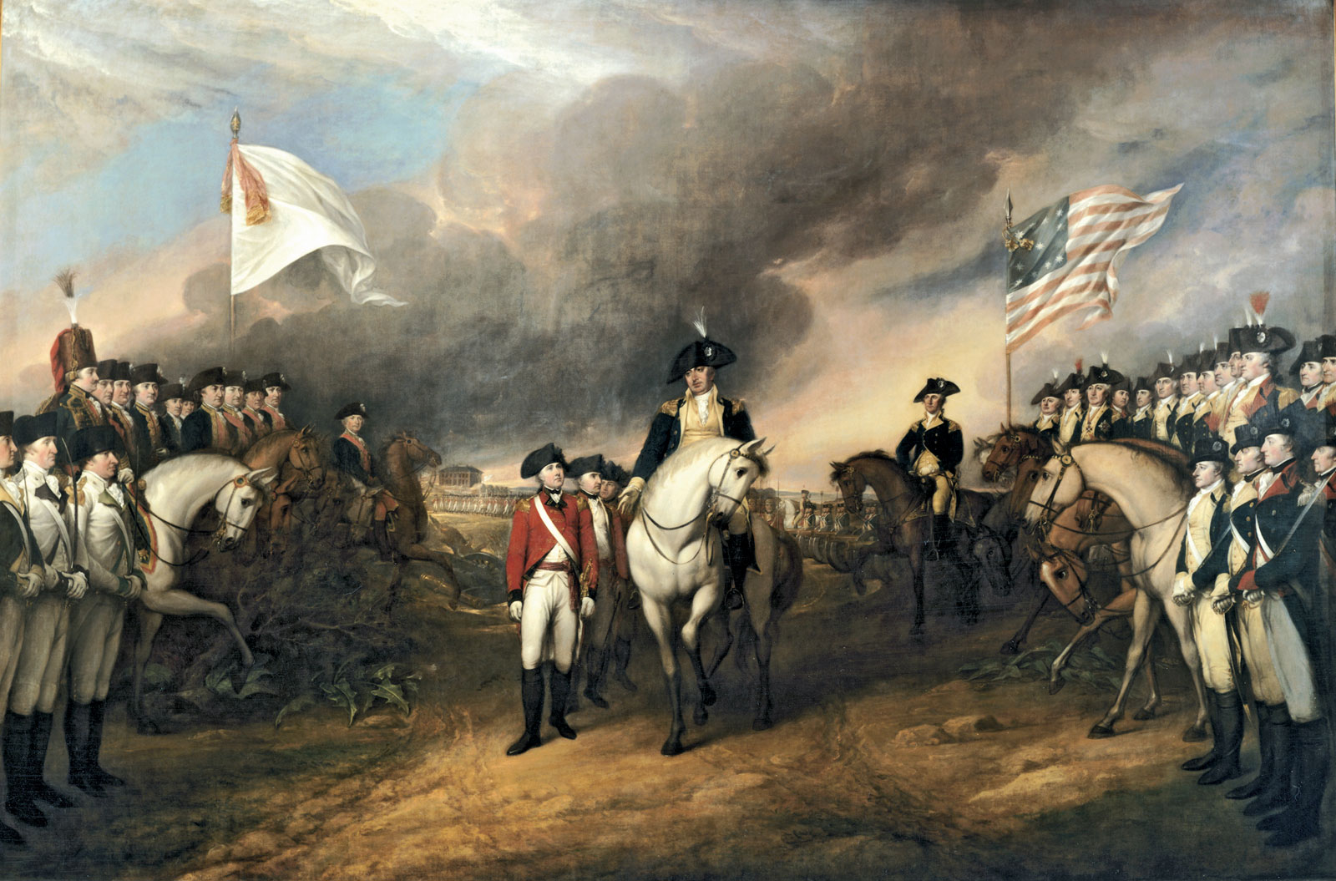
Turn and Talk: What do you know about the founding of America?

Slide 54
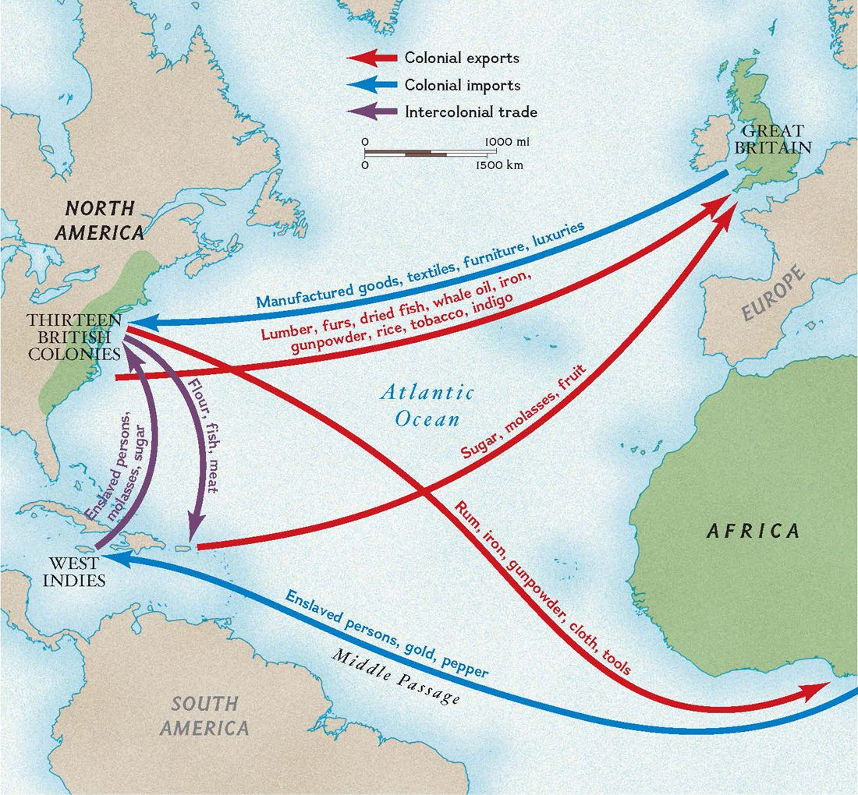
Slavery in what is now America began in 1619.
This was a time when the East coast was been invaded and colonized (settled) by Europeans, mostly the British (same as English). They began to kidnap and enslave Africans to develop the colonies.
The United States would not be created for another 150 years.

Slide 55
The United States began in 1776
In 1776 the English colonies rebelled against England and formed their own government called a democracy. This would become the United States.
A democracy is a type of government in which the people choose their leaders.
Declaration of Independence promised “life, liberty, and the pursuit of happiness”.

Slide 56
Before We Read: What are the 3 steps to summarizing?
Read paragraph. Circle any confusing words.
Often, words will have definition in [brackets]. If not, use context clues to predict, then Google!
Read paragraph again. Underline main topics and arguments.
Write the main idea of the paragraph in your own words.

Slide 57
Pro Tip
Look for contrasting words like…
But
However
Yet

Slide 58
Paragraph 1
Even though Jones grew up in a worn down house, her father always flew a pristine American flag.
My dad always flew an American flag in our front yard. The blue paint on our two-story house was perennially [permanently] chipping; the fence, or the rail by the stairs, or the front door, existed in a perpetual [constant] state of disrepair, but that flag always flew pristine [spotless]. Our corner lot, which had been redlined by the federal government, was along the river that divided the black side from the white side of our Iowa town. At the edge of our lawn, high on an aluminum pole, soared the flag, which my dad would replace as soon as it showed the slightest tatter [rip].

Slide 59
Your Reading Goals From Yesterday
The science is clear. Reading out loud is one of the best ways to strengthen your reading fluency, which is your ability to read quickly and effortlessly.
The less time you spend sounding out and identifying words, the MORE time you spend understanding the meaning of what you read. That’s the good part!
I want to improve the speed at which I read and am still able to comprehend the text.
My read out louds. I tend to stutter because my eyes read faster than my mouth. So I tend to go back and read it because I didn't catch it the first time.
I want to learn new and big words
My ability to read fluently out loud in front of people
i want to improve on pronunciation
Learn difficult words that prevent me from understanding the meaning

Slide 60
Now You Try with Paragraph 2
First Partner reads. Circle any confusing words.
Often, words will have definition in [brackets]. If not, use context clues to predict, then Google!
Read to yourself, underline main topics and arguments.
Write the main idea of the paragraph in your own words.

Slide 61
Paragraph 2
Summary:
So when I was young, that flag outside our home never made sense to me. How could this black man, having seen firsthand the way his country abused black Americans, how it refused to treat us as full citizens, proudly fly its banner? I didn’t understand his patriotism. It deeply embarrassed me.

Slide 62
Read the Rest of the Article with your Partner
First Partner reads outloud. Circle any confusing words.
Often, words will have definition in [brackets]. If not, use context clues to predict, then Google!
Read it again to yourself. Underline main topics and arguments.
Write the main idea of the paragraph in your own words.

Slide 63
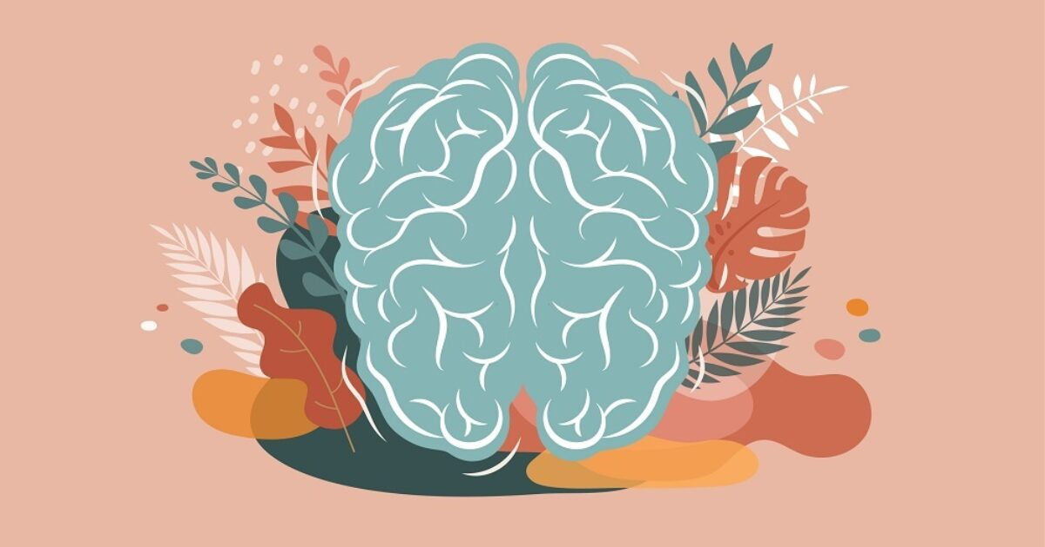
Mindful Minute!
Stretching!
Forward/Backward Arm Spins
Floating Hotdog, Periphery
Palm Energy

Slide 64
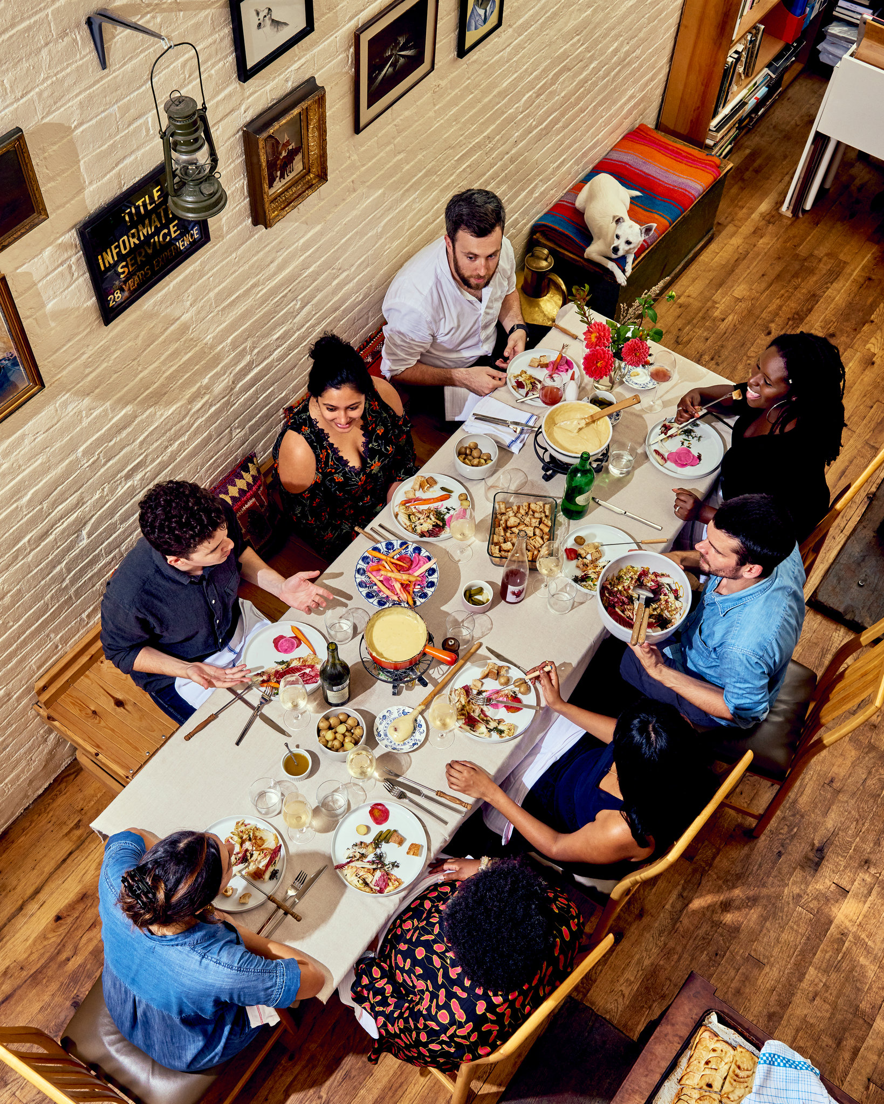
Dinner Table Discussions
This is our chance to debrief, share out ideas,and make sense of this article together.
Use the questions in your Day 3 Packet as a guide!
How can I be successful?
Participate actively
Include others and live out our norms
Cite the text when you share

Slide 65
Dinner Table Discussion Questions
What surprised you about the reading? What did you learn? List at least 3 observations.
How did Jones’ relationship with her father change throughout the article?
What is Jones’ thesis (main argument) in this article? Do you agree? Disagree?
Do you agree or disagree with Jones that black Americans, and perhaps all people of color, have the greatest claim to the American flag?
What questions does the reading make you want to ask?

Slide 66
Week 1 Day 4

Slide 67
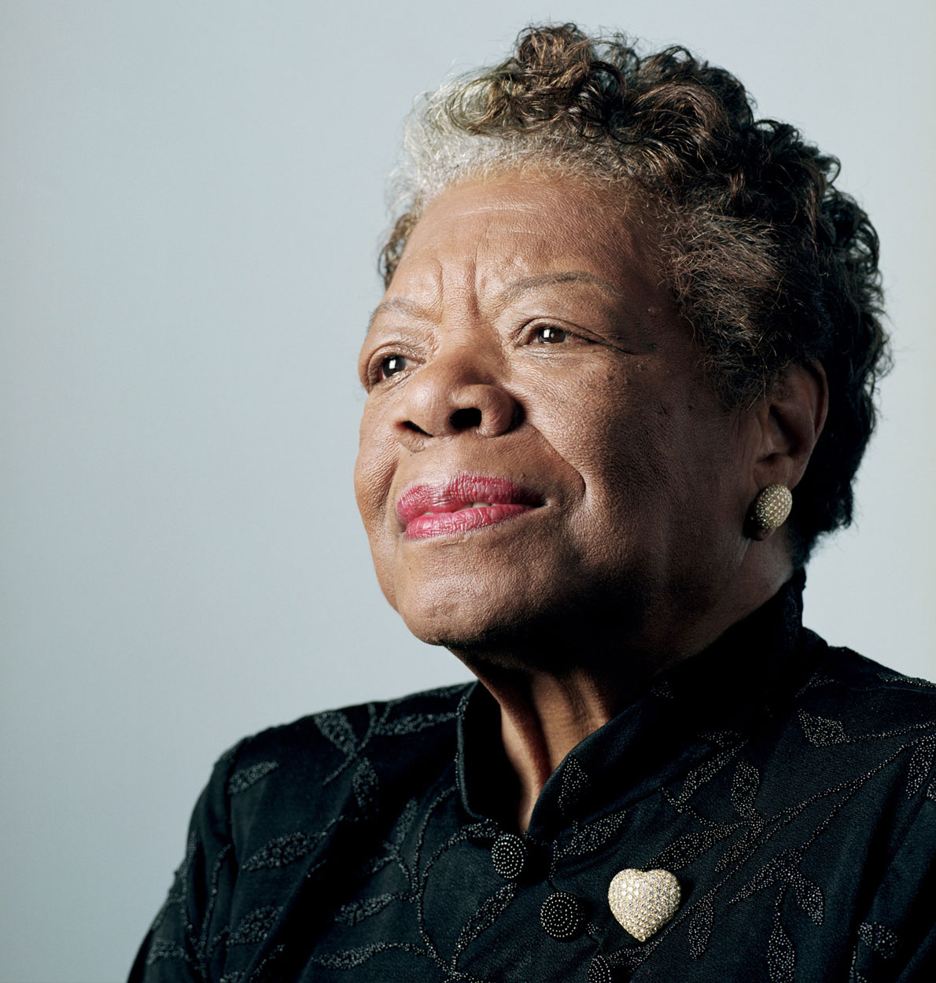
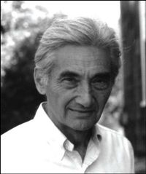
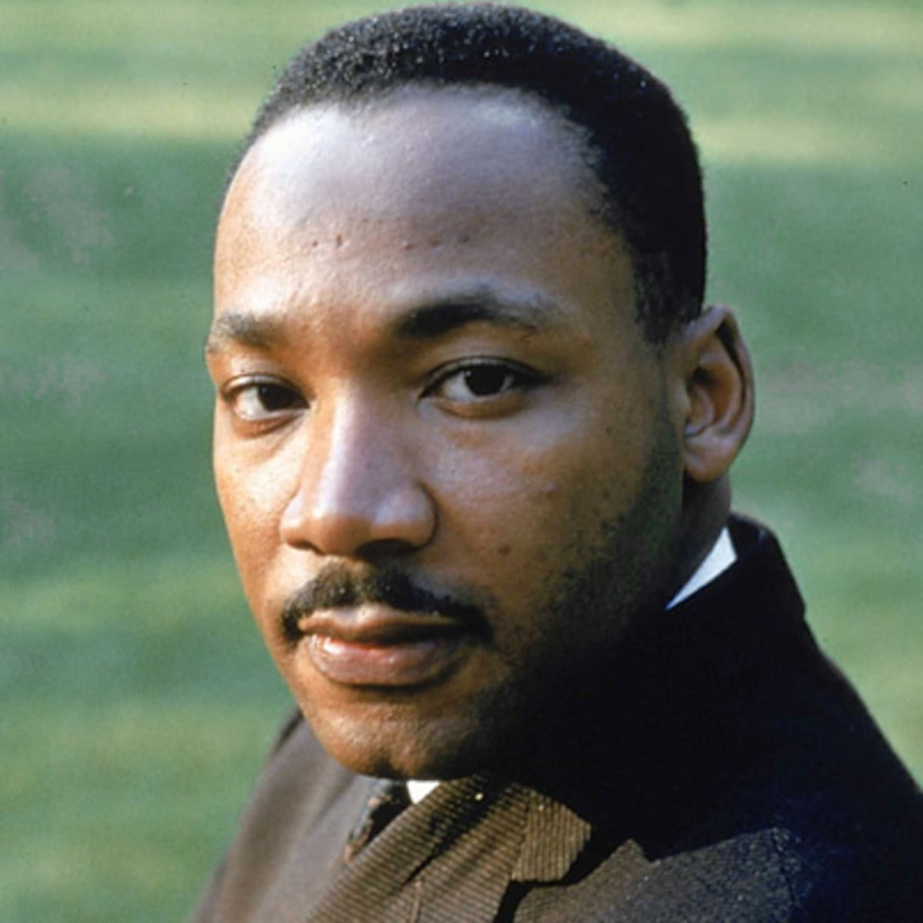
Do Now - Pick one quote and write about what it means to you!
1
“History, despite its wrenching pain, cannot be unlived, but if faced with courage, need not be lived again.”
― Maya Angelou, Author and Poet
“There is no flag large enough to cover the shame of killing innocent people.”
― Howard Zinn, Historian
“I refuse to accept the view that mankind is so tragically bound to the starless midnight of racism and war that the bright daybreak of peace and brotherhood can never become a reality.... I believe that unarmed truth and unconditional love will have the final word.”
― Martin Luther King, Jr.
2
3

Slide 68
Small Talk!
Stand up.
Quickly find someone in the room who picked the same quote as you.
Stand by them.
Share your thoughts on this quote. Listen to their share.
Look for points of connection and difference in your perspectives.

Slide 69
Agenda:
Objective: I can evaluate multiple perspectives of America and present my own perspective in writing.
Language Objective: I can summarize the main idea of academic paragraphs to identify the main idea of a whole text.
Do Now
Four Perspectives
Idea of America Free Write
Personal Survey

Slide 70
Nikole Hannah-Jones “Idea of America”
Yesterday, we read this!
At first she could not understand why her father celebrated the American flag because of the horrible ways America has treated African Americans.
But Hannah-Jones learned about the many contributions African Americans have made to the country and to our freedom.

Slide 71
Nikole Hannah-Jones “Idea of America”
She realized that her father celebrated the flag to honor those contributions.
She understood that for her father, the flag was a way to claim a place in American history and to acknowledge that African Americans have made the best of America.

Slide 72
What should we think about America?
People will tell you what you should believe about America. But ultimately, this is a question only you can answer. We all approach this question with our own experiences and pasts.

Slide 73
What should we think about America?
Bored student: “Mr. Jue, I don’t really care about America. It’s whatever.”
Most of us didn’t choose to grow up in America. But as an adult, you can choose anywhere in the world to live. You have this one life. Where you call home matters.
So if you are going to stay and live here, you should have an answer to this question.

Slide 74
Today’s Readings
In our readings today, we will hear from several other perspectives on this question:
What should we think about America?
Is it a revolutionary place where big dreams come true?
Is it an oppressive place where only some benefit?

Slide 75
What does "revolution" mean?
A forcible overthrow of a government or social order, in favor of a new system.
A dramatic and wide-reaching change in the way something works or is organized or in people's ideas about it.
Related Words:
Revolutionary Radical | Drastic Change

Slide 76
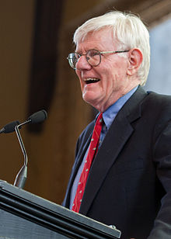
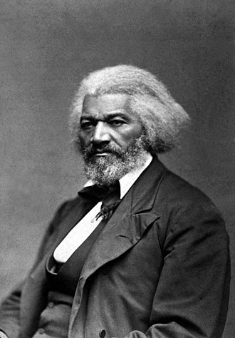
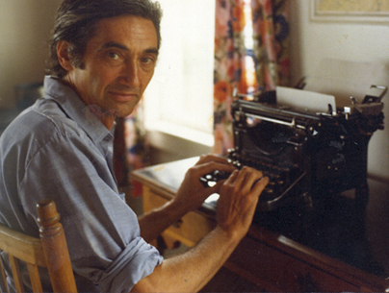
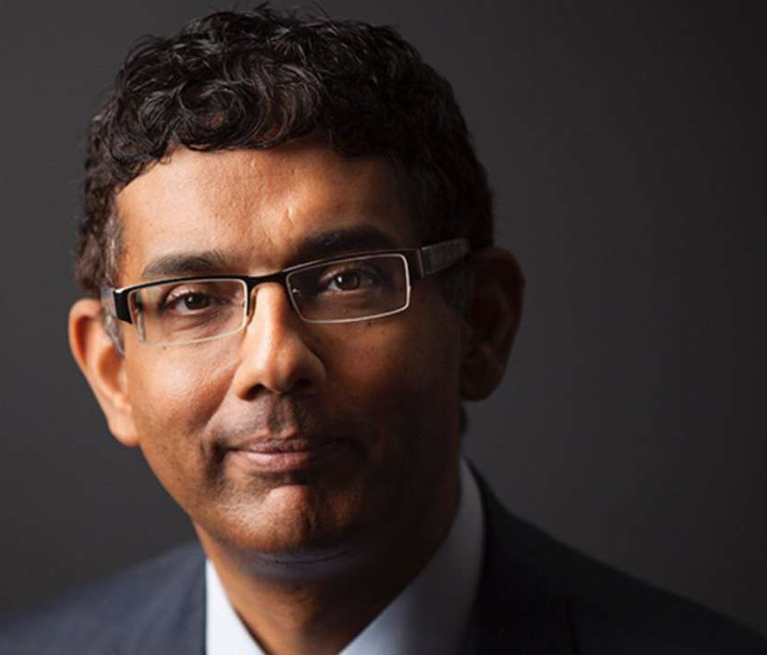
Our Four Perspectives...
You may agree with some, disagree with others. You may have a strong reaction to what you read. That is ok. You will have a chance to express all of your thoughts when we write later today.
Howard Zinn, famous historian
Indian-American political writer
Gordon Wood, famous historian
Frederick Douglass, writer, speaker, abolitionist

Slide 77
Frederick Douglass
1817-1895
Born into slavery in Maryland.
Escaped slavery and rose to become the most famous abolitionist (against slavery), writer, and speaker of his time.
He was the most photographed person of his time.

Slide 78
4 Perspectives
Each pair will get one perspective at a time.
Take turns reading paragraphs out loud!
Circle unknown words
Underline main ideas
Write a one sentence summary for each paragraph
Answer the questions in your Day 4 Packet.
When your pair finishes a reading, raise your hand for Mr. Jue to check your work and get the next reading!

Slide 79
Today’s Challenge
After summarizing each paragraph, you must identify the main idea of the whole text.
Hint: Look at your summary sentences first! See how they flow or connect.

Slide 80
Brain Break!
Snap and Point!

Slide 81
Idea of America Free Write
What does America mean to you?
Open this assignment on Google Classroom.
You have until the end of class to answer the prompt(s) in writing.
This is our first formative assignment, meaning it is worth 30% of your grade.

Slide 82
About Me Survey
Please complete the survey! Please tell me more about yourself and how you learn. I want to do my best to support your learning.
It is our homework for the weekend.

