Slide 1
Reconstruction
Summarized by 11th Graders at Life Academy
2021

Slide 2
Reconstruction Summary
By:
Armando, Sugeiry, Amilia

Slide 3
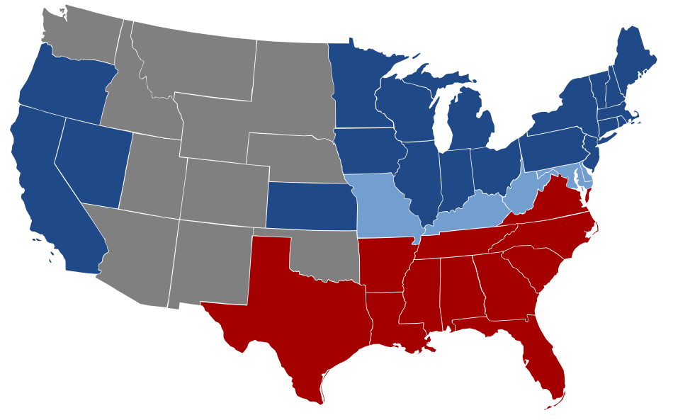
Key points:
America had a balance between free and slavery states.
The south couldn’t compromise to free the slaves but the north wanted the union together.
Lincoln wrote the emancipation proclamation which abolished slavery
Reconstruction phase took 11 years
The 14th and 15th amendment gave African Americans their freedom.
The freedmen’s Bureau was program that help set up freed slaves to deal with the real world

Slide 4
Civil War
Amy jackie and Angel

Slide 5
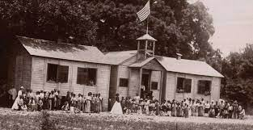
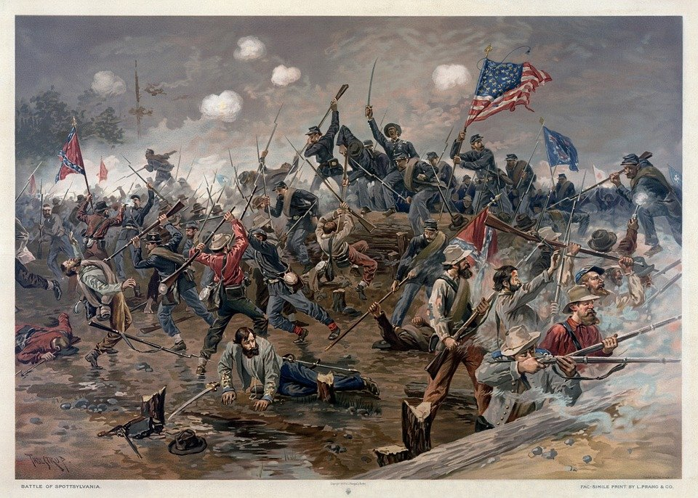
The Civil War
The Civil War was between the North and South in the U.S between 1861 to 1865
The North focused on industrial factories and the South focused on agriculture(Farming)
The goal of the war was to abolish Slavery
Abraham wrote the “Emancipation Proclamation” which freed Slaves
The 13th and 14th amendment made Savery illegal and let formerly enslaved people vote during reconstruction
After the Slaves were freed, a program called the Freedmen’s Bureau gave displaced African Americans housing, food and schools.

Slide 6
The Civil War:
VS
America was made up of the North and the South. The North was an industrial set of states while the South relied on agriculture and slave labor for their economy.
The Civil war was an inevitable battle between the North and the South do to having different opinions on slavery.
During the war, Lincoln writes the emancipation proclamation and 13th amendment which makes slavey illegal.
After the war, reconstruction created the 14th and 15th amendments and Freedmen’s Bureau that helped Afrcan-Americans begin life after slavery. Allowed enslaved people to have equal rights and treatment. Also to begin life after slavery.

Slide 7
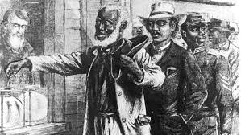
Reconstruction
The Civil War was a fight between the Union against the Confederates to abolish slavery. The war happened between 1861-1865.
13th Amendment made slavery illegal.
The South had to rebuild their whole economy for 11 years to make sure it was not precarious.
Freedmen’s Bureau made sure ex-slaves had the right tools to live like a citizen and made sure they were able to succeed.

