Slide 1
This Lecture is on Peardeck!
Go to the link posted on the Google Classroom Stream.
When taking notes, tilt your computer screen to half-mast.
Open your laptop only when answering Peardeck questions.

Slide 2
Reconstruction and the Freedmen’s Bureau
Get ready to fly through 100 years of history.

Slide 3
How familiar are you with Peardeck?
What is Peardeck? Expert Level
1 2 3 4 5
Notes:
🍐 This is a Pear Deck Draggable™ Slide.
🍐 To edit the type of question, go back to the "Ask Students a Question" in the Pear Deck sidebar.

Slide 4
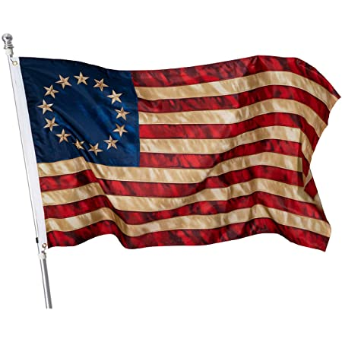
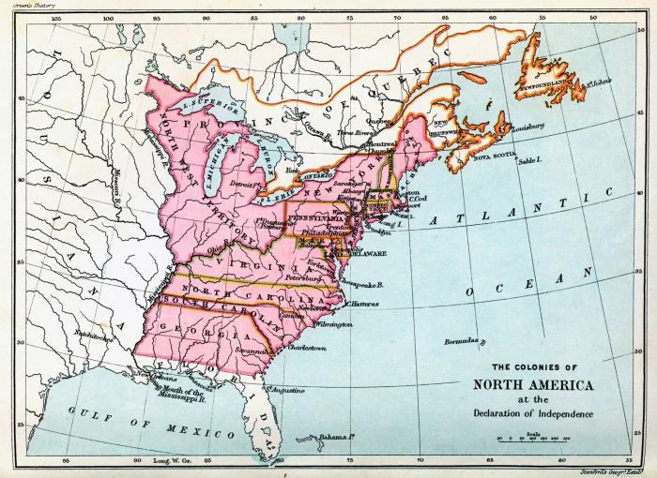
1776 - America Founded and Divided
13 colonies were deeply divided over slavery
Tension over slavery existed right from the beginning. Slavery ignored in the Constitution, too tense of an issue.
Pattern over next 70 years: a series of compromises balancing power between free and slave states.

Slide 5
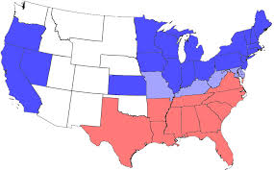
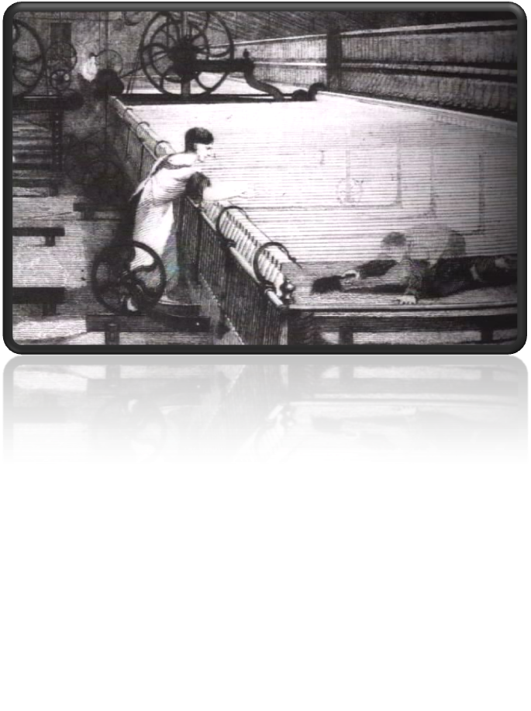
Economy (North)
Industrial—products, such as clothes, iron, boats, machines, and more, were made in factories which made products.
85% of the nation’s factories were in the North.
Notes:
‹#›
‹#›
‹#›

Slide 6
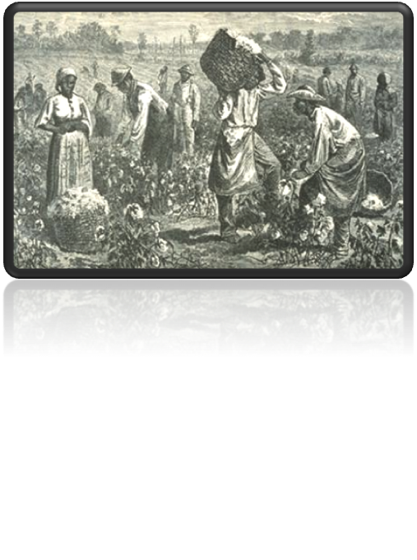
Economy (South)
Agricultural—independent farmers (not companies) grew most of the crops to sell.
Cash crops—crops grown to sell rather than to use—were rice, tobacco, & cotton.
Exports—sold cotton and other cash crops to the North and to Europe.
Notes:
‹#›
‹#›
‹#›

Slide 7
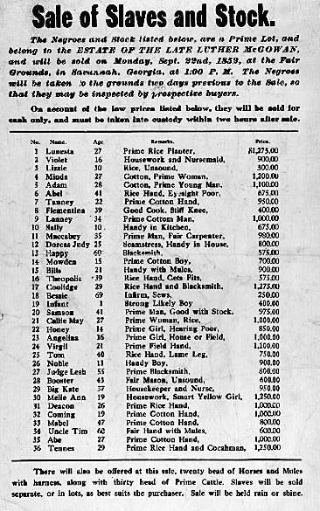
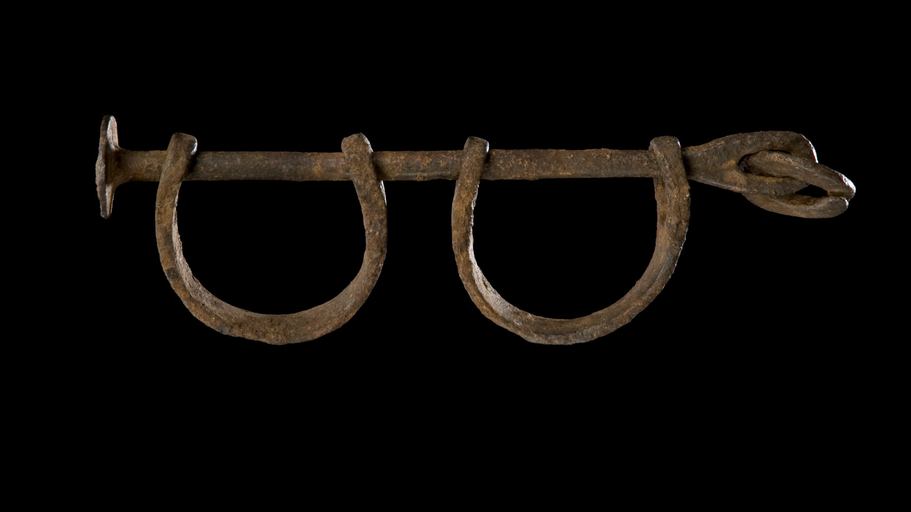
Slavery
Slavery: legal and economic system where people are treated as property.
The kidnapping, enslavement, and transport of Africans to North America existed for over 200 years. 12.5 million Africans had been kidnapped and forced into slavery.
Slavery was built into to the economy in the South because enslaved people offered a source of free labor to farm cash crops.
Notes:
‹#›
‹#›

Slide 8
How was the economy of the South different from the North?
They were the same
South built on buying cash crops from the North
South built on factory production
South grew and sold cash crops using slave labor
Notes:
🍐 This is a Pear Deck Multiple Choice Slide. Your current options are: A: A, B: B, C: C, D: D,
🍐 To edit the type of question or choices, go back to the "Ask Students a Question" in the Pear Deck sidebar.

Slide 9
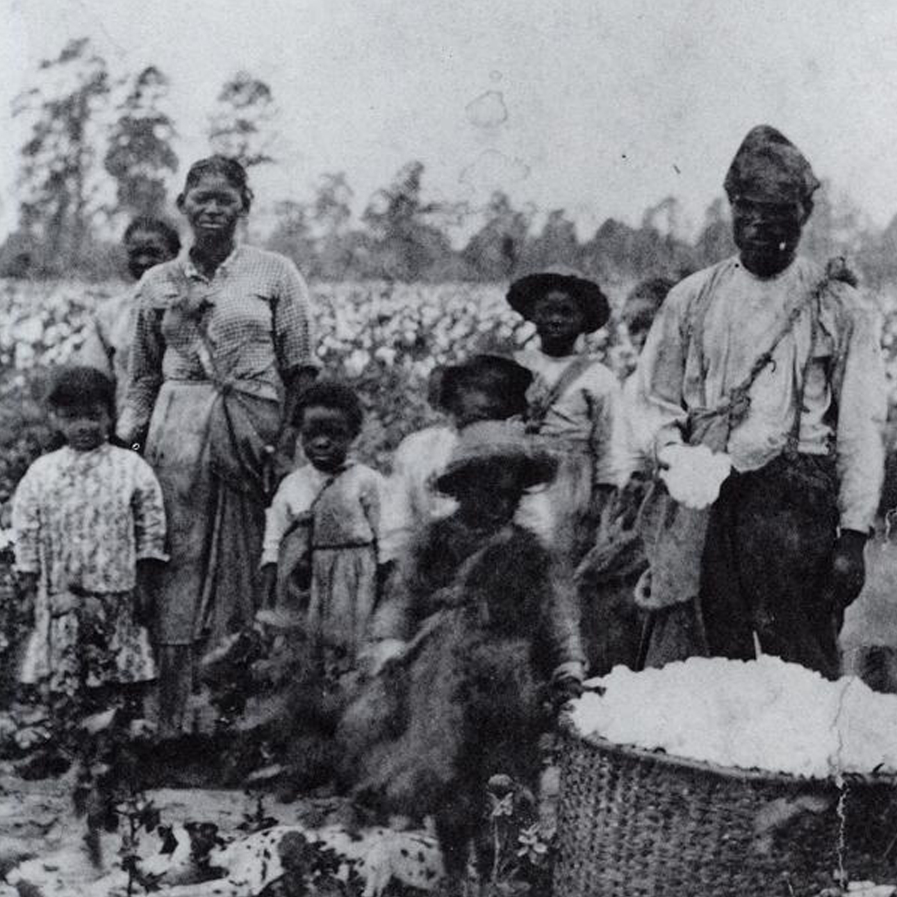
Slavery
Enslaved people endured horrific conditions, physical and sexual violence, backbreaking labor, and constant control over every aspect of life.
Slavery was justified using white supremacy, the false belief that white people are superior to all others.
Notes:
‹#›
‹#›

Slide 10
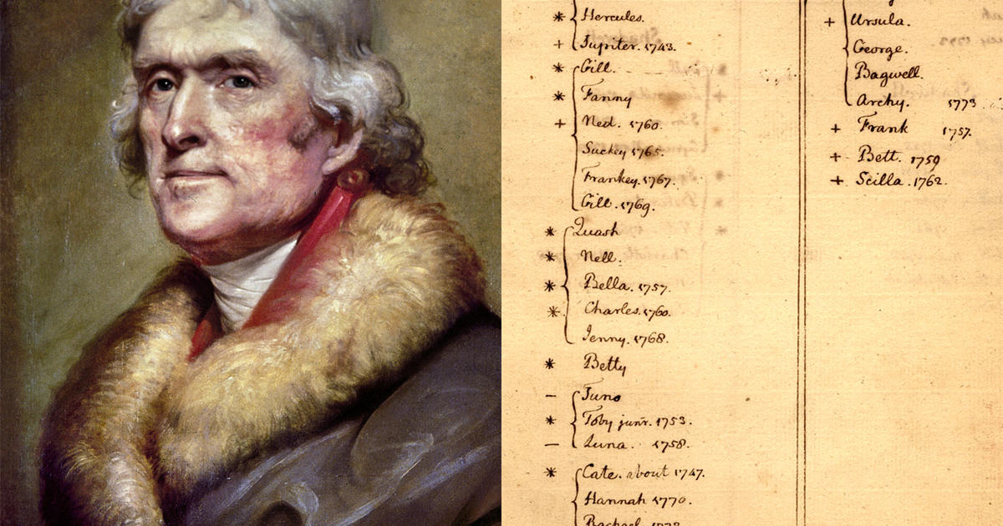
What do you think Jefferson means by this quote?
“we have the wolf by the ear, and we can neither hold him, nor safely let him go. justice is in one scale, and self-preservation in the other.”
-- Thomas Jefferson discussing slavery, 1820
Notes:
🍐 This is a Pear Deck Text Slide
🍐 To edit the type of question, go back to the "Ask Students a Question" in the Pear Deck sidebar.

Slide 11
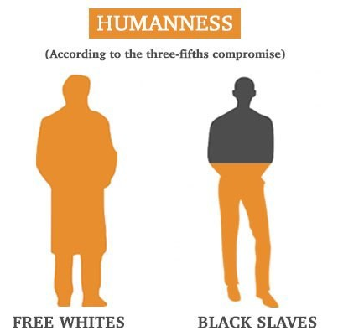
History of Shameful Compromises
⅗ Compromise: gave slave states the right to count an enslaved person as three-fifths of a person in order to increase their representation in the House of Representatives (government) but denied any right of citizenship to those enslaved people.

Slide 12
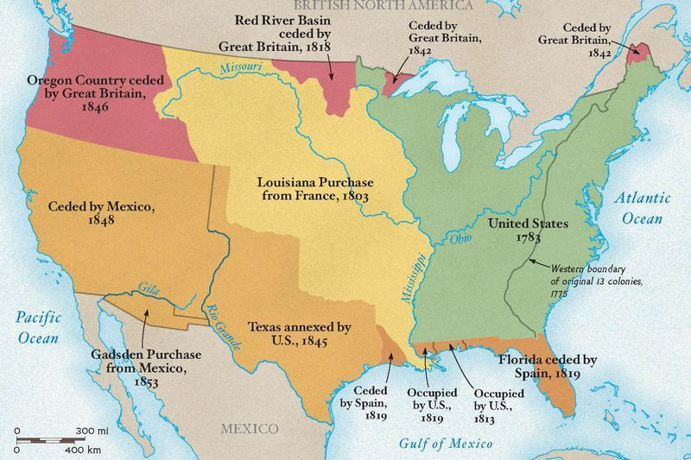
Expansion West
As America grew more powerful, it expanded westward, pushing out indigenous people and Europeans. Slavery expanded with it.
For each new state added to the U.S., the balance between free and slave states was precariously kept.

Slide 13
As you see the following maps, what do you notice?
What do you wonder?

Slide 14
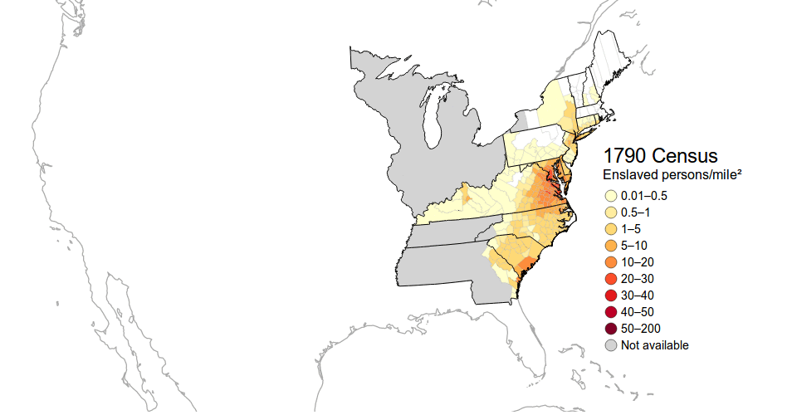

Slide 15
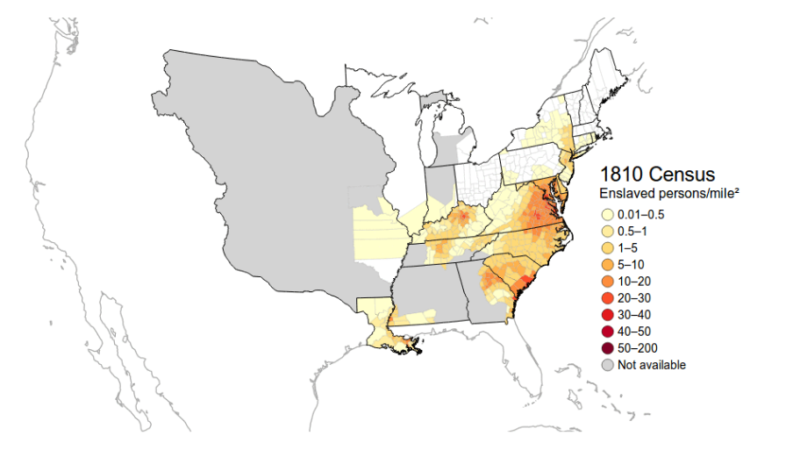

Slide 16
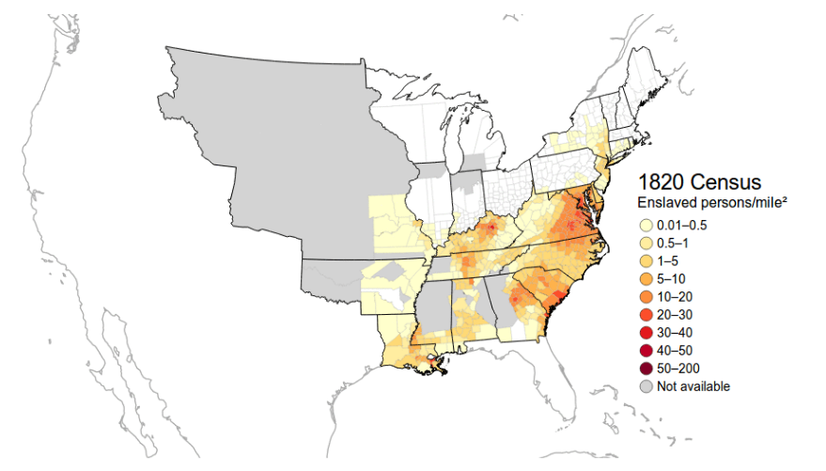

Slide 17
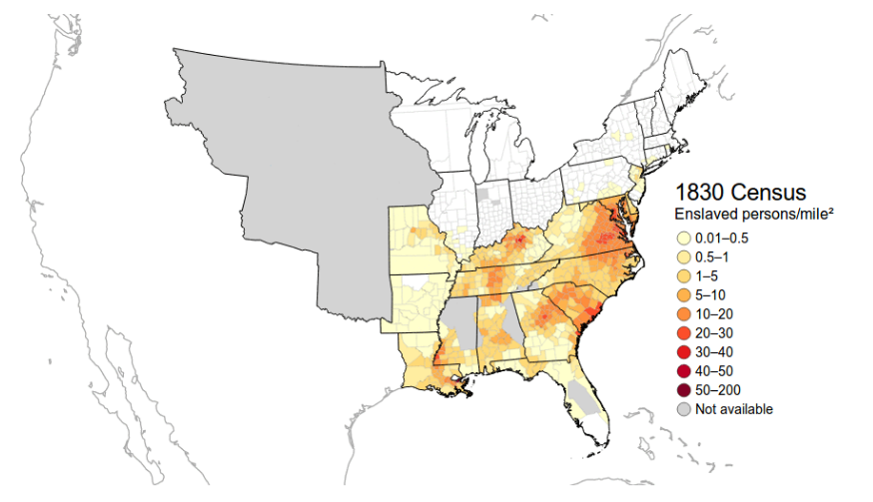

Slide 18
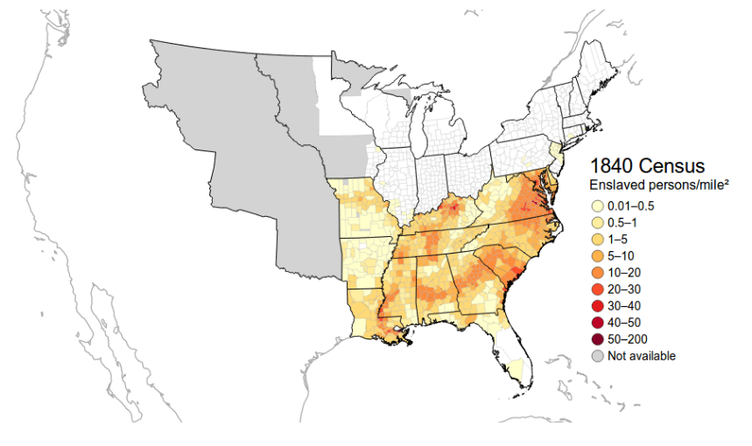

Slide 19
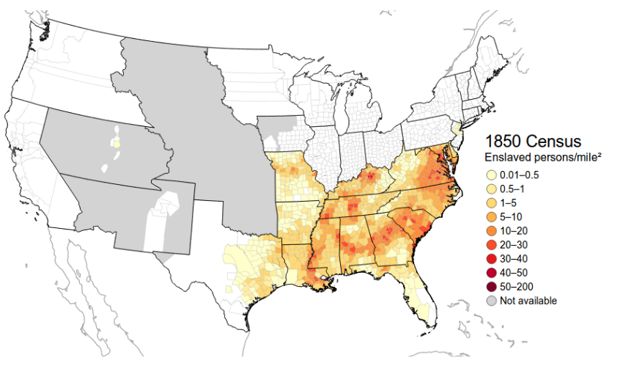

Slide 20
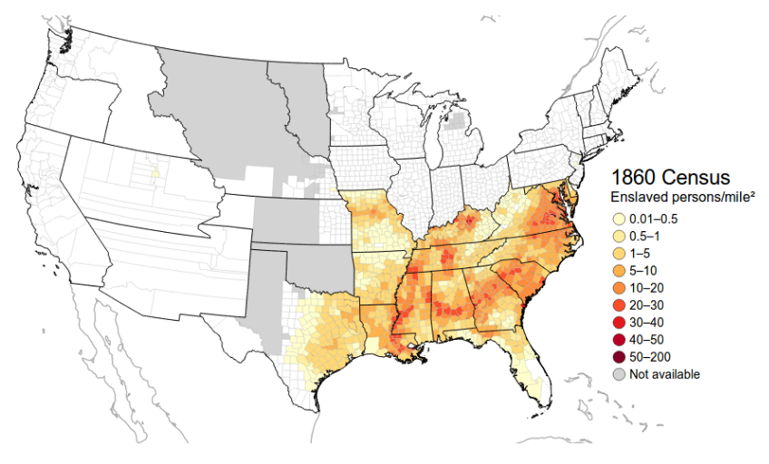

Slide 21
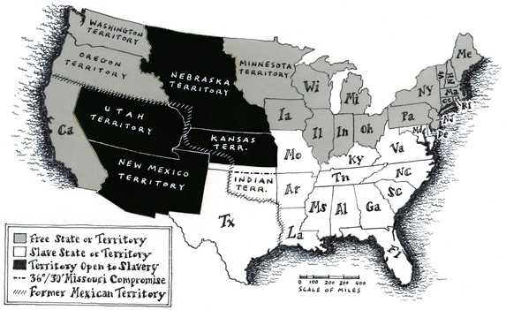

Slide 22
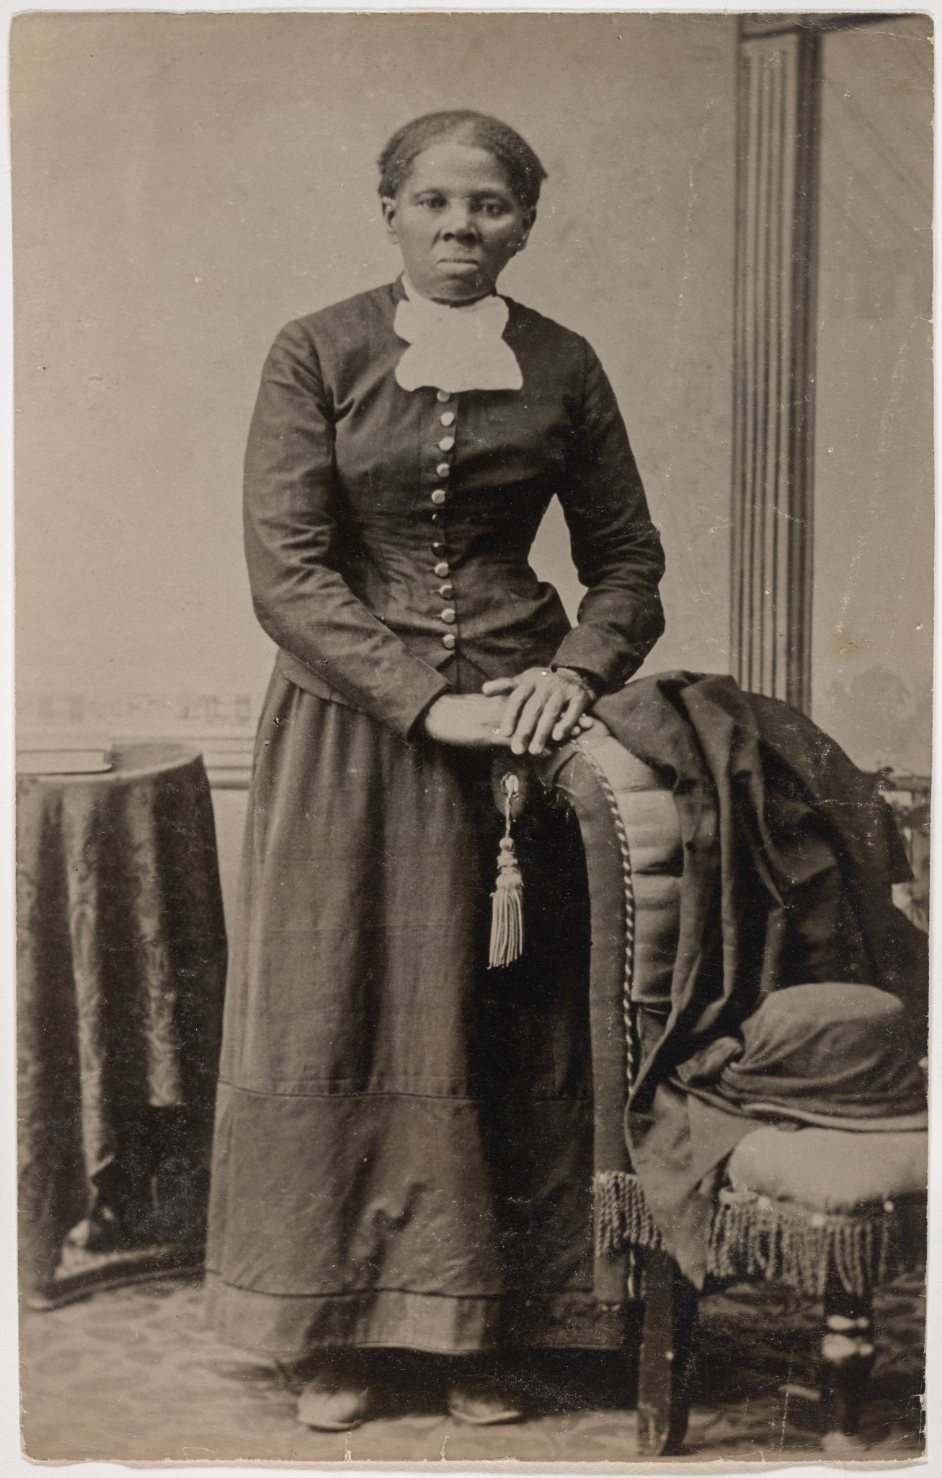
Tensions Mount
Abolitionists grow supporters in the North
Many efforts to both help and stop enslaved people who fled slavery.
Southern states increasingly accuse government of controlling them

Slide 23
The Civil War
The North (the Union) vs. the South (the Confederacy).
Years of tension about slavery escalated to civil war. The South refused to emancipate (free) slaves and wanted to secede or break apart from the U.S. and start their own country.
The North wanted to keep the Union or the country together.
Lasted from 1861-1865
North vs. South
Notes:
‹#›
‹#›

Slide 24
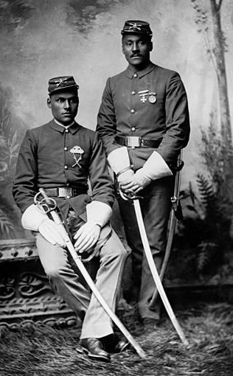
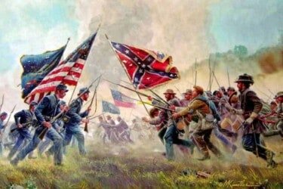
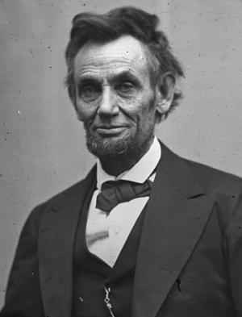
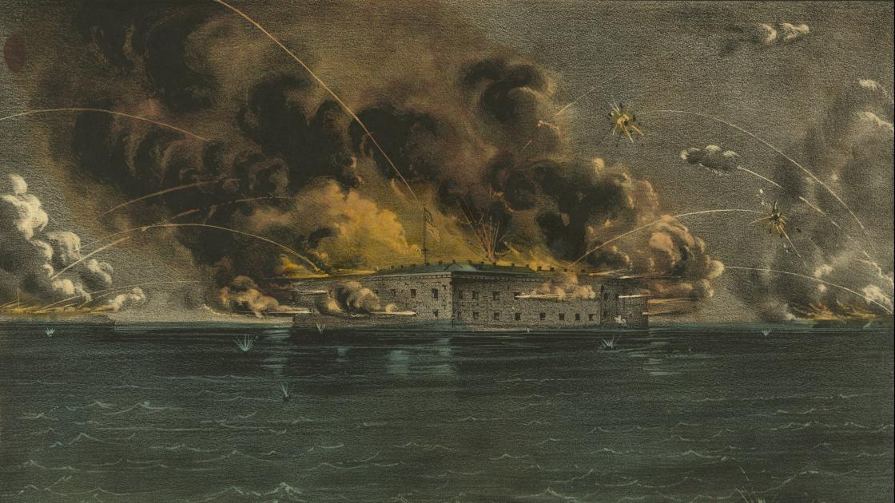
Civil War
1861-1865
More than 620,000 people died in the Civil War: America’s bloodiest war.

Slide 25
What was the Civil War?
A war fought in the 1700s that gave America its independence as a country
A war fought between enslaved people and white people in the South
A war between the Union and the Confederacy about the institution of slavery
A war Abraham Lincoln started about the 12th amendment.
Notes:
🍐 This is a Pear Deck Multiple Choice Slide. Your current options are: A: A, B: B, C: C, D: D,
🍐 To edit the type of question or choices, go back to the "Ask Students a Question" in the Pear Deck sidebar.

Slide 26
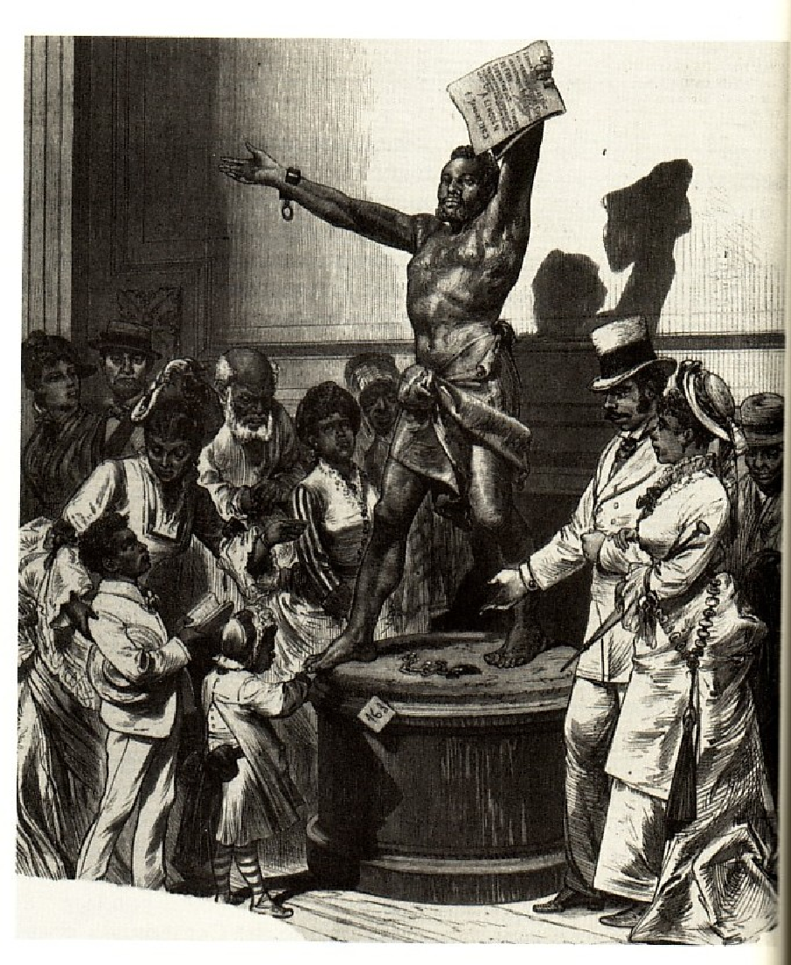
Emancipation
1862 Abraham Lincoln writes the “Emancipation Proclamation” which would free enslaved people in the Southern States.
The 13th Amendment (1865) to the Constitution was passed by Congress which officially made slavery illegal.
Notes:
‹#›
‹#›

Slide 27
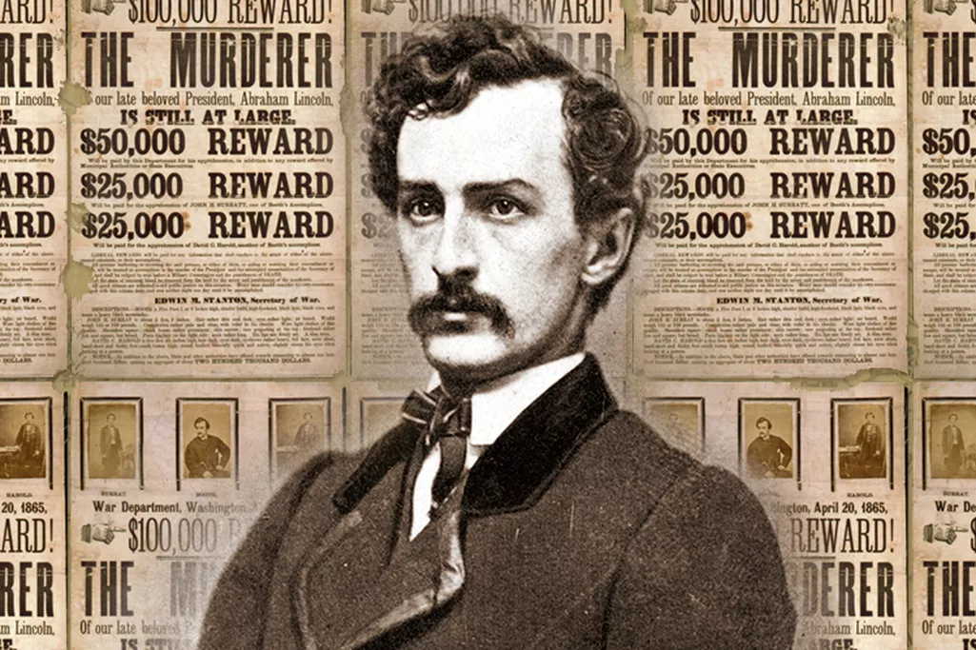
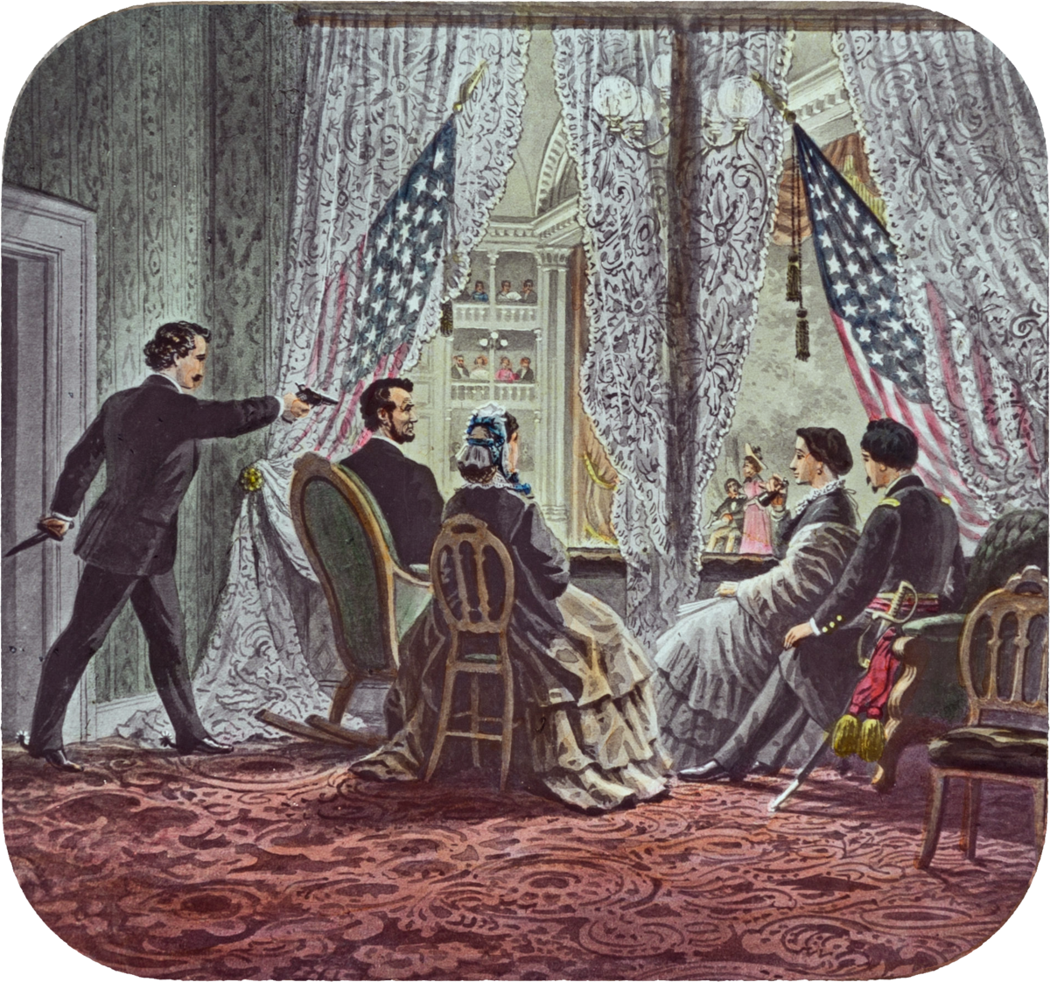
Lincoln Assassination April 14 1865
Lincoln becomes last casualty of the Civil War:
South Surrenders April 9th 1865
Lincoln Shot by John Wilkes Booth April 14 1865
Lincoln Dies April 15th 1865.
Andrew Johnson becomes president

Slide 28
How does America repair itself? What kind of country will America be now?
Who gets what?
What will life be like for African Americans now?

Slide 29
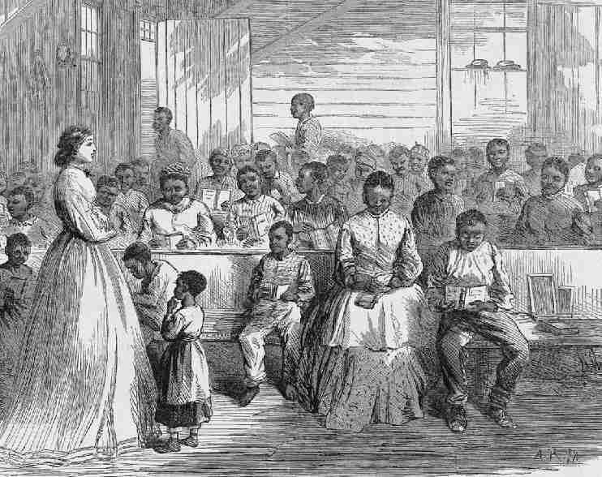
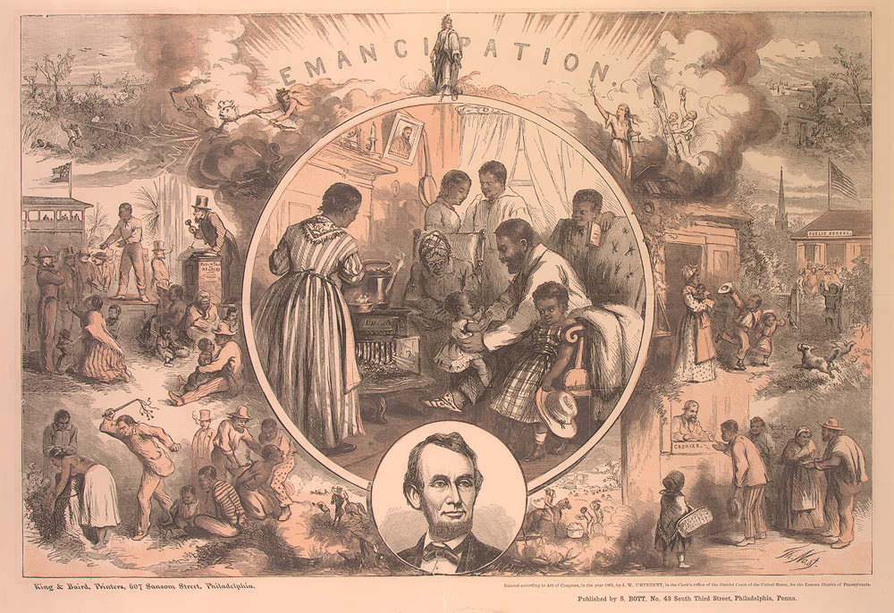
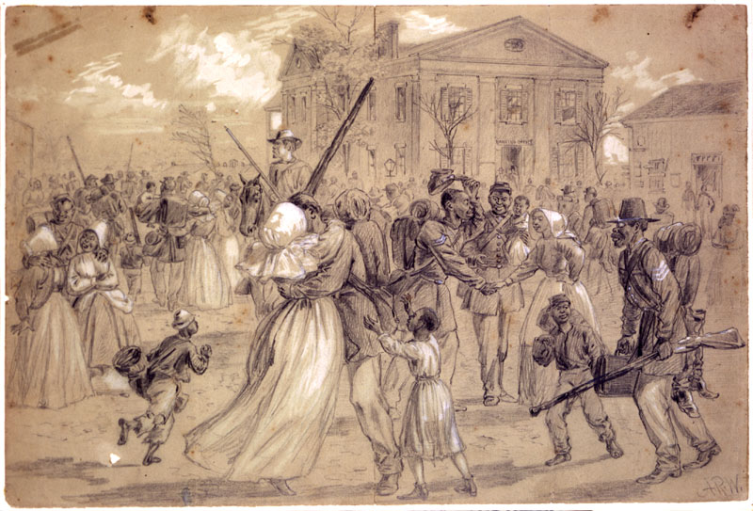
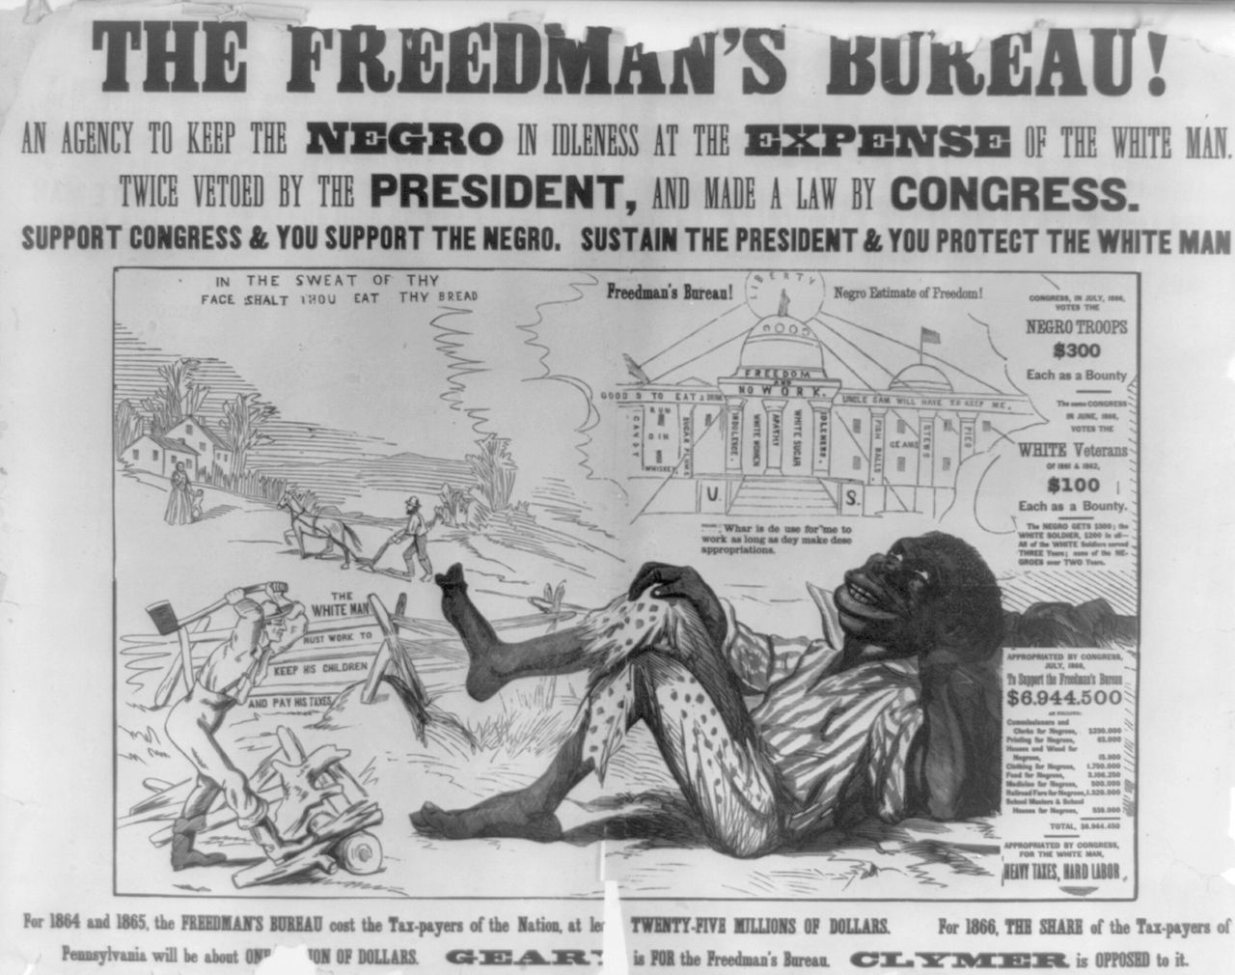
Reconstruction and the Black South

Slide 30
What should the nation focus on?
What supports do the newly freed African American population need?
Notes:
🍐 This is a Pear Deck Text Slide
🍐 To edit the type of question, go back to the "Ask Students a Question" in the Pear Deck sidebar.

Slide 31
Reconstruction and the Black South
Reconstruction is the period right after the war, when the south was being REBUILT.
Notes:
‹#›
‹#›

Slide 32
The Beginning of Reconstruction
Reconstruction lasted roughly 11 years. U.S. government held troops in the South to enforce new laws.
There was not one shared goal of Reconstruction:
U.S. government: rebuild the destroyed South, defeat any remaining resistance.
Abolitionists: ensure African Americans had equal rights and were protected under the law
Most white northerners: Make sure South obeyed so the war wasn’t fought for nothing, but get back to life as usual
Most white southerners: keep the racial structure of power as similar to slavery as possible
Newly freed African Americans: Remake life as a free person. Be prosperous, freely use rights as citizens, and live safely.
Notes:
‹#›
‹#›

Slide 33
What was the attitude of many white northerners about Reconstruction?
ensure African Americans had equal rights and were protected under the law
Make sure South obeyed so the war wasn’t fought for nothing, but get back to life as usual
Provide African Americans with everything they would need to be successful
Return to slavery
Notes:
🍐 This is a Pear Deck Multiple Choice Slide. Your current options are: A: A, B: B, C: C, D: D,
🍐 To edit the type of question or choices, go back to the "Ask Students a Question" in the Pear Deck sidebar.

Slide 34
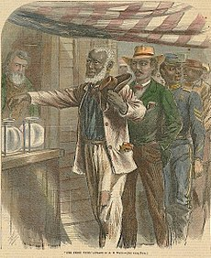
Reconstruction Amendments
14th Amendment: granted birthright citizenship and equal treatment under the law for all people
15th Amendment: Gives voting rights to all citizens, regardless of skin color
Notes:
‹#›
‹#›

Slide 35
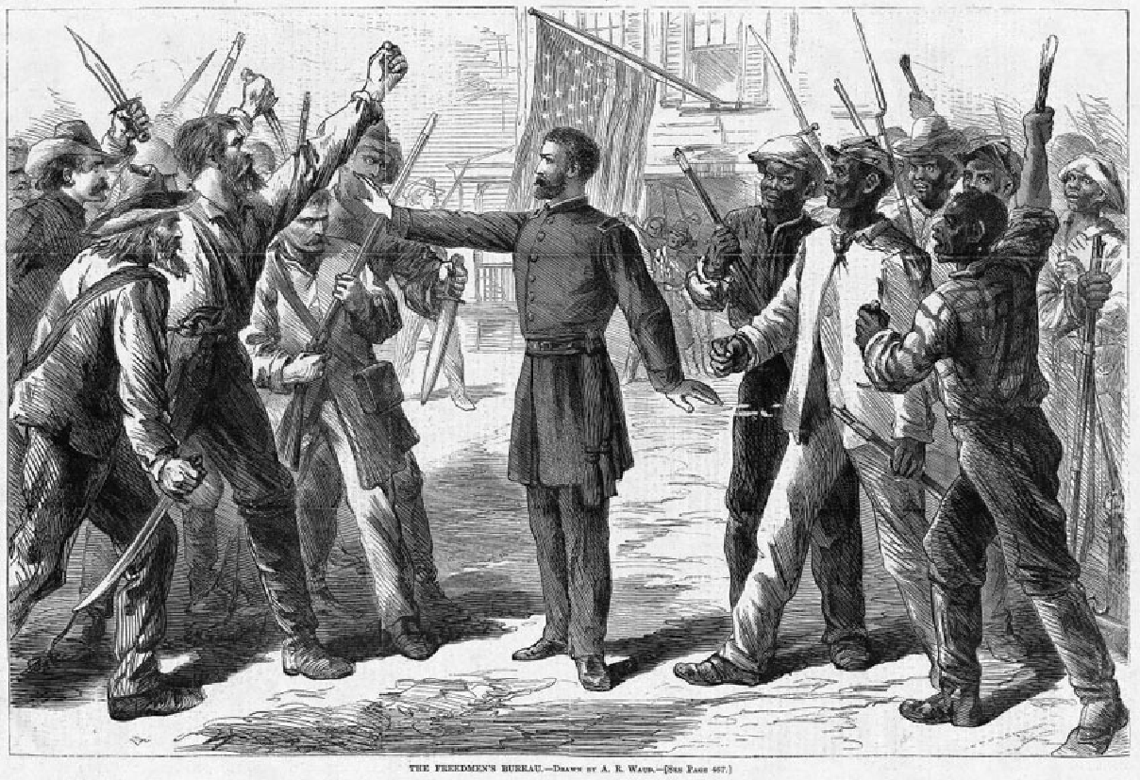
Freedmen’s Bureau
The Freedmen’s Bureau was a program set up by the Northern government given the responsibility of helping African Americans begin life after slavery.
The purpose of the Bureau was to provide food, shelter, clothing, medical services, and land to displaced Southerners, primarily newly freed African Americans.
Notes:
‹#›
‹#›

Slide 36
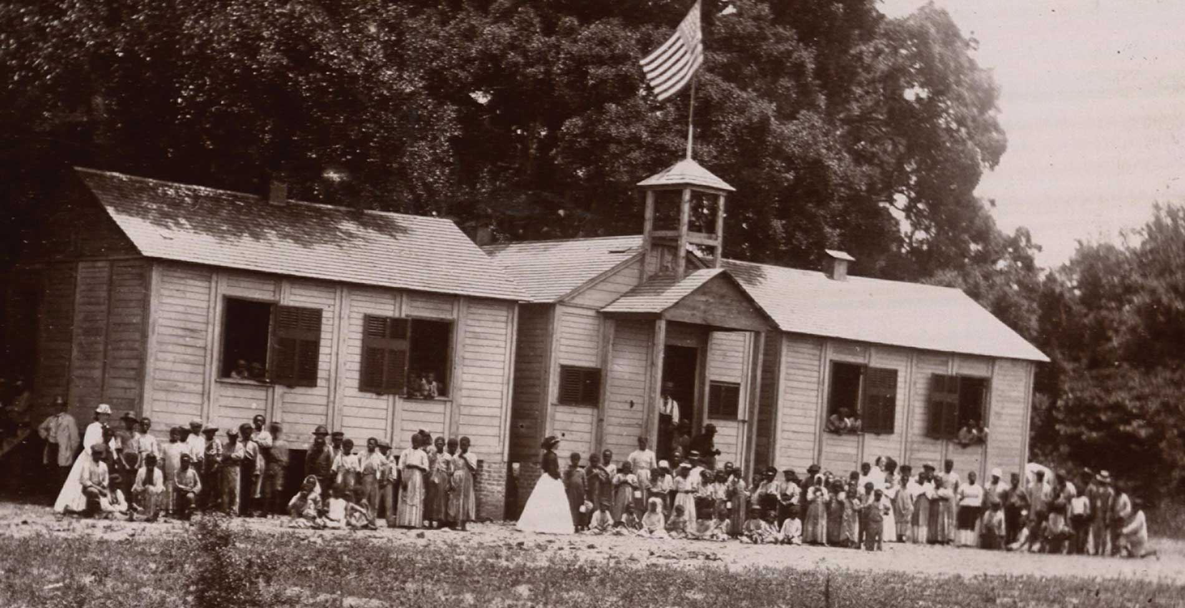
The Freedmen’s Bureau, 1865 - 1872
The Bureau established, among other things, schools and hospitals for African Americans throughout the U.S. South.
The Bureau also had the goal of redistributing land to newly freed African Americans, but did not have much success.
Freedmen’s Bureau school on St. Helena’s Island, South Carolina, 1866

Slide 37
How successful was the Freedmen’s Bureau in helping African Americans realize their aspirations?

Slide 38
Reconstruction Summary Slide
Your group of 4 will: create a google slide that summarizes the key points of today’s lecture!
Must Haves 3 (B) | Amazing 4 (A)
Accurately presents key points Slide is shared with all group members and Jue (jack.jue@ousd.org) | Uses images and appealing slide design

Slide 39
Before You Leave Today
Week 2 Feedback Form

