Slide 1
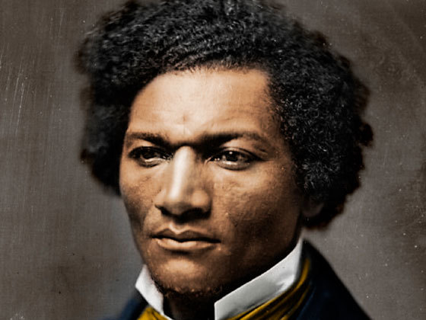
Our First Unit
Race, Power, and Health: Past and Present

Slide 2
The Ugly Reality of Our Past
In August of 1619, over 400 years ago, a ship appeared on the horizon of Virginia. It carried 20 kidnapped and enslaved Africans. These human beings were sold to the English colonists.
The institution of slavery would become the most toxic, destructive, and poisonous legacy in American history. No other event in American history has remained untouched by slavery.

Slide 3
The Ugly Reality of Our Present
The legacy of slavery CONTINUES to shape our country today. Racism remains a powerful and dangerous force in America and it affects ALL of us.
You have learned about racism in many ways in your education. You are on a journey of anti-racism: learning to fight against racism and create a better future.
To become better anti-racists, we must understand racism and its history.

Slide 4
QUESTIONS TO THINK ABOUT AS WE READ...
Why have people with power often assume they are better or superior?
What is the relationship between power and race?

Slide 5
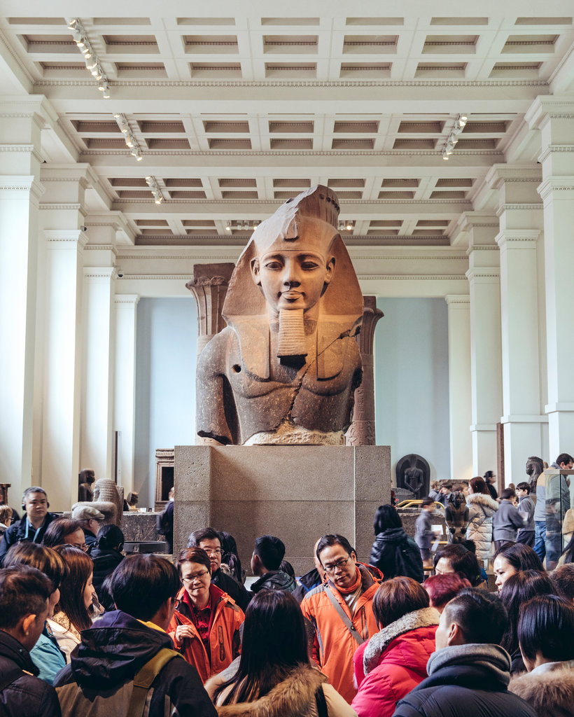
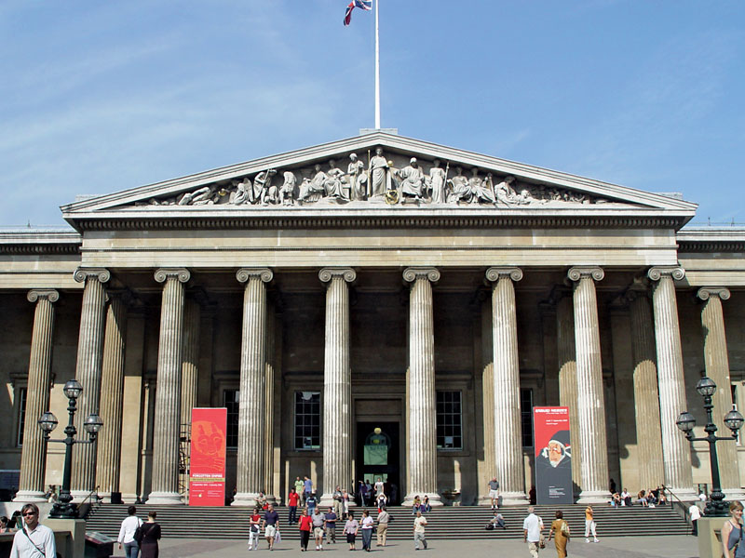
British Museum Fast Facts
Our next reading is about the British Museum.
Located in London, England.
One of the largest and oldest museums in the world.
It has objects from all over the world, many taken by the British Empire during colonialism 200-400 years ago.
It was created BEFORE the U.S. was even a country.

Slide 6
Connecting Yesterday to Today
Yesterday, we discussed the way power can lead to feelings of superiority and entitlement. We can come to believe the inequalities we see around us are ‘natural’ and supposed to be this way--even though they were created by human beings!
Race is a tool that has been used by the powerful to dehumanize, control, and justify their power.

Slide 7
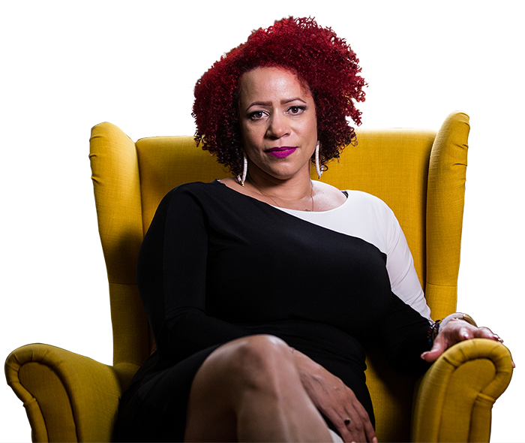
Connecting Yesterday to Today
Today, we will read an article about how race has been used as a tool of power.
We will learn about a writer’s own relationship with American history, and then we will begin to think about our own.
Nikole Hannah-Jones

Slide 8
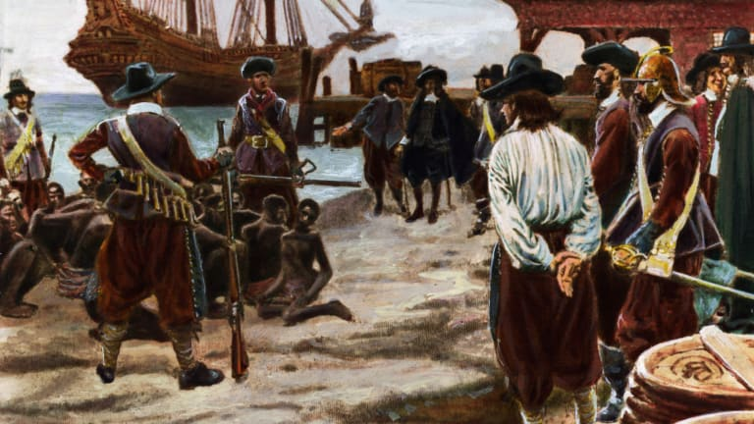
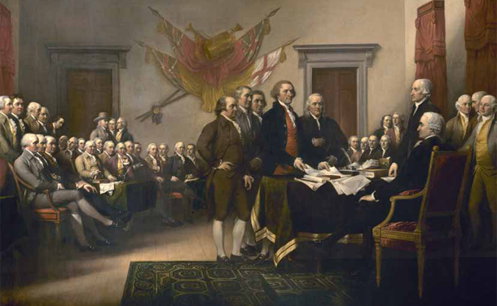
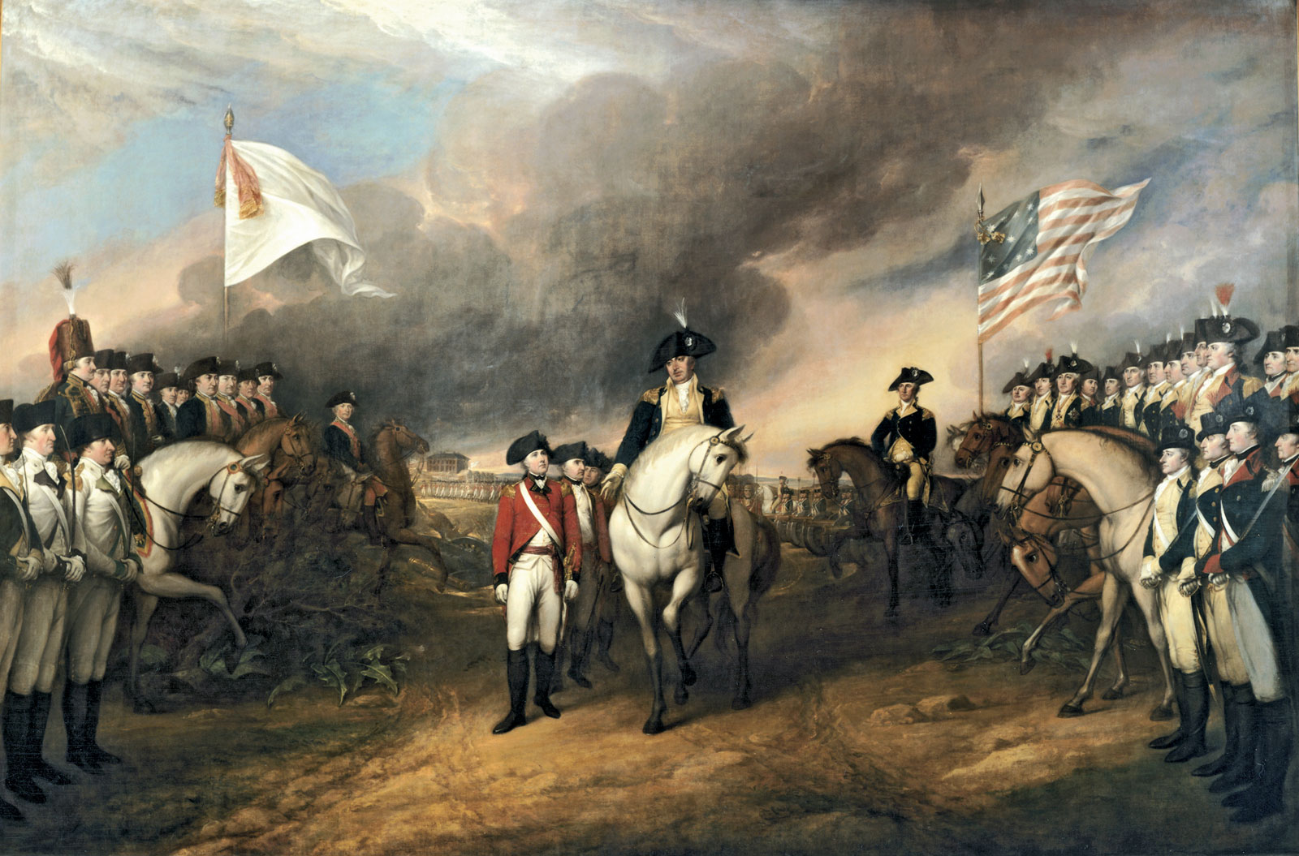
Turn and Talk: What do you know about the founding of America?

Slide 9
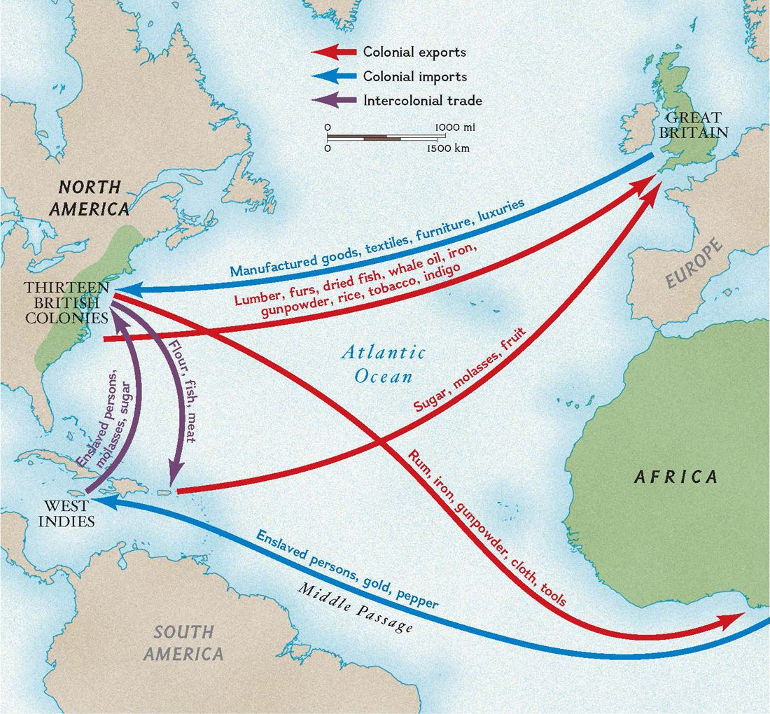
Slavery in what is now America began in 1619.
This was a time when the East coast was been invaded and colonized (settled) by Europeans, mostly the British (same as English). They began to kidnap and enslave Africans to develop the colonies.
The United States would not be created for another 150 years.

Slide 10
The United States began in 1776
In 1776 the English colonies rebelled against England and formed their own government called a democracy. This would become the United States.
A democracy is a type of government in which the people choose their leaders.
Declaration of Independence promised “life, liberty, and the pursuit of happiness”.

Slide 11
Nikole Hannah-Jones “Idea of America”
Yesterday, we read this!
At first she could not understand why her father celebrated the American flag because of the horrible ways America has treated African Americans.
But Hannah-Jones learned about the many contributions African Americans have made to the country and to our freedom.

Slide 12
Nikole Hannah-Jones “Idea of America”
She realized that her father celebrated the flag to honor those contributions.
She understood that for her father, the flag was a way to claim a place in American history and to acknowledge that African Americans have made the best of America.

Slide 13
What should we think about America?
People will tell you what you should believe about America. But ultimately, this is a question only you can answer. We all approach this question with our own experiences and pasts.

Slide 14
What should we think about America?
Bored student: “Mr. Jue, I don’t really care about America. It’s whatever.”
Most of us didn’t choose to grow up in America. But as an adult, you can choose anywhere in the world to live. You have this one life. Where you call home matters.
So if you are going to stay and live here, you should have an answer to this question.

